Slide 1
DATA ENGINEERING PROJECT
Real Estate Insights
End-to-End Medallion Architecture on Databricks — ELT, Automated CDC, and CI/CD with Lakeflow
Catalog: real_estate_dev
Repo: github.com/mohittaneja786/real_estate_insights
Mohit Taneja | Data Engineer

Slide 2
PROJECT OVERVIEW
Why this project
A fully synthetic, production-shaped real estate dataset — raw source data generated with Claude AI — used to build a real Databricks data engineering pipeline from scratch: ingestion, CDC, cleansing, aggregation, orchestration, and CI/CD.
1
2
3
4
Raw Data Source
ELT on Databricks
Medallion Architecture
Automated CI/CD
Synthetic property, agent, location & transaction data generated via Claude AI — full load + 60 days of incremental CDC files.
Data lands as-is, then is transformed inside Databricks using PySpark + Delta Lake — not transformed before load.
Bronze (raw) → Silver (cleansed & merged) → Gold (business aggregates), fully modeled in Unity Catalog.
Dev branch → Git → main → Databricks, orchestrated end-to-end with a scheduled Lakeflow Job. No manual steps.
02

Slide 3
ARCHITECTURE
ELT + Medallion pipeline
BRONZE
SILVER
GOLD
Raw / parent data
Cleansed & merged
Business aggregates
agents, locations
properties_full
sales_transactions_full
properties_cdc (Auto Loader)
sales_transactions_cdc
properties (MERGE INTO CDC)
sales_transactions (merged)
properties_cleansed
properties_quarantine
dedup + validation rules
price_trends_by_location
agent_performance
feeds dashboard directly
→
→
ELT approach: raw files are loaded into Bronze exactly as received (Extract → Load), and every transformation — cleansing, deduplication, CDC merge, aggregation — happens afterward inside Databricks (→ Transform).
03

Slide 4
DEVELOPMENT WORKFLOW
Dev → Git → Main → Databricks
1
Develop in Dev
Notebooks authored & tested in the dev workspace / dev branch against real_estate_dev catalog.
2
Commit to dev branch
Changes committed and pushed to the dev branch on GitHub for review.
3
Merge to main
Pull request reviewed and merged from dev into main — main is the source of truth.
4
Pull into prod Databricks
Databricks Repos pulls main into the production workspace — code promoted, no manual copy-paste.
5
Lakeflow Job runs
Scheduled Job executes the notebooks in main automatically — Bronze → Silver → Gold.
04

Slide 5
BRONZE LAYER — CODE
Setup & full load
00_setup.ipynb
01_bronze_full_load.ipynb
spark.sql("CREATE CATALOG IF NOT EXISTS real_estate_dev")
spark.sql("CREATE SCHEMA IF NOT EXISTS real_estate_dev.bronze")
spark.sql("CREATE SCHEMA IF NOT EXISTS real_estate_dev.silver")
spark.sql("CREATE SCHEMA IF NOT EXISTS real_estate_dev.gold")
spark.sql("CREATE VOLUME IF NOT EXISTS real_estate_dev.bronze.vl_real_estate")
base = "/Volumes/real_estate_dev/bronze/vl_real_estate"
def load_full(path_glob, table_name):
df = (spark.read.option("header", True)
.option("inferSchema", True)
.csv(path_glob)
.select("*", "_metadata.file_name",
"_metadata.file_size"))
df.write.mode("overwrite").format("delta")
.option("overwriteSchema", True)
.saveAsTable(f"real_estate_dev.bronze.{table_name}")
load_full(f"{base}/full_load/agents_full_load.csv", "agents")
load_full(f"{base}/full_load/locations_full_load.csv", "locations")
load_full(f"{base}/full_load/properties_full_load_part*.csv",
"properties_full")
load_full(f"{base}/full_load/sales_transactions_full_load_part*.csv", "sales_transactions_full")
Bronze is the parent data — loaded exactly as received (ELT), tagged with source file
metadata for lineage.
05

Slide 6
BRONZE LAYER — CODE
Incremental ingestion (Auto Loader)
02_bronze_incremental_autoloader.ipynb
def autoload_cdc(subfolder_glob, schema_hint_name, table_name):
(spark.readStream.format("cloudFiles")
.option("cloudFiles.format", "csv") .option("header", True)
.option("cloudFiles.schemaLocation", f"{base}/_schema/{schema_hint_name}")
.load(f"{base}/incremental/{subfolder_glob}")
.withColumn("_source_file", F.col("_metadata.file_path"))
.withColumn("_ingested_at", F.current_timestamp())
.writeStream.format("delta").option("checkpointLocation", f"{base}/_checkpoints/{schema_hint_name}").trigger(availableNow=True) # picks up new files, then stops.toTable(f"real_estate_dev.bronze.{table_name}").awaitTermination())
autoload_cdc("properties_incremental_*.csv","properties_cdc", "properties_cdc")
autoload_cdc("sales_transactions_incremental_*.csv","sales_transactions_cdc", "sales_transactions_cdc")
Move processed files
After ingestion, source files that were successfully loaded are copied into an
Incremental_Processed/
folder in the volume — a simple audit trail of what's already been ingested, without deleting the originals.
target_dir = (base +
"/Incremental_Processed/")
os.makedirs(target_dir, exist_ok=True) for f in processed_files:
shutil.copy(f, target_dir)
06

Slide 7
SILVER LAYER — CODE
CDC merge (INSERT / UPDATE / DELETE)
03_silver_merge_cdc.ipynb
# Seed Silver from the full load (first run only)
spark.sql("""CREATE TABLE IF NOT EXISTS
real_estate_dev.silver.properties
AS SELECT * FROM real_estate_dev.bronze.properties_full""")
w = Window.partitionBy("property_id").orderBy(F.col("cdc_timestamp").desc())
cdc_latest = (cdc_df.withColumn("rn", F.row_number().over(w)).filter("rn = 1").drop("rn"))
silver_tbl = DeltaTable.forName(spark, "real_estate_dev.silver.properties")
(silver_tbl.alias("t").merge(cdc_latest.alias("s"), "t.property_id = s.property_id")
.whenMatchedDelete(condition="s.operation_type = 'DELETE'")
.whenMatchedUpdateAll(condition="s.operation_type = 'UPDATE'")
.whenNotMatchedInsertAll(condition="s.operation_type = 'INSERT'")
.execute())
sales_transactions merge
Transactions are INSERT-only (never mutated once created), so a simple append-merge is enough:
txn_tbl = DeltaTable.forName(spark,
"real_estate_dev.silver.sales_transactions")
(txn_tbl.alias("t")
.merge(txn_cdc.alias("s"),
"t.transaction_id =
s.transaction_id")
.whenNotMatchedInsertAll()
.execute())
07

Slide 8
SILVER LAYER — CODE
Cleansing rules for dirty data
04_silver_cleanse_dirty_data.ipynb
cleaned = (dirty
# trim whitespace + standardize property_type casing
.withColumn("property_type", F.trim(F.col("property_type"))) .withColumn("property_type", F.upper(F.col("property_type")))
.withColumn("property_type", F.regexp_replace("property_type", "SFH|SINGLE-FAMILY|SINGLE FAMILY", "SINGLE FAMILY"))
.withColumn("property_type", F.initcap(F.col("property_type")))
# strip $ and , from price/fee columns, cast to double
.withColumn("listing_price", F.regexp_replace(F.col("listing_price"), "[$,]", "").cast("double"))
.withColumn("hoa_fee", F.regexp_replace( F.col("hoa_fee"), "[$,]", "").cast("double"))
# normalize mixed booleans (Yes/Y/1/True -> True, etc.)
.withColumn("has_pool", F.when(F.upper(F.col("has_pool")) .isin("YES","Y","1","TRUE"), True)
.when(F.upper(F.col("has_pool")).isin("NO","N","0","FALSE"), False).otherwise(None))
# parse mixed date formats (ISO / MM-DD-YYYY / DD-Mon-YYYY)
.withColumn("list_date", F.coalesce( F.try_to_date("list_date", "yyyy-MM-dd"), F.try_to_date("list_date", "MM/dd/yyyy"),
F.try_to_date("list_date", "dd-MMM-yyyy"))))
08

Slide 9
SILVER LAYER — CODE
Imputation, quarantine & final write
04_silver_cleanse_dirty_data.ipynb (cont.)
# impute nulls: type-aware defaults, e.g. bathrooms by property_type
.withColumn("bathrooms", F.when(F.col("bathrooms").isNull(),F.when(F.col("property_type") == "Single Family", F.lit(1.0)) .when(F.col("property_type") == "Land", F.lit(0.0)).otherwise(F.col("avg_bathrooms_by_type"))).otherwise(F.col("bathrooms")))
# quarantine rows that fail basic validity rules
bad = cleaned_with_date.filter( F.col("listing_price").isNull() | (F.col("listing_price") <= 0) | F.col("bedrooms").isNull() | (F.col("bedrooms").cast("double") < 0) | (F.col("year_built").cast("double") > 2026) | F.col("list_date").isNull())
good = cleaned_with_date.subtract(bad)
# drop rows with orphaned foreign keys
good = (good.join(valid_agents, "agent_id", "left_semi").join(valid_locations, "location_id", "left_semi"))
# de-duplicate on property_id, keep most recently updated row
good = good.withColumn("rn", w).filter("rn = 1").drop("rn") good.write.mode("overwrite").format("delta")
.saveAsTable("real_estate_dev.silver.properties_cleansed")
bad.write.mode("overwrite").format("delta”) .saveAsTable("real_estate_dev.silver.properties_quarantine")
09

Slide 10
GOLD LAYER — CODE
Business aggregates
05_gold_aggregates.ipynb
-- Properties sold by location
CREATE OR REPLACE TABLE real_estate_dev.gold.price_trends_by_location AS
SELECT l.city, l.state, p.property_type,date_trunc('month', p.sold_date) AS sold_month, percentile_approx(p.sold_price, 0.5) AS median_sold_price,count(*) AS homes_sold FROM real_estate_dev.silver.properties p
JOIN real_estate_dev.bronze.locations l ON p.location_id = l.location_id WHERE p.status = 'Sold'
GROUP BY 1,2,3,4
-- Agent performance (completed transactions)
CREATE OR REPLACE TABLE real_estate_dev.gold.agent_performance AS
SELECT a.agent_id, a.first_name, a.last_name, a.agency_name, count(t.transaction_id) AS deals_closed, sum(t.commission_amount) AS total_commission, avg(t.sale_price) AS avg_sale_price FROM real_estate_dev.silver.sales_transactions t
JOIN real_estate_dev.bronze.agents a ON t.seller_agent_id = a.agent_id
WHERE t.transaction_status = 'Completed’ GROUP BY 1,2,3,4
10

Slide 11
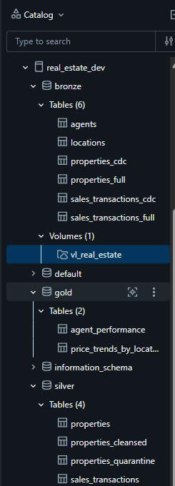
UNITY CATALOG
real_estate_dev catalog structure
bronze (6 tables + 1 volume)
agents, locations, properties_full, properties_cdc, sales_transactions_full, sales_transactions_cdc, and the vl_real_estate volume holding raw files.
silver (4 tables)
properties, properties_cleansed, properties_quarantine, sales_transactions — the merged, validated layer.
gold (2 tables)
agent_performance, price_trends_by_location — ready for BI / dashboarding.
11

Slide 12
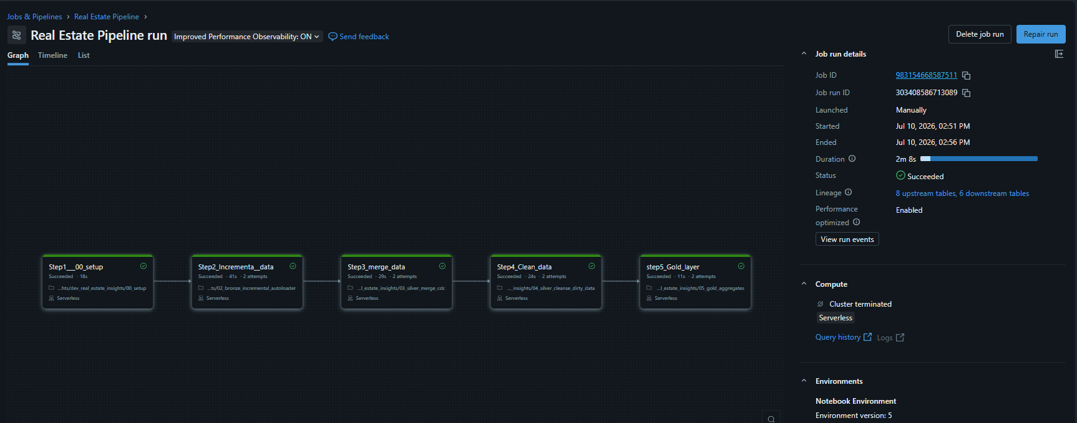
ORCHESTRATION & CI/CD
Fully automated Lakeflow Job
5-step job: 00_setup → 02_incremental_autoloader → 03_merge_cdc → 04_cleanse_dirty_data → 05_gold_layer, run serverless end-to-end in 2m 8s.
Triggered automatically whenever new incremental files land in the volume — Bronze, Silver, and Gold all rebuild with zero manual steps. Combined with the dev → main Git flow (slide 4), this is a complete CI/CD pipeline: code changes are promoted through Git, and data changes are promoted through this Lakeflow job.
12

Slide 13
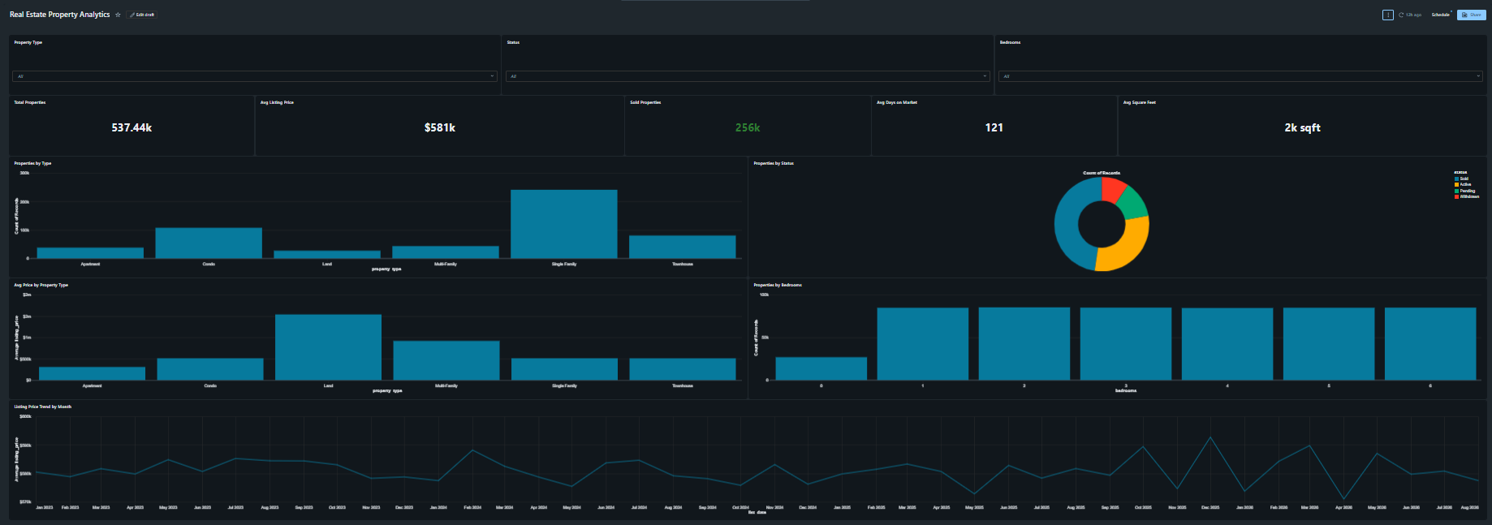
GOLD LAYER IN ACTION
Real Estate Property Analytics dashboard
537.44K
$581K
256K
121
Total properties
Avg listing price
Sold properties
Avg days on market
13

Slide 14
SUMMARY
What this project demonstrates
Raw data engineering
ELT + Medallion on Databricks
Synthetic-but-realistic source data (Claude AI) — full load + 60 days of daily CDC files, sized like a real production feed.
Bronze → Silver → Gold entirely inside Databricks using PySpark, Delta Lake, Auto Loader, and MERGE INTO.
Data quality engineering
Full automation
Deliberate dirty-data handling: type coercion, boolean/date normalization, imputation, orphan-key checks, dedup, and quarantine — not just happy-path code.
One Lakeflow Job runs the entire pipeline end-to-end on a schedule — no manual steps from raw file to Gold table.
Git-driven CI/CD
BI-ready output
Dev branch → PR → main → Databricks Repos pull, so code promotion is auditable and repeatable.
Gold tables (price_trends_by_location, agent_performance) feed a live Databricks dashboard.
14

Slide 15
Thank you
Questions welcome
Repo: github.com/mohittaneja786/real_estate_insights
Catalog: real_estate_dev

