Slide 1
Scenario - Office Building Floor

Slide 2
Hypothesis
Companies and office building owners want to provide their employees a pollution free and clean air within their offices for them to work effectively and stay healthy. As a result they are willing to invest in such solutions.
Players
Client: Senior Company Manager who approves the deal to pay for the installation of the SafeAir measurement device and its SaaS services.
(Admin) User: This user has the admin access to the SafeAir account of their building. These could be building management system manager, HR Manager and security Manager etc.
(End) User: The End user has access to analytics and information that is allowed by the Admin User.

Slide 3
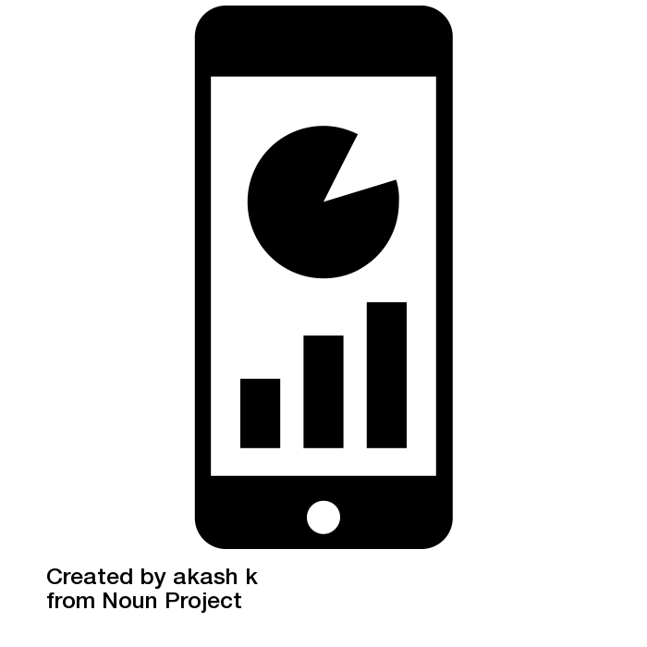





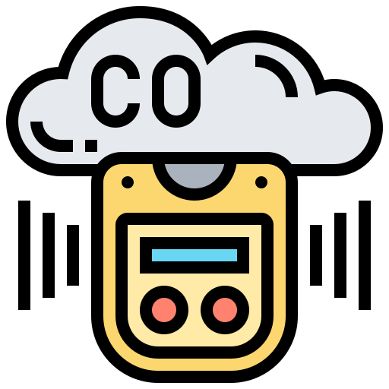



Scenario - Office Building Floor Air Quality Management
Office Building Floor
Admin User
(BMS/Security)
Admin User
(HR)
SafeAir
SafeAir
SafeAir
Backend
SafeAir App makes regular surveys to collect the data about the employee health and satisfaction.
SafeAir measurement devices constantly measures air quality. Temp, humidity etc. and send it to the Safe Air back end server.
The SafeAir backend server records and analyses the data to push alerts and recommendations to the admin/end user.
SafeAir

Slide 4
Recommendation Features (Work backward from the user and then use Science)
Compliance related Air Quality Measurements (input from JF):
Potential Fire: Abnormal rise of CO2
Abnormal rise of (Like TVOC) life threatening poisonous gas such CO
Productivity*
Consistent presence or increase in a gas or a compound level rise to give sore throat and headaches
Wellness/Convenience *
Thermal Comfort
* The individual metrics measured by the SafeAir device and their correlation to symptoms and user safety will be finalized after discussions with Sina and Dr. Bala.

Slide 5
Priority 1:
IAQI = Indoor Air Quality Index
Thermal Comfort
Indoor Environment Quality (IEQ)
Wellbeing/Wellness Index
3 families of indexes - Indexes = aggregation of Raw data
Ram data: 10 values we collect
⇒ 5 indexes already exist
Air Quality / SLA compliancies
Indoor Air Quality ⇒ 78 (dangerous)
etc
Threats / Health
Favorable environment for sore throat
etc
Wellness / Convenience
Thermal comfort
etc
⇒ Only respect of regulation
⇒ Need to have a feedback from the users
Trend engine (predictive engine)
Careful: regarding the trends of historical data, you will reach 89 in 3.5 hours. And this is Hazardous ares.
Recommendation engine
In the context of this area (ex: meeting room) you have 2 solutions:
Open the window
Increase air flow
Notes:
No regulatory authority for indoor air quality. Office spaces included.

