Slide 1
Government Polytechnic Jamnagar
MY STYLE

Slide 2
Project Details
Project name : MY STYLE
Project guide : J.V.SHAPARIA
About project :
Create the account in this site, after the user is login using the user name, password.
In this site, user can but clothes to cash on delivery when they like the clothes and get the bill.

Slide 3
Scope & advantages
Scope :
Purchasing and selling products and services over the internet without the need of going physically to the market is what online shopping all about. Online shopping is just like a retail store shopping that we do by going to the market, but it is done through the internet.
Online shopping has made shopping painless and added more fun. Online stores offer product description, pictures, comparisons, price and much more.
Advantages :
Better prices. Cheap deals and better prices are available online, because products come to you direct from the manufacturer or seller without middleman being involved. Many online shops offer discount coupons and rebates as well. Apart from this, online shops are only required to collect a sales tax if they have a physical location in our state, even if we buy from a store across the world.

Slide 4
User characteristics
USER MODULE
Registration
Log-in
Search clothes
Add to products to cart
Complain if any problem
Buy new products
Logout
ADMIN MODULE
Login
View product detail
Add new product
VISITOR MODULE
Show the product & and other details of it.

Slide 5
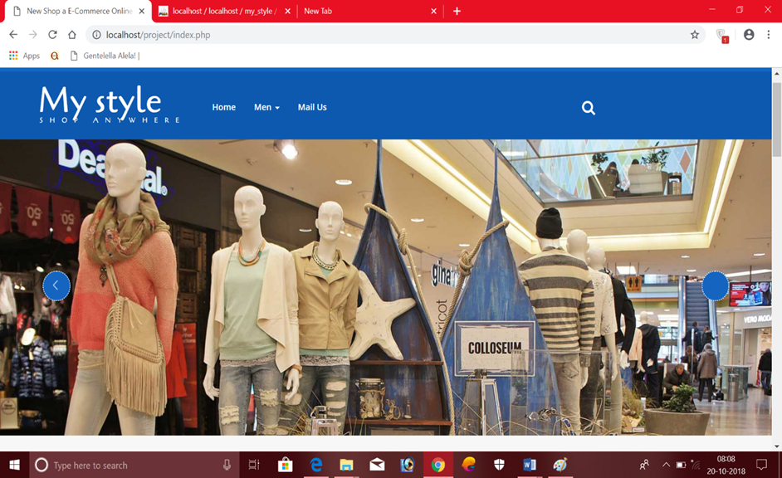
Home Screen

Slide 6
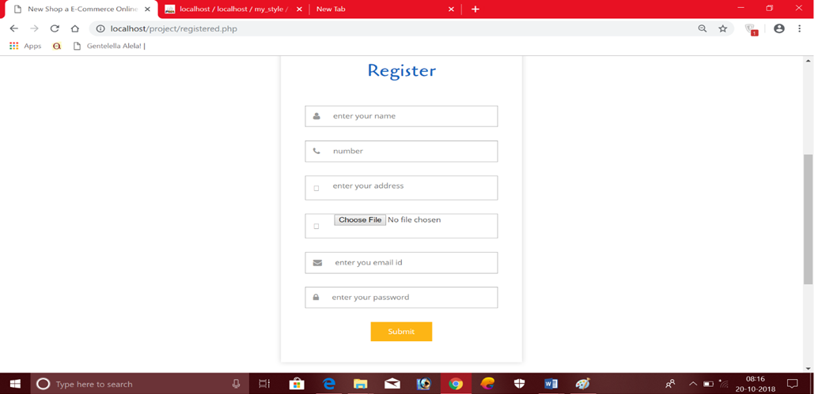
Regestration

Slide 7
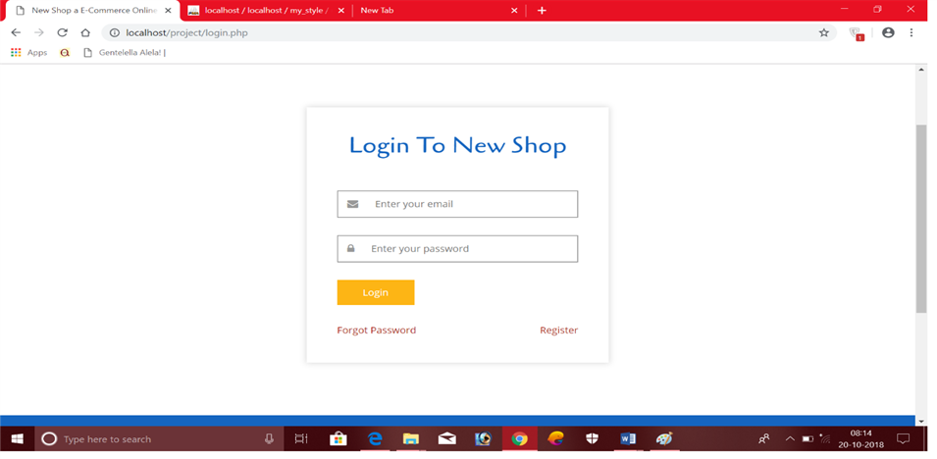
Login Page

Slide 8
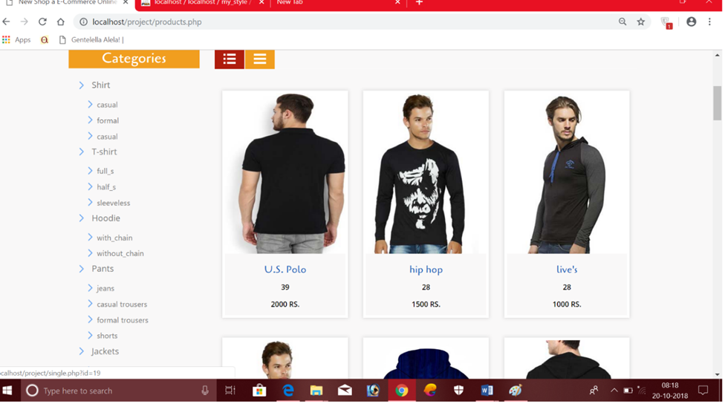
Choose Products

Slide 9
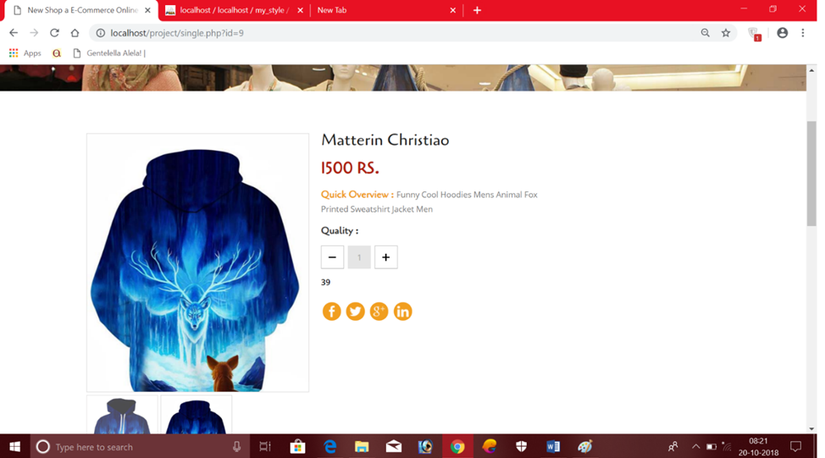
User buy the product

Slide 10
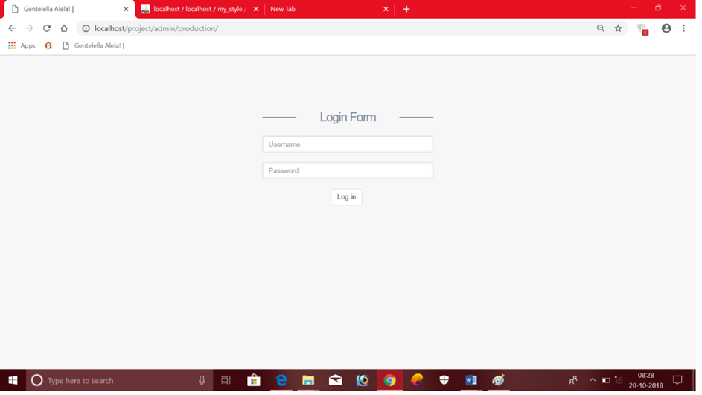
Admin Login

Slide 11
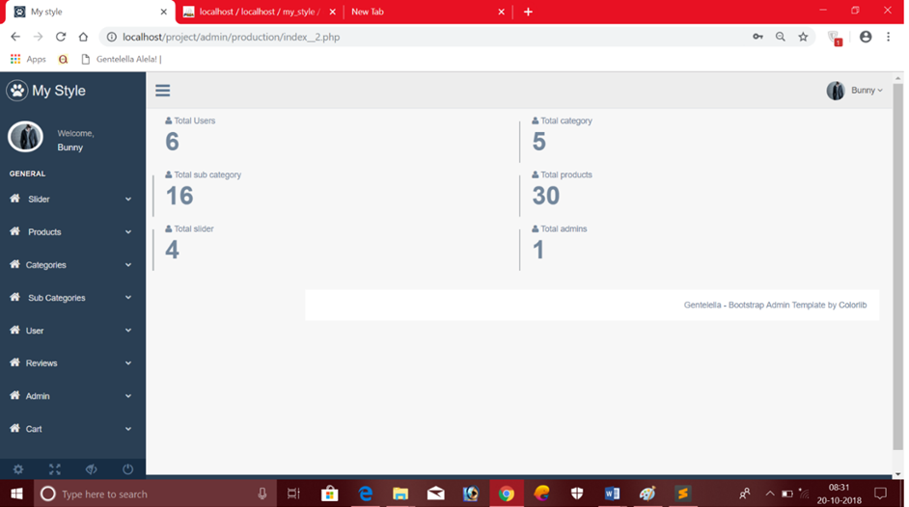
Admin main page

Slide 12
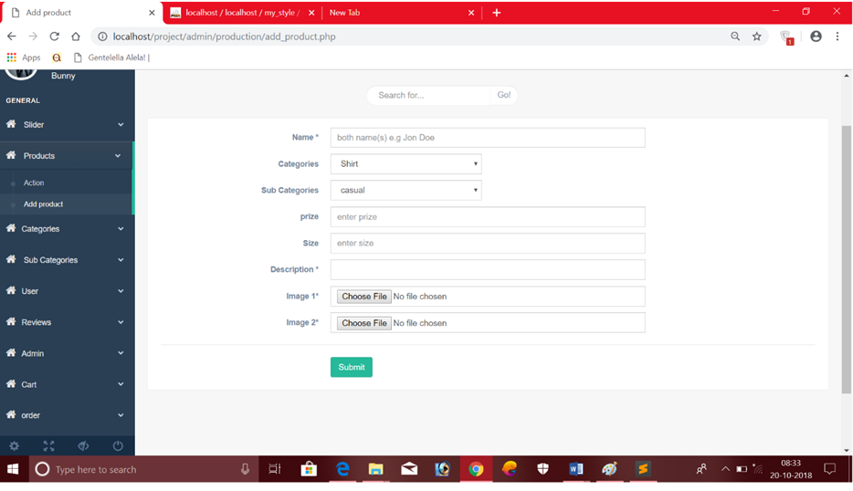
Add new product

Slide 13
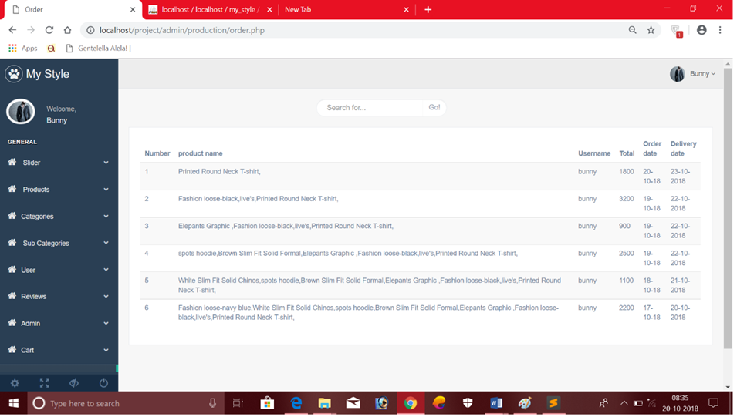
Manage orders

Slide 14
Created By
Mohit vaghela - (166250307056)
Bhavik chudasama - (166250307007)

