Slide 1
Minimal RAG workflow
Mohit Shrivastava

Slide 2
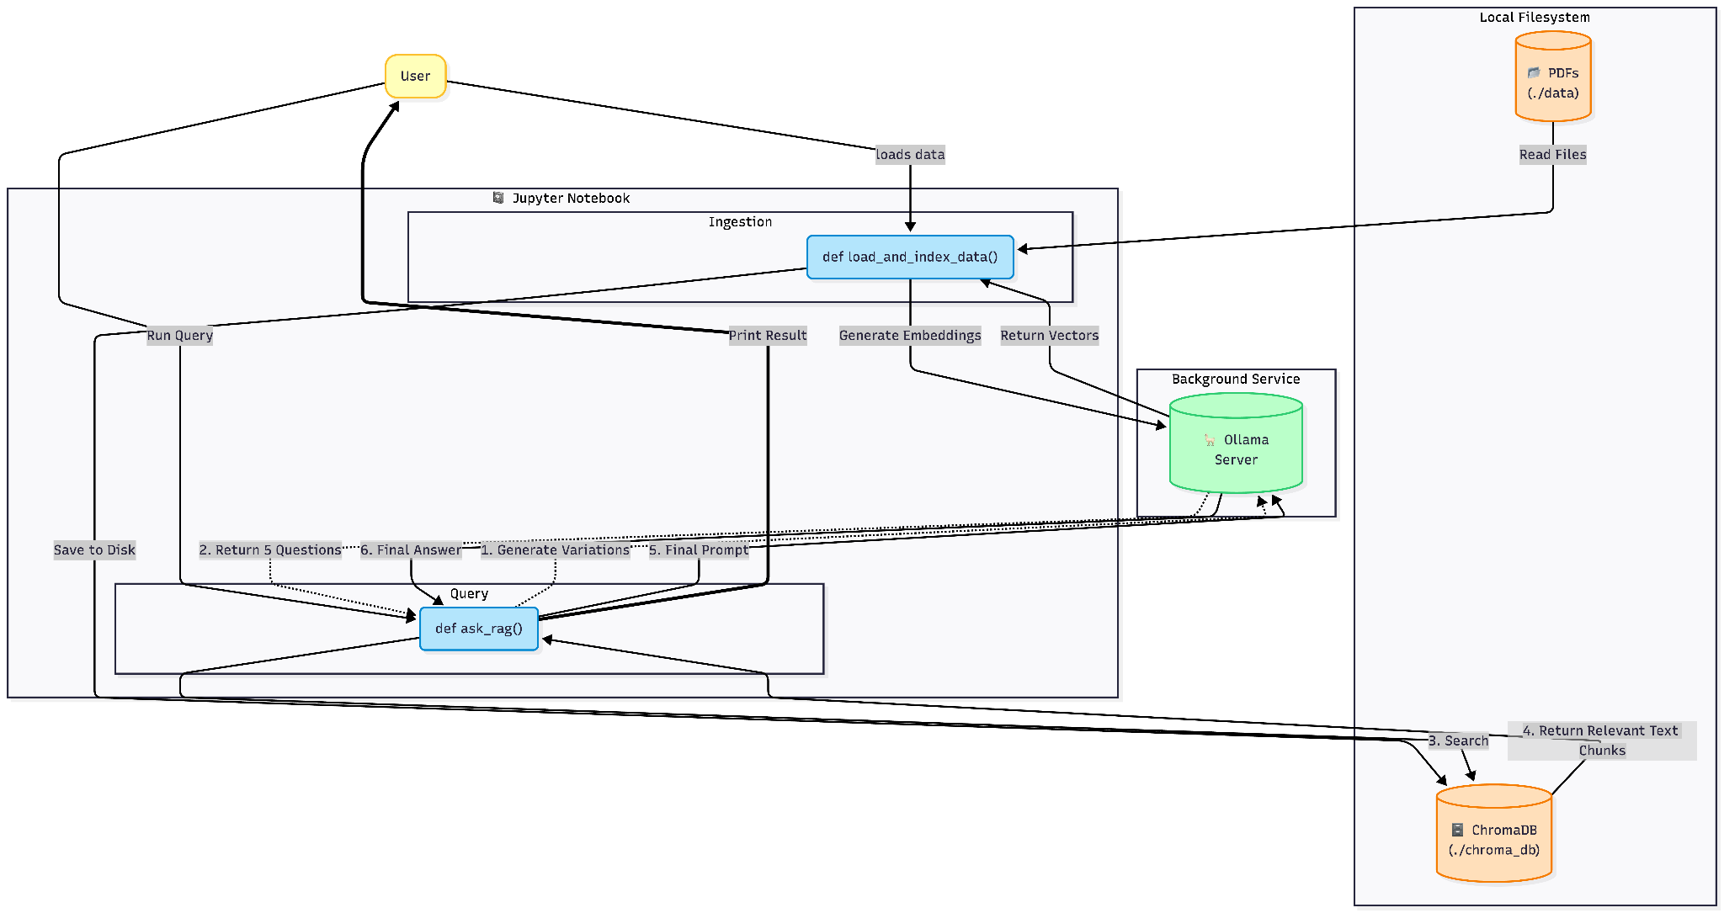
High level architecture diagram

Slide 3
Key Components
RAG Controller (Jupyter/Python):
Orchestrates ingestion, indexing, retrieval and LLM calls.
PDF Source
Local document corpus (folder data/) providing raw content to index.
PDF Loader (PyMuPDF)
Robust extraction of text and metadata from PDFs.
Text Splitter
Breaks long documents into semantic chunks for embedding (controls chunk_size/overlap).
Embedding Engine (Ollama Embeddings)
Generates vector representations locally for privacy and low latency.
Vector Store (ChromaDB)
Persists vectors and metadata for fast nearest‑neighbor retrieval.
Retriever (MultiQueryRetriever)
Generates multiple query variants and fetches top candidate chunks.
LLM & Prompting (ChatOllama + Prompt Templates)
Consumes retrieved context + user question and generates grounded answers.

Slide 4
How It Fits Together: The Workflow
Ingestion Pipeline (The 'Write' Path)
PyMuPDFLoader reads raw PDFs from the './data' folder.
RecursiveCharacterTextSplitter creates semantic chunks (7500 chars).
Text is sent to Ollama for embedding, then stored in ChromaDB.
Retrieval Pipeline (The 'Read' Path)
User Query is expanded into 5 variations via the MultiQueryRetriever.
ChromaDB performs vector searches for all variations.
Unique results are fused and sent to Llama 3 for the final answer.

Slide 5
Implementation Plan
Phase 0: Environment Setup
Create venv, install dependencies (requirements.txt), ensure ollama serve and model availability.
Phase 1: Ingestion
Implemented load_and_index_data(folder_path): load PDFs, normalize text, split into chunks.
Validated text quality on sample PDFs.
Phase 2: Indexing
Create embeddings via OllamaEmbeddings, build/persist Chroma collection.
Retrieval & QA
Implement MultiQueryRetriever + prompt templates and chain (ChatOllama → StrOutputParser).
Add example queries and verify answers are grounded

Slide 6
Challenges & Solutions
Challenge 1: Vocabulary Mismatch
Issue: Users asked questions differently than how the PDF was written.
Solution: Implemented 'MultiQueryRetriever' to generate 5 AI variations of the user's prompt, increasing search coverage.
Challenge 2: Loss of Context
Issue: Whole documents were too large for the context window.
Solution: Implemented 'Recursive Semantic Chunking' (7500 chunk size, 100 overlap) to keep related sentences together.
Challenge 3: Dependency Conflicts
Issue: Python 3.14 (Beta) caused conflicts between Pydantic V1 (Chroma) and V2 (Ollama).
Solution: Enforced a stable Python 3.12 environment using 'venv' and updated to 'langchain-ollama' specific packages.

