Slide 1


BRAC University | June 2026
DEEP LEARNING FRAMEWORKS FOR
SUSPICIOUS ACTIVITY DETECTION IN VIDEO SURVEILLANCE SYSTEMS

Slide 2
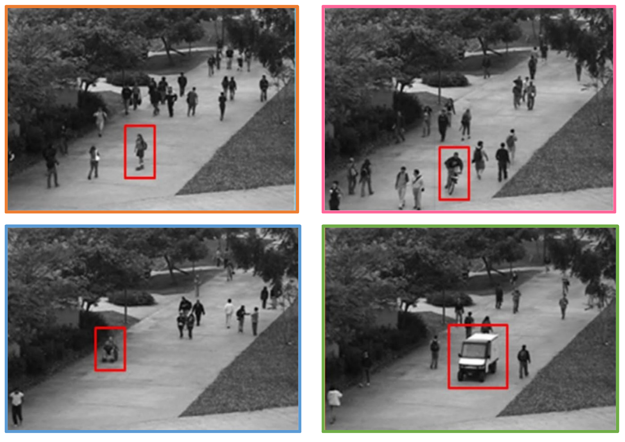
Research Overview
Deep Learning Frameworks for Suspicious Activity Detection in Video Surveillance Systems
Focus
  Video Anomaly Detection
  Intelligent Surveillance
  Public Safety Monitoring
  Automated Incident Response
Objective
  Detect suspicious activities automatically from surveillance videos

Slide 3


Research Motivation
Why This Research?
Limitation of Existing Studies
  Models evaluated on isolated datasets
  Difficult to compare architectures fairly
  Limited assessment of real-world generalization
Our Solution
  Unified and comprehensive evaluation framework
  Multi-dataset benchmark for comprehensive comparison

Slide 4
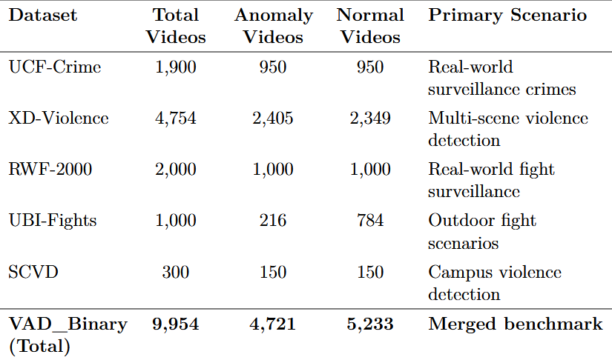

Slide 5
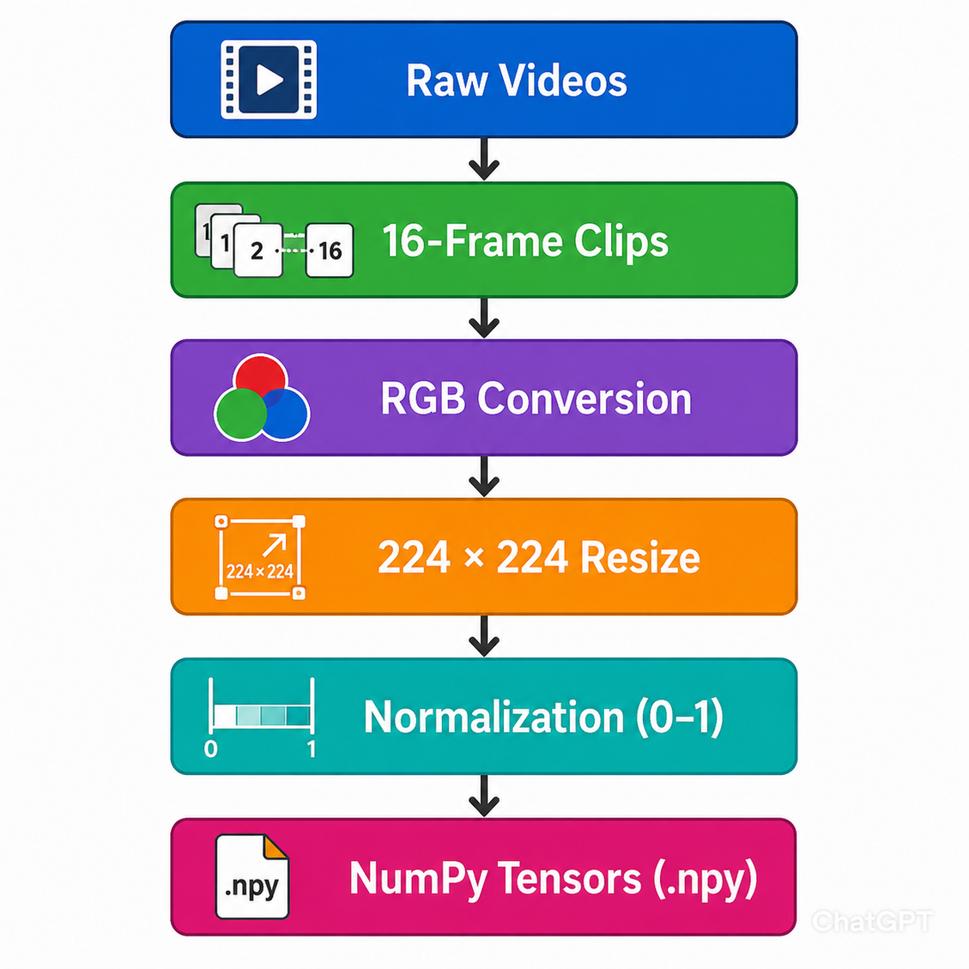
VAD_Binary Dataset Construction
  Unified multiple benchmark datasets
  Binary classification:
    Class 0: Normal
    Class 1: Anomaly
  Encourages learning of generalized abnormal behaviors
Key Benefits
  Standardized input format
  Reduced computational overhead
  Consistent benchmarking environment

Slide 6
Research Framework
Dataset Partitioning
Stratified Sampling
  Training: 70%
  Validation: 15%
  Testing: 15%
  Fixed random seed: 42
  Preserves anomaly-to-normal ratio across all subsets
Class Imbalance Mitigation
Training Data Format
  Real-world surveillance is heavily normal-dominated
  Computed class weights from training labels
  Penalized majority-class bias during learning
  Tensor Shape: 16 × 224 × 224 × 3
  Batch Size: 4

Slide 7
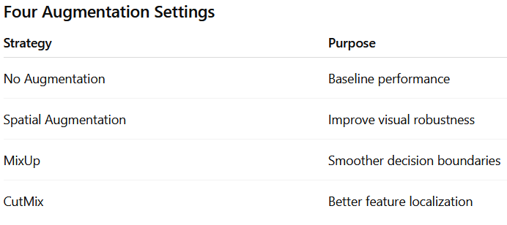
Data Augmentation Strategies
Spatial Augmentation
  Horizontal Flip
  Brightness Adjustment
  Contrast Adjustment
  Applied consistently across all 16 frames
Video-Aware Mixing Techniques
MixUp
  Blend two video clips and labels
CutMix
  Insert spatial patch across all frames
  Adjust label using mixed-region ratio
Why?
  To preserve the physical realism and lighting of the scene
  To be much more reliable on edge cases
  To preserve the temporal context
Efficient Training
  Augmentations applied on-the-fly
  Custom data generator
  No additional storage overhead

Slide 8

Nano Family Models
Video anomaly detection must understand both space and time.
Space
Time
▣
◷
What is happening
inside each frame
How things change
across frames
person · road · crowd
movement · fighting · running
sudden abnormal motion
+
Spatiotemporal
Understanding
Space
Time
Traditional 3D CNNs can capture spatiotemporal information, but many are computationally heavy.
That is why we proposed the Nano3D family.

Slide 9
Nano3D: Balanced Compact Model
Compact multi-scale spatiotemporal model for binary anomaly detection
model flow
16-frame RGB Video Clip
Factorized 3D Convolution
Factorized 3D Convolution
• Spatial convolution learns visual patterns inside frames
• Temporal convolution learns motion patterns across frames
Residual Connections
spatial + temporal
features
Squeeze-and-Excitation Attention
Multi-Scale Feature Fusion
Multi-Scale Feature Fusion
• Earlier stages capture small motion details
• Deeper stages capture higher-level anomaly patterns
Lightweight Classification Head
Normal or Anomalous

Slide 10
Nano3D Family Variants
Nano3D
Nano3D Edge
Nano3D Turbo
⚖
◡
»
Balanced version
Ultra-lightweight version
Speed-oriented version
✓
Compact multi-scale spatiotemporal model
16 thousand
parameters
0.06 MB
model size
✓
Designed for faster video processing
✓
Best practical balance
✓
Grouped 3D convolutions
✓
Designed for edge devices
✓
Aggressive downsampling
✓
Useful when memory and computation are very limited
✓
Focused on speed and parallel processing
Nano3D = balanced
Nano3D Edge = ultra-lightweight
Nano3D Turbo = speed-oriented

Slide 11
Why Nano3D is Practical
A surveillance model should not only be accurate, but also fast and lightweight enough for practical deployment.
Heavy 3D CNNs
Nano3D
C3D / I3D / ResNet3D
• Large 3D convolutional structures
• Higher parameter count
• Larger model size
• Higher inference cost
VS
• Around 486 thousand parameters
• 1.86 MB model size
• Compact architecture
• Better practical trade-off
Parameter Count
around 28 million parameters
Model Size
above 100 MB
C3D
C3D
Nano3D
around 486 thousand parameters
Nano3D
1.86 MB
A carefully designed compact architecture can provide a better practical trade-off between accuracy, efficiency, and deployability.

Slide 12
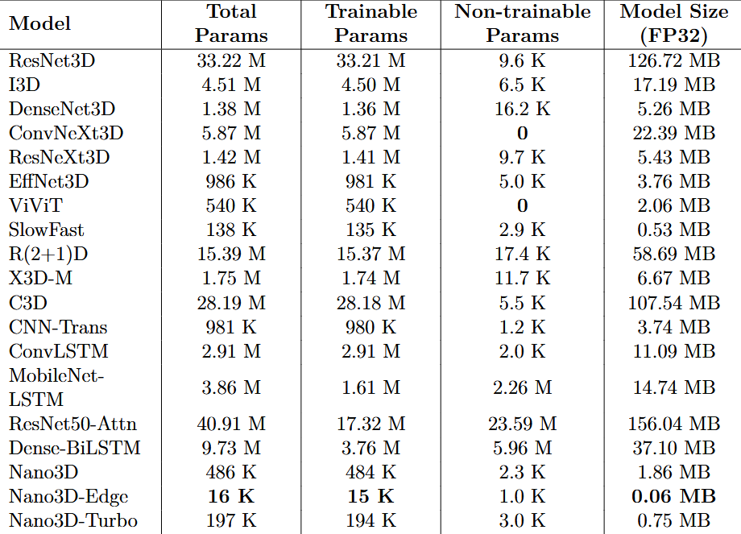

Slide 13
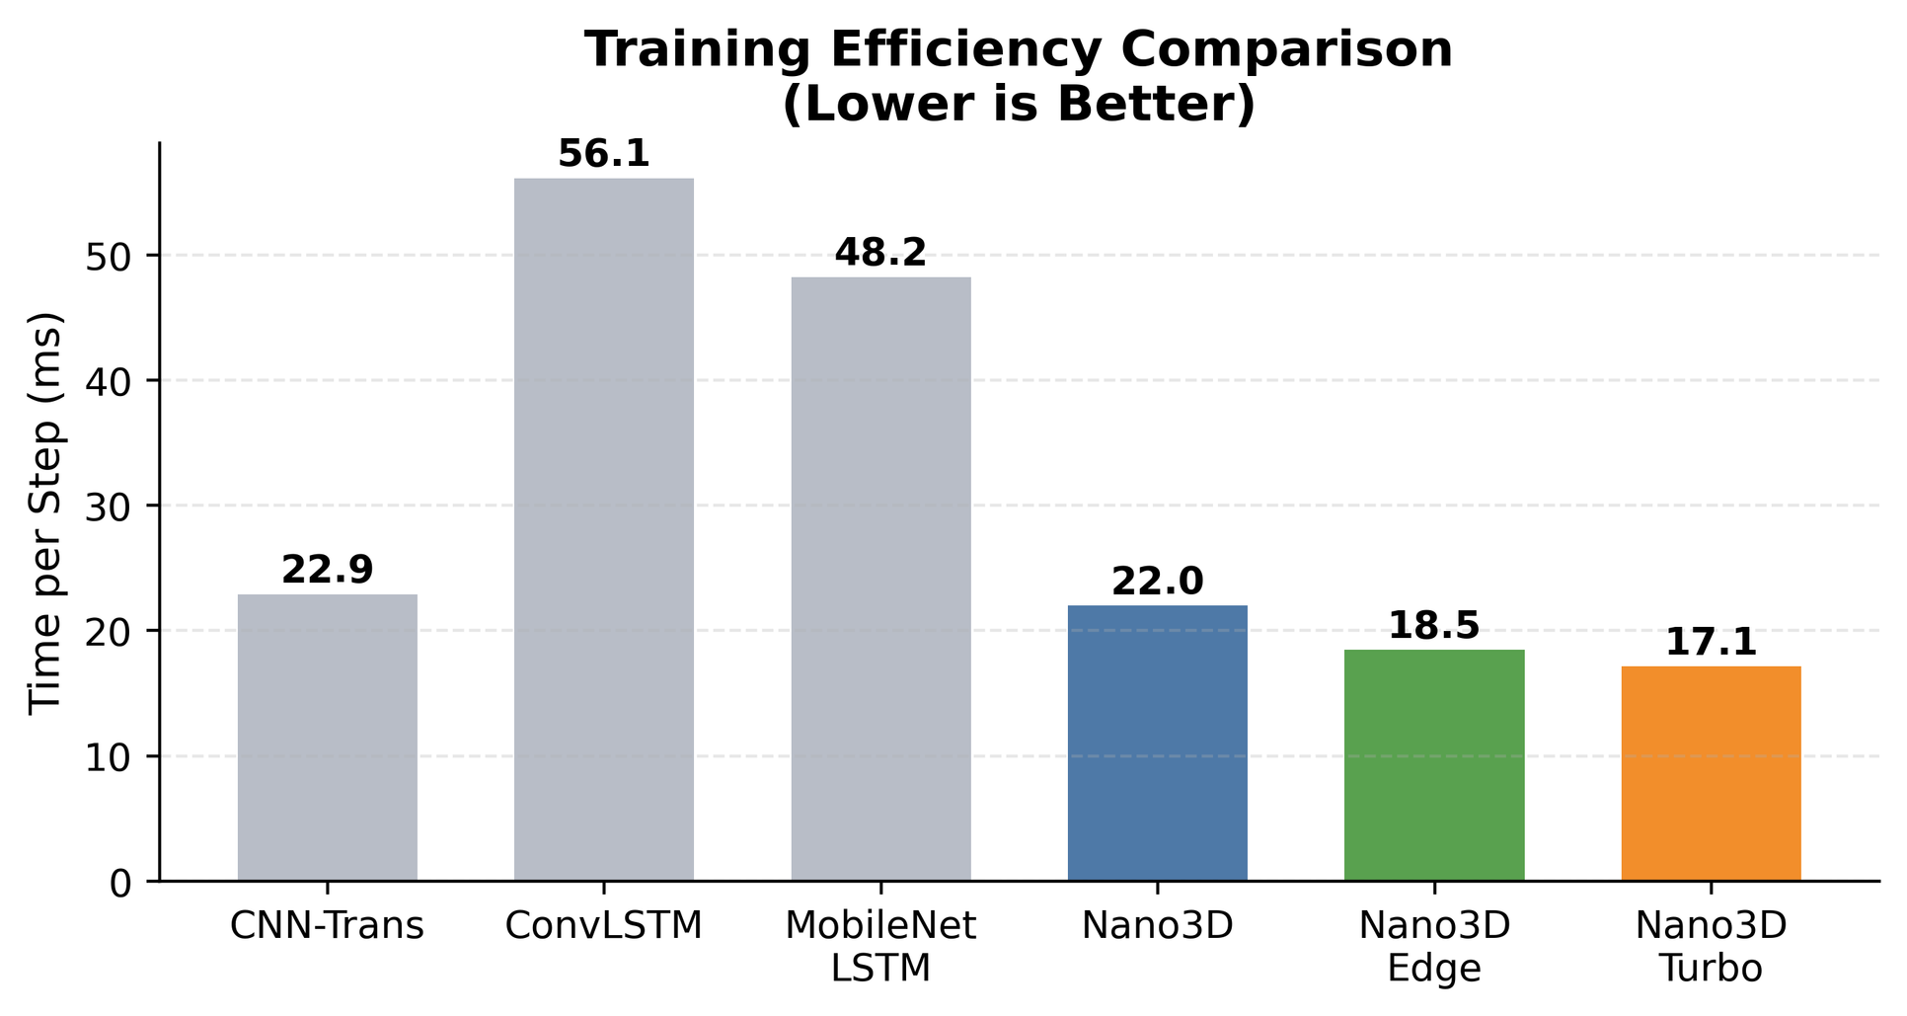

Slide 14
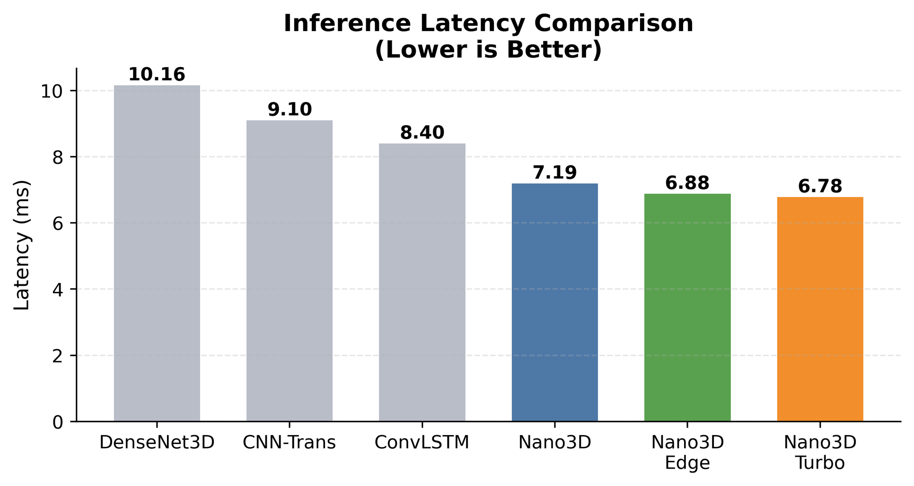

Slide 15
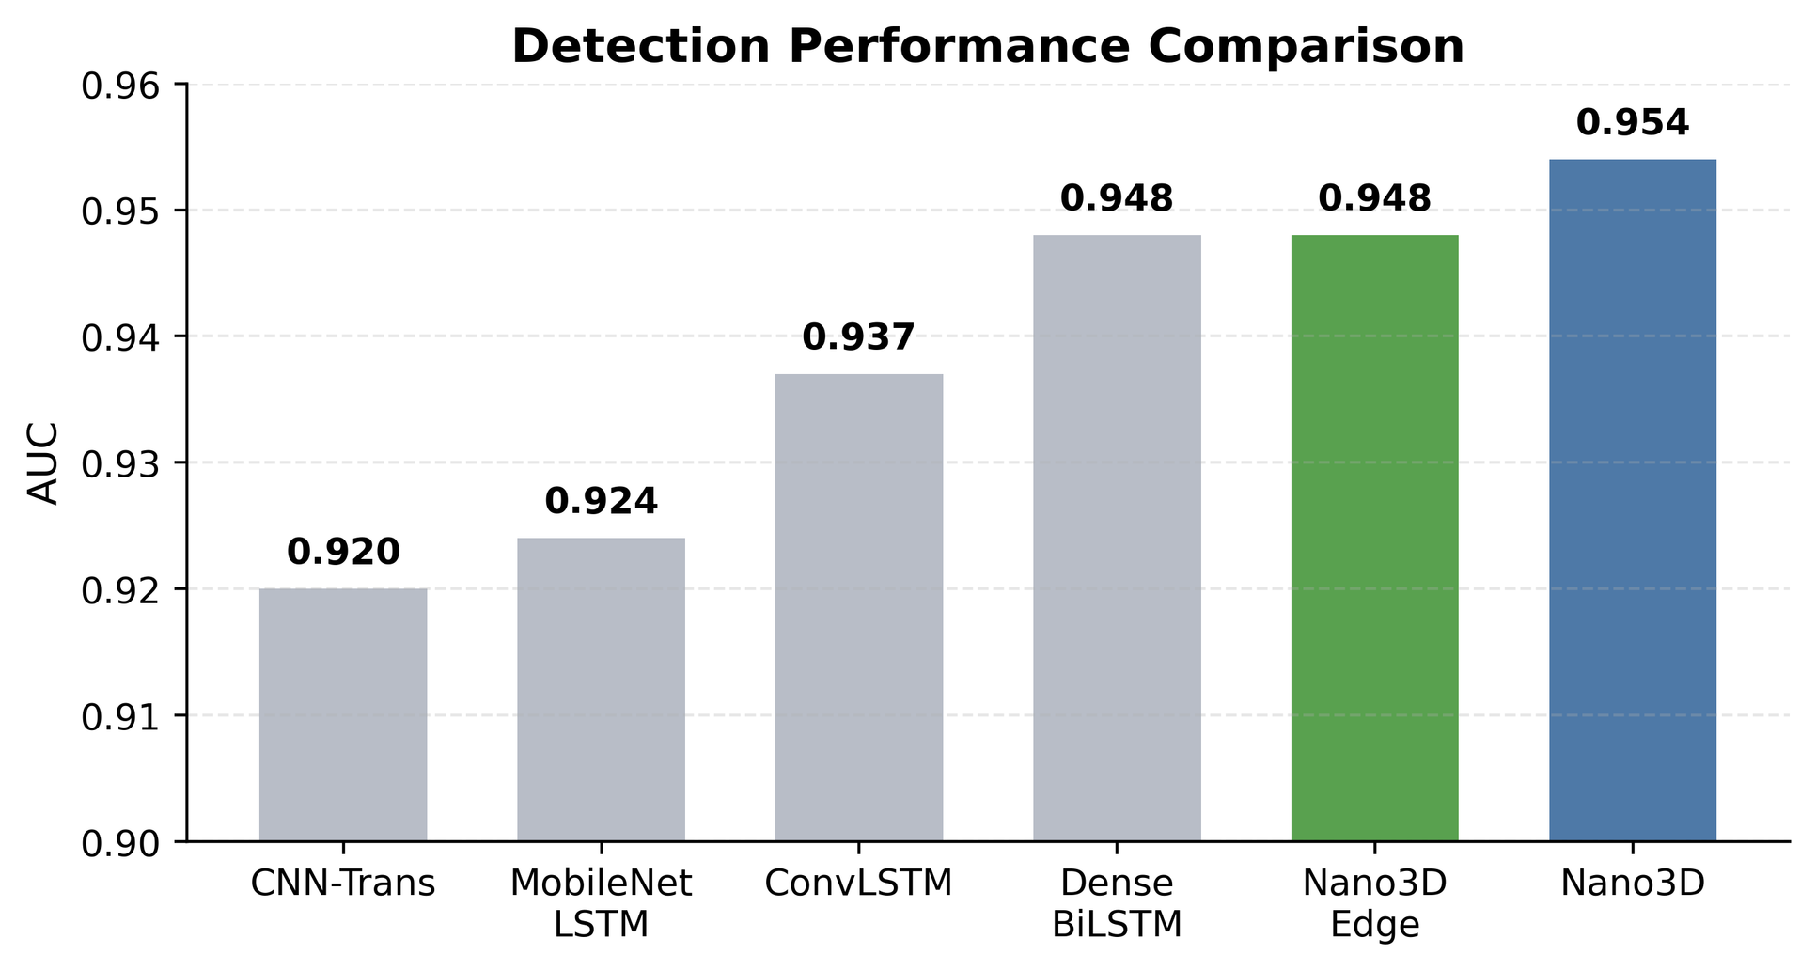

Slide 16
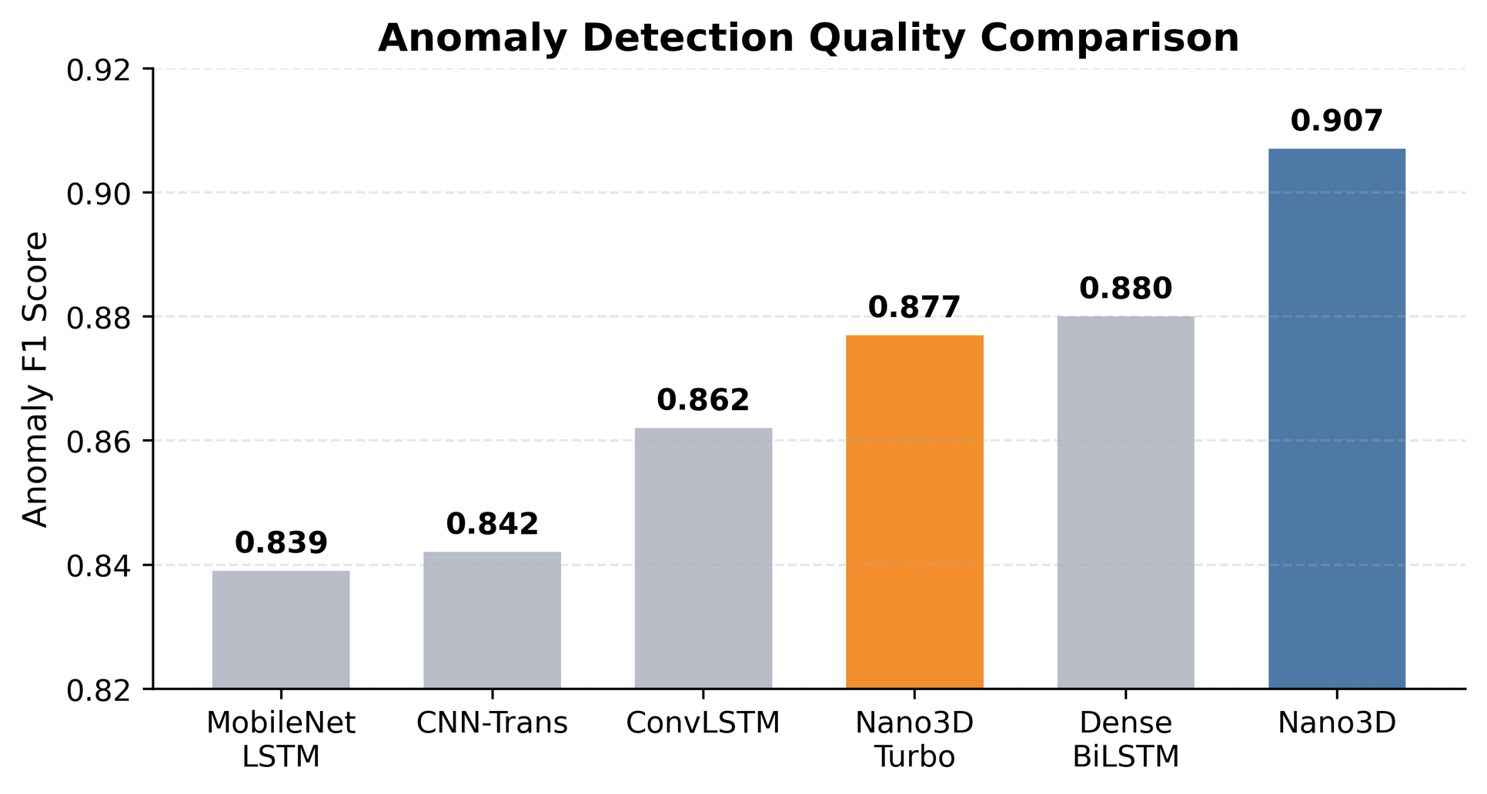

Slide 17
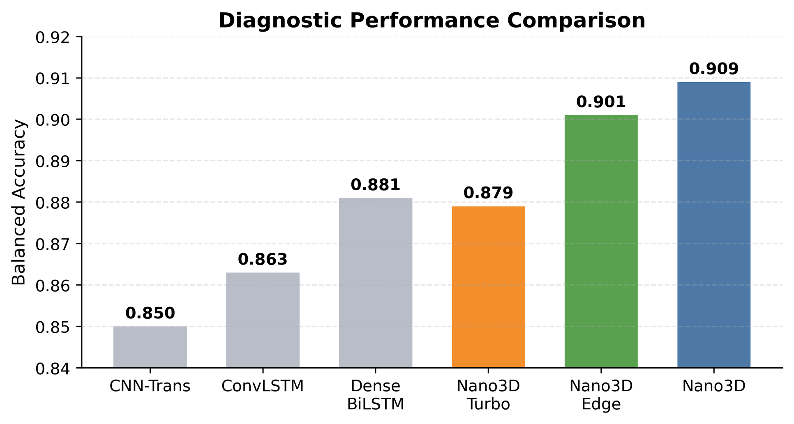

Slide 18
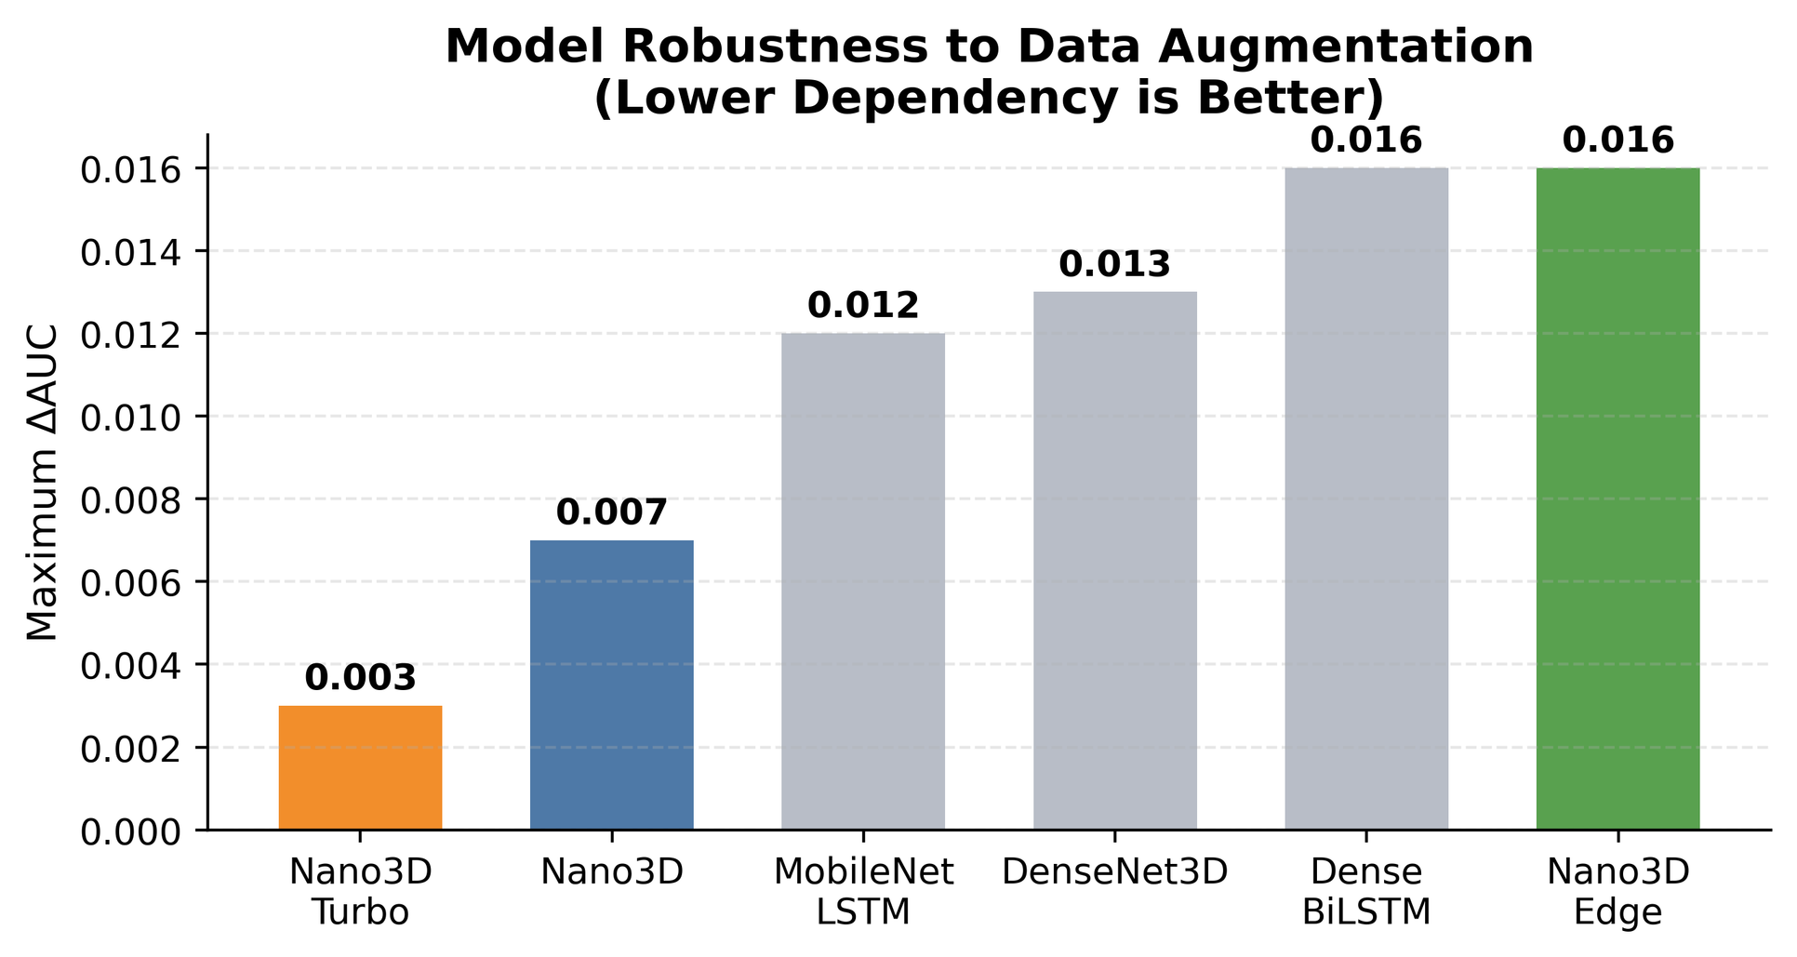

Slide 19
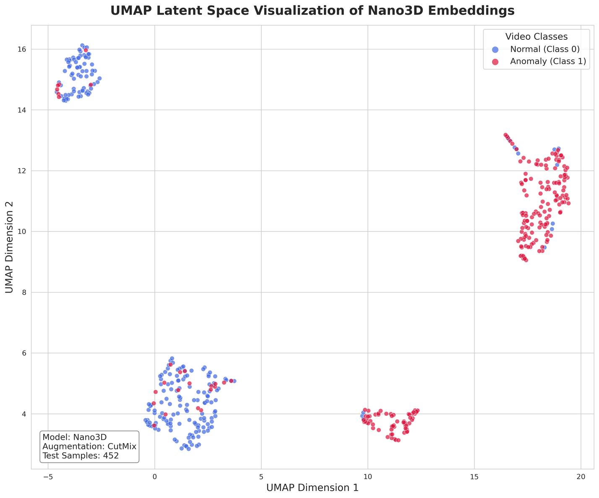

Slide 20
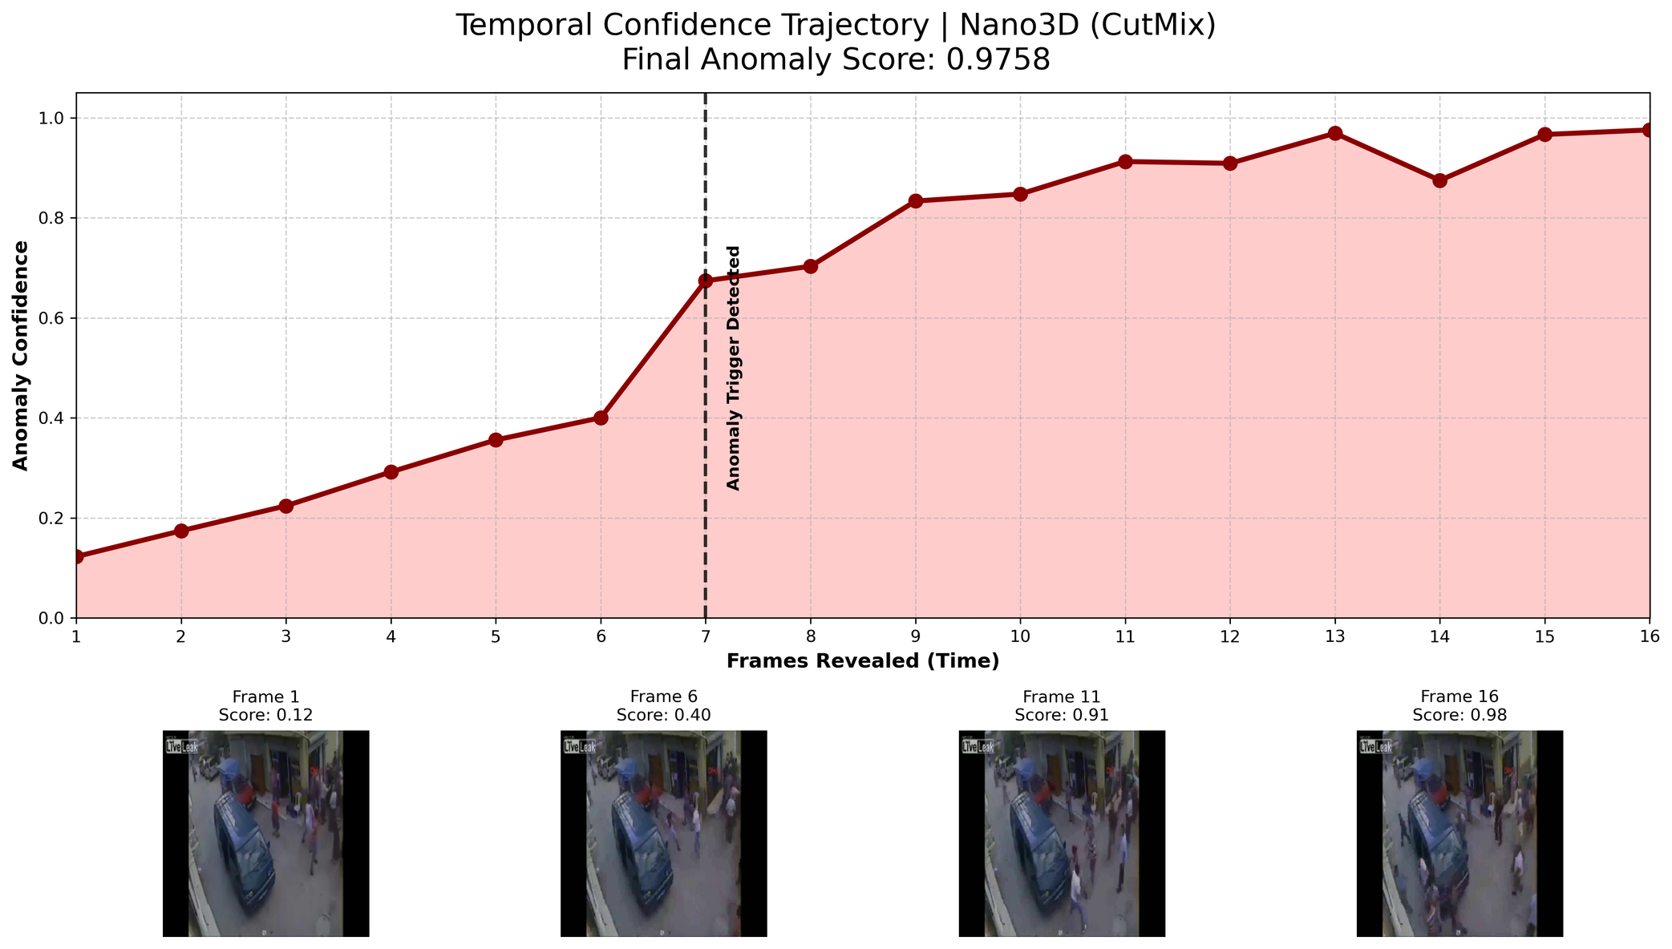

Slide 21
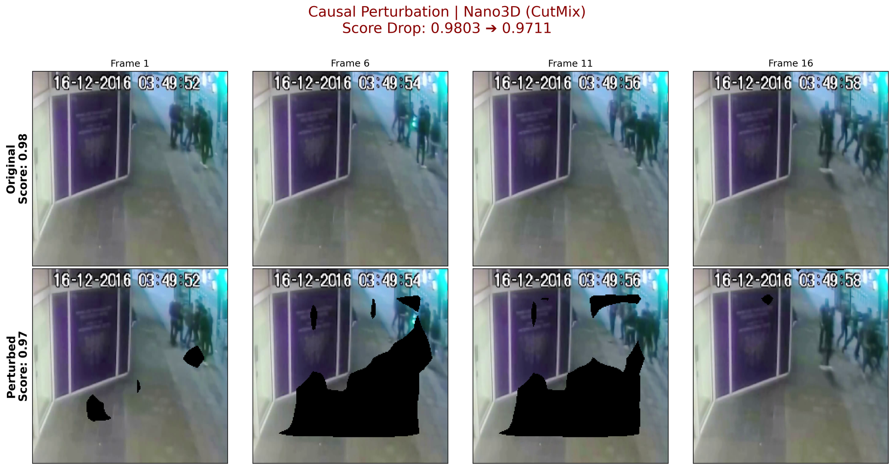

Slide 22
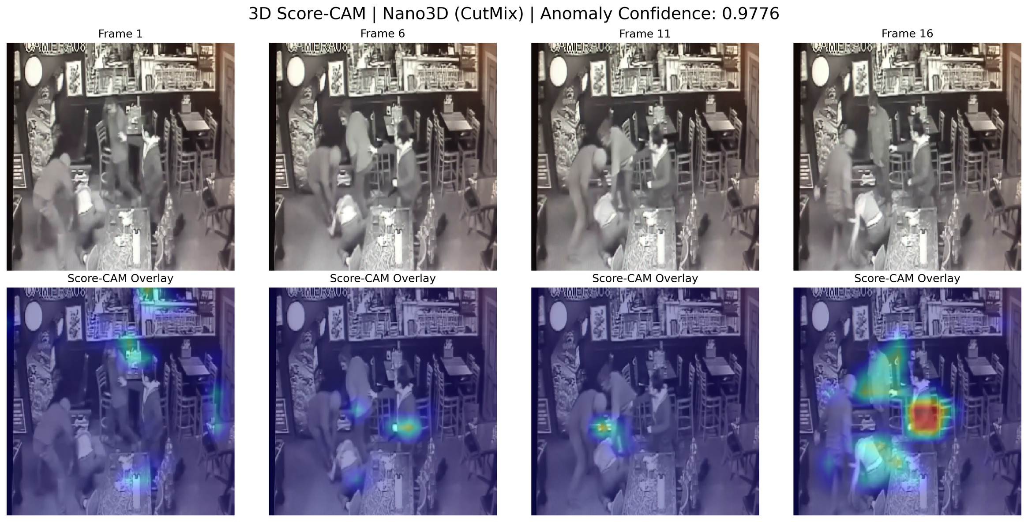

Slide 23
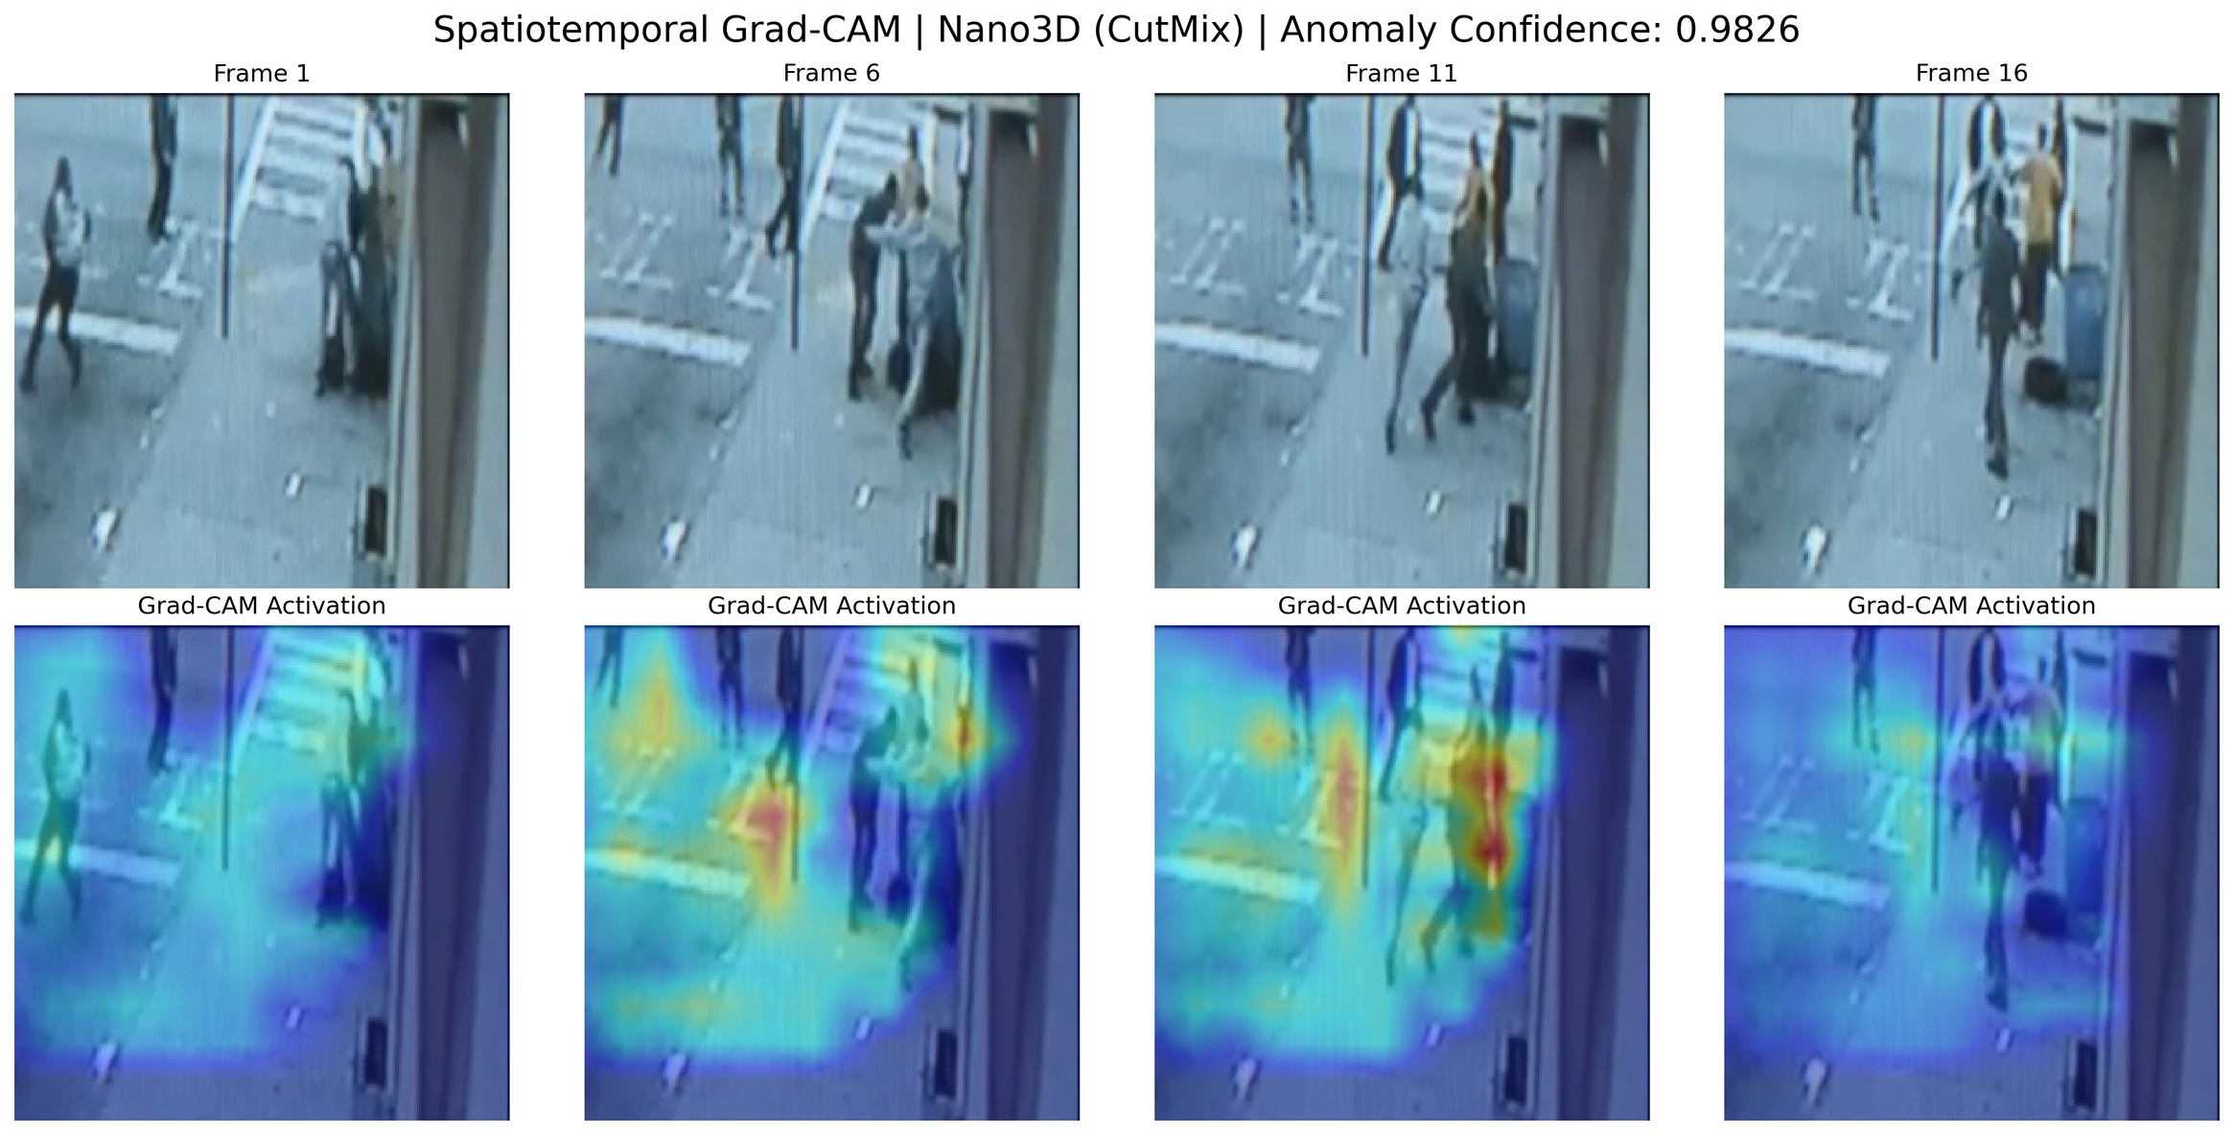

Slide 24
Questions?

