Slide 1
Function Detective
Shahrukh Mohiuddin

Slide 2
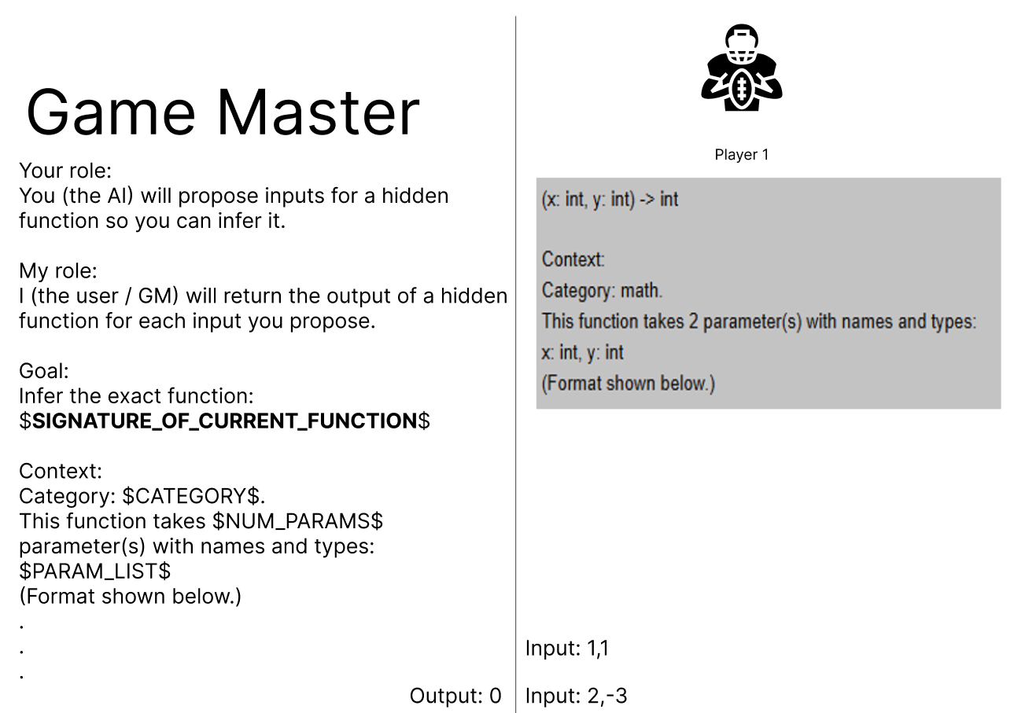
Game Concept

Slide 3
Experiment design considering the RQ
Research question:
Is the performance of a LLM model
a function of problem hardness or
do different LLM models react differently to the range of problems.
The outcome we want, 2 types of evaluations:
Evaluate performance on hardness
Evaluate performance on range of problems

Slide 4
The 3x5 Experiment Grid
Difficulty
Range (Have several domains)
Easy
Medium
Hard
Scalar math (1 input)
Pair math (2 inputs)
List sequence
String
Logic (logic/ true false)

Slide 5
What this grid reveals
Hardness effect:
Easy, Medium, Hard
If the performance drops across hardness, then that answers, hardness reduces the model's performance
Range Effect:
At a fixed difficulty level, compare the results across domains
If the model is much better on some domains than others, we can conclude that "range matters”

Slide 6
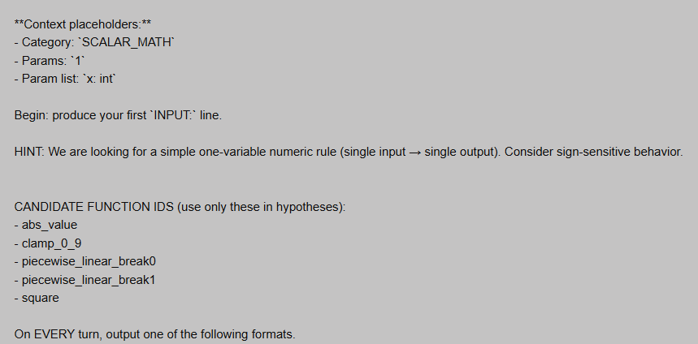
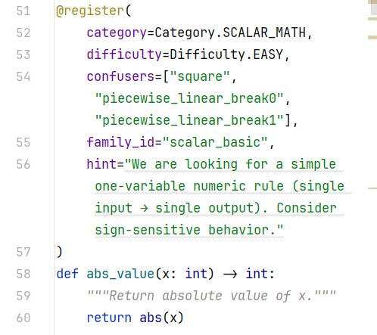











Hint mode addition
A hint mode of the game was introduced where a “hint” is revealed to the model, along with the initial prompt.

Slide 7
No penalty mode
Code is generated on each turn
This code:
If correct → Game ends with win
If wrong → Turn gets consumed, game keeps going
What it aims to measure:
Turns till solution
Whether errors decrease with turns
Do the models use probing or now there is a shift towards brute-guessing

Slide 8
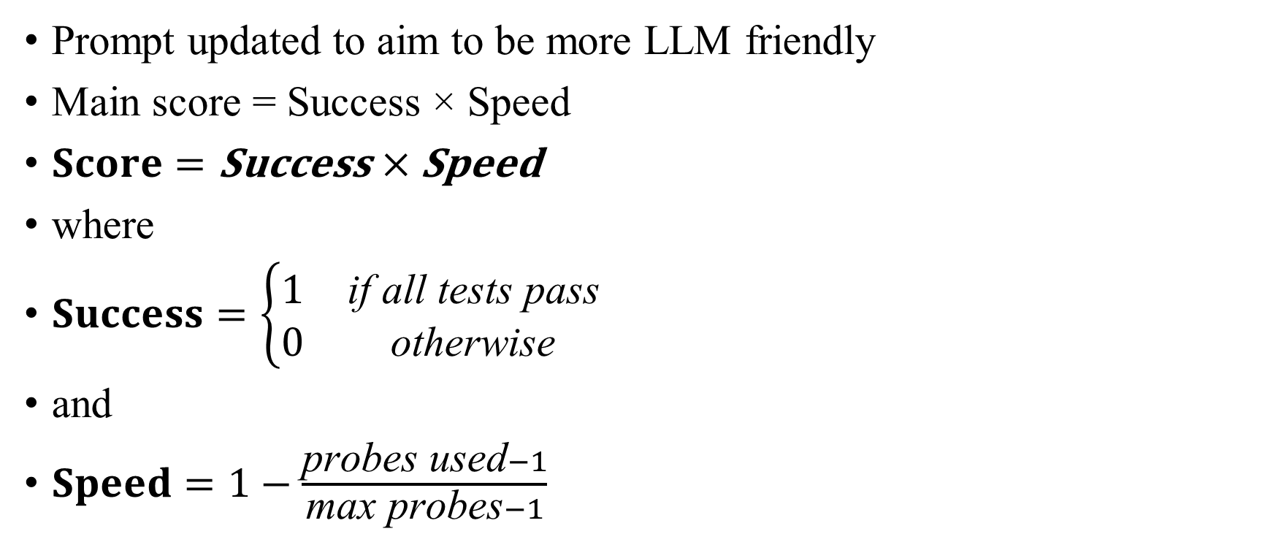
Updates and Changes
Prompt updated to aim to be more LLM friendly
Main score = Success × Speed
$\text{Score}=\text{Success}×\text{Speed}$
where
$\text{Success}=\left\{\begin{matrix}1 & \text{if} \text{all} \text{tests} \text{pass} \\ 0 & \text{otherwise}\end{matrix}\right.$
and
$\text{Speed}=1−\frac{\text{probes} \text{used}−1}{\text{max} \text{probes}−1}$

Slide 9
Conclusion and future work
All hypotheses, candidate_ID and confusers have been removed to simplify the game, for now.
Future work focuses on finalizing a prompt that is:
Even simpler
Short

