Slide 1
Induction Game
Shahrukh Mohiuddin

Slide 2
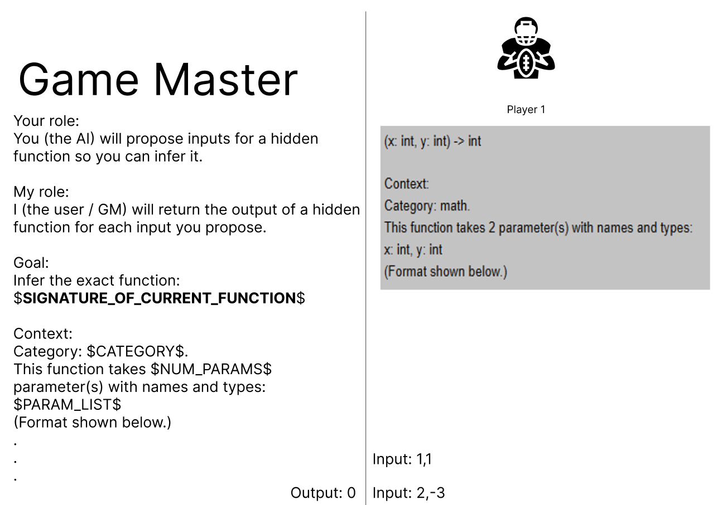
Game Concept

Slide 3
Old approach and Issue
Old approach was using exec() in main code
Issues: Many
Full access to:
File system
Env Variables
Network
Internals (Python)
So, if someone “guessed” this code:
import os os.system("rm -rf /") // The whole system’s os would be wiped.

Slide 4
Solution 1 (VE)
Use a virtual environment
But… a virtual env doesn’t provide:
Filesystem Isolation
Network Isolation
Process Isolation
No CPU/ main memory (RAM) limitations
No security boundaries
What a VE offers is isolation of dependencies, not behavior

Slide 5
Solution 2 (Containers)
Sidecar (Sleeping/ longliving) Container
Ephemeral (Short lived) Container
Weak security
Run once and used again and again
Partially Isolated
State leak is possible
Not always reproducible
Not so complex to implement
Strong security
Run once per guess from scratch
Fully isolated
State leak proof
Reproducible
Robust
More complicated to implement and manage

Slide 6
Ephemeral Containers
Used by CodeForces and LeetCode
ML evaluation harnesses
Secure sandboxes
Cloud function execution
Therefore: A reliable, reproducible, safe and widely used solution to adapt to

Slide 7
Integration
What runs in the container
What runs outside
The guessed function
Execution of test cases
Game logic
Turn handling
Scoring and logging
Input Generation
Ground truth function
Result comparison

Slide 8
Integration
Guesser Submits code
Framework provides test cases
Ephemeral container spins
Code execution
Test cases are tested
Results returned to framework
Container destroyed
Evaluation of results

Slide 9
Implementation
Implemented a small sandbox outside of the game to see if it works
After that successfully worked
Integrated into framework
Results: A safe, robust and mostly reliable framework

Slide 10
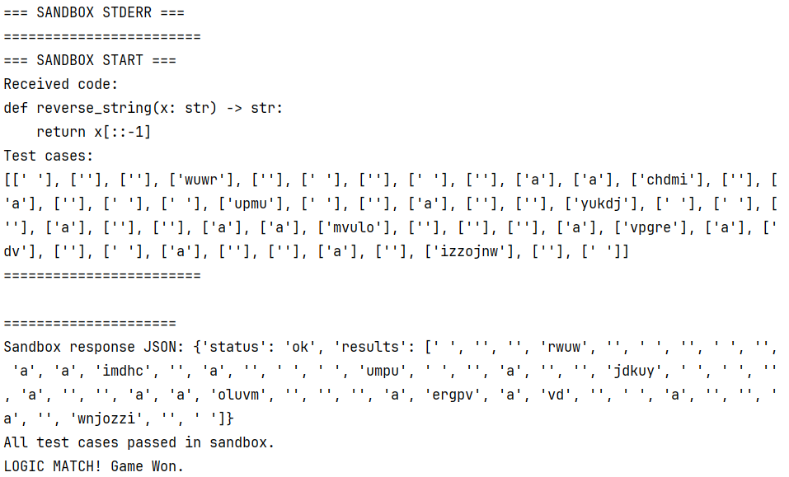
Sandbox response

Slide 11
How do the test cases work?
Look at the expected input type (str. Int, list, etc.)
Generate a matching random value
Add edge cases (empty values, negative values, really large numbers, all kinds of strings)
```
Python
List[int]
sees the input should be a List
chooses a random length
Fills it with random numbers and edge cases
[0, -1, 8, 32, …]
```

Slide 12
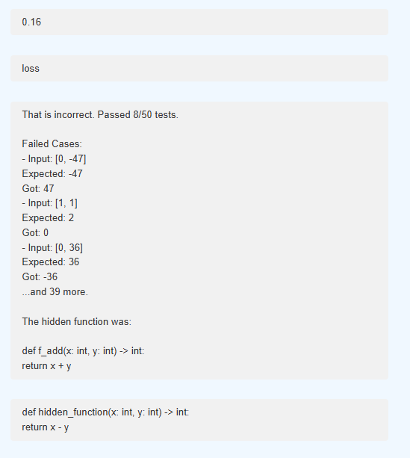
When the model fails
Not just 1 or 0 anymore
Check the number of testcases that passed
The framework shows some (top 3) of the test cases that failed
Reveal the hidden function to the guesser
Show the user their guess

Slide 13
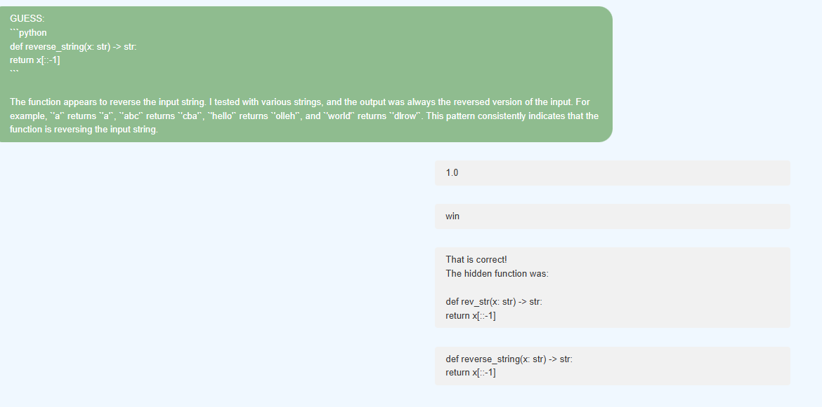
Framework

Slide 14
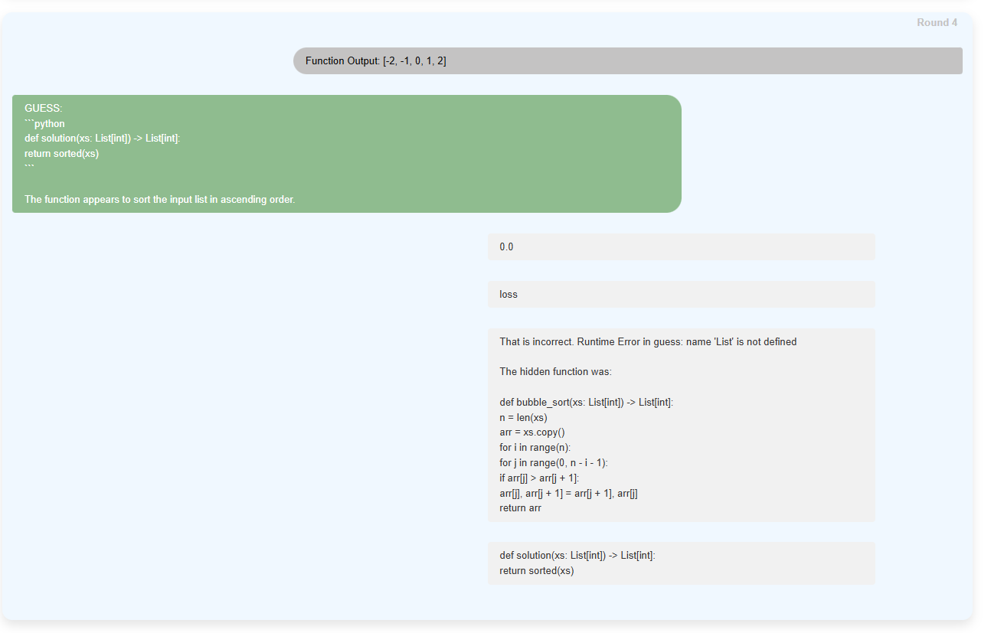
New type of problem
Bubble sort
Arr.sort() is an inbuilt and in our game, we don’t allow this because then its too trivial of a problem.

Slide 15
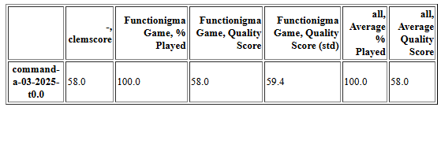
Scoring
For scoring its not 1 or 0 rather, the accuracy is checked:
Total passed cases / Total test cases

Slide 16
Whats next
Search for better prompts:
A good prompt should function for the “dumbest” model (at least the format of inputs should be followable)
More:
Models to test on
Scoring metrics
Problems
Refinement (but later)

