Slide 1
Forecasting House Prices for Ten Illinois Metropolitan Statistical Areas
First Report
Geoffrey Hewings
Gianfranco Piras
Regional Economics Applications Laboratory
Institute of Government and Public Affairs
University of Illinois
July, 2007
R | E | A | L

Slide 2
Outline of the presentation
  Construction of the dataset
  Preliminary analysis of the data: some descriptive statistics
  Relationship between the house pricing and the economic business cycle: the Augmented Distributed Lag Model (ADLM)
  The forecasting methodology
  Results of the forecast from the ARIMA models and measures of forecasting accuracy

Slide 3
Data
Some checks and modifications needed to be made on the original data:
Eliminate the observations for which the listing date is after the closing date
Many variables have missing values or errors and cannot be considered (age, acreage, internal footage, taxes and county assessed value)
Number of bedrooms and number of bathrooms present some problem. However it is an acceptable loss of information to eliminate the observations that present incongruence. We decided to eliminate all the observations for which either the number of bedrooms was higher than 11, or the number of bathrooms was higher than 7
We generated the variable time on market as the difference (number of days) between the closing and the listing date
Then the mean price for each month by MSA is calculated in order to produce a time series of the mean price by MSA
For the analysis we consider the logarithm of the price (note that the forecast can be easily produced for data in levels by taking the exponential of the predicted values)

Slide 4
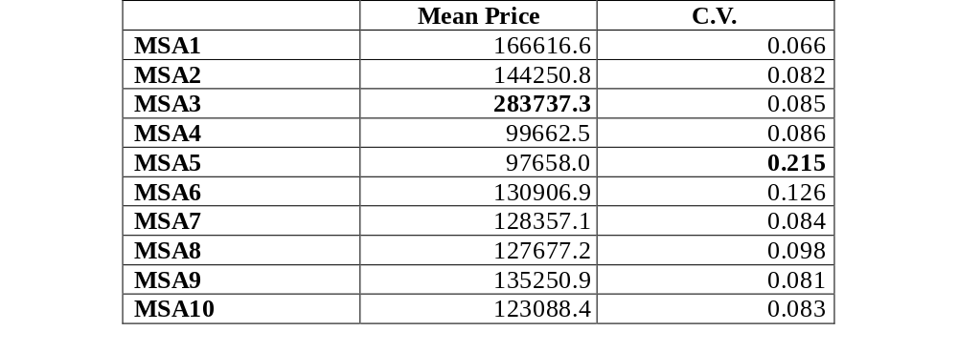
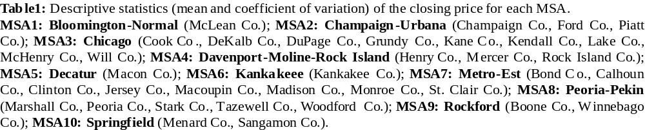
Preliminary analysis
Notes:
As it was easily predictable the MSA that has the highest mean price is Chicago (sensibly higher, in some cases almost double, with respect to the mean price in the other MSA).
The variability (measured by the coefficient of variation that is the ratio between the standard deviation and the mean of a variable) for each time series is low. The low degree of variability in the data depends on the aggregation. Having a more detailed information (either in space or in time) will increase the degree of variability in the data and help the forecast.

Slide 5
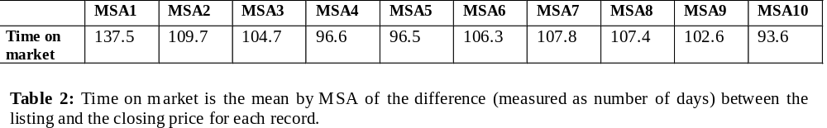
Preliminary analysis
NOTE: We can add the difference between the Listing and Closing price to see whether the price increases or decreases with the time on market.

Slide 6
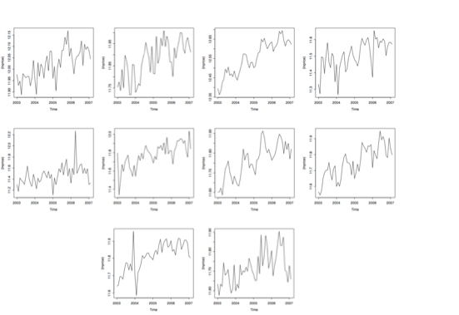
Series to be forecasted
Notes:
The series are not seasonally adjusted.
The data are in logarithm so the variations (that seems very high in some of the graphs) are not so huge (see comment in previous slide).
We tried to use data before January 2003 that were in the version of the datatset they sent us. However, It was not possible to use all the information since there was a huge difference in the mean price and this would have introduced a sort of break in the series difficult to handle in terms of forecast. Furthermore, the shift would have depend upon measurement errors, and it was not reflecting the true cycle of the data.

Slide 7
The Autoregressive Distributed Lag Model
  The intuition behind the model:
      Past values of the dependent variable are relevant to explain the actual value (level of the price in previous periods helps explaining the actual value of the price: autoregressive structure)
      A set of explanatory variables (and their past values) is specified under the assumption that they have some power to explain the variations in the price level. This is the link with the economic business cycle

Slide 8
The Autoregressive Distributed Lag Model
  Variables that may potentially be interesting:
  Characteristics of the house (number of bedrooms, number of bathrooms, time on market)
  Economic Indicators (unemployment rate, wages, consumer price index, interest rate on certificates of deposit, interest rate on mortgage,electricity consumption)
  Note: The economic business cycle is a long-run process that is hard to capture with the actual dimension of the data, which is only three years.
  Our sense is that the link with the economic data will intensify as the time series expands (i.e., we add more observations)

Slide 9
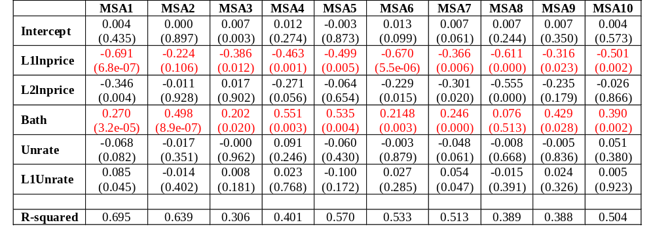
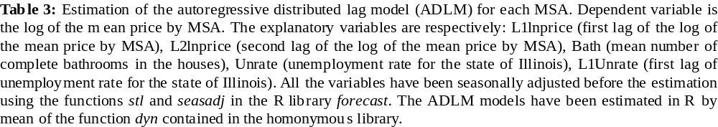
Results from the ADL Model
Notes:
From the estimation results it is quite clear that the most relevant part, given the actual set of information, is the past information over the level of the price. A very relevant variable is the number of bathrooms. This might look surprising since the number of bedrooms can sound more reasonable to indicate the dimension and then the characteristic of the house. However, the correlation between the price and the number of bathrooms is higher than the correlation between the price and the number of bedrooms. This last evidence is encountered in many other datasets used in the literature on hedonic price models

Slide 10
Forecasting methodology
  There were many potential alternative methodologies to be used all documented in the literature:
    ARCH or GARCH models: typically used to forecast data with high variability (not our case since we are forecasting mean prices and the variability is not really high as we saw in the previous plots of the variables).They also require a long time series dimension
    VAR and Bayesian VAR models: require many time series observations (problems of identification since the number of parameters is higher than the time series dimension and increases with the number of explanatory variables in the model)
    ADLM: potentially interesting but the relationship between the house pricing and the economic business cycle is not yet strong enough (see the comments in the previous slide)
    ARIMA models: very easy to implement and update when new observations of the variables become available; typically produces very good forecasts

Slide 11
Intuition behind the ARIMA
The idea developed in the ARIMA type of models is very straightforward. The stochastic process behind the time series is composed of two parts:
  An autoregressive component: all the past values of the series (the values of the price in previous periods in our case) determine the value at time t
  A moving average component: the error term in the model can be represented as a potentially infinite sum of all the error terms in previous periods

Slide 12
Model selection criteria
The autoregressive part and the error component can potentially be of very high order (i.e., include many lags).
In practice, we need to find a criteria to fix the number of lags in order to be able to estimate the model given the limitations on our data
We are following the approach suggested by Hyndman and Khandaker (2007) that is based on a very powerful algorithm that minimize the AIC value (a measure of the trade off between goodness-of-fit and simplicity of the model)

Slide 13
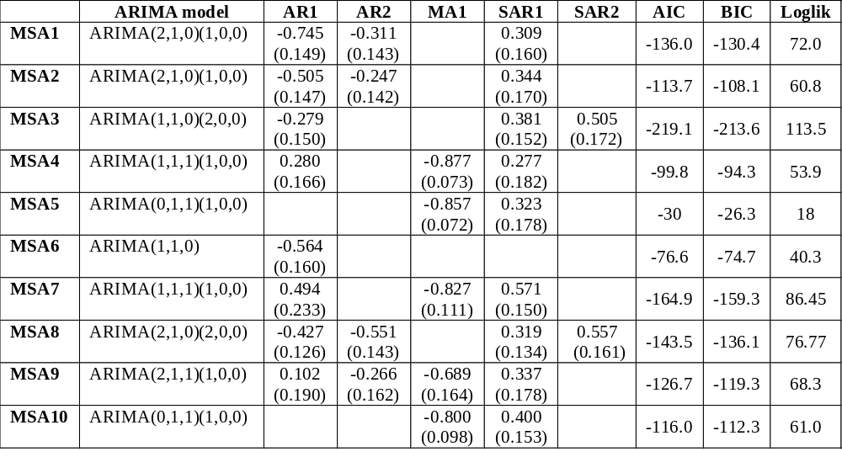
Identification of the ARIMA models by MSA
Notes:
All the series are integrated and have a seasonal component. The unit roots may be “spurious” and depend on the algorithm that identify the model. In fact, unit roots tests require many observations to be efficient and then even though we run the tests, we cannot be very confident on the results.It is important to bear in mind that this is a pure statistical problem since in economics it is well known that time series of prices are clearly integrated!!!

Slide 14
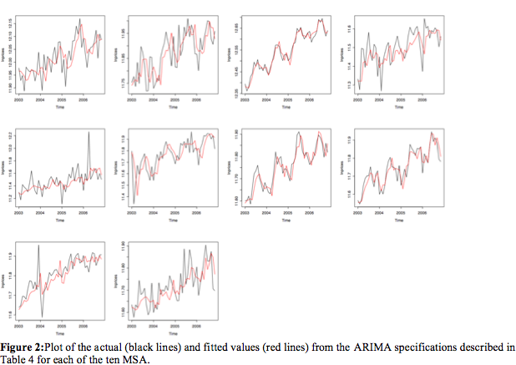
Fit of the model: in sample forecast
Notes:
The fit of the model is, all in all, very good. The ARIMA is also capturing pretty well the most of the variations (the peaks in the plots) that sometime are sensible even if expressed in logarithms.

Slide 15
Fit of the model: out of sample forecast
To have a measure of the forecast accuracy we had to keep three observations out of the sample.
This is a way to allow comparison between the true values of the data (the three observations) and the forecast by using the ARIMA model
To simulate a real situation (in which the three values would not be known) the ARIMA model is identified over the short erdataset (The values of the estimated parameters of the model may indeed change if the number of observations changes)
Finally, to have a benchmark for our model, we also estimated an exponential smoothing which is a very typical forecasting procedure that is known to perform very well when the forecasting period is short (like in our case)

Slide 16
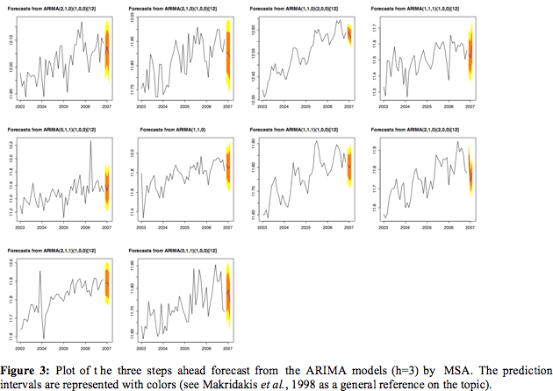
Fit of the model: out of sample forecast
Notes:
This graphs report the three steps ahead forecast for each time series (MSA). The colored part represents the confidence intervals of the forecast. (95% and 90%) For example, for the forecast interval at the 95% we can conclude that the value of the series in the next period will fall within the two extreme values of the interval with a probability equal to 0.95.

Slide 17
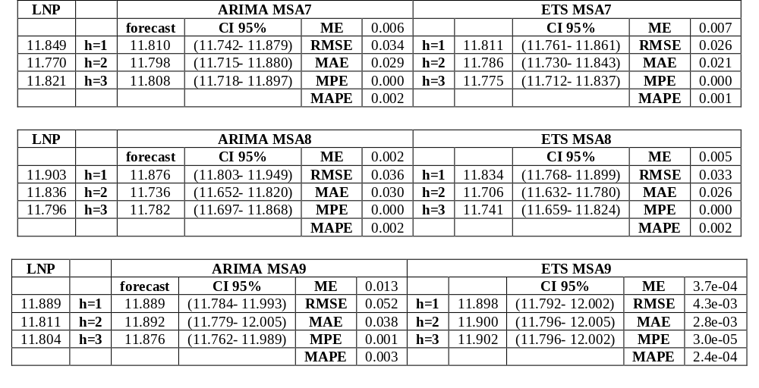
Forecast accuracy
Notes:
The first column LNP is the true value of the series. Then the forecast (h=1, 2, 3, represents the steps ahead) from the ARIMA model and from the exponential smoothing are presented with the relative forecast accuracy measures. ME: Mean Error; RMSE: Root Mean Square Error; MAE: Mean Absolute Error, MPE: Mean Prediction Error; MAPE: Mean Absolute Prediction Error. We report results only for 3 MSA only to save space, since they are representative of all.
Both models perform very well, since all the measures of forecast accuracy are low. This may suggest that an interesting strategy is to mix the two forecast creating a weighted average of the two models. Note also that the values produced by the forecast are close to the true values of the data.
In case of MSA9 the value forecasted with the ARIMA is exactly equal to the true value!!!!!

Slide 18
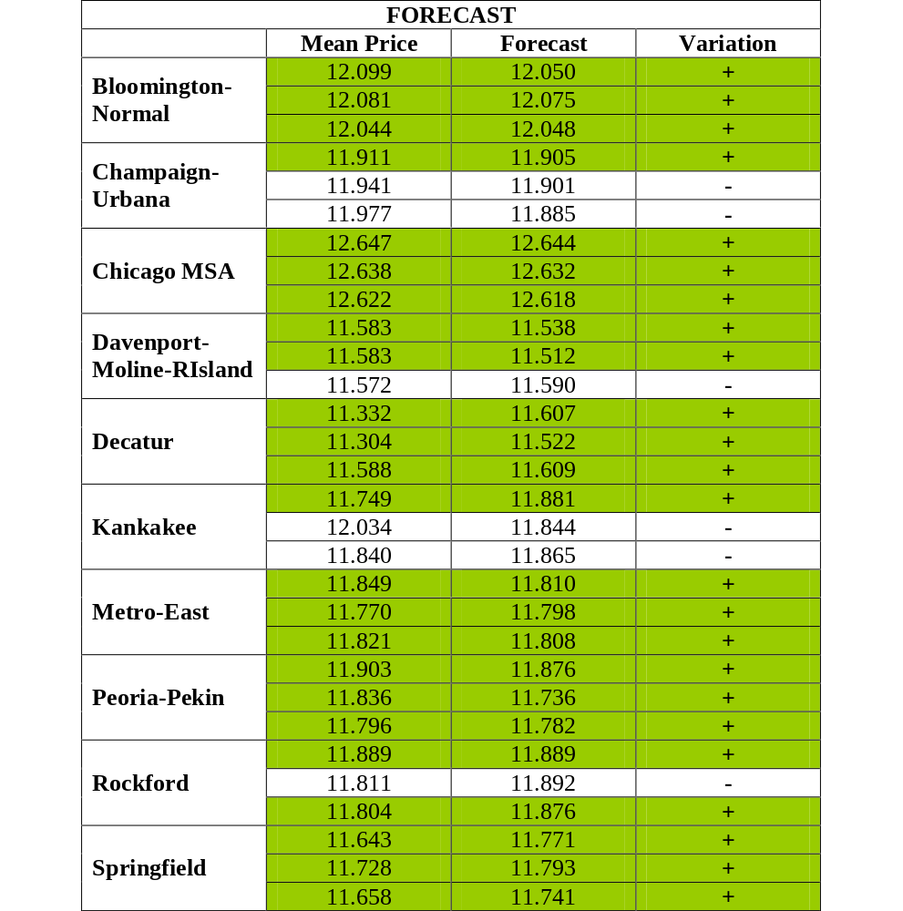
Forecast accuracy
Forecast one, two and three months ahead for each MSA. Mean price reports the true realized value of the series. Forecast is the value of the series predicted with the ARIMA models.
The last column (variations) indicates whether the forecast is predicting correctly the variation of the series:
+ means that the price is increasing (decreasing) and the forecast is predicting an increase (decrease).
– indicates that while the price is increasing (decreasing), the ARIMA is forecasting a decrease (increase).
Notes:
The first column LNP is the true value of the series. Then the forecast (h=1, 2, 3, represents the steps ahead) from the ARIMA model and from the exponential smoothing are presented with the relative forecast accuracy measures. ME: Mean Error; RMSE: Root Mean Square Error; MAE: Mean Absolute Error, MPE: Mean Prediction Error; MAPE: Mean Absolute Prediction Error. We report results only for 3 MSA only to save space, since they are representative of all.
Both models perform very well, since all the measures of forecast accuracy are low. This may suggest that an interesting strategy is to mix the two forecast creating a weighted average of the two models. Note also that the values produced by the forecast are close to the true values of the data.
In case of MSA9 the value forecasted with the ARIMA is exactly equal to the true value!!!!!

Slide 19
Conclusions
The augmented distributed lag model provides an appropriate framework to relate the house pricing and the economic business cycle
The forecast from the ARIMA models is very satisfactory and the measures of forecasting ability of the model are good
The quality of the analysis will further improve with the data availability and in particular with the increase of the time series dimension

Slide 20
Conclusions
Possible improvements:
Work on the quality of the data: many of the variables in the dataset are potentially interesting but cannot actually be used due to measurement errors or missing observations
Produce a mixed forecast as a weighted average of two different models: the ARIMA and the ETS seems to perform both very well. The ETS is more powerful in producing the forecast for the first period, the ARIMA is better for period two and three. The weights can be changed including this information
Move to simultaneous models and vector specifications (VAR and Bayesian VAR) that can also consider interactions among MSA when the length of the time series dimension will increase.

