Slide 1
Profile Caching for the
Java Virtual Machine
Marcel Mohler, ETH Zurich
Bachelor Thesis
Supervisors: Zoltan Majo, Oracle
Tobias Hartmann, Oracle
Prof. Thomas Gross, Laboratory for Software Technology, ETH
Notes:
Welcome

Slide 2
Tiered Compilation in HotSpot JVM
profiling
profiling
Interpreter
C1
client compiler
C2
server compiler
thresholds reached
thresholds reached
Notes:
First off, a few things about the Just-in-time compiler of Hotspot
Hotspot is a JVM maintained by Oracle and the most used JVM world wide
Very complex system, 250 thousand LoC
Profiles crucial to the performance of the code

Slide 3
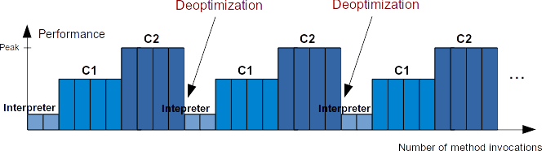
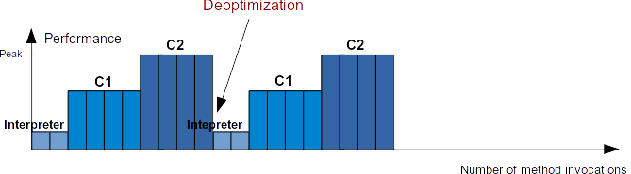
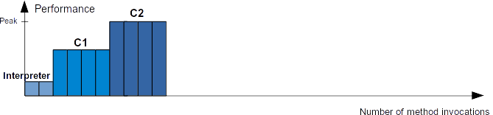
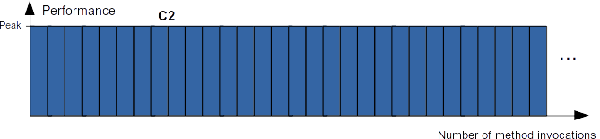
Problem: performance fluctuations
Goal: Decrease performance fluctuations
Notes:
What is the current problem?
Methods start compiling at Interpreter and have to go through multiple tiers until reaching peak performance
In case of deoptimizations we start from the beginning again
Ideally we want this

Slide 4
Observation
Profiles need to be gathered each time the JVM starts
Most frequently used methods often do not change
→ Idea: cache and reuse the profiles!

Slide 5
Outline
Design
Implementation
Performance evaluation
Conclusion

Slide 6
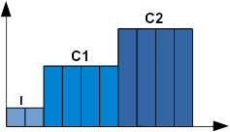
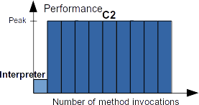
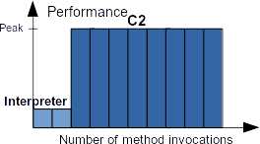
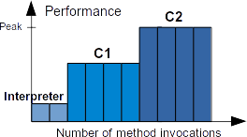
Design: 3 modes
standard tiered compilation
Mode 0
Mode 1
Mode 2
Notes:
Thesis includes 3 modes
First one immediately uses cached profiles in C2 with lowered thresholds
Interpreter step needed because of class loading
We realized this could result in an increased load on the compile queue
Mode 1: similar to 0 but does not lower thresholds
Finally a Mode 2 which puts as much load on the compile queue as baseline

Slide 7

Design: Mode 2
(I) unmodified
(C1) remove profiling code
→ ~30% speedup
(C2) use cached profile
→ better code quality
(I)
(C1)
(C2)

Slide 8
Implementation
Based on existing compilation replay functionality
Configurable by JVM flags
Select all or single methods

Slide 9
Evaluation
ETH Data Center Observatory
Focus on warmup
2 benchmark suites
- SPECjvm 2008
17/21 individual benchmarks used
- Google Octane (using Nashorn)
16/17 individual benchmarks used
Notes:
DCO provided by ETH
Some benchmarks skipped because of incompatibility with JDK9
Had to focus on warmup since it doesn't really affect performance for a long running benchmark
Divided benchmarks up in their parts and restarted JVM in between benchmarks
Also several microbenchmarks which are presented in the thesis
Going to present numbers from Mode2, there is a lot more in the thesis

Slide 10
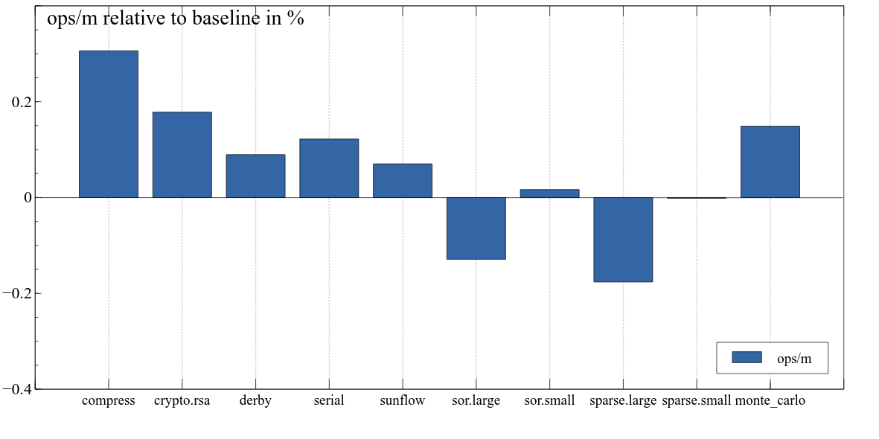
Performance evaluation
Performance (higher is better)
+ ~30%
- ~17%
Notes:
Performance example of SpecJVM benchmark
1 run, around 5-30 seconds

Slide 11
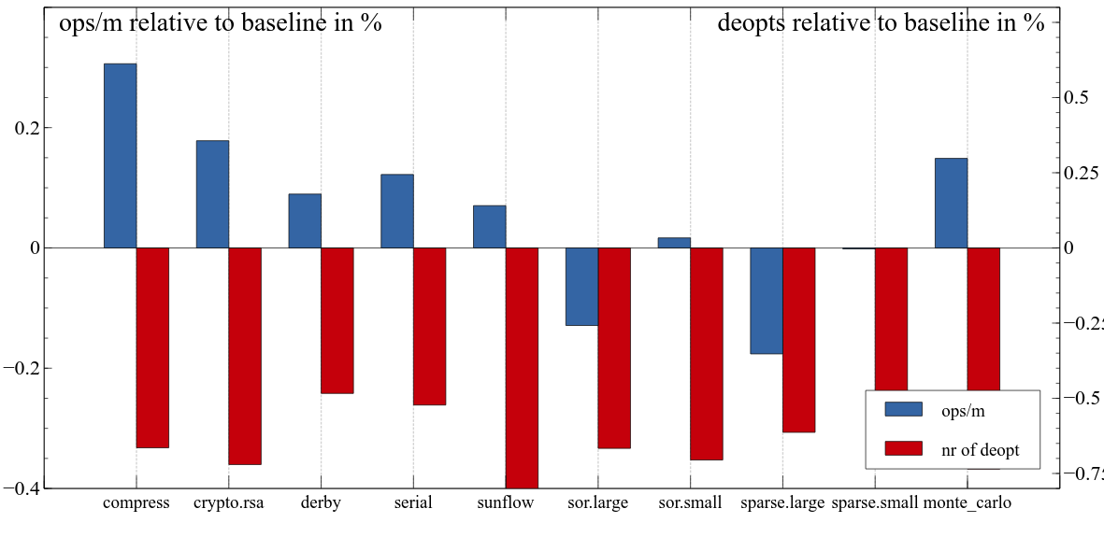
Performance evaluation
Deoptimizations (lower is better)
- ~50%
- ~80%
Notes:
Deoptimizations lowered significantly, good indicator of improved code quality
Still difficult to measure how much influence a deopt has

Slide 12
Other benchmark results
Benefit mainly from C2 compilations. Disabling interpreter profiles rarely affects performance
Around 70% of the compilations use cached profiles
No association between performance and load on compile queue
Notes:
Rest 30% are mainly L1/L2 compilations and a few skipped ones (lambda expressions etc)

Slide 13
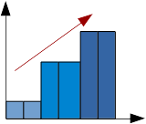
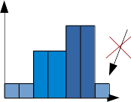
Conclusion
Cached profiles can improve warmup performance
System allows fine tuning
Main benefits:
faster warmup fewer deoptimizations
Room for future work
Notes:
Future work: modify / merging profiles
Improve data structure used

Slide 14
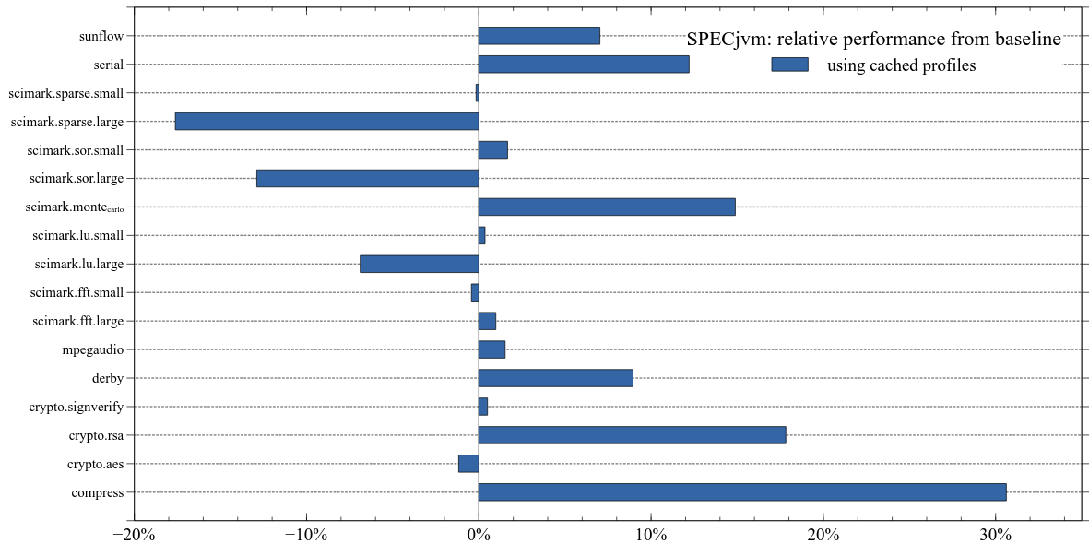
SPECjvm: relative performance

Slide 15
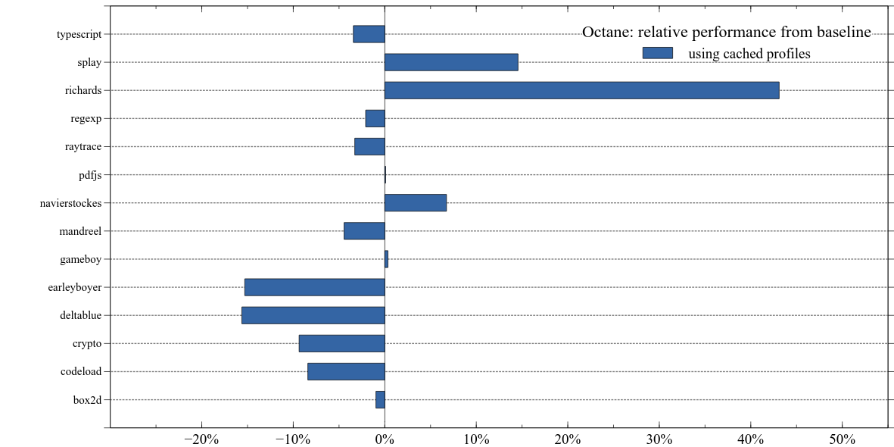
Octane: relative performance

Slide 16
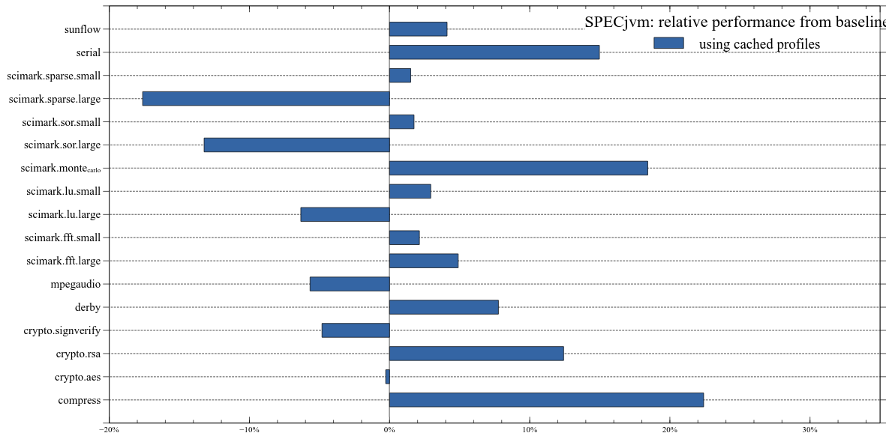
SPECjvm: relative performance without interpreter profiles

Slide 17
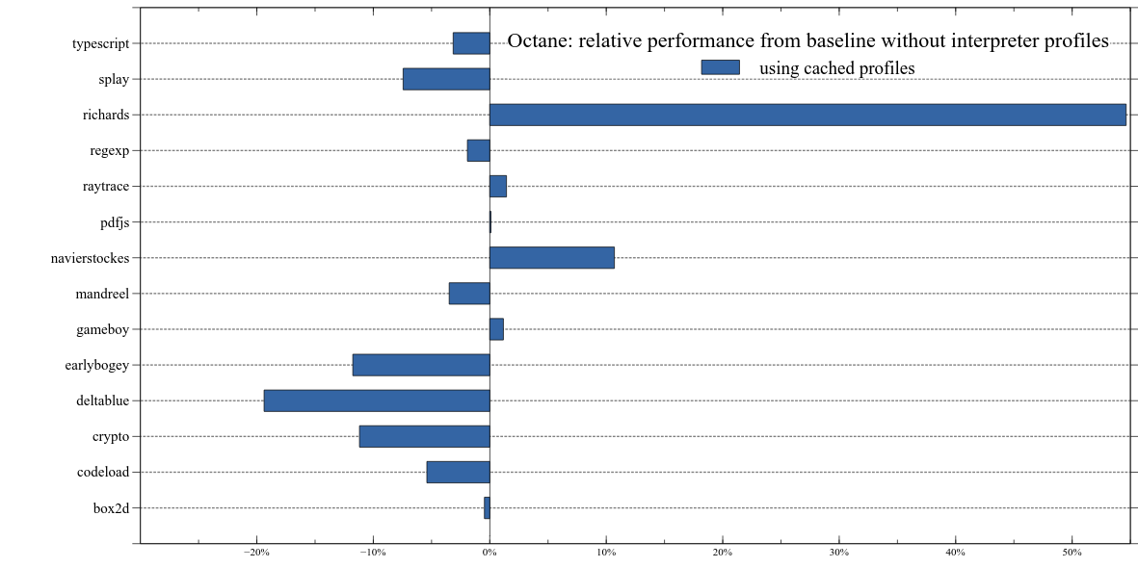
Octane: relative performance without interpreter profiles

Slide 18
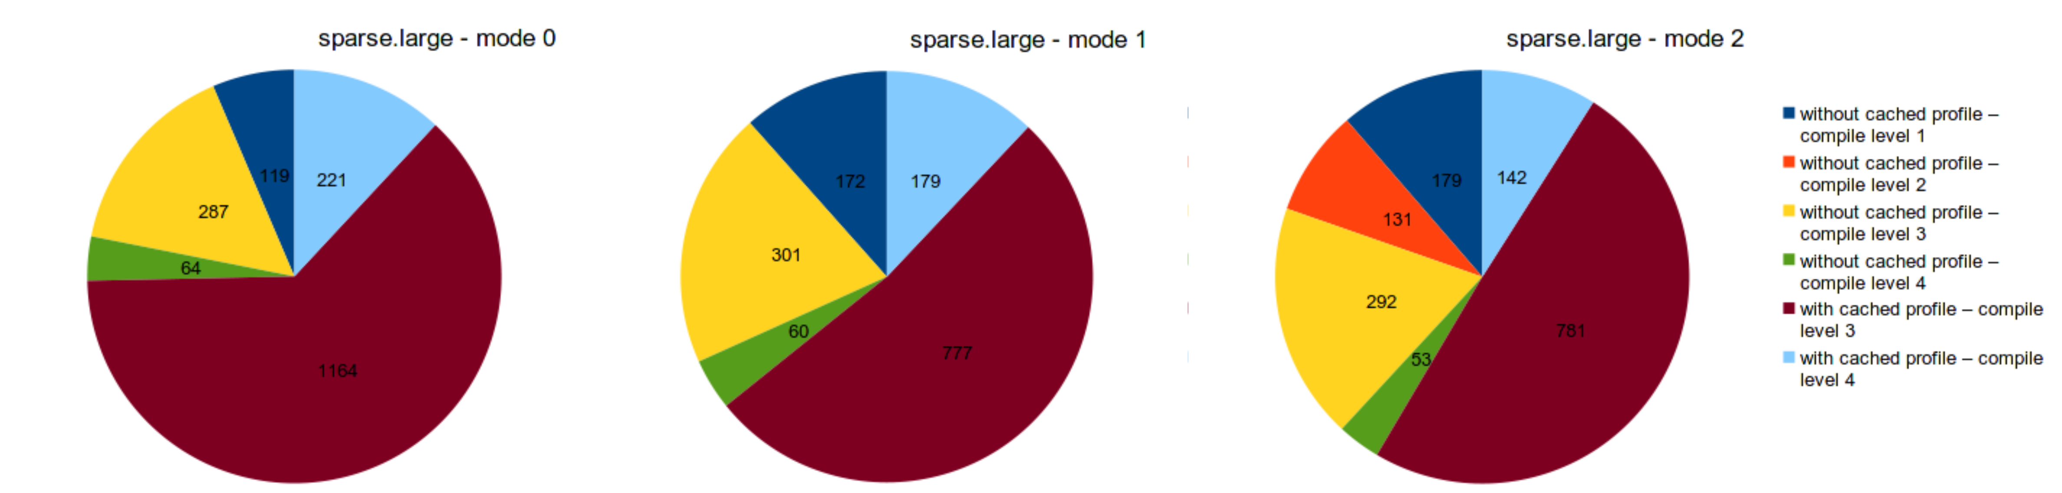
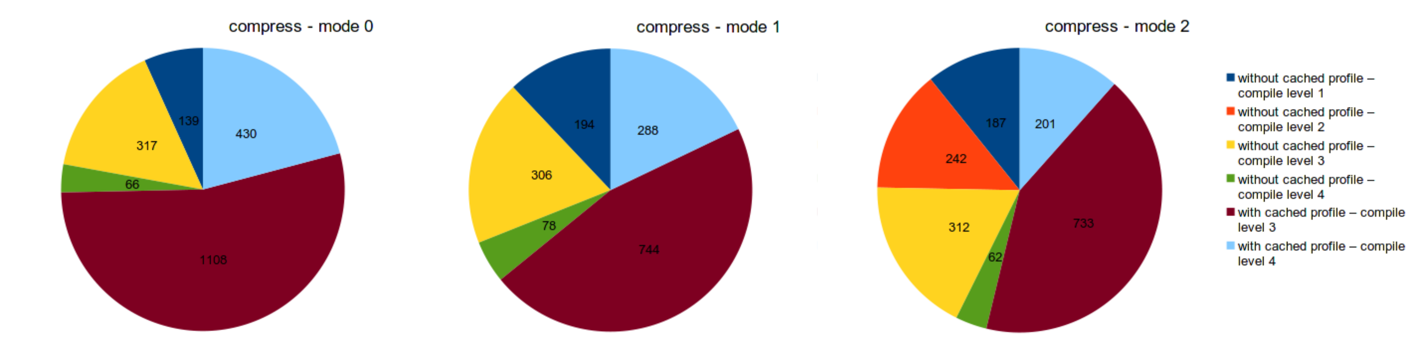
Type of compilations

Slide 19
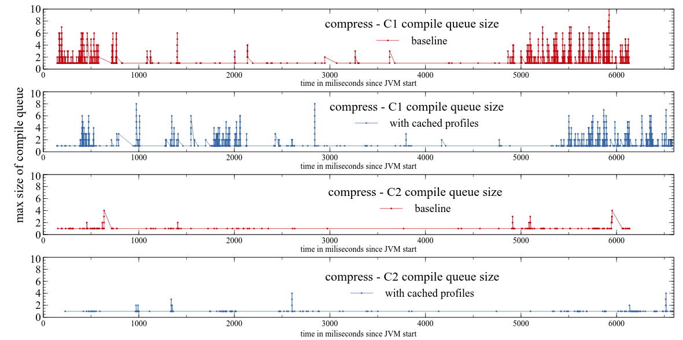
Compile queue
compress

Slide 20
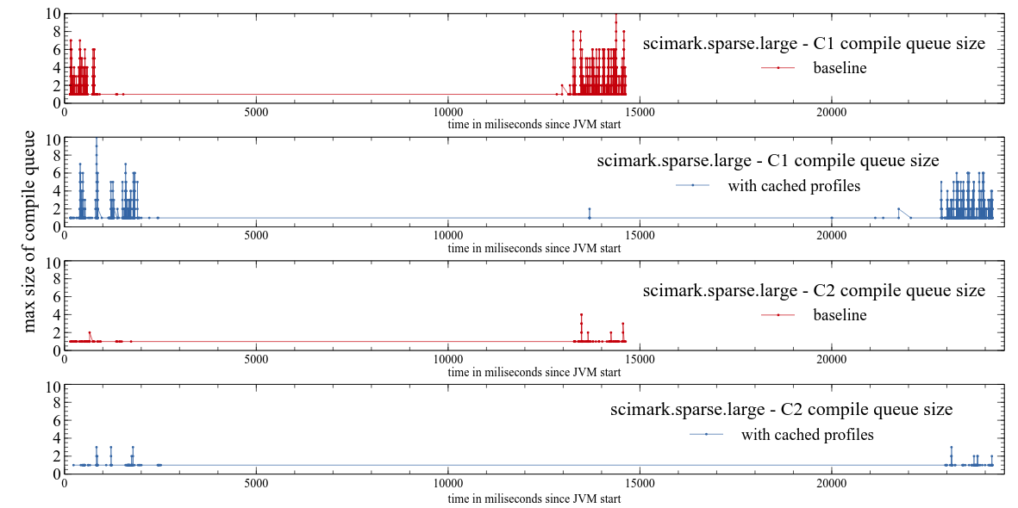
Compile queue
scimark.sparse.large

Slide 22
Goals
Decrease performance fluctuations
Faster method performance warmup
→ reach peak performance quicker
Fewer deoptimizations
→ stay on peak performance

Slide 23


Design: use profiles
Notes:
In a future run of the JVM we can then use these profiles
They get stored in a data-structure located in the C++ heap
And used whenever possible
I present mode 2 with focus on keeping the original tiered compilation steps (being conservative), there are 2 more modes

Slide 24
Implementation
1846 lines of code
24 files affected
2 new classes
- ciCacheProfiles
- ciCacheProfilesBroker
Notes:
More than 1800 lines of code
Two dozens of files affected
Separated from the rest, turning feature of results in JVM being unaffected by the changes

Slide 25
Other approaches
Presented: Mode2
Mode 0: skip C1 & lower compilation thresholds
Mode 1: skip C1 & keep original compilation thresholds

