Slide 1
Wide World Importers
By
Team 2

Slide 2
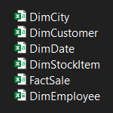
About data
5 Tables : 4 Diminutions Table Dim City _Dim Customer _Dim Date & Dim Employee
And 1Fackt Table
Fact Sale

Slide 3
The approach
How much Revenue &Profit
Where We Sale And When
What Product We Sale
Who Sales

Slide 4
The cleaning process
We Used Cleaning Process That’s Focused On Our Goals in The Approach We Have Chosen
Our Steps Were Simple And Effective Such As
Promted Headers
Changed Type
Removed First Row In Customer Dim

Slide 5
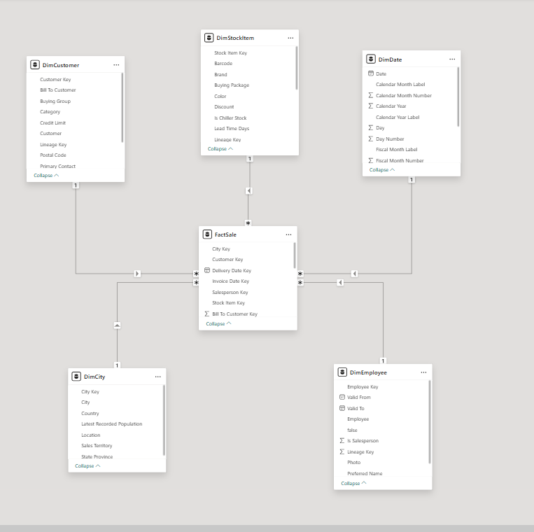
Molding data

Slide 6
Dax measures
Our Table Of Measure Contains The Necessary Items For Examples
Total Quantity , Revenue And Profit
Top 10 Revenue Products , cites And Employee
Top 10 Profit Products , cites And Employee
Rank Products By Revenue And Profit
Quantity Percentage For Time And Place

Slide 7
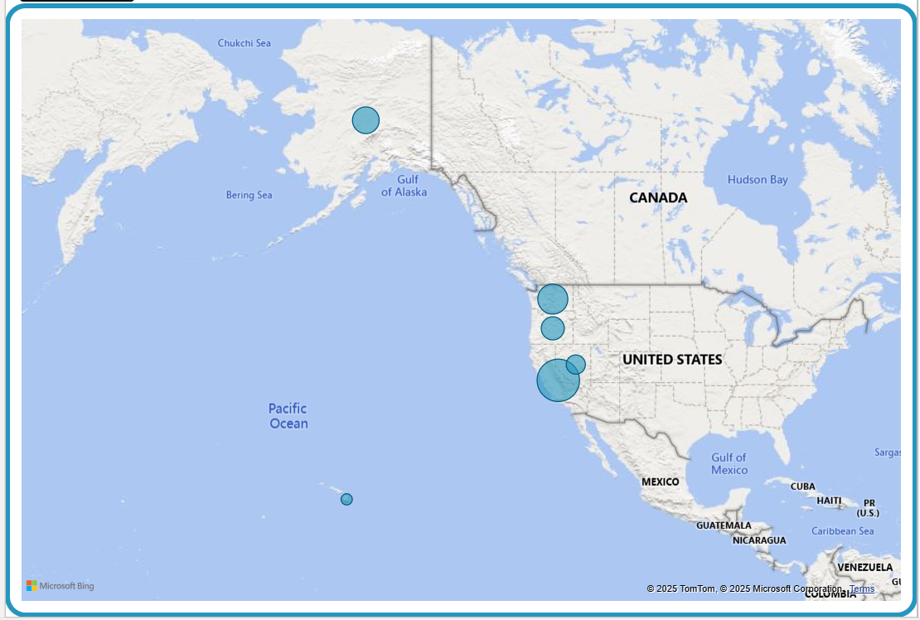
Where

Slide 8
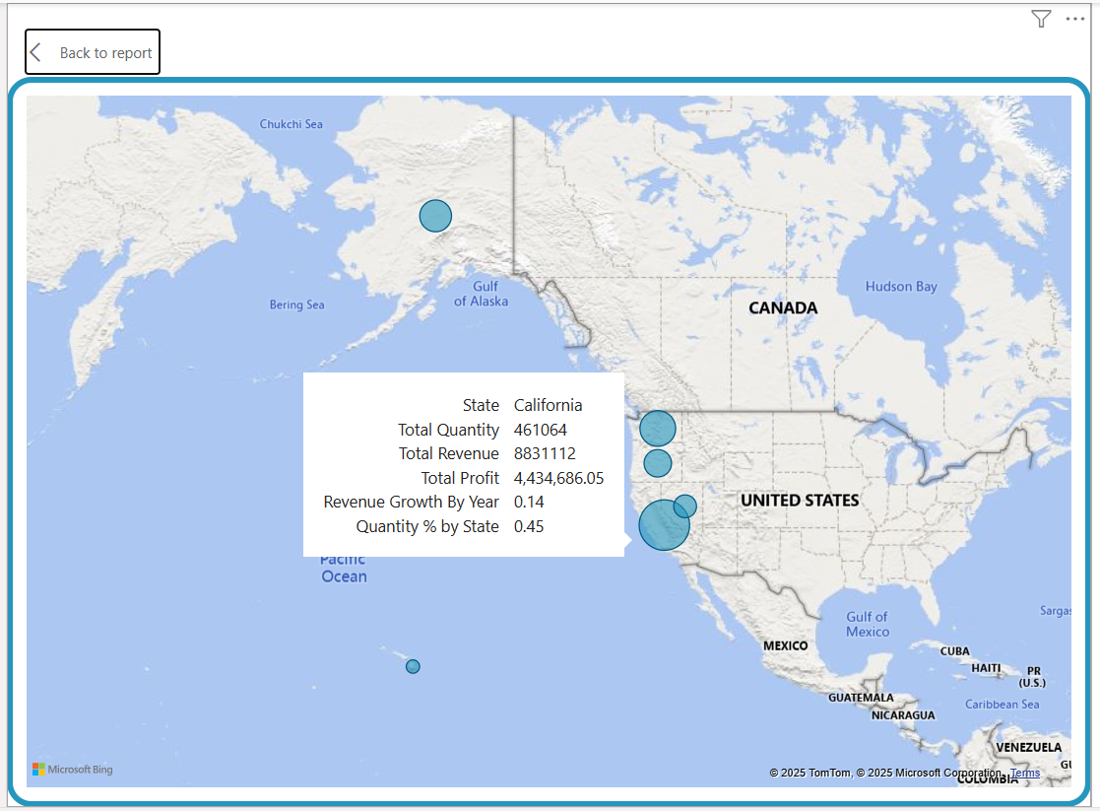
Where 2

Slide 9
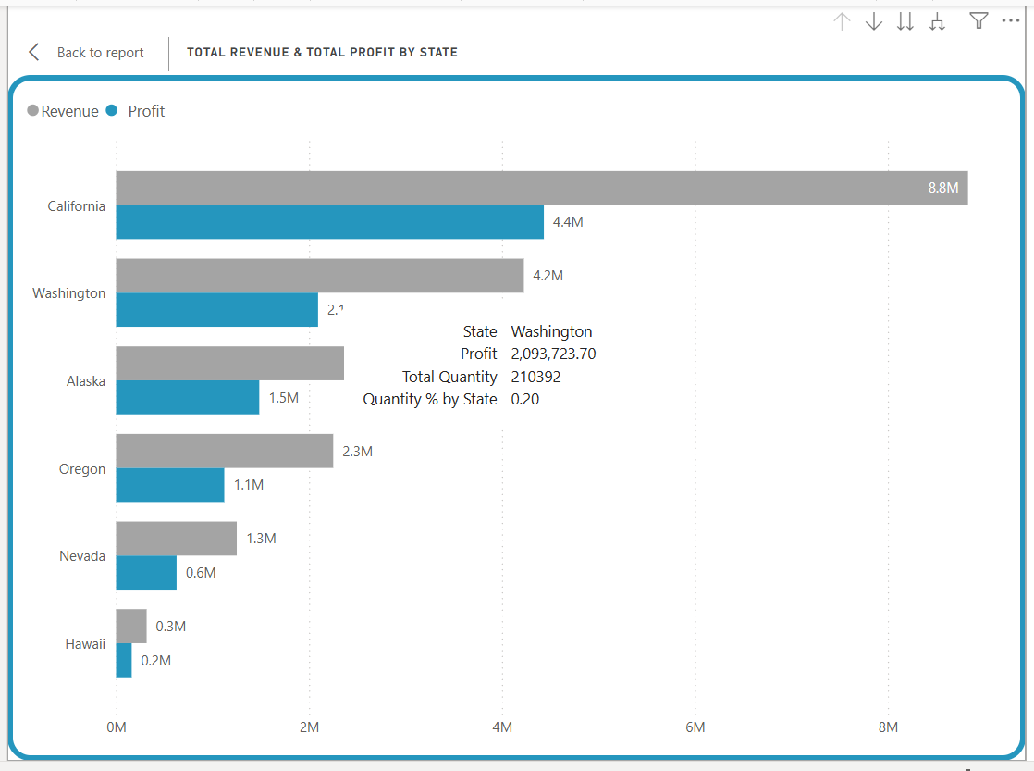
Where 3

Slide 10
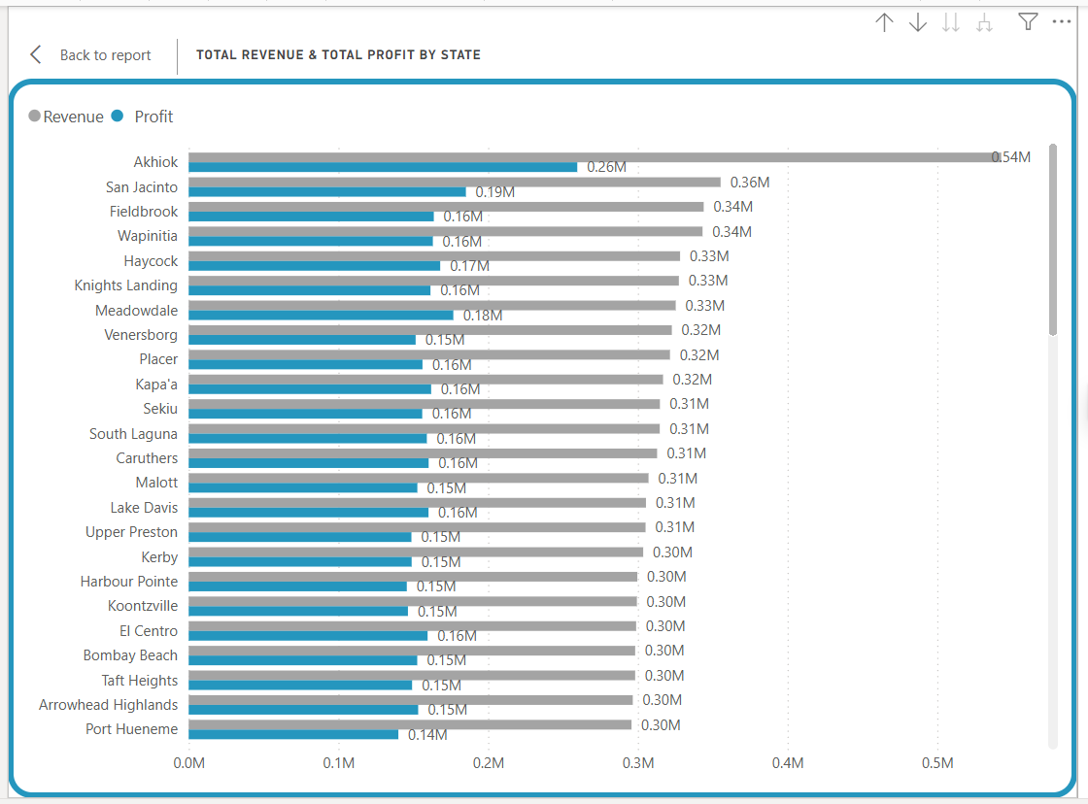
Where 4

Slide 11
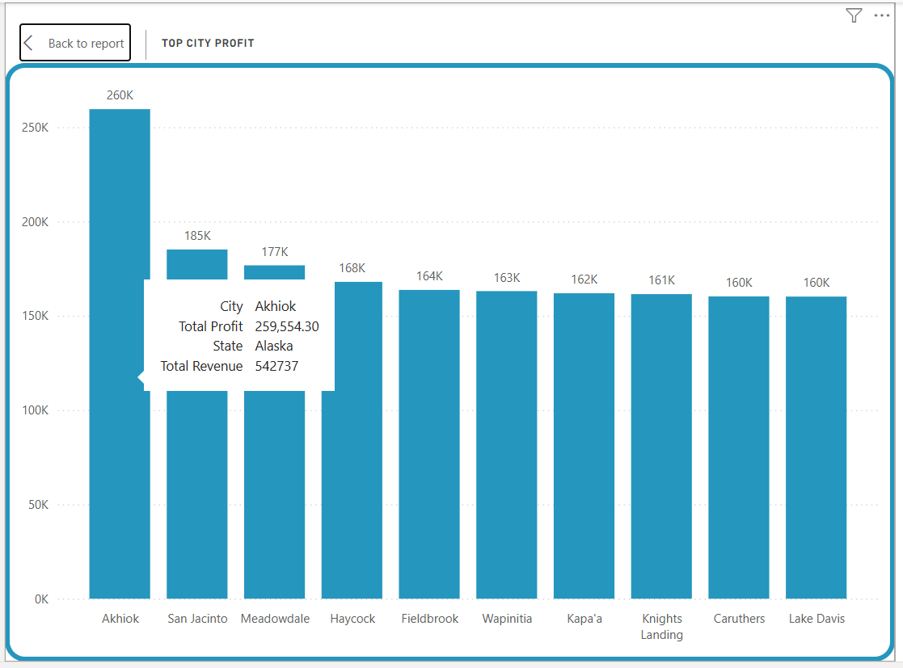
Where 5

Slide 12
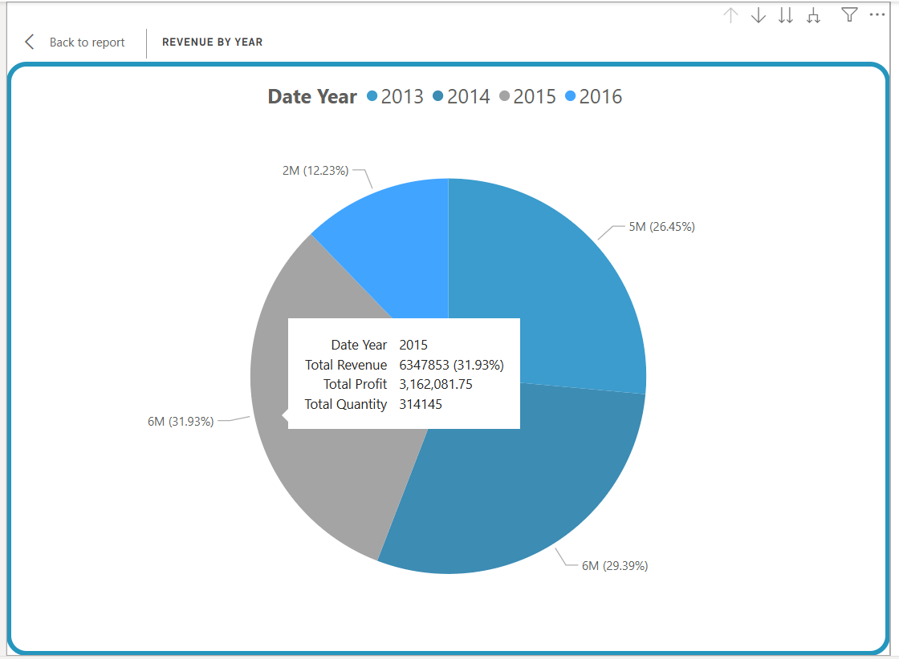
when

Slide 13
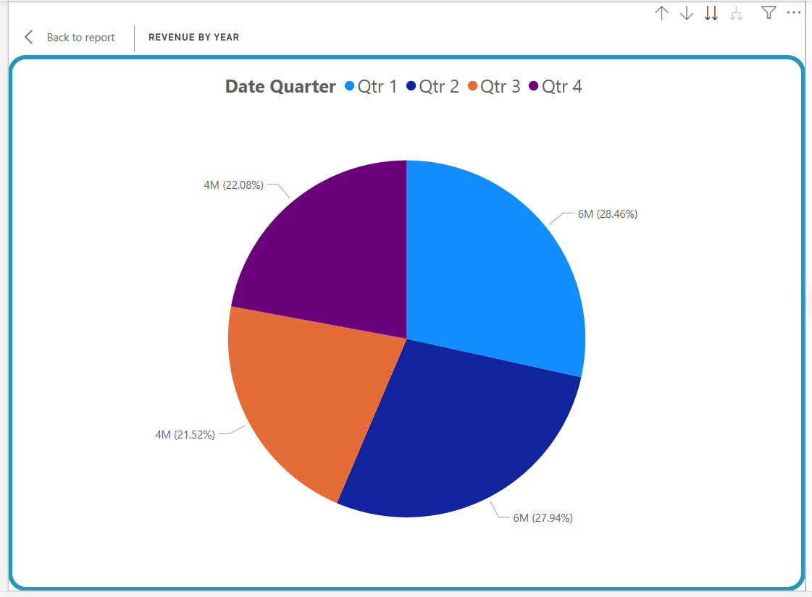
When 2

Slide 14
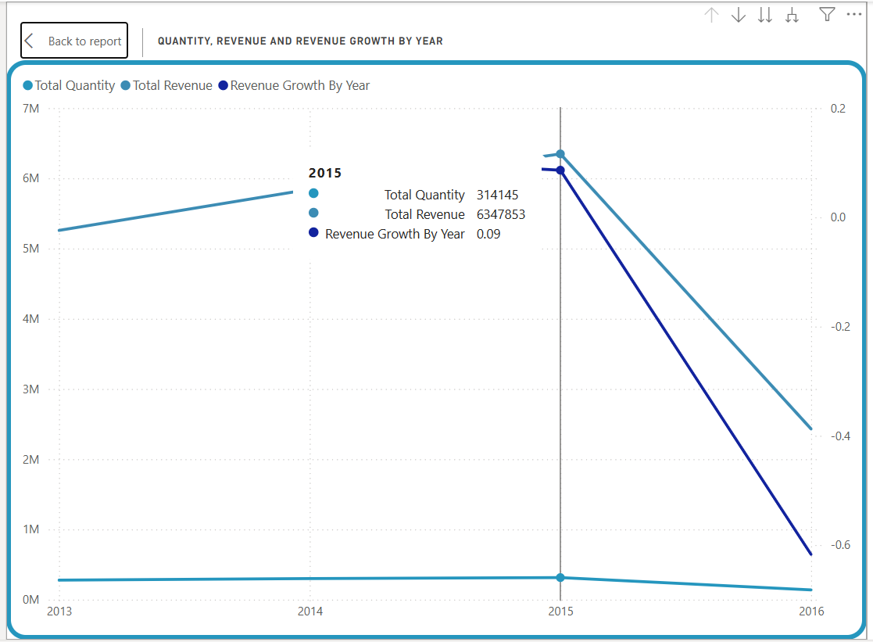
When 4

Slide 15
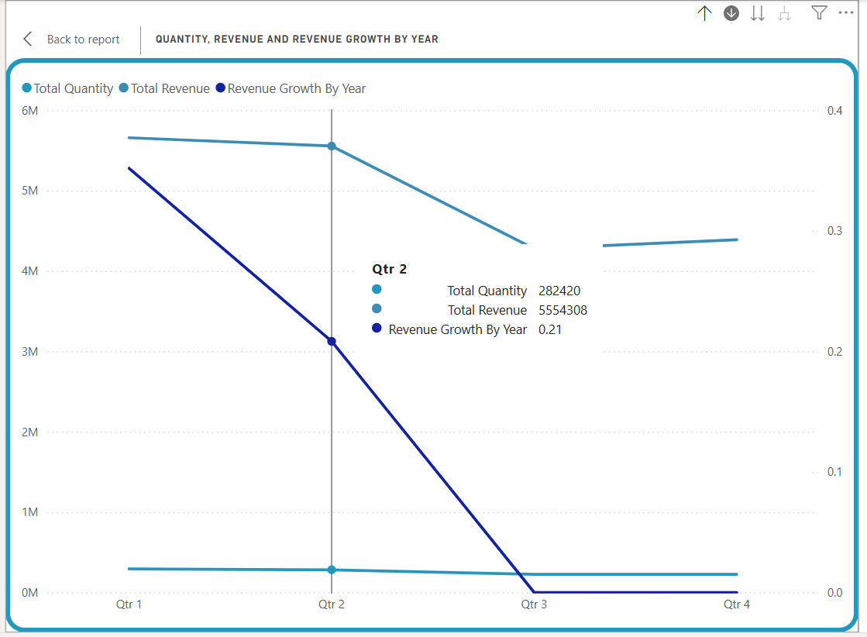
When 5

Slide 16
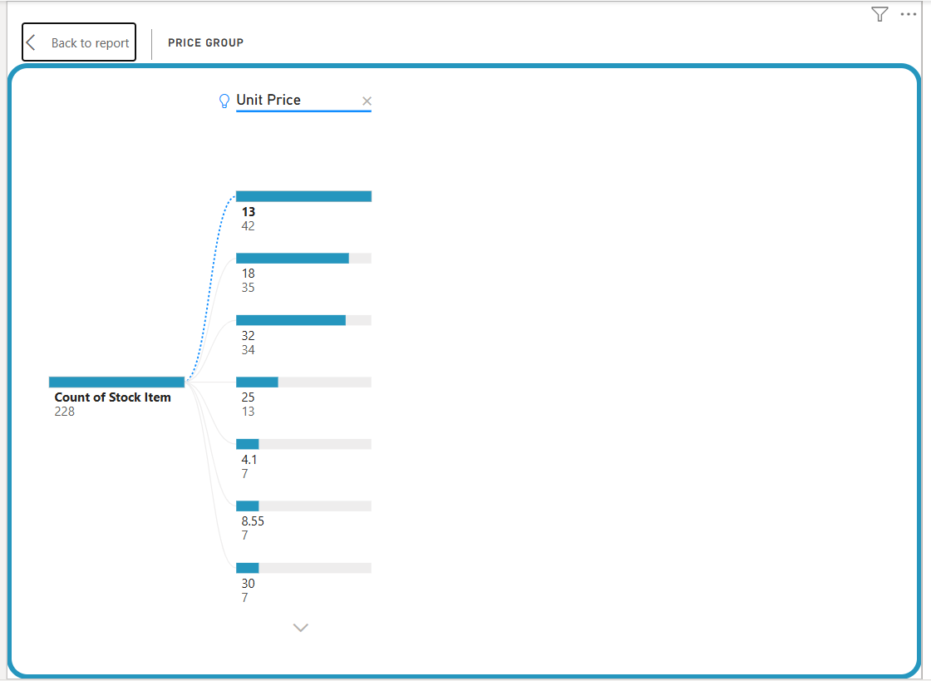
what

Slide 17
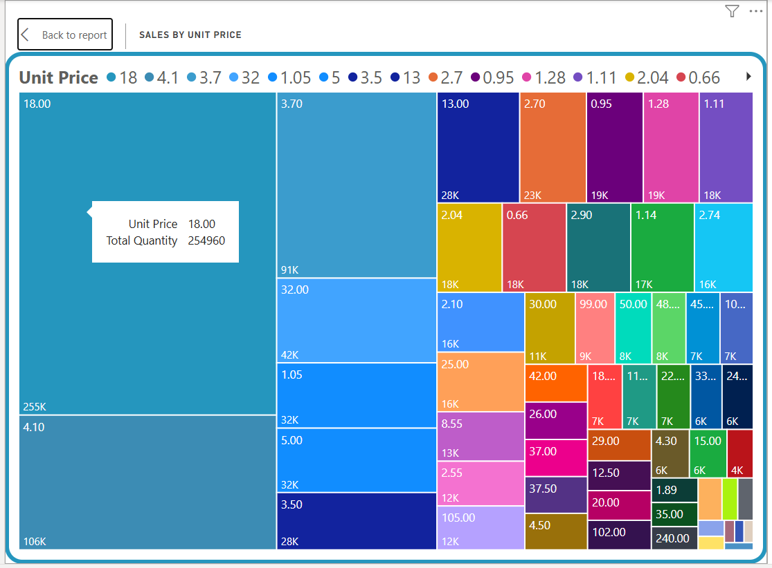
What 2

Slide 18
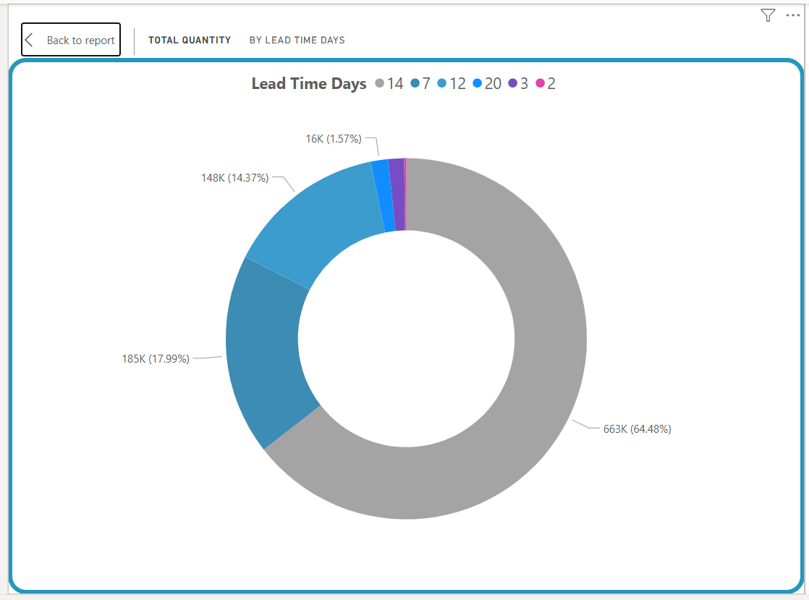
What 3

Slide 19
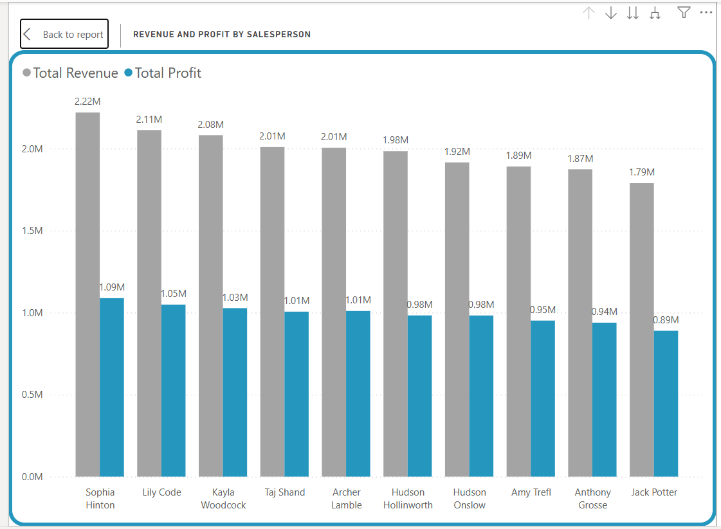
who

Slide 20
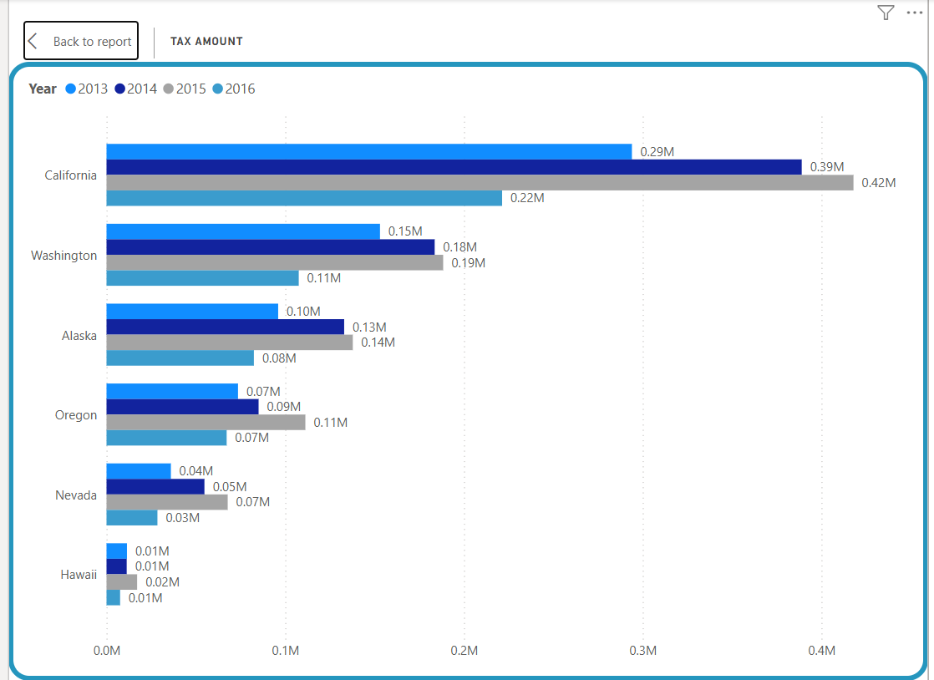
tax

Slide 21
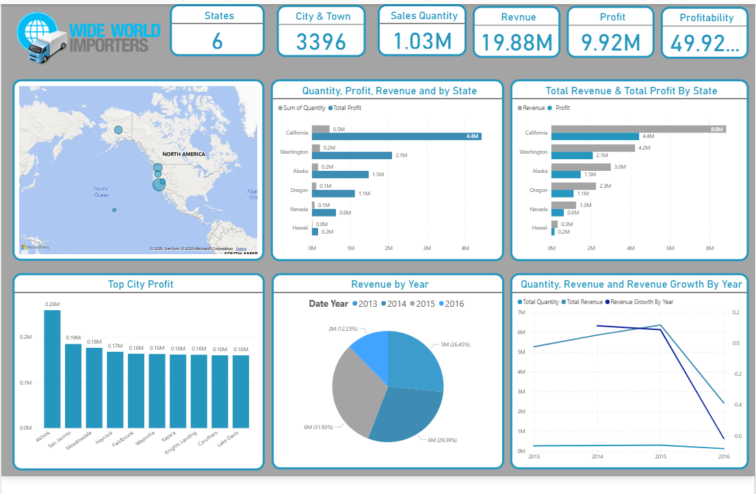
Our dashboard

Slide 22
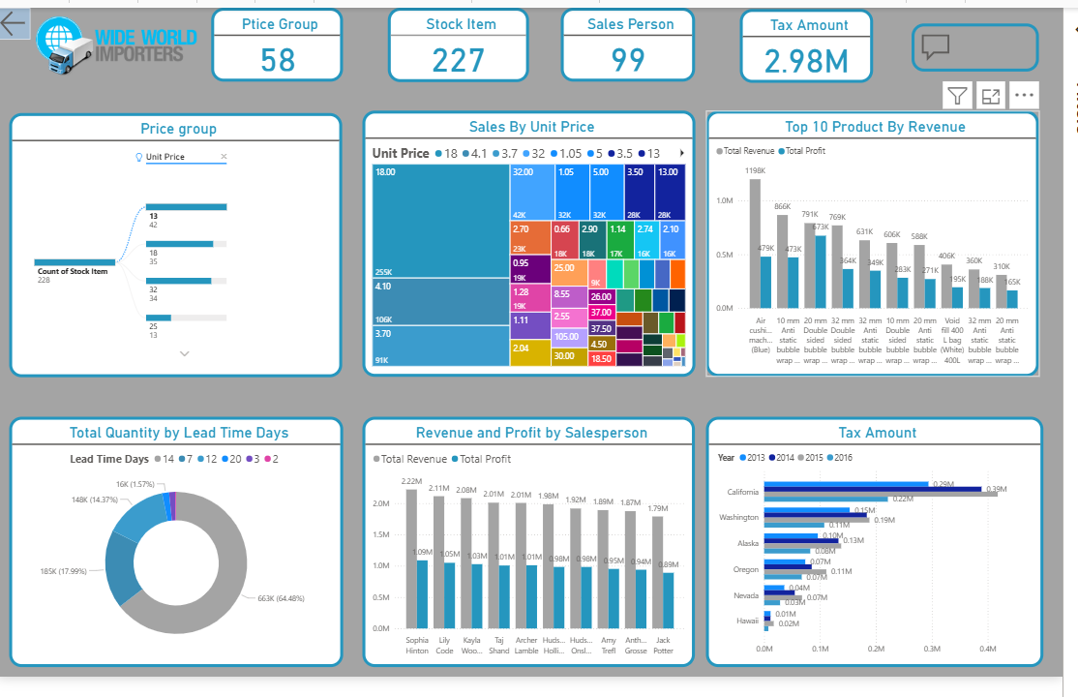
Our dashboard 2

