Slide 1
Wide World Importers
Insights in Power BI
By Group 2

Slide 2
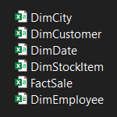
About data
5 Tables
4 Diminutions Table
Dim City
Dim Customer
Dim Date
Dim Employee
And 1Fackt Table
Fact Sale

Slide 3
The approach
How much
Revenue
Profit
Where
When
What
Who
Buy
Sales
Why

Slide 4
The cleaning process
We Used Cleaning Process That’s Focused On Our Goals in The Approach We Have Chosen
Our Steps Were Simple And Effective Such As
Promted Headers
Changed Type
Removed First Row In Customer Dim

Slide 5
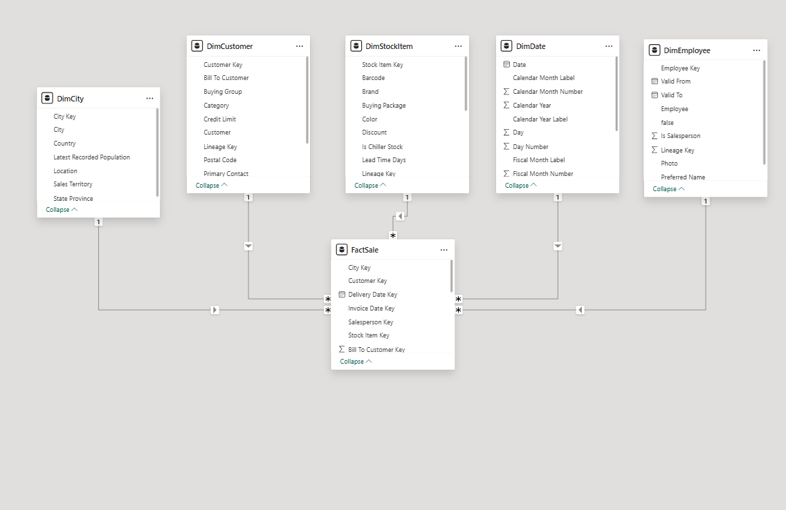
Molding data

Slide 6
Dax measures
Our Table Of Measure Contains The Necessary Items For Examples
Total Quantity , Revenue And Profit
Top 10 Revenue Products , cites And Employee
Top 10 Profit Products , cites And Employee
Rank Products By Revenue And Profit
Quantity Percentage For Time And Place

Slide 7
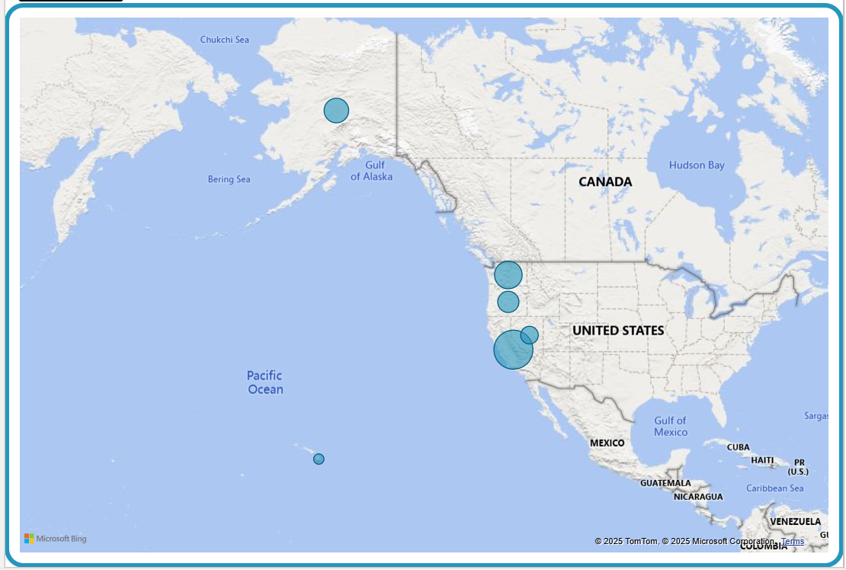
Where

Slide 8
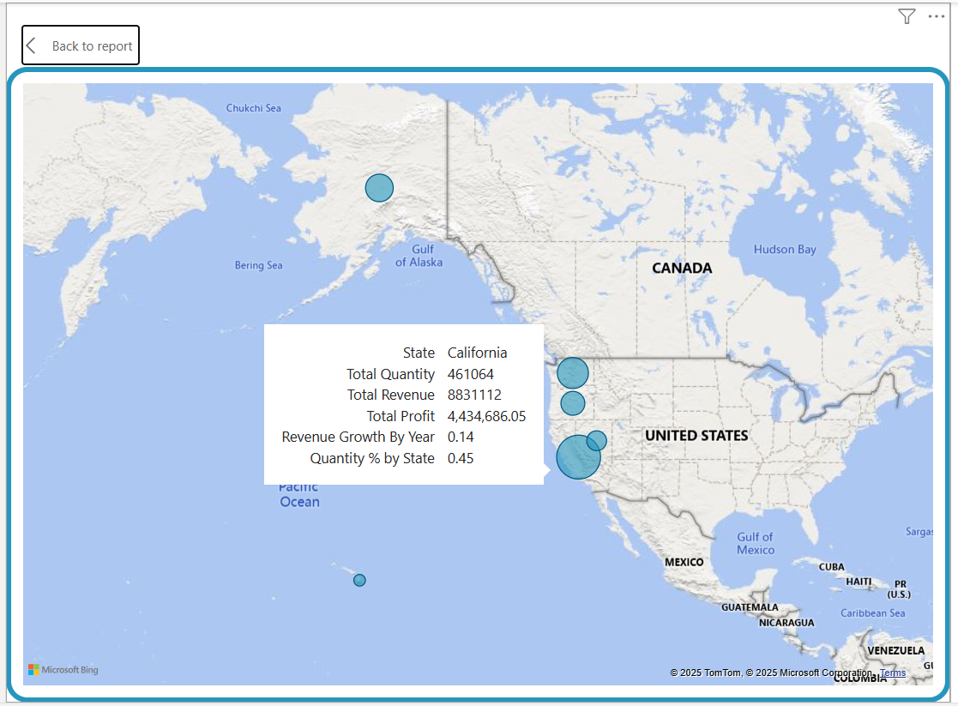
Where 2

Slide 9
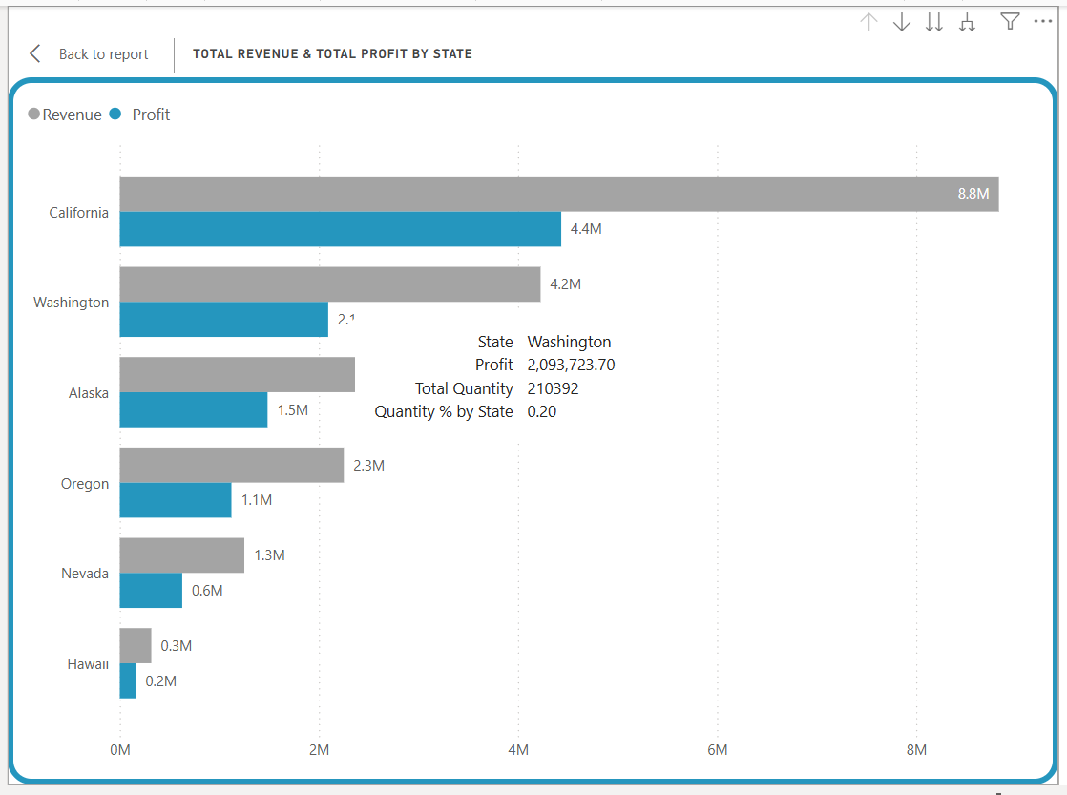
Where 3

Slide 10
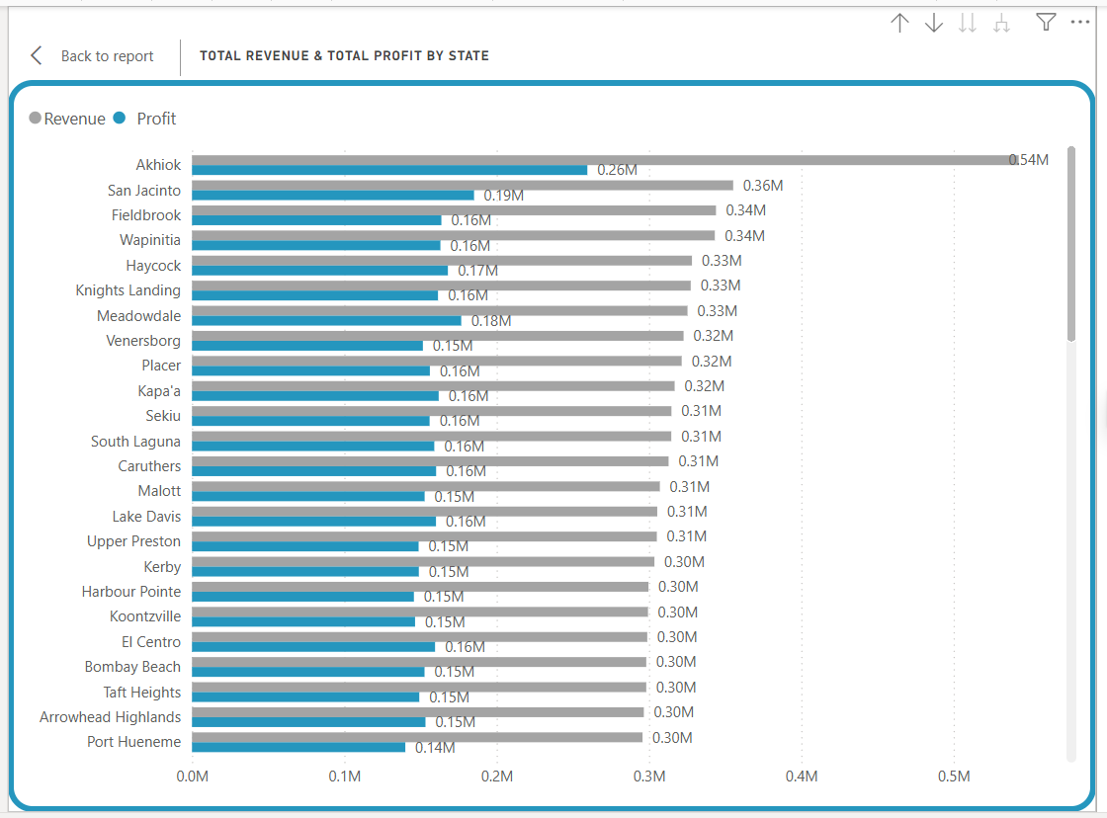
Where 4

Slide 11
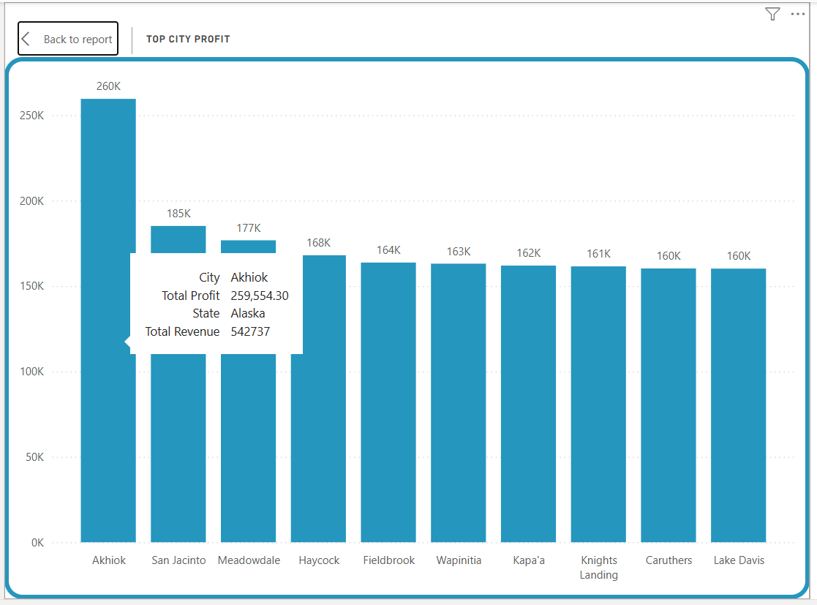
Where 5

Slide 12
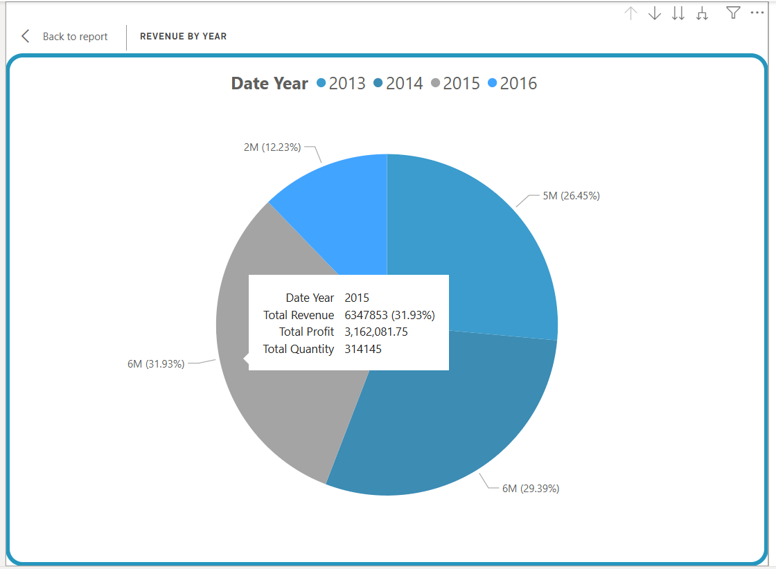
when

Slide 13
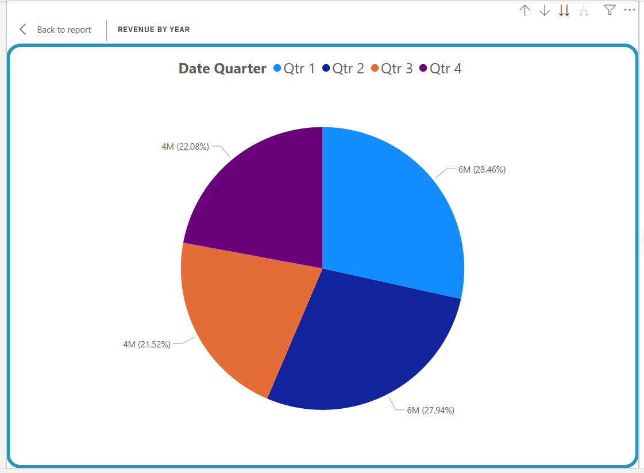
When 2

Slide 14
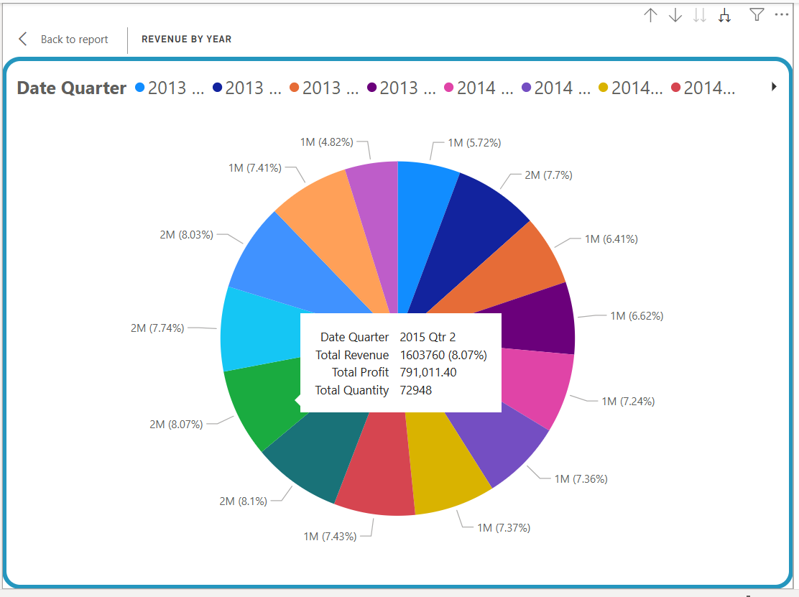
When 3

Slide 15
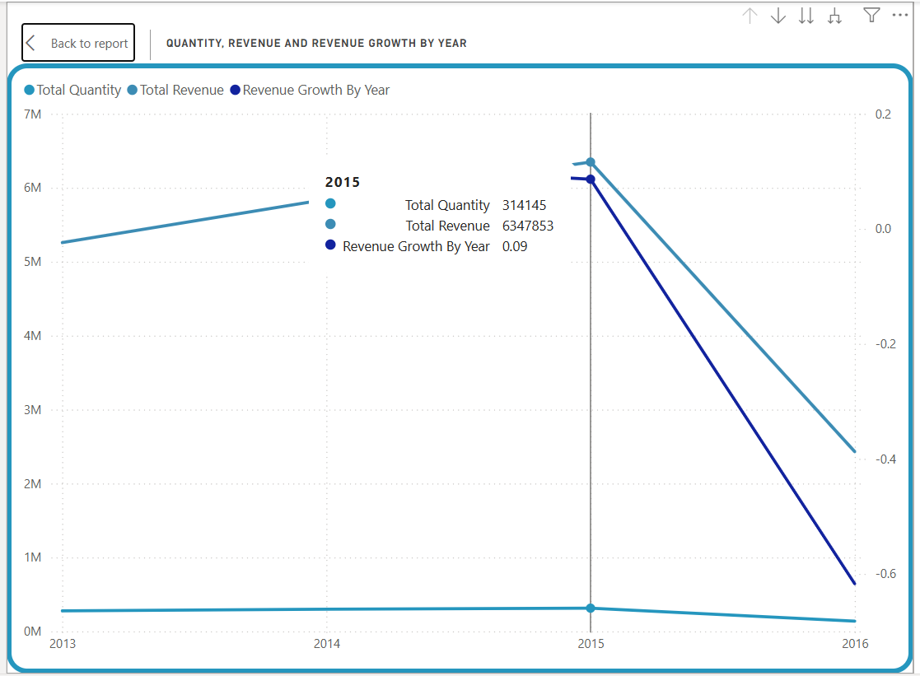
When 4

Slide 16
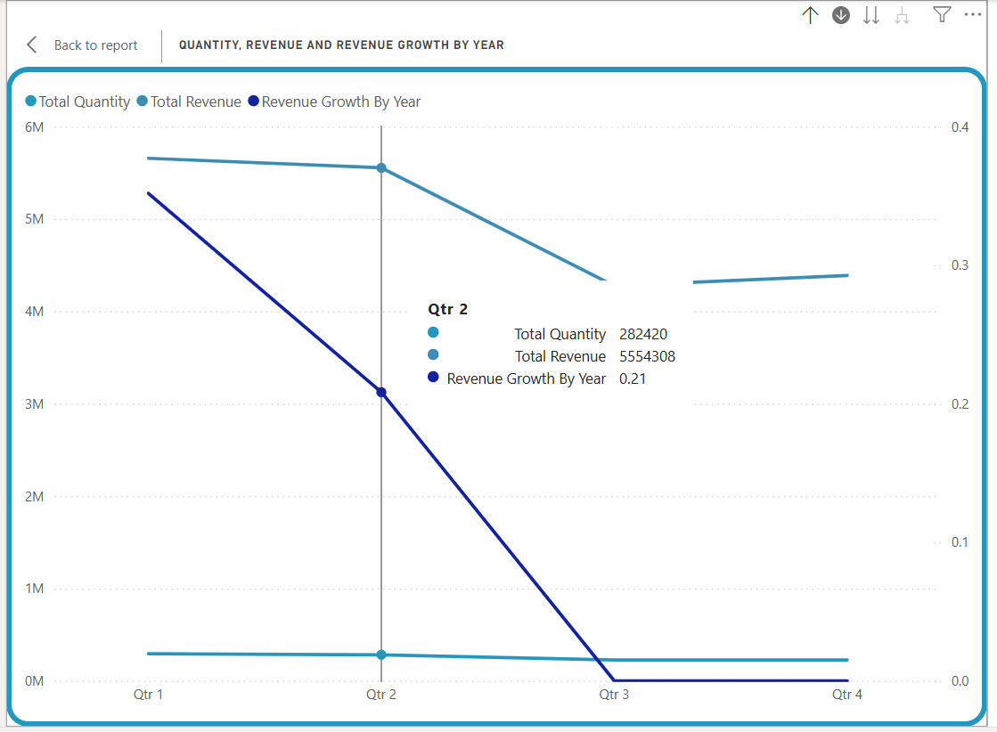
When 5

Slide 17
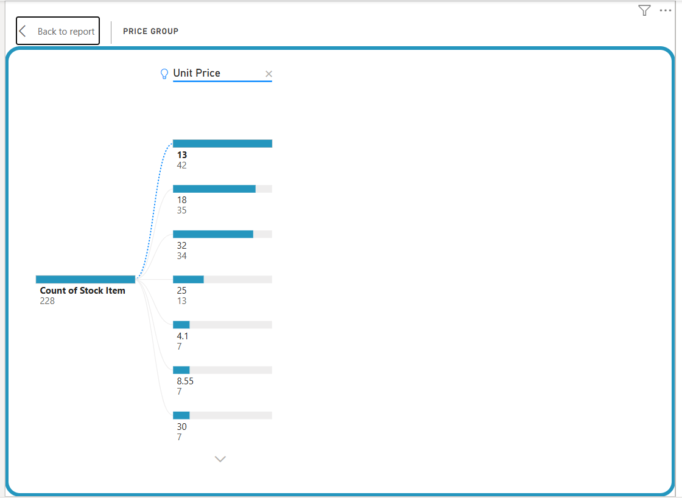
what

Slide 18
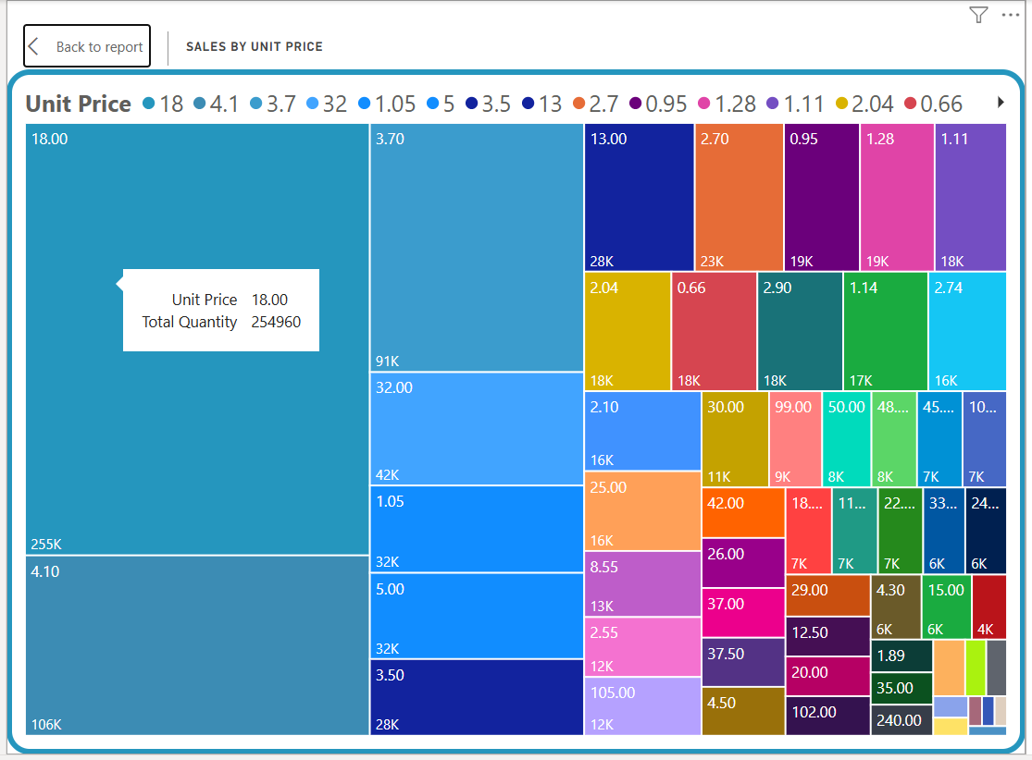
What 2

Slide 19
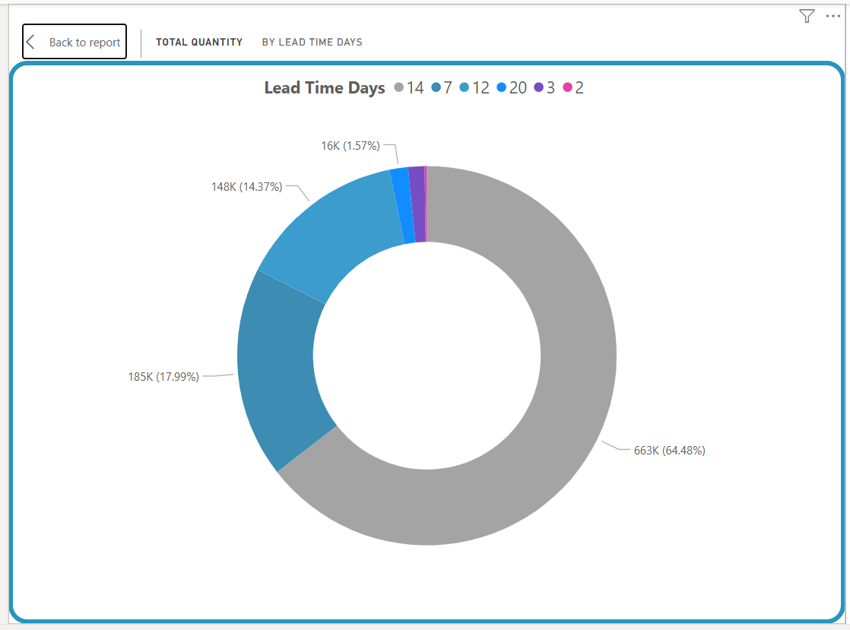
what3

Slide 20
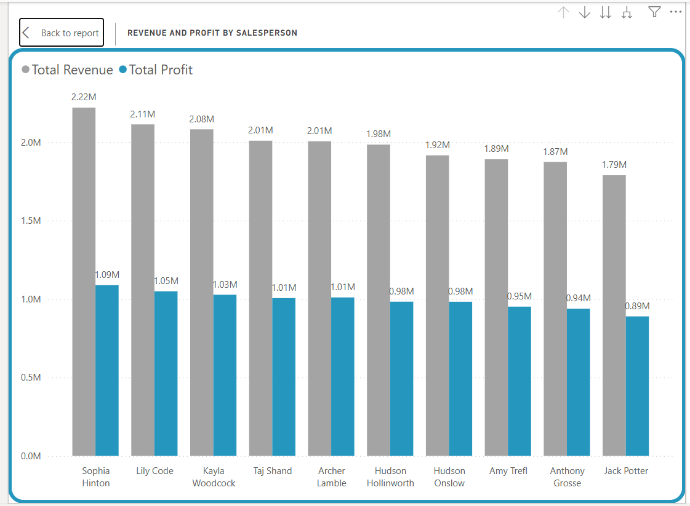
who

Slide 21
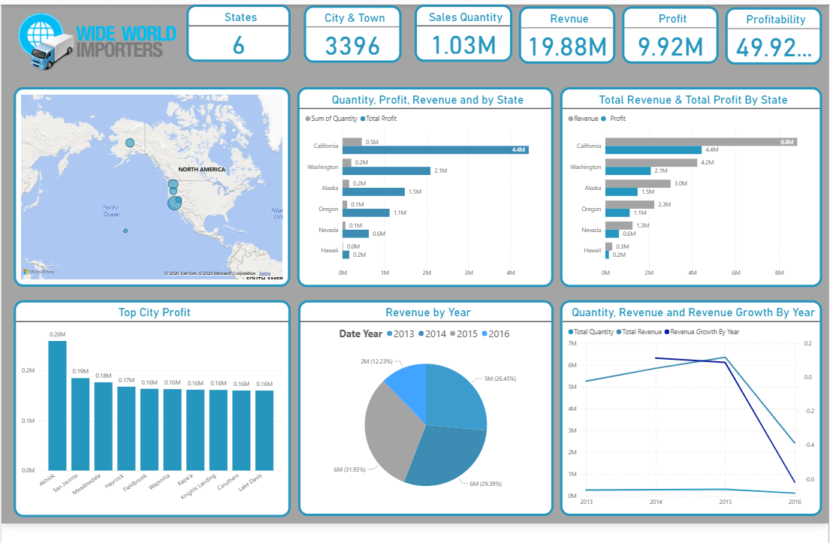
Our dashboard

Slide 22
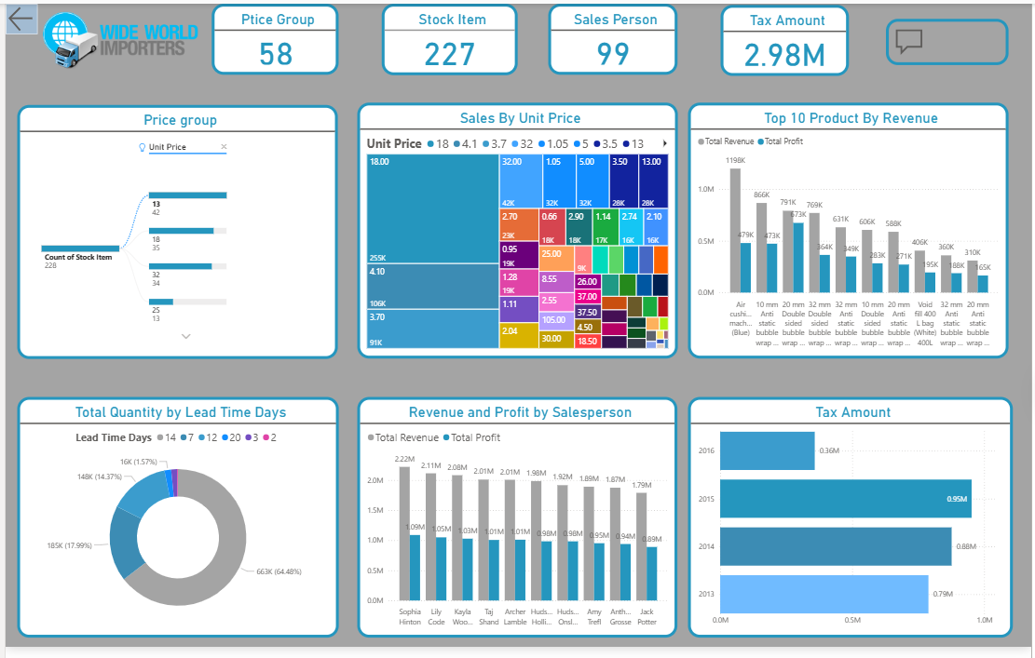
Our dashboard 2

