Slide 1

Wide World Importers
By
Team 2

Slide 2

About data
The model consists of a single Fact Table that connects to four Dimension Tables : The Fact Table (Fact Sale) Records each individual sales transaction, containing key metrics such as revenue and quantity . The Dimension Tables: Provide the detailed context for each sale. These tables include data on the cities, customers, dates, and employees, enabling us to answer key quest

Slide 3
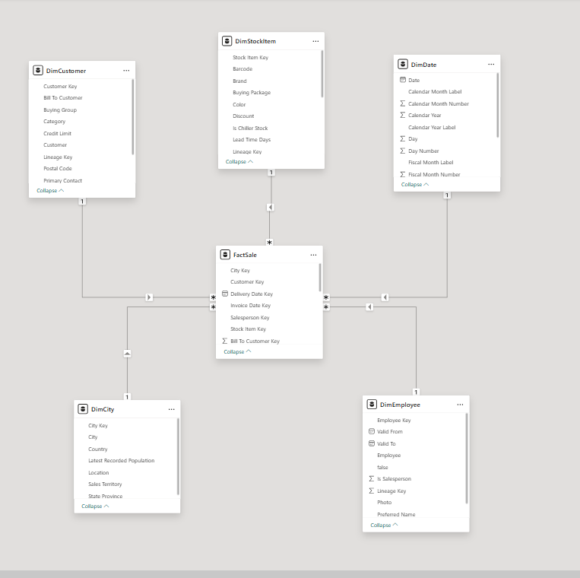
Molding data
Our data model is designed based on a Star Schema concept

Slide 4
The cleaning process
To ensure the accuracy of our analysis, we followed a specific data cleaning methodology focused on achieving our study's goals. Our steps were simple and effective : Promote Headers: We used the first row of data as column headers to streamline the analysis process. Change Data Types: We adjusted the data type of each column to match its content (e.g., converting text to numbers or dates).Remove Unnecessary Rows: We specifically removed the first row from the Customer dimension table to eliminate redundant data.

Slide 5
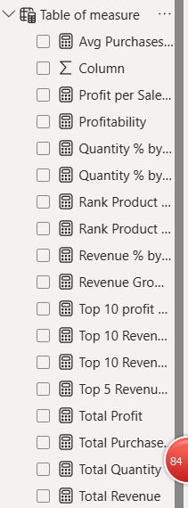
Dax measures
Our Table Of Measure Contains The Necessary Items For Examples
Total Quantity , Revenue And Profit
Top 10 Revenue Products , cites And Employee
Top 10 Profit Products , cites And Employee
Rank Products By Revenue And Profit
Quantity Percentage For Time And Place

Slide 6
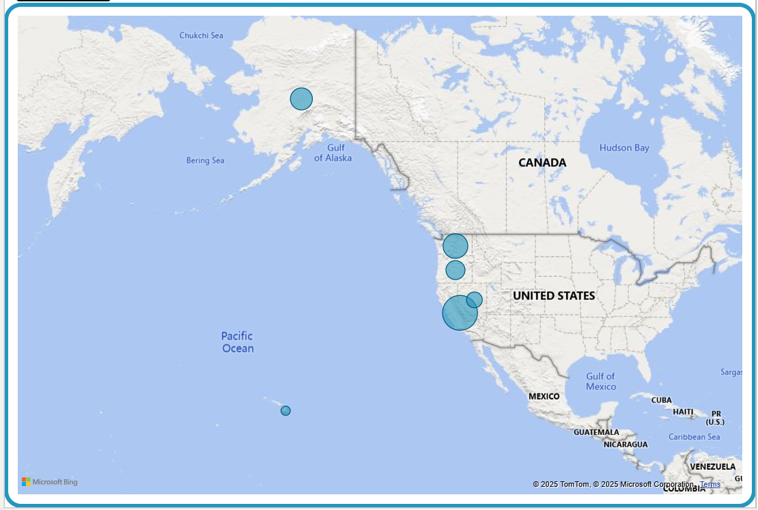
Where
We currently operate in a single market, the United States, with our operations focused exclusively on the West Coast region. We serve six key states: California, Nevada, Oregon, Washington, Alaska, and Hawaii

Slide 7
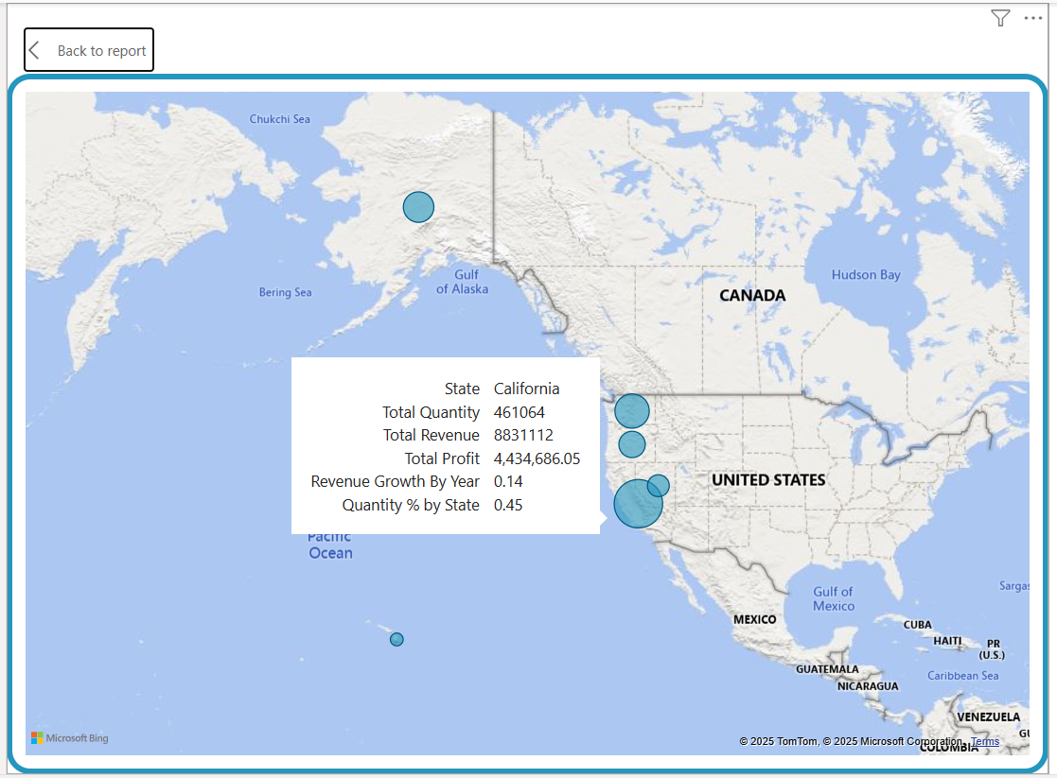
Where 2
As we can see, California is by far our largest market, followed by Washington and Oregon. The data indicates that California achieves the highest total revenue and profit, in addition to significant year-over-year revenue growth.

Slide 8
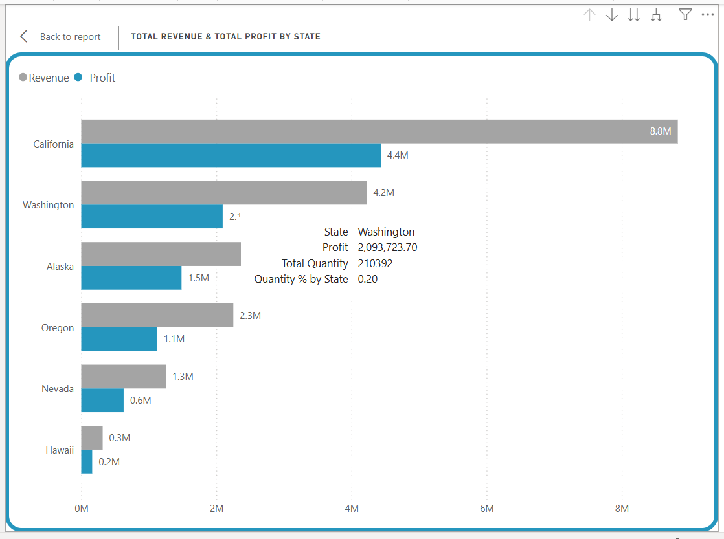
Where 3
As this chart clearly shows, California is our top-performing state, generating over $8.8M in revenue and $4.4M in profit. Washington follows as our second largest market, with both revenue and profit significantly higher than the remaining states.

Slide 9
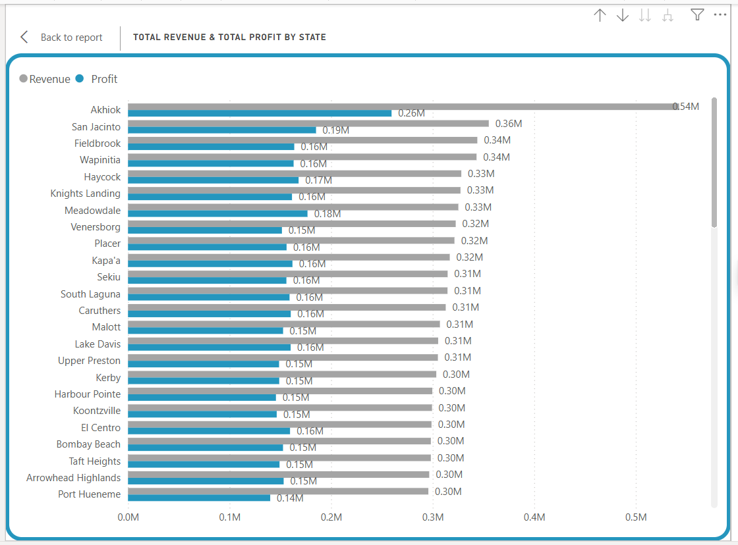
Where 4
Using the "Drill-down" feature, we moved from the state level to a more detailed view: city-level sales performance.
This chart shows the cities that contribute the most to revenue and profit. The city of Ahok the list with revenues of $0.54 million, making it our most significant individual market in this group.

Slide 10
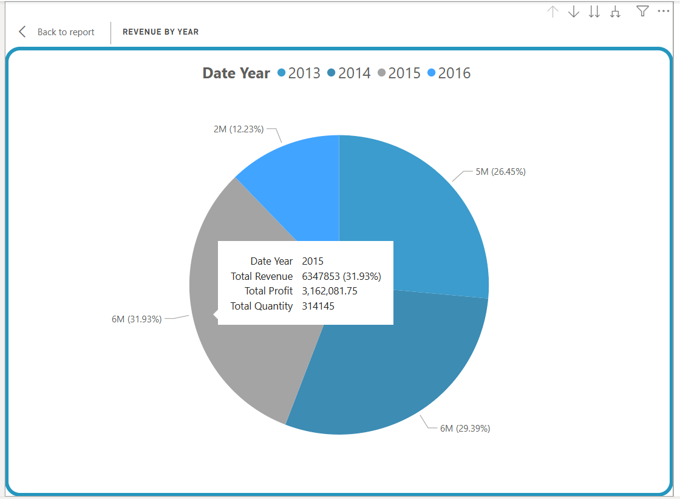
when
revenues from 2014 and 2015 making up the largest share, at over $6 million for each year.
It is worth noting that the data for 2016 is incomplete, as it represents only a part of the fiscal year. Despite this, the performance so far shows a positive contribution to our total revenue.

Slide 11
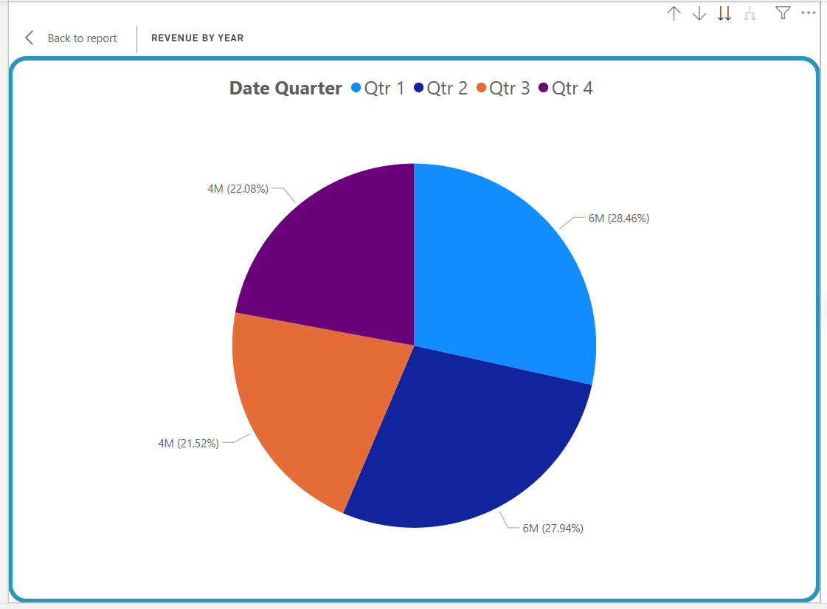
When 2
the first and second quarters are the strongest performers, with each contributing a significant share of revenue, amounting to approximately $6 million per quarter. It is worth noting that these figures reflect the available data, as the data for the third and fourth quarters of 2016 is not available, which affects the total calculation.

Slide 12
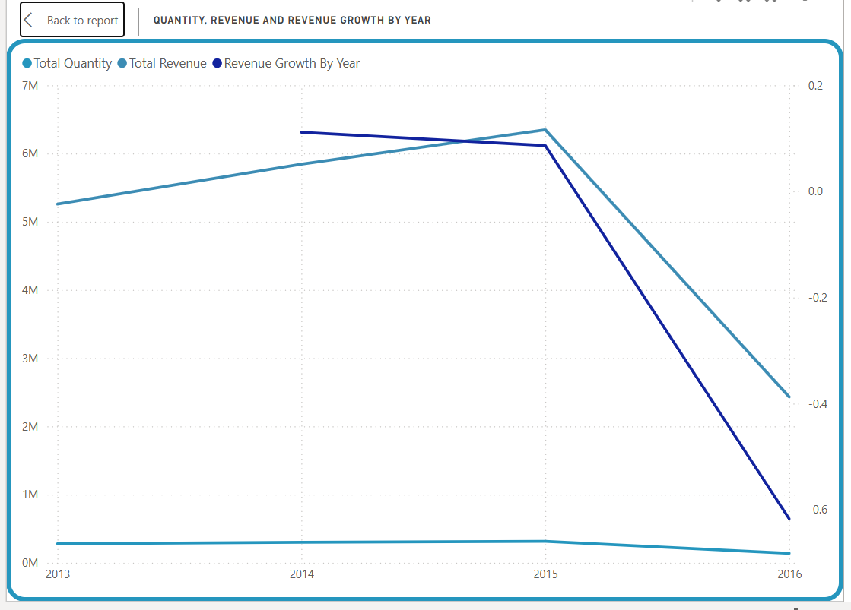
When 4
We can observe that Total Revenue (light blue line) experienced steady growth from 2013, peaking in 2015, before a sharp decline in 2016. This decrease was directly reflected in Revenue Growth (dark blue line), which shifted from positive to a significantly large negative. It's also worth noting that the line for Total Quantity (thinner line at the bottom) remained relatively stable over the years. This significant discrepancy is primarily due to the incomplete data for 2016, which affects the overall calculation

Slide 13
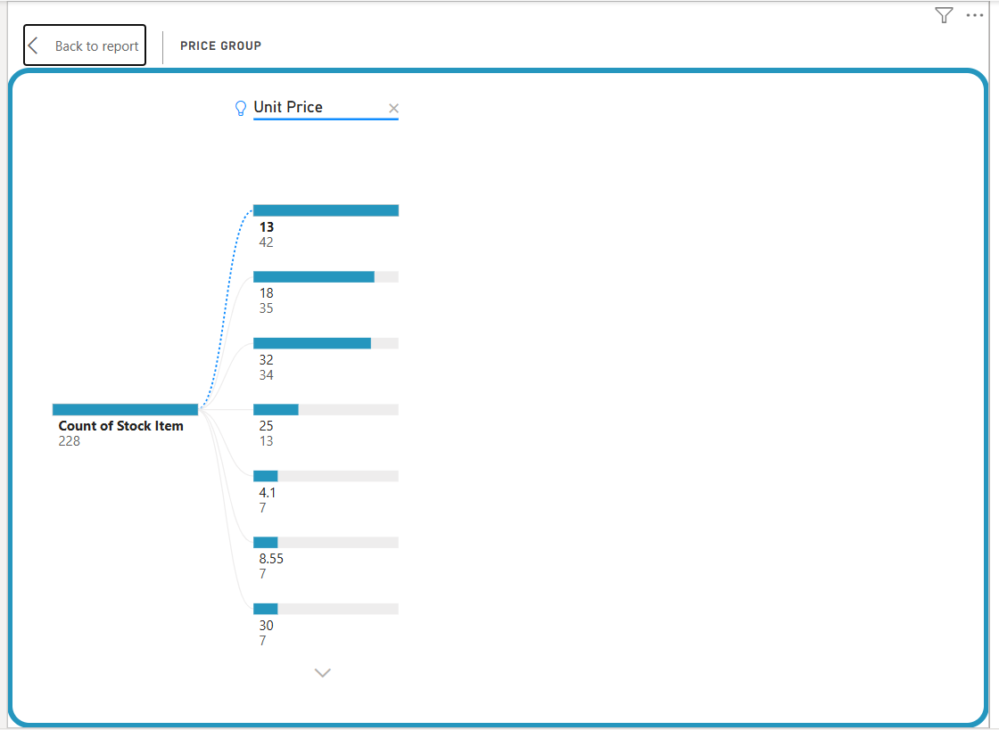
what
our 228 products are grouped by their price categories, with each category showing the number of items it contains. For example, we have 42 items with a price of $13, and 35 items with a price of $18.

Slide 14
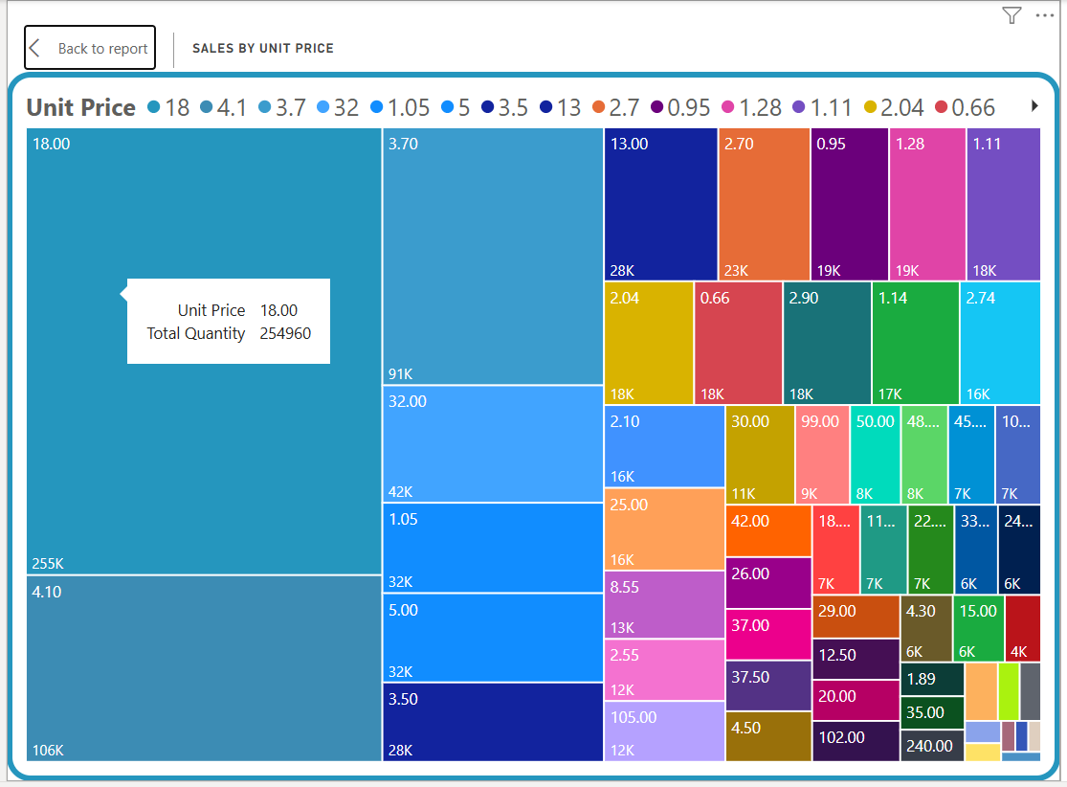
What 2
the price group with a unit price of $18 is the best-selling in terms of quantity, making it the most popular with customers. Other price categories, such as $4.1 and $3.7, also show large sales quantities

Slide 15
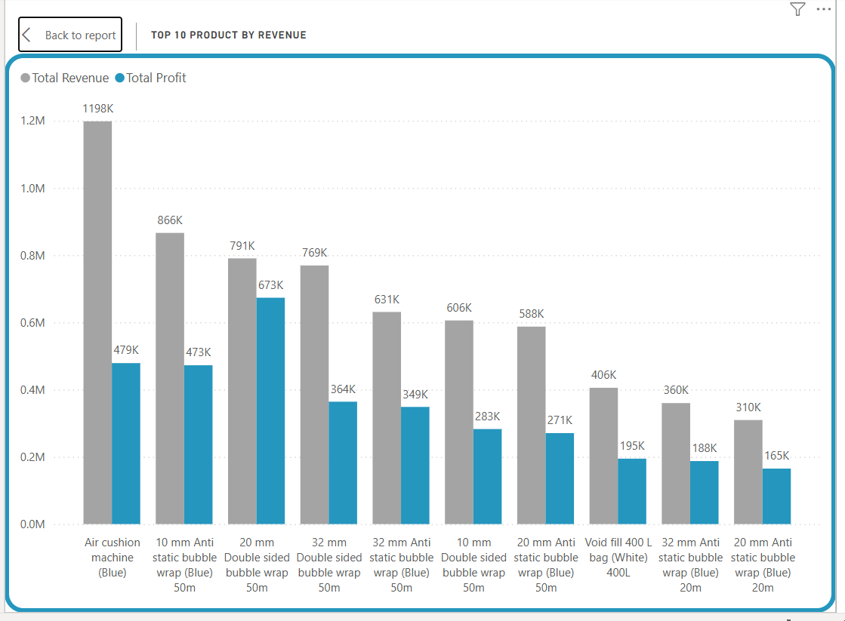
What 3
The "Air cushion machine (Blue)" product leads the list by a clear margin, having achieved revenues of $1.198 million and profits of $479 thousand. Furthermore, various "Bubble wrap" products show a clear dominance over the remaining positions on the list.

Slide 16
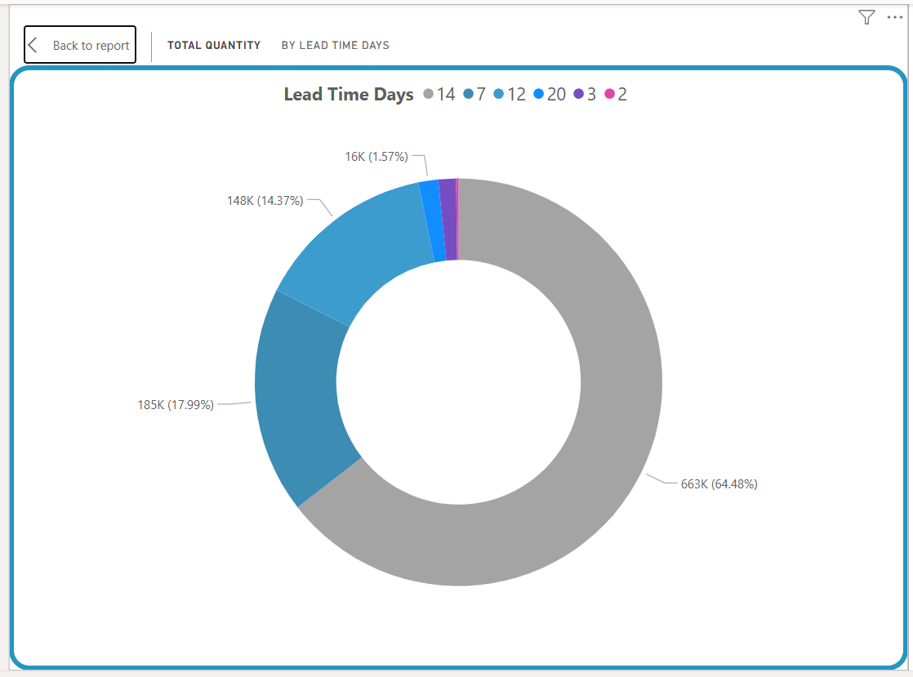
What 3
the most common lead time for our inventory is 14 days, as this period represents nearly 65% of our total product quantity. This means most of our products take two weeks to be restocked.

Slide 17
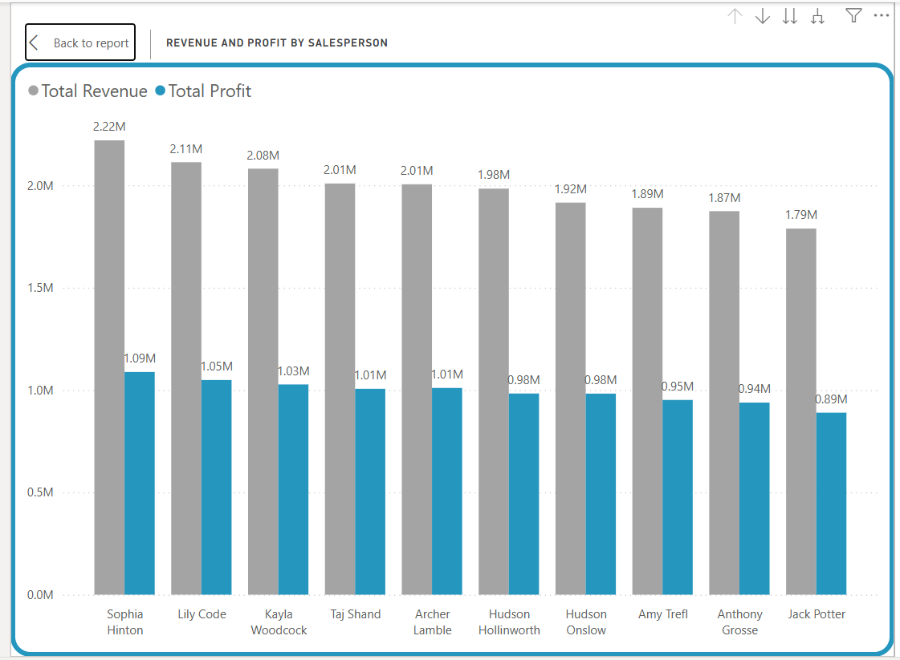
who
Sophia Hinton leads the sales team by a clear margin, achieving the highest total revenue of $2.22 million and the highest profit of $1.09 million. She is followed by the strong performance of Lily Code and Kayla Woodcock. This ranking confirms that our top ten salespeople are largely responsible for generating most of the the company's total revenue and profit.

Slide 18
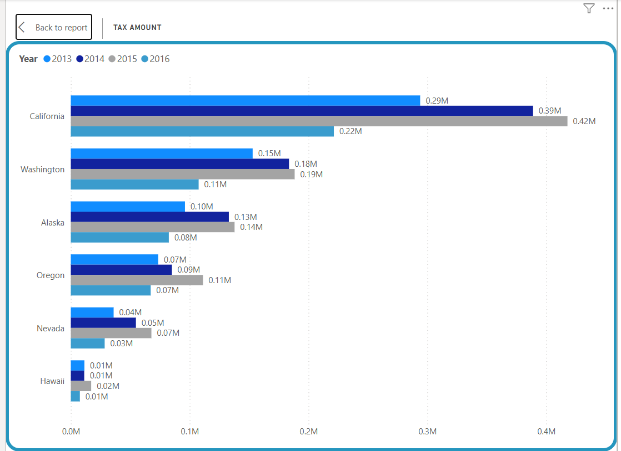
tax
California is the largest contributor to taxes each year, with the tax amount reaching $0.42 million in 2015. It is followed by Washington as the second-largest contributor.

Slide 19
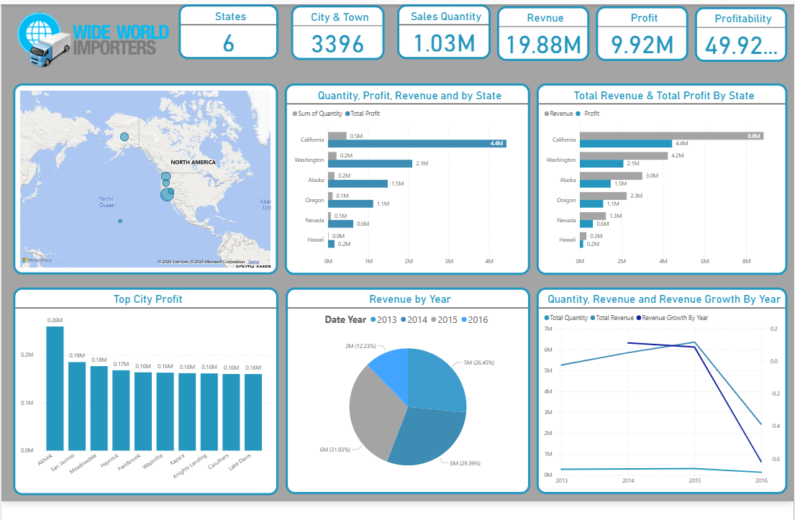
Our dashboard

Slide 20
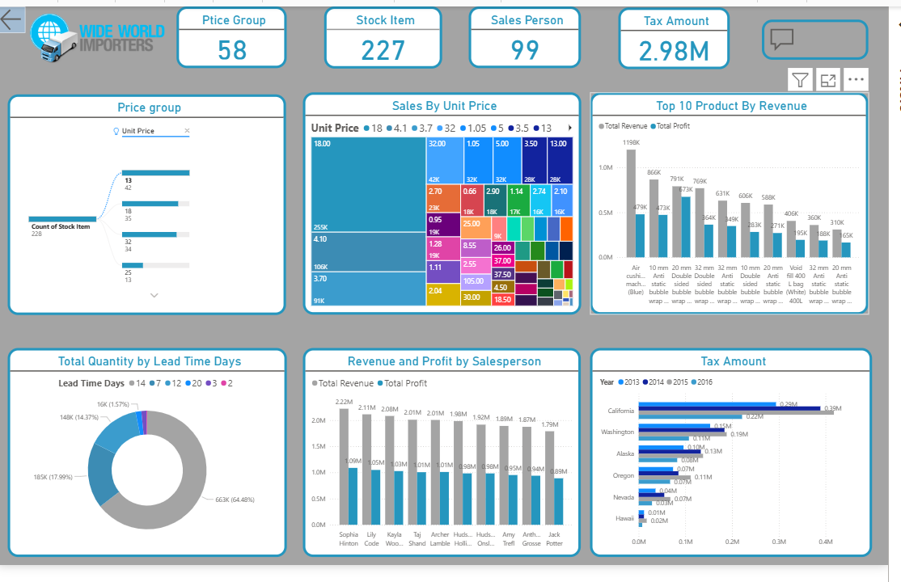
Our dashboard 2

