Slide 1



Stroke Prediction Modeling

Slide 2
Introduction – What is a Stroke?
Stroke is caused by the lack of blood supply to the brain either due to a blood clot resulting from a blocked artery or a ruptured artery within the brain.
A stroke can cause irreversible brain damage which can result in disability or cause death.

Slide 3
F.A.S.T Warning Signs
F = Face Drooping
A = Arm Weakness
S = Speech Difficulty
T = Time to call emergency (911)

Slide 4
Data Set
The dataset consists of 11 attributes which are a combination of both numerical and categorical which help make predictions about the likelihood of a person getting a stroke or not.
Link: https://www.kaggle.com/datasets/fedesoriano/stroke-prediction-dataset

Slide 5
Dataset Attributes
id : unique identifier
gender : "Male", "Female" or "Other"
age : age of the patient
hypertension: 0 if the patient doesn't have hypertension, 1 if the patient has hypertension
heart_disease : 0 if the patient doesn't have any heart diseases, 1 if the patient has a heart disease
ever_married : "No" or "Yes"
work_type : "children", "Govt_jov", "Never_worked", "Private" or "Self-employed"
Residence_type : "Rural" or "Urban"
avg_glucose_level : average glucose level in blood
bmi : body mass index
smoking_status : "formerly smoked", "never smoked", "smokes" or "Unknown"*
stroke : 1 if the patient had a stroke or 0 if not

Slide 6
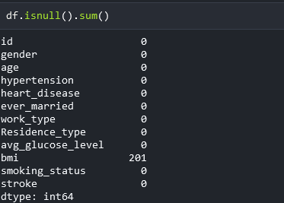
Exploratory Data Analysis- Missing Values
Missing data can lead to bias
Missing data can impede a model’s performance
Missing values skew the interpretability of a data analysis

Slide 7
How to handle missing values?
Depends on the category of the attribute
Numerical : Mean or Median
Categorical: Mode (most occurring value)

Slide 8
Data transformations
Dropped features like id that add no significance to the model
Dropped rows of gender where the value was described as ‘Other’

Slide 9
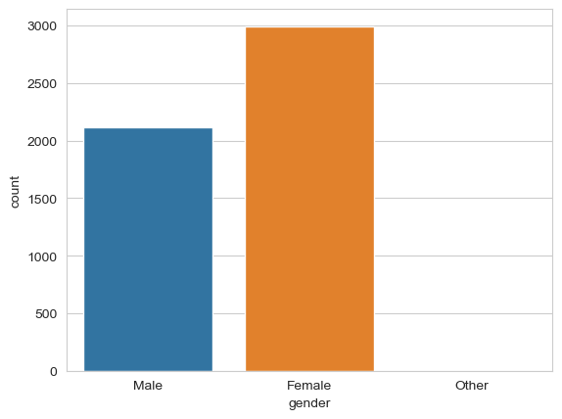
Data Transformations
Other category of gender only had 1 value and hence was deleted

Slide 10
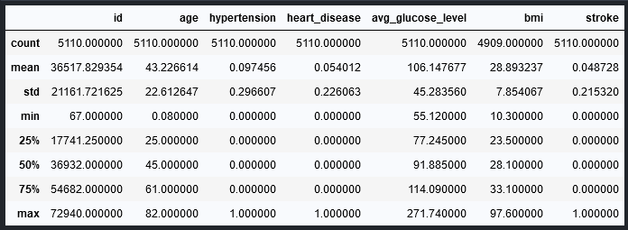
Statistical Analysis
75% of the population are aged 61 or lower
25 % of the population is aged 25 or lower
Maximum age is 82
Quick way to find out total count, mean and standard deviation

Slide 11
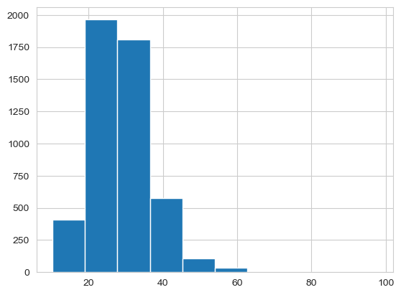
Data Visualizations
Plot shows the distribution of the ‘bmi’ attribute which is slightly right skewed
One can also argue that it is normally distributed

Slide 12
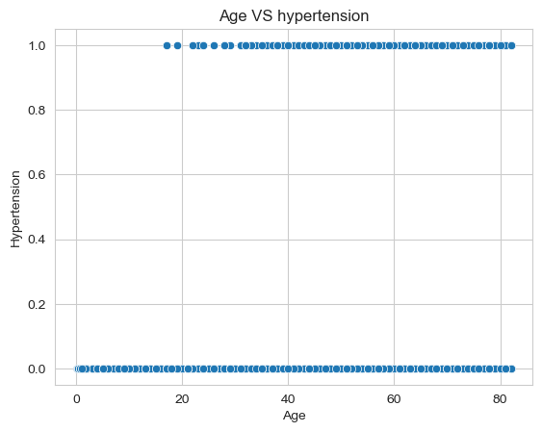
Data Visualizations
Shows the weak positive correlation between age and hypertension
As age increases, the hypertension also increases
Correlation between the two attributes is 0.276

Slide 13
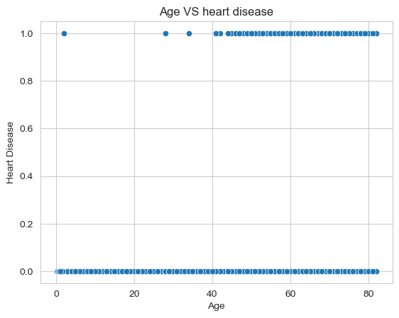
Data Visualizations
Shows a weak positive correlation between age and heart disease
As age increases the risk of heart disease also increases
Correlation between the two attributes is 0.263

Slide 14
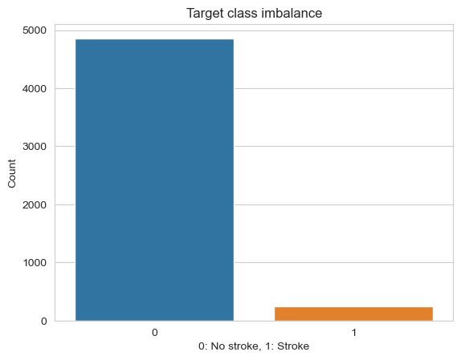
Target Class Imbalance
Instances belonging to class 1 were significantly lower than instances belonging to class 0
Leads to model bias towards the majority class

Slide 15
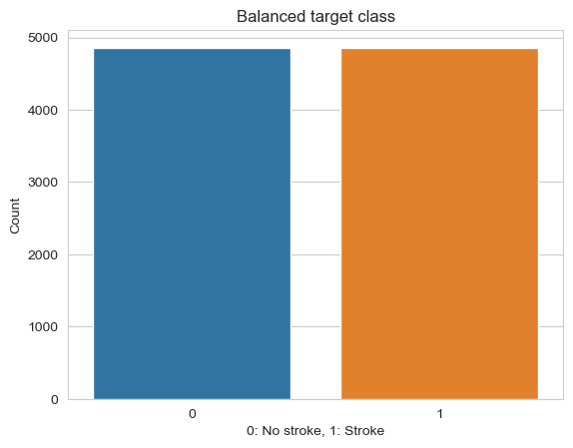
Target Class Imbalance - Solution
Can use Down Sampling, Up Sampling or SMOTE
S.M.O.T.E – Synthetic Minority Oversampling Technique
Creates synthetic data points and balances the entire data set

Slide 16
Model Building and Evaluating Algorithms
The data set was split into .60 train, .20 validate and .20 test sets.
Three models were trained namely, Decision tree, Random Forest and Neural network.

Slide 17
Performance Metric
Accuracy was used as the performance metric to evaluate our algorithms.
Decision tree scored 0.877 in accuracy score
Random Forest scored 0.875 in accuracy score
Neural network scored 0.875 in accuracy score

Slide 18
Conclusion
Since Decision tree had the highest accuracy score on the test set, we will use that as our final model for predicting stroke given the attributes.

Slide 19


Slide 20
References
IEEE. (2018, April 20). Artificial Intelligence and Ethics in Design Request Received - IEEE Innovation at Work. IEEE Innovation at Work. https://innovationatwork.ieee.org/aie1_ty/
AiThority. (2022, August 9). iHealthScreen Inc. Introduces An Automated Stroke Prediction Model, based on AI and Color Fundus Imaging. https://aithority.com/medical-apps/healthcare-management/ihealthscreen-inc-introduces-an-automated-stroke-prediction-model-based-on-ai-and-color-fundus-imaging/

