Slide 1
Chapter 4 - Introduction to XHTML: Part 1
Outline
4.1 Introduction
4.2 Editing XHTML
4.3 First XHTML Example
4.4 W3C XHTML Validation Service
4.5 Headers
4.6 Linking
4.7 Images
4.8 Special Characters and More Line Breaks
4.9 Unordered Lists
4.10 Nested and Ordered Lists
4.11 Web Resources

Slide 2
Objectives
In this chapter, you will learn:
  To understand important components of XHTML documents.
  To use XHTML to create Web pages.
  To be able to add images to Web pages.
  To understand how to create and use hyperlinks to navigate Web pages.
  To be able to mark up lists of information.

Slide 3
4.1 Introduction
Extensible HyperText Markup Language
  XHTML
  A markup language
  Separation of the presentation of a document from the structure of the document’s information
  Based on HTML
    Technology of the World Wide Web Consortium (W3C)

Slide 4
4.2 Editing XHTML
XHTML documents
  Source-code form
  Text editor (e.g. Notepad, Wordpad, emacs, etc.)
  .html or .htm file-name extension
  Web server
    Stores XHTML documents
  Web browser
    Requests XHTML documents

Slide 5
4.3 First XHTML Example
XHTML comments
  Start with <!-- and end with -->
  html element
    head element
      Head section
        Title of the document
        Style sheets and scripts
    body element
      Body section
        Page’s content the browser displays
  Start tag
    attributes (provide additional information about an element)
      name and value (separated by an equal sign)
  End tag

Slide 6
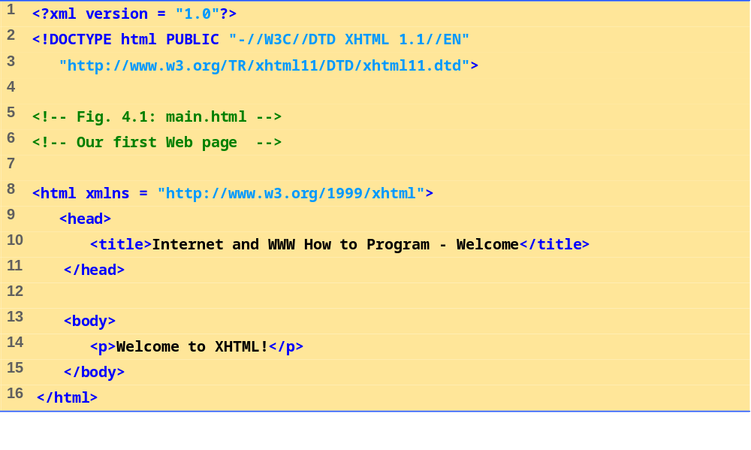
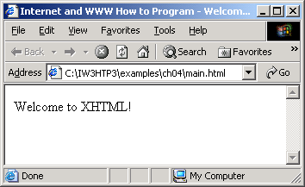
main.html
(1 of 1)

Slide 7
4.4 W3C XHTML Validation Service
Validation service ( validator.w3.org )
  Checking a document’s syntax
    URL that specifies the location of the file
    Uploading a file to the site
    validator.w3.org/file-upload.html

Slide 8
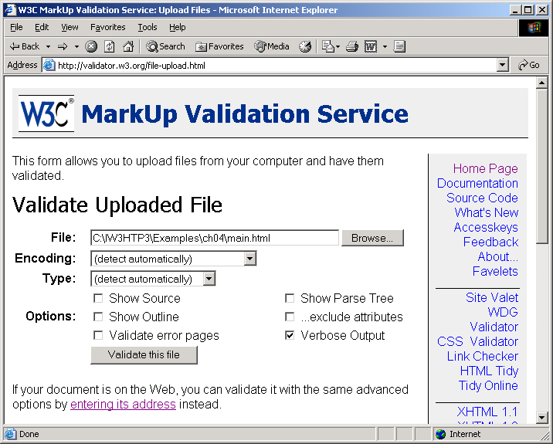
4.4 W3C XHTML Validation Service

Slide 9
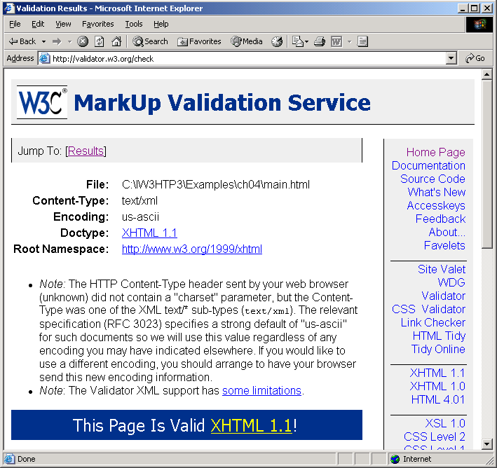
4.4 W3C XHTML Validation Service

Slide 10
4.5 Headers
Six headers ( header elements)
  h1 through h6

Slide 11
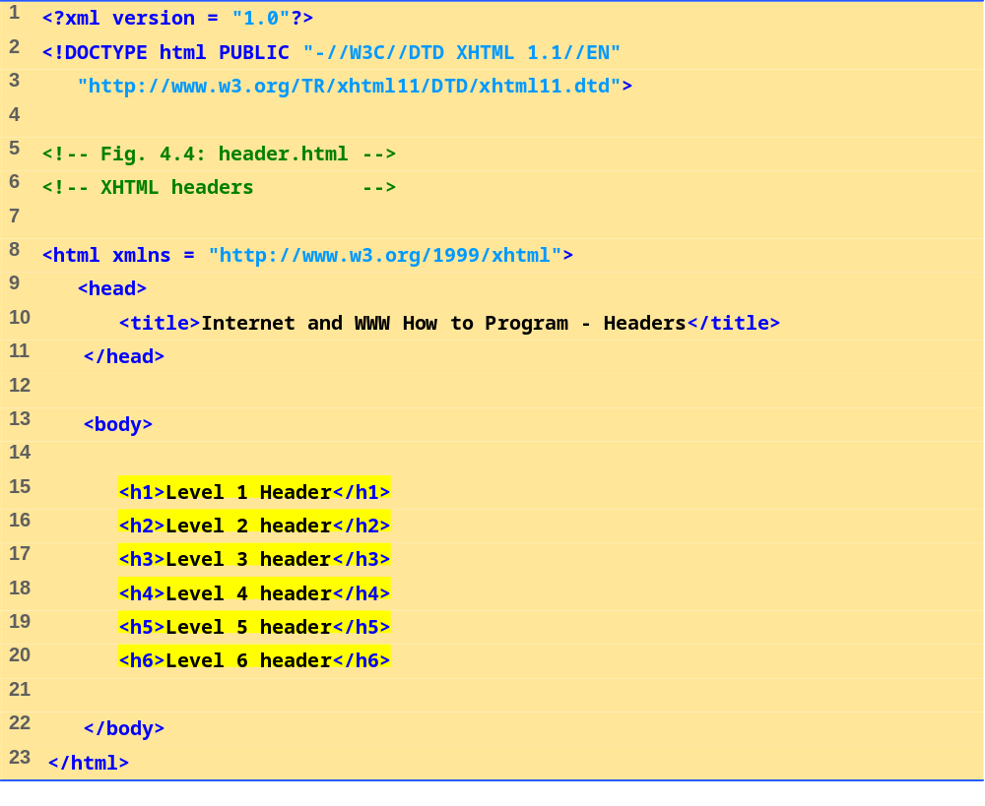
header.html
(1 of 1)

Slide 12
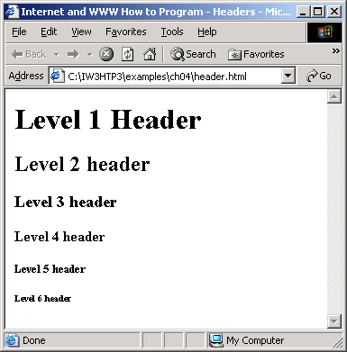

Slide 13
4.6 Linking
Hyperlink
  References other sources such as XHTML documents and images
  Both text and images can act as hyperlinks
  Created using the a (anchor) element
    Attribute href
      Specifies the location of a linked resource
    Link to e-mail addresses using mailto: URL
<strong> tag
  Bold

Slide 14
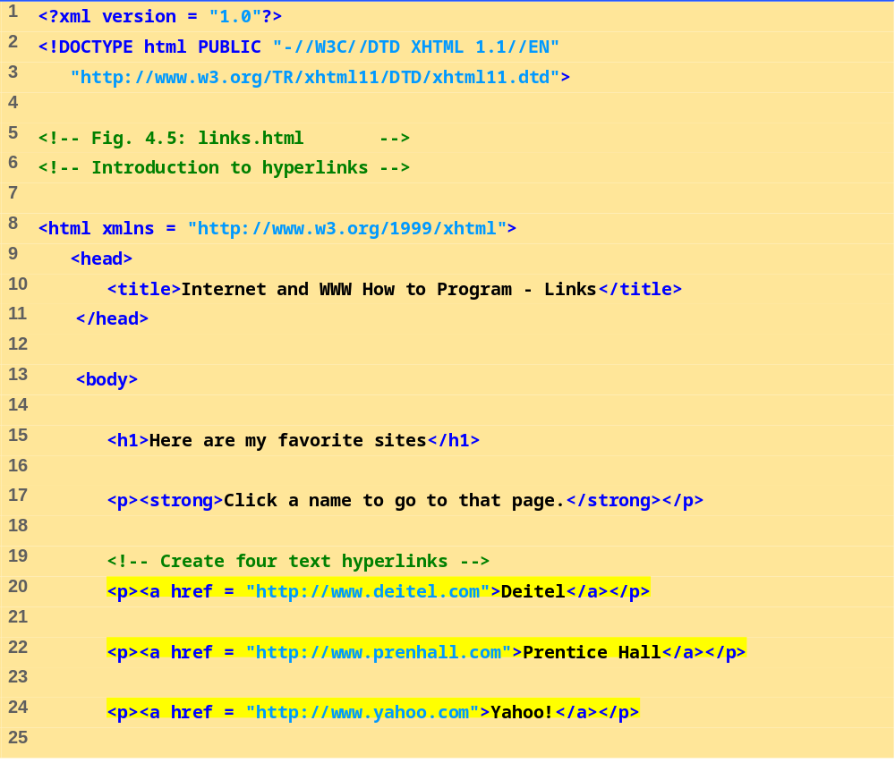
links.html
(1 of 2)

Slide 15
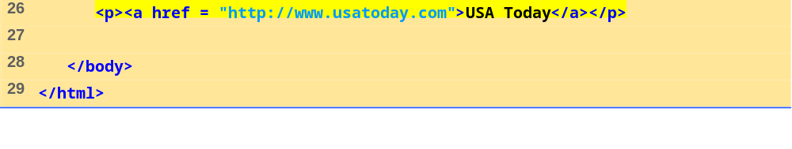
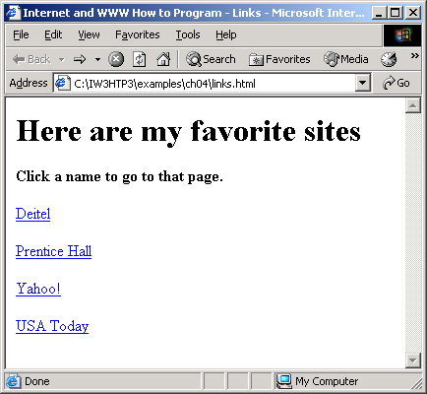
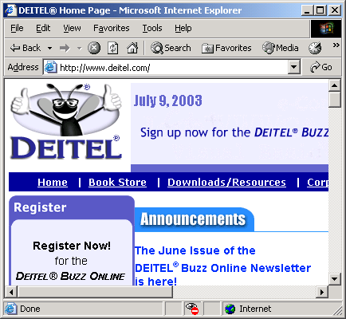
links.html
(2 of 2)

Slide 16
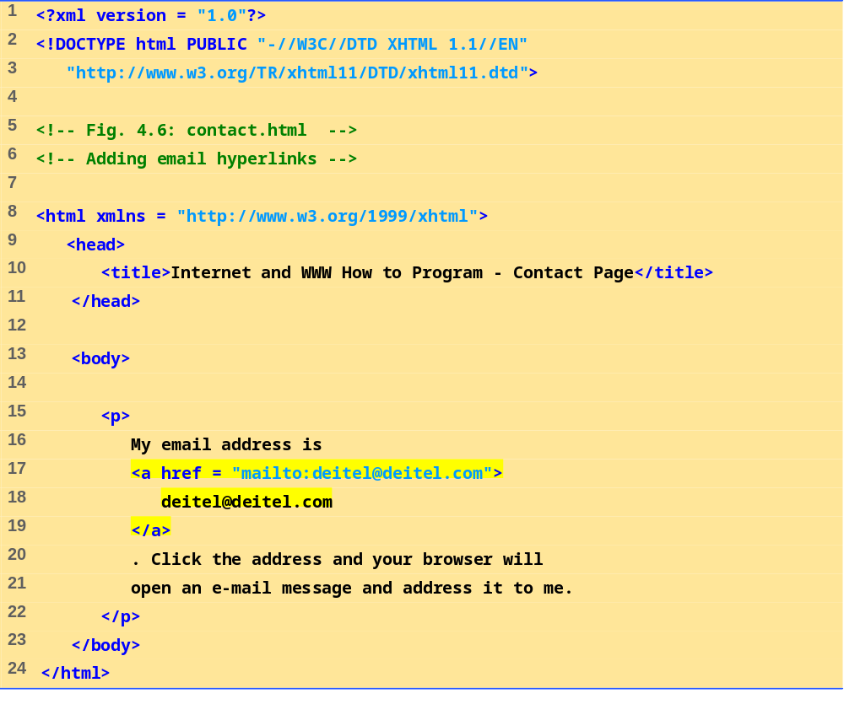
contact.html
(1 of 1)

Slide 17
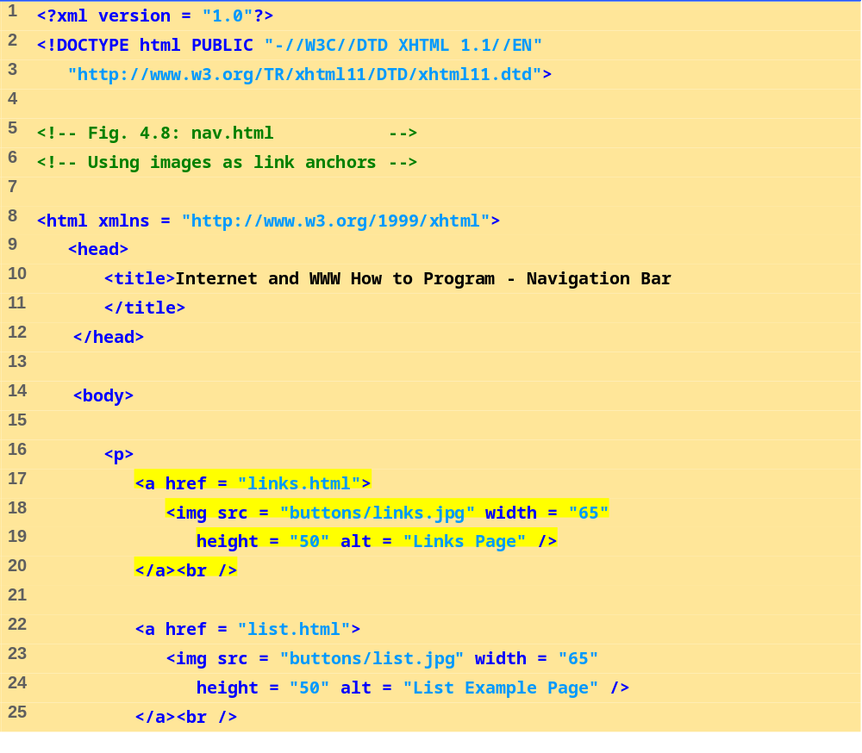
nav.html
(1 of 2)

Slide 18
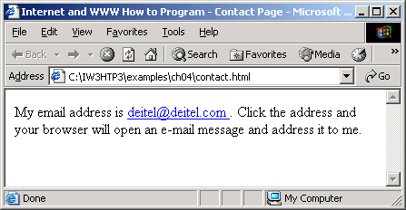
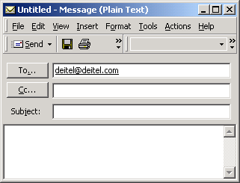

Slide 19
4.7 Images
Three most popular formats
  Graphics Interchange Format (GIF)
  Joint Photographic Experts Group (JPEG)
  Portable Network Graphics (PNG)
  img element
    src attribute
      Specifies the location of the image file
    width and height
Pixels (“picture elements”)
Empty elements
  Terminated by character / inside the closing right angle bracket (>), or by explicitly including the end tag
br element
  Line break

Slide 20
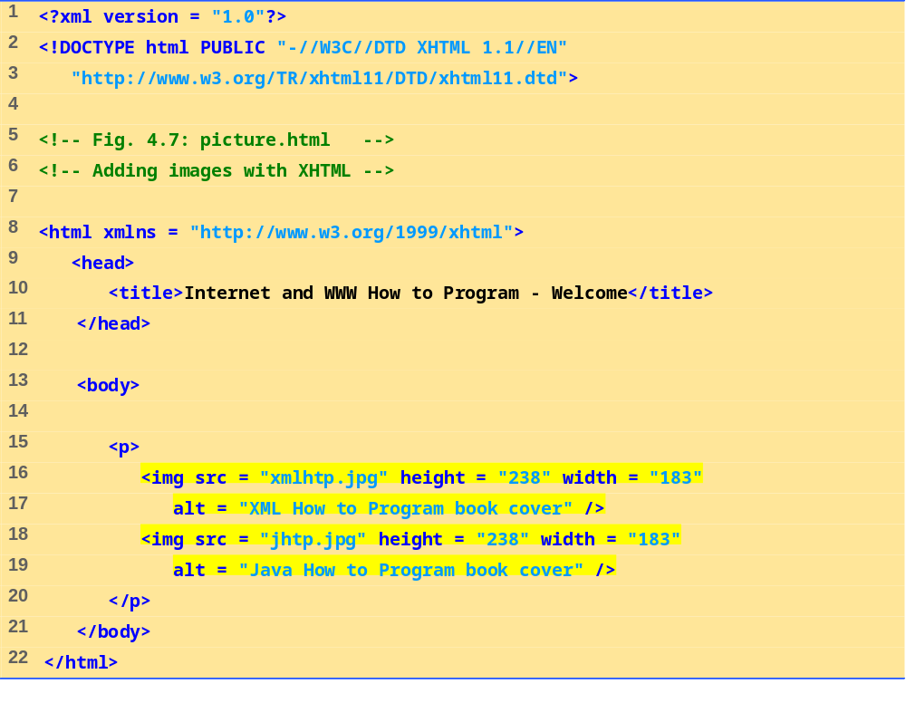
picture.html
(1 of 1)

Slide 21
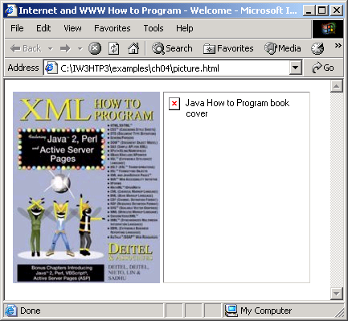

Slide 22
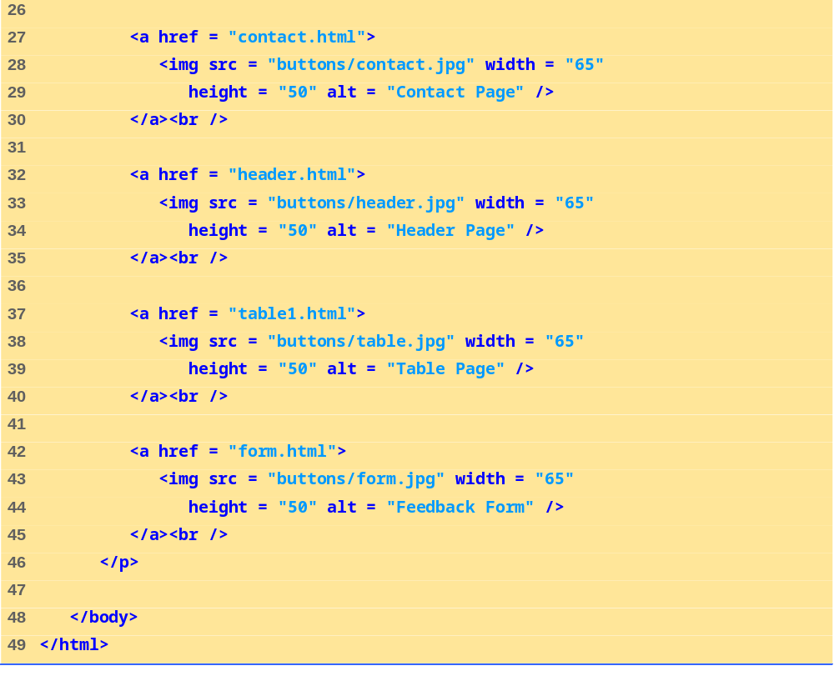
nav.html
(2 of 2)

Slide 23
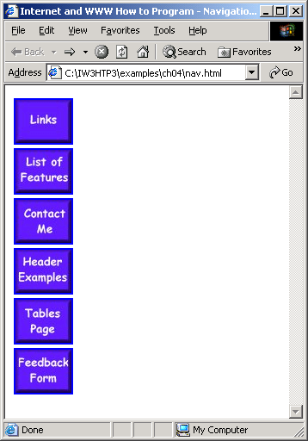
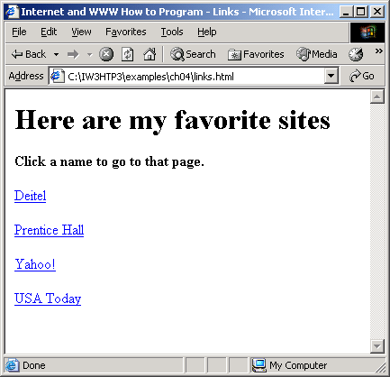

Slide 24
4.8 Special Characters and More Line Breaks
Character entity references (in the form &code;)
Numeric character references (e.g. &#38;)
del
  Strike-out text
sup
  Superscript text
sub
  Subscript text
<hr />
  Horizontal rule (horizontal line)

Slide 25
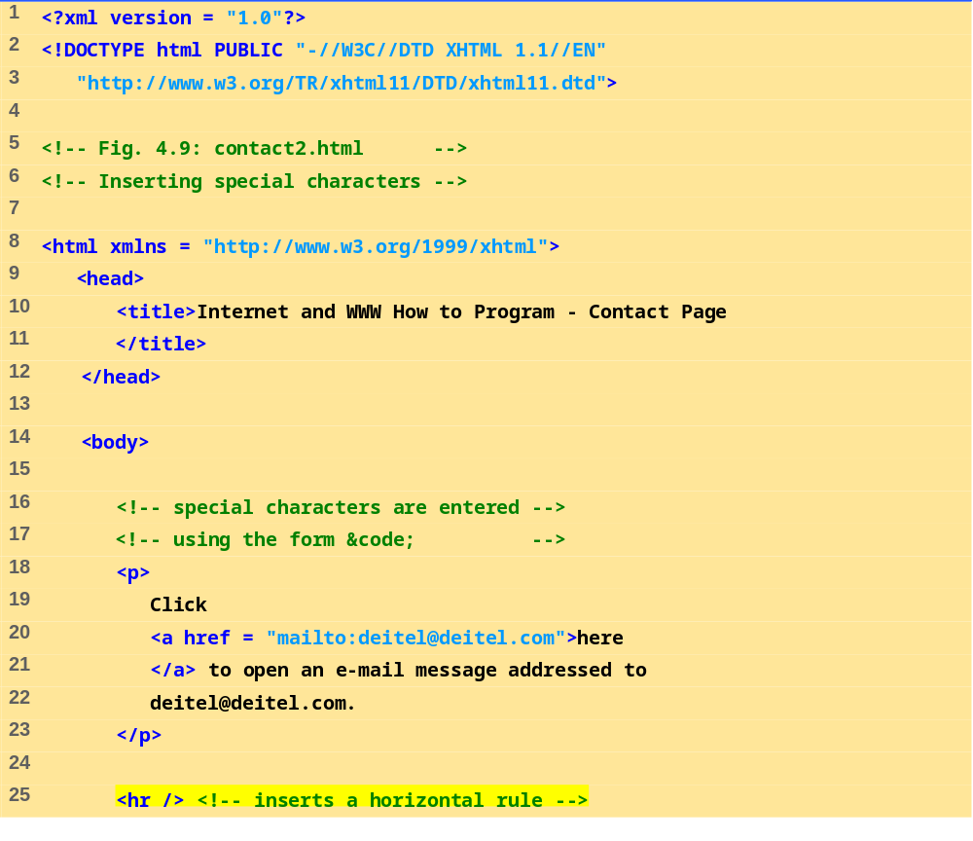
contact2.html
(1 of 2)

Slide 26
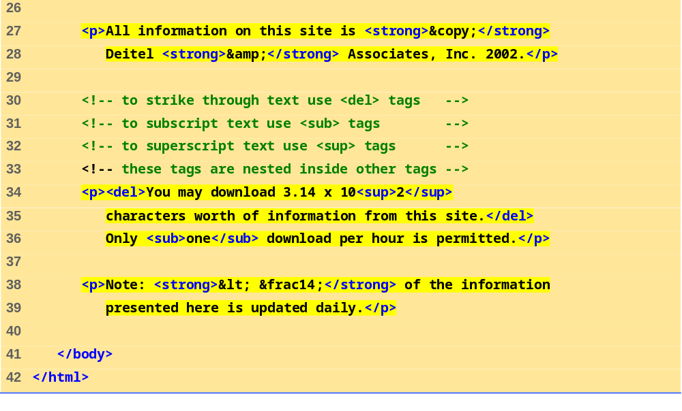
contact2.html
(2 of 2)

Slide 27
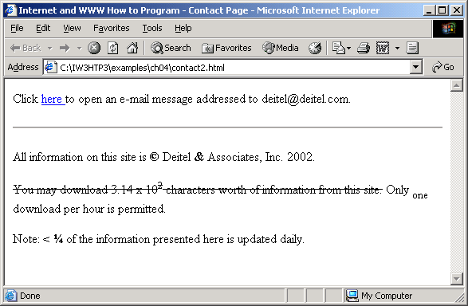

Slide 28
4.9 Unordered Lists
Unordered list element ul
  Creates a list in which each item begins with a bullet symbol (called a disc)
  li (list item)
    Entry in an unordered list

Slide 29
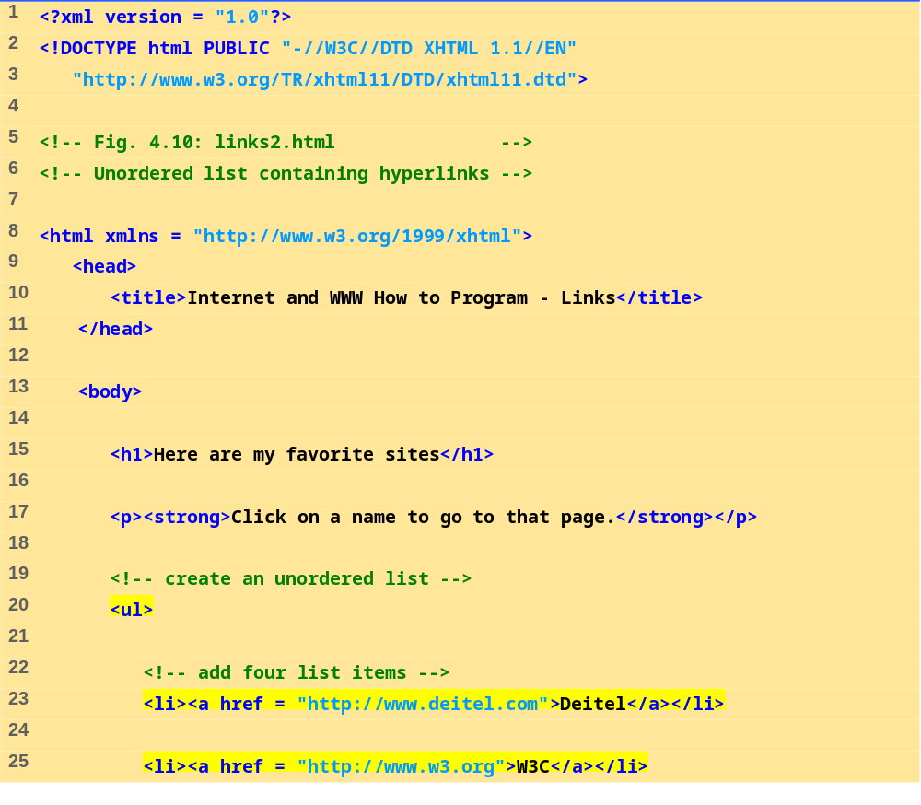
links2.html
(1 of 2)

Slide 30
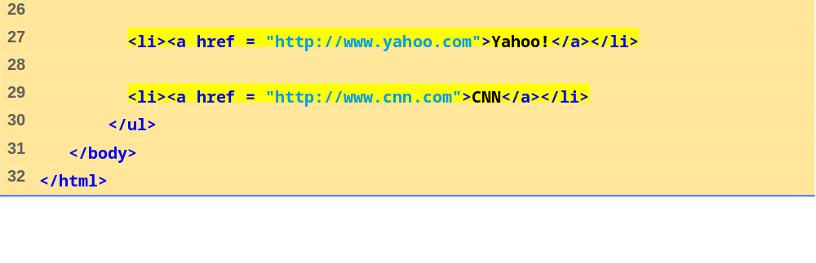
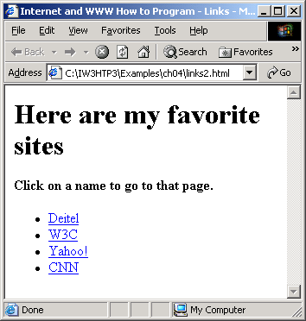
links2.html
(2 of 2)

Slide 31
4.10 Nested and Ordered Lists
Represent hierarchical relationships
Ordered lists (ol)
  Creates a list in which each item begins with a number

Slide 32
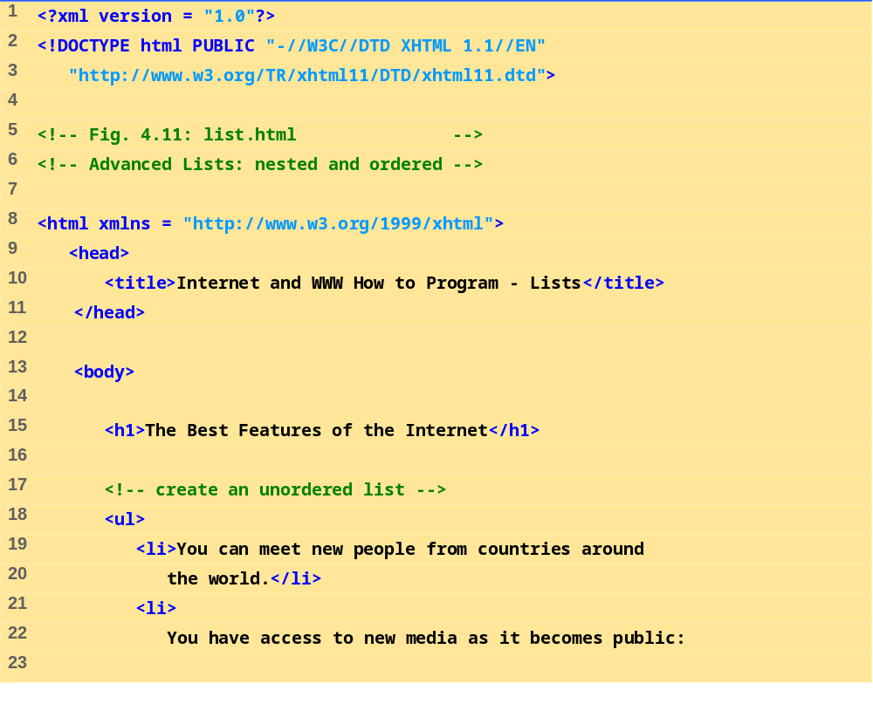
list.html
(1 of 3)

Slide 33
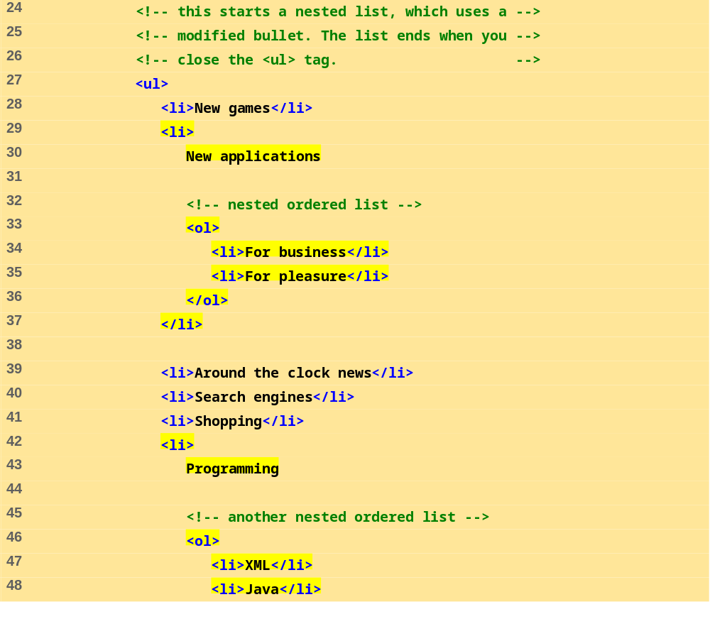
list.html
(2 of 3)

Slide 34
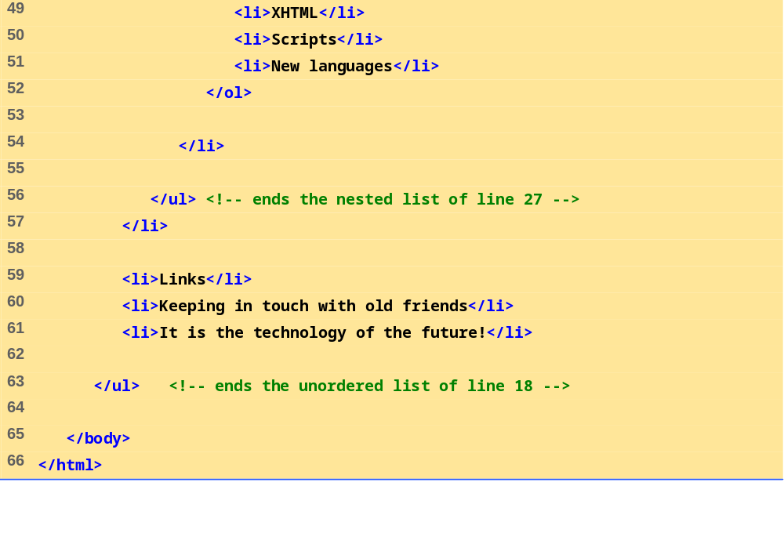
list.html
(3 of 3)

Slide 35
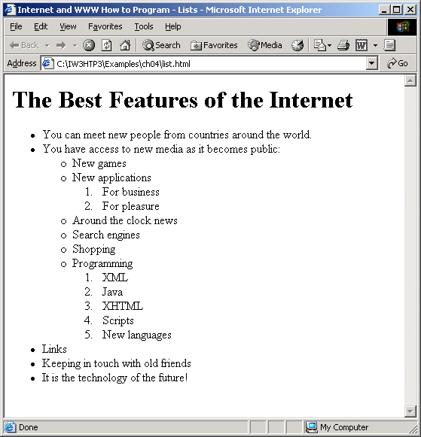

Slide 36
4.11 Web Resources
www.w3.org/TR/xhtml11
www.xhtml.org
www.w3schools.com/xhtml/default.asp
validator.w3.org
hotwired.lycos.com/webmonkey/00/50/index2a.html
wdvl.com/Authoring/Languages/XML/XHTML
www.w3.org/TR/2001/REC-xhtml11-20010531

