Slide 1
Chapter 5 - Introduction to XHTML: Part 2
Outline
5.1 Introduction
5.2 Basic XHTML Tables
5.3 Intermediate XHTML Tables and Formatting
5.4 Basic XHTML Forms
5.5 More Complex XHTML Forms
5.6 Internal Linking
5.7 Creating and Using Image Maps
5.8 meta Elements
5.9 frameset Element
5.10 Nested framesets
5.11 Web Resources

Slide 2
Objectives
In this lesson, you will learn:
  To be able to create tables with rows and columns of data.
  To be able to control table formatting.
  To be able to create and use forms.
  To be able to create and use image maps to aid in Web-page navigation.
  To be able to make Web pages accessible to search engines using meta elements.
  To be able to use the frameset element to display multiple Web pages in a single browser window.

Slide 3
5.1 Introduction
Tables
  Present information
Forms
  Collect information from visitor
Internal linking and image maps
  Enhance Web page navigation
Frames
  Display multiple documents in the browser

Slide 4
5.2 Basic XHTML Tables
Organize data into rows and columns
table element
  Attribute border
    Specifies the table’s border width in pixels
  Attribute summary
    Describes the table’s contents
  Attribute caption
    Describes the table’s content and helps text-based browsers interpret table data
  Head section (header cell, defined with a thead element)
    Contains header information such as column names
    tr element (defines an individual table row)
    th element (defines the columns in the head section)
  Foot section (defined with a tfoot element)
  Table body (defined with a tbody element)
  Data cells (defined with td element)

Slide 5
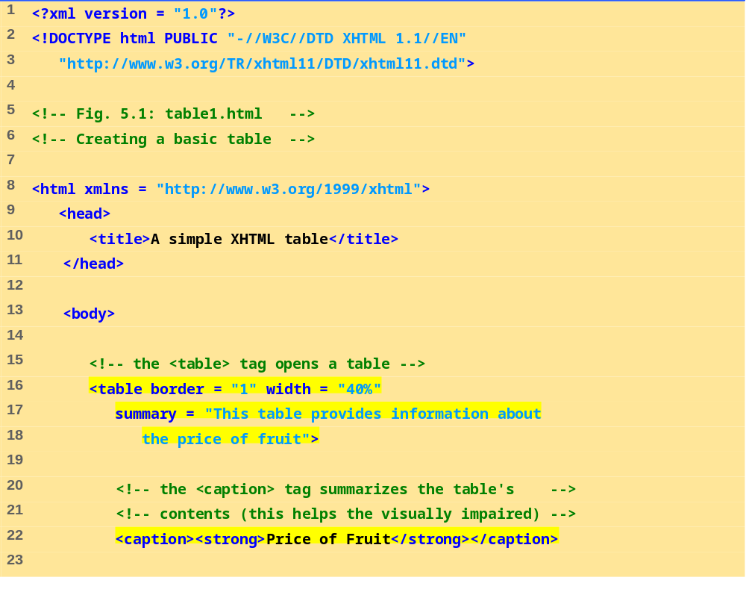
table.html
(1 of 3)

Slide 6
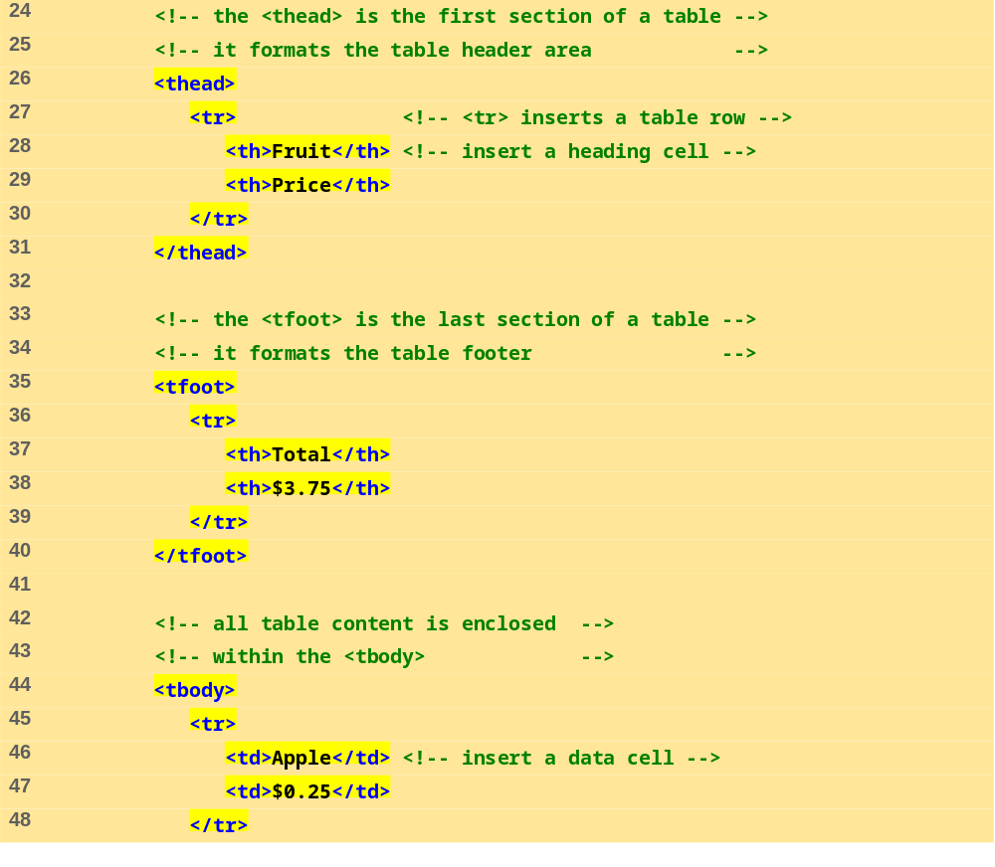
table.html
(2 of 3)

Slide 7
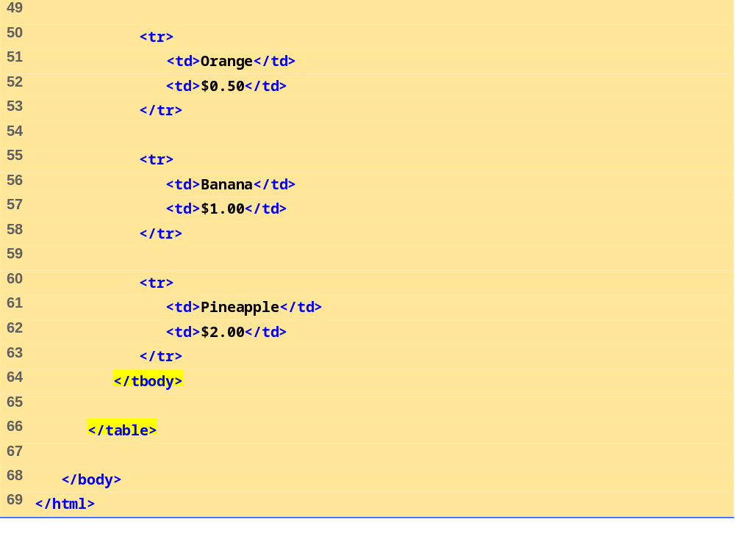
table.html
(3 of 3)

Slide 8
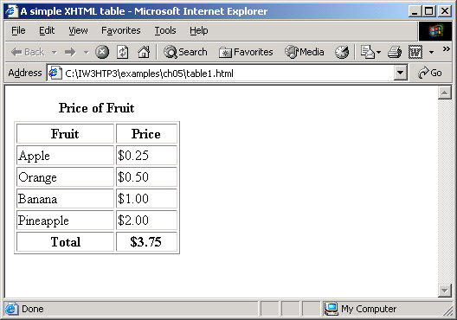

Slide 9
5.3 Intermediate XHTML Tables and Formatting
Element colgroup
  Groups and formats columns
Element col
  Attribute align
    Determines the alignment of text in the column
  Attribute span
    Determines how many columns the col element formats
    rowspan and colspan
      Specify the number of rows or columns occupied by a cell
  valign
    Aligns data vertically
    One of the four values: “top”, “middle”, “bottom”, “baseline”

Slide 10
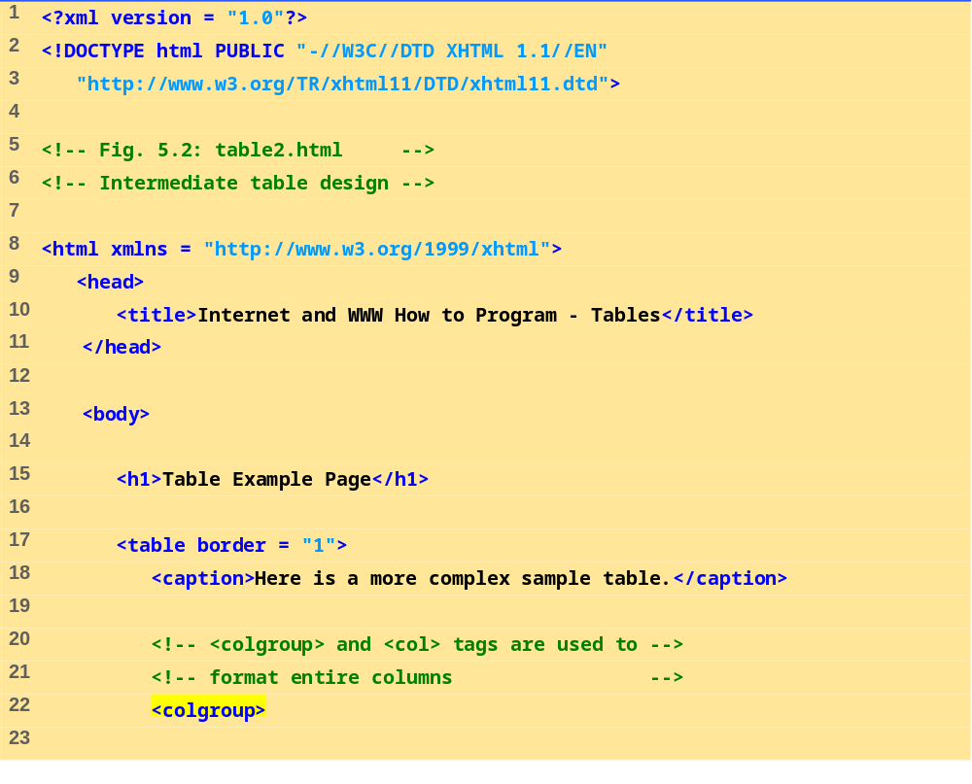
table2.html
(1 of 4)

Slide 11
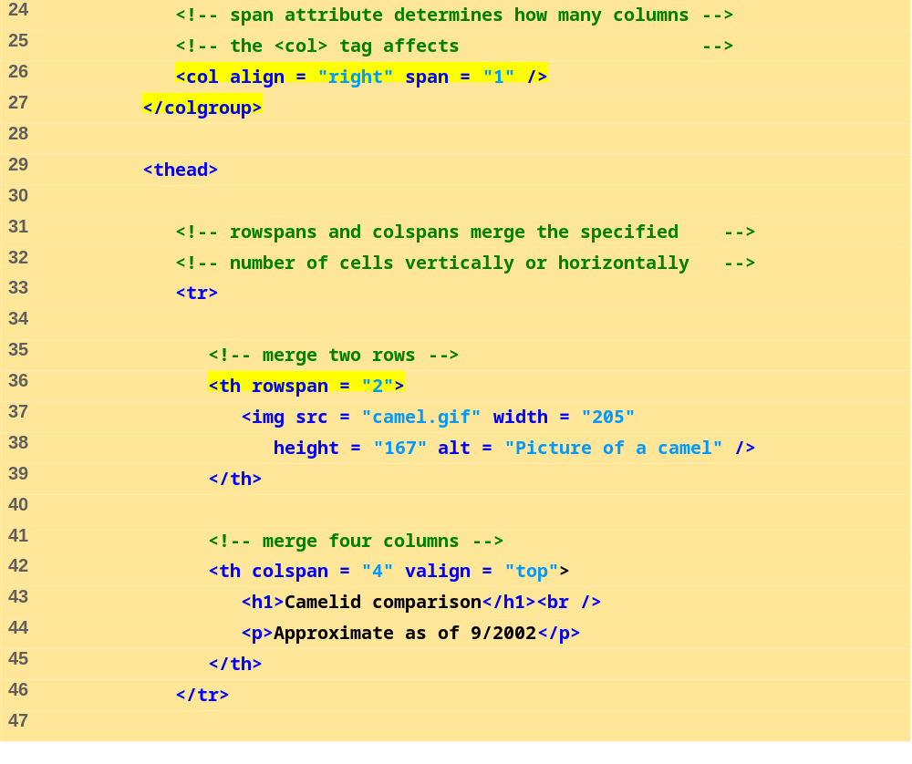
table2.html
(2 of 4)

Slide 12
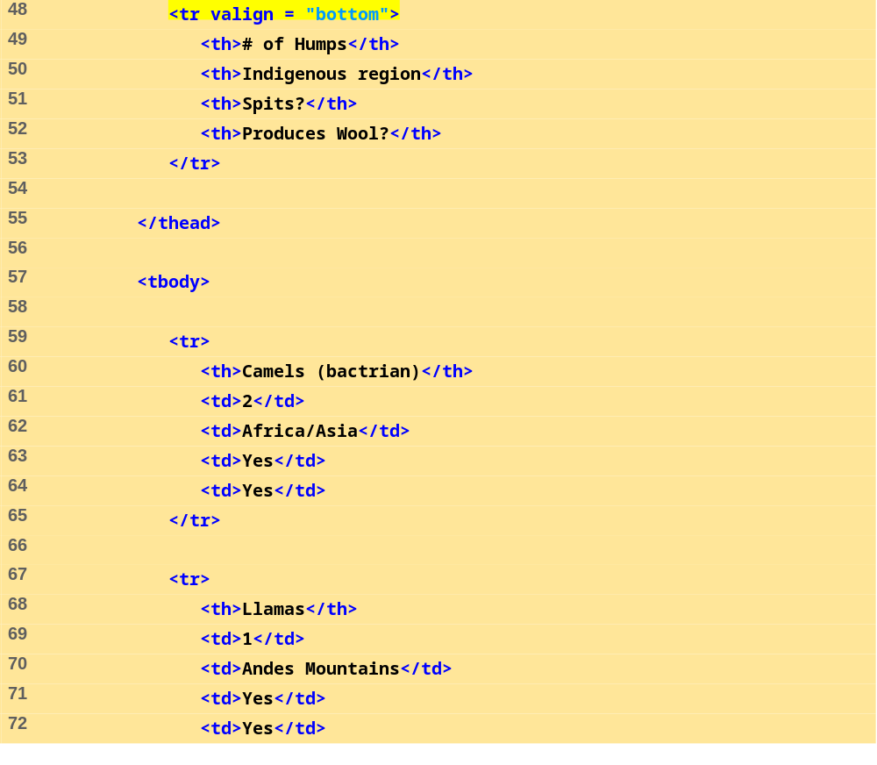
table2.html
(3 of 4)

Slide 13
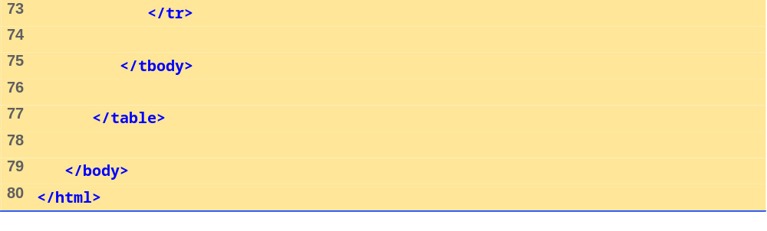
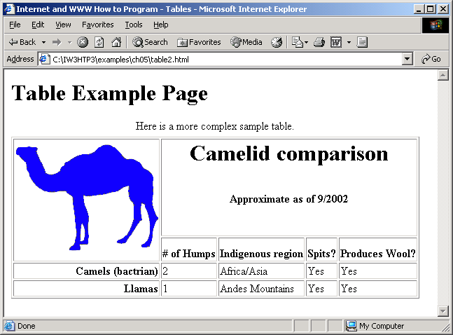
table2.html
4 of 4

Slide 14
5.4 Basic XHTML Forms
Element form
  Attribute method
    Specifies how the form’s data is sent to Web server
    method = “post”
      Appends form data to the browser request
    method = “get”
      Appends form data directly to the end of the URL
  Attribute action
    Specifies the URL of a script on the Web server
  input
    Specifies data to provide to the script that processes the form

Slide 15
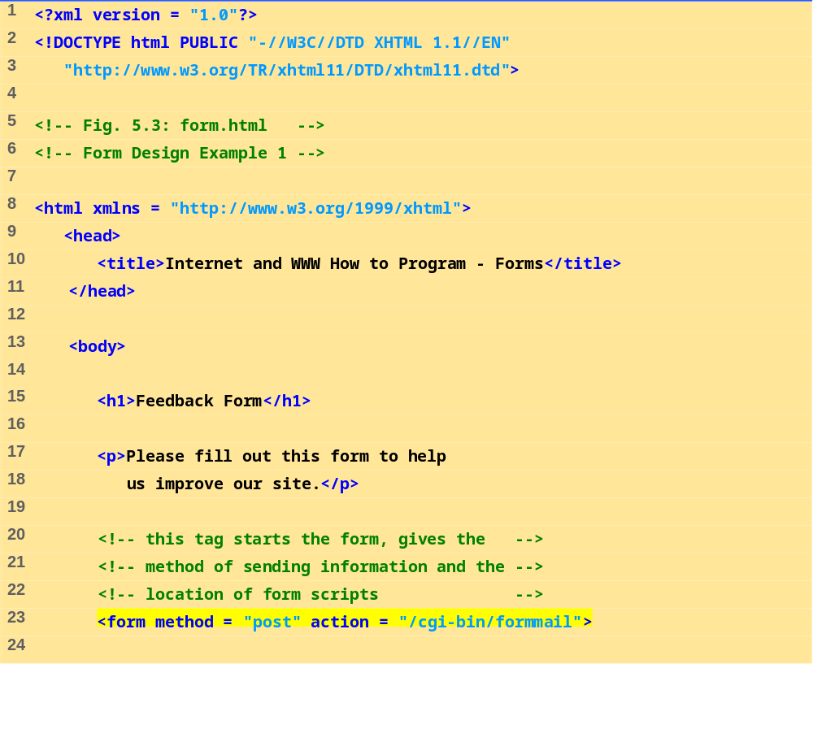
form.html
(1 of 3)

Slide 16
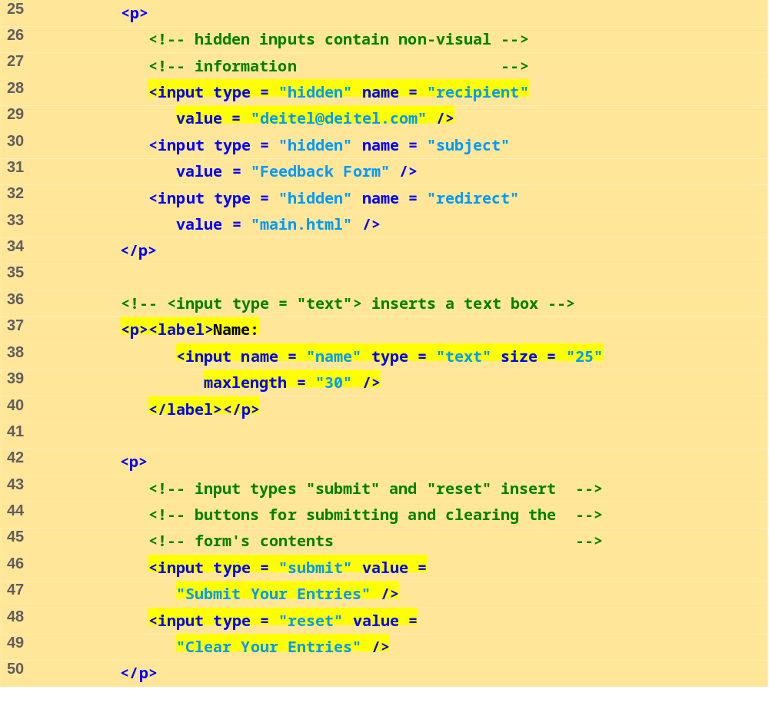
form.html
(2 of 3)

Slide 17
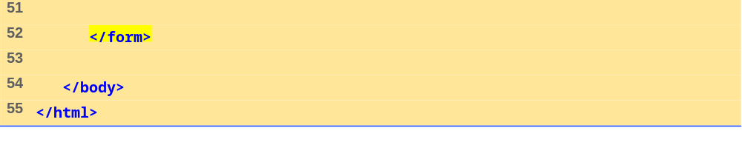
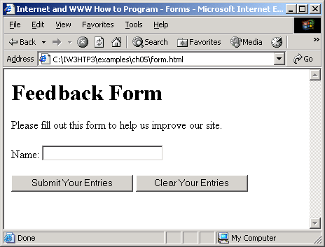
form.html
(3 of 3)

Slide 18
5.5 More Complex XHTML Forms
Element textarea
  Inserts a multiline text box (text area)
  Attribute rows
    Specifies the number of rows
  Attribute cols
    Specifies the number columns
  Input “password”
    Inserts a password box with the specified size
Element checkbox
  Enable users to select from a set of options
Element select
  Provides a drop-down list of items
Element option
  Adds items to the drop-down list
  Attribute selected
    Specifies which item initially is displayed as the selected item

Slide 19
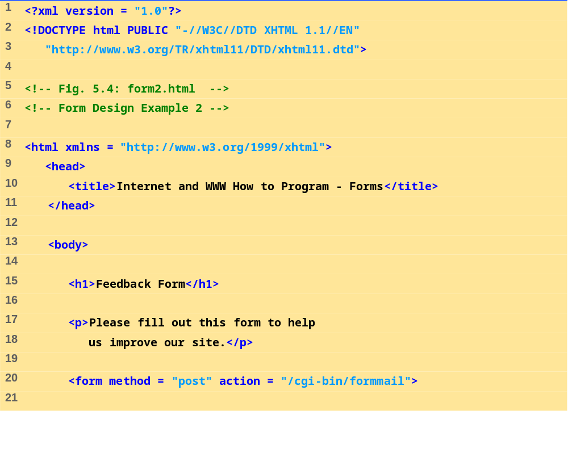
form2.html
(1 of 4)

Slide 20
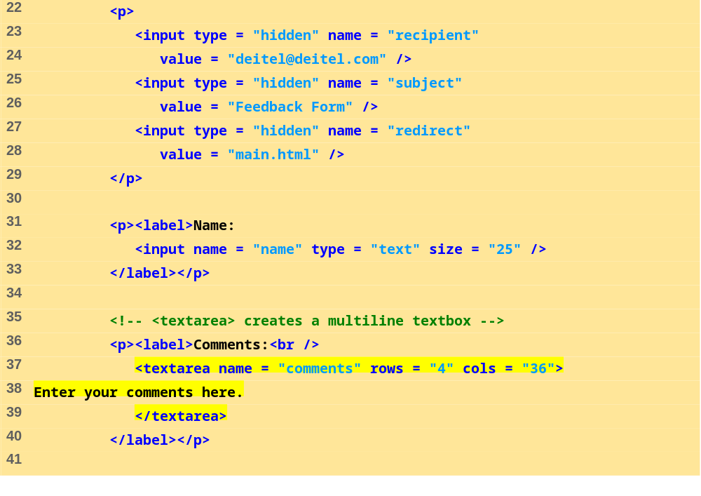
form2.html
(2 of 4)

Slide 21
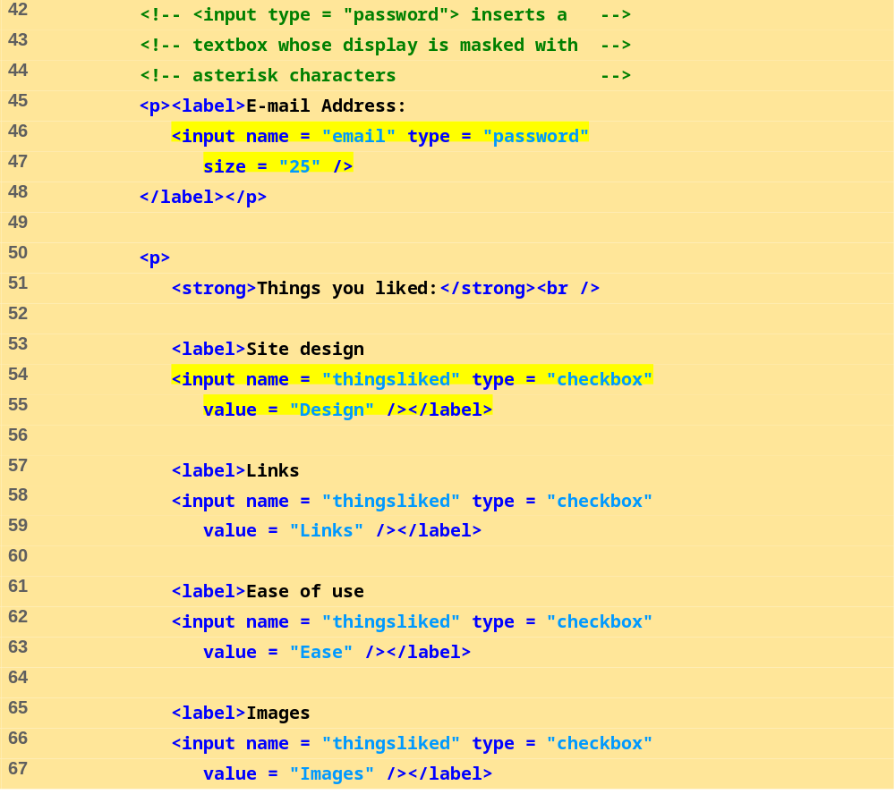
form2.html
(3 of 4)

Slide 22
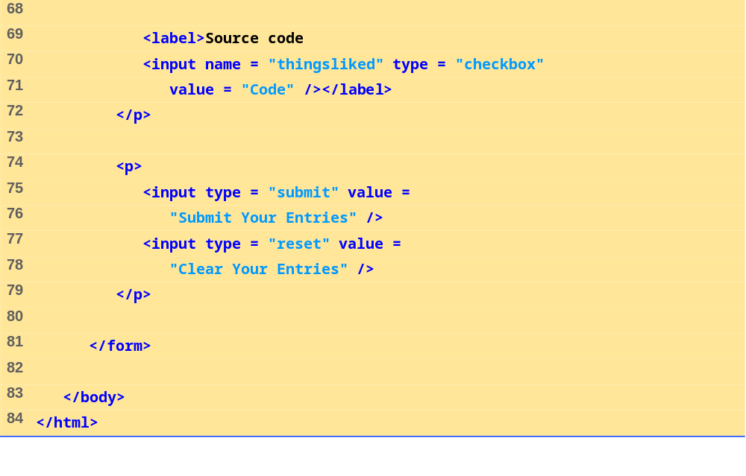
form2.html
(4 of 4)

Slide 23
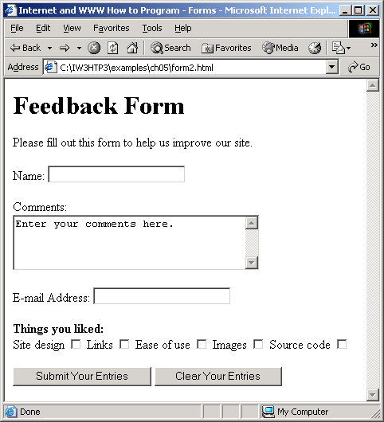
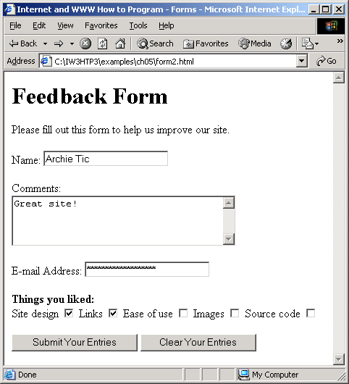

Slide 24
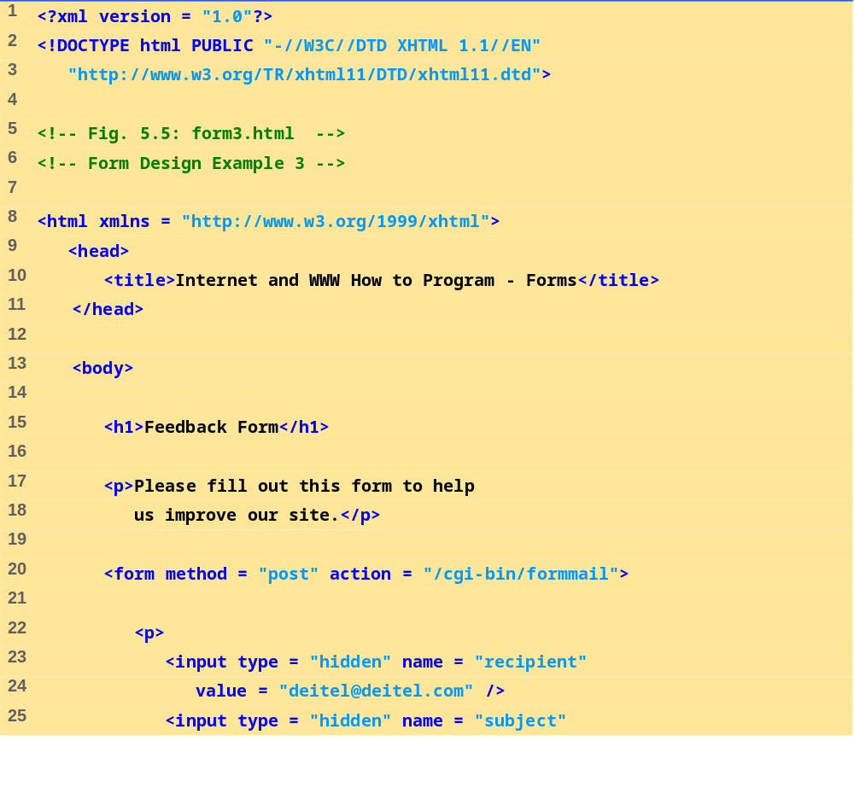
form3.html
(1 of 6)

Slide 25
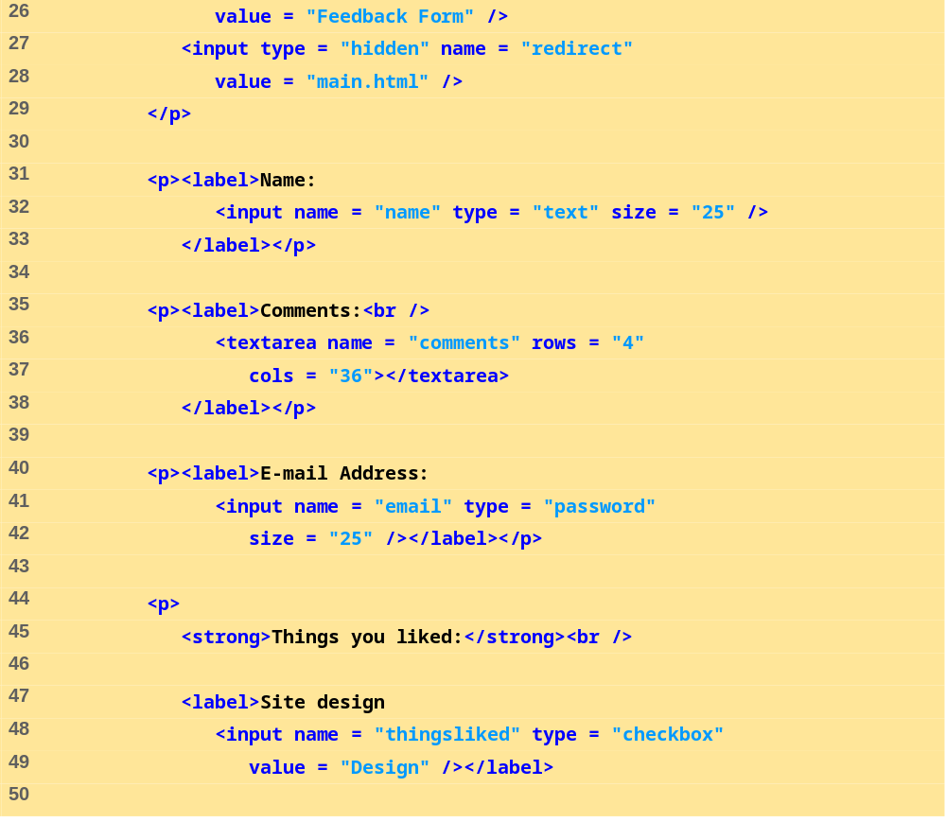
form3.html
(2 of 6)

Slide 26
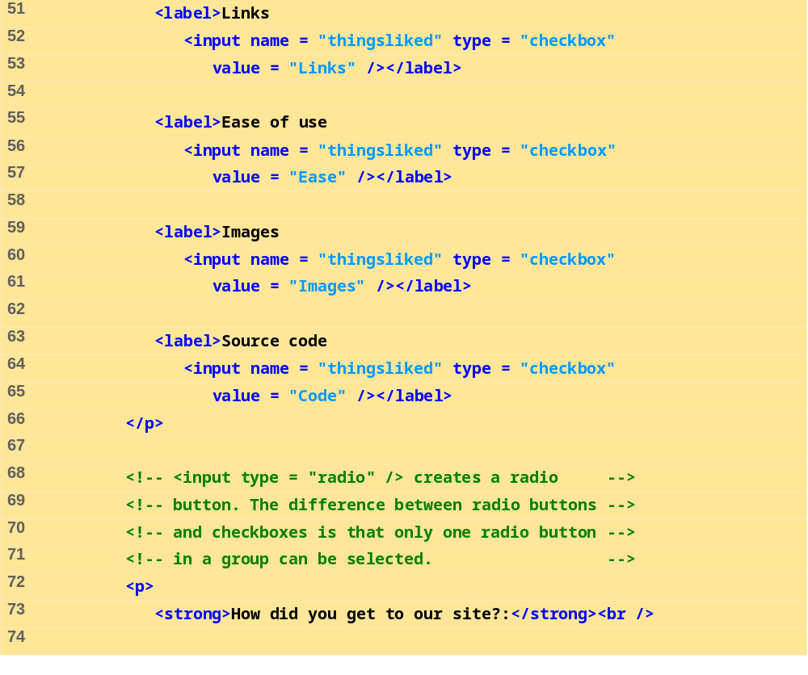
form3.html
(3 of 6)

Slide 27
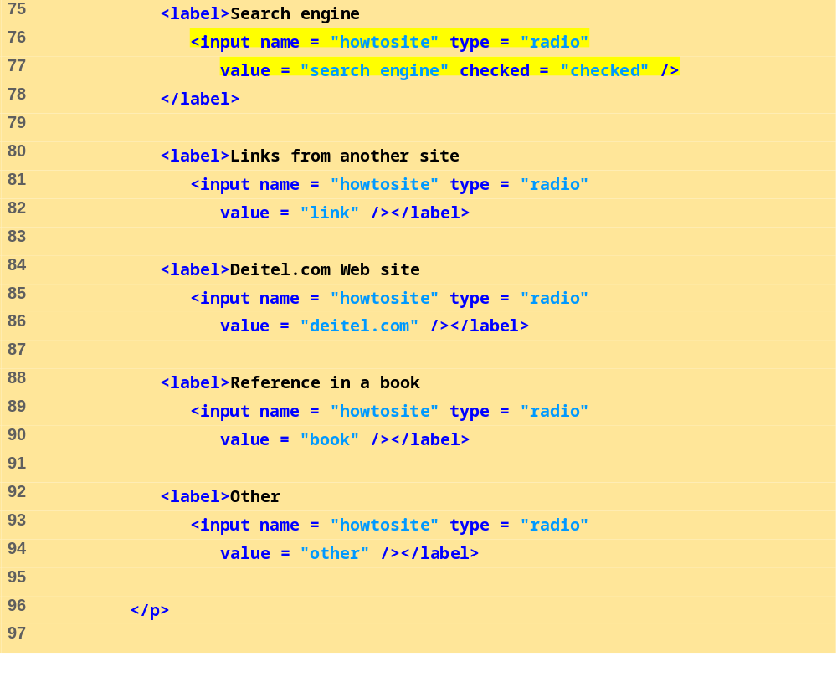
form3.html
(4 of 6)

Slide 28
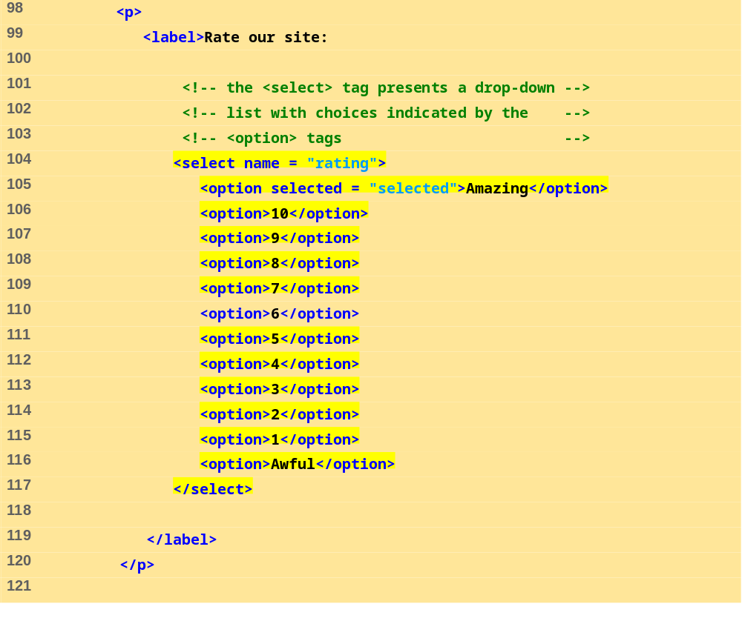
form3.html
(5 of 6)

Slide 29
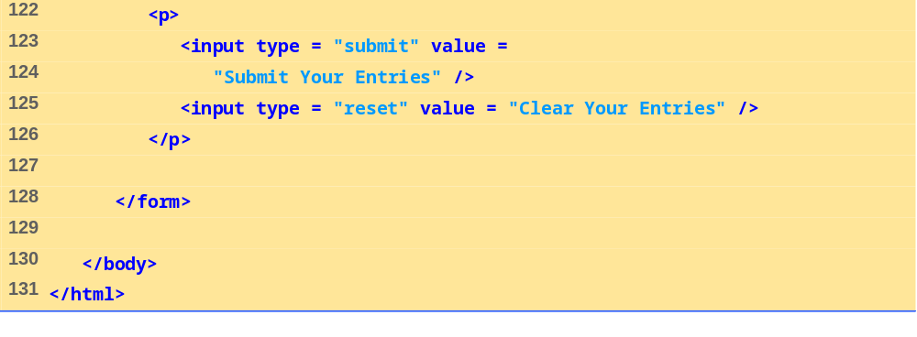
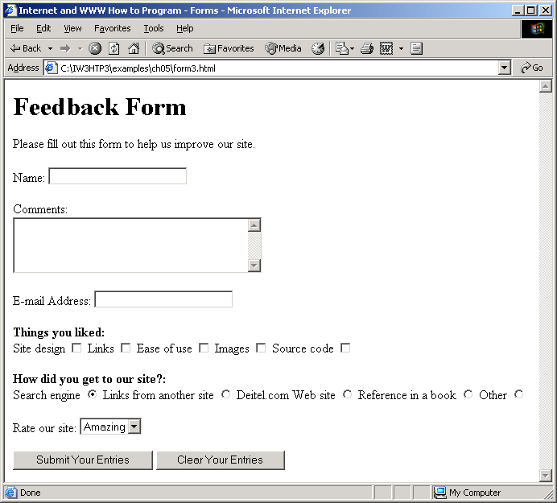
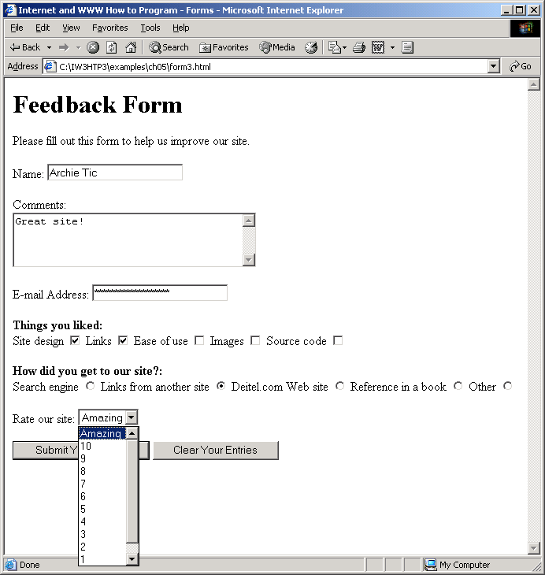
form3.html
(6 of 6)

Slide 30
5.6 Internal Linking
Enables the user to jump between locations in the same document

Slide 31
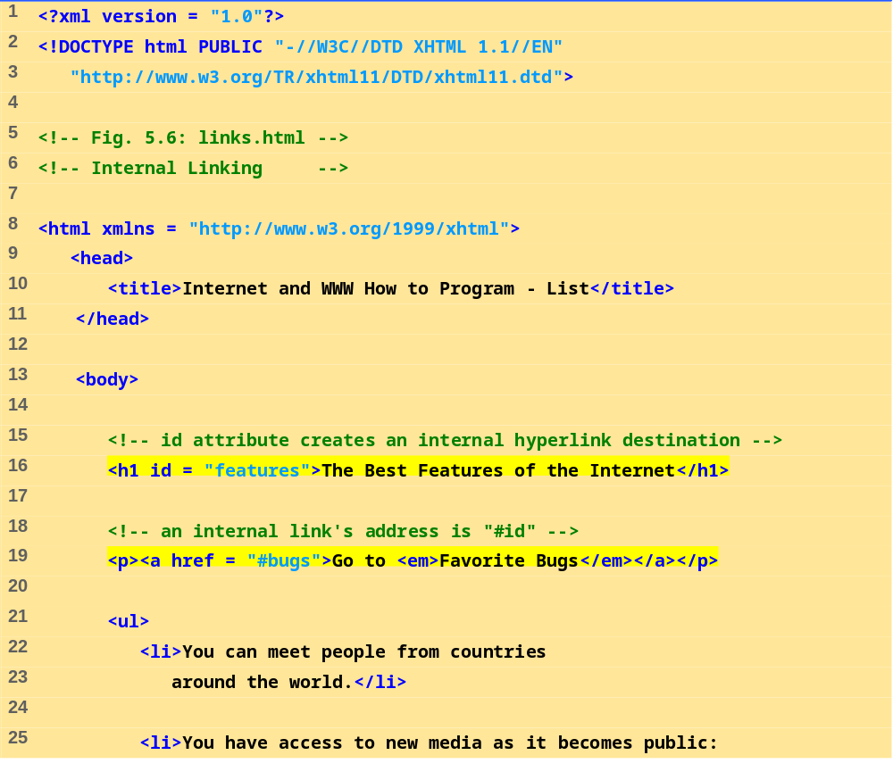
links.html
(1 of 3)

Slide 32
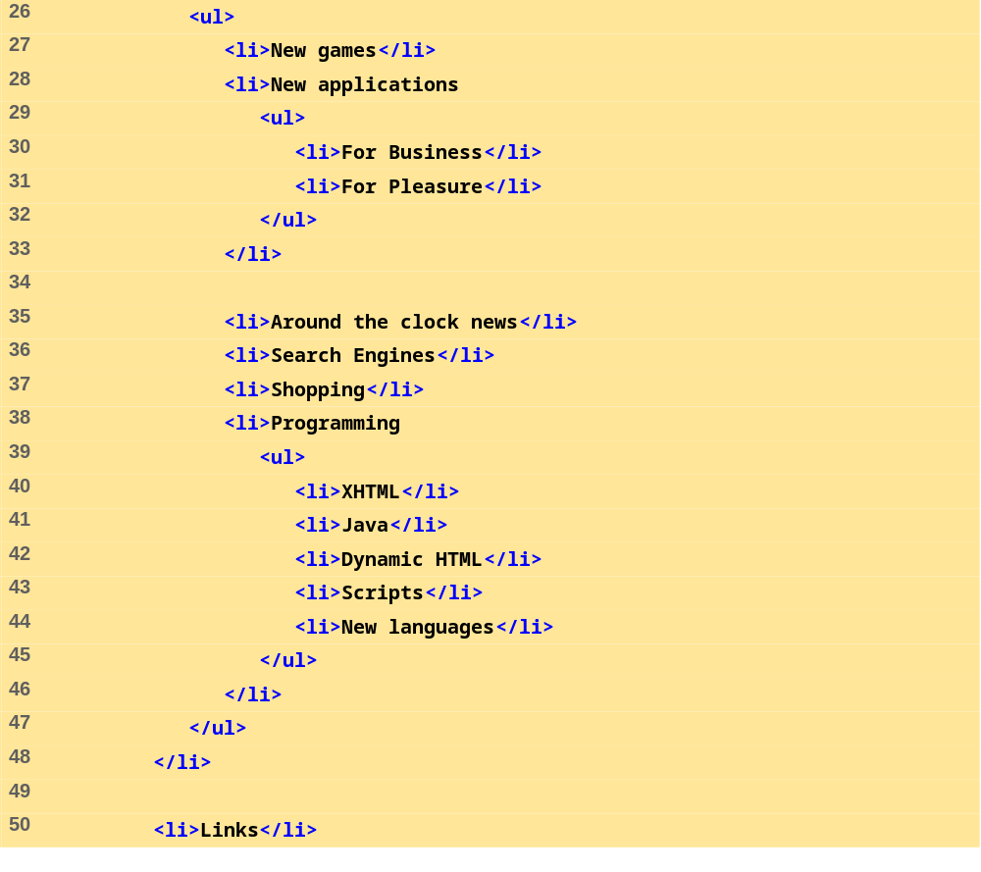
links.html
(2 of 3)

Slide 33
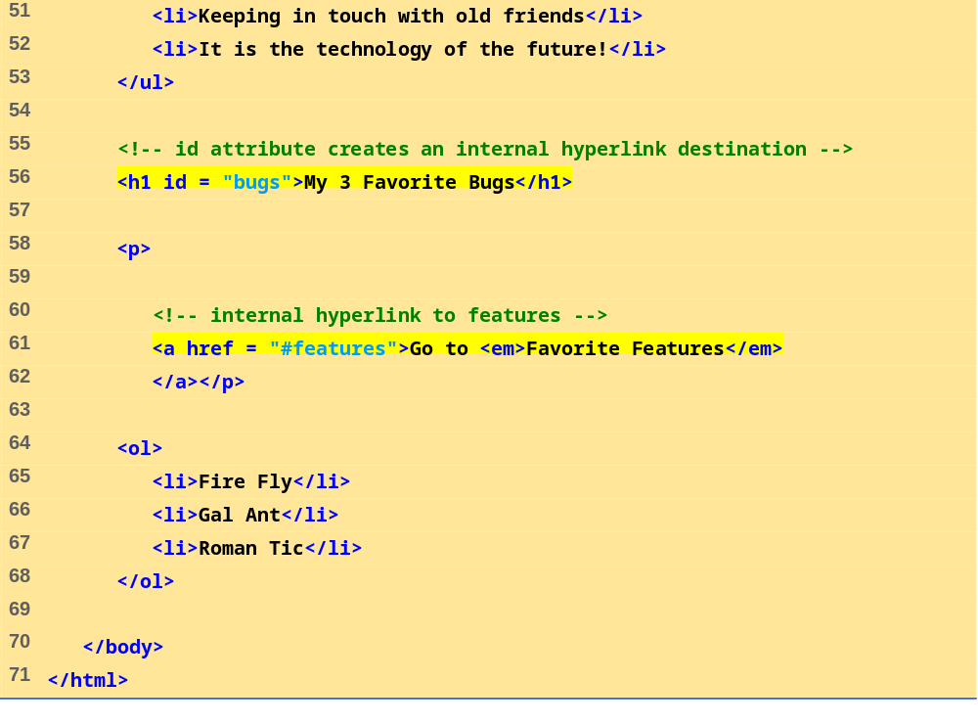
links.html
(3 of 3)

Slide 34
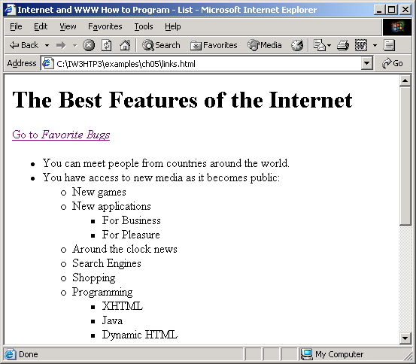
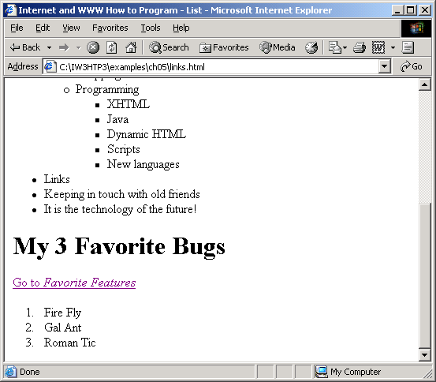

Slide 35
5.7 Creating and Using Image Maps
Designate certain areas of an image (called hotspots) as links
  Element map
    Attribute id
      Identifies the image map
    Element area
      Defines hotspot
      Attribute shape and coords
        Specify the hotspot’s shape and coordinates
      Rectangular ( shape = “rect” )
      Polygon ( shape = “poly” )
      Circle ( shape = “circle” )

Slide 36
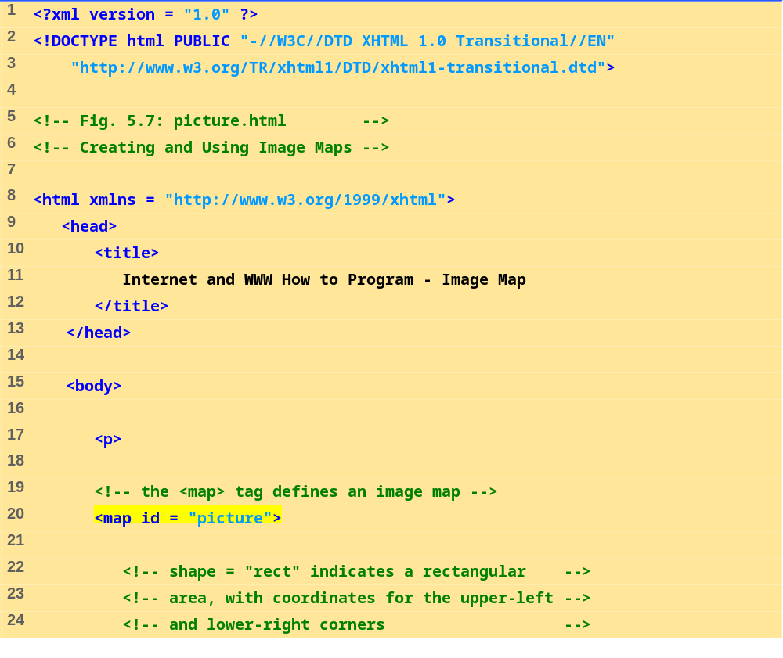
picture.html
(1 of 3)

Slide 37
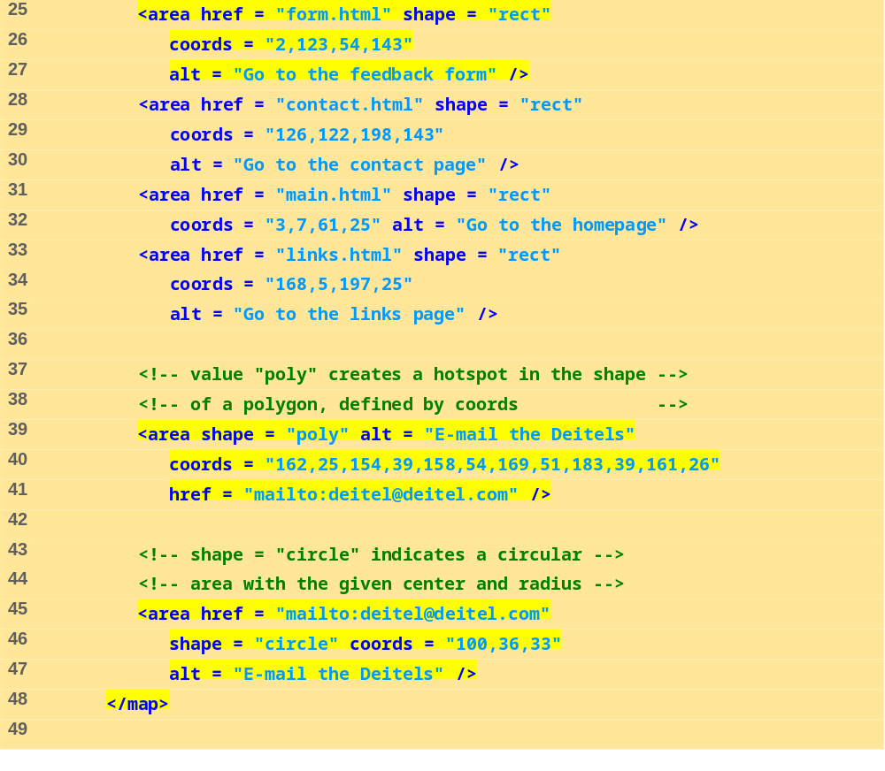
picture.html
(2 of 3)

Slide 38
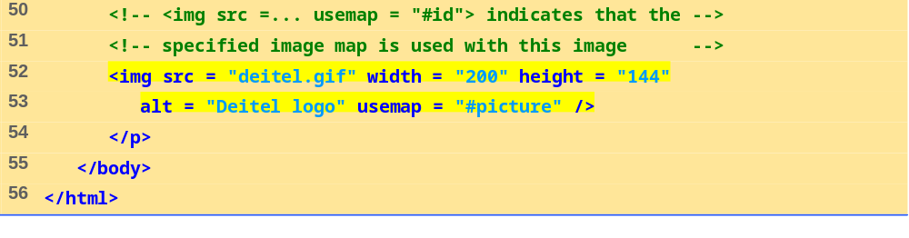
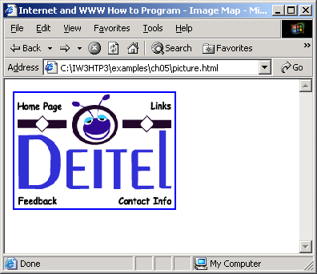
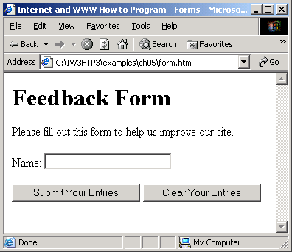
picture.html
(3 of 3)

Slide 39
5.8 meta Elements
Specify information about a document
  Attribute name
    Identifies the type of meta element
    “keywords” ( name = “keywords” )
      Provides search engines with a list of words that describe a page
    “description” ( name = “description” )
      Provides a description of a site
  Attribute content
    Provides the information search engine use to catalog pages

Slide 40
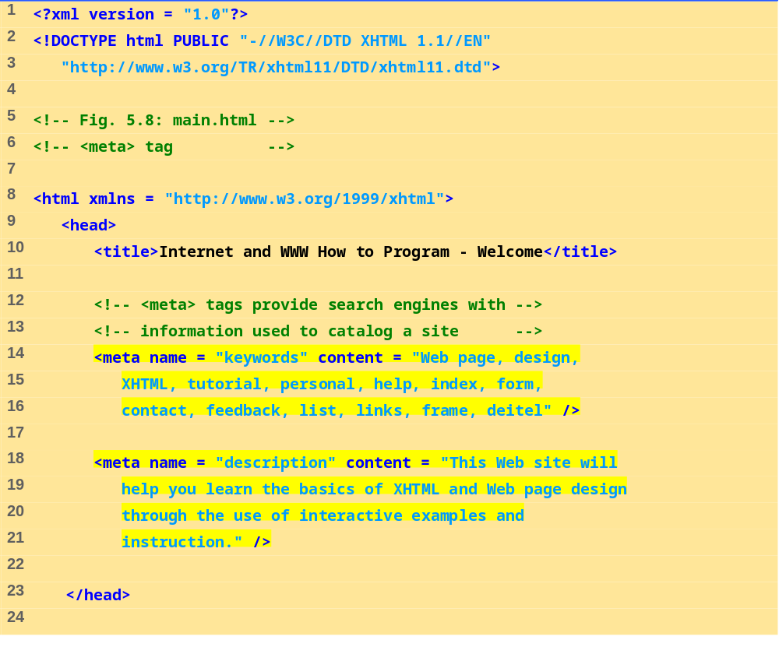
main.html
(1 of 2)

Slide 41
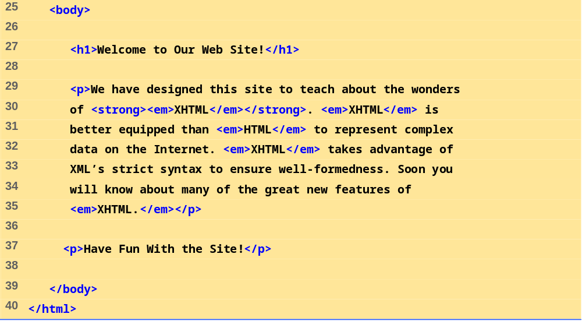
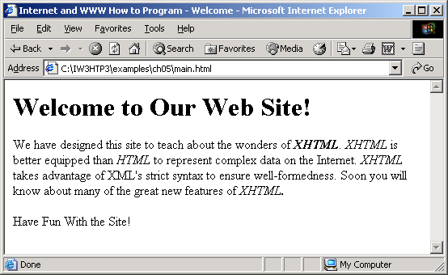
main.html
(2 of 2)

Slide 42
5.9 frameset Element
Allow browser display more than one document simultaneously
  Element frameset
    Attribute cols
      Specifies the frameset’s column layout
    Attribute rows
      Specifies the number of rows and the size of each row
    Element frame
      Specifies the documents that will be loaded
      Attribute src
        Specifies URL of the page to display

Slide 43
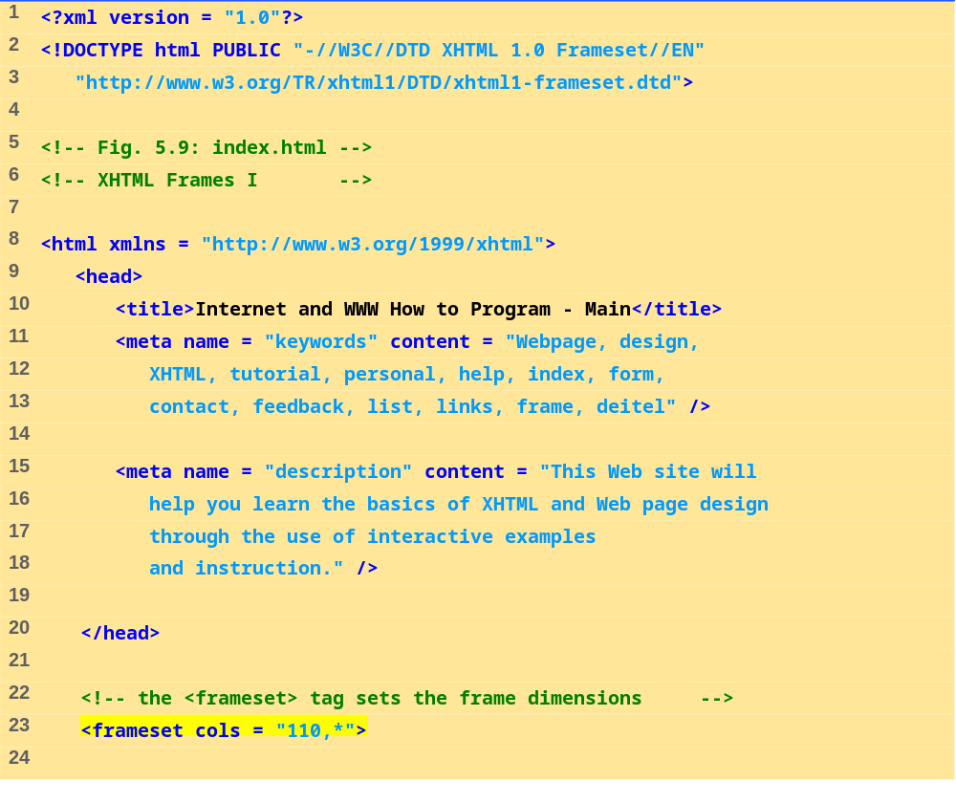
index.html
(1 of 2)

Slide 44
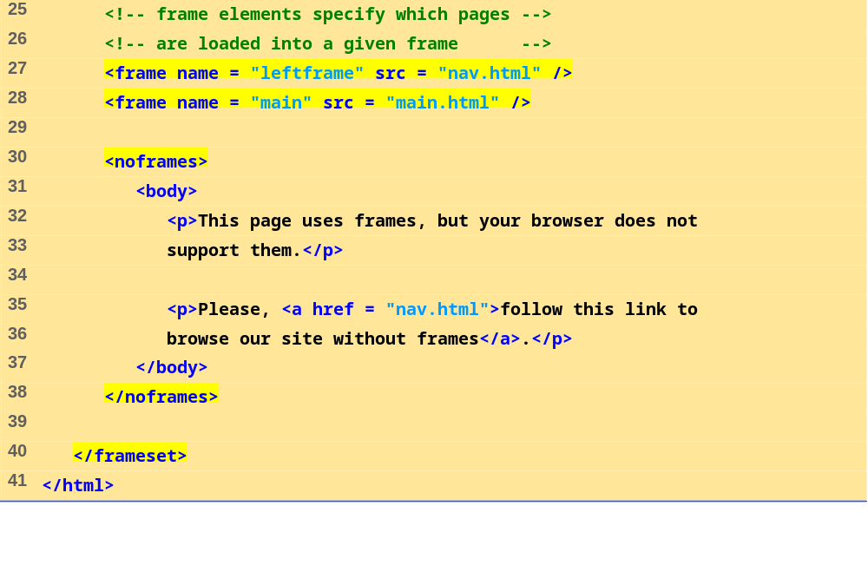
index.html
(2 of 2)

Slide 45
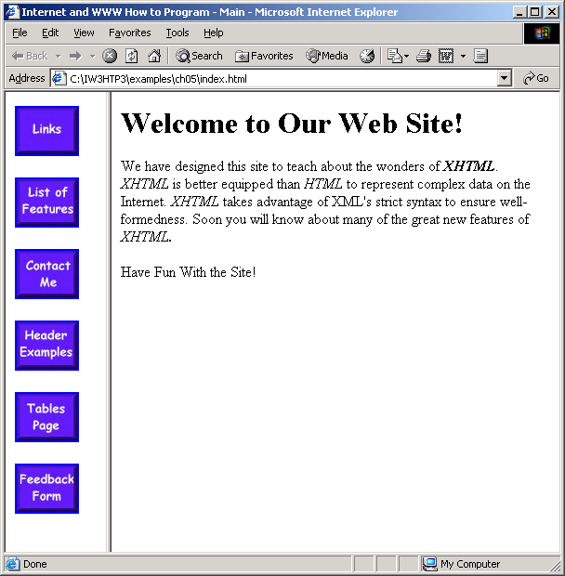
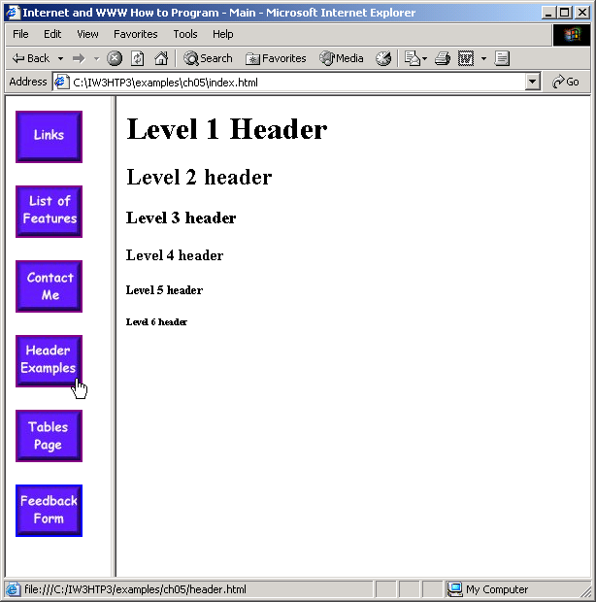

Slide 46
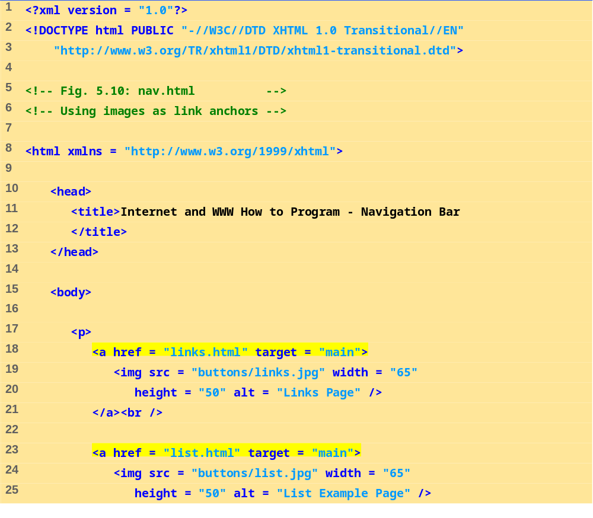
nav.html
(1 of 2)

Slide 47
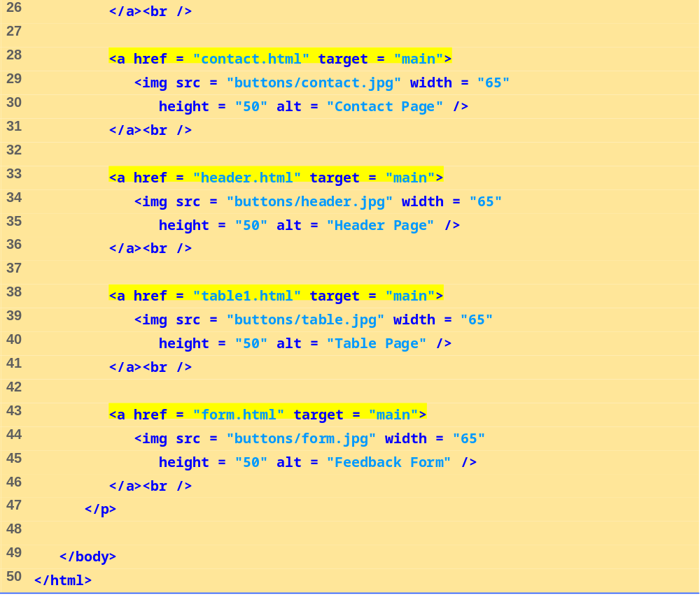
nav.html
(2 of 2)

Slide 48
5.10 Nested framesets
framesets within framesets

Slide 49
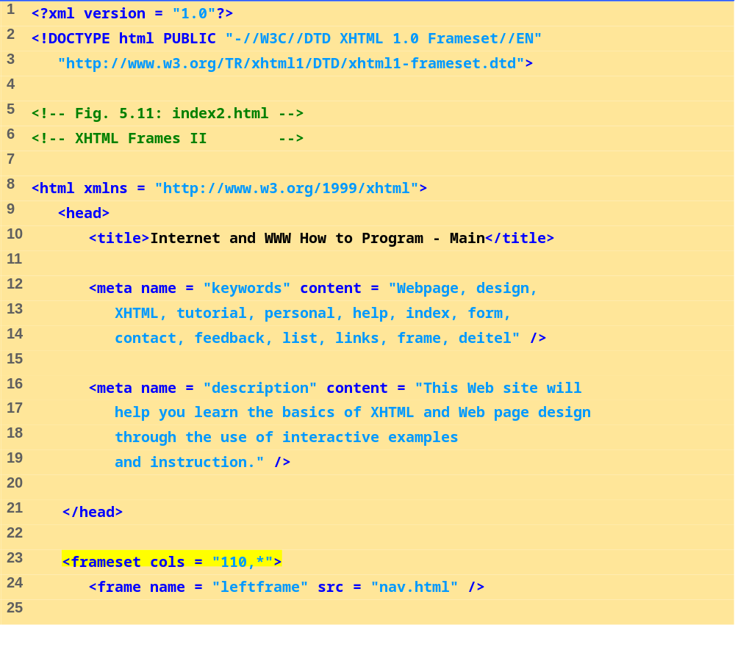
index2.html
(1 of 2)

Slide 50
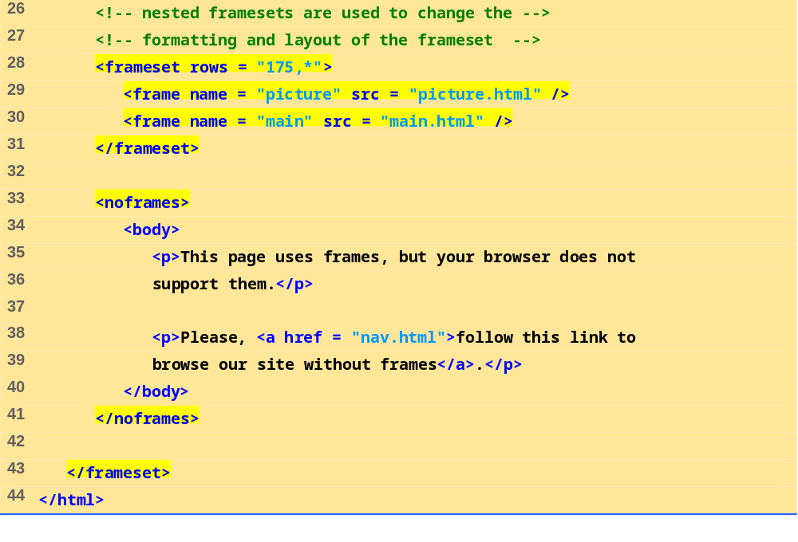
index2.html
(2 of 2)

Slide 51
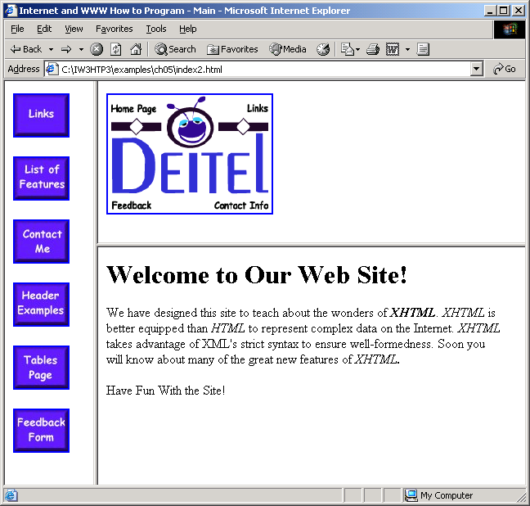

Slide 52
5.11 Web Resources
www.vbxml.com/xhtml/articles/xhtml_tables
www.webreference.com/xml/reference/xhtml.html

