Slide 1
Chapter 6 - Cascading Style Sheets™ (CSS)
Outline
6.1 Introduction
6.2 Inline Styles
6.3 Embedded Style Sheets
6.4 Conflicting Styles
6.5 Linking External Style Sheets
6.6 W3C CSS Validation Service
6.7 Positioning Elements
6.8 Backgrounds
6.9 Element Dimensions
6.10 Text Flow and the Box Model
6.11 User Style Sheets
6.12 Web Resources

Slide 2
Objectives
In this lesson, you will learn:
  To control the appearance of a Web site by creating style sheets.
  To use a style sheet to give all the pages of a Web site the same look and feel.
  To use the class attribute to apply styles.
  To specify the precise font, size, color and other properties of displayed text.
  To specify element backgrounds and colors.
  To understand the box model and how to control the margins, borders and padding.
  To use style sheets to separate presentation from content.

Slide 3
6.1 Introduction
Cascading Style Sheets (CSS)
  Separation of structure from presentation

Slide 4
6.2 Inline Styles
Declare an individual element’s format
  Attribute style
  CSS property
    Followed by a colon and a value

Slide 5
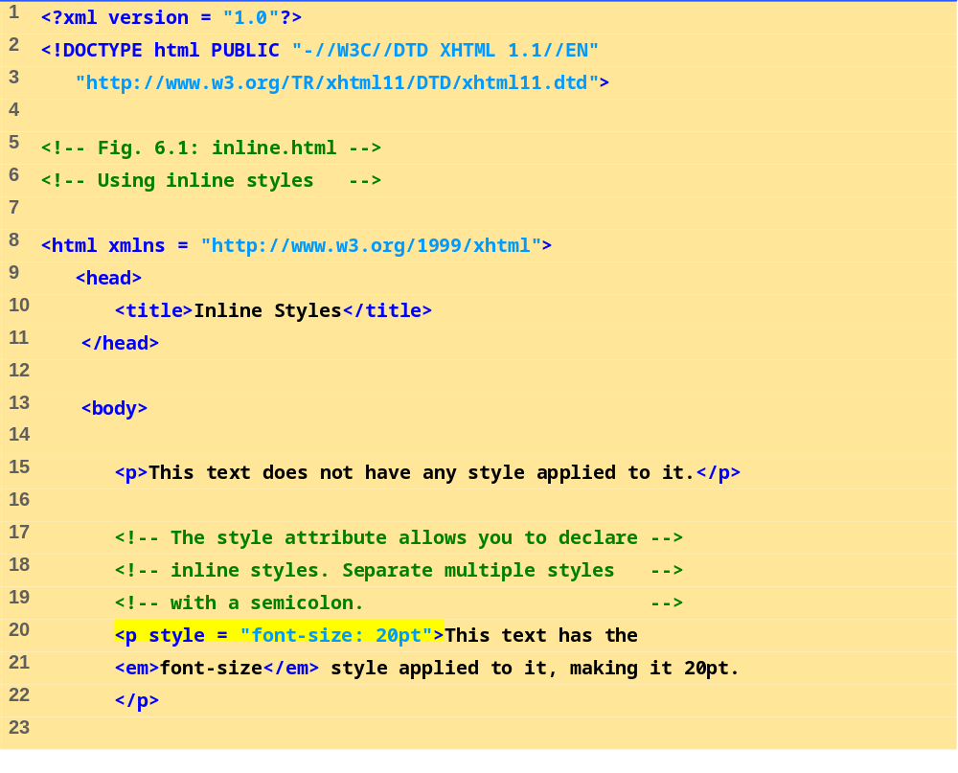
inline.html
(1 of 2)

Slide 6
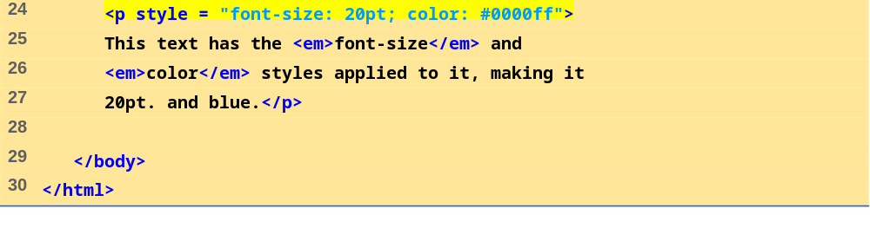
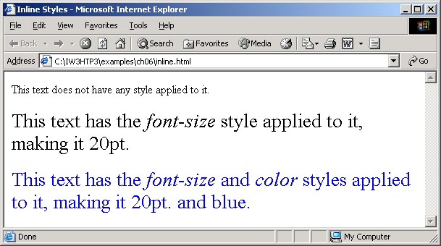
inline.html
(2 of 2)

Slide 7
6.3 Embedded Style Sheets
Embed an entire CSS document in an XHTML document’s head section
  Multipurpose Internet Mail Extensions (MIME) type
    Describes a file’s content
  Property background-color
    Specifies the background color
  Property font-family
    Specifies the name of the font to use
  Property font-size
    Specifies a 14-point font

Slide 8
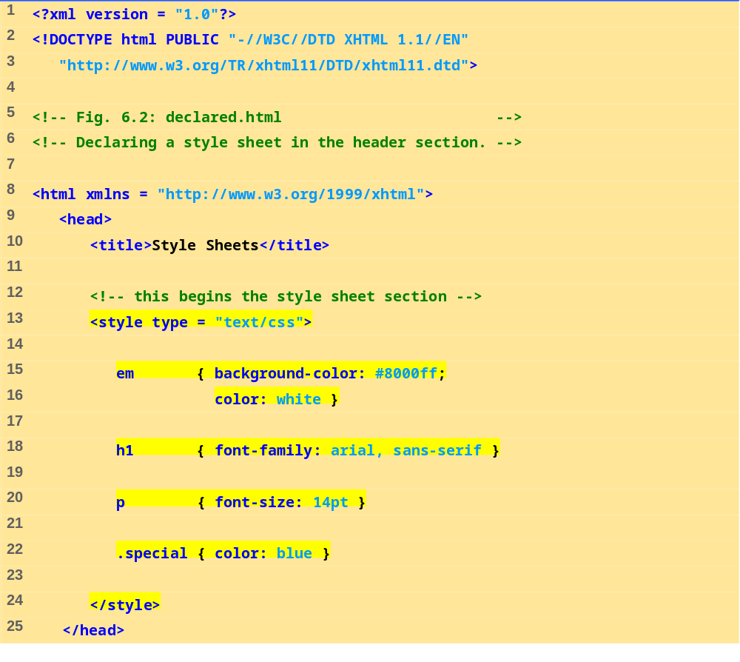
declared.html
(1 of 3)

Slide 9
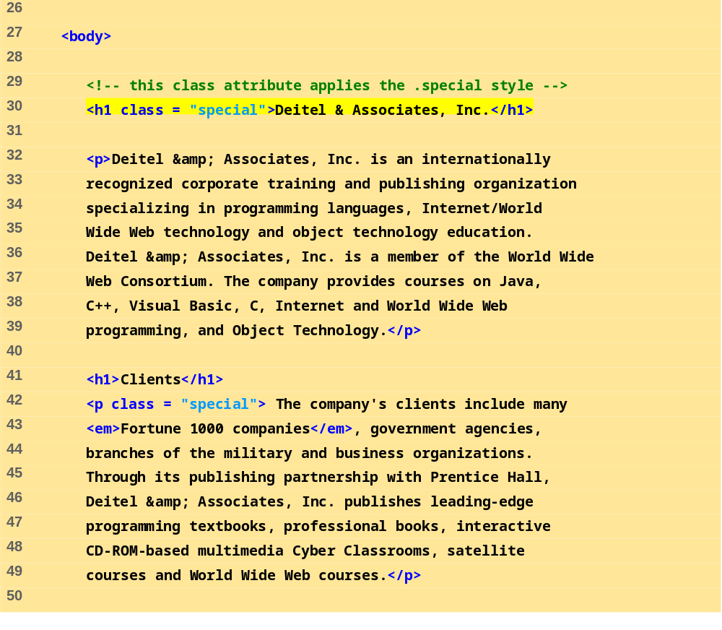
declared.html
(2 of 3)

Slide 10
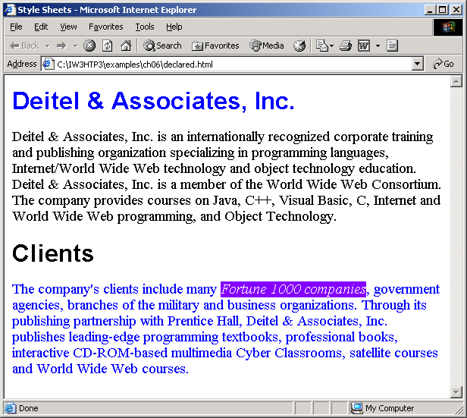
declared.html
(3 of 3)

Slide 11
6.4 Conflicting Styles
Inheritance
  Descendant’s properties have greater specificity than ancestor’s properties

Slide 12
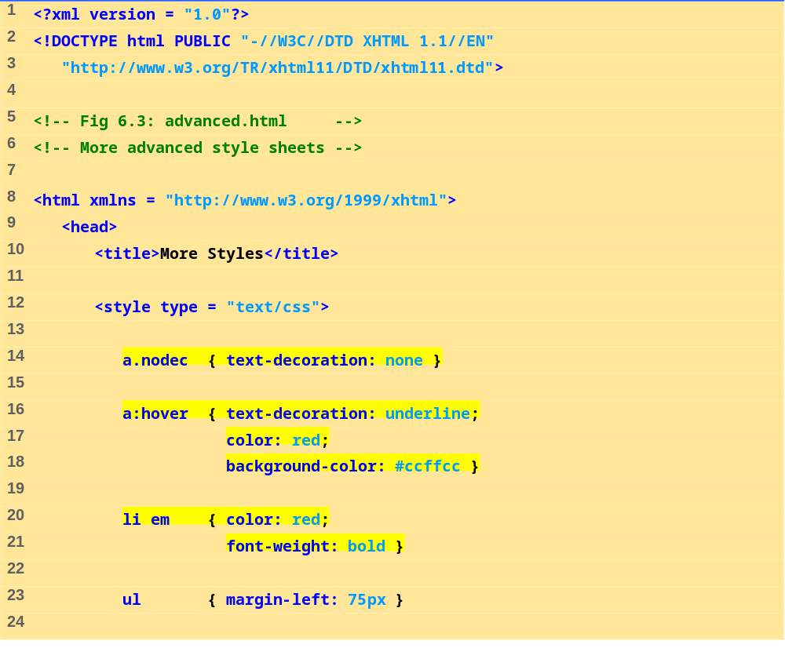
advance.html
(1 of 3)

Slide 13
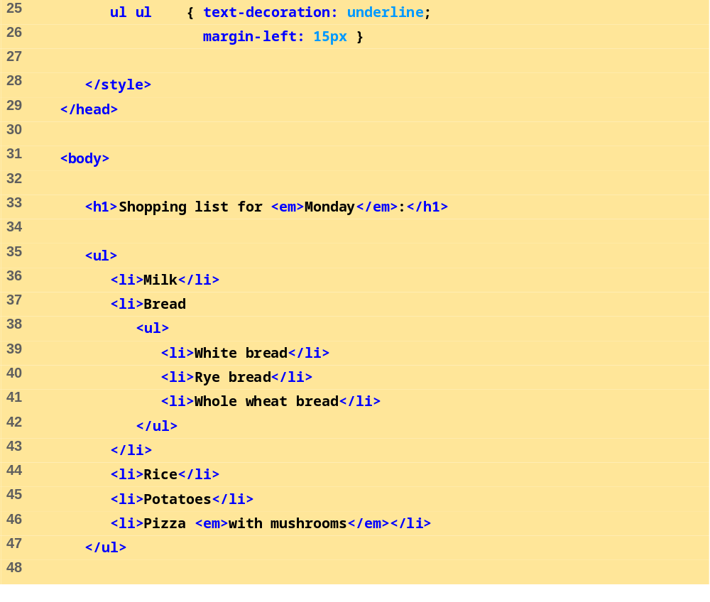
advance.html
(2 of 3)

Slide 14
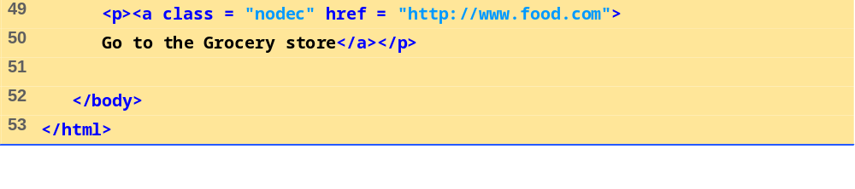
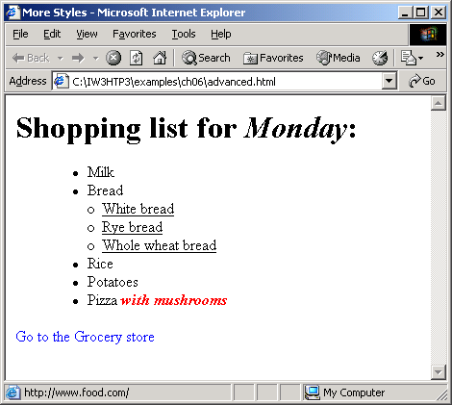
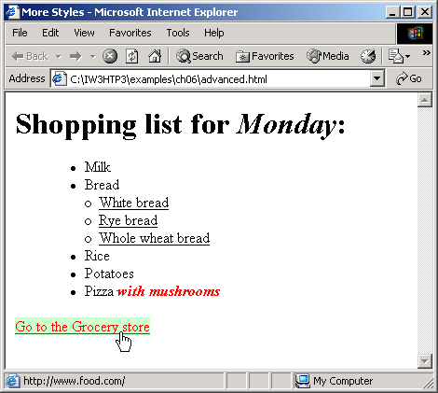
advance.html
(3 of 3)

Slide 15
6.5 Linking External Style Sheets
External style sheets
  Can provide uniform look and feel to entire site

Slide 16
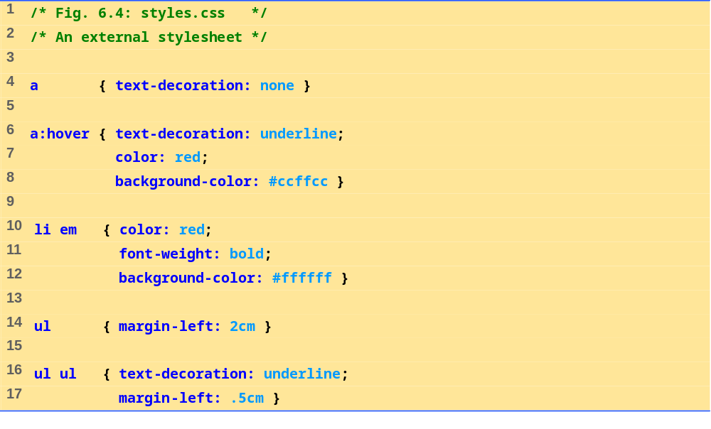
styles.css
(1 of 1)

Slide 17
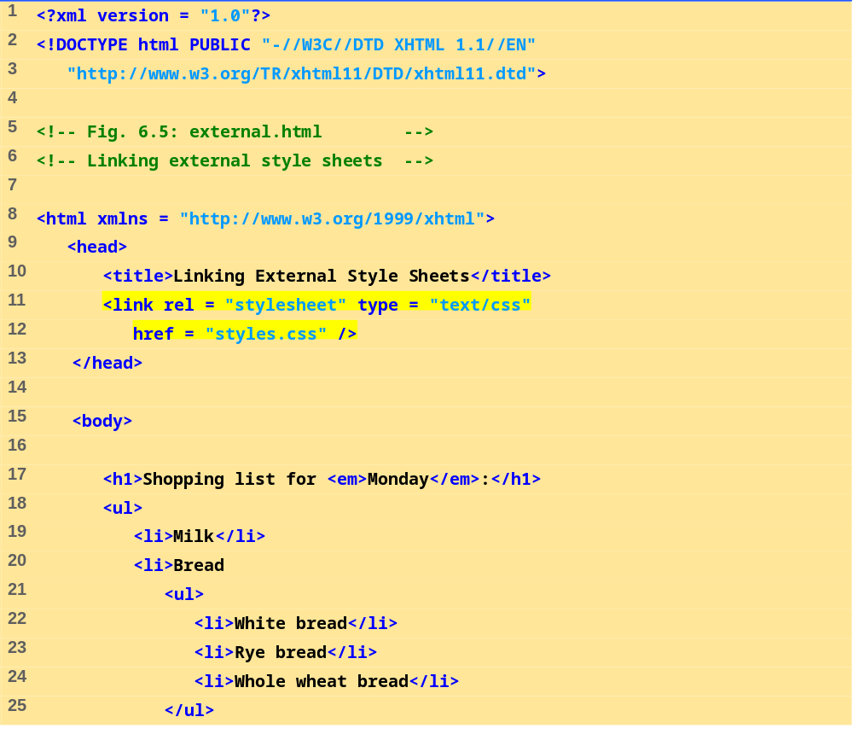
external.html
(1 of 2)

Slide 18
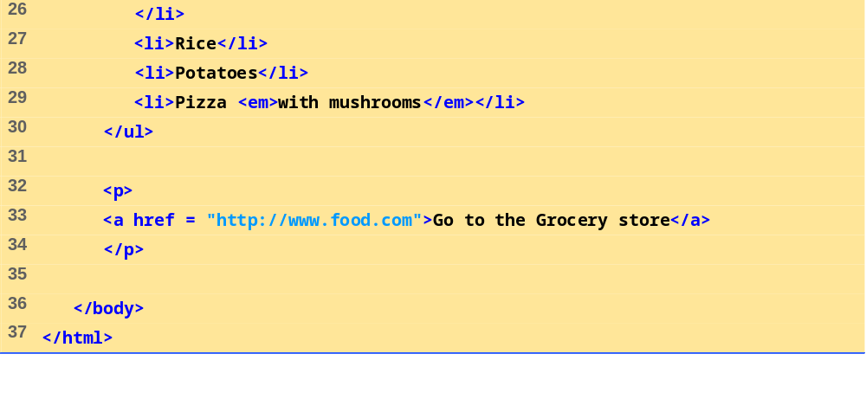
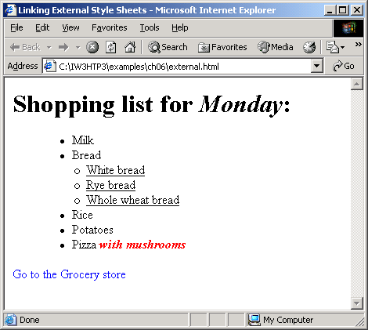
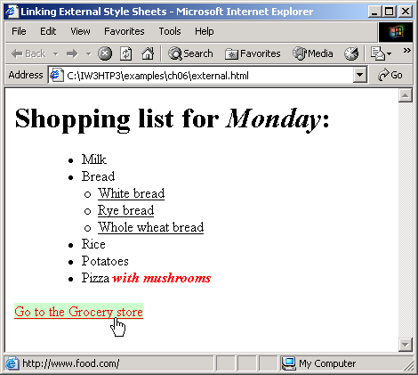
external.html
(2 of 2)

Slide 19
6.6 W3C CSS Validation Service
Validates external CSS documents
Ensures that style sheets are syntactically correct

Slide 20
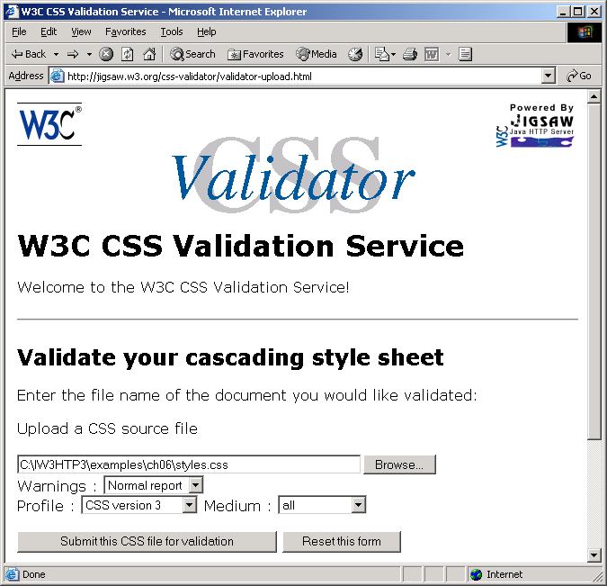
6.6 W3C CSS Validation Service
Fig. 6.6 Validating a CSS document. (Courtesy of World Wide Web Consortium (W3C).)

Slide 21
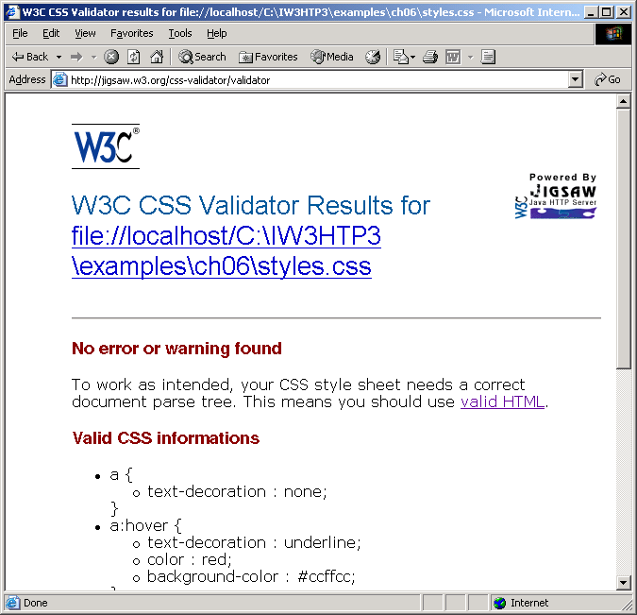
6.6 W3C CSS Validation Service
Fig. 6.7 CSS validation results. (Courtesy of World Wide Web Consortium (W3C).)

Slide 22
6.7 Positioning Elements
Absolute positioning
  z-index attribute
    Layer overlapping elements properly
Relative positioning
  Elements are positioned relative to other elements

Slide 23
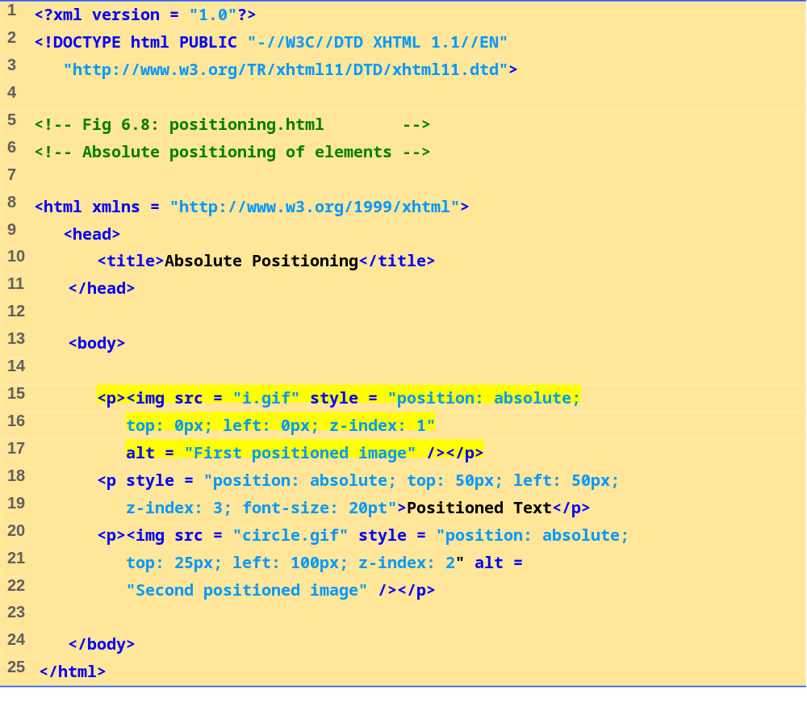
positioning.html
(1 of 1)

Slide 24
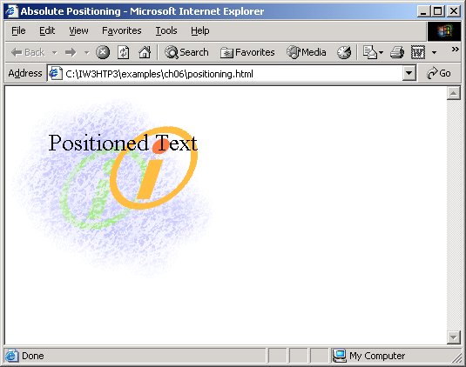

Slide 25
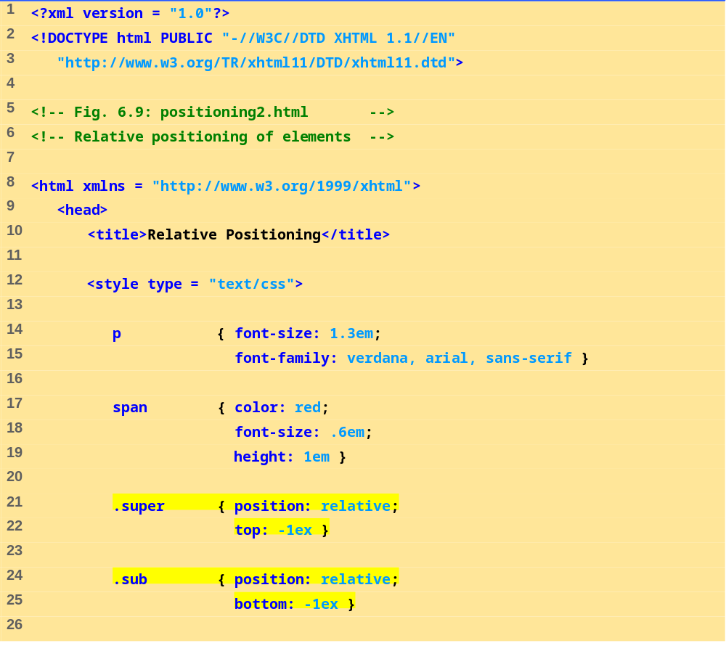
positioning2.html
(1 of 2)

Slide 26
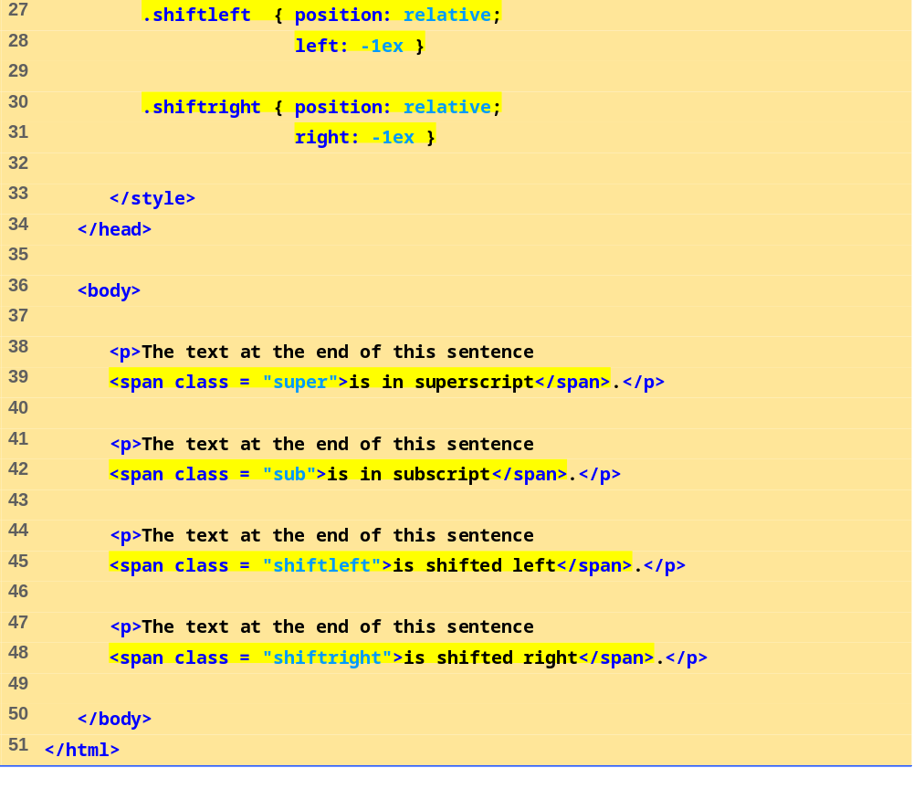
positioning2.html
2 of 2

Slide 27
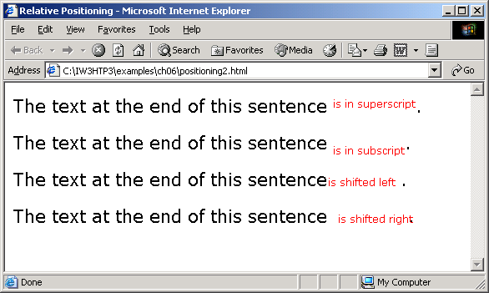

Slide 28
6.8 Backgrounds
background-image
  Specifies the image URL
background-position
  Places the image on the page
background-repeat
  Controls the tiling of the background image
background-attachment
  fixed
  scroll
font-weight
  Specify the “boldness” of text

Slide 29
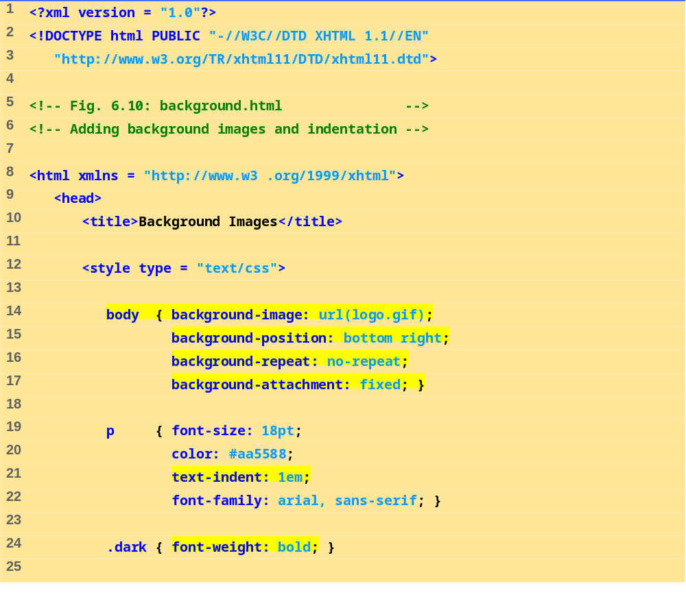
background.html
(1 of 2)

Slide 30
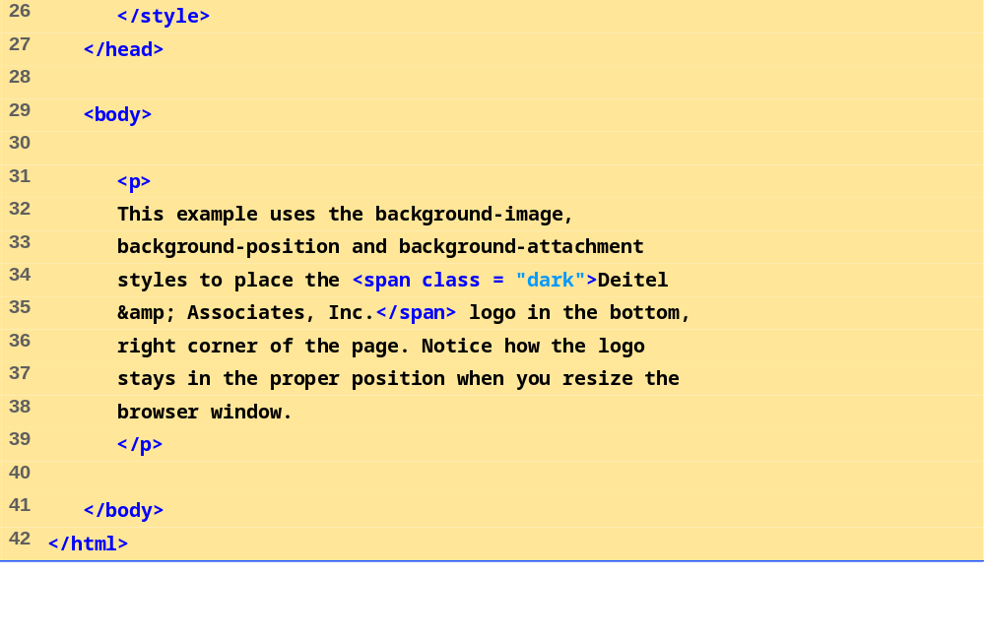
background.html
(2 of 2)

Slide 31
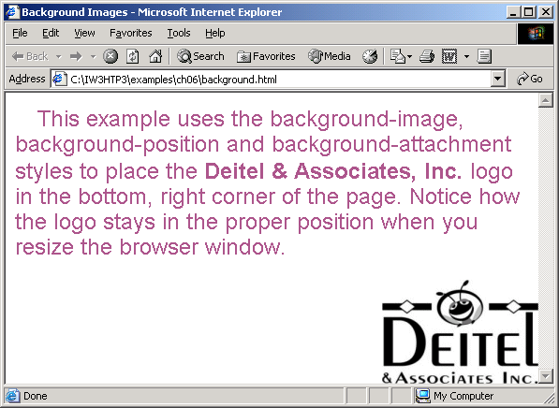

Slide 32
6.9 Element Dimensions
CSS rules can specify the actual dimensions of each page element

Slide 33
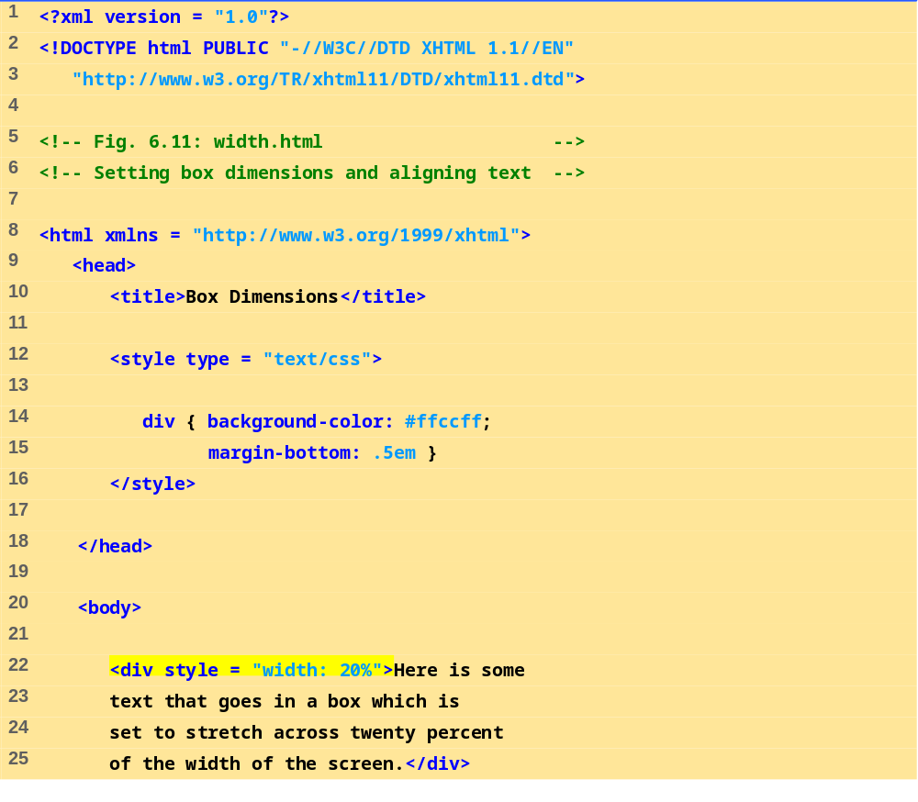
width.html
(1 of 2)

Slide 34
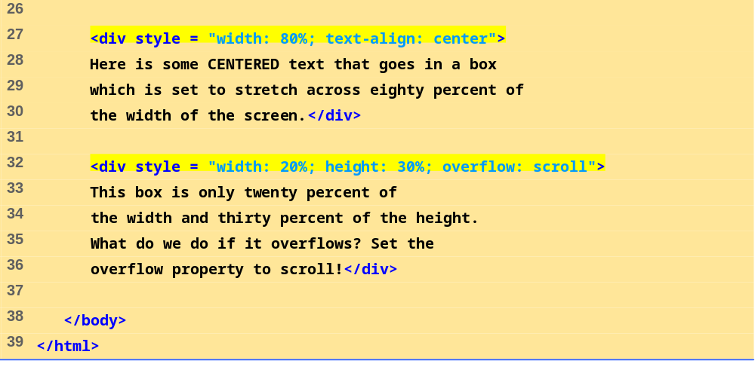
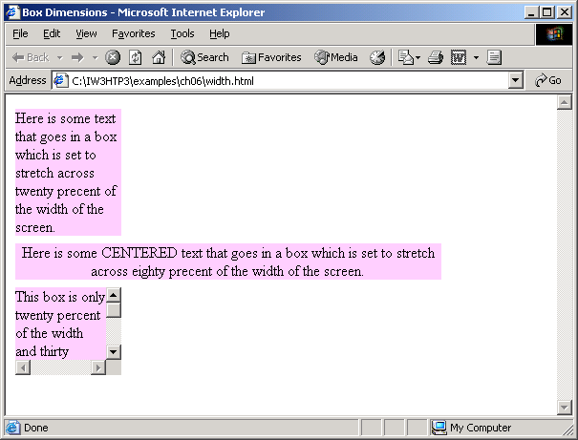
width.html
(2 of 2)

Slide 35
6.10 Text Flow and the Box Model
Floating
  Move an element to one side of the screen
Box model
  Margins
    margin-top, margin-right, margin-left, margin-bottom
  Padding
    padding-top, padding-right, padding-left, and padding-bottom
  Border
    border-width
      thin, medium, thick
    border-color
      Sets the color
    border-style
      none, hidden, dotted, dashed, solid, double, groove, ridge, inset and outset

Slide 36
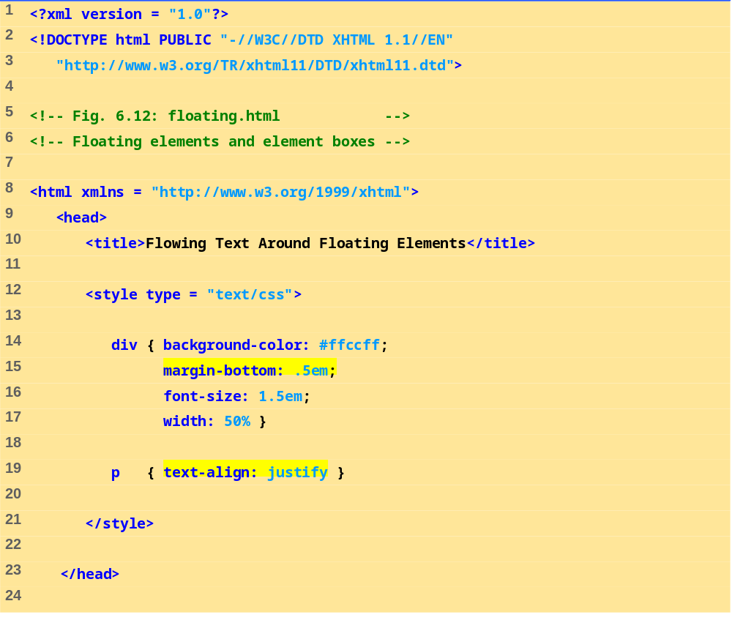
floating.html
(1 of 3)

Slide 37
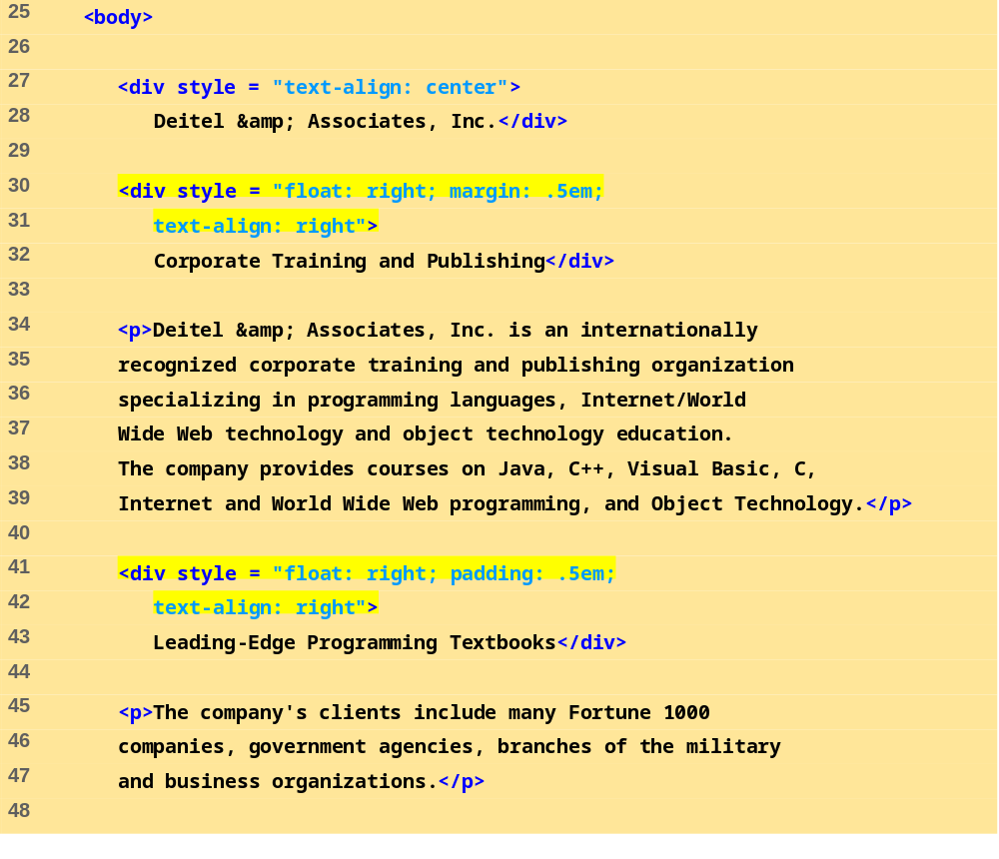
floating.html
(2 of 3)

Slide 38
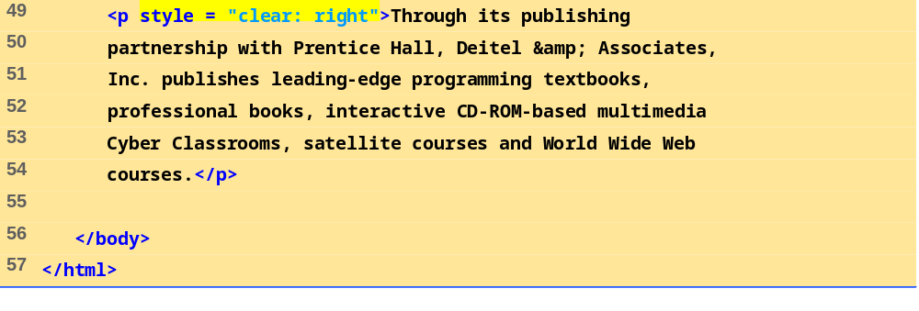
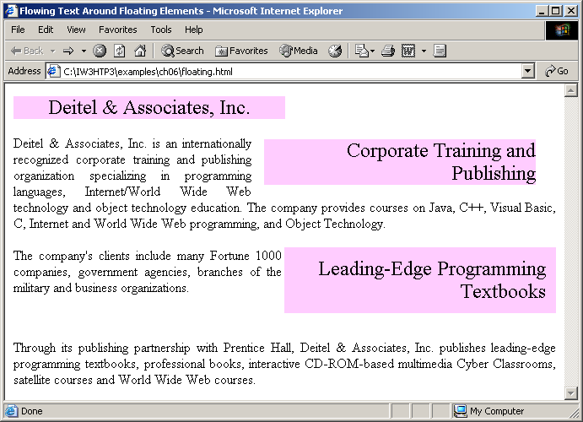
floating.html
(3 of 3)

Slide 39
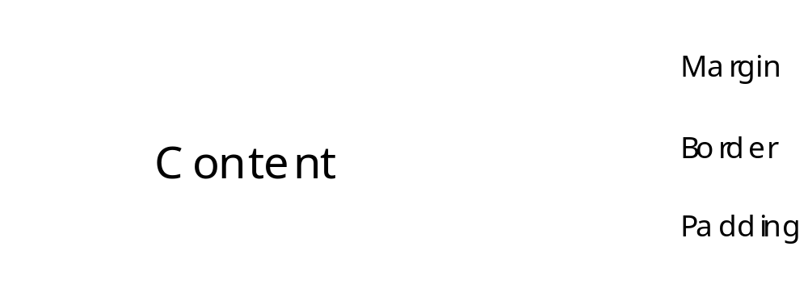
6.10 Text Flow and the Box Model
Fig. 6.13 Box model for block-level elements.

Slide 40
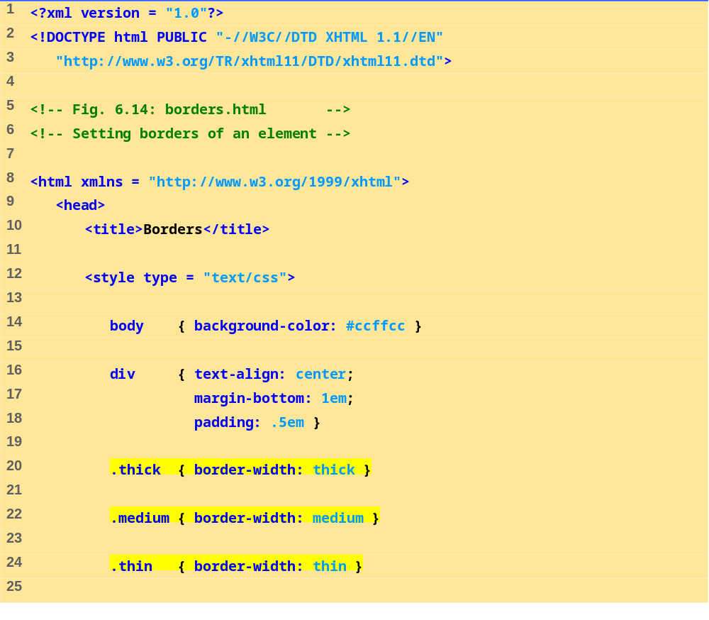
borders.html
(1 of 2)

Slide 41
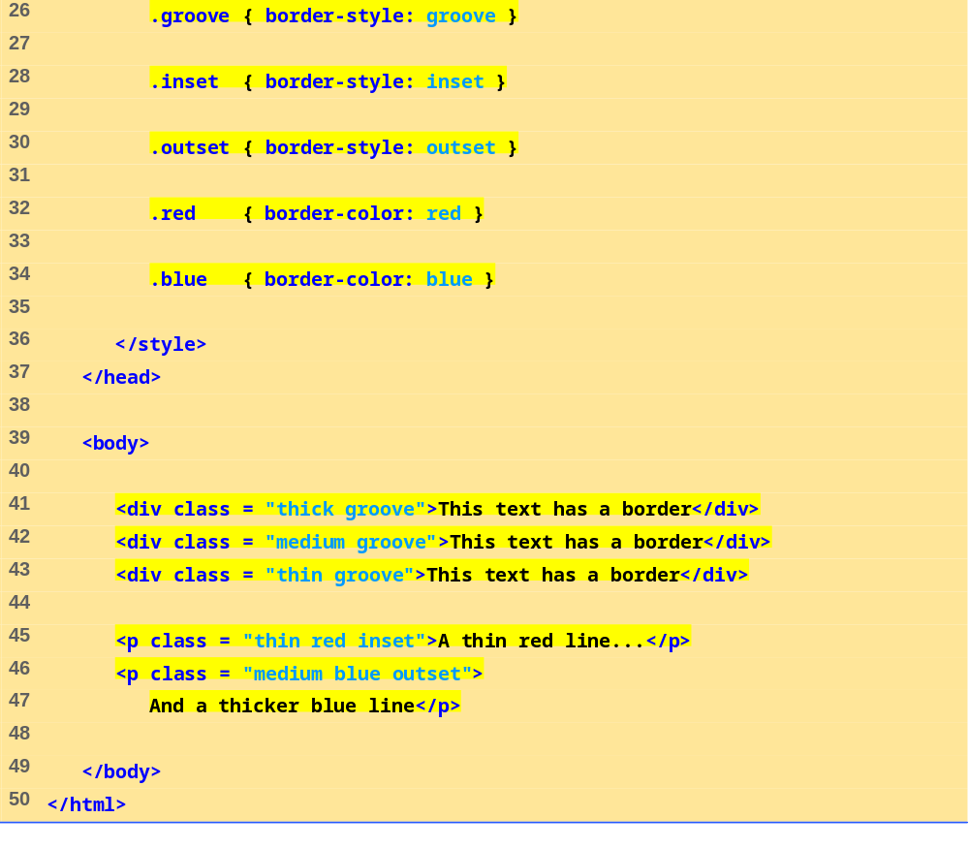
borders.html
(2 of 2)

Slide 42
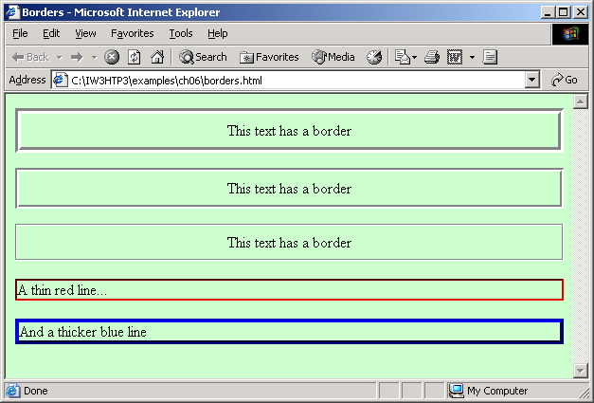

Slide 43
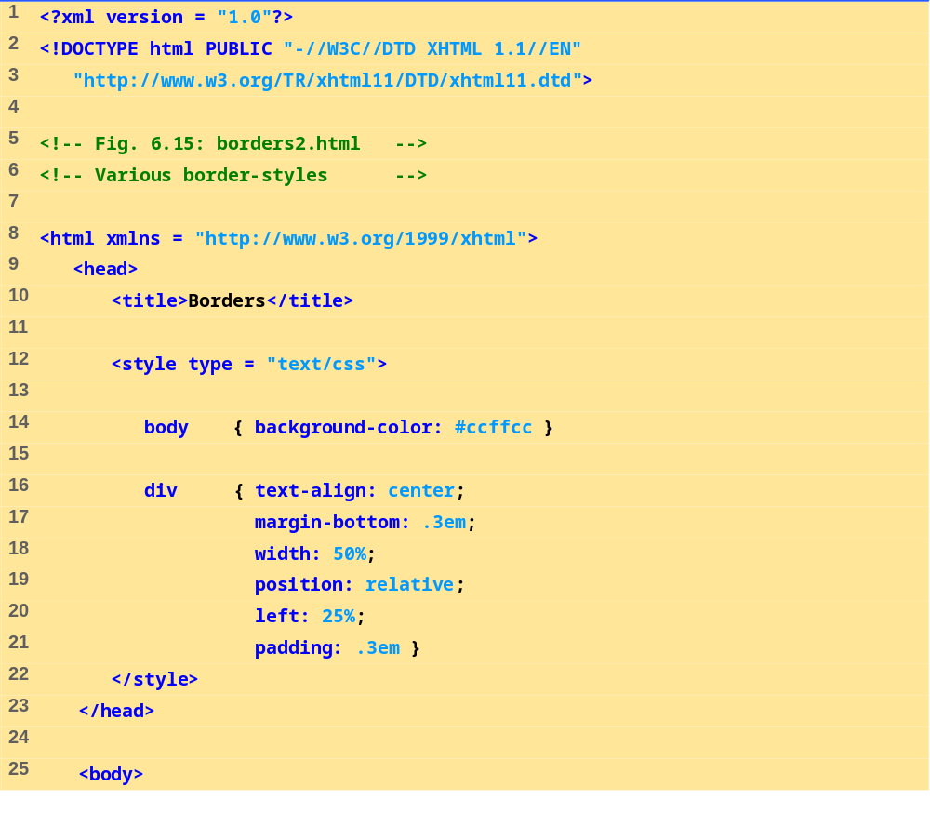
borders2.html
(1 of 2)

Slide 44
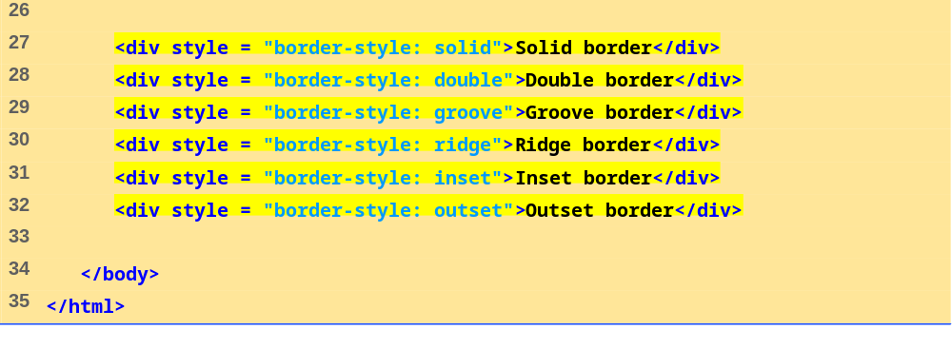
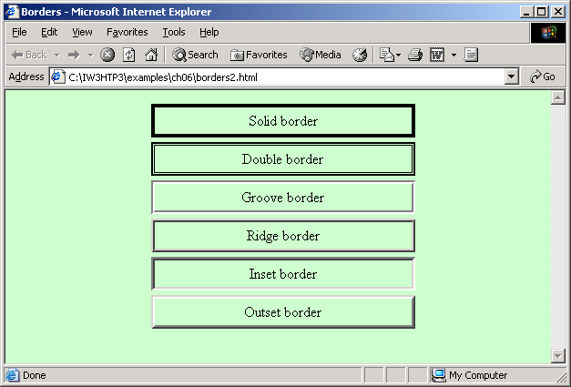
borders2.html
(2 of 2)

Slide 45
6.11 User Style Sheets
Format pages based on preferences

Slide 46
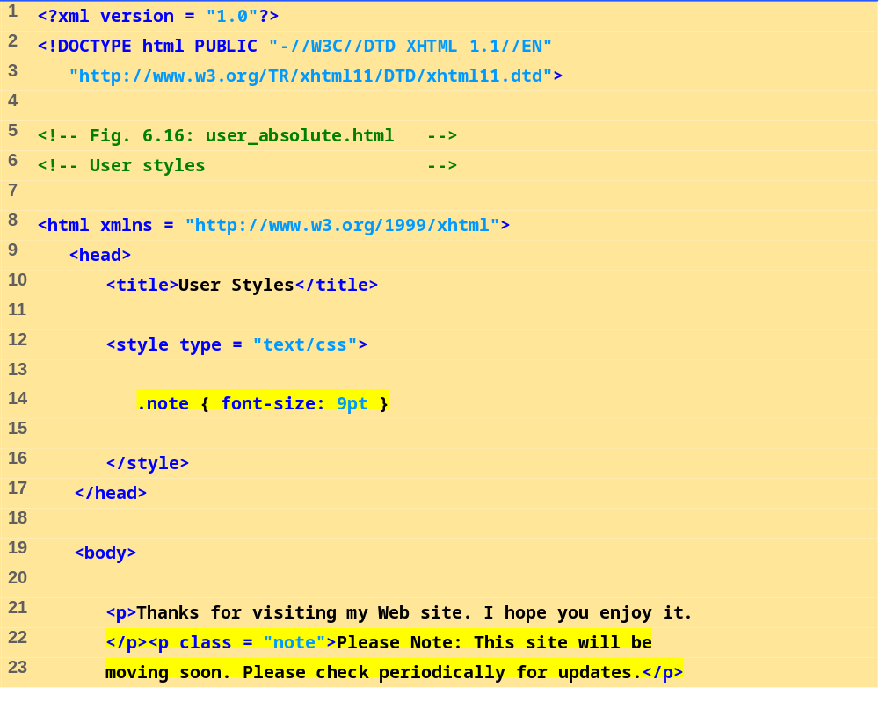
User_absolute.html
(1 of 2)

Slide 47
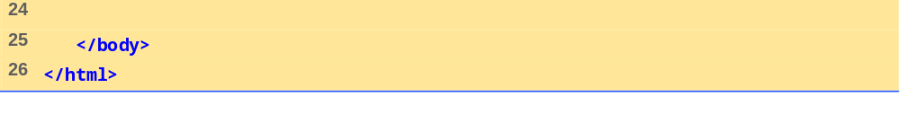
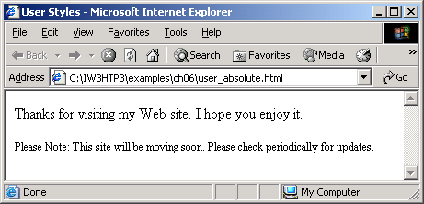
User_absolute.html
(2 of 2)

Slide 48
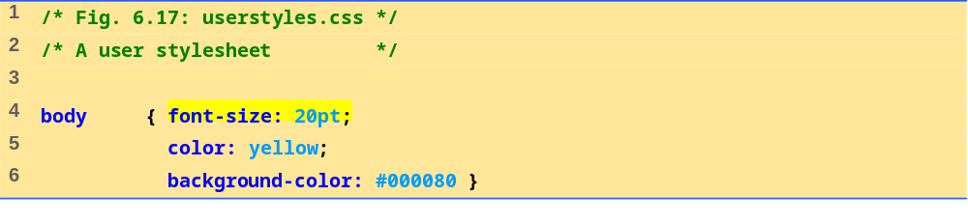
userstyles.css
1 of 1

Slide 49
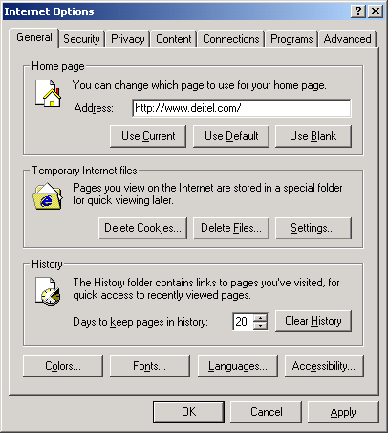
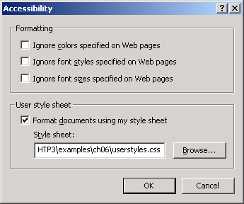
6.11 User Style Sheets
Fig. 6.18 User style sheet in Internet Explorer 6.

Slide 50
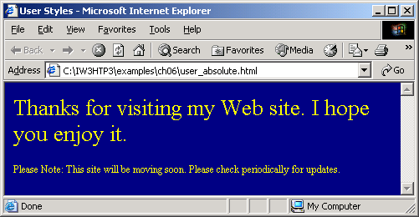
6.11 User Style Sheets
Fig. 6.19 User style sheet applied with pt measurement.

Slide 51
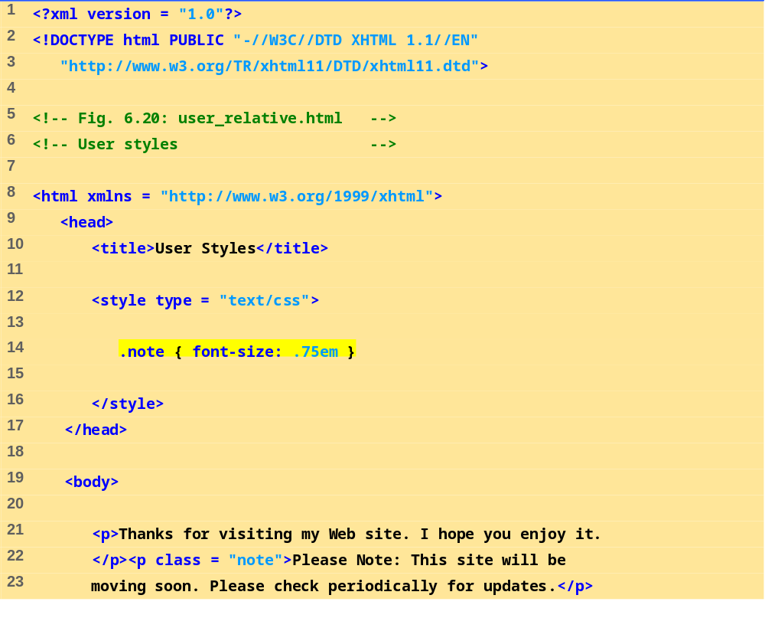
User_relative.html
(1 of 2)

Slide 52

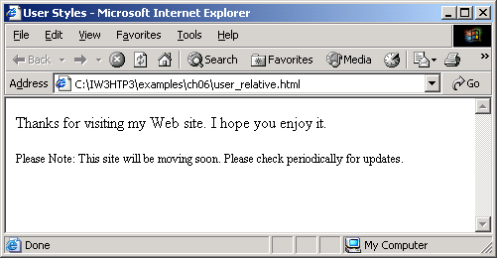
User_relative.html
(2 of 2)

Slide 53
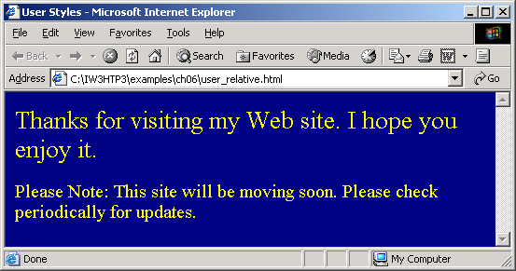
6.11 User Style Sheets
Fig. 6.21 User style sheet applied with em measurement.

Slide 54
6.12 Web Resources
www.w3.org/TR/css3-roadmap
www.ddj.com/webreview/style
tech.irt.org/articles/css.htm

