Slide 1
Chapter 7 - JavaScript: Introduction to Scripting
Outline
7.1 Introduction
7.2 Simple Program: Printing a Line of Text in a Web Page
7.3 Obtaining User Input with prompt Dialogs
7.3.1 Dynamic Welcome Page
7.3.2 Adding Integers
7.4 Memory Concepts
7.5 Arithmetic
7.6 Decision Making: Equality and Relational Operators
7.7 Web Resources

Slide 2
Objectives
In this lesson, you will learn:
  To be able to write simple JavaScript programs.
  To be able to use input and output statements.
  To understand basic memory concepts.
  To be able to use arithmetic operators.
  To understand the precedence of arithmetic operators.
  To be able to write decision-making statements.
  To be able to use relational and equality operators.

Slide 3
7.1 Introduction
JavaScript scripting language
  Enhances functionality and appearance
  Client-side scripting
    Makes pages more dynamic and interactive
  Foundation for complex server-side scripting
  Program development
  Program control

Slide 4
7.2 Simple Program: Printing a Line of Text in a Web Page
Inline scripting
  Written in the <body> of a document
  <script> tag
    Indicate that the text is part of a script
    type attribute
      Specifies the type of file and the scripting language use
    writeln method
      Write a line in the document
    Escape character ( \ )
      Indicates “special” character is used in the string
    alert method
      Dialog box

Slide 5
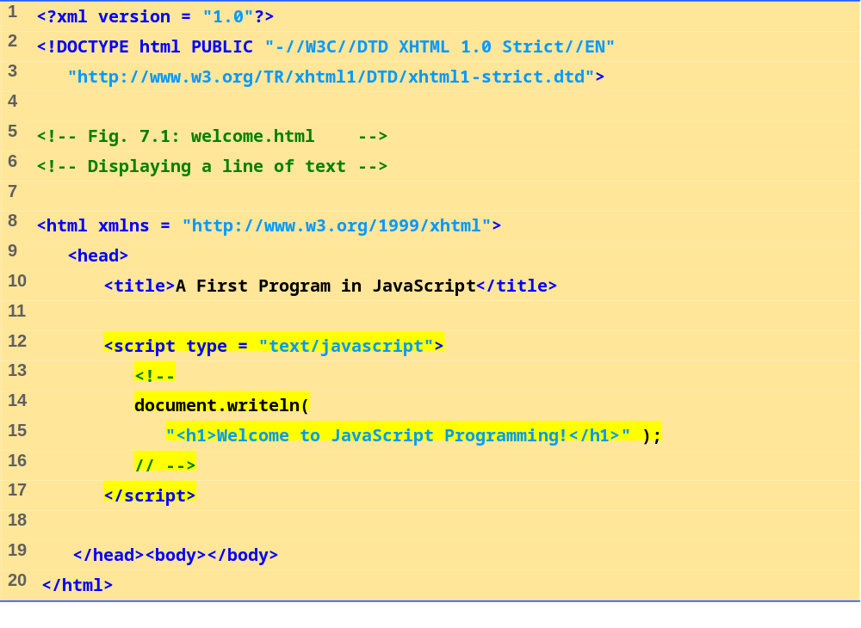
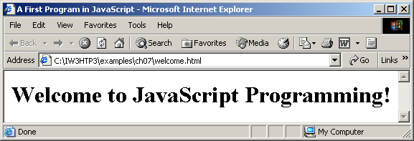
welcome.html
(1 of 1)

Slide 6
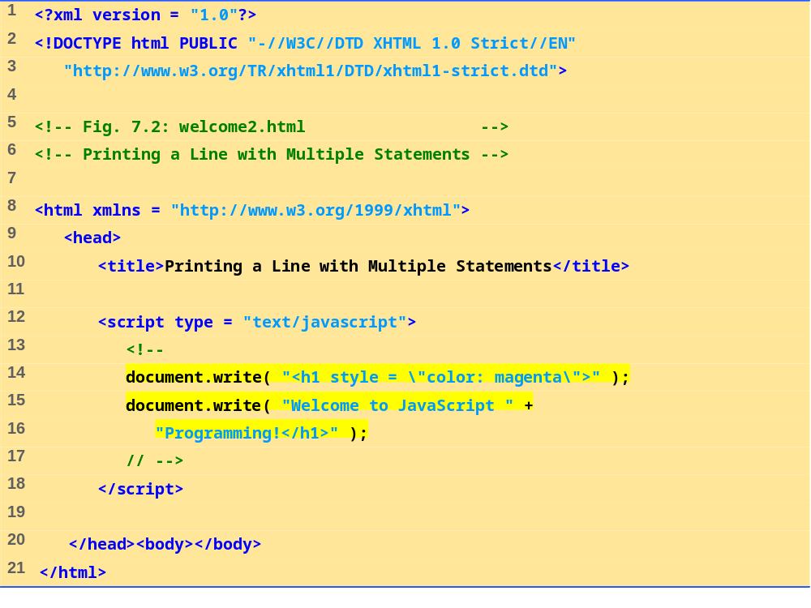
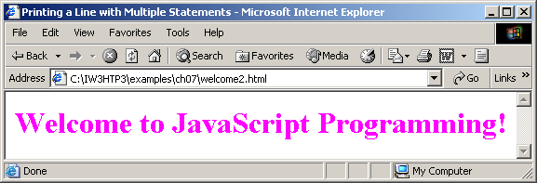
welcome2.html
(1 of 1)

Slide 7
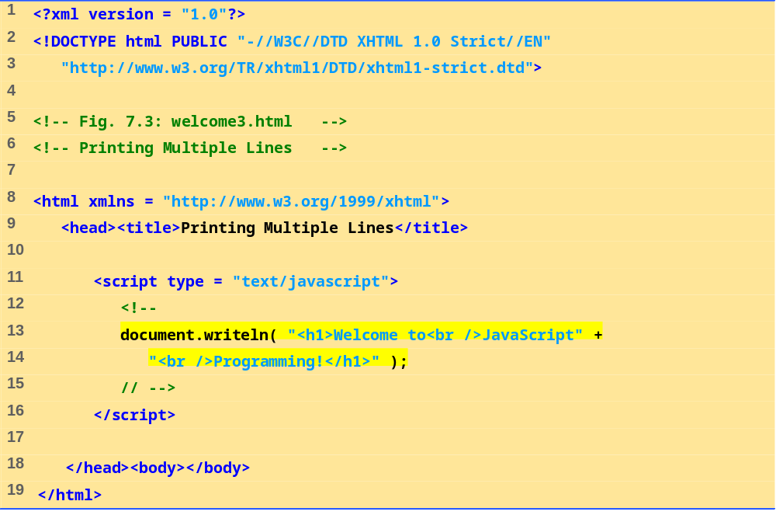
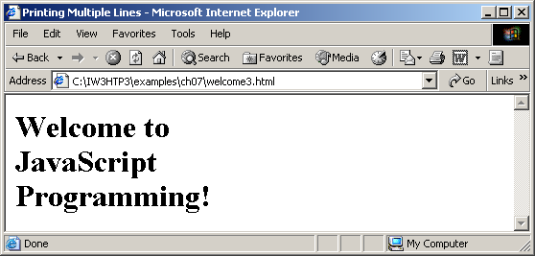
welcome3.html
1 of 1

Slide 8
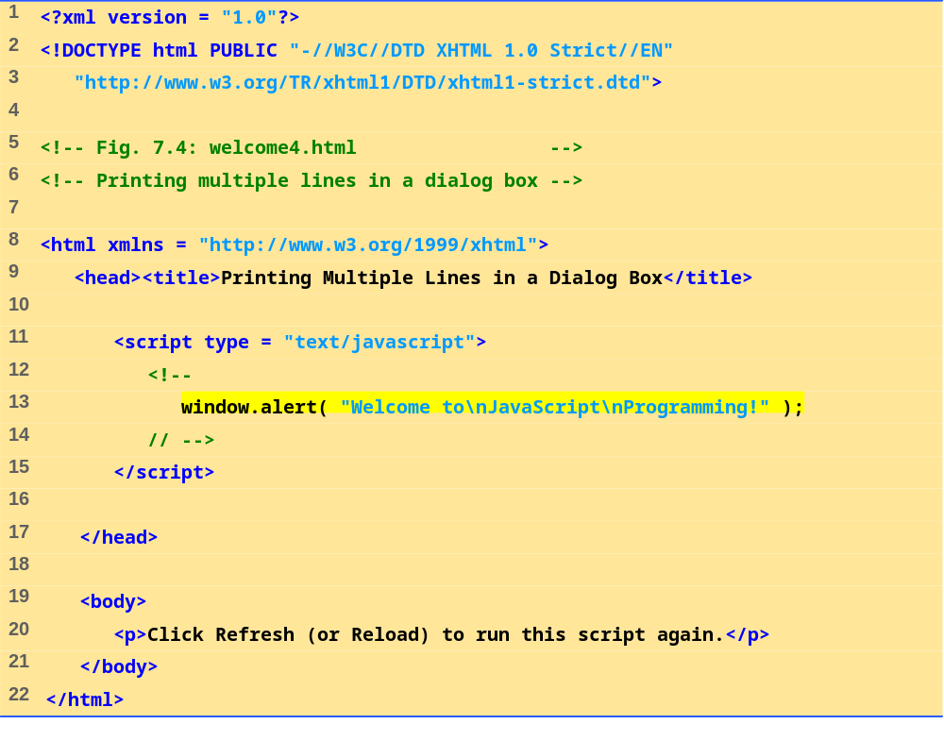
welcome4.html
1 of 1

Slide 9
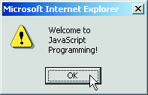
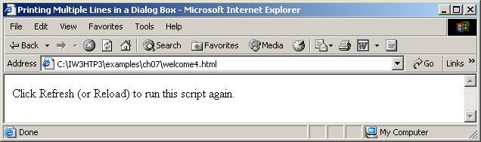

Slide 10
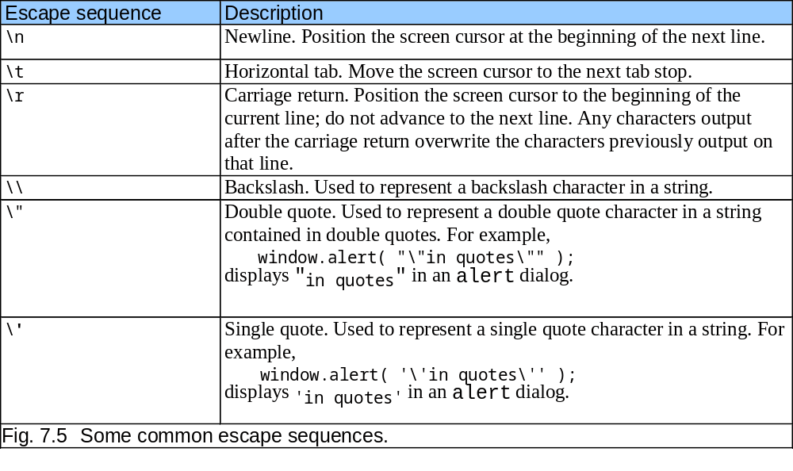
7.2 Simple Program: Printing a Line of Text in a Web Page

Slide 11
7.3.1 Dynamic Welcome Page
A script can adapt the content based on input from the user or other variables

Slide 12
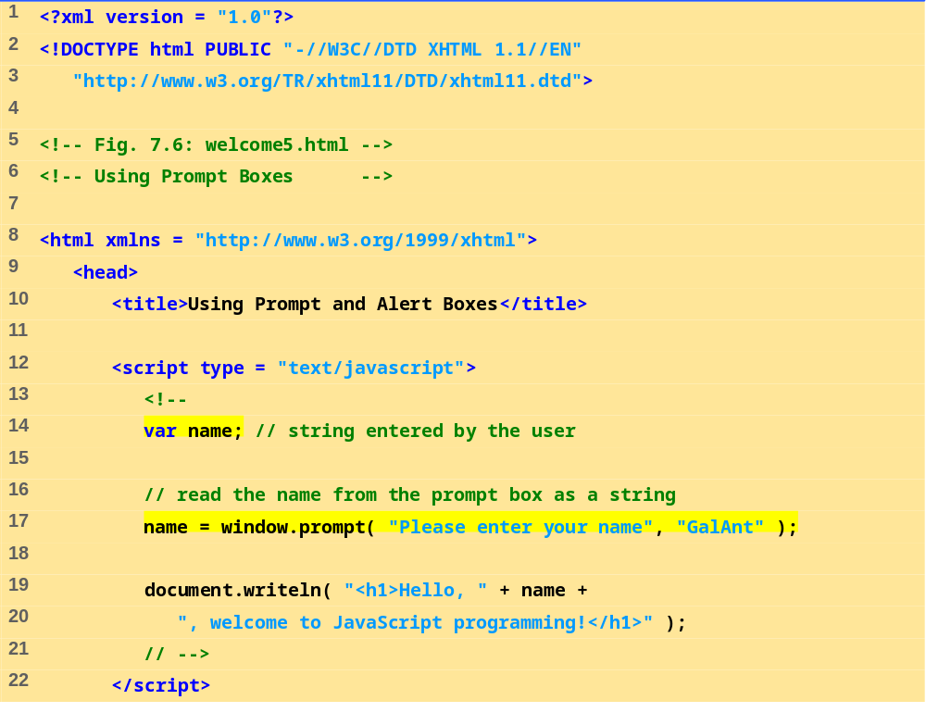
welcome5.html
(1 of 2)

Slide 13
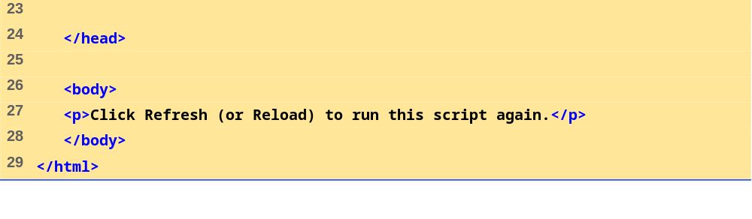
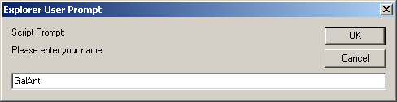
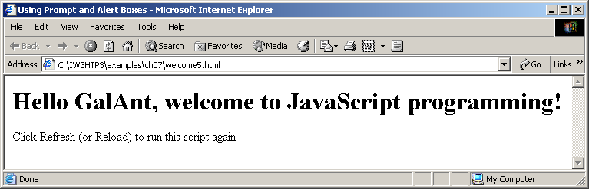
welcome5.html
(2 of 2)

Slide 14
7.3.1 Dynamic Welcome Page
When the user clicks OK, the value typed by the user is returned to the program as a string.
This is the prompt
to the user.
This is the text field in which the user types the value.
This is the default value that appears when the dialog opens.
Fig. 7.7 Prompt dialog displayed by the window object’s prompt method.

Slide 15
7.3.2 Adding Integers
Prompt user for two integers and calculate the sum (Fig. 7.8)
NaN (not a number)
parseInt
  Converts its string argument to an integer

Slide 16
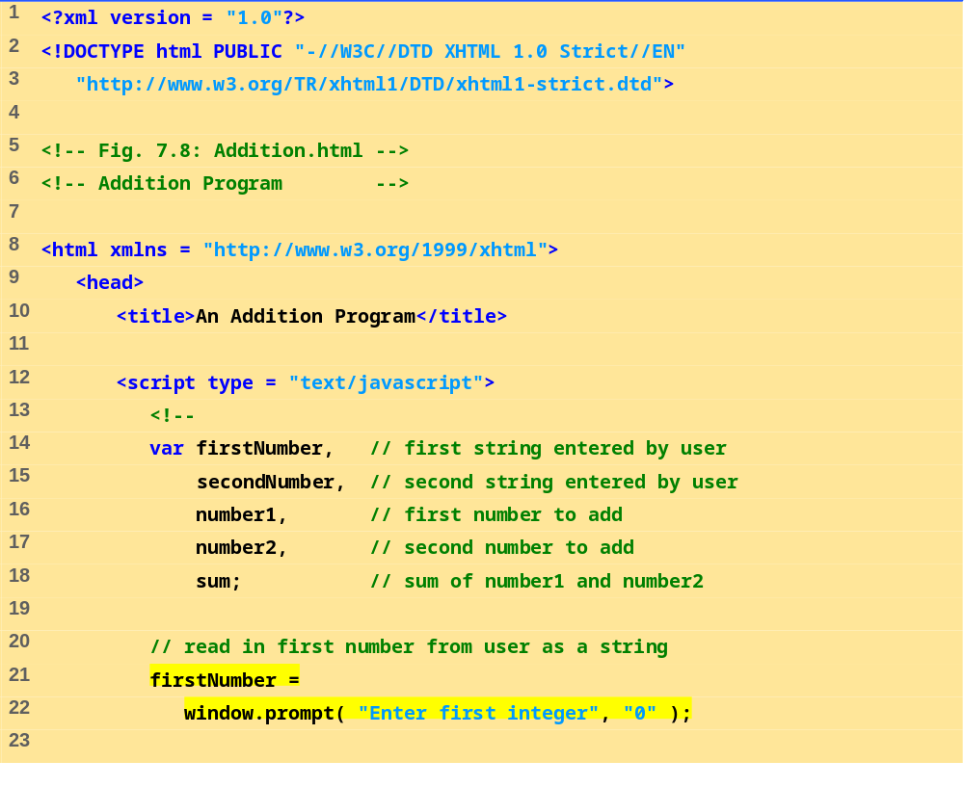
Addition.html
(1 of 2)

Slide 17
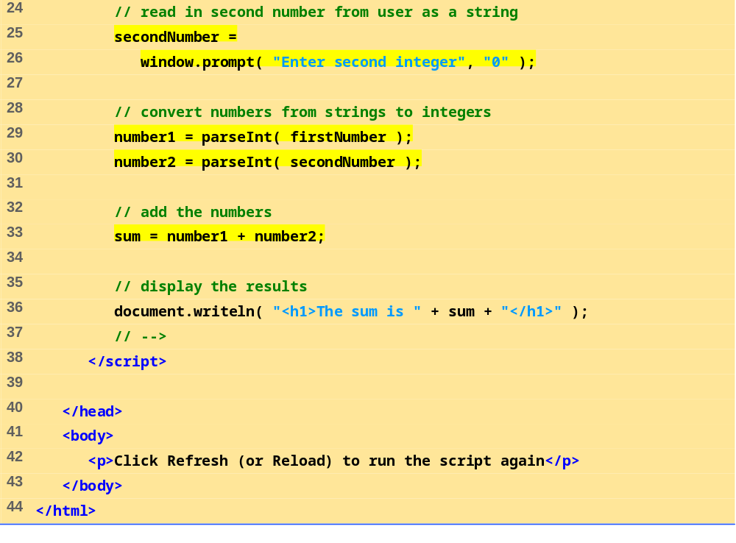
Addition.html
(2 of 2)

Slide 18
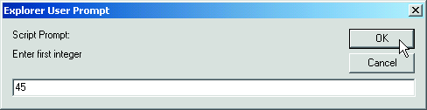
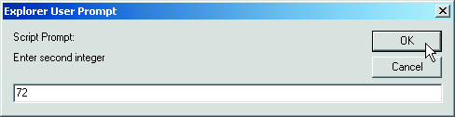
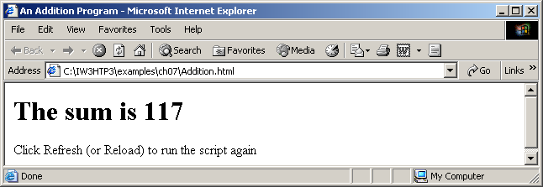

Slide 19
7.4 Memory Concepts
Variable names correspond to locations in the computer’s memory
Every variable has a name, a type, and a value
Read value from a memory location
  nondestructive

Slide 20
7.4 Memory Concepts
number1
45
Fig. 7.9 Memory location showing the name and value of variable number1.

Slide 21
7.4 Memory Concepts
number1
45
number2
72
Fig. 7.10 Memory locations after values for variables number1 and number2 have been input.

Slide 22
7.4 Memory Concepts
number1
45
number2
72
sum
117
Fig. 7.11 Memory locations after calculating the sum of number1 and number2.

Slide 23
7.5 Arithmetic
Many scripts perform arithmetic calculations
  Expressions in JavaScript must be written in straight-line form

Slide 24
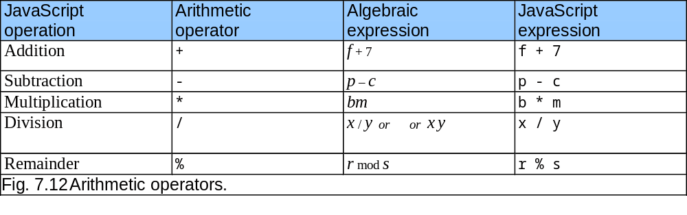
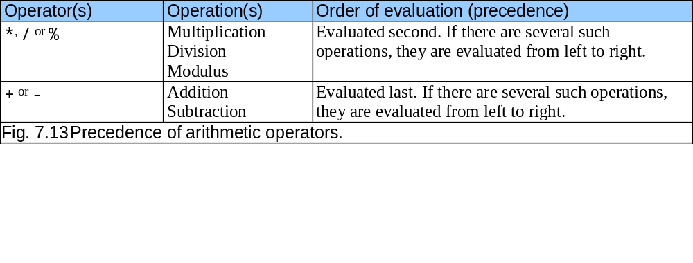
7.5 Arithmetic

Slide 25
7.5 Arithmetic
Step 1.
y = 2 * 5 * 5 + 3 * 5 + 7;
2 * 5 is 10
(Leftmost multiplication)
Step 2.
y = 10 * 5 + 3 * 5 + 7;
10 * 5 is 50
(Leftmost multiplication)
Step 3.
y = 50 + 3 * 5 + 7;
3 * 5 is 15
(Multiplication before addition)
Step 4.
y = 50 + 15 + 7;
50 + 15 is 65
(Leftmost addition)
Step 5.
y = 65 + 7;
65 + 7 is 72
(Last addition)
Step 6.
y = 72;
(Last operation—place
72
into
y
)
Fig. 7.14 Order in which a second-degree polynomial is evaluated.

Slide 26
7.6 Decision Making: Equality and Relational Operators
Decision based on the truth or falsity of a condition
  Equality operators
  Relational operators

Slide 27
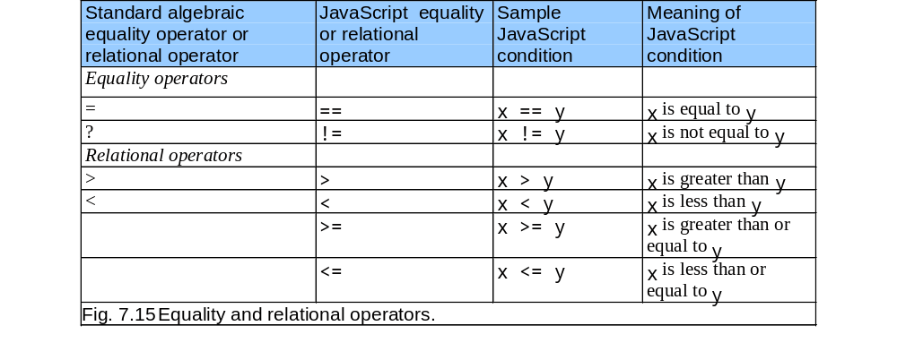
7.6 Decision Making: Equality and Relational Operators
≥
≤

Slide 28
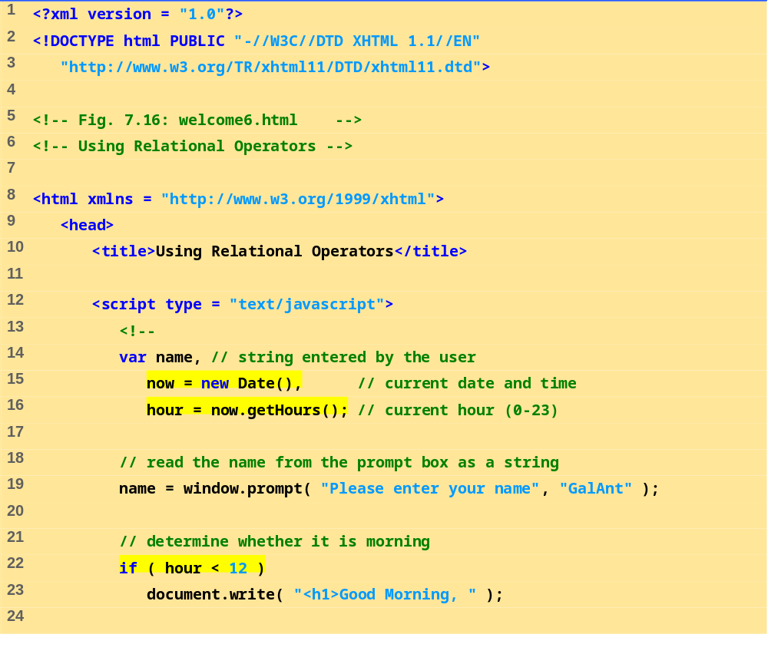
welcome6.html
(1 of 3)

Slide 29
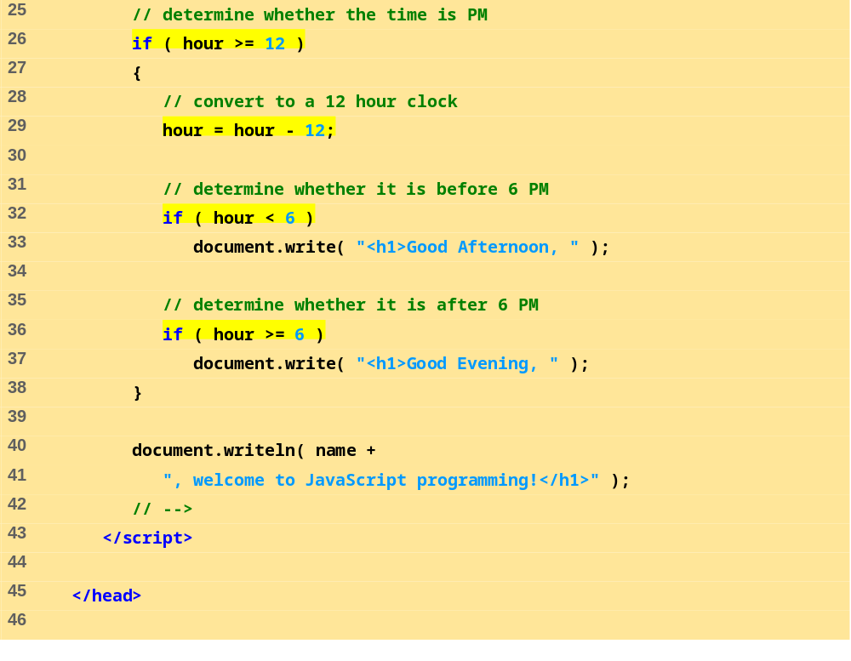
welcome6.html
(2 of 3)

Slide 30
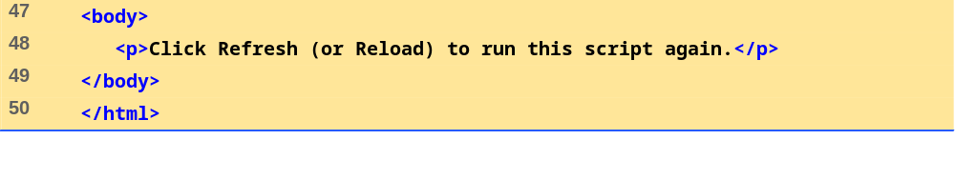
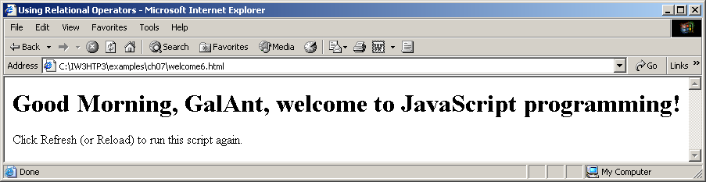
welcome6.html
(3 of 3)

Slide 31
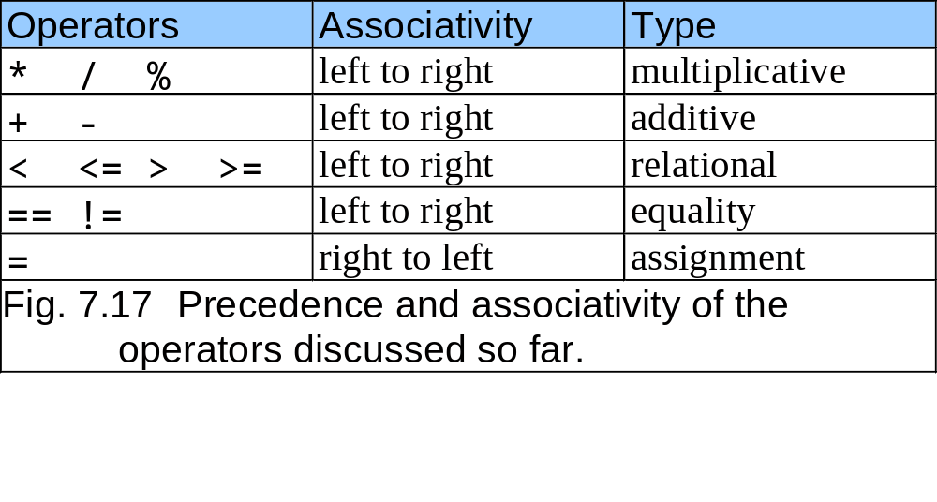
7.6 Decision Making: Equality and Relational Operators

