Slide 1
Isobaric Tagging for Relative and Absolute Quantification
(iTRAQ)

Slide 2
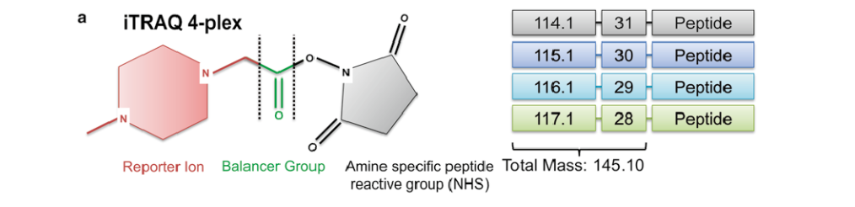
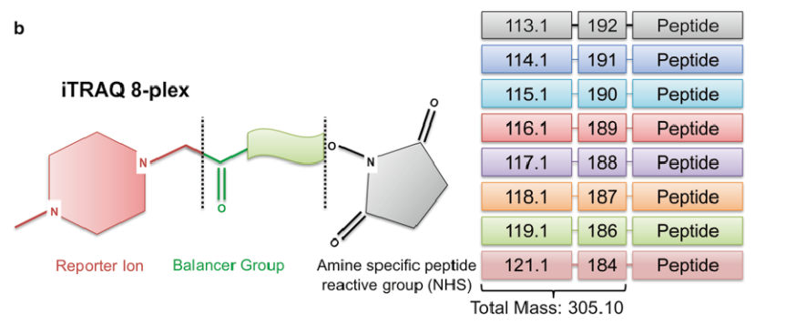
Types and Components of iTRAQ
There are two types of iTRAQ Reagents
• 4-plex - for processing up to 4 samples
• 8-plex - for processing up to 8 samples
Components of iTRAQ
Reporter group
The m/z value of the reporter group ranges from 114.1 - 117.1
(2) Mass balance carbonyl group
The balance group mass is 28 - 31 Da
(3) A peptide-reactive group
NOTE : reporter plus balance components remains constant 145.1 Da for all four reagents

Slide 3
iTRAQ Reagents
Reporter
• Provides signature ion in MS/MS
• Provides good b and y - ion series
• Maintains the charge state and ionization
efficiency of peptide
Balancer
• Balances mass change of reporter to
provide total mass of 145
• Neutral loss in MS/MS
Peptide reactive group

Slide 4
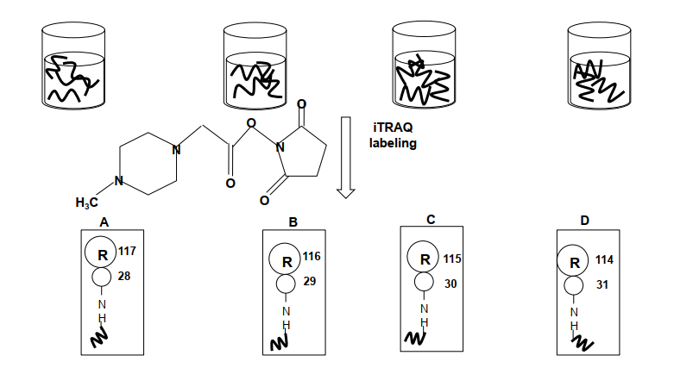
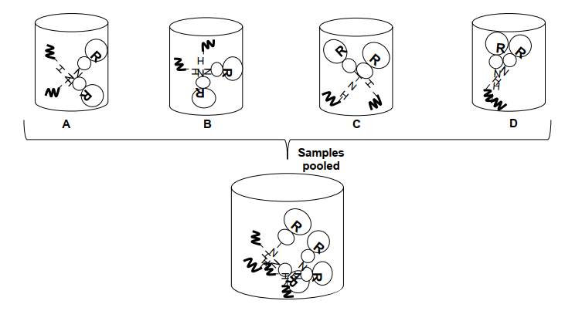
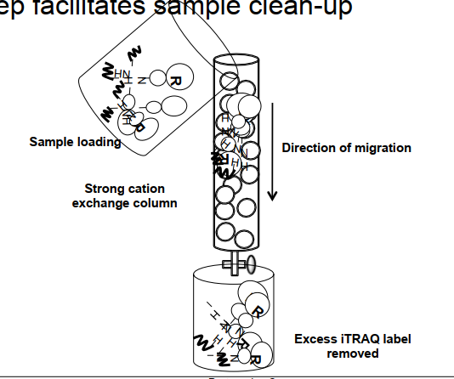
The workflow of iTRAQ
Add iTRAQ reagent to digested protein sample
Combine labeled samples in one tube
Remove excess unbound reagent

Slide 5
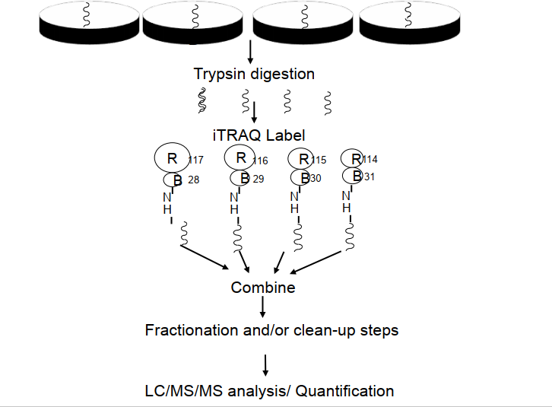
The
Workflow
of
iTRAQ

Slide 6
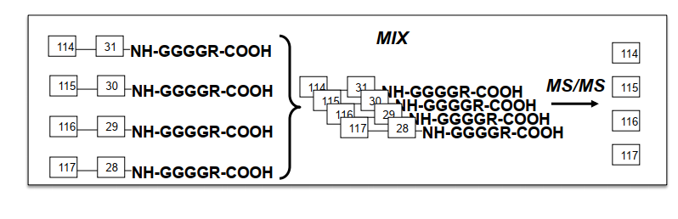
MS analysis
Peptides labeled , mixed together , measured by MS
Labels react with N-terminus
NOTE: N-terminus: The end of a peptide or protein primary structure in which the amino acid residue is not part of a peptide bond. The terminal group is often (but not always) an amine or ammonium cation.
Reporter group is lost during fragmentation
Samples with 4 reagents of same mass (145) give rise to four unique reporter ions ( Fig 1 )
Quantification occurs at the level of fragment ion spectrum (MS/MS)
Identification and quantification of peptide are achieved at MS/MS level
( Fig 1 )

Slide 7
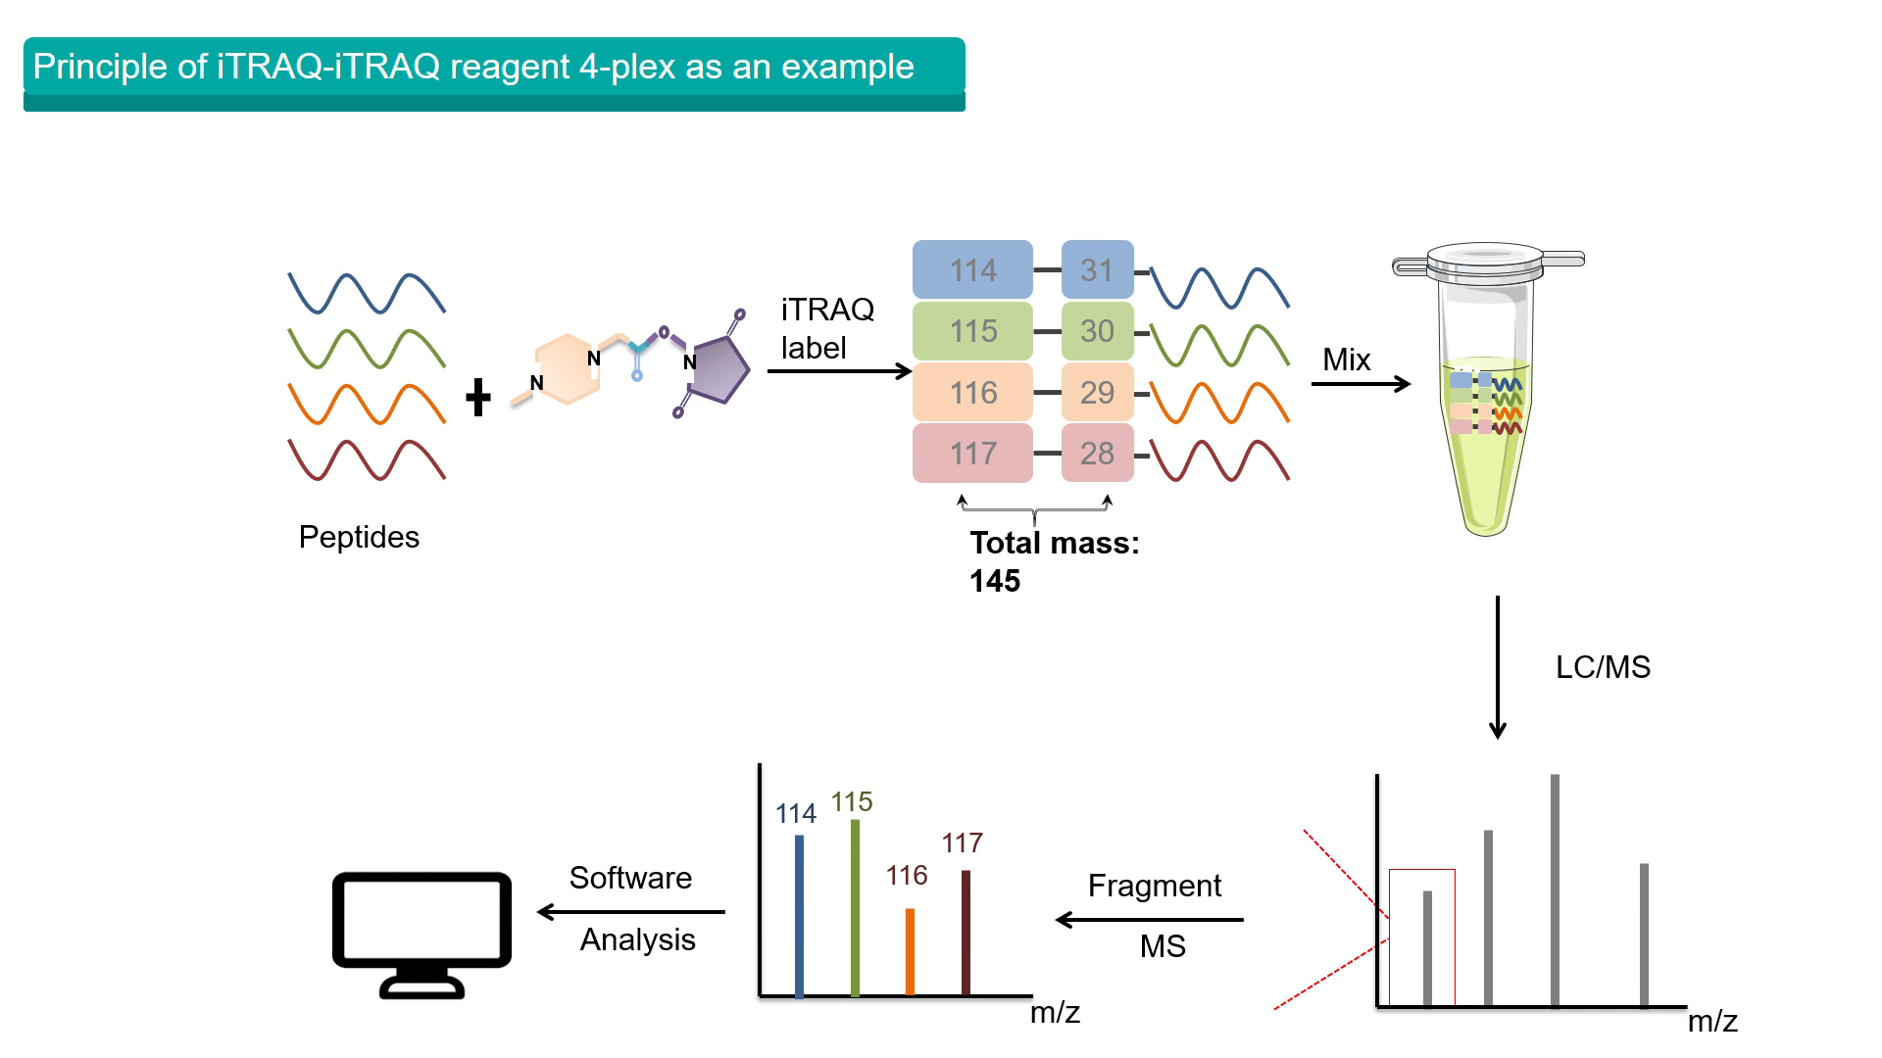
Quantification
Identification
Same peptide with different isotopic labels produce different mass in reporter ions
Bond between the balance group and peptide reactive group is broken and balance group lost
Same peptide from different sources is completely identical in molecular weight appear in same peak

Slide 8
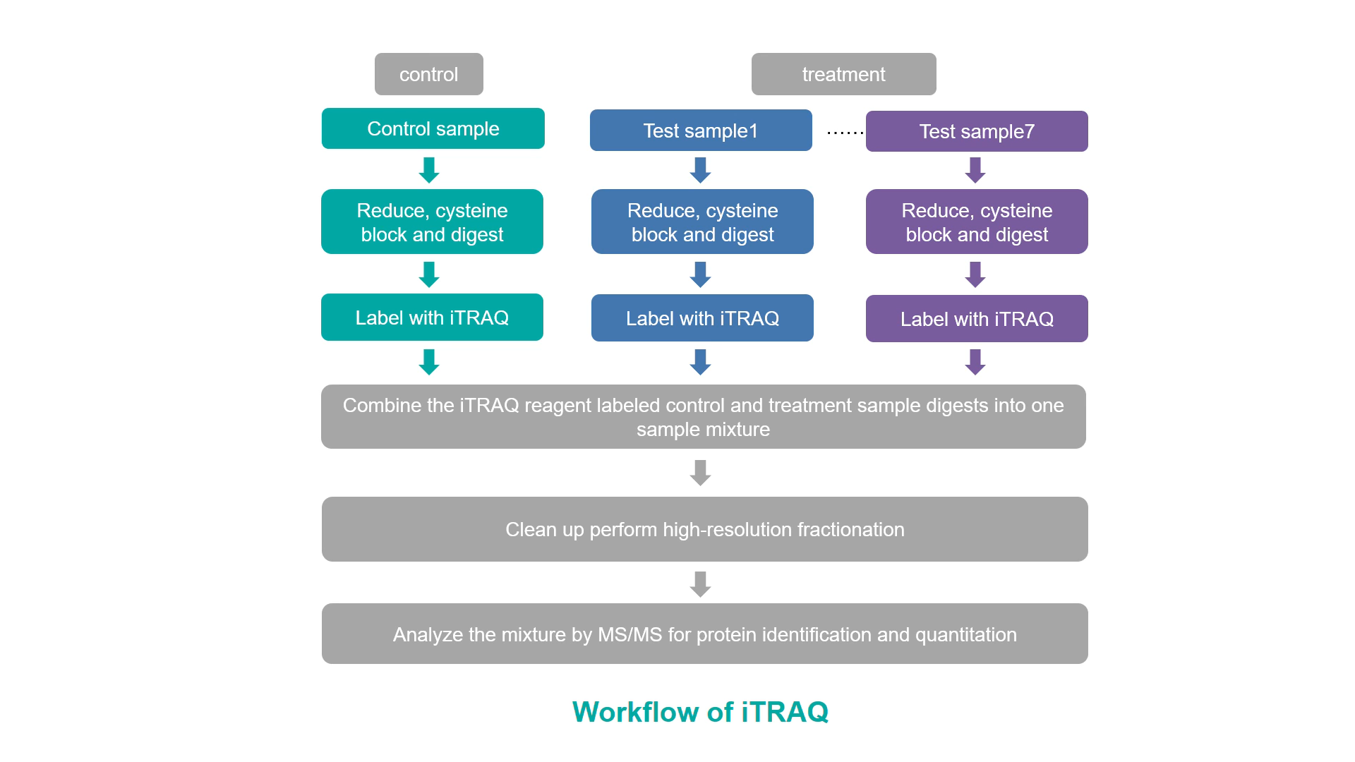

Slide 9
Advantage
High throughput quantification
Improve efficiency MS/MS fragmentation
Ability to combine & analyze several sample in one experiment
Studying protein interaction & pattern of expression

