Slide 1


INTERNET OF THINGS
BABY MONITORING
SYSTEM
KISHORE S(210701501)
MOHNEESH P(210701502)
DURAI GAJENDRAN(210701511)

Slide 2
INTRODUCTION
The Internet of Things (IoT) refers to the network of interconnected devices embedded with sensors, software, and other technologies that enable them to collect and exchange data over the internet. These devices can range from everyday objects like household appliances and wearable gadgets to industrial machinery and smart city infrastructure. The key characteristic of IoT devices is their ability to communicate with each other and with external systems, allowing for remote monitoring, control, and automation of various processes.
This connectivity not only enhances convenience for users but also offers opportunities for energy efficiency, security, and personalized experiences tailored to individual preferences.

Slide 3
LITERATURE SURVEY
Paper: Design and development of NodeMCU-based automation home system using the internet of things
Author: SA Ajagbe, OA Adeaga, OO Alabi
Year: 2024
Disadvantage: While the system is described as low-cost, it may lack advanced features found in more expensive solutions.
Paper: An IoT-based Smart Home System for Monitoring and Controlling Home Appliances
Author: S Islam, MM Hossain, MZ Uddin
Year: 2020
Disadvantage: The system's reliance on IoT connectivity may lead to issues with reliability and security..
Paper: A review on internet of things (IoT): Evolution, challenges and opportunities
Author: N Ahmed, ZK Ali, S Haider
Year: 2018
Disadvantage: The paper provides a broad overview of IoT but lacks in-depth analysis of specific IoT applications like baby monitoring systems.

Slide 4
LITERATURE SURVEY
Paper: A survey on Internet of Things architectures
Author: L Atzori, A Iera, G Morabito
Year: 2010
DisadvantageWhile the paper provides a comprehensive survey of IoT architectures, it may be slightly outdated in terms of the latest technologies and developments.
Paper: An IoT-based Smart Baby Monitoring System
Author: S Gupta, P Malhotra, A Arora
Year: 2021
Disadvantage: The system's reliance on IoT connectivity may lead to issues with reliability and security.
Paper: A review on internet of things (IoT): Evolution, challenges and opportunities
Author: N Ahmed, ZK Ali, S Haider
Year: 2018
Disadvantage: The paper provides a broad overview of IoT but lacks in-depth analysis of specific IoT applications like baby monitoring systems.

Slide 5
EXISTING SYSTEM
The existing systems for baby monitoring predominantly rely on traditional baby monitors, which typically include a camera and a microphone for audio-video surveillance. These monitors provide basic functionality such as live video feed and two-way audio communication, allowing parents to monitor their babies remotely.
However, traditional baby monitors have limitations, such as limited range, lack of integration with other smart devices, and basic monitoring capabilities. They also lack advanced features like environmental sensing, health monitoring, and intelligent alerts for anomalies. Additionally, the reliance on dedicated monitors or receivers restricts the mobility and convenience for parents.

Slide 6
PROPOSED SYSTEM
The proposed system is an IoT-based home security and environmental monitoring solution designed to offer a comprehensive and intelligent approach to modern home management. This system integrates various advanced technologies, including high-definition cameras, LED indicators, buzzers, PIR motion sensors, sound sensors, and environmental sensors, to provide real-time monitoring and alerts. This integration ensures that homeowners can keep a vigilant eye on their property and maintain optimal environmental conditions, offering peace of mind and convenience.
Real-time monitoring is a core feature of the proposed system, enabling homeowners to continuously access live data from the sensors. This capability ensures that they are always aware of the security and environmental status of their home. High-definition cameras provide clear and continuous video surveillance, while PIR motion sensors detect movement, and sound sensors capture and analyze ambient noise, allowing for comprehensive monitoring.

Slide 7
REQUIREMENTS
HARDWARE SPECIFICATION
Arduino uno r3
Rain sensor
Motion sensor
Sound Sensor
Breadboards and jumpers
16x2 lcd display
Resistors
SOFTWARE SPECIFICATION
8 GB RAM
Intel core i5
Node.js with Express.js for backend development
MongoDB for database management

Slide 8
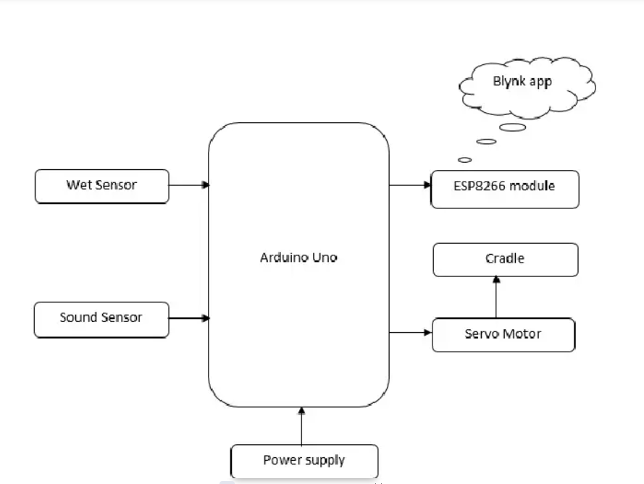
ARCHITECTURE DIAGRAM

Slide 9
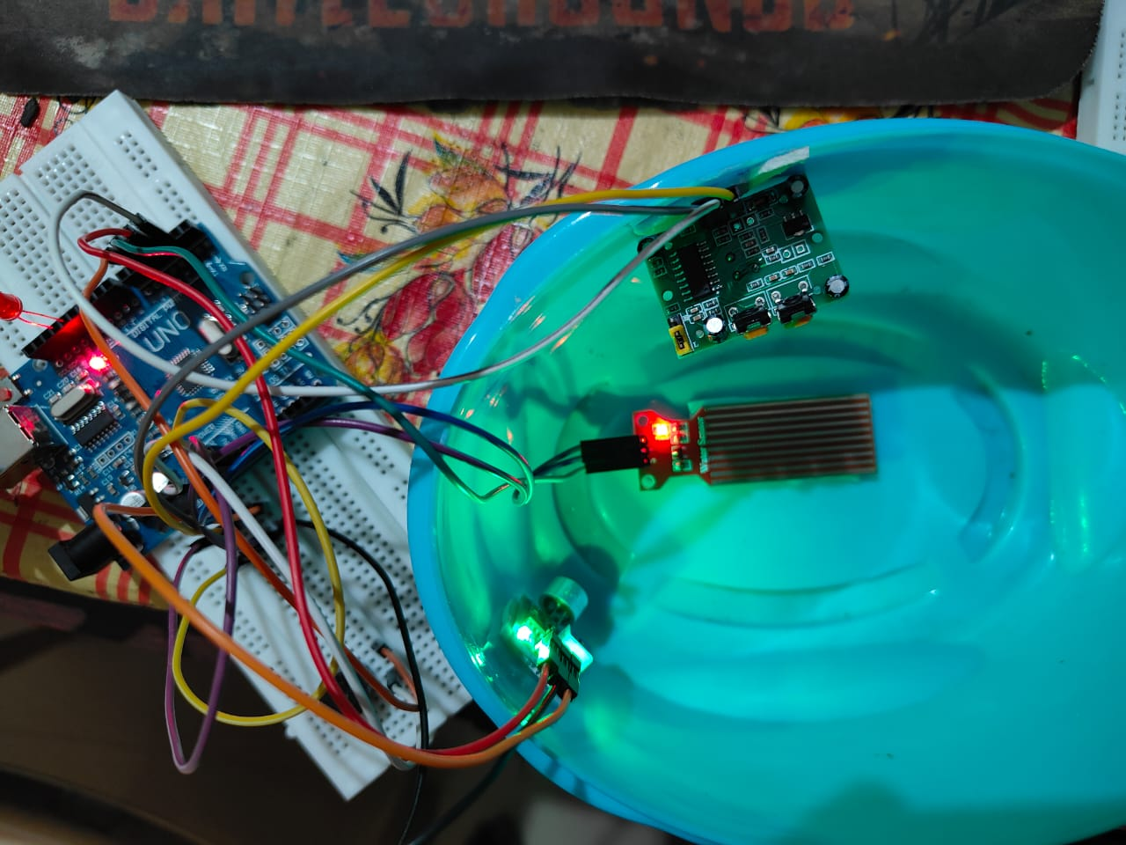
OUTPUT

Slide 10
CONCLUSION
In conclusion, the implementation of the IoT-based baby monitoring system presents a comprehensive solution that prioritizes the safety and well-being of infants while addressing the privacy concerns of parents and caregivers. The system's security model, incorporating data encryption, authentication, and authorization mechanisms, ensures that sensitive information is protected from unauthorized access. By utilizing secure communication protocols and data anonymization techniques, the system maintains the integrity and confidentiality of the collected data, enhancing trust in its functionality.
Regular security audits and updates, along with user education initiatives, are essential components of the system's security model, demonstrating a commitment to ongoing security improvements and user empowerment. Overall, the IoT-based baby monitoring system provides a reliable, real-time solution for monitoring infants, offering peace of mind to parents and caregivers and demonstrating the potential of IoT technology in addressing critical healthcare needs.

Slide 11
FUTURE ENHANCEMENTS
Future work on the IoT-based baby monitoring system could focus on several areas to enhance its functionality and effectiveness. One potential area for improvement is the integration of artificial intelligence (AI) and machine learning (ML) algorithms to provide more advanced analysis of the collected data. These algorithms could help in detecting subtle patterns and anomalies in the baby's behavior and health, allowing for earlier detection of potential issues.
Another area for future work is the development of a more intuitive and user-friendly interface for the mobile application. This could include features such as personalized notifications and alerts, real-time monitoring of multiple parameters, and integration with other smart home devices for seamless control of the baby's environment.

Slide 12
REFERENCES
Rush,A.M.(2015).ANeuralAttentionModelforAbstractiveSentenceSummarization.arXivpreprintarXiv:1509.00685.
Vaswani, A., Shazeer, N., Parmar, N., Uszkoreit, J., Jones, L., Gomez, A.N.,...&Polosukhin,I.(2017).Attentionisallyouneed.InAdvancesinneural informationprocessingsystems(pp.30-38).
Nallapati,R.,Zhou,B.,Santos,C.N.,Gulcehre,C.,&Xiang,B.(2016).Abstractive text summarization using sequence-to-sequence RNNs andbeyond.arXivpreprintarXiv:1602.06023.
Liu,P.J.,Saleh,M.,Pot,E.,&Goodrich,B.(2019).GeneratingWikipedia by Summarizing Long Sequences. arXiv preprintarXiv:1801.10198.

Slide 13
Thank You

