Slide 1


INSTITUTE FOR ADVANCED COMPUTING AND SOFTWARE DEVELOPMENT AKURDI, PUNE
WEB APPLICATION FIREWALL
GROUP NO: 8
Abhishek Dubey (233401)
Mohaneesh Shirbhayye(233418)
CENTRE COORDINATOR PROJECT GUIDE
Mr.Rohit Puranik Mr. Kartik Awari

Slide 2
Introduction
In today's digital landscape, web applications are a cornerstone of business operations and user interactions. However, their increasing complexity and connectivity expose them to a myriad of cyber threats. From SQL injection to cross-site scripting, attackers constantly exploit vulnerabilities within web applications to compromise data and disrupt services. As a result, there is an urgent need for robust security measures that can effectively counter these evolving threats.
This project centers around the implementation of a Web Application Firewall (WAF) to fortify the security of web applications. The fusion of pfSense, Snort, and the Damn Vulnerable Web Application (DVWA) creates a potent solution to safeguard web applications against a broad spectrum of attacks.
(pfSense): Defending the Perimeter, (Snort): Vigilance through Intrusion Detection, (DVWA): A Testing Ground for Resilience

Slide 3
Objective
A Web Application Firewall (WAF) is a security tool designed to protect web applications from various online threats and attacks. Its primary purpose is to enhance the security of web applications by identifying and mitigating vulnerabilities and attacks that could compromise the confidentiality, integrity, and availability of the application and its data.
To achieve secure web based application the main objective is
Accessibility
Integrity
Availability
Monitoring
Which are achieve by firewall and load balancer using Nagios.
By using logging system Accountability is achieved.

Slide 4
Requirement
Software Hardware
1. Operating system: Debian10, Ubuntu, kali
2. Firewall: Pfsense, snort (plugin)
3. Agent: DVWA
3. Database: MYSQL
Sr.no | Components | Minimum requirements
1 | CPU | 2.5 GHz
2 | RAM | 8 GB
3 | Storage | 500 GB
4 | Network | 50 Mbps

Slide 5
Architecture
Architectural Diagram of WAF
DVWA machine
server1
Pfsense
Internet
IDS+Load balencer
Firewall
sever2
DVWA machine

Slide 6
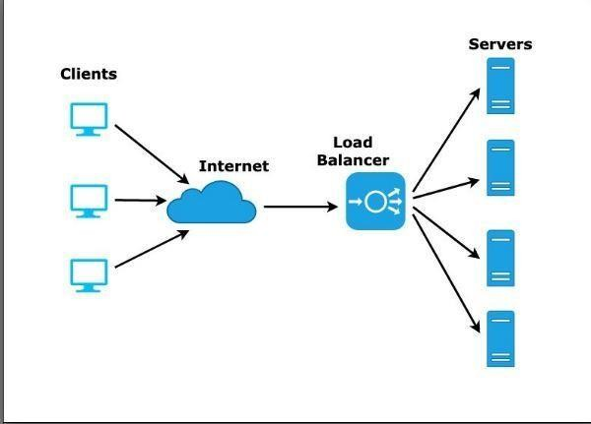
Load balencer

Slide 7
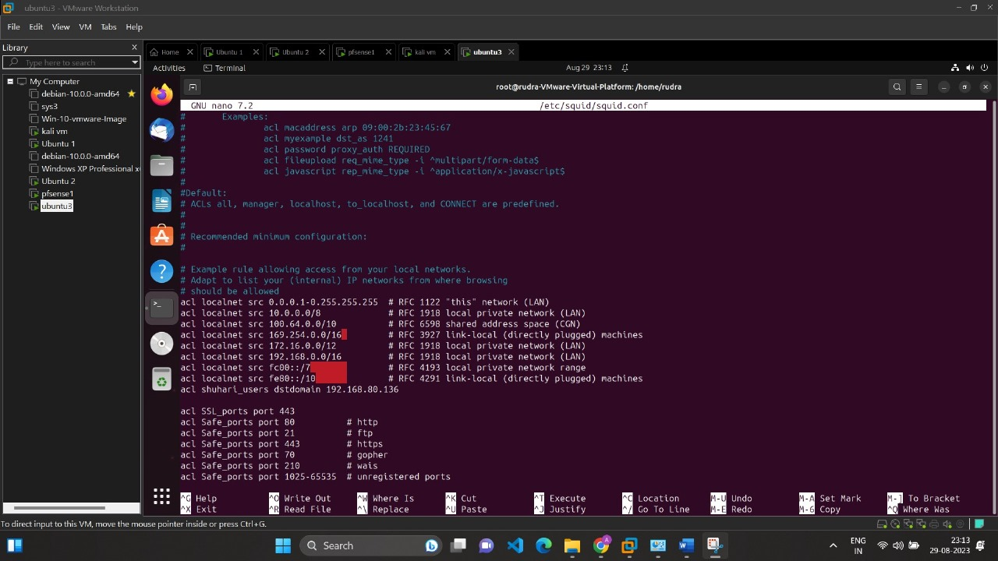
Load balancer/Squid configuration:

Slide 8
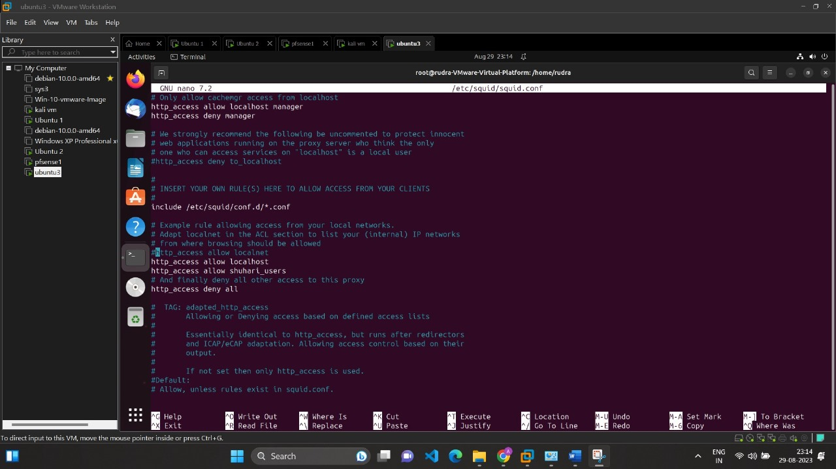

Slide 9
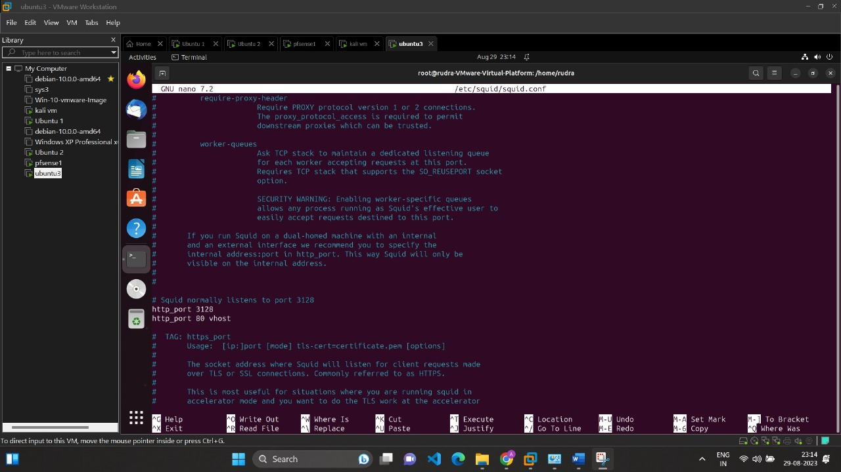

Slide 10
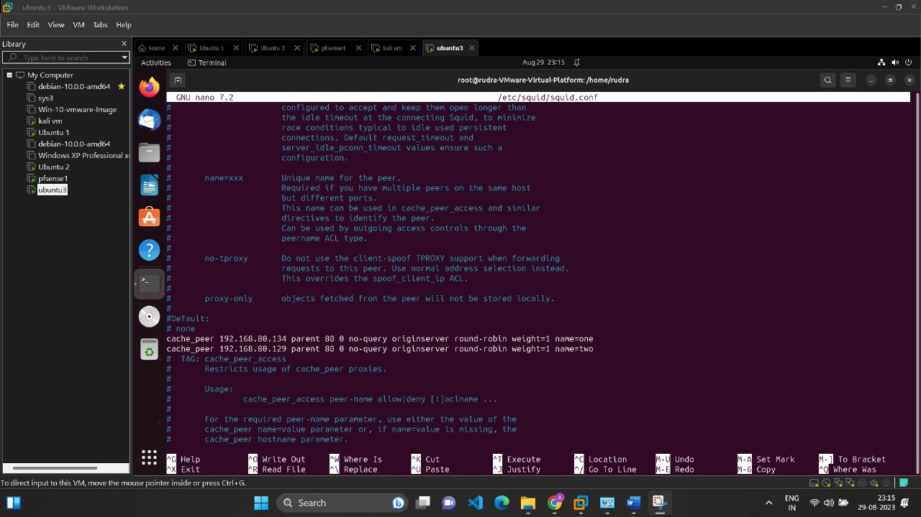

Slide 11
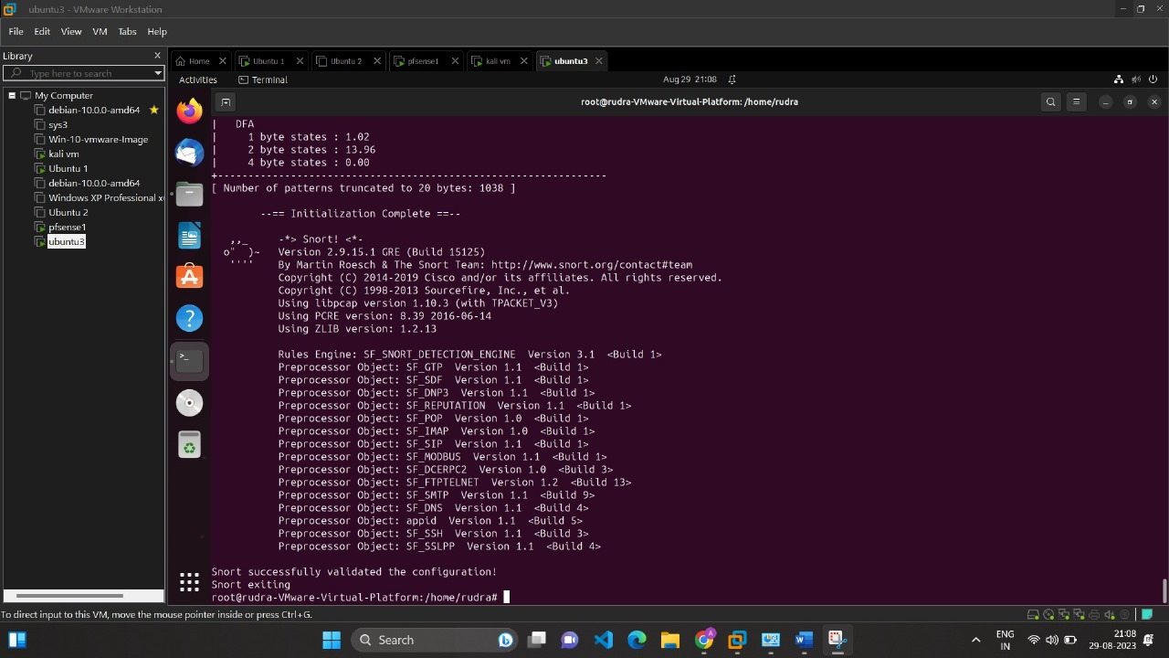
Snort successfully deployed for IDS and IPS

Slide 12
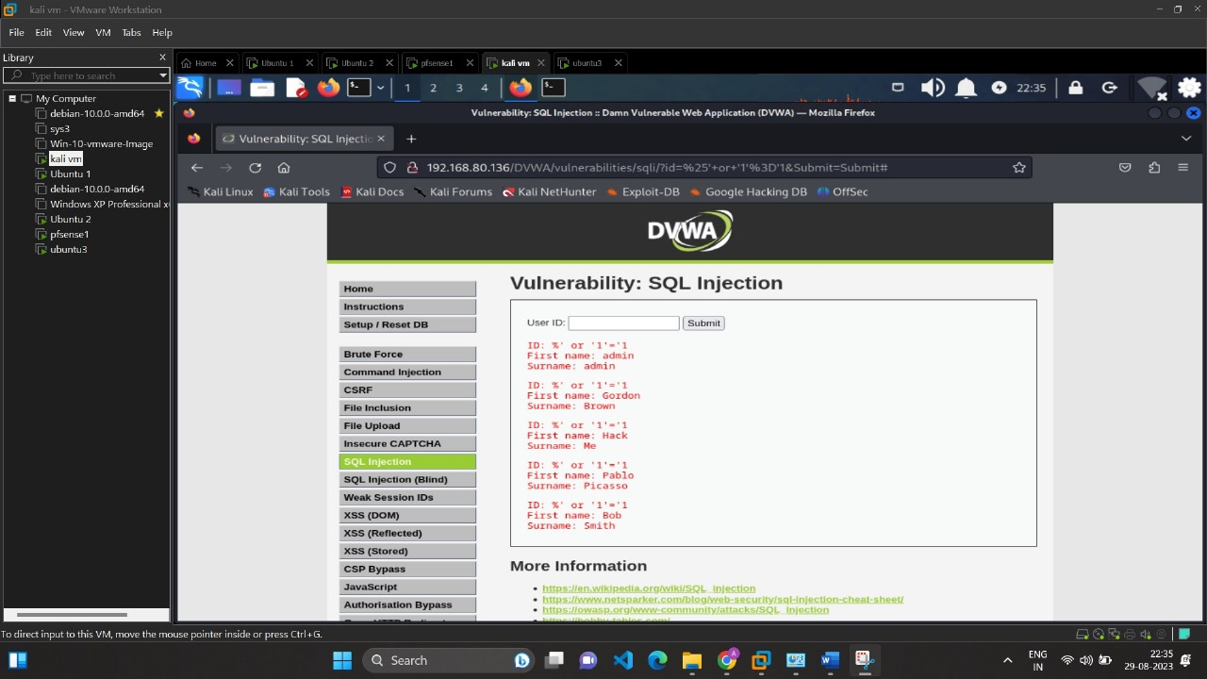
Different Attacks Testing SQL Injection Attack on Snort:

Slide 13
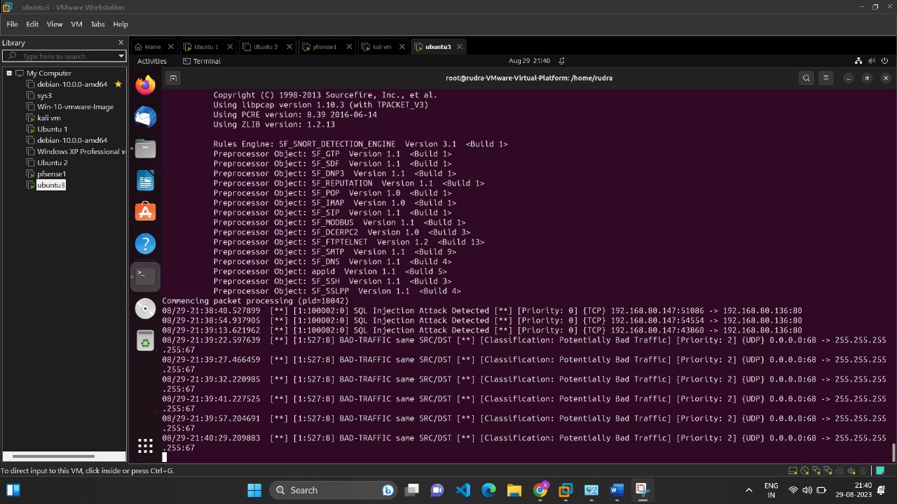

Slide 14
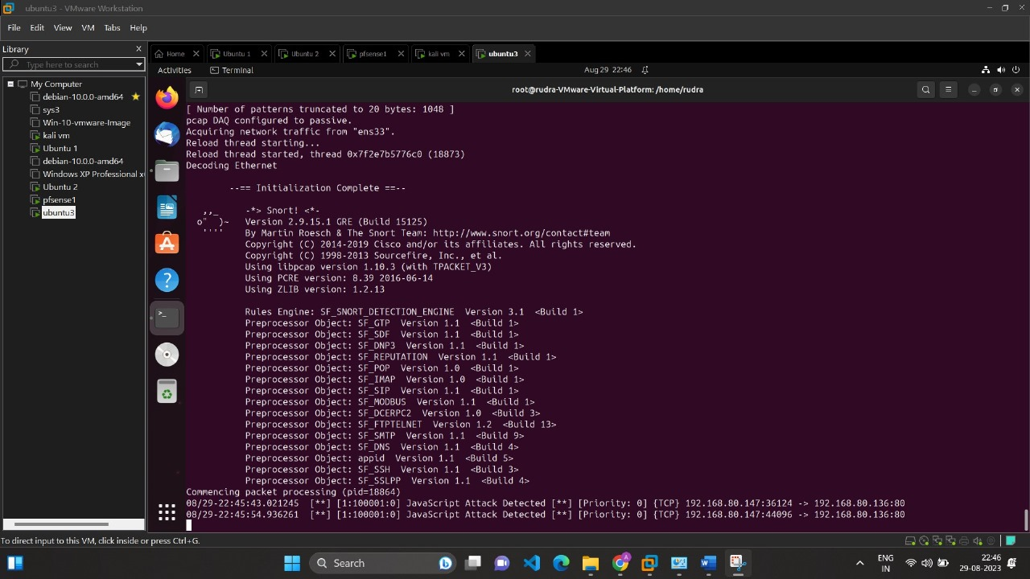
JavaScript Attack Testing On Snort:

Slide 15
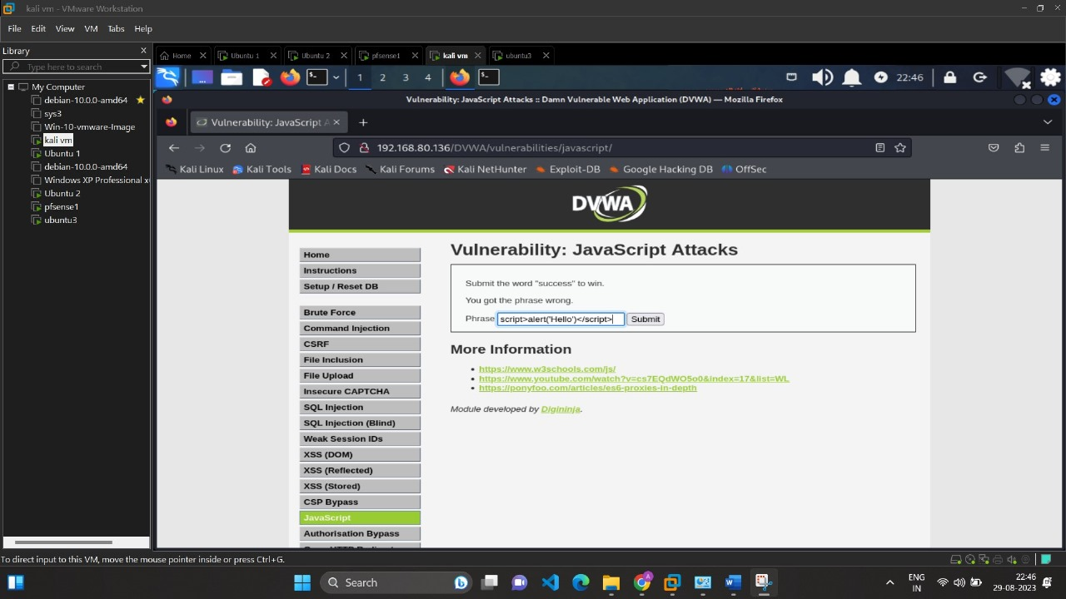

Slide 16
Conclusion
Enhanced Application Security:. The integration of Snort as a WAF within the pfsense network architecture has significantly bolstered the security of the web application. By actively monitoring and filtering incoming traffic, the system effectively detects and blocks a wide range of attacks, including SQL injection, cross-site scripting, and other common vulnerabilities
Real-time Threat Detection: The real-time nature of Snort's intrusion detection system has provided immediate threat detection capabilities. This is crucial in preventing attacks from successfully exploiting vulnerabilities in the web application. The dynamic rule-based approach of Snort allows for timely updates to address emerging threats.
Vulnerability Testing and Mitigation: The use of Damn Vulnerable Web Application (DVWA) as a testing platform has enabled the project team to simulate various attack scenarios, effectively gauging the effectiveness of the WAF. This has facilitated proactive vulnerability mitigation and fine-tuning of rule sets within Snort.

Slide 17
THANK YOU

