Slide 1
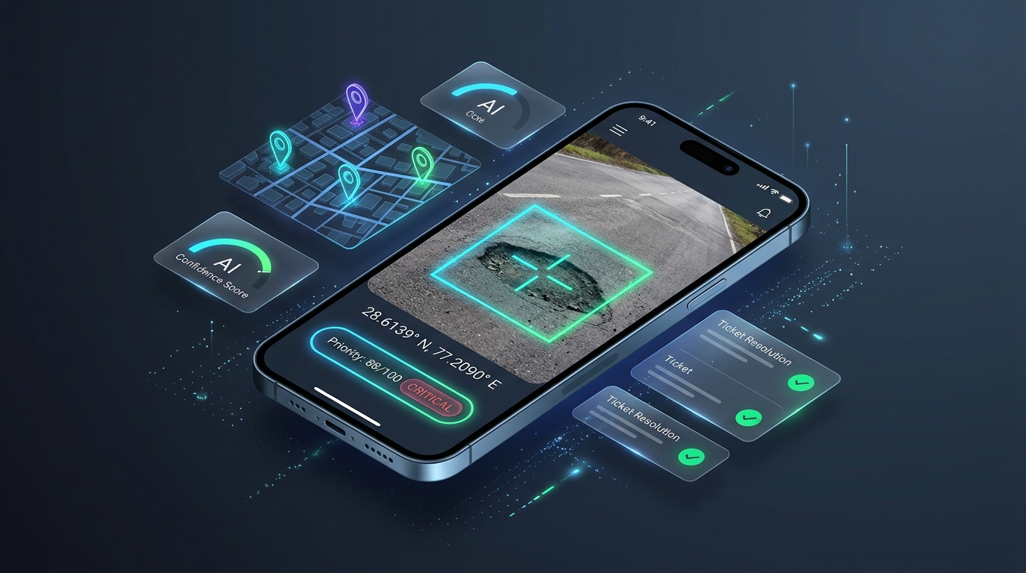
HACKNOVATE 2026 • PROBLEM STATEMENT 9
CivicPulse AI
Autonomous Civic Issue Intelligence & Transparent Resolution Protocol
Solving the Civic Black Hole through Explainable AI Priority Scoring (EDPS), Duplicate Ticket Suppression, and Verifiable Before/After Proof-of-Fix.
✔ AI Dynamic Priority (EDPS)
✔ Duplicate Shield (+1 Upvotes)
✔ Proof-of-Fix CV Verification

Slide 2
● OUR PROPOSED SOLUTION
CivicPulse: The 3 Pillars of Our Solution
A complete, closed-loop ecosystem bridging Citizens, AI Prioritization, and Municipal Field Teams.
PILLAR 1: SMART REPORTING
Frictionless Edge Capture
• Instant Geo-Tagging: 1-click photo automatically parses EXIF GPS metadata & reverse geocodes the exact street address.
• AI Multimodal Vision: Pre-classifies defect category (Pothole, Waste, Streetlight) with confidence score.
• Voice-First Ingestion: Speak grievances naturally in Hindi or English with real-time speech transcription.
• Zero Barriers: No tedious logins required. Designed for 100% citizen adoption.
PILLAR 2: ALGORITHMIC TRIAGE
Explainable Priority (EDPS)
• Mathematical Formulation: Calculates a dynamic 0–100 severity index combining 5 real-time vectors.
• Geospatial Zone Proximity: Distance-decay boost for defects near hospitals, schools, and transit hubs.
• Civic Equity Guarantee: Prevents less digitized wards from being deprioritized due to smartphone disparity.
• Plain-English Reasoning: Generates a human-readable audit card explaining why the score was assigned.
PILLAR 3: VERIFIABLE TRUST
Proof-of-Fix Protocol
• Before / After AI Audit: Repair crews must upload an After photo at the exact GPS coordinates; CV verifies fix.
• Community Consensus: Original reporter & nearby citizens vote to confirm quality before ticket archives.
• Public Milestone Tracker: Full public visibility from Reported → Triaged → Dispatched → Verified.
• Ward SLA Scorecards: Live ward rankings holding municipal contractors accountable.

Slide 3
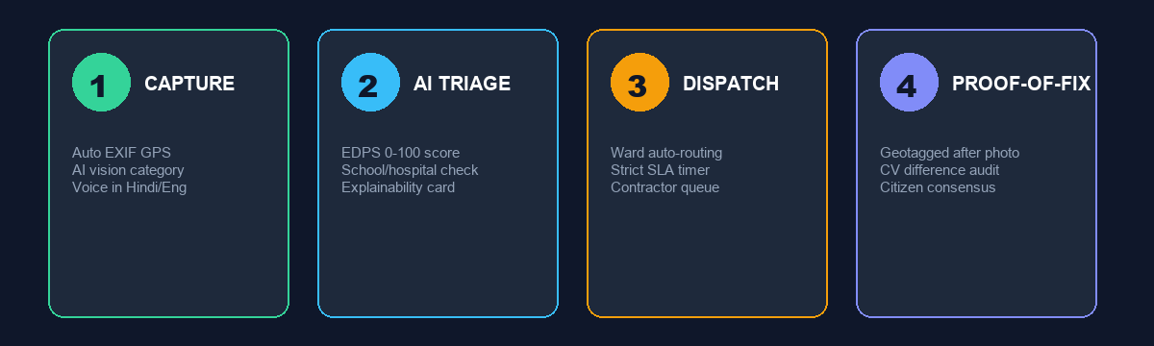
● SYSTEM WORKFLOW
How It Works: 4 Transparent Steps to Resolution
From citizen smartphone to automated triage, field repair, and public verification.
Step 1: Smart Capture
Citizen snaps photo. GPS coordinates, timestamp, and AI hazard bounding box are locked instantly.
Step 2: AI Triage (EDPS)
Calculates dynamic 0–100 priority score factoring in depth, hospital proximity, and crowd upvotes.
Step 3: Ward Dispatch
Auto-routed to the specific Ward Department (PWD/Sanitation) with a strict SLA countdown timer.
Step 4: Proof-of-Fix
Contractor uploads geotagged after-photo. AI diff checks repair, and citizens cast a verification vote.

Slide 4
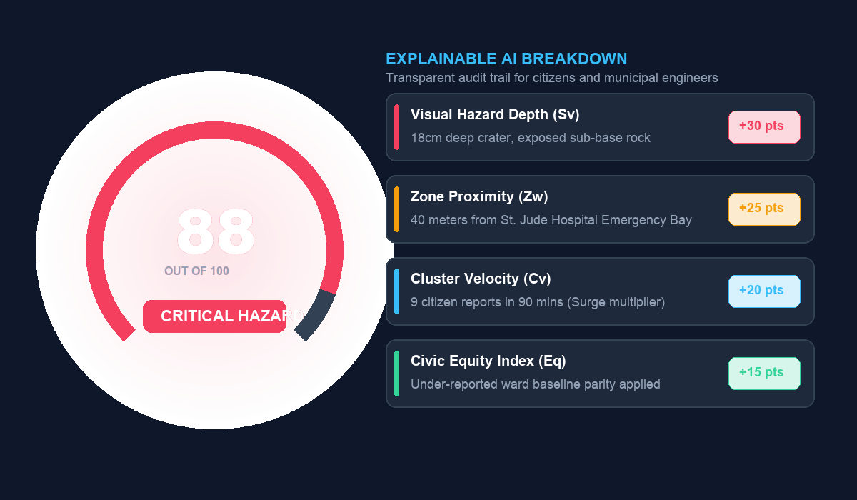
● THE ALGORITHMIC CORE
Explainable Dynamic Priority Scoring (EDPS Engine)
Directly tackling the hackathon challenge: genuine mathematical prioritization with transparent reasoning.
THE FORMULA: Priority = min( 100, 0.30·Sv [Hazard] + 0.25·Zw [Zone] + 0.20·Cv [Velocity] + 0.15·Eq [Equity] + 0.10·Te [SLA] )

Slide 5
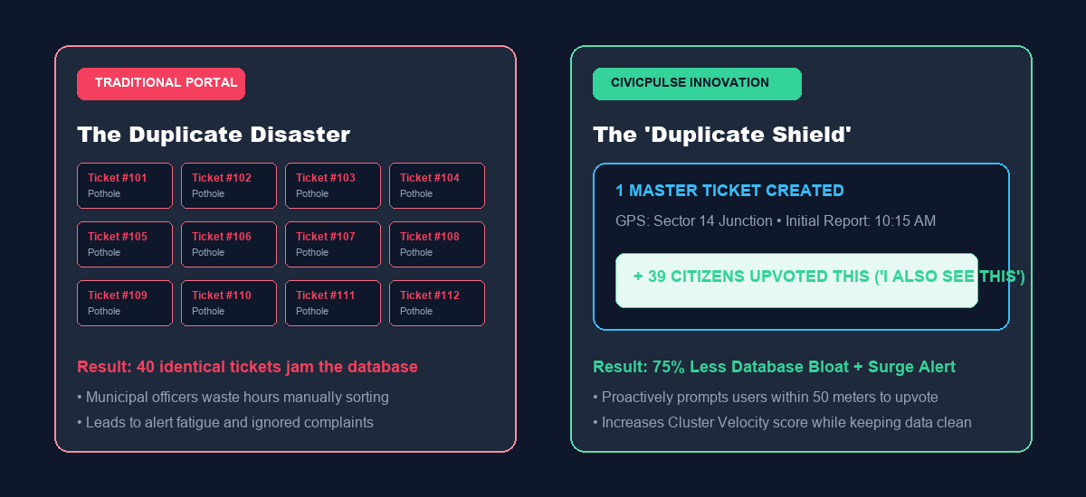
● MUNICIPAL EFFICIENCY
The 'Duplicate Shield': Eliminating Alert Fatigue
How CivicPulse solves the avalanche of redundant complaints that paralyze city engineers.
IMPACT: 75% Reduction in Database Bloat • Zero Alert Fatigue • Instant Emergency Surge Detection

Slide 6
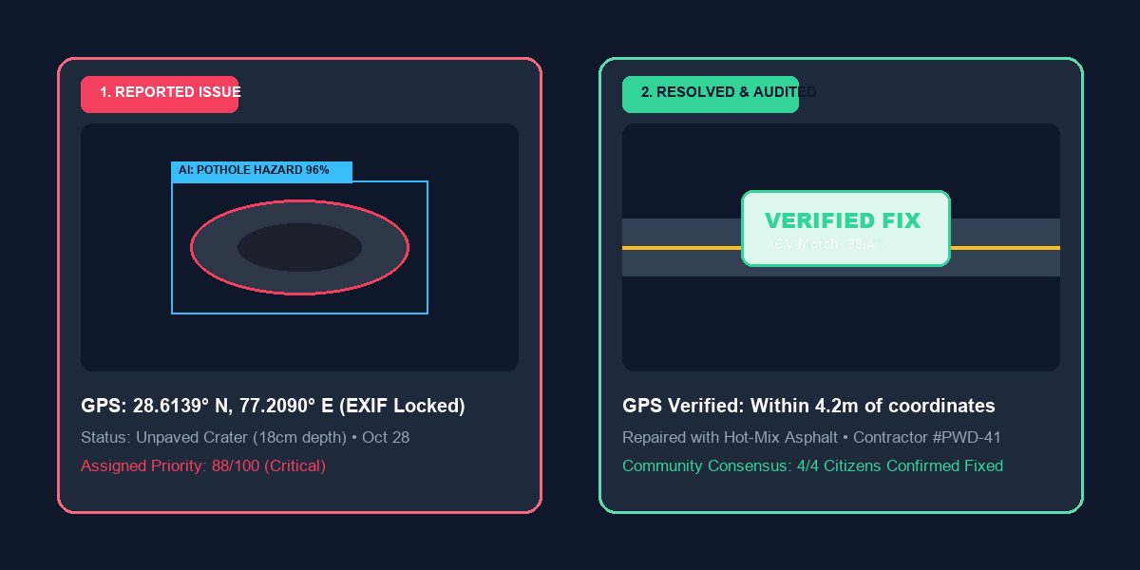
● PUBLIC ACCOUNTABILITY
The 'Proof-of-Fix' Protocol: Verifiable Closures
Restoring citizen trust through Computer Vision Before/After verification and community consensus.
CLOSING THE LOOP: Geotagged Photo Lock • AI Computer Vision Difference Analysis • 24-Hour Community Consensus Gate

Slide 7
● TWO-SIDED PLATFORM
Public Resolution Tracker & Municipal Command Center
Empowering both citizens and city administration through real-time geospatial intelligence.
FOR CITIZENS: PUBLIC RESOLUTION TRACKER
100% Transparent Civic Governance
• Live 5-Stage Journey: Real-time tracking: Submitted → AI Triaged → Dispatched → Repaired → Verified.
• Interactive GIS City Map: Search any neighborhood or ward to see active, in-progress, and resolved repairs.
• Explainability Cards: Every ticket displays the exact reason for its assigned priority score.
• Community Voice: Vote on the quality of completed repairs directly from your phone.
FOR CITY OFFICIALS: COMMAND CENTER
Data-Driven Municipal Operations
• Geospatial Hotspot Heatmap: Pinpoints civic failure density across urban sectors in real time.
• Automated SLA Countdown: Critical tickets trigger strict 24-hour clocks with auto-escalation to commissioners.
• Work-Order Routing: Automatically dispatches tickets to specific ward departments (PWD, Electricity, Sanitation).
• Ward Performance Leaderboard: Ranks contractors and ward officers by fix speed, quality, and citizen satisfaction.

Slide 8
HACKNOVATE 2026 • PROBLEM STATEMENT 9
Thank You!
CivicPulse AI: Turning Civic Frustration into Prioritized, Transparent Civic Action.
We are open for Questions & Feedback.
AI Explainable Dynamic Priority Scoring • Duplicate Shield • Verifiable Proof-of-Fix Protocol

