Slide 1


PROJECT PRESENTATION
Hospital Readmission Analytics & Prediction Using Public Data
Data Engineering and MLOps | Individual Project | Part 1: Data Pipeline Implementation
Student Name
: MOHNISH JAKHAR
USN
: 1CR23AI066
CMRIT, Bengaluru

Slide 2
CMR INSTITUTE OF TECHNOLOGY | DATA ENGINEERING AND MLOps
PROJECT PRESENTATION
1. Project Overview
The problem
Unplanned 30-day readmissions are costly and hard to spot early. Hospitals need a reliable, privacy-safe view of who is readmitted, why, and which patients are high risk.
3
5
different source types
mart tables
What Part 1 delivers
Multi-source ingestion with segregated raw zones
Cleaning, validation and integration on a patient-safe surrogate key
PostgreSQL healthcare mart orchestrated by Apache Airflow
Interactive Streamlit dashboard with 6 analytical views
6
4
dashboard views
interactive filters
Only de-identified public data is used; no personal patient information.
Student Name: MOHNISH JAKHAR | USN: 1CR23AI066
CMRIT 2

Slide 3
CMR INSTITUTE OF TECHNOLOGY | DATA ENGINEERING AND MLOps
PROJECT PRESENTATION
2. Dataset & Data Sources
SOURCE 1 | FILE
SOURCE 2 | REST API
SOURCE 3 | DOCUMENTS
UCI Diabetes 130-US Hospitals
NLM Clinical Tables ICD-9-CM
Clinical Feedback & Discharge Notes
Format: CSV, encounter-level
Ingestion: Python / Pandas file read
Attributes: Age, admission type, discharge disposition, specialty, diagnoses, readmission label
Size: 101,766 encounters x 50 attributes (130 hospitals, 1999-2008)
Access: Free download, UCI ML Repository
Format: JSON over HTTPS
Ingestion: Python API calls per diagnosis code
Attributes: ICD-9 code, official diagnosis description, lookup status
Size: One lookup per distinct primary diagnosis code
Access: Free public API, no key needed
Format: Unstructured text
Ingestion: Document ingestion + NLP keyword scoring
Attributes: risk_keyword_score, feedback_available
Size: Partial coverage, tracked as 'Notes Linked %'
Access: Student-generated, no real patient data
Common key: surrogate_key (patient-safe) | Each source keeps its own raw zone | DB credentials via environment variable (DATABASE_URL)
Student Name: MOHNISH JAKHAR | USN: 1CR23AI066
CMRIT 3

Slide 4
CMR INSTITUTE OF TECHNOLOGY | DATA ENGINEERING AND MLOps
PROJECT PRESENTATION
3. Proposed Data Architecture
SOURCES
RAW ZONES
CLEAN & MAP
INTEGRATE
DATA MART
ANALYTICS
UCI Encounters
CSV file
file raw
+ ingest metadata
Replace codes, dedupe, standardize
Join on
surrogate_key
Missing notes stay NULL + flag
PostgreSQL
readmissions
admissions
diagnoses
diagnosis_reference
specialty_feedback
Streamlit
6 views
4 filters
5 KPI cards
NLM ICD-9 API
REST / JSON
api raw
+ ingest metadata
Match code, flag lookup status
Discharge Notes
Text documents
document raw
+ ingest metadata
Parse text, keyword score
Apache Airflow DAG: ingest > validate > transform > load (scheduled, repeatable, logged)
Part 2: MLOps
Sources stay identifiable in separate raw zones until integration; only cleaned, validated data reaches the mart.
Student Name: MOHNISH JAKHAR | USN: 1CR23AI066
CMRIT 4

Slide 5
CMR INSTITUTE OF TECHNOLOGY | DATA ENGINEERING AND MLOps
PROJECT PRESENTATION
4. Data Ingestion Pipeline
1
2
3
4
5
Extract
Log metadata
Keep raw copy
Orchestrate
Handle errors
Pandas reads the CSV; Python calls the NLM API; note documents are read from disk.
Each run records source, extraction date, file/API status and row count.
Untouched extract saved in a separate raw zone per source.
Airflow DAG schedules the run; re-runs are repeatable.
Failed lookups and bad records are logged, flagged and retried, not dropped silently.
Ingestion metadata kept per source: source name | ingestion time | file / API status | row count
Security: DB credentials come from the DATABASE_URL environment variable; nothing is hard-coded.
Student Name: MOHNISH JAKHAR | USN: 1CR23AI066
CMRIT 5

Slide 6
CMR INSTITUTE OF TECHNOLOGY | DATA ENGINEERING AND MLOps
PROJECT PRESENTATION
5. ETL & Data Quality
Cleaning & transformation rules
Missing-data strategy
Replace special missing-value codes with NULL
Standardize age, admission type, discharge disposition and diagnosis fields
Remove duplicate and invalid encounters
Create patient-safe surrogate_key (no direct identifiers)
Validate mandatory vs optional fields before load
Write failures to rejected-record / error log
Situation | Handling
No discharge note for encounter | Keep NULL, set feedback_available = 0 (never 0-fill)
API returns no diagnosis match | Record diag_1_lookup_status, retry, exclude from diagnosis chart
Special code in source CSV | Convert to NULL, keep raw copy for traceability
Optional feature absent | Leave NULL; impute only if a model needs it (Part 2)
Student Name: MOHNISH JAKHAR | USN: 1CR23AI066
CMRIT 6

Slide 7
CMR INSTITUTE OF TECHNOLOGY | DATA ENGINEERING AND MLOps
PROJECT PRESENTATION
6. Database / Star Schema
admissions
readmissions (fact)
diagnoses
admission & discharge detail
surrogate_key (FK)
admission / discharge fields
one row per encounter
surrogate_key (PK)
readmitted_30d
length_of_stay
prior_admissions
diagnosis_count
high_risk_flag
age_group, medical_specialty
admission_type_name
discharge_disposition_name
feedback_available, risk_keyword_score
primary diagnosis per encounter
surrogate_key (FK)
diag_1, diag_1_description
diag_1_lookup_status
surrogate_key
surrogate_key
specialty_feedback
diagnosis_reference
Source 3: document signal
specialty-level feedback
keyword risk score
Source 2: NLM ICD-9 lookup
ICD-9 code
official description
Fact-centred (star-style) mart. surrogate_key is the patient-safe join key; diag_1 links to the ICD-9 reference.
Student Name: MOHNISH JAKHAR | USN: 1CR23AI066
CMRIT 7

Slide 8
CMR INSTITUTE OF TECHNOLOGY | DATA ENGINEERING AND MLOps
PROJECT PRESENTATION
7. Feature Engineering
Feature | Origin | Logic / purpose
readmitted_30d | Source 1 | Target label: readmitted within 30 days (1) or not (0)
length_of_stay | Source 1 | Days spent in hospital per encounter
prior_admissions | Source 1 | Count of earlier admissions for the patient
diagnosis_count | Source 1 | Number of documented diagnoses
high_risk_flag | Derived | 1 when prior_admissions >= 2 and diagnosis_count >= 7
age_group | Source 1 | Standardized age bracket for cohort analysis
diag_1_description | Source 2 | Official ICD-9 description of the primary diagnosis
risk_keyword_score | Source 3 | Count of risk keywords found in the discharge note
feedback_available | Source 3 | 1 if a note is linked, 0 if missing (NULL kept)
Student Name: MOHNISH JAKHAR | USN: 1CR23AI066
CMRIT 8

Slide 9
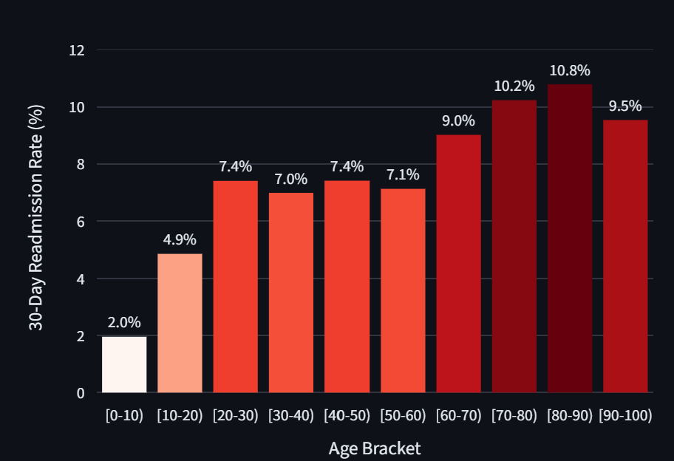
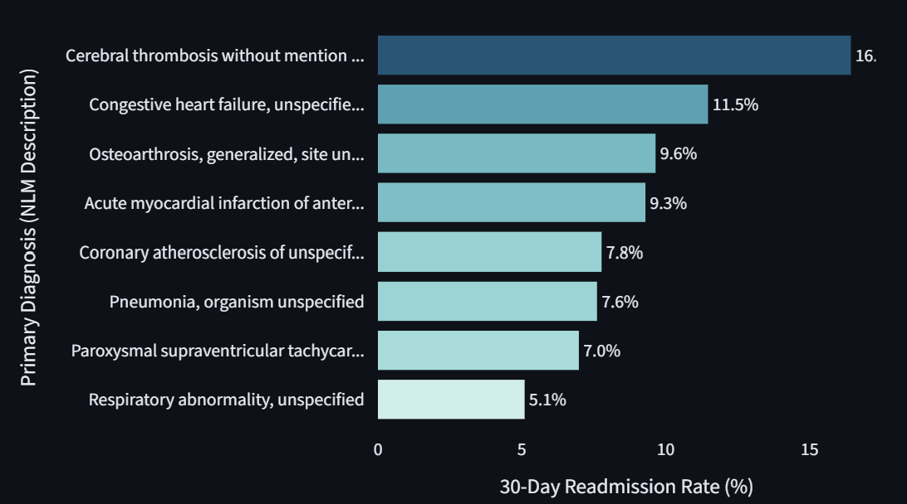
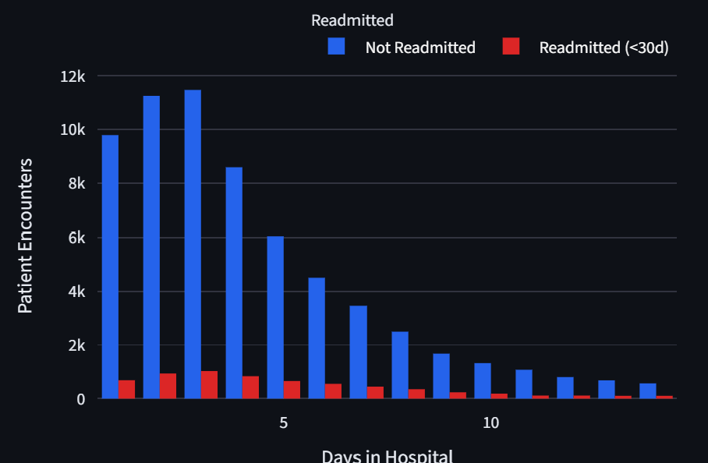
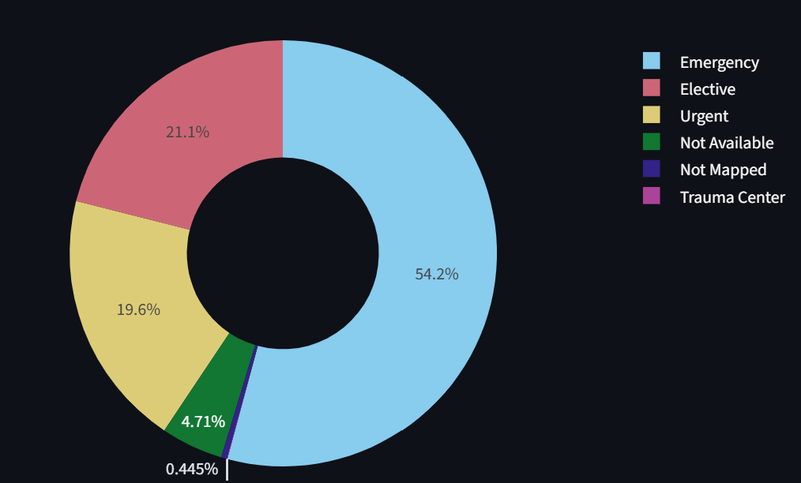
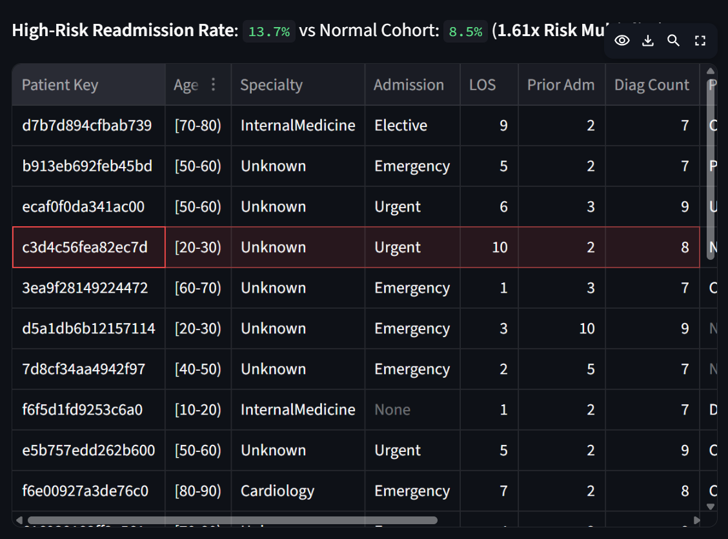
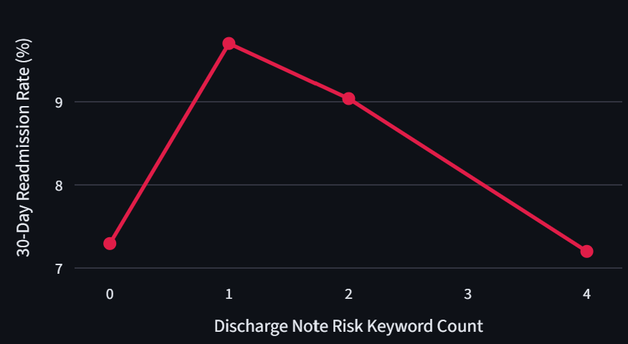
CMR INSTITUTE OF TECHNOLOGY | DATA ENGINEERING AND MLOps
PROJECT PRESENTATION
8. Dashboard & Analytics
1. Readmission rate by age group
2. Readmission by diagnosis (NLM API)
3. Length-of-stay distribution
Insert Streamlit screenshot
Insert Streamlit screenshot
Insert Streamlit screenshot
4. Admission types & discharge dispositions
5. High-risk cohort table & risk multiplier
6. Discharge-note risk signal (Source 3)
Insert Streamlit screenshot
Insert Streamlit screenshot
Insert Streamlit screenshot
Sidebar filters: Medical Specialty | Age Group | Clinical Risk Tier | Admission Type
Student Name: MOHNISH JAKHAR | USN: 1CR23AI066
CMRIT 9

Slide 10
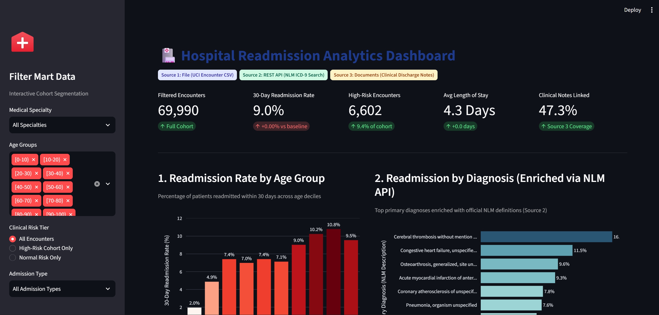
CMR INSTITUTE OF TECHNOLOGY | DATA ENGINEERING AND MLOps
PROJECT PRESENTATION
9. Pipeline Execution Evidence
1
Airflow DAG: successful run, all tasks green
2
Ingestion log: source, date, status, row count
Insert screenshot / log
Insert screenshot / log
3
PostgreSQL: populated mart tables
4
Streamlit dashboard: final output
Insert screenshot / log
Insert screenshot / log
One end-to-end run: ingestion > raw > validation > transformation > PostgreSQL > dashboard
Student Name: MOHNISH JAKHAR | USN: 1CR23AI066
CMRIT 10

Slide 11
CMR INSTITUTE OF TECHNOLOGY | DATA ENGINEERING AND MLOps
PROJECT PRESENTATION
10. MLOps Extension – Part 2
PLANNED | NOT PART OF PART 1
Target definition
Model candidates
MLflow tracking
Model registry
Predict 30-day readmission (readmitted_30d) with a chronological train / validation / test split.
Logistic Regression, Random Forest and XGBoost, compared on the same features.
Recall, precision, F1, ROC-AUC and calibration logged with parameters and artifacts.
Register and version the selected model for controlled promotion.
FastAPI + Docker
Explainability
Monitoring
Retraining criteria
Serve predictions via FastAPI in a Docker container; academic decision-support prototype only.
Feature importance and SHAP to explain individual risk scores.
Input data quality, drift, calibration, subgroup performance, latency and failures.
Retrain on drift or performance drop; document the full model lifecycle.
Student Name: MOHNISH JAKHAR | USN: 1CR23AI066
CMRIT 11

Slide 12
CMR INSTITUTE OF TECHNOLOGY | DATA ENGINEERING AND MLOps
PROJECT PRESENTATION
11. Results & Key Insights
9.0 %
6,602
4.3 days
47.3 %
30-day readmission rate
High-risk risk multiplier
Avg length of stay
Clinical notes linked
Three different source types were integrated on one patient-safe key into a single healthcare mart.
Cohort views by age, diagnosis, length of stay, admission and discharge show where readmissions concentrate.
High-risk cohort (2+ prior admissions and 7+ diagnoses) is compared with the normal cohort using a risk multiplier.
Discharge-note keyword score is tracked against readmission rate as an early-warning signal.
Student Name: MOHNISH JAKHAR | USN: 1CR23AI066
CMRIT 12

Slide 13
CMR INSTITUTE OF TECHNOLOGY | DATA ENGINEERING AND MLOps
PROJECT PRESENTATION
12. Challenges & Learning Outcomes
CHALLENGE
HOW IT WAS SOLVED
Three different formats (CSV, JSON, text)
Separate ingestion and raw zone per source, then map to one surrogate_key.
Not every encounter has a discharge note
Kept NULL with feedback_available flag instead of filling zeros.
API lookups can fail or find no match
diag_1_lookup_status records the outcome; only described diagnoses are charted.
Same code for dev and production databases
DATABASE_URL selects PostgreSQL; local SQLite fallback; cached reads.
Key learning outcomes
Multi-source ingestion
Missing-data strategy
Dimensional modelling
Airflow orchestration
Streamlit analytics
Student Name: MOHNISH JAKHAR | USN: 1CR23AI066
CMRIT 13

Slide 14
CMR INSTITUTE OF TECHNOLOGY | DATA ENGINEERING AND MLOps
PROJECT PRESENTATION
13. Conclusion & Future Scope
What was achieved
Future scope
Ingested 3 heterogeneous sources into segregated raw zones
Cleaned, validated and integrated data on a patient-safe key
Loaded a PostgreSQL healthcare mart via an Airflow-orchestrated ETL
Delivered an interactive dashboard with 6 views and 4 filters
Handled missing data transparently with flags, not zeros
Part 2: train and compare Logistic Regression, Random Forest, XGBoost
MLflow tracking, model registry, FastAPI and Docker serving
SHAP explainability and subgroup fairness checks
Drift and calibration monitoring with retraining triggers
Additional sources such as MIMIC-IV (credentialed access)
Student Name: MOHNISH JAKHAR | USN: 1CR23AI066
CMRIT 14

Slide 15
CMR INSTITUTE OF TECHNOLOGY | DATA ENGINEERING AND MLOps
PROJECT PRESENTATION
14. References
Data sources
Tools & documentation
UCI Machine Learning Repository: Diabetes 130-US Hospitals for Years 1999-2008
Strack et al. (2014), Impact of HbA1c Measurement on Hospital Readmission Rates, BioMed Research International
NLM Clinical Tables Search Service: ICD-9-CM diagnosis codes (clinicaltables.nlm.nih.gov)
Student-generated clinical feedback / discharge note text (no real patient data)
Python, Pandas, SQLAlchemy
Apache Airflow documentation
PostgreSQL documentation
Streamlit and Plotly documentation
Course brief: Project 5, Hospital Readmission Analytics and Prediction
Student guideline: multi-source segregation and missing-data handling
Student Name: MOHNISH JAKHAR | USN: 1CR23AI066
CMRIT 15

Slide 16
CMR INSTITUTE OF TECHNOLOGY | DATA ENGINEERING AND MLOps
PROJECT PRESENTATION
Thank You
Student Name: MOHNISH JAKHAR | USN: 1CR23AI066
Student Name: MOHNISH JAKHAR | USN: 1CR23AI066
CMRIT 16

