Slide 1

Translating Human-Readable Pseudo Code into C, C++, and Java
(PSEUDO CODE TO SOURCE CODE GENERATOR)
Presented by:
A. Surendra Naidu [CSE23004]
G. Mohnish Krishna [CSE 23013]
Mokshagna K [CSE 22502]
Department of Computer Science
Course: Compiler Design (23CSE314)
Submitted to: : Dr.K.S.Lakshmi Prasanna Mam

Slide 2

Table of Contents
01
Introduction & Objective
08
Abstract Syntax Tree (AST)
02
Base Paper - Literature Review
09
Code Generation
03
Problem Statement
10
GUI Interface
04
System Architecture
11
Live Demo Example
05
Compiler Phases
12
Technologies Used
06
Lexical Analysis (Lexer)
13
Future Enhancements
07
Syntax Analysis (Parser)
14
Conclusion

Slide 3
Introduction & Objective
This project is a complete Pseudo Code to Source Code Generator— a compiler that translates human-readable pseudo code into compilable and executable source code.
It demonstrates the core phases of compiler design: Lexical Analysis, Syntax Analysis (Parsing), AST Construction, and Code Generation.
The system supports multiple target languages: C, C++, and Java.
A graphical user interface (GUI) built with Tkinter makes it user-friendly and interactive.
🎯 Project Objectives
Build a working compiler from scratch in Python
Implement all four phases of compilation
Support multi-language code generation (C, C++, Java)
Handle complex expressions, strings, loops, functions
Provide an interactive GUI for easy use
Display token analysis for educational insight

Slide 4

Problem Statement
Writing source code in languages like C, C++, or Java requires detailed knowledge of syntax, headers, libraries, and language-specific conventions.
For students & beginners, this step learning curve makes it difficult to focus on algorithmic thinking and logic design.
❌ The Problem
✅ Our Solution
• Each language has unique syntax rules
• Headers & boilerplate code add complexity
• String handling differs across languages
• Students spend time on syntax, not logic
• Write simple pseudo code once
• Compiler translates it to C, C++, or Java
• Handles all headers, types, and syntax automatically
• Focus on logic — the tool handles the rest

Slide 5
Base Paper - Literature Review
Reference paper that inspired and guided this project
JETIR1904017 - Auto Source Code Generator
• Authors: Sagar Kesarkar, Prakash Karpe, Rahul Jadhav, Prof. Diksha Bhave
• Published: JETIR (Journal of Emerging Technologies and Innovative Research), April 2019, Volume 6, Issue 4
• Institution: Shivajirao S. Jondhale College of Engineering, Dombivli East, Maharashtra
Base Paper Summary
Our Enhancements Over Base Paper
• Translates pseudo code into C, C++, and HTML
• Uses compiler phases: analysis & synthesis
• NLP-based tokenization with POS database
• Desktop GUI built with Python + Tkinter
• Generates intermediate file, validates semantics
• Uses MySQL database for token mapping
• Added Java as a third target
• Full AST-based compilation (not just token mapping)
• No external database needed - self-contained compiler
• 30+ token types with proper lexer (vs. NLP approach)
• Recursive descent parser with error recovery
• Handles complex expressions, strings, arrays, functions

Slide 6
System Architecture
High-level overview of the compilation pipeline
📝 Pseudo Code
(Input)
🔤 Lexer
(Tokenization)
🌳 Parser
(Syntax Analysis)
📊 AST
(Abstract Syntax Tree)
💻 Code Generator
(C / C++ / Java)
→
→
→
→
The Lexer breaks the input into tokens (keywords, identifiers, operators, literals).
The Parser performs syntax analysis and builds an Abstract Syntax Tree (AST).
The Code Generator traverses the AST and emits target-language source code.
Each phase is implemented as a separate Python class for clean modular design.

Slide 7
Compiler Phases
Four essential phases implemented in this project
1. Lexical Analysis
Class: Lexer
Breaks pseudo code into tokens — keywords, identifiers, operators, literals, etc.
2. Syntax Analysis
Class: Parser
Validates token sequence and builds a structured parse tree (AST).
3. AST Construction
10+ AST Node Types
Creates an Abstract Syntax Tree with nodes for each language construct.
4. Code Generation
3 Generator Classes
Traverses the AST and emits syntactically correct C, C++, or Java code.

Slide 8
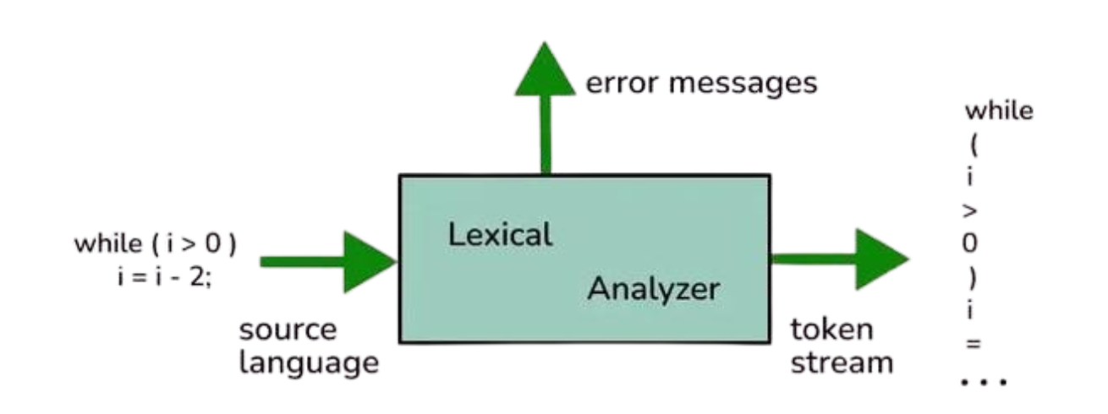
Lexical Analysis — The Lexer
Tokenization of pseudo code input
Scans the input character-by-character
Recognizes 30+ token types (keywords, operators, literals)
Handles strings with escape sequences
Tracks line and column numbers for error reporting
Supports aliases (e.g., 'display' → PRINT, 'read' → INPUT)
# Example Tokenization:
Input: "set x to 10 + y"
Tokens: SET → 'set'
IDENTIFIER → 'x'
TO → 'to'
NUMBER → '10'
PLUS → '+'
IDENTIFIER → 'y'
🔤 Supported Token Types
Keywords: START, END, IF, ELSE, WHILE, FOR, PRINT, INPUT...
Data Types: INTEGER, FLOAT, STRING
Operators: +, -, *, /, %, ==, !=, <, >, <=, >=
Logical: AND, OR, NOT
Delimiters: (, ), [, ], {, }, comma, semicolon
Literals: Numbers, Strings (single & double quotes)

Slide 9
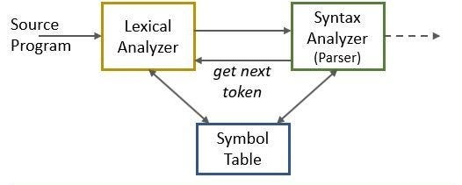
Syntax Analysis — The Parser
Building the Abstract Syntax Tree from tokens
Recursive descent parser that processes the token stream
Validates the syntactic structure of the pseudo code
Handles nested constructs (if-else, loops within loops)
Supports expression parsing with operator precedence
Error recovery with descriptive error messages
Strips NEWLINE tokens for cleaner parsing
📋 Supported Constructs
While-EndWhile loops
For-To-EndFor loops
Function definitions & calls
Return, Continue, Break statements
Complex expressions with operators
Variable declarations (DECLARE integer x)
Assignments (SET x TO expression)
Print/Display statements
Input/Read statements
If-Else-EndIf conditionals

Slide 10
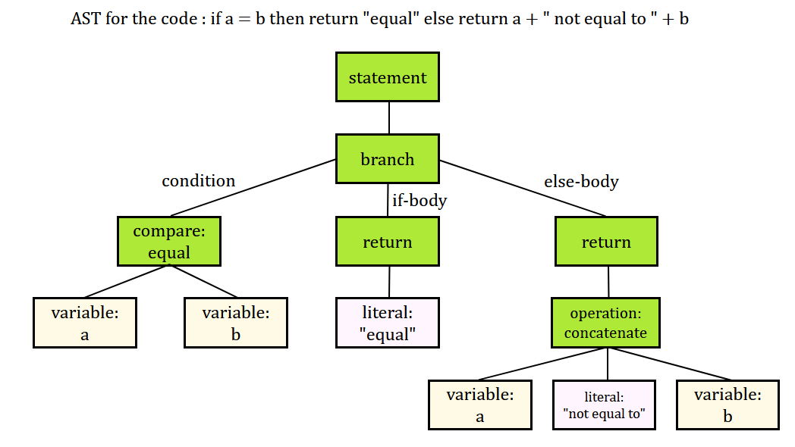
Abstract Syntax Tree (AST)
The intermediate representation of the parsed code
Program
If Statement
Root node: list of statements
Condition, then-block, else-block
Declaration
While Loop
Type, variable name, optional size
Condition and body
Assignment
For Loop
Variable and expression
Variable, start, end, body
Print Statement
FunctionDef
Expression to output
Name, parameters, body
Input Statement
Return Statement
Variable to read into
Expression to return

Slide 11
Code Generation
Translating AST to target language source code
C Code Generator
C++ Code Generator
Java Code Generator
• Uses stdio.h, stdlib.h, string.h, ctype.h
• char arrays for strings with fgets()
• printf/scanf for I/O
• Correct format specifiers (%d, %f, %s)
• Uses iostream, string, cctype
• std::string for string handling
• cout/cin with getline() for strings
• strlen() → .length() conversion
• Generates class Main structure
• Uses Scanner for input
• String type with .length()/.charAt()
• Character class methods for char ops
✨ Key Feature: Each generator creates a fresh instance per compilation for clean state management

Slide 12

Graphical User Interface
Built with Python Tkinter — Interactive & User-Friendly
• Split-pane layout: Input (left) & Output (right)
• Tabbed output: 'Generated Code' and 'Tokens' tabs
• Language selection via Radio Buttons (C, C++, Java)
• Action buttons: Compile, Clear, Save, Load
• Responsive 1200×800 window with dark theme
• Real-time compilation with success/error feedback
⚡ Functionality
🎨 Design Features
• One-click compilation to any target language
• Save generated code to .c, .cpp, .java files
• Load pseudo code from .txt files
• Token table with type, value, line, column info
• Professional dark theme (#2c3e50 palette)
• Consolas monospace font for code
• Color-coded token display (green on dark)
• Emoji icons for visual appeal

Slide 13
Live Demo — Leap Year Checker
Pseudo code input and generated C output
📝 Pseudo Code Input
💻 Generated C Code
start
declare integer year
set year to 2024
if year % 4 == 0 then
if year % 100 == 0 then
if year % 400 == 0 then
set isLeap to 1
endif
else
set isLeap to 1
endif
endif
if isLeap == 1 then
print "LEAP YEAR"
else
print "NOT a leap year"
endif
end
#include <stdio.h>
#include <stdlib.h>
#include <string.h>
#include <ctype.h>
int main() {
int year;
year = 2024;
if (year % 4 == 0) {
if (year % 100 == 0) {
if (year % 400 == 0) {
int isLeap = 1;
}
} else {
int isLeap = 1;
}
}
if (isLeap == 1) {
printf("LEAP YEAR\n");
} else {
printf("NOT a leap year\n");
}
return 0;
}

Slide 14
Technologies Used
Python 3.x
Core programming language for the entire compiler
Tkinter
GUI framework for the desktop application interface
Regular Expressions
Pattern matching for C++ expression conversion
Enum & Dataclass
Token type definitions and structured token data
Object-Oriented Design
Separate classes for Lexer, Parser, Generators, GUI

Slide 15
Future Enhancements
🐍 Python Code Generation
⚡ Optimization Pass
• Add Python as a fourth target language
• Dead code elimination, constant folding, loop optimization
🔧 Semantic Analysis
🌐 Web-Based Interface
• Type checking, scope validation, and semantic error detection
• Convert the Tkinter GUI to a web app using Flask or Django
📦 Array & Data Structure Support
📄 HTML/CSS Generation
• Multi-dimensional arrays, linked lists, and custom types
• Generate web page code from pseudo code descriptions

Slide 16
Conclusion
• Successfully built a complete pseudo code compiler that covers all four phases of compilation: Lexical Analysis, Parsing, AST Construction, and Code Generation.
• The system generates syntactically correct, compilable code in C, C++, and Java from simple pseudo code input.
• The modular OOP architecture makes it easy to add new target languages and language constructs.
• The interactive Tkinter GUI with token visualization makes it an excellent educational tool for understanding compiler design.
1,300+
30+
10+
3
Lines of Code
Token Types
AST Node Types
Target Languages

Slide 17
Research Paper Interest
Are we interested in publishing a research paper based on this project?
  ☐ Yes
  ☑ No

Slide 18
Thank You!
Department of Computer Science
Course: Compiler Design
Submitted to: Dr.K.S.Lakshmi Prasanna Mam
A.Surendra Naidu (23004) | G.Mohnish Kumar (23013) | K.Mokshagna (22502)

