Slide 1

INFORMATION SECURITY | RESEARCH PROTOTYPE
Identity Shield
An Aadhaar-Inspired Multi-Layer Defense Framework Against Biometric Identity Impersonation
PRESENTED BY
G Mohnish Krishna – AV.SC.U4CSE23013
Pallapothu Moulika – AV.SC.U4CSE23036
GUIDED BY
Dr. Raghavendra Narayan

Slide 2
Aadhaar and the Digital Security Challenge
Aadhaar is India's 12-digit unique ID, linked to demographic data and biometrics: fingerprint, iris and face
Used for banking, KYC, subsidies, SIM issuance and e-governance
Authentication means matching a fresh sample against stored records, at national scale
One central system holds the identity of over a billion residents
CORE DIGITAL SECURITY PROBLEM
Permanent
Biometrics cannot be reset like a password once stolen
Centralized
One breach or linkage attack exposes many identities
Spoofable
Fake fingerprints, printed photos and deepfakes can impersonate a user

Slide 3
How Aadhaar Authentication Works
User
ID number + fingerprint or face
Capture device
Scans biometric and encrypts it
Auth service
Forwards request to UIDAI
UIDAI database
Compares with enrolled template
Response
Yes / No match result
HOW ATTACKERS GET IN
1 Stolen ID and data
Leaked Aadhaar number and demographics from breaches or phishing
2 Fake fingerprint
Silicone or gelatin copies made from lifted or stolen fingerprint images
3 Fake face
Printed photo, screen replay or deepfake shown to the camera
4 Database or replay
Breach of the central store, or replay of captured biometric data
Identity Shield defends attacks 1 to 3 at authentication time and stores credentials only as hashes.

Slide 4
Base Papers Used
Paper 1 | Aadhaar Security Survey
Paper 2 | DeepFace
Debanjan Sadhya, Tanya Sahu. Computers & Security, vol. 140, 2024. DOI 10.1016/j.cose.2024.103782
Taigman, Yang, Ranzato, Wolf. CVPR 2014
Reviews demographic and biometric data security
Threats: fake biometrics, cloning, breaches, linkage attacks
Privacy risks of centralized biometric databases
A survey only: proposes no executable system
Pipeline: detect, align, deep representation, classify
Deep features beat hand-crafted features for verification
Verification = comparing embeddings by distance
We use the DeepFace library with the FaceNet model (Schroff et al., 2015)
Our contribution: turn the survey’s threats into a working, measurable defense pipeline.

Slide 5
Aadhaar 2024 Survey: What We Implemented
Concern raised in the survey | What we implemented
Fake biometrics and spoofing | Face and fingerprint PAD gates (Random Forest)
Exposure of identity numbers | Credentials stored only as SHA-256 hashes
Weak single-factor checks | 5 sequential hard-stop gates: ID, face, fingerprint
Centralized template linkage | Separate tables for credentials, templates, demographics; synthetic data only
No audit trail of attempts | Every attempt logged with gate results and attack type
How we used the DeepFace paper (Gate 3)
Each face becomes a 128-dimensional FaceNet embedding [3], computed through the DeepFace library [2]. Same person gives a small distance, different people a large one. Access continues only if the distance is below the model threshold.

Slide 6
Research Gap, Question and Hypothesis
2024 reference paper [1]
Our work
A security and privacy survey
Describes threats and preventive measures
Covers the broad Aadhaar ecosystem
Descriptive: no executable system
Executable prototype
Controlled attack simulation
Face + fingerprint, 5 sequential gates
Quantitative, gate-wise evaluation
RESEARCH QUESTION
How effective is a sequential multi-layer authentication architecture in preventing unauthorized access when a valid credential is combined with incorrect or presentation-attacked biometric evidence?
HYPOTHESIS
Combining credential verification, biometric matching and presentation-attack detection across face and fingerprint will reduce unauthorized acceptance compared with credential-only or single-biometric authentication in a controlled experiment.

Slide 7
Datasets and Synthetic Identity Creation
Faces: Biggest Gender/Face Recognition Dataset [5]
Large set of face images (men and women) used as enrolled and probe faces
Fingerprints: SOCOFing [4]
6,000 real prints from 600 subjects plus 55,000+ altered copies, used as spoof samples
BUILDING THE SYNTHETIC IDENTITY DATASET
1 Label gender
Faces: pretrained FairFace-based gender classifier (label + confidence). Fingerprints: M/F from the SOCOFing filename.
2 Pair biometrics
One face and one fingerprint of the same gender per identity; faces renamed male_ / female_
3 Generate details
Random Indian name, age 18 to 80, gender and address
4 Aadhaar-style ID
Unique 12-digit number, no digit repeated more than twice, stored as SHA-256 hash
Output: aadhaar_dataset.csv, loaded into SQLite (hash, template paths, demographics).

Slide 8
System Architecture: 5-Gate Pipeline
INPUT: 12-digit identity number + face image + fingerprint image
1
2
3
4
5
Credential check
SHA-256 hash lookup
Static face PAD
Random Forest on RGB histograms
Face match
FaceNet embeddings, 1:1 distance
Fingerprint PAD
Random Forest on grayscale stats
Fingerprint match
ORB keypoints + BFMatcher
FAIL: BLOCK
FAIL: BLOCK
FAIL: BLOCK
FAIL: BLOCK
FAIL: BLOCK
ACCESS GRANTED
All 5 gates pass: a digital identity card is generated from the matched record
ACCESS BLOCKED
Failing gate reported; every attempt logged in SQLite

Slide 9
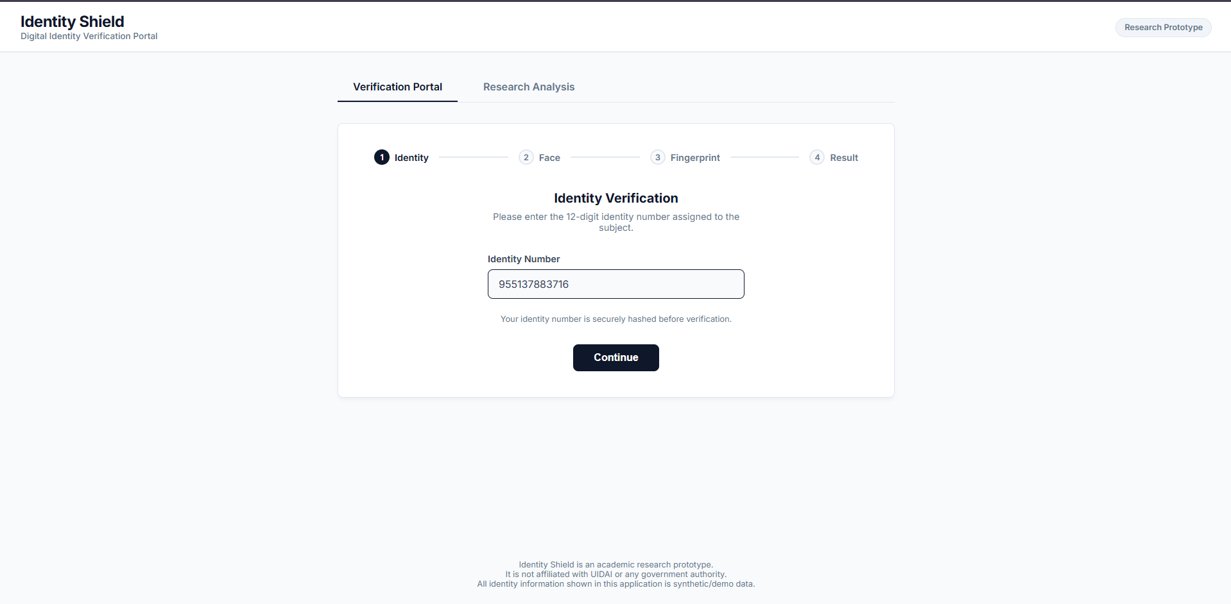
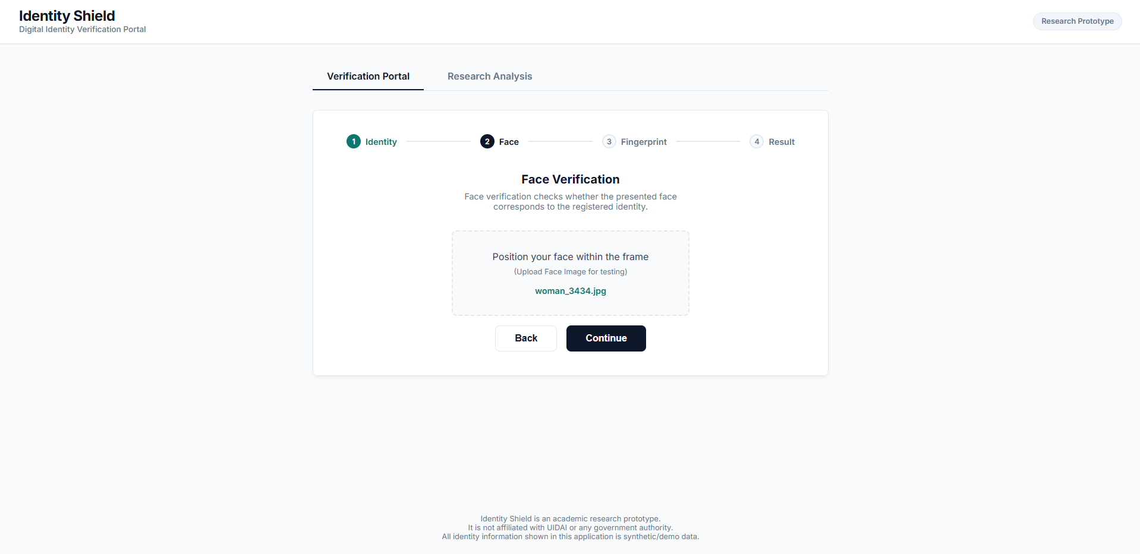
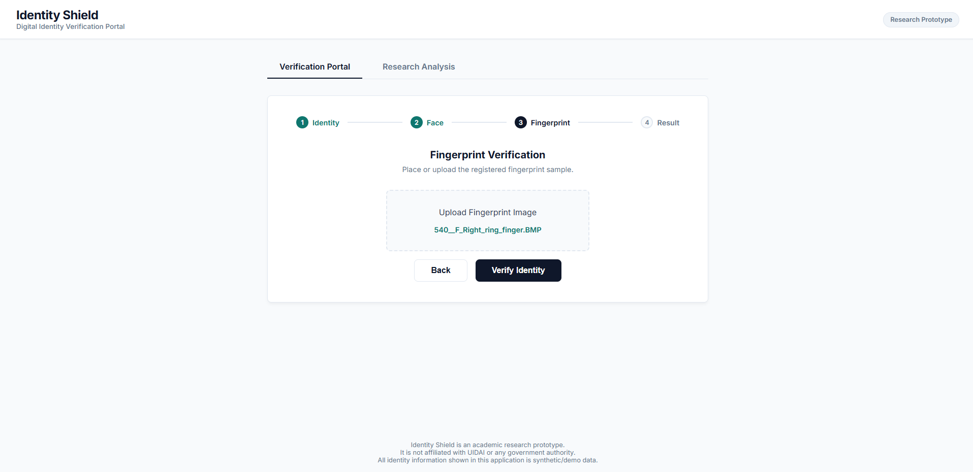

Implementation and Test Cases
TEST CASES (expected block point)
Genuine user: access granted (shown)
Wrong ID number: Gate 1
Fake / GAN face: Gate 2
Other person’s face: Gate 3
Altered fingerprint: Gate 4
Other person’s fingerprint: Gate 5
1 Enter identity number
2 Upload face
3 Upload fingerprint
4 Result: identity verified

Slide 10
Attack Scenarios and Expected Outcomes
Category | Scenario | Expected block point
Credential | Invalid ID, or one digit of a valid ID changed | Gate 1
Face | Valid ID + another person’s face | Gate 3
Face | Synthetic or fake face image | Gate 2
Fingerprint | Valid ID + another person’s fingerprint | Gate 5
Fingerprint | Altered or latent fingerprint | Gate 4
Cross-modal | Correct face + wrong fingerprint | Gate 5
Cross-modal | Wrong face + correct fingerprint | Gate 3
Cross-modal | Wrong face + wrong fingerprint | Gate 3 (fails early)
Robustness | Heavily blurred target face | Gate 2 or Gate 3
System | Step bypass: backend enforces the order, missing input is blocked | Fusion engine
Baseline | Genuine user, all inputs correct | Access granted
Expected outcomes by design. Measured results to be added after the test suite is executed.

Slide 11
Real vs Fake Detection: Models Used
Gate | Model | Features | Decision
1 Credential | SHA-256 (hashlib) | 12-digit ID to 64-char hash | VALID / INVALID
2 Face PAD | Random Forest (100 trees, depth 10) | 96-dim RGB histogram, 128x128 | LIVE / SPOOF
3 Face match | FaceNet via DeepFace [2,3] | 128-dim embedding distance | MATCH / NON_MATCH
4 Fingerprint PAD | Random Forest (100 trees, depth 10) | 34-dim histogram + mean + std, 96x96 | GENUINE / SPOOF
5 Fingerprint match | ORB + BFMatcher (Hamming) [9] | Binary keypoints, at least 15 good matches | MATCH / NON_MATCH
Fake or spoofed input
PAD gates (2 and 4) reject spoofs before any matching happens
Wrong person
Match gates (3 and 5) reject impostors with genuine-looking samples

Slide 12
Models Used: Machine Learning vs Deep Learning
MACHINE LEARNING
Random Forest
Gates 2 and 4: face and fingerprint PAD
DEEP LEARNING
FaceNet CNN
Gate 3: face verification via DeepFace [2,3]
CLASSICAL VISION
ORB + BFMatcher
Gate 5: fingerprint matching [9]
100 decision trees, max depth 10 [8]
Hand-crafted histogram features
Face: 96-dim RGB. Fingerprint: 34-dim grayscale
Output: genuine or spoof with probability
Why: fast, small features, easy to explain
Deep CNN trained with triplet loss
128-dim embedding for each face
Small distance = same person
Also: a pretrained FairFace-based CNN labels gender of face images [10]
FAST keypoints + binary descriptors
Hamming distance matching
At least 15 good matches = MATCH
Not learned: a baseline, not minutiae / AFIS matching
Gate 1 (SHA-256) is hashing, not a learned model. CNN-based PAD in place of Random Forest is future work.

Slide 13
Experimental Design and Results
Configuration | Layers used
A Credential only | Gate 1
B Credential + face | Gates 1, 3
C Credential + face + fingerprint | Gates 1, 3, 5
D Full Identity Shield | Gates 1 to 5
Same attack scenarios run on all four configurations.
Metric shown: unauthorized acceptance rate (UAR). FAR, FRR, processing time and confusion matrices are still to be added.
Ethics and scope: synthetic identities only, no real Aadhaar records, no UIDAI API, controlled research-only attack simulation [7].
UAR falls from 100.0% (credential only) to 9.0% (full system) on a sampled run of the attack set.

Slide 14
Results: Attack Detection by Category
READING THE RESULTS
Credential attacks: 100% detected
Face attacks: 98%. Cross-modal attacks: 96%
Fingerprint is the weakest at 84%, in line with the histogram PAD and ORB baselines
Sampled simulation run: confirm on the full attack set before final claims

Slide 15
Survey Baseline vs Identity Shield
Attack | ID + matching | Identity Shield
Wrong face | ✓ | ✓
Wrong fingerprint | ✓ | ✓
Fake face (photo / GAN) | ✗ | ✓
Fake fingerprint | ✗ | ✓
Qualitative comparison from system design. ✓ = detected and blocked. The baseline has no presentation-attack detection.

Slide 16
Conclusion
Turned the Aadhaar 2024 survey’s threats into a working 5-gate defense pipeline
Combined credential hashing, presentation-attack detection and 1:1 matching for face and fingerprint
Every gate is a hard stop and every attempt is logged
Runs end to end on synthetic identities built from SOCOFing and a large face dataset
LIMITATIONS AND FUTURE WORK
Dataset pairings are not validated identity ground truth
Static-image PAD is not physical liveness: add video or challenge-response
ORB is a baseline: move to minutiae-based matching
Synthetic IDs only: no UIDAI integration or real Aadhaar data
Report measured accuracy, FAR and FRR
CNN-based PAD and a larger validated dataset

Slide 17
References
D. Sadhya, T. Sahu, "A Critical Survey of the Security and Privacy Aspects of the Aadhaar Framework," Computers & Security, vol. 140, art. 103782, 2024. doi:10.1016/j.cose.2024.103782
Y. Taigman, M. Yang, M. Ranzato, L. Wolf, "DeepFace: Closing the Gap to Human-Level Performance in Face Verification," CVPR, 2014. openaccess.thecvf.com/content_cvpr_2014/html/Taigman_DeepFace_Closing_the_2014_CVPR_paper.html
F. Schroff, D. Kalenichenko, J. Philbin, "FaceNet: A Unified Embedding for Face Recognition and Clustering," CVPR, 2015. openaccess.thecvf.com/content_cvpr_2015/html/Schroff_FaceNet_A_Unified_2015_CVPR_paper.html
Y. I. Shehu, A. Ruiz-Garcia, V. Palade, A. James, "Sokoto Coventry Fingerprint Dataset (SOCOFing)," arXiv:1807.10609, 2018. kaggle.com/datasets/ruizgara/socofing
M. Gronczynski, "Biggest Gender/Face Recognition Dataset," Kaggle. kaggle.com/datasets/maciejgronczynski/biggest-genderface-recognition-dataset
LivDet: Fingerprint Liveness Detection Competition. livdet.org
UIDAI, Authentication FAQs (general concept only; no affiliation). uidai.gov.in/en/303-faqs/authentication.html
L. Breiman, "Random Forests," Machine Learning, vol. 45, no. 1, pp. 5-32, 2001. doi:10.1023/A:1010933404324
E. Rublee, V. Rabaud, K. Konolige, G. Bradski, "ORB: An Efficient Alternative to SIFT or SURF," ICCV, 2011.
K. Karkkainen, J. Joo, "FairFace: Face Attribute Dataset for Balanced Race, Gender and Age," WACV, 2021.

