Slide 2
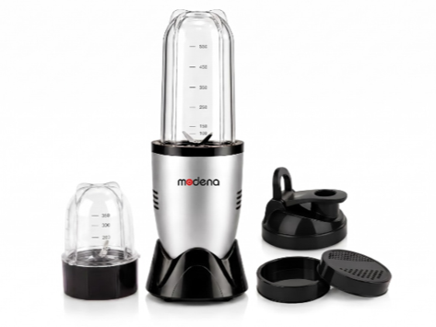
Key Features
Powerful High-Speed Motor for fast blending and grinding.
Food-Grade Polycarbonate Jars – BPA-free, durable, and unbreakable.
Stainless Steel Cross Blade for smooth blending of fruits, vegetables, shakes, and smoothies.
Dry Grinding Jar for coffee beans, spices, dry fruits, and masalas.
Leak-Proof Travel Lid lets you carry your drink anywhere.
Sipper Lid Included for convenient on-the-go use.
Compact & Space-Saving Design suitable for modern kitchens.
One-Touch Operation for easy and hassle-free blending.
Non-Slip Base for enhanced stability during operation.
Easy to Clean – detachable jars and blade assembly.
Low Noise Operation with efficient performance.
Elegant Premium Finish complements every kitchen.

Slide 3
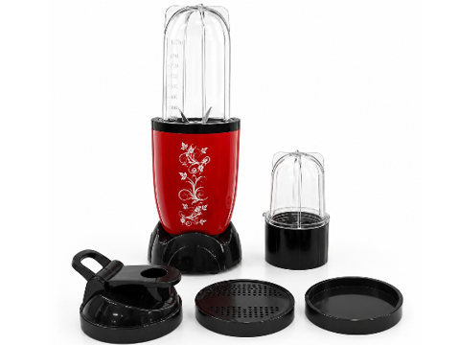
Powerful High-Speed Performance
Efficiently blends fruits, vegetables, smoothies, shakes, juices, and protein drinks in seconds.
Multi-Purpose Grinding
Ideal for dry grinding spices, coffee beans, dry fruits, nuts, seeds, chutneys, and masalas.
Food-Grade Unbreakable Jars
Durable, BPA-free polycarbonate jars designed for everyday use.
Crystal-clear body for easy visibility while blending.
Two Jar Set
Large Jar: Perfect for smoothies, shakes, juices, and blending.
Small Jar: Ideal for dry grinding and chutney preparation.
Stainless Steel Blades
Precision-engineered stainless steel blades provide fast and uniform grinding.
Corrosion-resistant for long-lasting performance.
Leak-Proof Operation
Secure locking mechanism and tight-seal lid help prevent spills during operation.
Shaker/Sipper Lid Included
Convert the blending jar into a portable bottle for direct drinking and easy carrying.
Compact & Space Saving
Modern compact design occupies minimal kitchen counter space.
One-Touch Operation
Simple press-and-twist operation for effortless blending.
Easy to Clean
Detachable jars and smooth surfaces make cleaning quick and convenient.
Elegant Premium Finish
Attractive glossy red body with stylish floral design enhances kitchen aesthetics.
Stable Anti-Skid Base
Provides better grip and stability during operation.

Slide 4
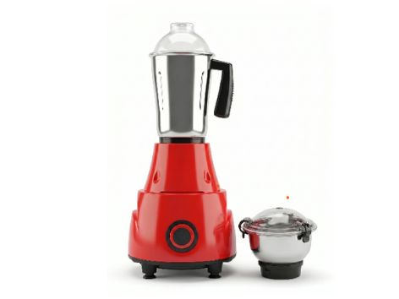
Specification | Details
Motor Power | 550 Watts
Motor Type | High-Performance Motor
Voltage | 220–240V AC
Frequency | 50–60 Hz
Speed | Approx. 18,000–20,000 RPM
Speed Control | 3 Speed + Pulse
Number of Jars | 2
Jar Material | Food-Grade Stainless Steel
Blade Material | Stainless Steel
Body Material | ABS Plastic
Safety Feature | Overload Protection
Feet | Anti-Skid Rubber Feet
Warranty

Slide 5
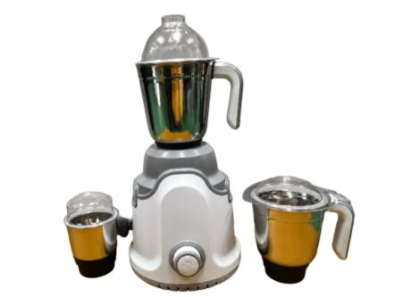
Specification | Details
Motor Power | 750 Watts
Motor Type | High Performance Motor
Voltage | 220–240V AC
Frequency | 50–60 Hz
Speed | 20,000–22,000 RPM (Approx.)
Speed Settings | 3 Speed + Pulse
Number of Jars | 3
Jar Material | Food Grade Stainless Steel
Blade Material | Stainless Steel
Body Material | ABS Plastic
Safety Feature | Overload Protection
Feet | Anti-Skid Vacuum Feet
Warranty

Slide 6
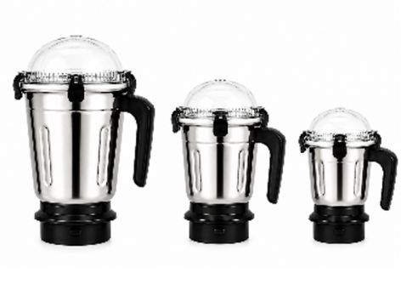
Sujata Jar Set
Features
🥣 Complete 3-Jar Set
Includes Liquidizing Jar, Dry Grinding Jar, and Chutney Jar for all kitchen needs.
🛡️ Premium Stainless Steel
Made from food-grade, rust-resistant stainless steel for durability and hygiene.
🔪 Sharp Stainless Steel Blades
Precision-engineered blades for fast, fine, and efficient grinding.
💪 Heavy-Duty Construction
Strong body designed to withstand daily kitchen use.

Slide 7
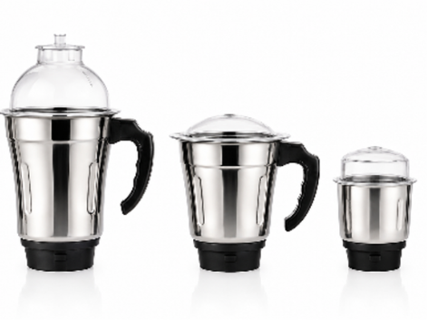
Karina Jar Set With PC Lid
Features
🥣 Complete 3-Jar Set
Includes Liquidizing Jar, Dry Grinding Jar, and Chutney Jar for all kitchen needs.
🛡️ Premium Stainless Steel
Made from food-grade, rust-resistant stainless steel for durability and hygiene.
🔪 Sharp Stainless Steel Blades
Precision-engineered blades for fast, fine, and efficient grinding.
💪 Heavy-Duty Construction
Strong body designed to withstand daily kitchen use.

Slide 8
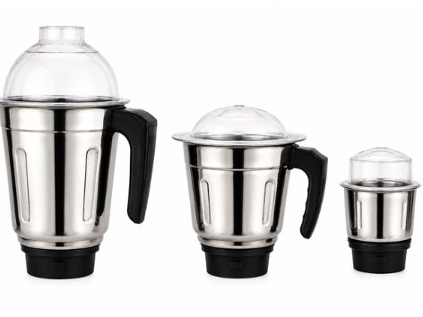
Preethi Jar Set
Features
🥣 Complete 3-Jar Set
Includes Liquidizing Jar, Dry Grinding Jar, and Chutney Jar for all kitchen needs.
🛡️ Premium Stainless Steel
Made from food-grade, rust-resistant stainless steel for durability and hygiene.
🔪 Sharp Stainless Steel Blades
Precision-engineered blades for fast, fine, and efficient grinding.
💪 Heavy-Duty Construction
Strong body designed to withstand daily kitchen use.

Slide 9
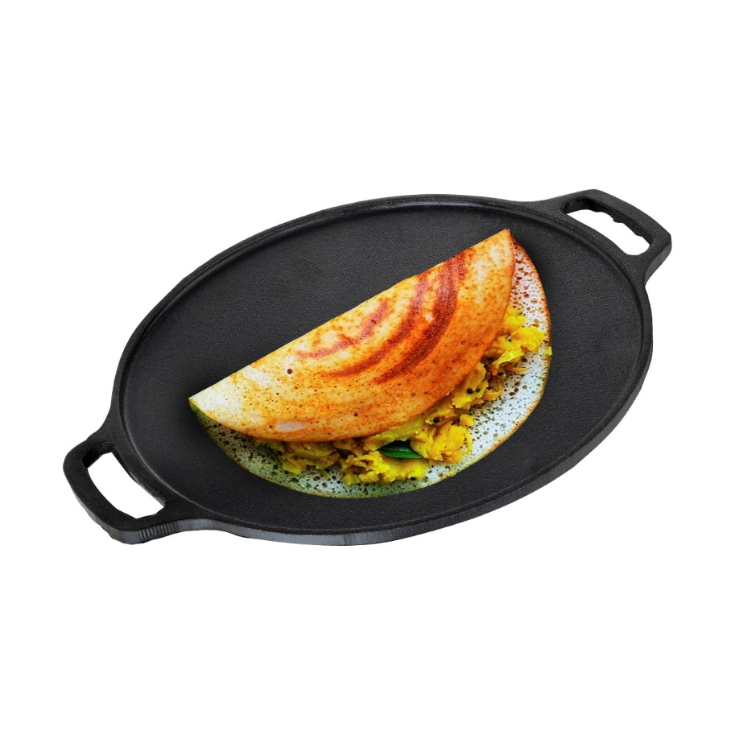
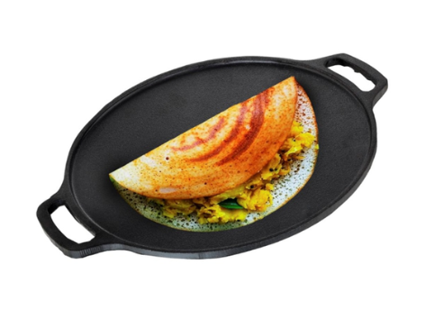
PRODUCT SPECIFICATION — DOSA TAWA
Brand
Material | Cast Iron
Model Name | Cast Iron
Recommended Uses For Product | sauteing vegetables, searing steaks, frying eggs, griddling pancakes
Special Feature | Non Stick
Colour | Black
Capacity | 1 Kilograms
Compatible Devices | Gas
Product Care Instructions | Dishwasher Safe
Maximum Temperature | 500 Degrees Fahrenheit

Slide 10
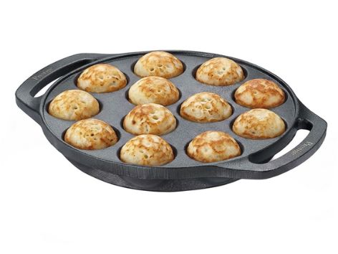
PRODUCT SPECIFICATION — Paniyaram
Brand
Material | Cast Iron
Handle Material | Cast Iron
Recommended Uses For Product | Pan Roasting, Sauteing, Frying, Griddling
Special Feature | Heavy Gauge -Lasts For Generations The Cast Iron Cookware Is Heavy Duty, Long Lasting And Is A Cookware That You Will Use For Generations To Come., Retains Heat For Long Ensuring Food Remains Hot For A Long Time., Size-9 Pits; Cast Iron, Smooth Finish Cookware, Suitable For Outdoor Cooking This Cookware Can Be Used Even For Outdoor Cooking Making It The Right Pick.Heavy Gauge -Lasts For Generations The Cast Iron Cookware Is Heavy Duty, Long Lasting And Is A Cookware That You Will Use For Generations
Colour | Black
Capacity | 0.5 litres
Compatible Devices | Smooth Surface Induction
Product Care Instructions | Hand Wash Only
Item Weight | 2.5 Kilograms

Slide 11
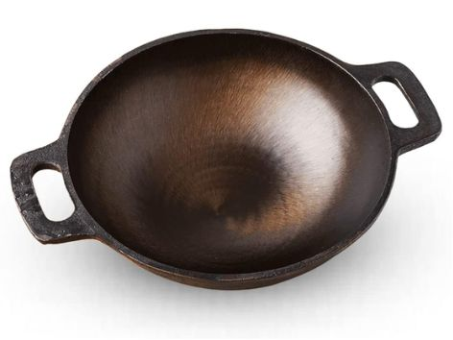
PRODUCT SPECIFICATION — Kadai
Brand
Material | Cast Iron
Special Feature | Non Stick
Colour | Brown
Capacity | 2.5 litres
Compatible Devices | Smooth Surface Induction
Product Care Instructions | Hand Wash Only
Handle Material | Cast Iron
Item Weight | 2.4 Kilograms
Is Oven Safe | No

Slide 12
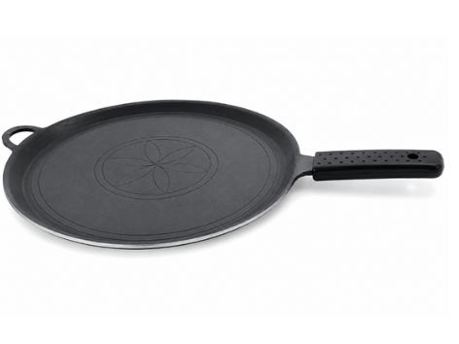
PRODUCT SPECIFICATION — Chapati Tawa
Specification | Details
Product Type | Non-Stick Flat Tawa
Coating | Premium Non-Stick
Handle | Heat-Resistant Wooden Handle
Surface | Scratch-Resistant Non-Stick
Body | Heavy Gauge Construction
Heat Distribution | Uniform Heating
Cooktop Compatibility | Gas Stove
Cleaning | Easy Clean Surface

Slide 13
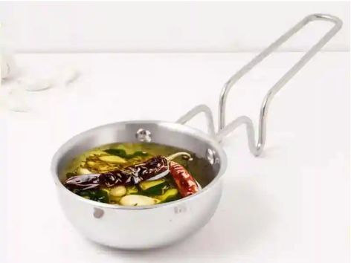
PRODUCT SPECIFICATION — Tadka Pan
TurboCuk Triply Stainless Steel Tadka Pan 300ml for Spice Seasoning/Heating, Premium Quality, 3 Layer Thick Body, 100% Toxin-free, Non-stick, Induction & Gas

Slide 14
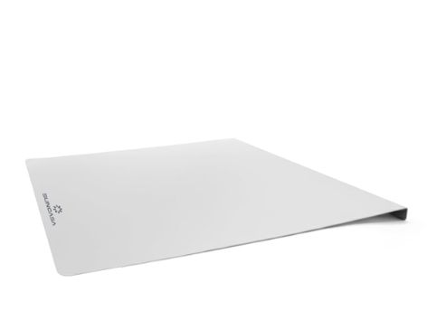
PRODUCT SPECIFICATION — Chopping Board
Brand
Colour | Grey
Product Dimensions | 41L x 31W x 0.1Th Centimeters
Material | Stainless Steel
Recommended Uses For Product | Cutting vegetables, fruits, meat, fish, dough preparation, home kitchen use, professional kitchen use, daily meal preparationCutting vegetables, fruits, meat, fish, dough preparation, home kitchen use, professional kitchen use, daily meal preparation
Shape | Rectangular
Product Care Instructions | Dishwasher Safe
Special Feature | Rust Resistant, Double Sided, Heavy Duty, Hygienic, Odor Free, Non-Porous, Dishwasher Safe, Non-Slip, Stain Resistant, Easy to CleanRust Resistant, Double Sided, Heavy Duty, Hygienic, Odor Free, Non-Porous, Dishwasher Safe, Non-Slip, Stain Resistant, Easy to Clean
Item Weight | 0.9 Kilograms
Number of Packs | 1

Slide 15
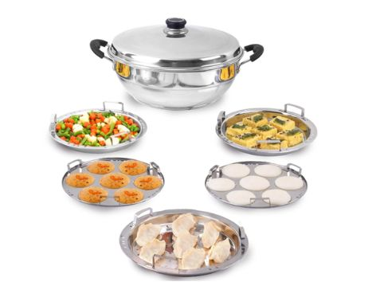
PRODUCT SPECIFICATION — Multi Kadai
🤗100% CHEMICAL FREE: No harmful toxic coatings. 100% food-safe.
😊QUALITY ASSURANCE: Made of premium quality, food-grade 304 stainless steel. Certified by NABL Laboratory
3️⃣3 LAYERED BOTTOM: Tri-ply sandwich bottom is made of 3 layers of metals. Durable, scratch and rust resistant.
✨SUPERIOR PERFORMANCE: The ergonomically designed body of the idli cooker enables heat distribution evenly.
🥘FAST & EFFORTLESS COOKING: Aesthetically designed for enhanced convenience. Faster cooking compared to aluminium idli cooker. Perfect for daily use & urban lifestyle.
💰SAVES MONEY: Fast heat transfer cooks healthy and tasty dishes in a few minutes. Thus, saving time, gas and money for you!
💪SUPER DURABLE: This premium quality stainless steel multi-pot will last for years
👩🏻‍🍳MULTI-PURPOSE: Effortlessly cook healthy dishes with multiple plates. It fits 2 plates at a time. Suitable for both gas and induction stove.
🧼EASY TO CLEAN: Stainless steel body with triply base prevents water stains at the bottom. Prevents food burning or sticking to the plates/surface. So, no cleaning hassles.

