Slide 1




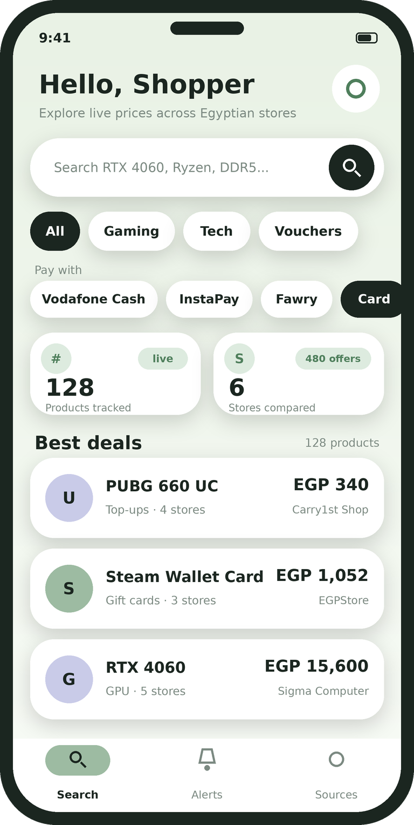
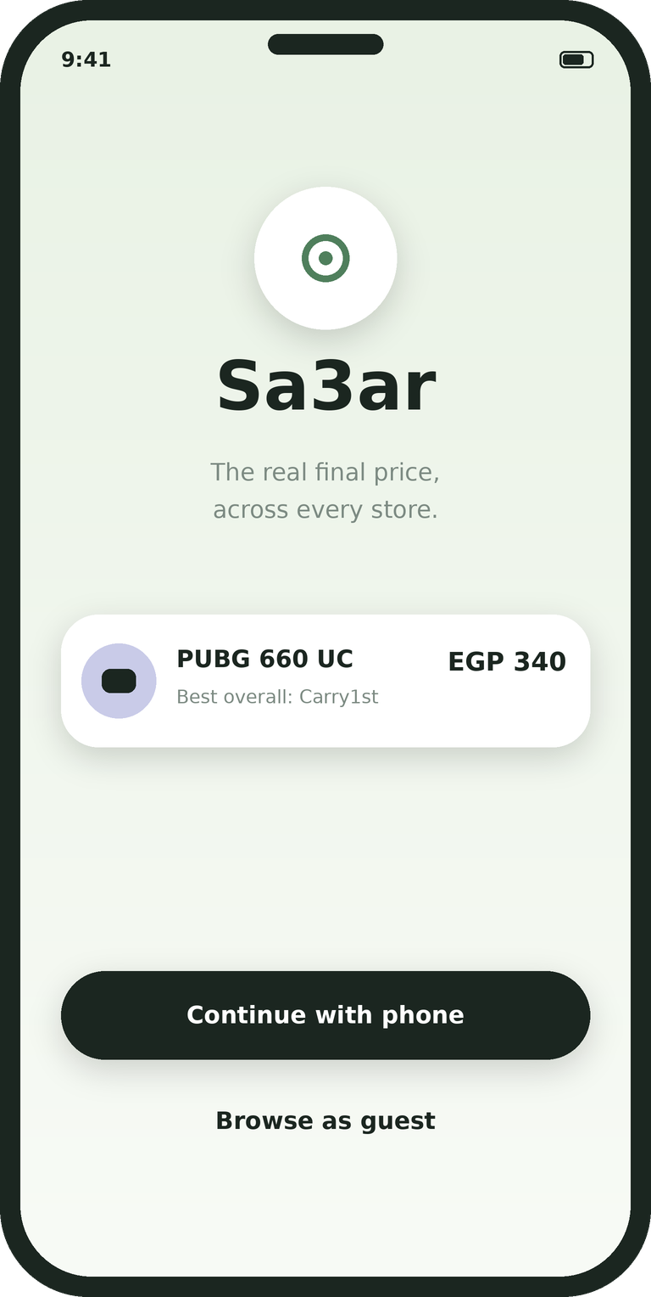


Sa3ar
MS3106 & MOBILE PROGRAMMING
A mobile app that shows what you will really pay for a product, across Egyptian stores and payment methods.
MADE BY
Mohamed Rabiea, Mahmoud Hawk, Omar Afifi, Ahmed Hassan and Yousef Naser
Notes:
Mohamed: Good morning everyone, we are team Sa3ar. Sa3ar means price, and our app shows what you will really pay for something in Egypt, with every fee included. I'm Mohamed, and with me are Hawk, Afifi, Ahmed Hassan and Jo. We'll take you through our customer, the problem, the ideas we looked at, the research, our plan and the app itself.

Slide 2






Our Customer and Their Problem
Presenter: Mohamed and Hawk
Who we build it for
Egyptian gamers, PC builders and online shoppers
What they need
To see the real final price, with every fee, before they pay
Their main problem
The listed price is not what they pay at checkout.
EGP 325 becomes 340
PROBLEM STATEMENT
A top-up card listed at 325 costs 340 once the card processing fee is added.
The price on the listing is not the price you pay.
Lots of ways to pay
InstaPay, Vodafone Cash, Fawry, credit cards and valU all charge different fees.
Hard to trust sellers
Buyers can't tell verified sellers from third-party listings that may sell invalid codes.
Notes:
Mohamed: Sa3ar is for Egyptian gamers, PC builders and online shoppers. What they need is to see the real final price, with every fee, before they pay. Their main problem is simple: the listed price is not what they pay at checkout. Hawk will explain the problem in more detail. Hawk: Thanks Mohamed, I'm Hawk. Here is the problem. A top-up card listed at 325 pounds costs 340 once the card fee is added. People pay in many ways: InstaPay, Vodafone Cash, Fawry, cards and valU, and each one charges different fees. On top of that, buyers can't tell a verified seller from a third-party listing that may sell an invalid code.

Slide 3






1. Our App Ideas
Presenter: Hawk
We evaluated 7 ideas. Each one has a problem, a user and a reason it matters (or doesn't).
CHOSEN
Campus Carpool
Marketplace & Lost-and-Found
Study Buddy
Sa3ar
PROBLEM
PROBLEM
PROBLEM
PROBLEM
Getting to campus is slow and costs money.
Students can't easily buy, sell or find lost things.
It's hard to find people to study with.
Fees at checkout make the real price hard to see.
USER
USER
USER
USER
Students
Students
Students
Online shoppers in Egypt
HOW IT WENT
HOW IT WENT
HOW IT WENT
HOW IT WENT
Most ambitious. Maps and safety are risky, and free WhatsApp groups already do it.
Safest and easy to build, but not very different and the commissions are small.
Good story, but scheduling is fiddly and it earns no direct revenue.
Everyone feels it, it is all software, and feasibility scored 4.0 out of 5.
Also evaluated: Canteen Express and Timetable Hub.
Notes:
Hawk: We looked at seven ideas. Campus Carpool was the most ambitious, but maps and safety are risky and free WhatsApp groups already do it. The marketplace was the safest, but not very different and the commissions are small. Study Buddy had a good story, but scheduling is fiddly and it earns no direct revenue. We also looked at Canteen Express and Timetable Hub. Sa3ar won because everyone who shops online feels the problem, it is all software, and feasibility scored 4.0 out of 5.

Slide 4






2. Studies and Search Record
Presenter: Ahmed Hassan
We kept the searches short and wrote down every term, so anyone can repeat them.
ACADEMIC
ACADEMIC
MARKET
Consumer Reactions to Drip Pricing
Price Salience and Product Choice
Yaoota, Egyptian shopping search
Santana, Dallas and Morwitz (2020), Marketing Science 39(1), 188-210
Blake, Moshary, Sweeney and Tadelis (2021), Marketing Science
Wamda (2017), article about Yaoota buying two phone comparison sites
Across six studies, when extra fees are added later, people pick the lower base price even when it costs more in total.
In a StubHub experiment, buyers who only saw fees at checkout spent about 21% more than buyers shown the full price.
Compares prices across Egyptian online stores. The coverage we found does not mention payment-method fees.
Database or tool | Search terms | Filters | Results used
Web search (8 Nov 2026) | drip pricing hidden fees consumer behavior study journal | English, peer-reviewed or publisher pages preferred | 2 academic studies
Web search (8 Nov 2026) | price comparison website Egypt Yaoota electronics compare prices stores | English, Egypt market | 1 market source
Notes:
Ahmed Hassan: Thanks Hawk, I'm Ahmed Hassan and I'll take the research. We found three sources on hidden fees. Santana, Dallas and Morwitz in 2020 found that when fees are added late, people pick the lower base price even when it costs more in total. Blake and colleagues in 2021 ran a StubHub experiment where buyers who only saw fees at checkout spent about 21 percent more. The third is Yaoota, an Egyptian price comparison site, and the coverage we found does not mention payment-method fees. Ahmed Hassan: We wrote down every search so anyone can repeat it. On 8 November 2026 we searched the web for drip pricing and hidden fee studies, and for Egyptian price comparison sites like Yaoota. We kept two academic studies and one market source.

Slide 5






3. Comparing the Studies and Sa3ar
Presenter: Ahmed Hassan
 | Santana et al. 2020 | Blake et al. 2021 | Yaoota | Sa3ar
Type | Academic, experiments | Academic, field experiment | Market product | Our app
Looks at fees | Yes | Yes | Not mentioned | Yes: gateway fee, shipping, promo
Seller trust | No | No | Not mentioned | Yes: verified vs marketplace
Egypt | No | No | Yes | Yes
Main point | Late fees hide the real cost | Hidden fees raise spending | Compare stores | Show the final price
The research shows that hidden fees mislead buyers. The Egyptian coverage we found helps people find stores, but it doesn't describe payment fees or seller checks. That is the gap Sa3ar fills.
Notes:
Ahmed Hassan: Side by side: both studies look at fees, but not at Egypt or seller trust. Yaoota is Egyptian, but we found no mention of fees or seller checks. Sa3ar covers fees, seller trust and Egypt together, and that is the gap we fill.

Slide 6






4. Why We Chose This Project
Presenter: Hawk
1
The gap
What do the studies leave unsolved? Trackers show the base price, not the price with all fees.
Evidence: Studies and comparison slides
2
The need
Do users really have this problem? Shoppers run into hidden fees and fake sales.
Evidence: Research plus our customer's own words
3
The choice
Why this idea and not the other five? It beat them on feasibility and revenue.
Evidence: Weighted score table, next slide
4
Feasibility
Can we deliver it? About 540 coding hours with Flutter, Playwright and PostgreSQL.
Evidence: Prototype already running
5
Success
How will we know it worked? Three measurable criteria.
Evidence: Project brief slide
We picked with a weighted score
30%
25%
20%
15%
10%
User need
Feasibility
Gap left
Mobile fit
Risk
Notes:
Hawk: Five questions led to our choice. The gap: trackers show the base price, not the price with fees. The need: shoppers run into hidden fees and fake sales. The choice: we scored every idea with weights, user need 30 percent, feasibility 25, gap left 20, mobile fit 15 and risk 10, and Sa3ar came out on top. Feasibility: about 540 coding hours with Flutter, Playwright and PostgreSQL. Success: three measurable criteria, which Mohamed will show later.

Slide 7






Weighted Score for Every Idea
Presenter: Hawk
Idea | User need (30%) | Feasibility (25%) | Gap left (20%) | Mobile fit (15%) | Risk (10%) | Weighted score
Sa3ar | 4 | 4 | 4 | 4 | 3 | 3.90
Marketplace & Lost-and-Found | 3 | 5 | 2 | 4 | 4 | 3.55
Timetable Hub | 3 | 4 | 2 | 4 | 4 | 3.30
Study Buddy | 3 | 3 | 3 | 4 | 3 | 3.15
Canteen Express | 3 | 3 | 3 | 4 | 2 | 3.05
Campus Carpool | 4 | 2 | 2 | 5 | 1 | 2.95
Sa3ar scores highest at 3.90 out of 5. Each score runs from 1 to 5 (5 is best; for Risk, 5 means the lowest risk). Weighted score = each score multiplied by its weight, added up.
Notes:
Hawk: Here is the weighted score for every idea. We used the same five weights for all of them: user need 30 percent, feasibility 25, gap left 20, mobile fit 15 and risk 10. Scores run from 1 to 5, and for risk a 5 means the lowest risk. Sa3ar comes out on top at 3.90. Marketplace and Lost-and-Found is next at 3.55 because it is easy to build, but it leaves little gap. Campus Carpool scores lowest because of its safety and map risks.

Slide 8






5. Business Case: Options, Costs and Benefits
Presenter: Ahmed Hassan
Option | Costs | Benefits
Do nothing | Costs nothing, but shoppers keep overpaying and no local tool exists | No effort and no risk for the team
Use existing comparison sites | Free to use, but they don't show fees or seller trust in what we found | Already available in Egypt
Build Sa3ar | About 540 coding hours over 7.5 weeks, plus keeping the scrapers working | The true final price, verified sellers and price alerts
COSTS OF BUILDING IT
HOW IT CAN EARN
Team time over one semester
Fixing scrapers when store pages change
Affiliate commissions from stores
Featured merchant listings
Free tier plus premium WhatsApp alerts
Notes:
Ahmed Hassan: For the business case we compared three options. Doing nothing costs nothing, but shoppers keep overpaying and no local tool exists. Existing comparison sites are free, but in what we found they don't show fees or seller trust. Building Sa3ar costs about 540 coding hours over seven and a half weeks, plus keeping the scrapers working, and it gives the true final price, verified sellers and price alerts. It can earn from affiliate commissions, featured merchant listings and a premium tier with WhatsApp alerts.

Slide 9






SWOT: Sa3ar vs Two Rival Ideas
Presenter: Ahmed Hassan
 | Sa3ar (chosen) | Campus Carpool | Marketplace & Lost-and-Found
Strengths | No physical logistics Shows true final price Working prototype | Real daily need Cuts travel costs One campus community | Safest, easiest to build Clear student need Simple features
Weaknesses | Scrapers need upkeep Small team, one semester Payment fees unconfirmed | Needs maps and tracking Hard to guarantee safety Needs enough drivers | Not very different Small commissions Needs many users
Opportunities | Egypt e-commerce growing Many stores and payments Affiliate and premium | Rising transport costs University promotion Paid or premium rides | Grow beyond one campus Student union help Paid featured listings
Threats | Scrapers get blocked Names differ per store Prices change fast | Free WhatsApp groups Legal risk Stranger trust issues | Facebook groups, OLX Scams, fake listings Moderation work
Notes:
Ahmed Hassan: Here is the SWOT for Sa3ar next to our two closest rival ideas. Sa3ar has no physical logistics, shows the true final price and already has a working prototype. Its weaknesses are that scrapers need upkeep, we are a small team with one semester, and payment fees are not confirmed. The opportunities are growing e-commerce in Egypt, many stores and payment methods, and affiliate and premium revenue. The threats are blocked scrapers, product names that differ between stores, and fast-changing prices. Campus Carpool has a real daily need but needs maps and tracking, and free WhatsApp groups already do the job. The marketplace is the safest and easiest to build, but it is not very different and the commissions are small.

Slide 10






6. Stakeholders
Presenter: Mohamed
Who | How they are affected | What they decide
Shoppers | Pay less and avoid risky sellers | Whether they use the app
Stores and merchants | More buyers, and their fees become visible | Whether our data and links are allowed
Our customer | Gets the tool they need | Confirms the need and signs off the tested app
Tutors | Assess the work | Approve the proposal and give marks
Our team | Builds and delivers it | Scope and design
Notes:
Mohamed: Thanks Ahmed. Shoppers are affected most: they pay less and avoid risky sellers, and they decide whether to use the app. Stores gain buyers and their fees become visible, and they decide whether our data and links are allowed. Our customer gets the tool they need and signs off the tested app. Tutors assess the work and approve the proposal, and our team builds it and decides scope and design.

Slide 11






7. Project Brief
Presenter: Mohamed
OBJECTIVE
Deliver a working Flutter app that ranks stores by the true final price of a product.
OUTLINE SCOPE
MEASURABLE SUCCESS CRITERIA
In: vouchers, gaming items, PC parts and major e-commerce stores (Amazon EG, Noon, Jumia).
Out: buying inside the app, and iOS.
1
The final price matches the store checkout price (we agree the allowed difference with the customer).
2
Search results load in under 1 second on mobile data.
3
Our real customer confirms the need and signs off the acceptance test.
Notes:
Mohamed: Our objective is a working Flutter app that ranks stores by the true final price. In scope are vouchers, gaming items, PC parts and the big stores, Amazon EG, Noon and Jumia. Out of scope are buying inside the app, and iOS. We have three measurable success criteria: the final price matches the store checkout price within a difference we agree with the customer, search results load in under one second on mobile data, and our real customer confirms the need and signs off the acceptance test.

Slide 12






Proposed Solution and MVP
Presenter: Afifi
APP NAME
Must have (MVP)
Sa3ar
Search across stores
Itemized fee calculation
Choose the payment method
Verified-seller badges
Push price alerts
TARGET USERS
Egyptian gamers, PC builders and online shoppers
PROBLEM
The listed price is not the checkout price, and buyers can't spot risky sellers
Nice to have
WhatsApp alerts
Unlimited watchlist
Price history charts
SOLUTION
A mobile app that ranks stores by the true final price for the payment method you pick
Notes:
Afifi: Thanks Mohamed, I'm Afifi, the UI developer. The app is called Sa3ar, which means price. The must-haves are search across stores, the itemized fee calculation, choosing the payment method, verified-seller badges and push price alerts. WhatsApp alerts, an unlimited watchlist and price history charts are nice to have for later.

Slide 13






Main User Journey
Presenter: Afifi
1
2
3
4
5
6
Open the app
Search a product
Pick a payment method
Compare final prices
Set a price alert
Get notified and buy
EXAMPLE
A gamer wants 660 UC for PUBG. One store lists it at EGP 325, but paying by card adds EGP 15, so it costs 340. Sa3ar shows Carry1st as the best overall choice: also 340, but with an instant top-up from an official seller. The gamer sets an alert and buys when the price drops.
Notes:
Afifi: Here is the main user journey in six steps: open the app, search a product, pick a payment method, compare final prices, set a price alert, then get notified and buy. For example, a gamer wants 660 UC for PUBG. One store lists it at 325, but paying by card adds 15, so it costs 340. Sa3ar shows Carry1st as the best overall choice, also 340 but with an instant top-up from an official seller. The gamer sets an alert and buys when the price drops.

Slide 14




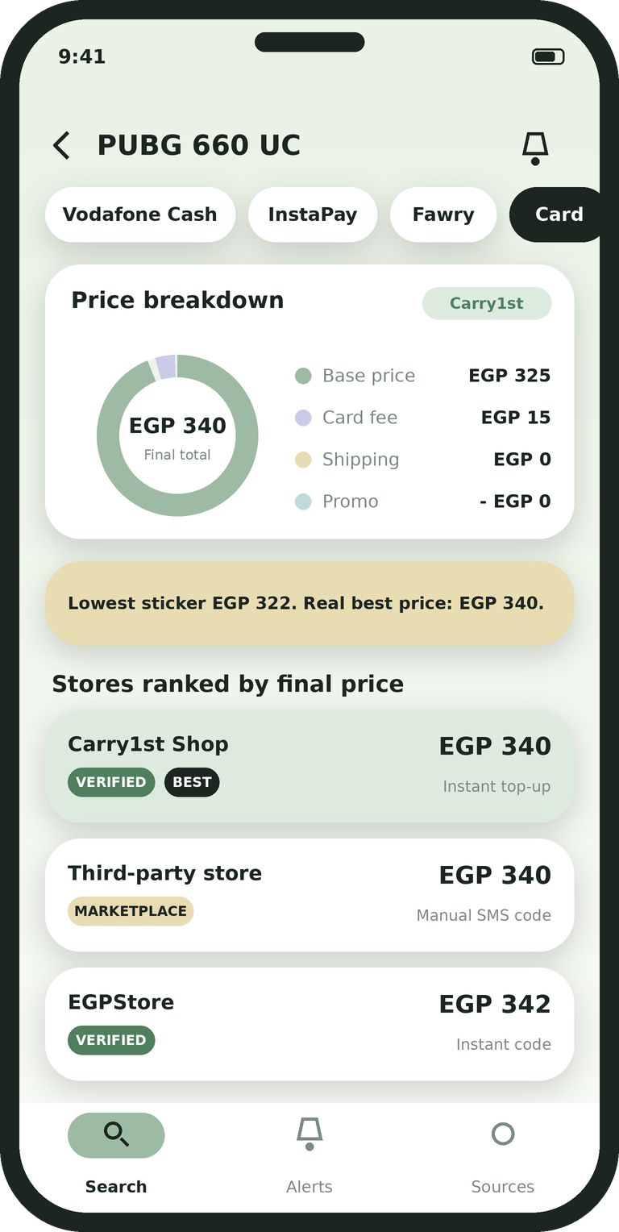
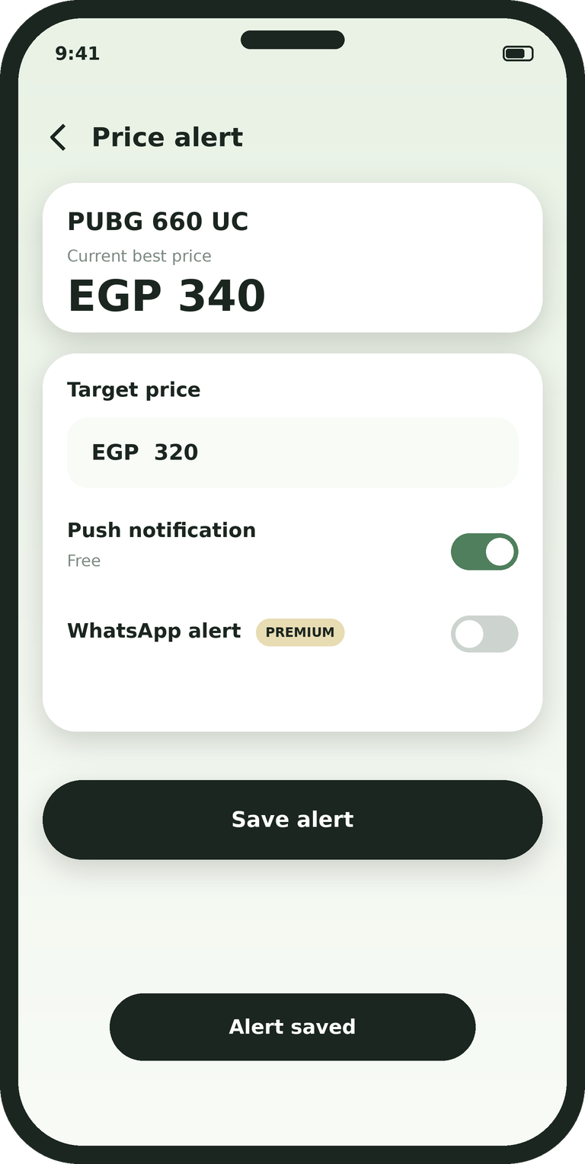


Screens and Navigation
Presenter: Afifi
continue
tap a product
tap the bell
1 Welcome / Login
2 Search
3 Compare and fees
4 Alerts
Phone sign-in or guest mode
Search, category and payment pills
Final = base + fee + shipping - cashback
Target price. Push is free, WhatsApp is Premium
Notes:
Afifi: These are our four main screens. You start on the welcome screen, or continue as a guest. Then you search, using the category and payment pills. Tapping a product opens the compare screen, where the final price is base plus fee plus shipping minus cashback, and if you change the payment method the stores are ranked again. Tapping the bell opens alerts, where you set a target price. Push alerts are free and WhatsApp alerts are premium.

Slide 15






Time Budget and How We Solve the Risks
Presenter: Mohamed and Ahmed Hassan
Risk | How it could hurt us | How we solve it
Scrapers get blocked | Stores block our IP and prices stop updating | Rotate headless browsers, use selectors that survive page changes, fall back to official store APIs
Same product, different names | Arabic and English titles do not match, so prices are not compared fairly | Fuzzy matching and title clean-up group identical products
Payment fees not confirmed | A wrong fee means a wrong final price | Check fees against real checkout pages and agree the allowed difference with our customer
Small team, one semester | We run out of time or burn out | Protected 4-hour weekly buffer, change control, risk log updated every two weeks
Prices change fast | Users see old prices and miss real drops | Scheduled refresh and a Redis cache for hot prices
Time budget: 540 coding hours over 7.5 weeks, 12 coding hours per person each week, and a protected 4-hour buffer for classes. Our plan is the baseline.
Notes:
Mohamed: Back to me for the plan. We budgeted 540 coding hours over seven and a half weeks: twelve coding hours per person each week, plus a protected four-hour buffer for classes. Our plan is the baseline, so every change goes through change control and we update the risk log every two weeks. Our two main risks are stores blocking the scrapers and the same product having different names. Ahmed Hassan will explain how we solve them. Ahmed Hassan: Here is how we solve each risk. If stores block our scrapers, we rotate headless browsers, use selectors that survive page changes and fall back to official store APIs. If the same product has different names, including Arabic titles, we use fuzzy matching and title clean-up so identical products are grouped. Because the payment fees aren't confirmed yet, we check them against real checkout pages and agree the allowed difference with our customer. For the small team and short semester, we protect the buffer and use change control. And because prices change fast, we refresh on a schedule and cache hot prices.

Slide 16






How It Works Behind the App
Data ingestion
Data layer
Headless Playwright scrapers on a schedule
Official store APIs where available
Live catalog prices
PostgreSQL stores the indexed products
Redis keeps hot prices in cache
Fast results on mobile networks
Alert engine
Live demo
Scheduled jobs check target prices
Push notifications
WhatsApp messages through a webhook
Search in Arabic and English with typos
Switch payment method, fees update
Trigger a price-drop alert on the phone
Notes:
Presenter: Thanks Ahmed. Playwright scrapers and official APIs collect live prices on a schedule. PostgreSQL stores the products and Redis keeps hot prices in cache, so results stay fast on mobile networks. A scheduled job checks target prices and sends push notifications or WhatsApp messages through a webhook. In the demo we search in Arabic and English with typos, switch the payment method so the fees update, and trigger a price-drop alert on the phone.

Slide 17







Quality and Testing
Presenter: Jo
Automated tests
Device testing
Fee calculation formula
Verified-seller tie-breaker
Alert price thresholds
Different Android versions and screens
Dark Mode and Arabic right-to-left
Slow 3G network
Bug process
Acceptance
1. Log it with the details
2. Reproduce it in staging
3. Developer fixes it
4. Retest on real phones
Our customer tests against the criteria
They sign off, or we record why not
Peer review of documents before hand-in
Notes:
Jo: I'm Jo, the QA lead. We test the fee calculation, the verified-seller tie-breaker and the alert thresholds automatically. We also test on different Android versions and screen sizes, in Dark Mode, with Arabic right-to-left layouts and on a slow 3G network. Every bug goes through four steps: log it, reproduce it in staging, fix it, and retest on real phones. Our customer does the final acceptance test, and we peer review documents before hand-in.

Slide 18






Next Development Steps
Presenter: Jo
STEP 1
STEP 2
STEP 3
STEP 4
Mid-Nov
Late-Nov
Early-Dec
Mid-late Dec
Data and scrapers
Flutter and fee engine
Alerts and Redis
QA and polish
Next
Final presentation
Build the scrapers, connect the fee engine, then run acceptance testing with our real customer.
15 minutes plus 5 minutes of questions. Everyone speaks, and we will be honest about what changed.
Thank you. Any questions?
Notes:
Presenter: Next we build the scrapers in mid-November, connect the Flutter app to the fee engine in late November, and add alerts and Redis in early December.
Jo: Then comes QA and polish in mid to late December, and acceptance testing with our real customer. The final presentation is fifteen minutes plus five of questions, and everyone speaks. Thank you for listening, we're happy to take questions.

