Slide 1
CamBuzz
Social Media web app cum Resource Locator
Submitted by
MUHAMMED RAIHAN P A
21352030
Under the guidance of
Dr. M. Nandhini
Associate Professor

Slide 2
Project Overview
Cambuzz is an innovative social media website tailored specifically for the university community, including students and faculty members.
Its primary objective is to create a central hub where individuals can easily share information, collaborate on projects, and communicate effectively..
This is an application that is exclusively for the university community.

Slide 3
Modules
Student
Faculty
Admin
Resource Locator:
Resources
Details
Map to the resource
Social Media:
Profile
Posts
Stories
Events

Slide 4
Requirements
Hardware Requirements :
Processor: intel core i5 or above
Hard Disk/SSD: 250GB
Network connection: LAN/MAN/WAN
Memory : 4GB RAM or HIGHER

Slide 5
Requirements
Software Requirements :
Operating System: Windows 10 or above, macOS, or Linux
Web Server: Node server
Web Development Framework: MERN stack (with MySql)
Programming Languages: ReactJs, NodeJs, Express Js, HTML, SCSS
Relational Database Management System: MySQL

Slide 6
Features
Social Media Platform: Cambuzz provides a social media platform for students and faculty members to post photos, share stories, interact and connect with each other.
Chat and PU Forum: Cambuzz offers a forum for the Pondicherry University community to discuss campus-related issues. The chat feature enables students and faculty members to interact with each other in real-time.
Resource Locator: Cambuzz offers a campus resource locator that enables students to find resources such as food, toilets, printers, and other services on campus. This feature provides a convenient and efficient way for students to access the resources they need.
Events: Cambuzz enables users to create, discover and RSVP to events happening on campus. Users can filter by category, date, and location to find events of interest.

Slide 7
Implementation
This MERN stack web application was created in Visual Studio Code with ReactJS and NodeJS
Multer is used to store images at the server end.
Client and admin communicate with the server using axios.
User posts and stories and profile details are loaded using this without the need of reloading the webpage.
Cambuzz uses maps api and directions api to get the location and directions to the resources.

Slide 8
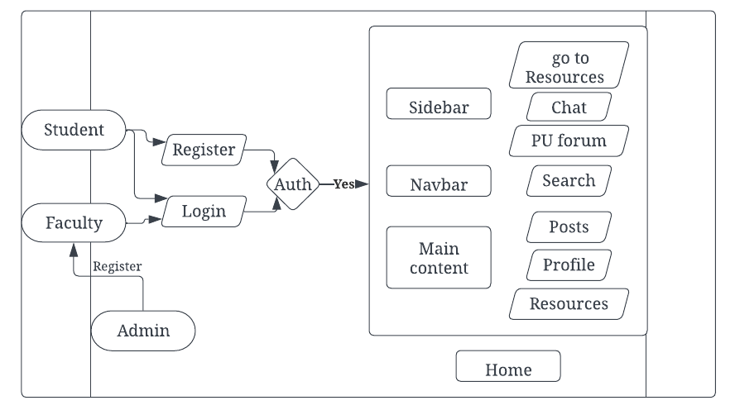
Architecture

Slide 9
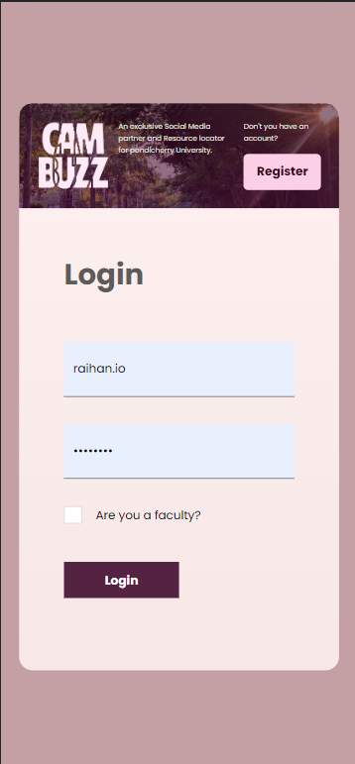
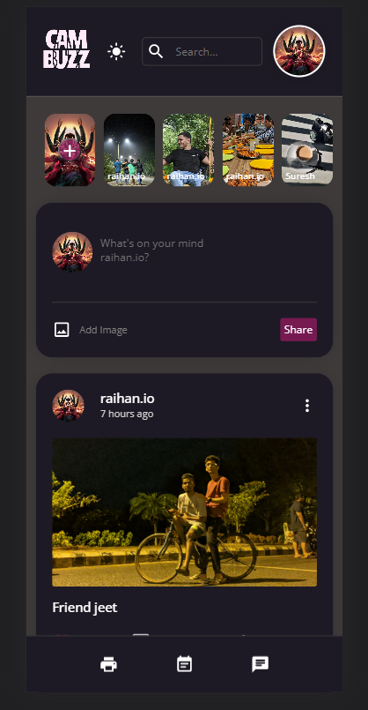
System Interface Snaps

Slide 10
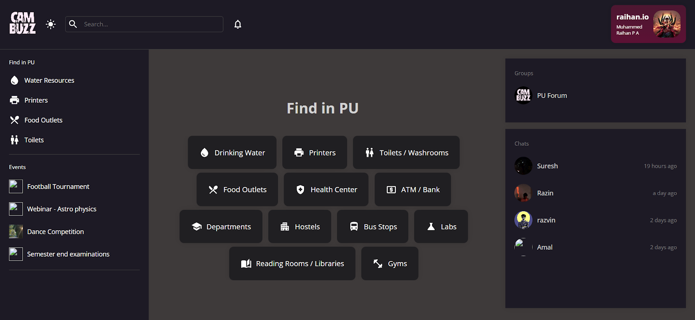

Slide 11
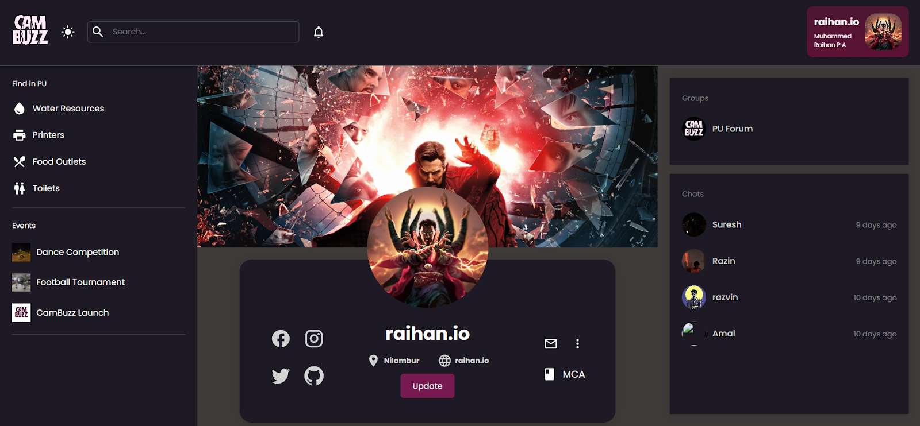

Slide 12
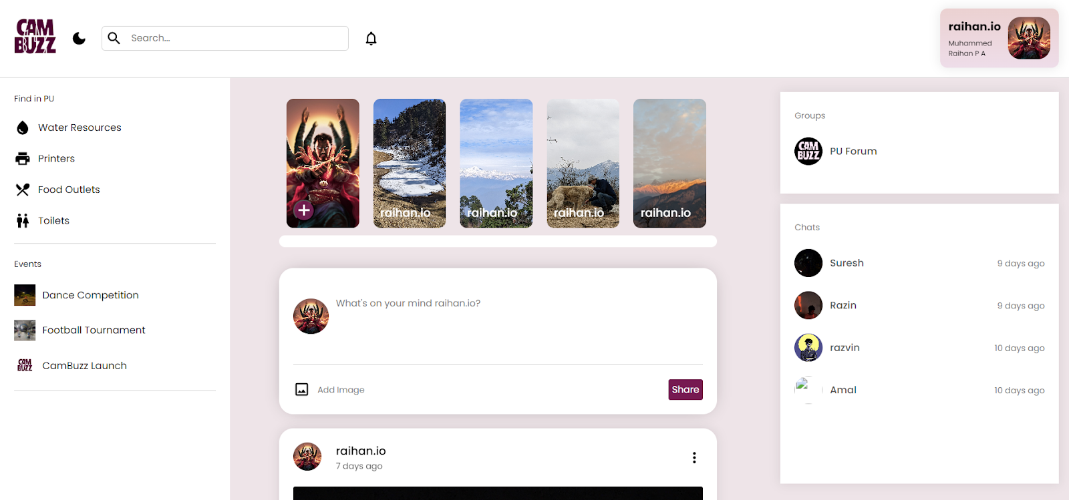

Slide 13
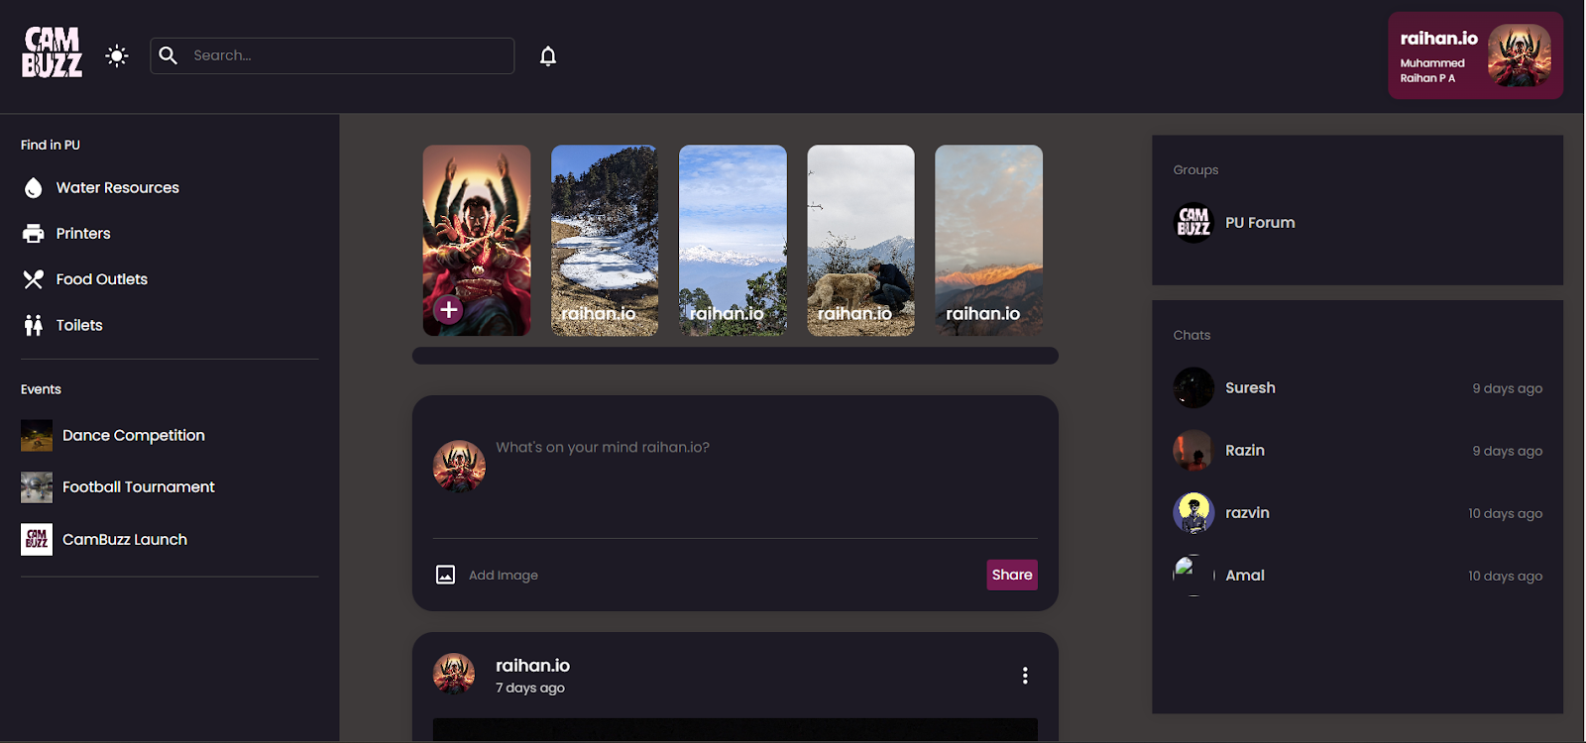

Slide 14
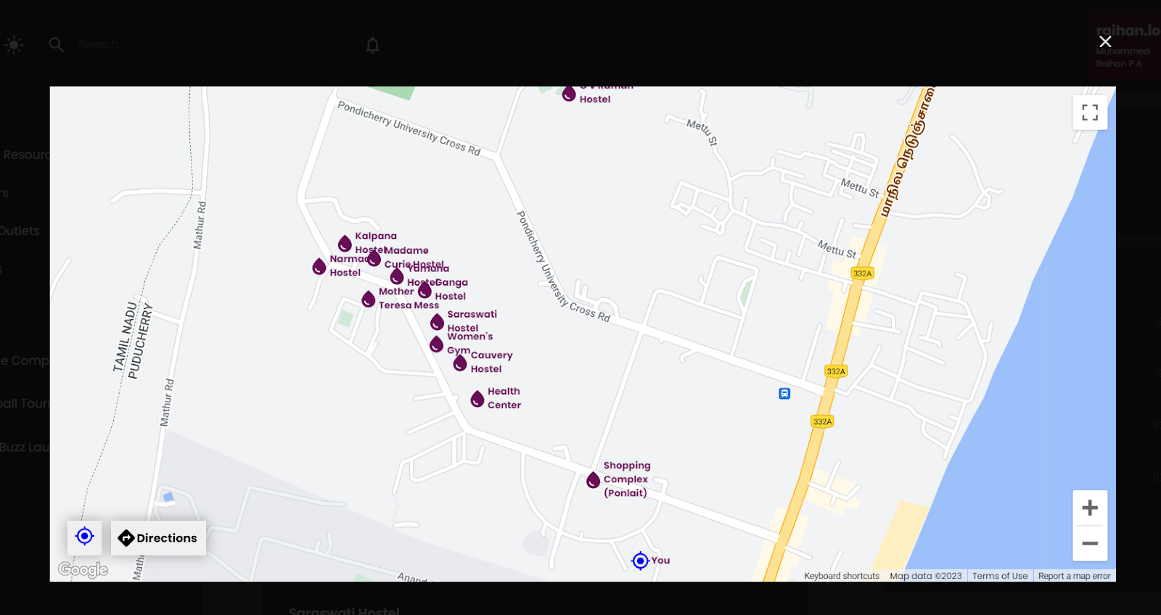

Slide 15
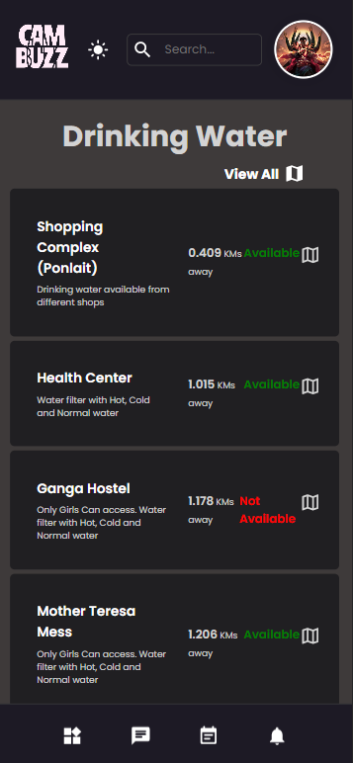
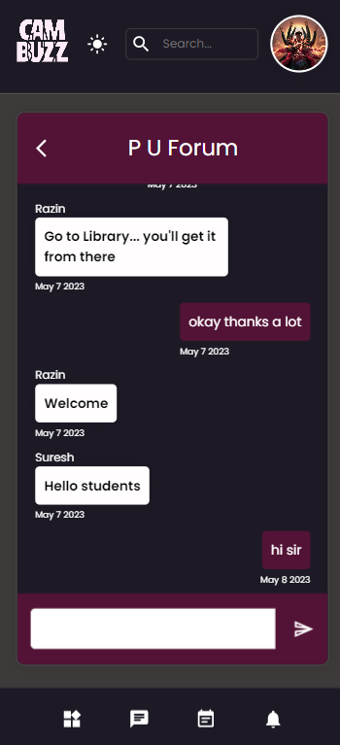

Slide 16
References
https://developers.google.com/maps/documentation/javascript
https://axios-http.com/docs/intro
https://tanstack.com/query/latest/docs/react/overview
https://www.permify.co/post/jwt-authentication-in-react
https://www.npmjs.com/package/react-jwt
https://developer.mozilla.org/en-US/docs/Web/API/URL/createObjectURL_static
https://firebase.blog/posts/2017/02/email-verification-in-firebase-auth

