Slide 1

FUNDAMENTALS OF DATABASES
Cell Culture Laboratory Management Database
A normalized MySQL system for experiments, passages, quality control, and cryostock inventory.
Student name: Merna Mikheal Alkes Student ID: 221001874
01

Slide 2

Problem and Scope
Laboratory need
System boundary
Cell-culture work depends on reliable tracking of biological materials, equipment, experiments, passages, quality-control tests, researchers, and frozen stocks.
The database manages laboratory operations and experimental metadata. It excludes patient-identifying data, authentication, and optional user-interface functionality.
02
CELL CULTURE LABORATORY MANAGEMENT

Slide 3
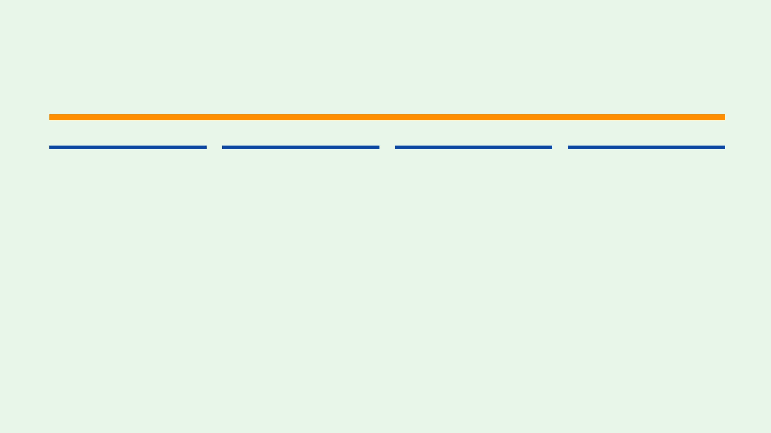
Requirements Addressed
09
3NF
2+1
10×
Meaningful tables, including one associative table.
Normalized relational schema with keys and constraints.
Two views plus a stored procedure and validation trigger.
Ten records in each main table, with varied test data.
03

Slide 4
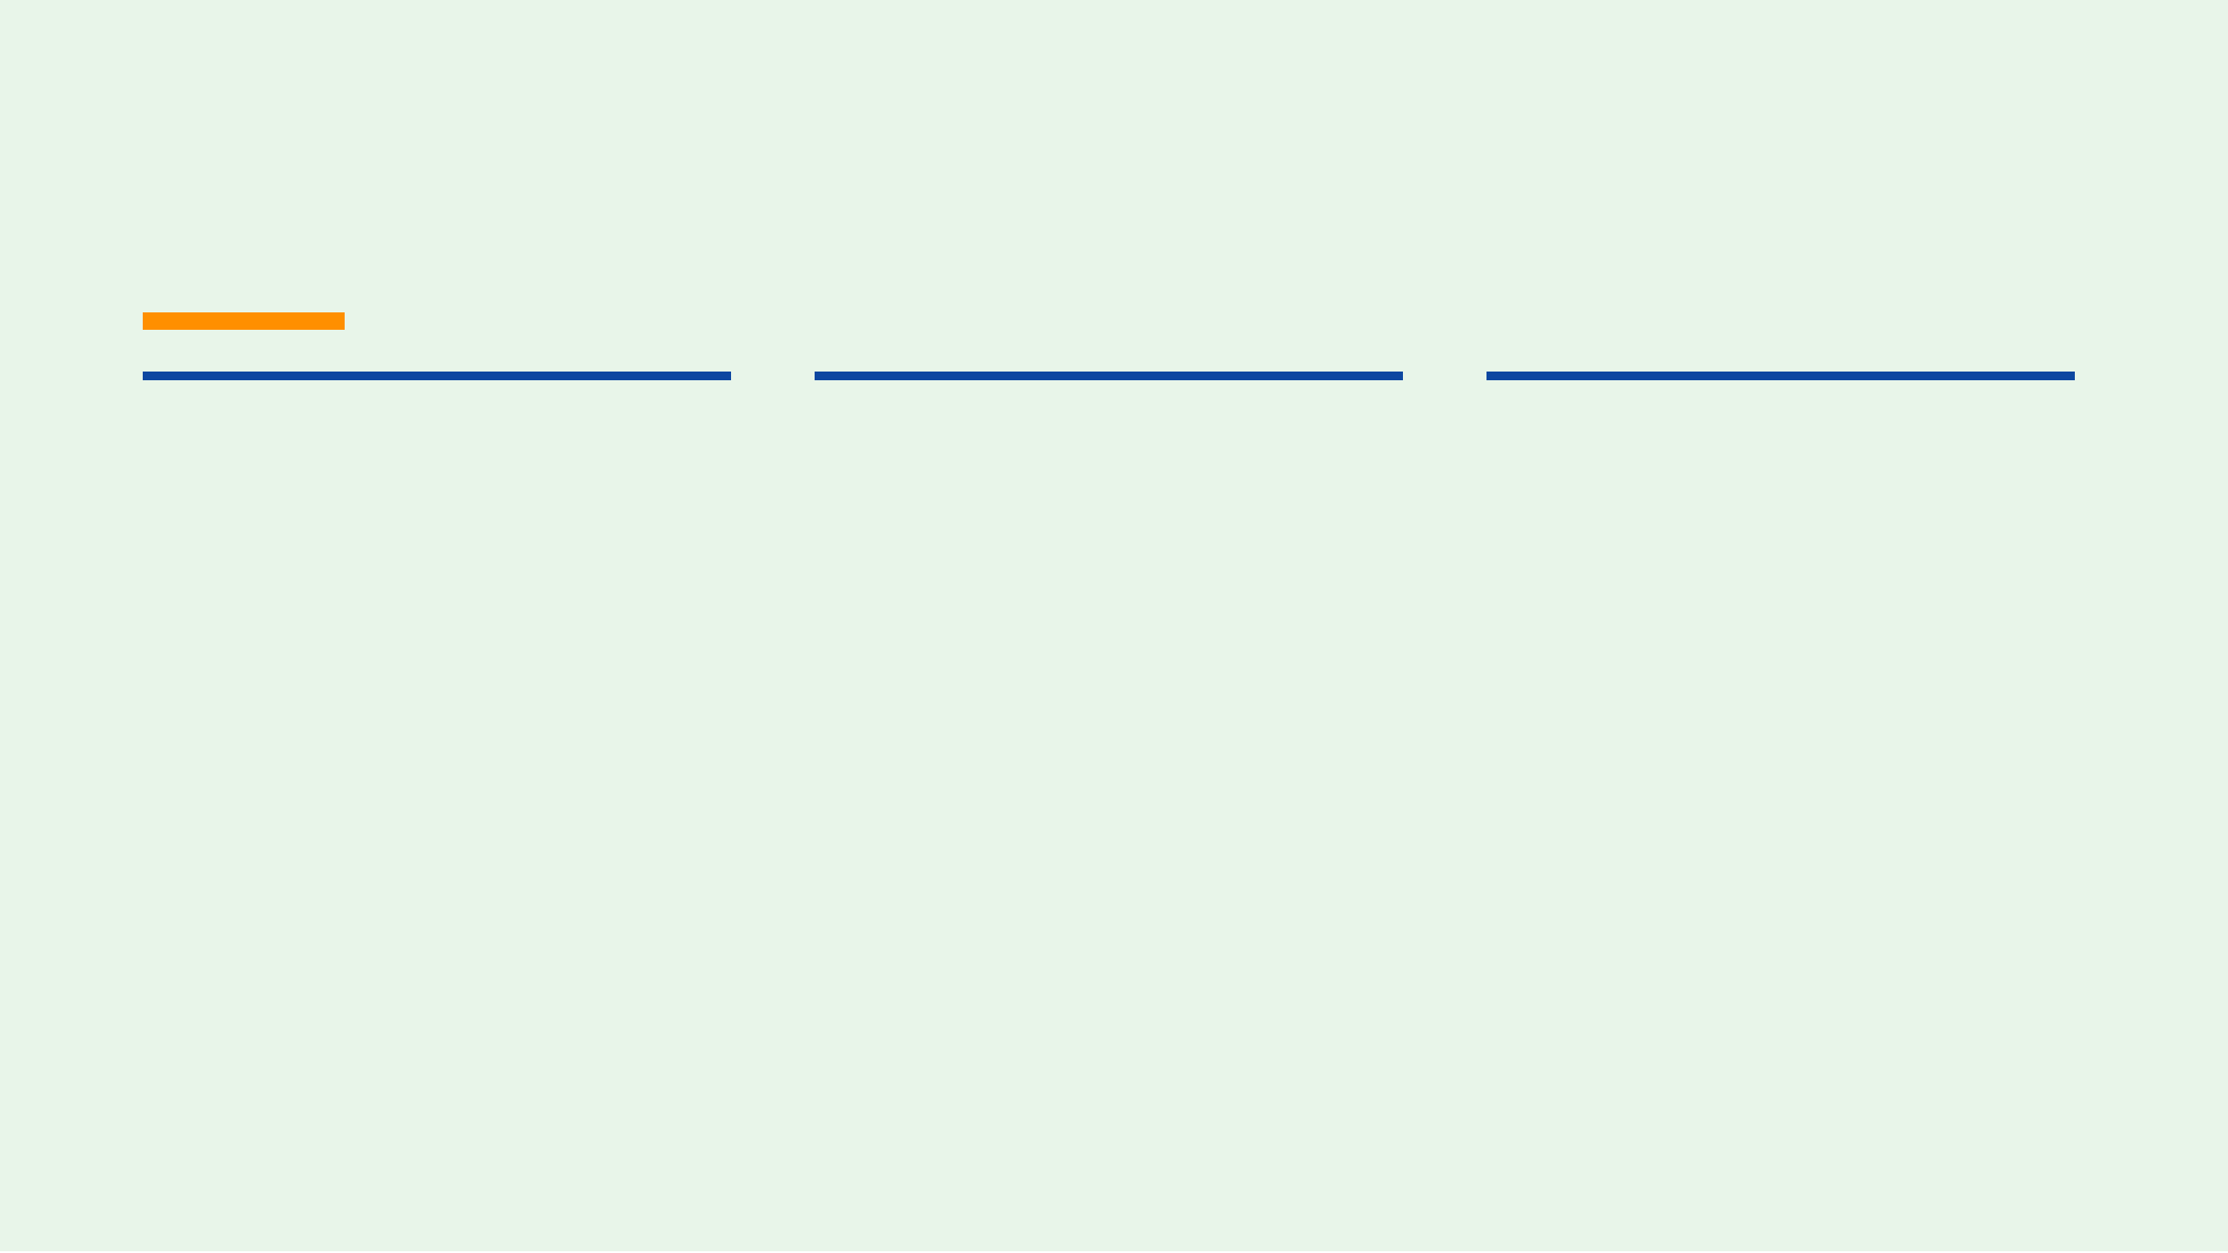
Main Entities
RESEARCHER — personnel and contact details.
CELL_LINE — organism, tissue origin, and biosafety level.
INCUBATOR — model, location, temperature, and CO₂.
EXPERIMENT — study title, status, dates, and cell line.
PASSAGE — propagation date, number, and split ratio.
CONTAMINATION_TEST — contaminant type and result.
EXPERIMENT_RESEARCHER — assignments and roles.
MEDIA — medium, serum, batch, and expiry data.
CRYOSTOCK — vial quantity, freeze date, and storage location.
04
NINE CORE TABLES · ONE ASSOCIATIVE RELATIONSHIP

Slide 5

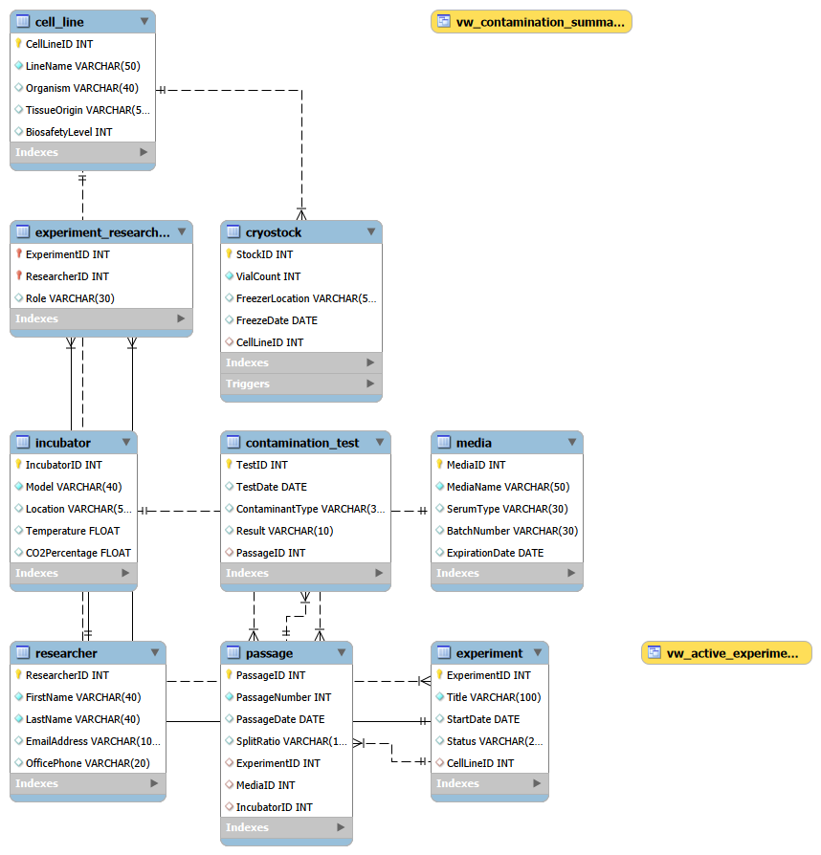
ERD and Relationships
Cardinality map
Cell line → experiments and stocks
One CELL_LINE can support many EXPERIMENT and CRYOSTOCK records.
Experiment → passage → test
Each EXPERIMENT can have many PASSAGE records, and each passage can have many CONTAMINATION_TEST records.
Researcher ↔ experiment
The many-to-many relationship is resolved by EXPERIMENT_RESEARCHER, which stores each researcher’s role.
05

Slide 6

Relational Schema and Normalization
KEY STRUCTURE
3NF DECISIONS
CELL_LINE 1 : N EXPERIMENT
01
Each table represents one subject and stores
↓
atomic attributes.
EXPERIMENT 1 : N PASSAGE
02
Non-key attributes depend on the whole key; `Role` belongs to the researcher–experiment assignment.
↓
PASSAGE 1 : N CONTAMINATION_TEST
03
Researcher, cell-line, media, and incubator
↕
details are separated to prevent repeated and
RESEARCHER M : N EXPERIMENT
transitively dependent data.
Resolved through EXPERIMENT_RESEARCHER with composite primary key (ExperimentID, ResearcherID).
06

Slide 7
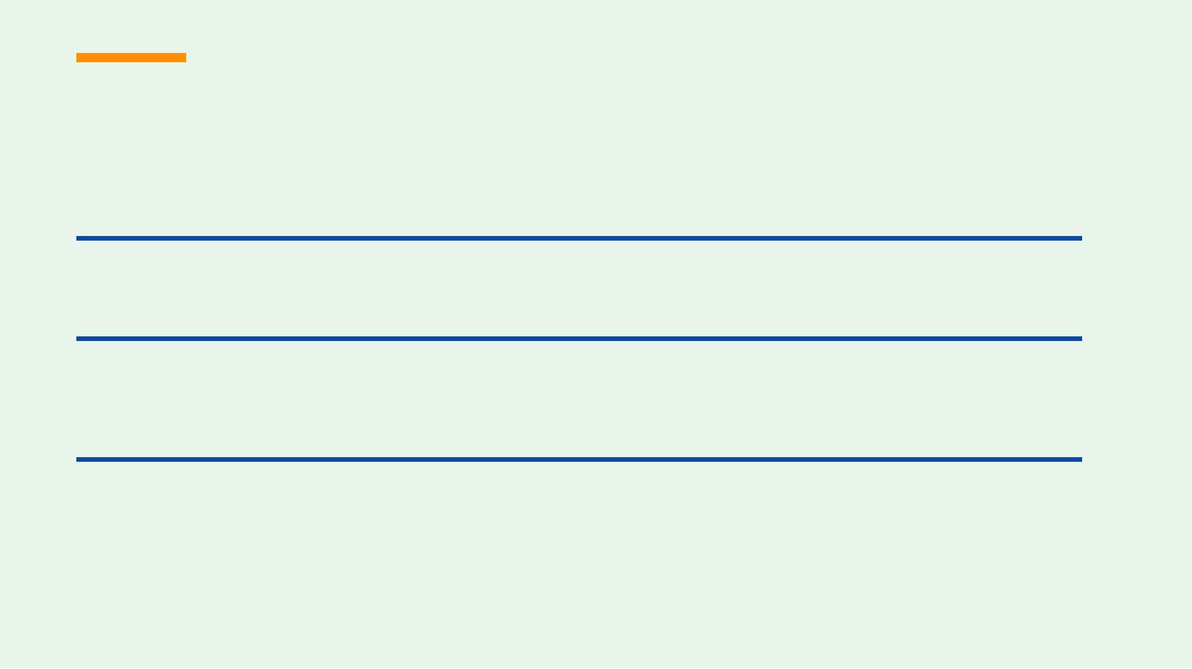
Integrity Constraints
The schema protects relationships and enforces laboratory business rules at the database layer.
FOREIGN KEYS
Primary and foreign keys preserve valid links among cell lines, experiments, passages, tests, researchers, resources, and cryostocks.
REFERENTIAL ACTIONS
Dependent experiment, passage, test, assignment, and cryostock records cascade when appropriate. Deleted media or incubators set nullable passage references to NULL.
BUSINESS RULE
Cryostock vial quantities cannot be negative. The BEFORE INSERT trigger rejects invalid inventory values with a clear database error.
VialCount ...) VALUES (..., -1, ...); .”
07

Slide 8
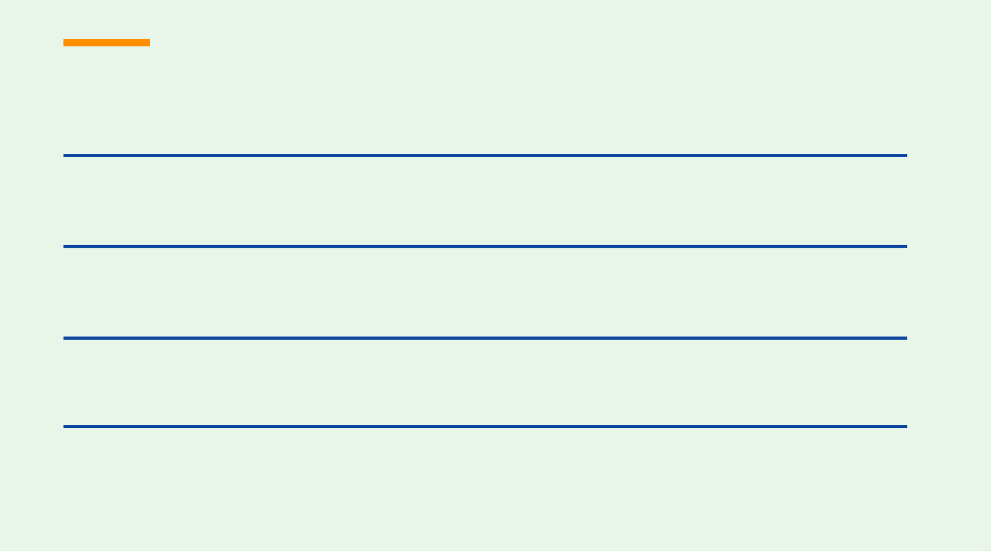
Views and Stored Procedure
ACTIVE EXPERIMENTS
Joins EXPERIMENT with CELL_LINE and exposes only records whose status is Active, together with the cell-line name and start date.
vw_active_experiments
CONTAMINATION SUMMARY
Combines CONTAMINATION_TEST and PASSAGE so laboratory users can review test results with passage numbers and experiment context.
vw_contamination_summary
CELL-LINE LOOKUP
Accepts a CellLineID parameter and returns active experiments associated with that biological cell line.
sp_GetActiveExperimentsByCellLine
08
ADVANCED OBJECTS SUPPORT REUSABILITY AND BUSINESS-RULE ENFORCEMENT

Slide 9
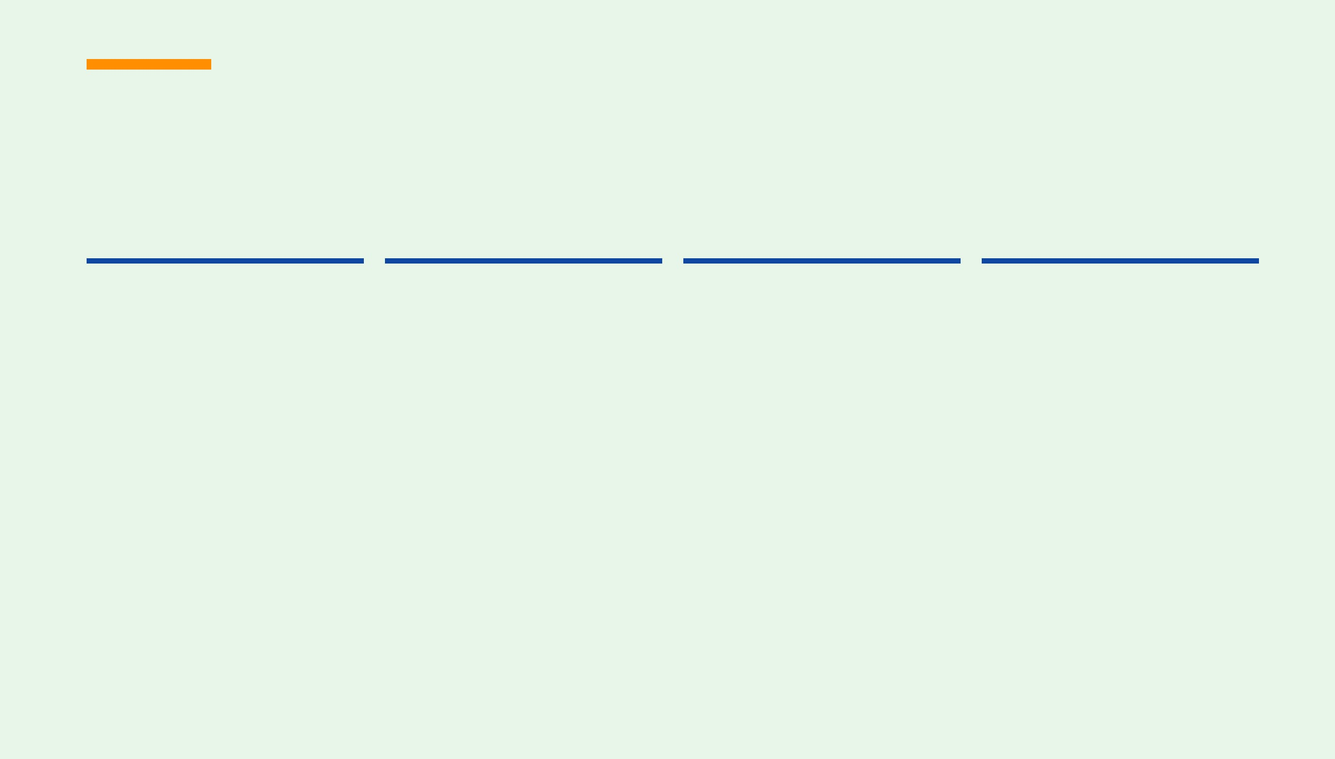
SQL Operations and Test Data
The query script demonstrates the required read, analysis, and data-modification operations against meaningful laboratory records.
01
02
03
04
Retrieve and filter
Join and aggregate
Subquery and objects
Modify safely
WHERE, ORDER BY, and LIKE queries for cell lines and researchers.
Multi-table joins plus GROUP BY and HAVING for cryostock totals.
An IN subquery, two view queries, and a stored-procedure call.
Standalone INSERT, UPDATE, and DELETE examples for demonstration.
SAMPLE-DATA COVERAGE
TESTING EVIDENCE
Each main table contains 10 meaningful records. The data includes active, completed, and terminated experiments; multiple researcher assignments; positive and negative contamination results; and varied cryostock quantities.
Run the scripts on a clean database, verify the views and procedure, then attempt an invalid negative vial count to confirm trigger enforcement.
Expected: Vial count cannot be negative.
09

Slide 10
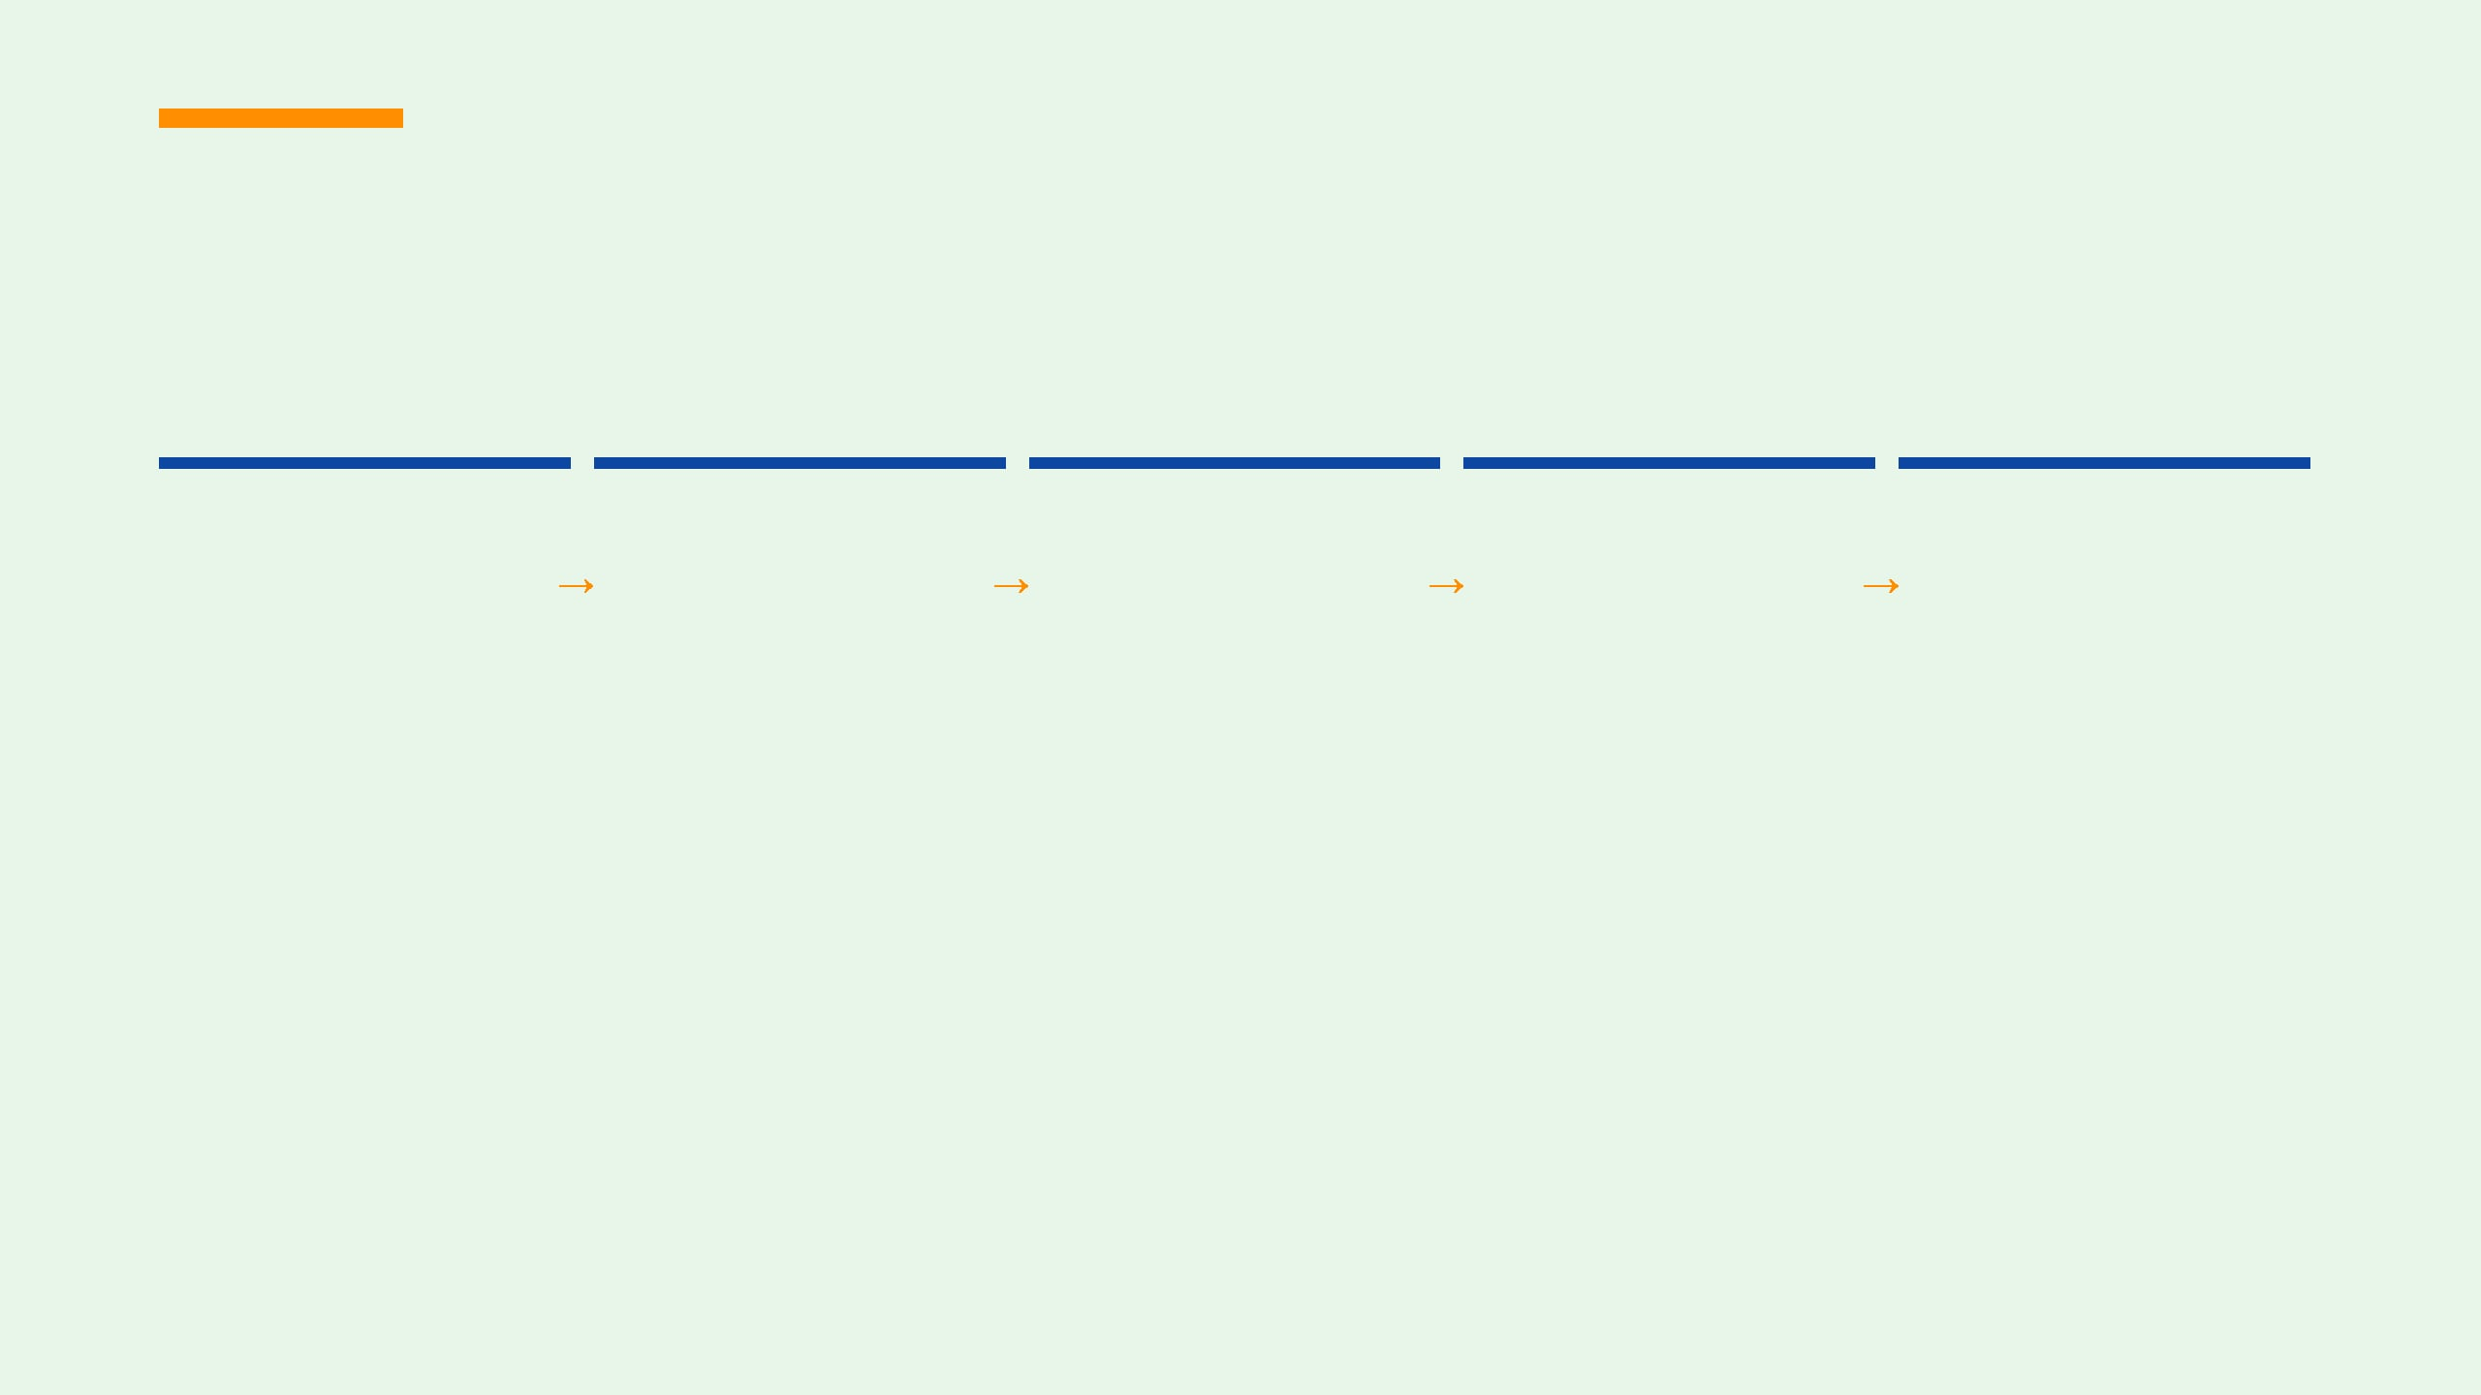
Demonstration and Conclusion
A short live sequence proves that the schema, data, queries, and business rules work together.
01
02
03
04
05
Build
Load
Query
Validate
Explain
Create the database and tables from the DDL script.
Insert the supplied meaningful test data.
Open a view and call the active-experiment procedure.
Attempt a negative vial insert and show the trigger error.
Run joins, aggregation, INSERT, UPDATE, and DELETE.
FINAL TAKEAWAY
A normalized, executable database foundation for reliable cell-culture laboratory management.
10

Slide 11
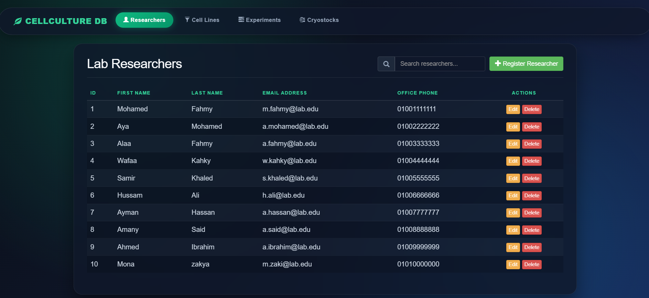
UI
11

