Slide 1
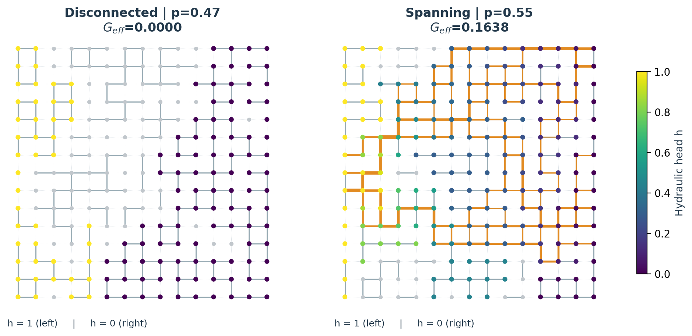
Flow in a 2D random network
Uncertainty, global sensitivity and verified computation
• Connectivity dominates flow variability over the selected ranges.
• 248,188 model evaluations; 24 independent verification tests.
• Completed analysis • 04 November 2026
RANDOM FLOW NETWORKS • 04 NOV 2026 • Source and full statistical intervals in the reports
1
Notes:
Open by distinguishing the probability of any flow from the amount of flow. All results are dimensionless.

Slide 2
A hierarchical random-network model
625 nodes · 1,200 possible links · n = 25
• Draw ONE p per realization: p = 0.5 + δU, U uniform on [−1, 1].
• Conditional on p: each link active independently with probability p.
• Active links: ln(g) ~ Normal(0, σ²); inactive links: g = 0.
• Left head = 1; right head = 0; no flow across top and bottom.
RANDOM FLOW NETWORKS • 04 NOV 2026 • Source and full statistical intervals in the reports
2
Notes:
The plotted examples use n=15 for legibility; the main study uses n=25. Unconditional edges share p and are correlated.

Slide 3
Solve only hydraulically relevant components
Sparse Kirchhoff equations with explicit disconnected-component treatment
Verification | Evidence
Uniform grid | G = g n/(n−1), exact linear head
Series / parallel branches | Analytical resistance identities
Conservation / energy | Qin = Qout = dissipated energy
Scaling / monotonicity | G(cg)=cG(g); Rayleigh property
Ishigami benchmark | Known first and total Sobol indices
1,000 random diagnostics | Max residual 2.75e-13
• Find components that touch both fixed-head boundaries.
• Solve L_FF h_F = −L_FB h_B on their free nodes.
• One-boundary clusters: constant head. Floating islands: arbitrary head, zero flow.
• G_eff = inlet flow / Δh; here Δh = 1.
RANDOM FLOW NETWORKS • 04 NOV 2026 • Source and full statistical intervals in the reports
3
Notes:
No artificial conductivity is added to disconnected links. Verification establishes numerical correctness, not field validation.

Slide 4
An explicit, reproducible experiment
Separate RNG streams; common random numbers for paired scenario comparisons
Experiment | Design | Evaluations
Main uncertainty | 9 × 10,000 | 90,000
Fixed-p sweep | 9 × 2,500 | 22,500
Extra sizes | 4 × 5,000 | 20,000
Grouped Sobol | 16,384 × 7 | 114,688
Numerical diagnostics | 1,000 | 1,000
Total | Size 25 reuses main data | 248,188
• δ = 0, 0.10, 0.25; σ = 0, 1, 2.
• Compare n = 15, 25 and 41 to expose finite-size dependence.
• Seed 20261104; all realization-level outputs are retained.
RANDOM FLOW NETWORKS • 04 NOV 2026 • Source and full statistical intervals in the reports
4
Notes:
Parameter ranges are exploratory. They are justified by covering the transition and strong heterogeneity, rather than claimed to be calibrated priors.

Slide 5
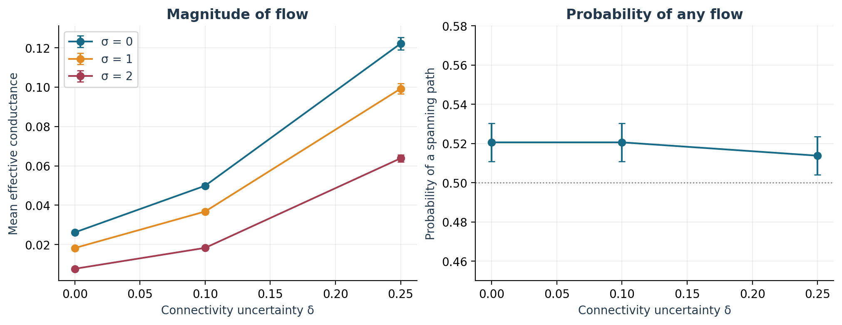
More uncertain connectivity raises mean flow
The probability of any flow remains close to one half
• At σ=1, mean G: 0.0183 → 0.0992 as δ: 0 → 0.25.
• Mean ratio: 5.44×, despite unchanged E[p]=0.5.
• Reference spanning probability: 51.38%.
• High-p realizations contribute substantial flow; low-p realizations often remain at zero.
RANDOM FLOW NETWORKS • 04 NOV 2026 • Source and full statistical intervals in the reports
5
Notes:
Error bars are sampling confidence intervals, not predictive intervals. The trend is empirical over these ranges.

Slide 6
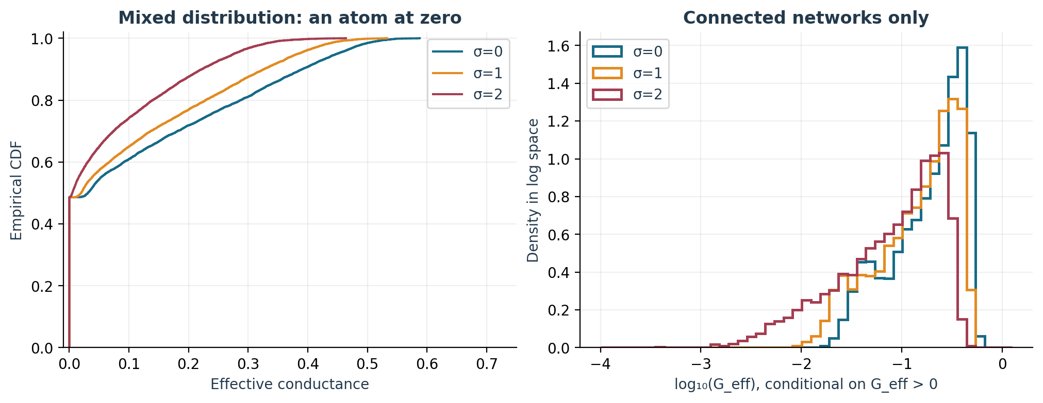
A mean cannot describe the output distribution
Separate zero-flow probability from positive-flow statistics
• Reference: δ=0.25, σ=1; P(G=0) = 48.62%.
• Mean 0.0992; median 0.0195; 95th percentile 0.3838.
• Mean given G>0: 0.1931.
• A single lognormal law is unsuitable for a distribution with an atom at zero.
RANDOM FLOW NETWORKS • 04 NOV 2026 • Source and full statistical intervals in the reports
6
Notes:
The histogram shows density in log space, conditional on positive flow. Full raw samples are provided.

Slide 7
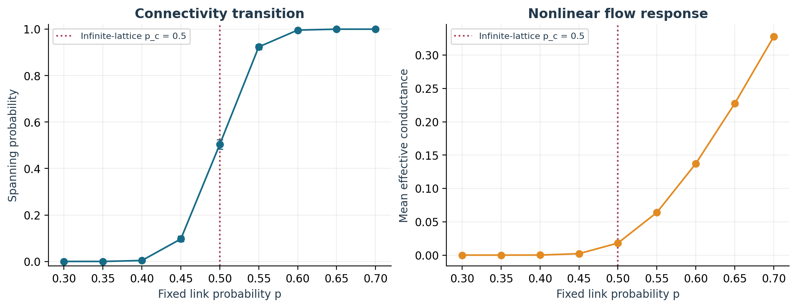
A transition controls the response
Fixed-p sweep: 2,500 realizations per p; σ=1; n=25
• For an infinite square bond lattice, p_c = 0.5 (Kesten, 1980).
• A finite network has a smooth connectivity crossover.
• Nonlinear flow response explains the strong effect of the width δ.
• Shared p induces covariance δ²/3 between distinct link indicators.
RANDOM FLOW NETWORKS • 04 NOV 2026 • Source and full statistical intervals in the reports
7
Notes:
Do not interpret p=0.5 as a deterministic no-flow condition in a finite network, or sample a different p for each link.

Slide 8
Sensitivity of a stochastic model
Grouped Sobol analysis on independent latent inputs
Group | Distribution / role
δ | Uniform(0, 0.25), connectivity width
σ | Uniform(0, 2), log-conductance SD
U | Uniform(−1, 1), p = 0.5 + δU
Topology W | 1,200 independent Uniform(0,1) values
Conductance Z | 1,200 independent standard normals
• Use five independent groups; keep δ and realized p out of the same independent-input list.
• Jansen first and total indices: interactions are explicitly retained.
• 16,384 base pairs; 1,000 paired-row bootstrap resamples.
• The estimator also passes the analytic Ishigami benchmark.
RANDOM FLOW NETWORKS • 04 NOV 2026 • Source and full statistical intervals in the reports
8
Notes:
The expanded simulator is deterministic given these inputs. Importance depends on priors and latent parameterization. Sobol indices target unconditional G, including zeros.

Slide 9
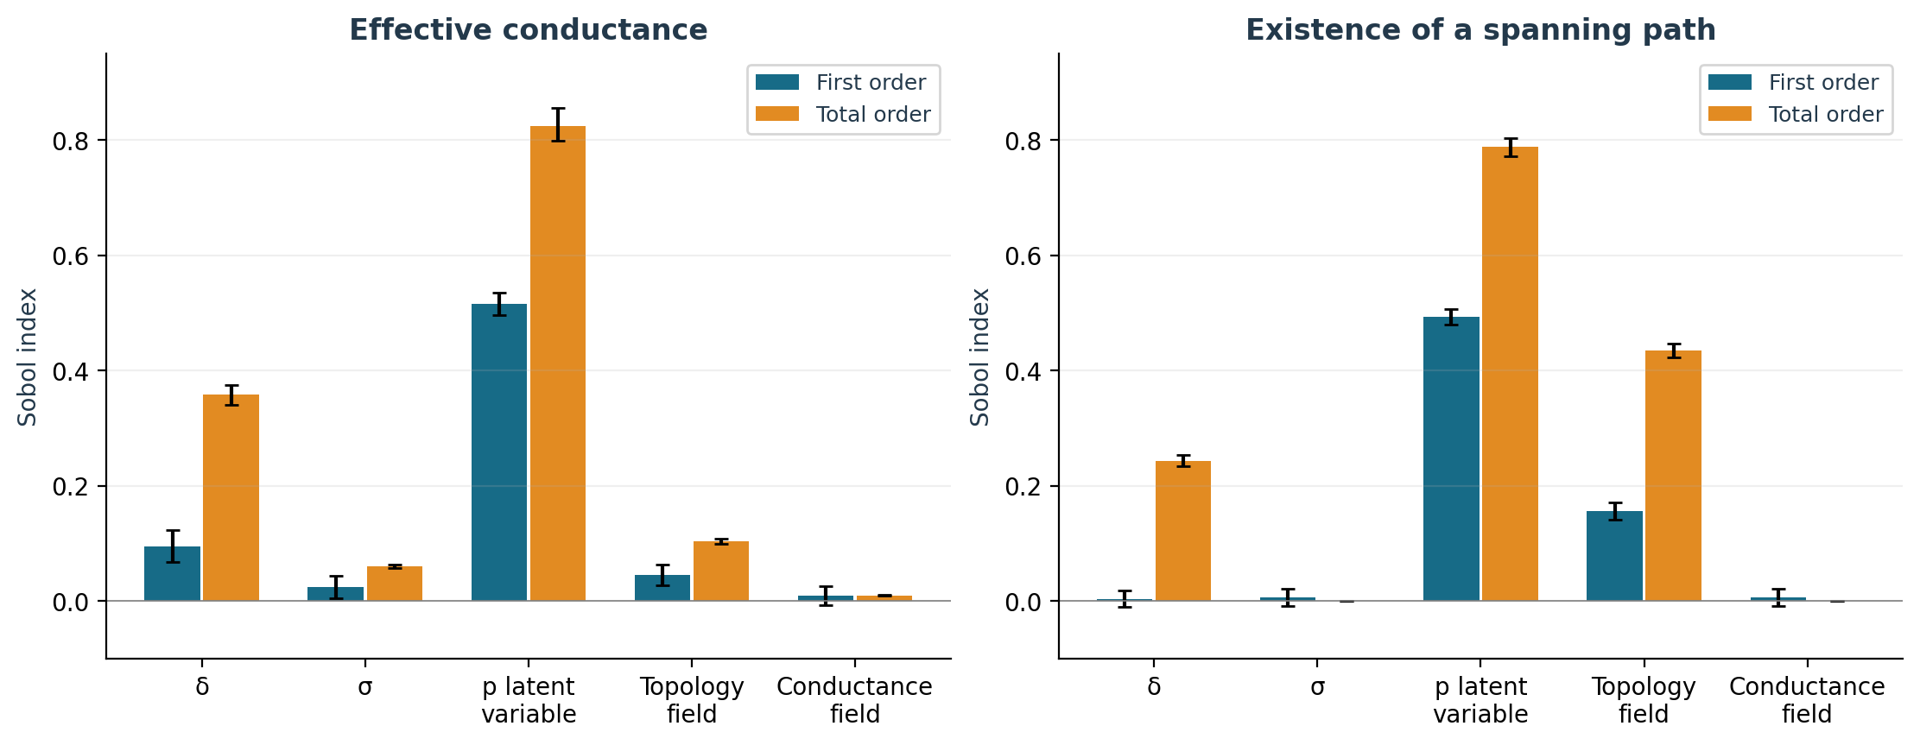
Global connectivity is the dominant influence
Total-order indices include every interaction involving each group
• U: total 0.825; first 0.516.
• δ: total 0.358; first 0.096. Strong interactions.
• Topology: 0.104; σ: 0.061; Z: 0.010.
• σ and Z have exactly zero total effect on path existence. Do not sum overlapping total indices.
RANDOM FLOW NETWORKS • 04 NOV 2026 • Source and full statistical intervals in the reports
9
Notes:
Small first-order estimates for known inactive factors reflect Monte Carlo error. Raw estimates and intervals are retained, including negatives.

Slide 10
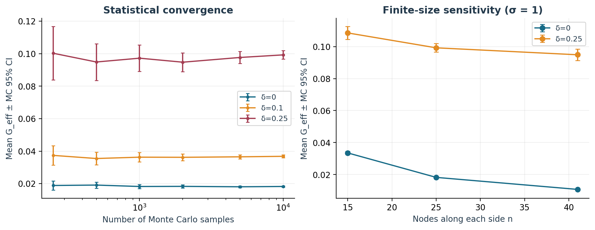
Sampling precision improves; size effects remain
Monte Carlo convergence is distinct from finite-size sensitivity
• Final relative 95% half-widths: 2.19–2.91% for scenario means.
• At δ=0, σ=1: mean G decreases substantially with n.
• Changing n changes the random-network ensemble.
• A size-independent continuum limit has not been demonstrated.
RANDOM FLOW NETWORKS • 04 NOV 2026 • Source and full statistical intervals in the reports
10
Notes:
Prefix Sobol convergence is supplied as figure 08 and CSV. The leading rank is resolved; tiny indices remain uncertain.

Slide 11
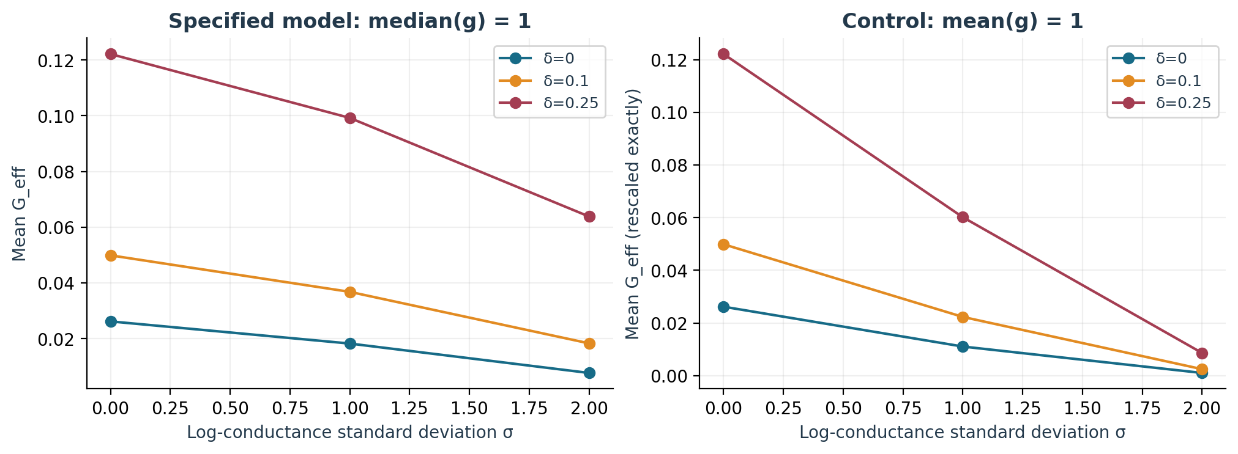
Heterogeneity is not a pure variance change
The specified lognormal family fixes the median, not the mean
• Active-link E[g] = exp(σ²/2): 1, 1.6487, 7.3891 for σ = 0, 1, 2.
• Mean network conductance still falls with σ over these scenarios.
• Weak links on series paths act as bottlenecks.
• Constant-mean control: g* = g exp(−σ²/2), so G* = G exp(−σ²/2) exactly.
RANDOM FLOW NETWORKS • 04 NOV 2026 • Source and full statistical intervals in the reports
11
Notes:
The constant-mean normalization is a supplementary control. It does not replace the assigned ln(g) ~ Normal(0, σ²) model.

Slide 12
Interpretation and next steps
Numerically verified behavior of a simplified dimensionless lattice
Deliverable | Location
Persian and English reports | reports/report_fa.pdf; report_en.pdf
Code and 24 tests | src/flow_network; tests/
Raw samples and statistics | results/
Executed notebook | notebooks/analysis.ipynb
One-command reproduction | README.md; scripts/
GitHub | mohrezsayeh90-ai/Interview_upsla
• Measure connectivity carefully; report connection probability and flow magnitude separately.
• Limits: regular 2D geometry, exploratory priors, steady linear single-phase flow, finite size.
• Next: 3D fracture geometry, aperture-based conductance, correlation, matrix exchange and calibration.
• No field-data validation or geological prediction accuracy is claimed.
RANDOM FLOW NETWORKS • 04 NOV 2026 • Source and full statistical intervals in the reports
12
Notes:
References: Jansen (1999), CPC 117, 35–43, doi:10.1016/S0010-4655(98)00154-4; Kesten (1980), CMP 74, 41–59, doi:10.1007/BF01197577. Full references are in both reports.

