Slide 1
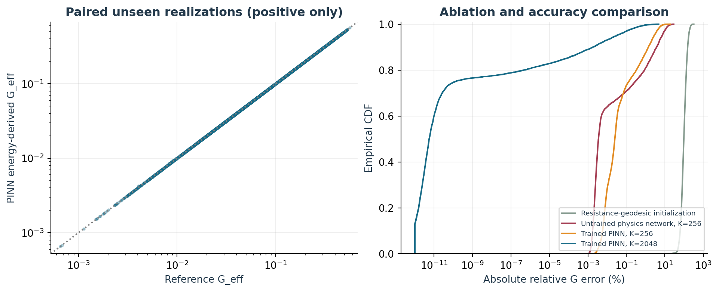
A reusable parametric graph PINN
Independent comparison with the verified random-network solver
• Main test: 9,000 unseen realizations; 4,518 carry positive flow.
• K=2048: mean relative conductance error 0.0200%.
• Weights are reused. Each input still receives fixed iterative physics updates.
• Completed study • 04 November 2026
PARAMETRIC GRAPH PINN • 04 NOV 2026 • Full error distributions and physical limits in the reports
1

Slide 2
Physical scalars do not identify a random network
The full conductance field, or a seed, must be part of the input
Input | Meaning
δ, p, σ | Distribution descriptors / neural conditioning
g field or random seed | Identifies the actual physical realization
h_left, h_right | Prescribed heads
Global conductance scale | Exact output scaling
Output | Head field, energy G estimate, flux diagnostics
• The same δ,p,σ can produce either a spanning or disconnected network.
• For a particular realization, input all 1,200 edge conductances.
• For only δ and σ, sample fields and predict ensemble statistics.
• Boundary heads and uniform conductance scaling use exact physical factors.
PARAMETRIC GRAPH PINN • 04 NOV 2026 • Full error distributions and physical limits in the reports
2

Slide 3
A discrete physics-informed architecture
Learned encoder + parametric coefficients + fixed graph layers
Block | Definition
Node encoder | 21 → 32 → 32 → 1
Coefficient MLP | 6 → 16 → 2
Physics layer | h_next = h − α(h−Ph) + β(h−h_prev)
Training objective | log Dirichlet energy ratio + residual term
Trainable parameters | 1,939
• Component analysis handles zero-flow and fixed-head components exactly.
• Resistance Dijkstra distances initialize head.
• Small neural networks learn initial correction and graph-level α,β.
• K residual layers update h; no new sparse solve or weight fitting.
PARAMETRIC GRAPH PINN • 04 NOV 2026 • Full error distributions and physical limits in the reports
3
Notes:
This is a custom unrolled graph PINN / learned iterative operator, not the original continuum coordinate PINN architecture. Fixed head updates are performed at every inference.

Slide 4
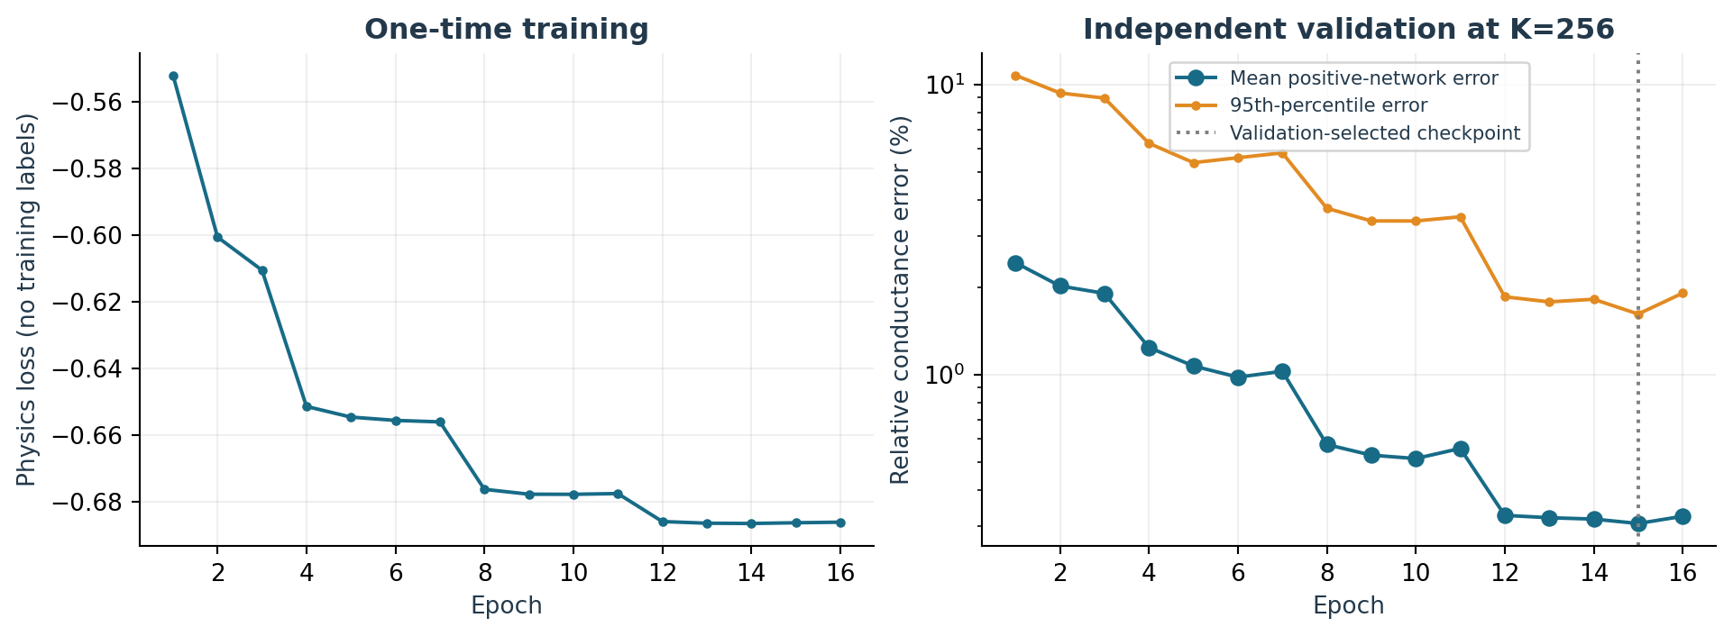
Train once without reference solution labels
4,096 spanning training fields; 512 independent validation fields
• Reference solutions are used for validation and tests only.
• 16 epochs; selected epoch 15; depth curriculum 32→64→128→256.
• Training loop 297.4s; total offline work 334.7s.
• Training, validation and test random streams are disjoint.
PARAMETRIC GRAPH PINN • 04 NOV 2026 • Full error distributions and physical limits in the reports
4

Slide 5
Accuracy improves with trained physical layers
All relative conductance errors below exclude exact zero-flow cases
• K=256 trained mean error: 0.4705%.
• Untrained K=256 mean error: 1.1381%.
• K=2048: mean 0.0200%, p95 0.0393%.
• Maximum K=2048 error: 4.739%; accuracy is not uniform.
PARAMETRIC GRAPH PINN • 04 NOV 2026 • Full error distributions and physical limits in the reports
5
Notes:
The validation target of a 99th-percentile error below 0.1% was not reached within the depth cap. The target failure is recorded; no test-based retuning was done.

Slide 6
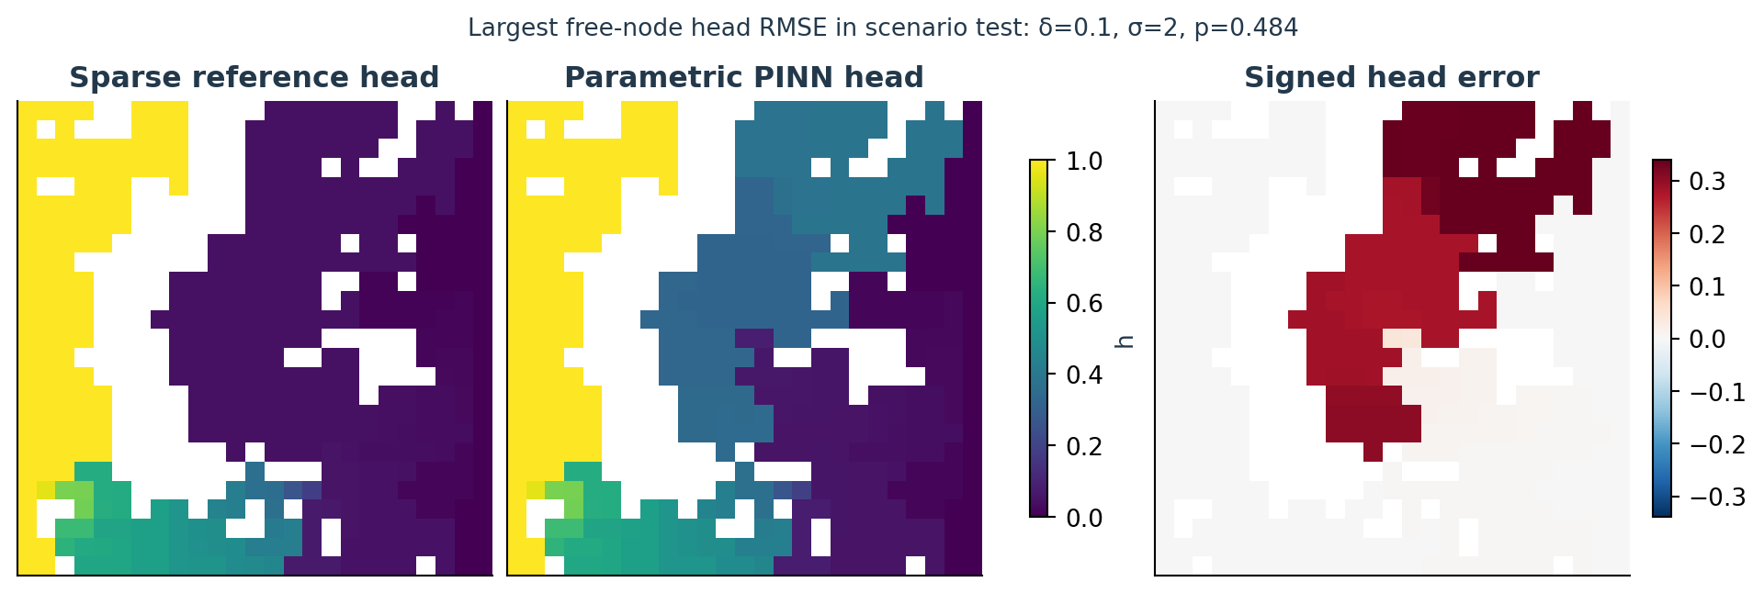
Energy accuracy and field accuracy differ
A deliberately difficult held-out head-field example
• G is estimated from Dirichlet energy, an admissible-head upper bound.
• Approximate inlet flux can differ from the energy estimate.
• Mean free-node head RMSE: 0.001460.
• 95th-percentile inlet/outlet imbalance: 3.02%.
PARAMETRIC GRAPH PINN • 04 NOV 2026 • Full error distributions and physical limits in the reports
6
Notes:
Local weakly connected branches can have significant head errors while contributing little energy. Raw flux and conservation diagnostics are retained.

Slide 7
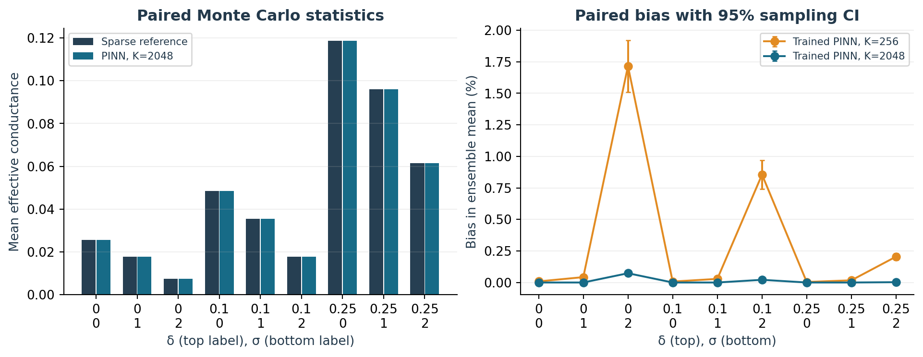
Paired uncertainty comparison
Same physical fields for sparse reference and neural prediction
• Nine scenarios × 1,000 new realizations each.
• Compare mean, standard deviation, median, upper quantile and conditional flow.
• P(G=0) agrees exactly through structural connectivity preprocessing.
• Old 10,000-sample study and new reference means differ by Monte Carlo variation.
PARAMETRIC GRAPH PINN • 04 NOV 2026 • Full error distributions and physical limits in the reports
7

Slide 8
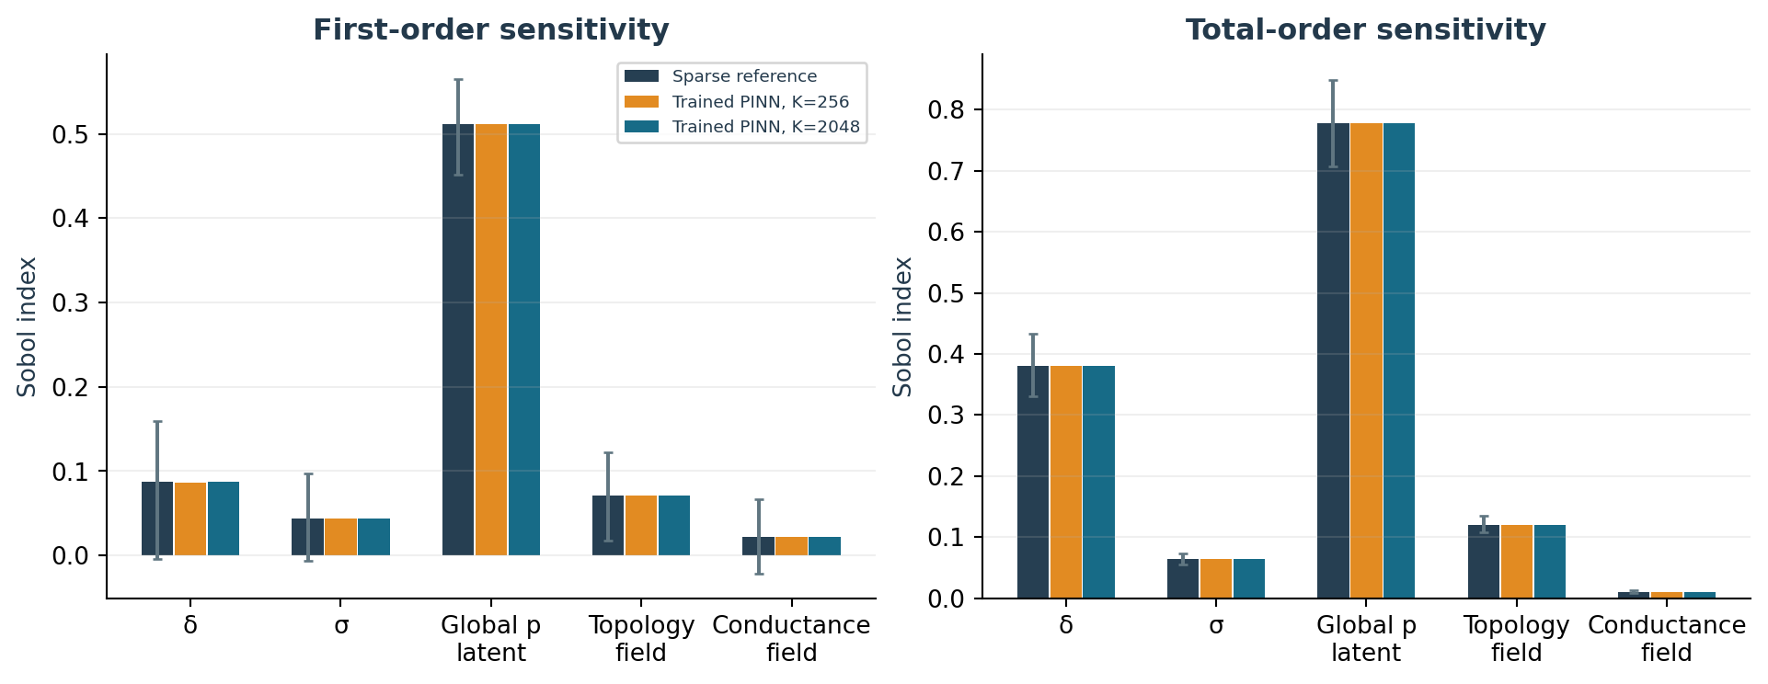
Sensitivity rankings are reproduced
2,048 independent base pairs; 14,336 matched physical fields
• Five groups: δ, σ, global-p latent U, topology W and conductance Z.
• 1,000 paired bootstrap resamples preserve input coupling.
• Compare model-minus-reference indices on the same fields.
• Total indices overlap; their sums are not independent variance shares.
PARAMETRIC GRAPH PINN • 04 NOV 2026 • Full error distributions and physical limits in the reports
8

Slide 9
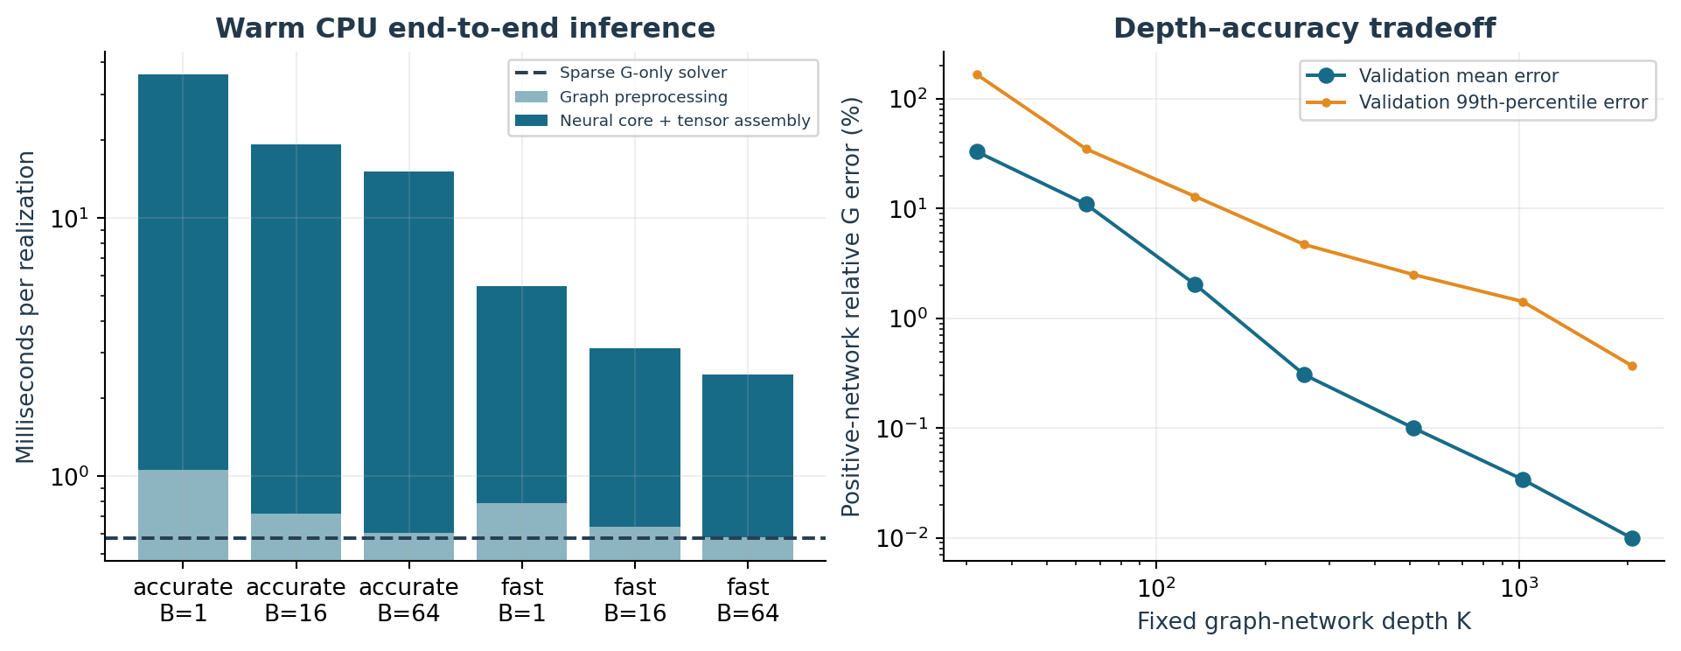
Reusable weights do not guarantee a speedup
Measured warm CPU cost includes graph preprocessing and tensor assembly
• Sparse G-only solver: 0.576 ms per realization.
• Fast PINN, batch 64: 2.508 ms per realization.
• Accurate PINN, batch 64: 15.097 ms per realization.
• For this 25×25 problem, direct solving is faster; no positive break-even was observed.
PARAMETRIC GRAPH PINN • 04 NOV 2026 • Full error distributions and physical limits in the reports
9
Notes:
Two CPU threads, float64 inference, three repetitions on the same 64 new fields. Model loading and field generation are excluded. Offline training is additional.

Slide 10
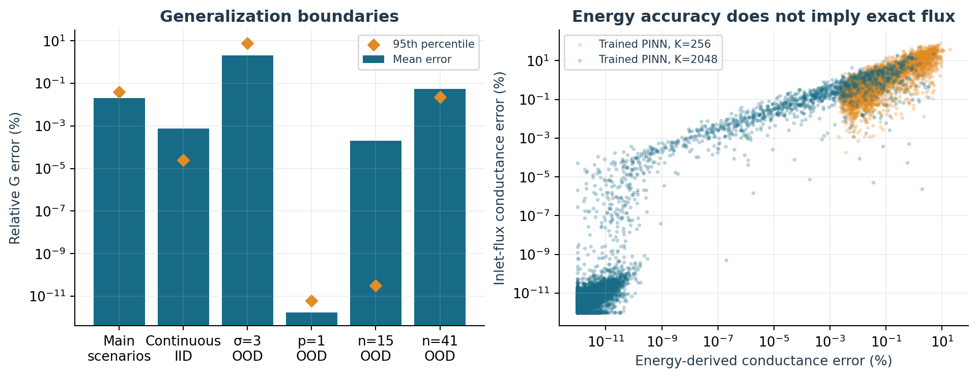
Generalization has boundaries
Stress tests do not imply a guarantee outside the training domain
• At σ=3, mean relative G error rises to 2.08%.
• The σ=3 maximum error is 20.26%.
• Other tests: p=1 and n=15,41; same learned weights, no refitting.
• Strong contrast and weak anchoring can require much larger depth.
PARAMETRIC GRAPH PINN • 04 NOV 2026 • Full error distributions and physical limits in the reports
10

Slide 11
Use the trained model directly
The default prediction path does not call the sparse solver
Task | Command from repository root
One realization | python parametric_pinn/scripts/predict.py --p .6 --sigma 1
Ensemble | .../predict.py --delta .25 --sigma 1 --draws 1000
Supplied field | .../predict.py --conductances field.npy
Optional reference check | .../predict.py --compare-reference
Complete reproduction | make -C parametric_pinn all
• Select fast K=256 or accurate K=2048.
• Provide a .npy conductance field, or distribution parameters plus a seed.
• Use multiple draws to obtain stochastic summaries.
• Keep inlet flux diagnostics separate from the energy-derived G estimate.
PARAMETRIC GRAPH PINN • 04 NOV 2026 • Full error distributions and physical limits in the reports
11

Slide 12
Conclusions and separate deliverables
36 automated tests; reproducible fields, checkpoints and paired comparisons
Artifact | Location
Reports | reports/comparison_fa.pdf; comparison_en.pdf
Trained weights | models/parametric_pinn.pt
Paired results and timings | results/
Executed notebook | notebooks/comparison.ipynb
API and reproduction | README.md; scripts/
• The graph PINN reuses trained parameters across unseen random fields.
• High in-domain conductance accuracy does not imply exact local conservation.
• The direct solver retains the advantage in precision and measured CPU cost here.
• All new outputs are isolated under parametric_pinn/.
PARAMETRIC GRAPH PINN • 04 NOV 2026 • Full error distributions and physical limits in the reports
12
Notes:
References: Raissi et al. (2019), doi:10.1016/j.jcp.2018.10.045; E and Yu (2018), doi:10.1007/s40304-018-0127-z; Jansen (1999), doi:10.1016/S0010-4655(98)00154-4. See reports for full context.

