Slide 1
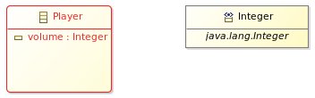
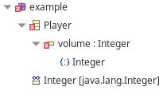
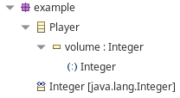
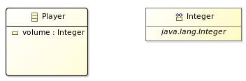
The attribute is not transient so it must have a data type that is serializable
Abstract Syntax Graph
Abstract Syntax Tree
Concrete Syntax
: EClass
: EAttribute
Property | Value
name = "Player"
eStructuralFeatures
name = "volume"
transient=false
transient | false
eType
serializable | false
: EDataType
name ="Integer"
serializable=false
Abstract Syntax Graph
Abstract Syntax Tree
Concrete Syntax
: EClass
: EAttribute
Property | Value
name = "Player"
eStructuralFeatures
name = "volume"
transient=false
transient | false
eType
serializable | true
: EDataType
name = "Integer"
serializable=true

Slide 2
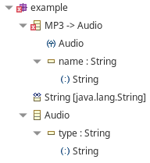
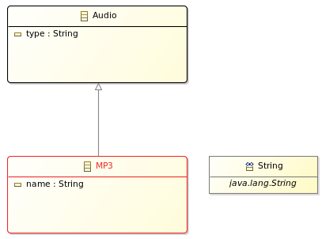
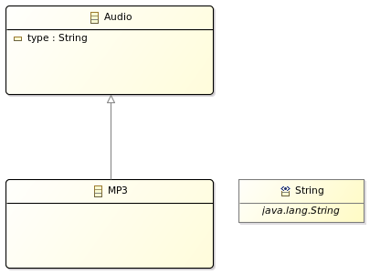
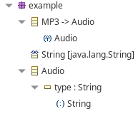
Two features can not both be IDs
Abstract Syntax Graph
Abstract Syntax Tree
Concrete Syntax
: EClass
eSuperTypes
: EClass
name = "MP3"
name = "Audio"
eStructuralFeatures
eStructuralFeatures
: EAtrribute
: EAtrribute
id = true
id = true
Abstract Syntax Graph
Abstract Syntax Tree
Concrete Syntax
: EClass
eSuperTypes
: EClass
name = "MP3"
name = "Audio"
eStructuralFeatures
: EAtrribute
id = true

Slide 3
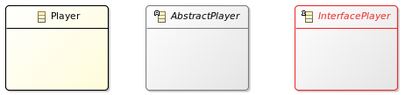
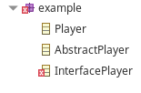
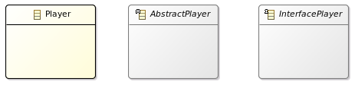
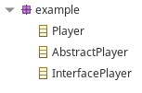
A class that is an interface must also be abstract
Abstract Syntax Graph
Abstract Syntax Tree
Concrete Syntax
Interface:
abstract Class:
concrete Class:
Property | Value
Abstract | false
Interface | false
: EClass
: EClass
: EClass
name = "Player"
interface=true
abstract=false
name = "Player"
interface=false
abstract=true
name = "Player"
interface=false
abstract=false
Abstract | true
Interface | false
Abstract | false
Interface | true
Abstract Syntax Graph
Abstract Syntax Tree
Concrete Syntax
Interface:
abstract Class:
concrete Class:
Property | Value
Abstract | false
Interface | false
: EClass
: EClass
: EClass
name = "Player"
interface=true
abstract=true
name = "Player"
interface=false
abstract=true
name ="Player"
interface=false
abstract=false
Abstract | true
Interface | false
Abstract | true
Interface | true

Slide 4
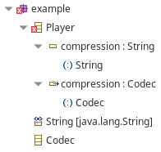
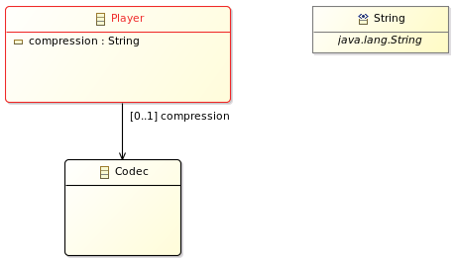
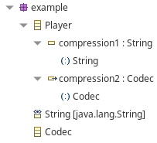
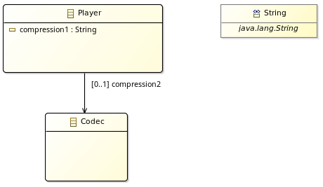
There may not be two features with the same name
Abstract Syntax Graph
Abstract Syntax Tree
Concrete Syntax
: EAttribute
: EDataType
name = "compression"
eType
name = "EString"
eStructuralFeatures
: EClass
name = "Player"
eStructuralFeatures
: EAttribute
: EClass
name = "compression"
eType
name = "Codec"
Abstract Syntax Graph
Abstract Syntax Tree
Concrete Syntax
: EAttribute
: EDataType
name = "compression1"
eType
name = "EString"
eStructuralFeatures
: EClass
name = "Player"
eStructuralFeatures
: EAttribute
: EClass
name = "compression2"
eType
name = "Codec"

Slide 5
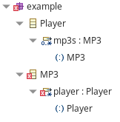
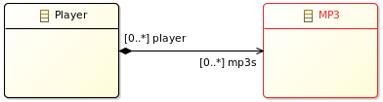
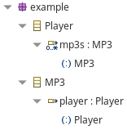
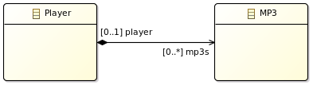
A container reference must have upper bound Of 1
Abstract Syntax Graph
Abstract Syntax Tree
Concrete Syntax
: EReference
eStructuralFeatures
containment = true
eType
: EClass
: EClass
name = "Player"
eOpposite
eOpposite
name = "MP3"
eType
: EReference
eStructuralFeatures
container = true
upperBound = - 1
Abstract Syntax Graph
Abstract Syntax Tree
Concrete Syntax
: EReference
eStructuralFeatures
containment = true
eType
: EClass
: EClass
name = "Player"
eOpposite
eOpposite
name = "MP3"
eType
: EReference
eStructuralFeatures
container = true
upperBound = 1

Slide 6
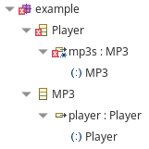
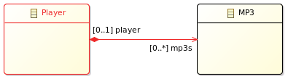
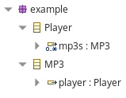
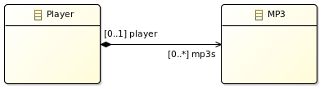
A containment or bidirectional reference must be unique if its upper bound is different from 1
Abstract Syntax Graph
Abstract Syntax Tree
Concrete Syntax
: EReference
eStructuralFeatures
upperBound = -1 (i.e. *)
unique = false
eType
: EClass
: EClass
name = "Player"
eOpposite
eOpposite
name = "MP3"
eType
: EReference
eStructuralFeatures
Abstract Syntax Graph
Abstract Syntax Tree
Concrete Syntax
: EReference
eStructuralFeatures
upperBound = -1 (i.e. *)
unique = true
eType
: EClass
: EClass
name = "Player"
eOpposite
eOpposite
name = "MP3"
eType
: EReference
eStructuralFeatures

Slide 7
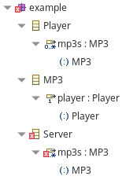
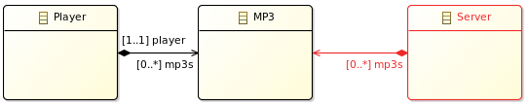
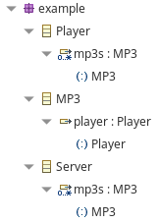
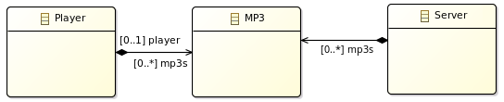
A containment reference of a type with a container feature that requires instances to be contained elsewhere
can not be populated
Abstract Syntax Graph
Abstract Syntax Tree
Concrete Syntax
: EReference
Property | Value
eStructuralFeatures
: EClass
containment | true
containment= true
eType
name = "Server"
: EClass
: EClass
container | true
lower bound | 1
name = "Player"
eOpposite
eOpposite
name = "MP3"
eStructuralFeatures
eType
eType
: EReference
eStructuralFeatures
: EReference
container = true
lower bound = 1
containment= true
Abstract Syntax Graph
Abstract Syntax Tree
Concrete Syntax
: EReference
Property | Value
eStructuralFeatures
: EClass
containment | false
containment=false
eType
name = "Server"
: EClass
: EClass
container | true
lower bound | 0
name = "Player"
eOpposite
eOpposite
name = "MP3"
eStructuralFeatures
eType
eType
: EReference
eStructuralFeatures
: EReference
container = true
lower bound = 0
containment= true

Slide 8
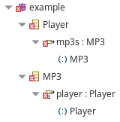
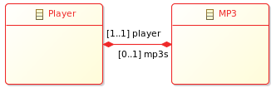
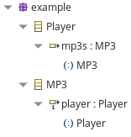
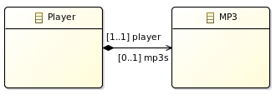
The opposite of a containment reference must not be a containment reference
Abstract Syntax Graph
Abstract Syntax Tree
Concrete Syntax
: EReference
eStructuralFeatures
containment = true
eType
: EClass
eOpposite
eOpposite
: EClass
name = "Player"
name = "MP3"
eType
: EReference
eStructuralFeatures
containment= true
Abstract Syntax Graph
Abstract Syntax Tree
Concrete Syntax
: EReference
eStructuralFeatures
containment = false
eType
: EClass
eOpposite
eOpposite
: EClass
name = "Player"
name = "MP3"
eType
: EReference
eStructuralFeatures
containment= true

Slide 9
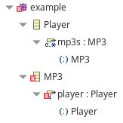
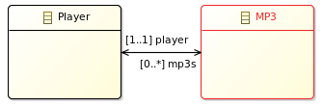

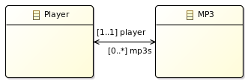
The opposite of a transient reference must be transient if it is proxy resolving
Abstract Syntax Graph
Abstract Syntax Tree
Concrete Syntax
: EReference
Property | Value
transient = false
resolveProxies = true
transient | false
eStructuralFeatures
eType
resolveProxies | true
: EClass
eOpposite
eOpposite
: EClass
Transient | true
name = "Player"
name = "MP3"
eType
: EReference
eStructuralFeatures
transient = true
Abstract Syntax Graph
Abstract Syntax Tree
Concrete Syntax
: EReference
Property | Value
transient = true
resolveProxies = true
transient | true
eStructuralFeatures
eType
resolveProxies | true
: EClass
eOpposite
eOpposite
: EClass
Transient | true
name = "Player"
name = "MP3"
eType
: EReference
eStructuralFeatures
transient = true

Slide 10
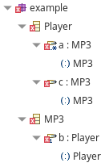
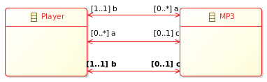
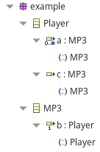
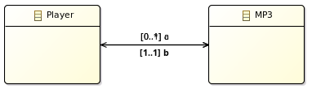
The opposite of the opposite may not be a reference different from this one
Abstract Syntax Graph
Abstract Syntax Tree
Concrete Syntax
: EReference
name = "a"
eOpposite
: EReference
eOpposite
name = "b"
eOpposite
: EReference
name = "c"
Abstract Syntax Graph
Abstract Syntax Tree
Concrete Syntax
: EReference
name = "a"
: EReference
name = "b"
eOpposite
eOpposite
: EReference
name = "c"

Slide 11
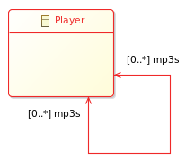

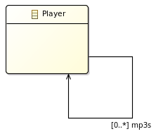

The opposite may not be its own opposite
Abstract Syntax Graph
Abstract Syntax Tree
Concrete Syntax
: EReference
name = "a"
eOpposite
Abstract Syntax Graph
Abstract Syntax Tree
Concrete Syntax
: EReference
name = "a"

Slide 12
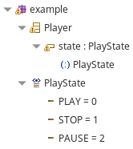
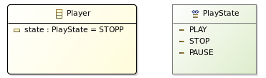
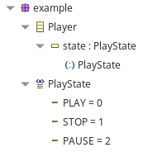
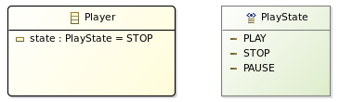
The default value literal must be a valid literal of the attributes type
Abstract Syntax Graph
Abstract Syntax Tree
Concrete Syntax
: EClass
eStructuralFeatures
: EAttribute
EAttribute
name = "Player"
name = "state"
defaultValueLiteral = "STOPP"
defaultValueLiteral
: ELiteral
name = "PLAY"
eLiterals
eType
EEnum
: ELiteral
eLiterals
: EEnum
name = "STOP"
name = "PlayState"
ELiterals
: ELiteral
eLiterals
name = "PAUSE"
Abstract Syntax Graph
Abstract Syntax Tree
Concrete Syntax
: EClass
eStructuralFeatures
: EAttribute
EAttribute
name = "Player"
name = "state"
defaultValueLiteral = "STOP"
defaultValueLiteral
: ELiteral
name = "PLAY"
eLiterals
eType
EEnum
: ELiteral
eLiterals
: EEnum
name = "STOP"
name = "PlayState"
ELiterals
: ELiteral
eLiterals
name = "PAUSE"

Slide 13
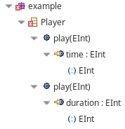
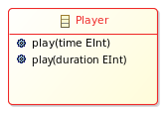
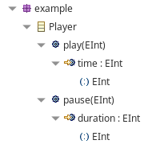
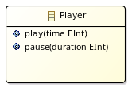
There may not be two operations and with the same signature
Abstract Syntax Graph
Abstract Syntax Tree
Concrete Syntax
: EOperation
eOperations
name = "play"
eType
: EClass
: EDataType
name = "Player"
name = "EInt"
eOperations
: EOperation
eType
name = "play"
Abstract Syntax Graph
Abstract Syntax Tree
Concrete Syntax
: EOperation
eOperations
name = "play"
eType
: EClass
: EDataType
name = "Player"
name = "EInt"
eOperations
: EOperation
eType
name = "pause"

Slide 14
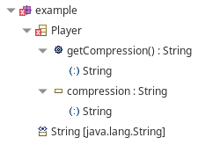



There may not be an operation with the same signature as an accessor method for feature
Abstract Syntax Graph
Abstract Syntax Tree
Concrete Syntax
: EAttribute
eStructuralFeatures
name = "compression"
eType
: EClass
: EDataType
name = "MP3"
name = "EString"
eOperations
: EOperation
eType
name = "getCompression"
Abstract Syntax Graph
Abstract Syntax Tree
Concrete Syntax
: EAttribute
eStructuralFeatures
name = "compression“
eType
: EClass
: EDataType
name = "MP3"
name = "EString"
eOperations
: EOperation
eType
name = "getCompressionName"

Slide 15




There may not be two Parameters with the same name
Abstract Syntax Graph
Abstract Syntax Tree
Concrete Syntax
: EClass
eOperations
: EOperation
name = "Player"
name = "play"
eParameters
eParameters
: EParameter
: EParameter
name = "time"
name = "time"
Abstract Syntax Graph
Abstract Syntax Tree
Concrete Syntax
: EClass
eOperations
: EOperation
name = "Player"
name = "play"
eParameters
eParameters
: EParameter
: EParameter
name = "start"
name = "time"

Slide 16




There may not be two classifiers with the same name
Abstract Syntax Graph
Abstract Syntax Tree
Concrete Syntax
: EClass
eClassifiers
name = "Audio"
: EPackage
name = "Player"
eClassifiers
: EClass
name = "Audio"
Abstract Syntax Graph
Abstract Syntax Tree
Concrete Syntax
: EClass
eClassifiers
name = "Audio"
: EPackage
name = "Player"
eClassifiers
: EClass
name = "MP3"

Slide 17




The typed element must have a type
Abstract Syntax Graph
Abstract Syntax Tree
Concrete Syntax
: EClass
name = "Folder"
eStructuralFeatures
: EAttribute
name = "name"
Abstract Syntax Graph
Abstract Syntax Tree
Concrete Syntax
: EClass
name = "Folder"
eStructuralFeatures
: EAttribute
name = "name"
eType
: EDataType
name = "EString"

Slide 18




The required feature must be set
Abstract Syntax Graph
Abstract Syntax Tree
Concrete Syntax
: EClass
eSuperTypes
: EClass
name = "MP3"
name = "Audio"
eStructuralFeatures
: EAttribute
name = "type"
Abstract Syntax Graph
Abstract Syntax Tree
Concrete Syntax
: EClass
eSuperTypes
: EClass
name = "MP3"
name = "Audio"
eStructuralFeatures
: EAttribute
name = "type"
eType
: EDataType
name = "EString"

Slide 19




The generic type associated with the classifier must not have more arguments then the classifier has type parameters
Abstract Syntax Graph
Concrete Syntax
Abstract Syntax Tree
The Classifier has just one type parameter. As a result, the Generic Type associated with the Classifier should not have two type arguments!

Slide 20




The generic type associated with the classifier must not have more arguments then the classifier has type parameters
Abstract Syntax Graph
Concrete Syntax
Abstract Syntax Tree

Slide 21




The generic type associated with the classifier is missing type arguments to match the number of type parameters of the classifier
Abstract Syntax Graph
Concrete Syntax
Abstract Syntax Tree
The Classifier has one type parameter and the Generic Type associated with the Classifier has no type arguments!

Slide 22
The generic type associated with the classifier is missing type arguments to match the number of type parameters of the classifier
Abstract Syntax Graph
Concrete Syntax
Abstract Syntax Tree

