Slide 1

KELAS: PREDICTIVE ANALYTICS WITH R
Predictive Analytics with
Technaut Education | www.technaut.co

Slide 2
Technaut Education | www.technaut.co
Workshop R Bulan Juli
Basic R
EDA R
Predictive R
PREDICTIVE ANALYTICS WITH R

Slide 3
Apa yang akan dipelajari?
Technaut Education | www.technaut.co
Pengenalan Predictive Analytics
Predictive Model menggunakan Machine Learning
Praktek
PREDICTIVE ANALYTICS WITH R

Slide 4
KELAS: PREDICTIVE ANALYTICS WITH R
Pengenalan Predictive Analytics
Technaut Education | www.technaut.co

Slide 5
Macam-Macam Analisis
Technaut Education | www.technaut.co
PREDICTIVE ANALYTICS WITH R
Predictive Analytics
Descriptive Analytics
Diagnostic Analytics
Prescriptive Analytics

Slide 6
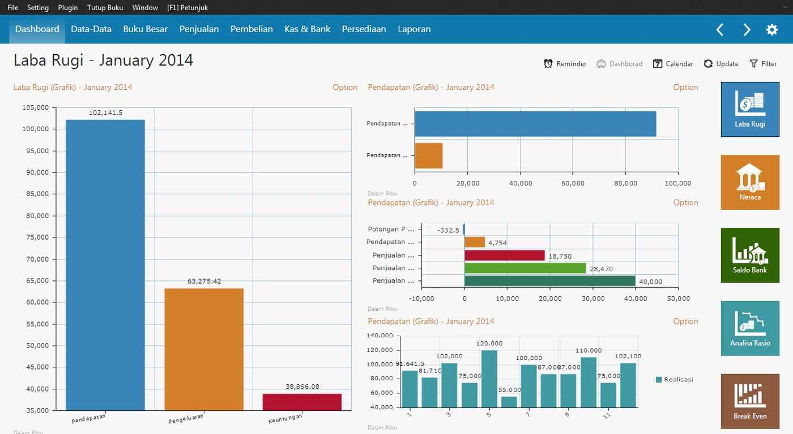
Descriptive Analytics
Technaut Education | www.technaut.co
What has happened ?
PREDICTIVE ANALYTICS WITH R
Cleaning
Relating
Summarize
Visualization

Slide 7
Diagnostic Analytics
Technaut Education | www.technaut.co
Why this happening
PREDICTIVE ANALYTICS WITH R
Drill down data discovery
Data mining
Correlation
Causation
Bajigur
Penjualan
Es Cendol
Jan
Apr
Agu
Des
Bulan

Slide 8
Predictive Analytics
Technaut Education | www.technaut.co
What’s gonna happen?
PREDICTIVE ANALYTICS WITH R
Build Model
Refine Model
Bajigur
Penjualan
Es Cendol
Past
Future
01/2014
01/2017
01/2020
01/2023
Bulan

Slide 9
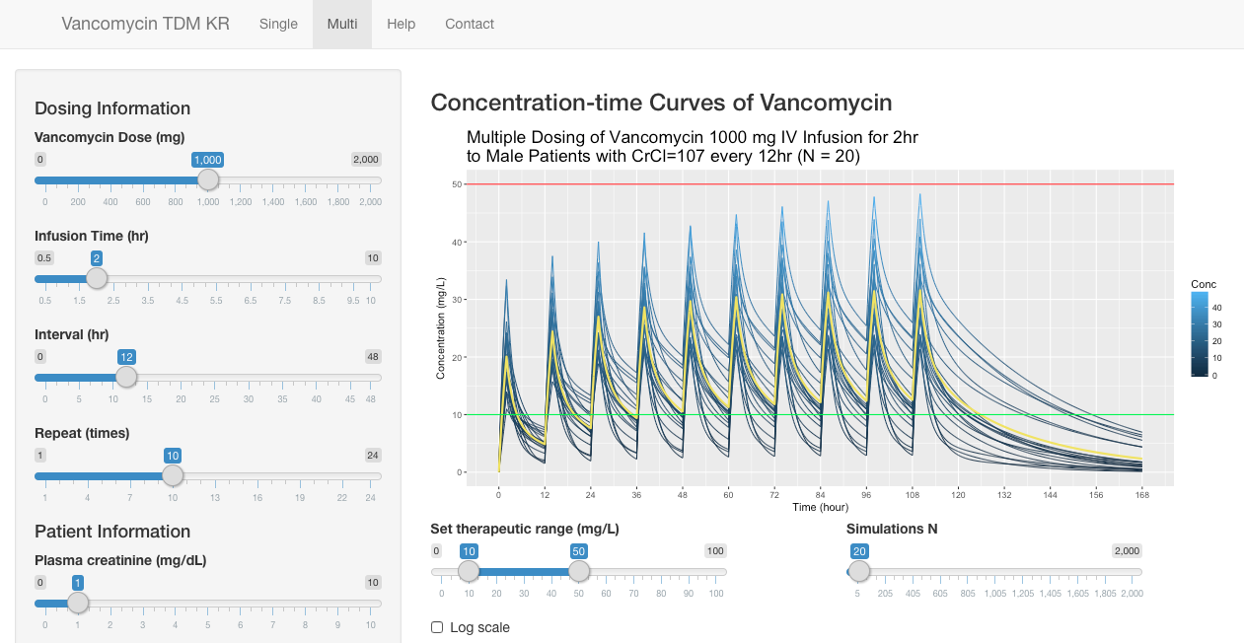
Prescriptive Analytics
Technaut Education | www.technaut.co
What should we do?
PREDICTIVE ANALYTICS WITH R
Suplement Model
Business integration
Deployment

Slide 10





Tahapan Predictive Analytics
Technaut Education | www.technaut.co
PREDICTIVE ANALYTICS WITH R
Communicate
Visualize
Import
Tidy
Understand
Deploy
Transform
Model

Slide 11
Penerapan
Technaut Education | www.technaut.co
Prediksi pergerakan stock
Deteksi fraud
Health care
dll
PREDICTIVE ANALYTICS WITH R

Slide 12
KELAS: PREDICTIVE ANALYTICS WITH R
Predictive Model Menggunakan ML
Technaut Education | www.technaut.co

Slide 13

Apa itu ML ?
Technaut Education | www.technaut.co
an application of artificial intelligence (AI) that provides systems the ability to automatically learn and improve from experience without being explicitly programmed
PREDICTIVE ANALYTICS WITH R

Slide 14
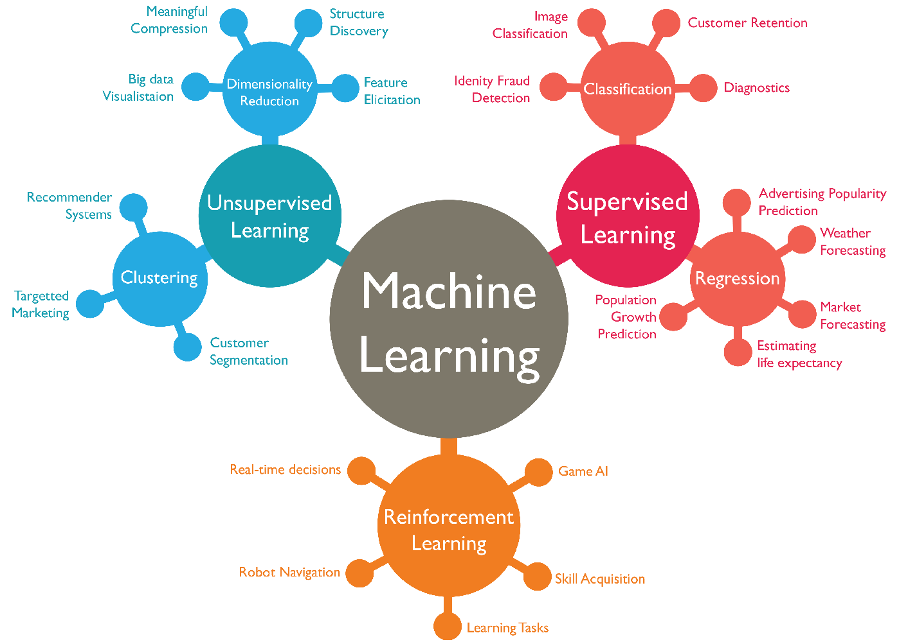
Jenis ML ?
Technaut Education | www.technaut.co
Predictive Model
PREDICTIVE ANALYTICS WITH R

Slide 15
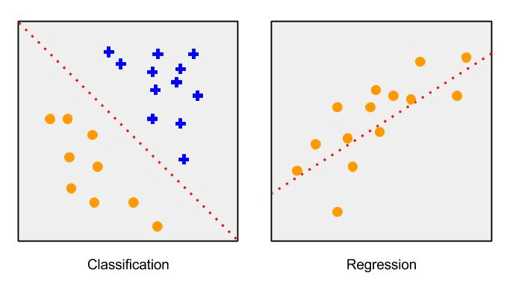
Klasifikasi vs Regresi
Technaut Education | www.technaut.co
PREDICTIVE ANALYTICS WITH R

Slide 16
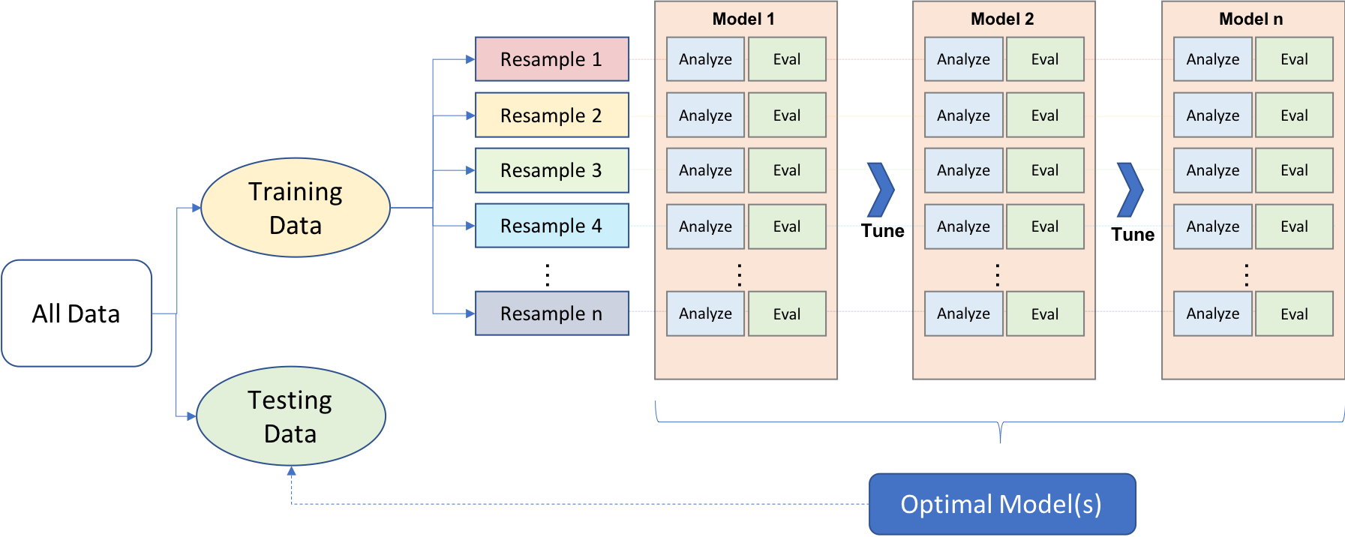
Tahapan Model
Technaut Education | www.technaut.co
Data Splitting
Resampling
Model + Tuning
PREDICTIVE ANALYTICS WITH R

Slide 17
Data Splitting
Technaut Education | www.technaut.co
60% - 80%
PREDICTIVE ANALYTICS WITH R
Test
Training
Disebut juga validation set
Digunakan untuk menguji performa model terpilih
Melatih model
Biasanya dipecah lagi untuk keperluan validasi silang dan hyperparameter tuning

Slide 18
Data Splitting
Technaut Education | www.technaut.co
PREDICTIVE ANALYTICS WITH R
Stratified
Populasi
Simple Random

Slide 19
Metode Resampling
Technaut Education | www.technaut.co
Simple hold-out validation
PREDICTIVE ANALYTICS WITH R
Validation
Training
Performa
Model

Slide 20
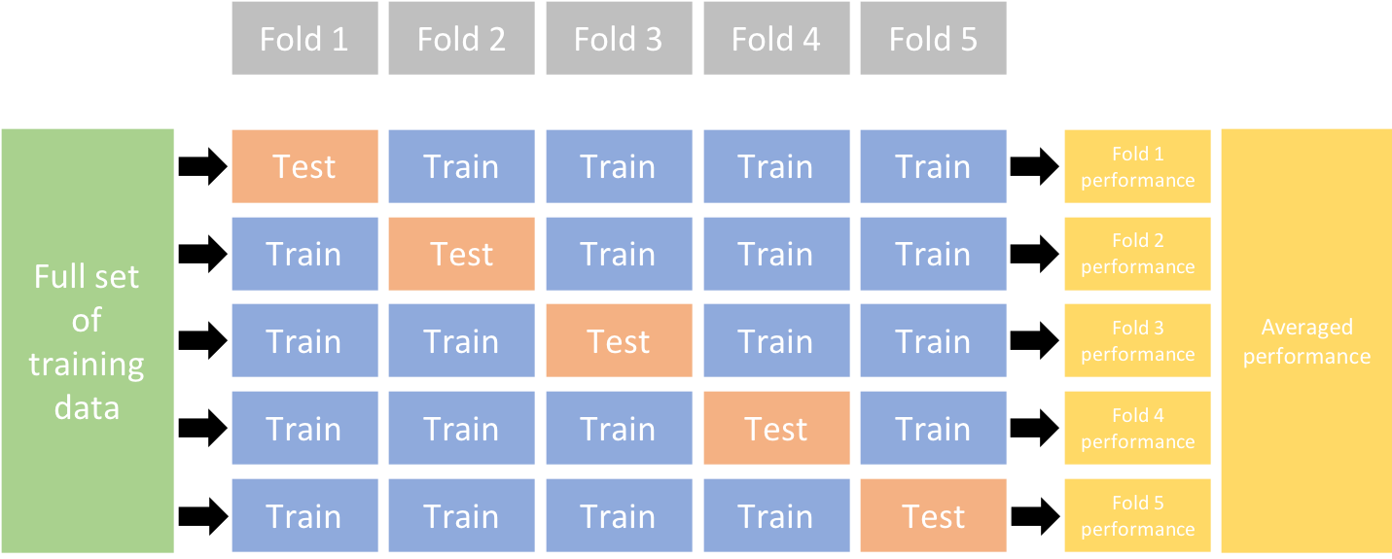
Metode Resampling
Technaut Education | www.technaut.co
K-Fold Cross Validation
PREDICTIVE ANALYTICS WITH R

Slide 21
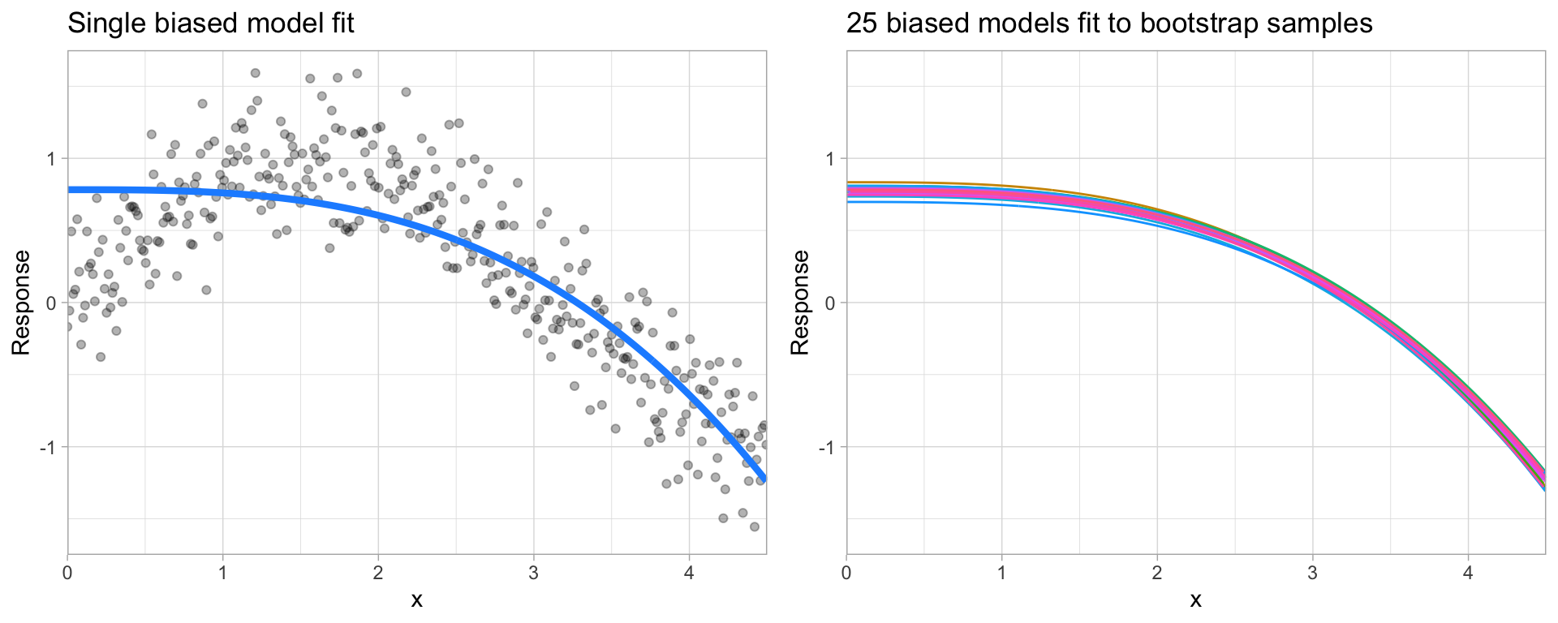
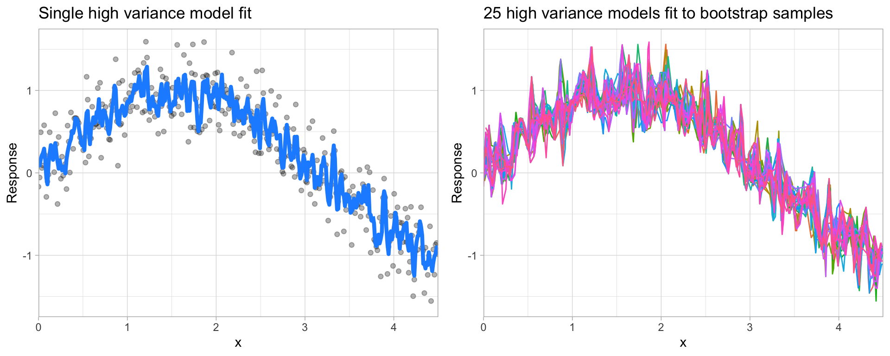
Bias Variance Trade-Off
Technaut Education | www.technaut.co
High Bias
Kurang fleksible
Jarang terpengaruh oleh noise pada data
PREDICTIVE ANALYTICS WITH R
High Variance
Terlalu fleksible
Mudah terpengaruh oleh noise pada data

Slide 22
Feature Preprocessing
Technaut Education | www.technaut.co
Variabel Numerik
Feature scaling
Variabel Kategorikal
Lumping
One-hot / dummy encoding
Label encoding
PREDICTIVE ANALYTICS WITH R

Slide 23


Feature Scaling
Technaut Education | www.technaut.co
Normalisasi
Standardisasi
PREDICTIVE ANALYTICS WITH R

Slide 24
Lumping
Technaut Education | www.technaut.co
Lokasi | n
Jakarta | 100
Bandung | 50
Surabaya | 80
Bima | 10
Salatiga | 4
Madiun | 1
Jember | 8
PREDICTIVE ANALYTICS WITH R
Lokasi | n
Jakarta | 100
Bandung | 50
Surabaya | 80
Lainnya | 23

Slide 25
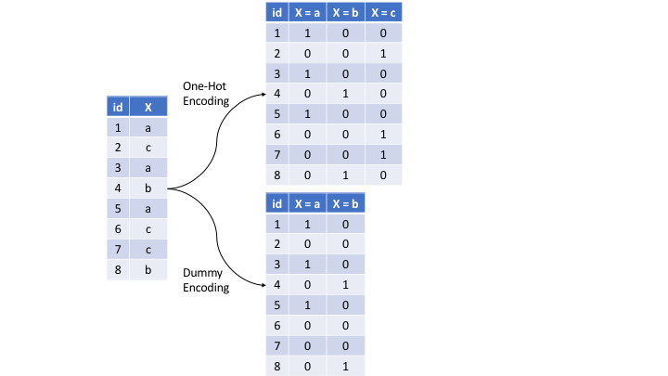
One-Hot / Dummy Encode
Technaut Education | www.technaut.co
PREDICTIVE ANALYTICS WITH R

Slide 26
Label Encoding
Technaut Education | www.technaut.co
Lokasi | n
Jakarta | 100
Bandung | 50
Surabaya | 80
Bima | 10
Salatiga | 4
Madiun | 1
Jember | 8
Lokasi | N
1 | 100
2 | 50
3 | 80
4 | 10
5 | 4
6 | 1
7 | 8
PREDICTIVE ANALYTICS WITH R

Slide 27
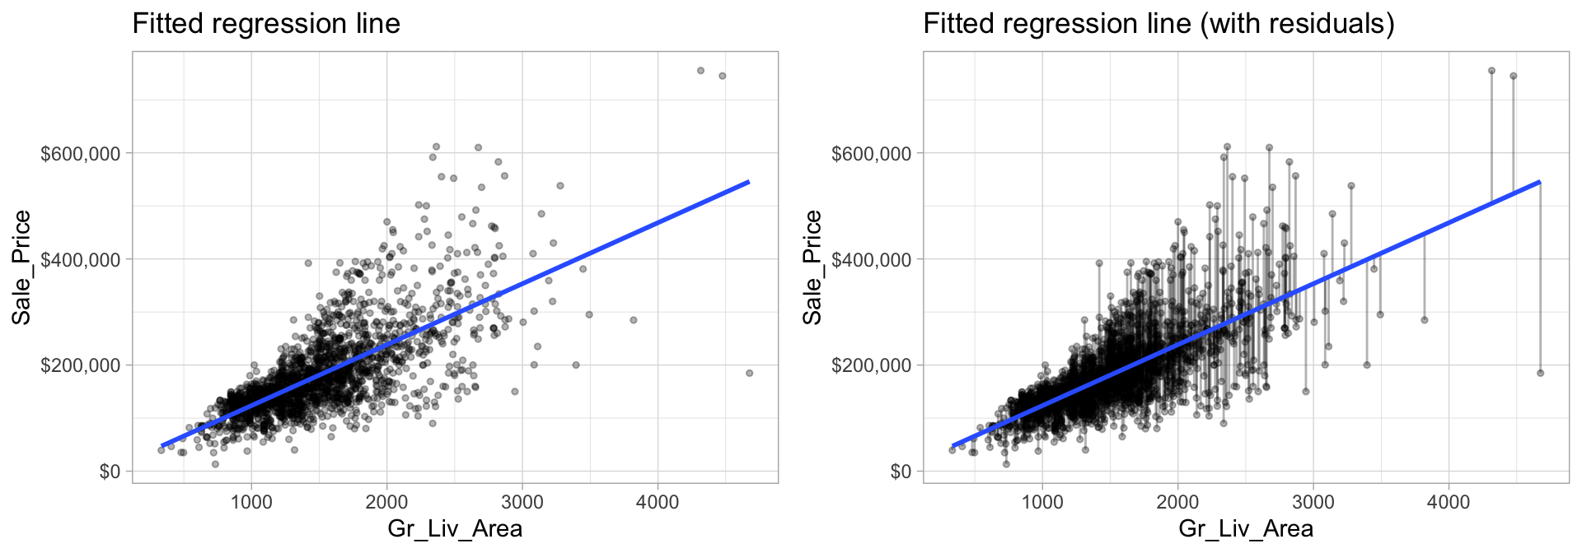
Regresi Linier
Technaut Education | www.technaut.co
PREDICTIVE ANALYTICS WITH R

Slide 28
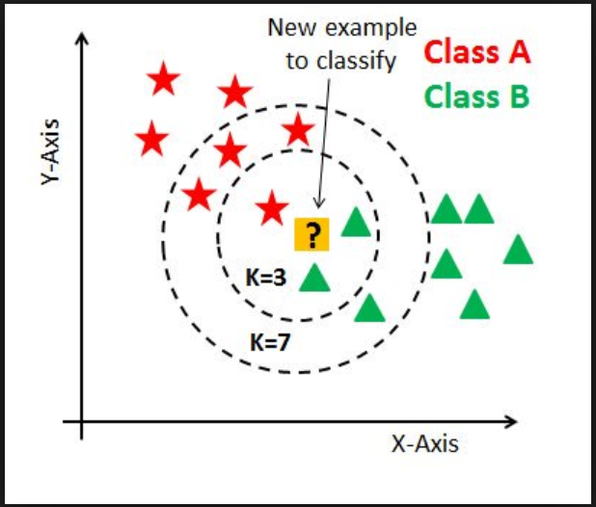
K-Nearest Neighbors
Technaut Education | www.technaut.co
K-nearest Neighbors (KNN) adalah algoritma yang sangat sederhana di mana setiap pengamatan diprediksi berdasarkan "kesamaan" dengan pengamatan lainnya.
PREDICTIVE ANALYTICS WITH R

Slide 29
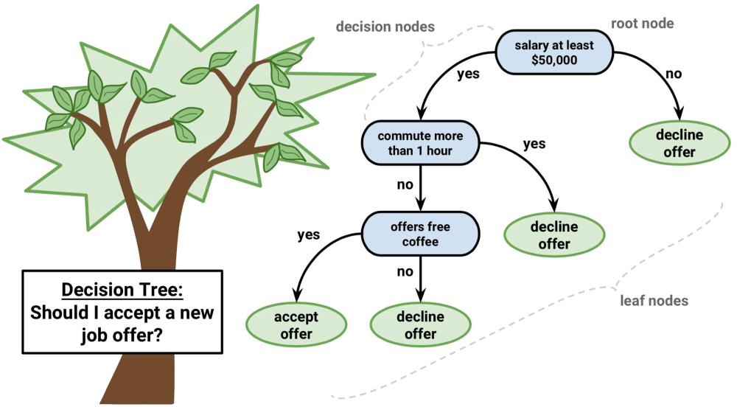
Decision Trees
Technaut Education | www.technaut.co
PREDICTIVE ANALYTICS WITH R

Slide 30

Evaluasi Model Regresi
Technaut Education | www.technaut.co
MSE
$$MSE=\frac{1}{n}\sum_{i=1}^{n}{{(y_{i}−\hat{y_{i}})}^{2}}$$
RMSE
$$RMSE=\sqrt{\frac{1}{n}\sum_{i=1}^{n}{{(y_{i}−\hat{y_{i}})}^{2}}}$$
PREDICTIVE ANALYTICS WITH R

Slide 31
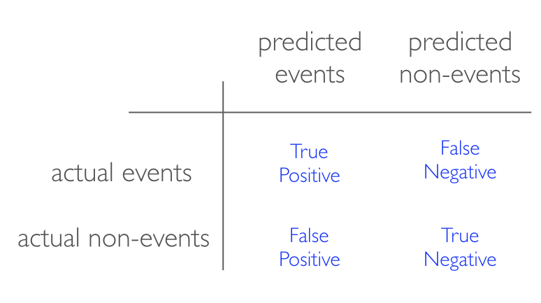
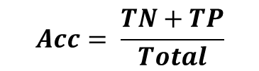
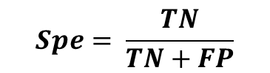
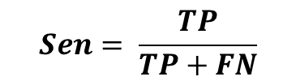
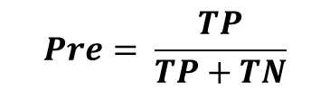
Evaluasi Model Klasifikasi
Technaut Education | www.technaut.co
Akurasi
Presisi
PREDICTIVE ANALYTICS WITH R
$$Acc= \frac{TN+TP}{Total}$$
$$Pre= \frac{TP}{TP+TN}$$
Sensitifitas
Spesitifitas
$$Sen= \frac{TP}{TP+FN}$$
$$Spe= \frac{TN}{TN+FP}$$

Slide 32
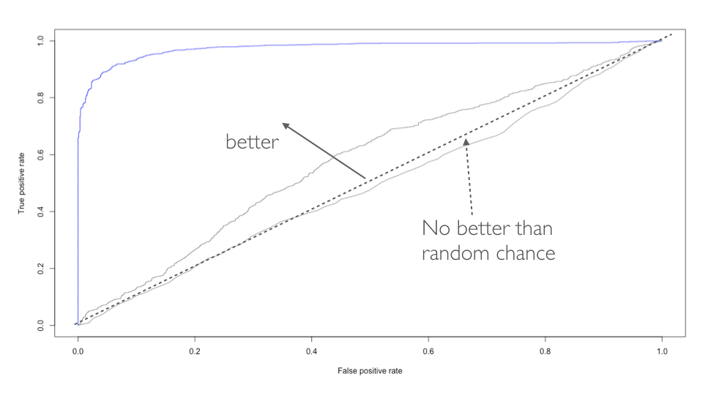
Evaluasi Model Klasifikasi
Technaut Education | www.technaut.co
PREDICTIVE ANALYTICS WITH R

Slide 33
Praktek
Technaut Education | www.technaut.co
PREDICTIVE ANALYTICS WITH R

