Slide 1
Language Co-occurrences within R Repositories
Robert Mohr
Email: mohrsignal@gmail.com
Github: mohrsignal/github-repos
R Network

Slide 2
Criteria for project selection
Sufficiently large and complex dataset that nontrivial insights likely exist
A topic in which I have sufficient domain knowledge
Something of likely interest to the target audience

Slide 3
The BigQuery Github repository data set
dfsfasf

Slide 4
What are we trying to learn?
Generally, what does the

Slide 5
Getting the data
dfsfasf

Slide 6
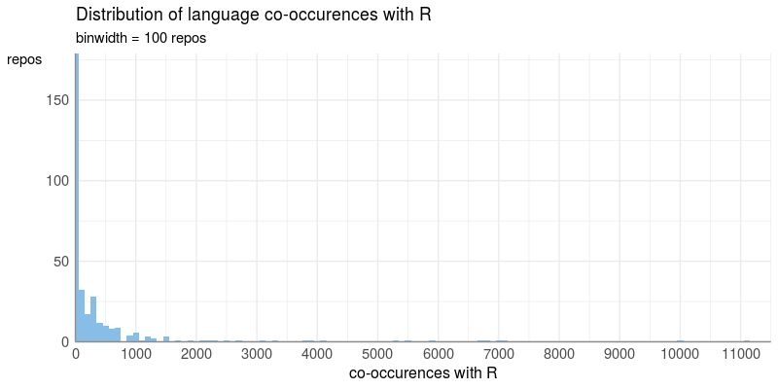
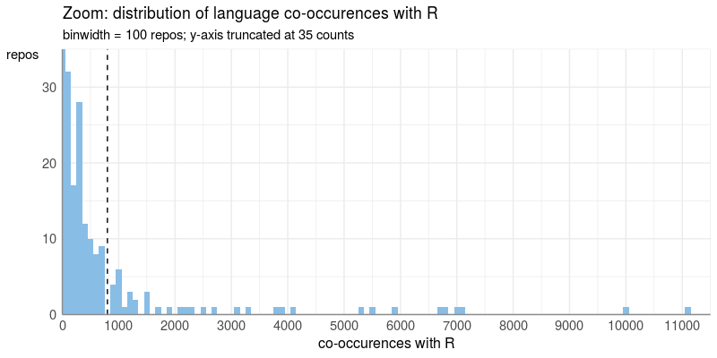
Counting co-occurences with R

Slide 7
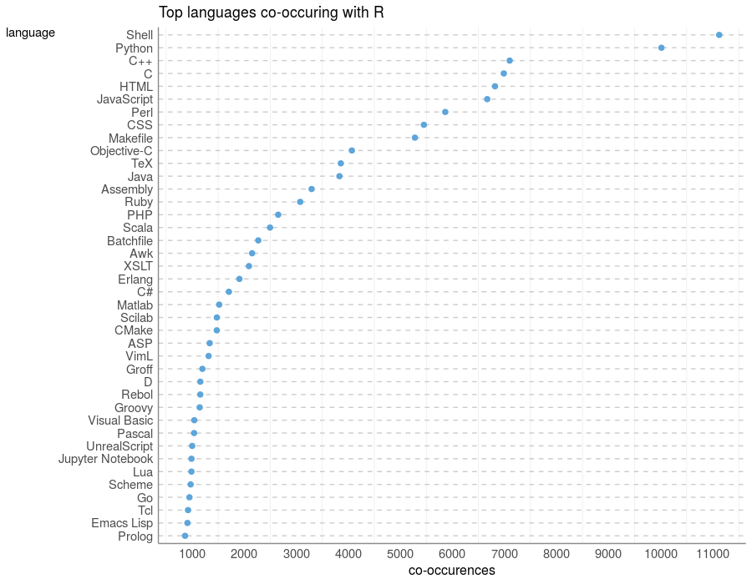
The top languages co-occuring with R

Slide 8
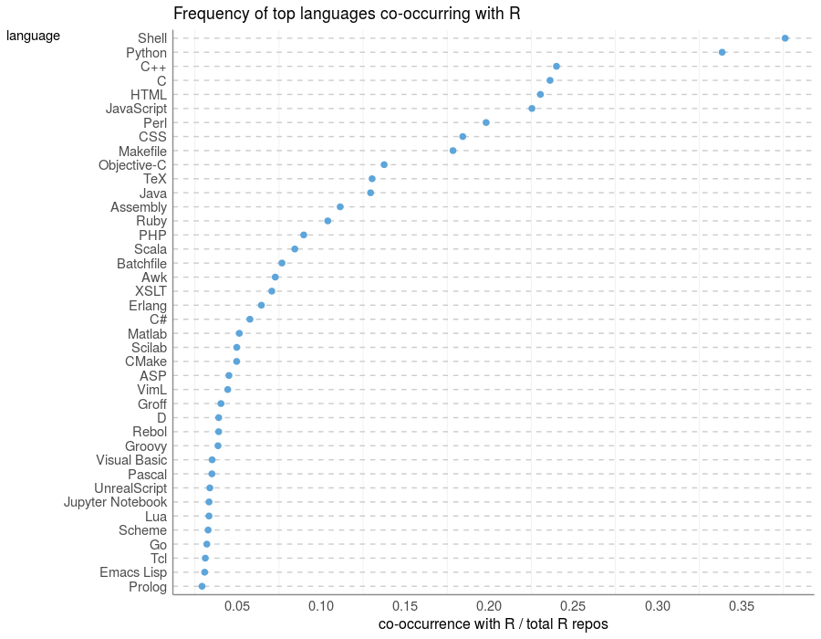
Frequency of top languages co-occuring with R

Slide 9
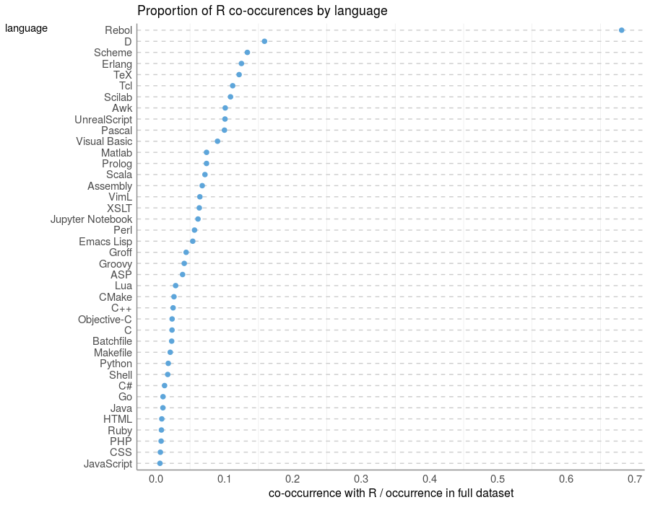
Probability of R given other languages

Slide 10
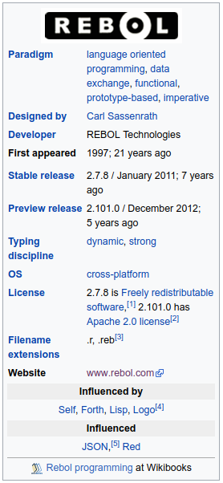
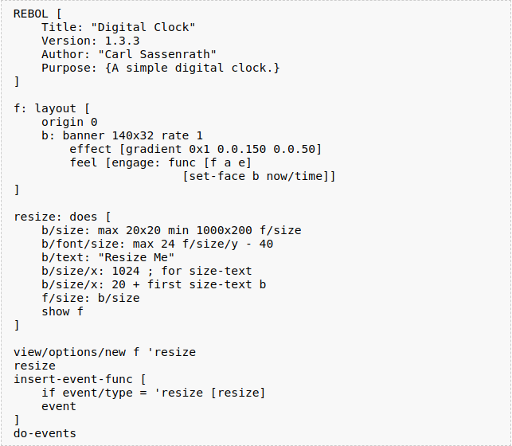
The curious case of Rebol
Rebol description
Rebol code for a clock display
http://www.rebol.com/docs/quick-start.html
Github issues on misclassification:
https://github.com/github/linguist/issues/3190
https://github.com/github/linguist/issues/2531
https://github.com/github/linguist/issues/1186
https://github.com/github/linguist/issues/296

Slide 11
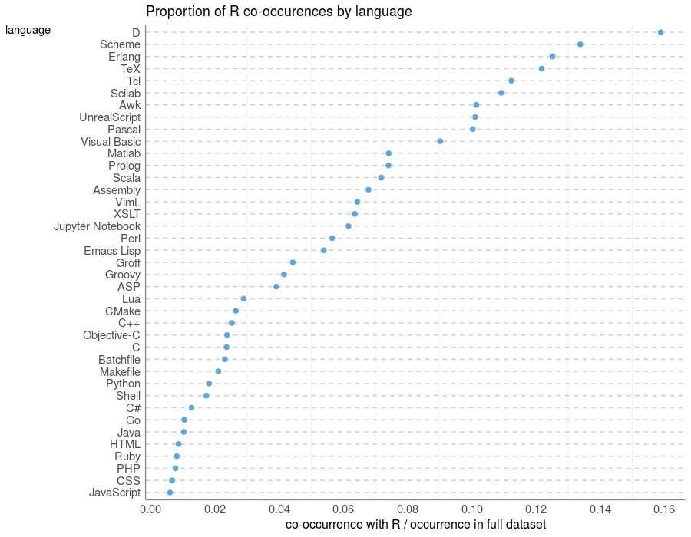
Probability of R given other languages

Slide 12
Co-occurrence networks
dfsfasf

Slide 13
A total mess
dfsfasf

Slide 14
Principles of good data visualization
dfsfasf

Slide 15
Gradually revealing the network

Slide 16
What have we learned?

Slide 17
Future work

