Slide 1


Slide 2
محمد تقی کریمی محقق برندینگ
Notes:
Hey im mt from ronevis

Slide 3
دیزاین ساده نیست
Notes:
90% of information transmitted to the brain is visual, and the problem is that the most people can't design what they want.

Slide 4
هوشمندانه و سریع + عناصر طراحی
Notes:
by help of ronevis you can design what you want, smart, fast and stylish way.

Slide 5
احساسات و تجربیات
Notes:
everyone who has a smartphone can be our customer with the potential need of designing something expressing their feelings or experiences

Slide 6
دمو ویدئو

Slide 7
40,000,000 گوشی هوشمند
منبع: باشگاه خبرنگاران جوان

Slide 8
فروش تبلیغات طراحی اداری
Notes:
our revenue stream is coming from selling app, in-app purchase packages,
printing services and design services

Slide 9
اولین در مارکت پرفروش ترین رهبر بازار الگوریتم اختصاصی

Slide 10
رقبا
رقبا
Notes:
and based on this perceptual map we do not have direct competitors.

Slide 11
اندروید مارکت وب سایت

Slide 12
کوبرندینگ محتوای ویدئو دهان به دهان
Notes:
our marketing plans include video content marketing, word of mouth, android market places, social networks and co-branding with companies that are related to us.

Slide 13
چرا تنها؟

Slide 14
کسب درآمد کاربران کاربری روزمره اعتماد به نفس، موفقیت، هیجان
Notes:
the value people can gain from this app is that they can make money by designing instagram pages or telegram channels.
everyday usages like sending a greeting card to a friend or family.
people can feel more confident, successful, and excited.

Slide 15
10,500
کاربر فعال
Notes:
We have 7 thousand 500 hundred active users

Slide 16
مبلغ فروش 44۶٬۶۶۳٬۲۴۴

Slide 17
بدون تبلیغات

Slide 18
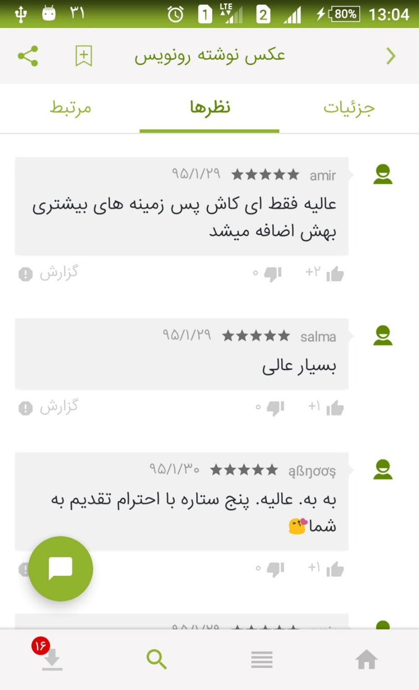
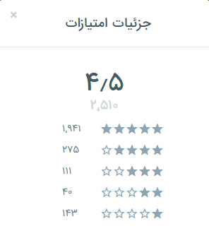
نظر مثبت کاربران
Notes:
We are rated 4.5 from 2 thousand 640

Slide 19
رهبر بازار

Slide 20
رابط و تجربه کاربری امکانات پیشرفته و کیفیت بالاتر

Slide 21
