Slide 1
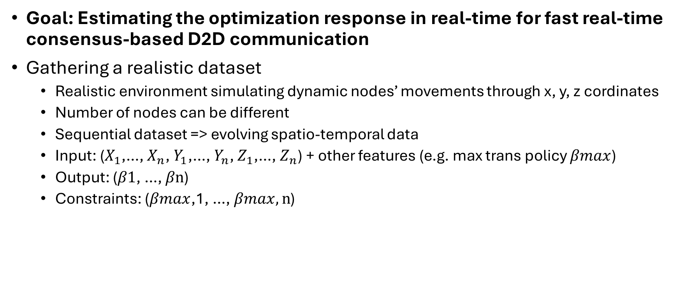
Machine Learning Approaches
Goal: Estimating the optimization response in real-time for fast real-time consensus-based D2D communication
Gathering a realistic dataset
  Realistic environment simulating dynamic nodes’ movements through x, y, z cordinates
  Number of nodes can be different
  Sequential dataset => evolving spatio-temporal data
  Input: ($X_{1}$,…, $X_{n}$, $Y_{1}$,…, $Y_{n}$, $Z_{1}$,…, $Z_{n}$) + other features (e.g. max trans policy $βmax$)
  Output: ($β1$, …, $βn$)
  Constraints: ($βmax$,1, …, $βmax,n$)

Slide 2
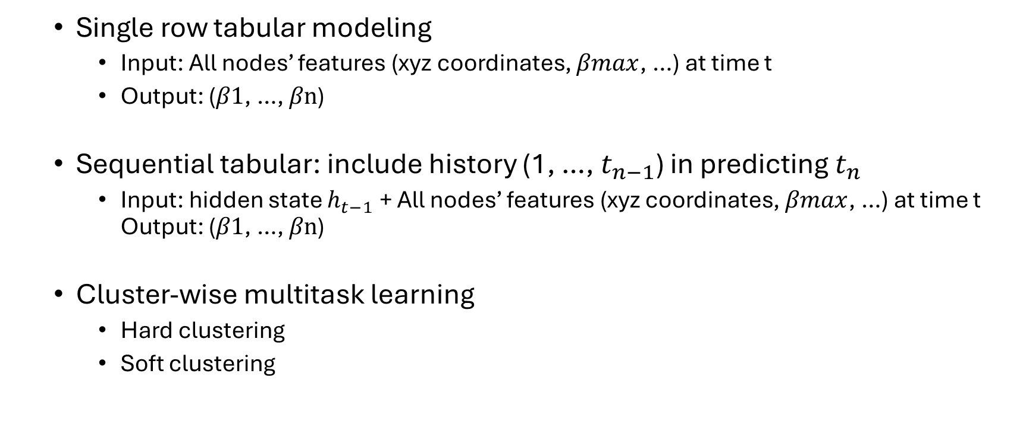
Machine Learning Approaches
  Single row tabular modeling
    Input: All nodes’ features (xyz coordinates, $βmax$, …) at time t
    Output: ($β1$, …, $βn$)
  Sequential tabular: include history (1, …, $t_{n−1}$) in predicting $t_{n}$
    Input: hidden state $h_{t−1}$+ All nodes’ features (xyz coordinates, $βmax$, …) at time t Output: ($β1$, …, $βn$)
  Cluster-wise multitask learning
    Hard clustering
    Soft clustering

Slide 3



Machine Learning Approaches
GNN modeling => formulating the problem as node classification
  Standard modeling
  Temporal modeling
Time
$$t_{2}$$
$$t_{3}$$
$$t_{1}$$

