Slide 1
Data logging with LOGO! 0BA7

Slide 2
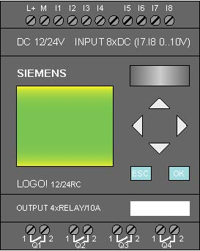
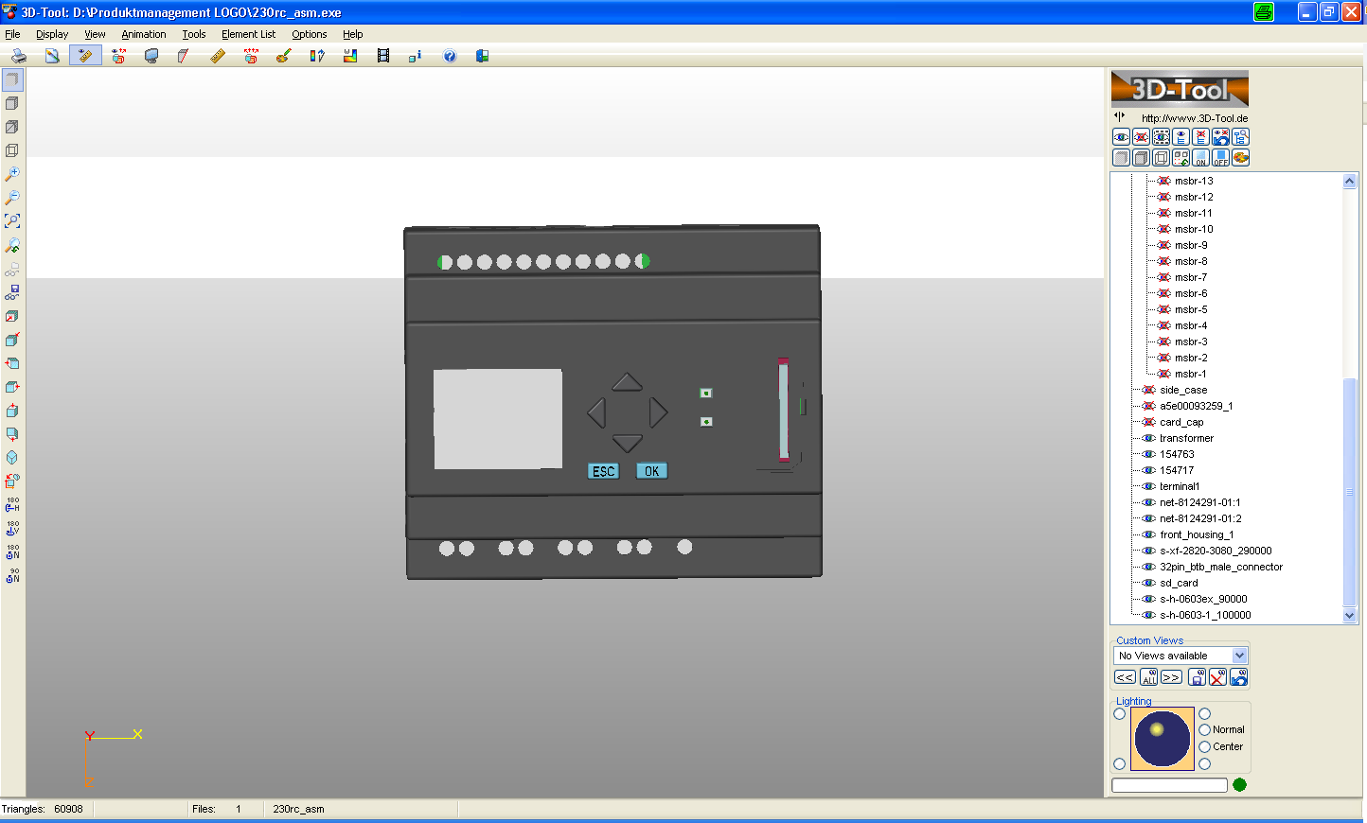
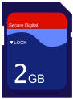
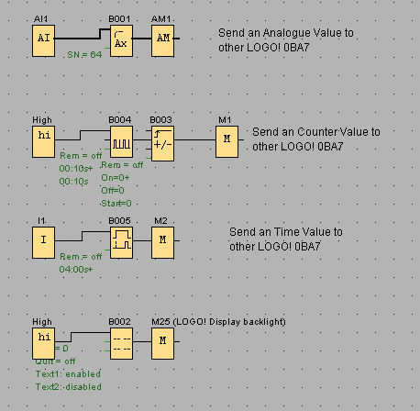
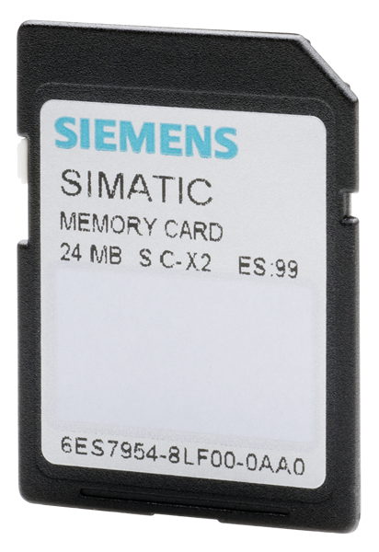
Data logging with LOGO! 0BA7
LOGO! 0BA7 now with Data logging
to internal memory
or to SD Card
E
E
Standard SD-Card
FAT 12, 16 or 32 supported
max. 8GB (48Mb/s 6MB/s) =Class 6
(faster SD-card possible but slower recording time)
SIMATIC Memory Card
requires a FAT format
is optimized for very small data packs
better life time and more write cycles

Slide 3
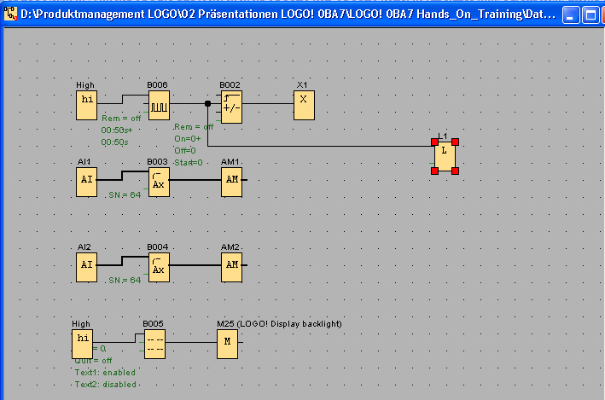
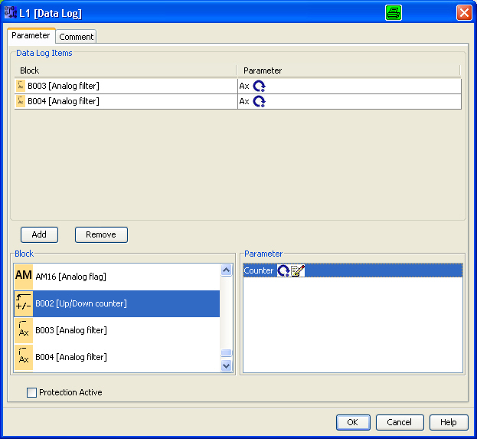
Data logging with LOGO! 0BA7
1
5
1
Place Data log FB in the program and open properties
4
2
Select the function block you want to log
3
3
Select the parameter of Function Blocks
4
Add or remove data from the Data log Item list
5
Data log Item list with specified data (max. 32)
2

Slide 4
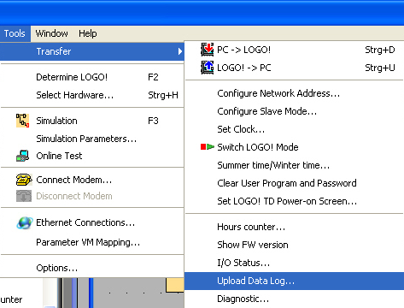

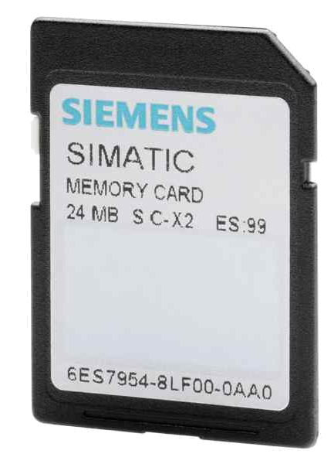
Data logging with LOGO! 0BA7
E
E
To upload the data log file from internal memory LOGO! Must be in “STOPP”mode,
select: Tools; Transfer; Upload Data log. Then upload data log and store the file on the PC.
To load the data log file from SD-Card to PC, plug in the SD-Card to the PC and copy the file.

Slide 5
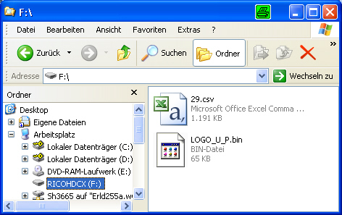
Data logging with LOGO! 0BA7
Files on SD-Card:
Xx.csv: This is the file of the logged data
LOGO_U_P.bin: This is the program witch can be executed by a LOGO! 0BA7
Any other file can also be store on the SD-Card

Slide 6
Data logging with LOGO! 0BA7
E
E
Internal Memory
SD-Cards
~ 200 “Log records” can be recorded
max. recording speed ~150ms
up to 32 data’s can be specified in one “LOG record”
2000 “Log records” can be recorded
max. recording speed ~150ms
up to 32 data’s can be specified
one data log file supported in
LOGO! Soft Comfort V7
Additional data log files will be
generated after RUN/STOP

Slide 7
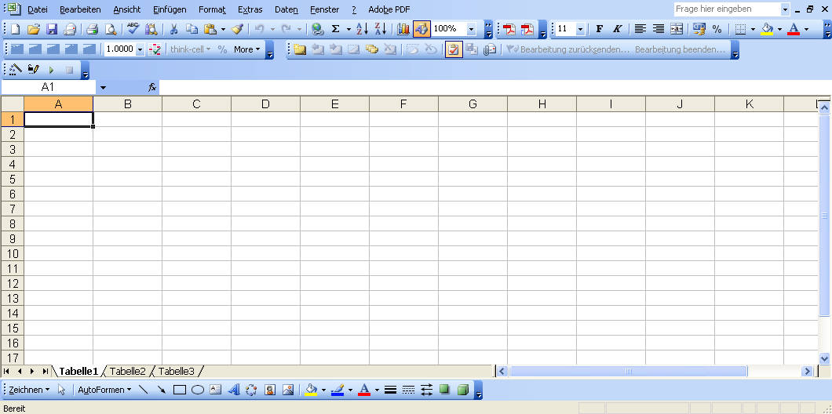

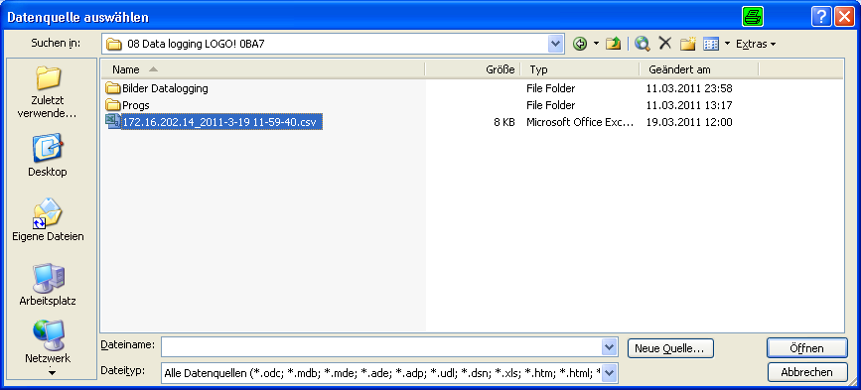
How to import to Excel with Filter
1
2
1
Open MS Excel and select: Data; Import external data; Import Data
2
Brows to the folder, where the data log file is stored

Slide 8
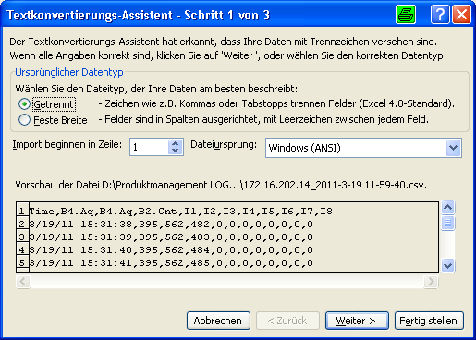
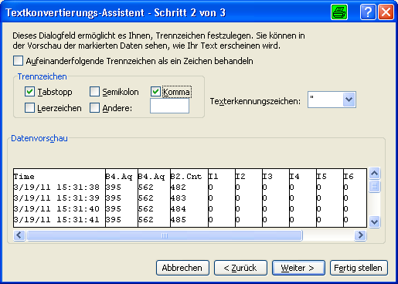
How to import to Excel with Filter
1
2
3
1
Enable: separated
2
Check if Taps and Comma as separation character is enables
3
Here you can see the result

Slide 9
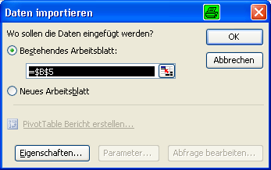
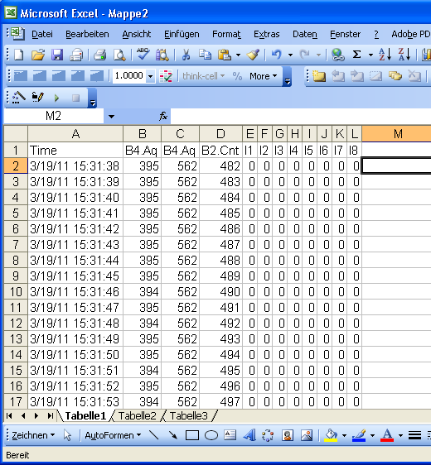
How to import to Excel with Filter
2
1
1
Specify how to insert the data
2
Result of the import

Slide 10
Networking wiht LOGO! 0BA7 V1
Thank you for your attention!
H. Schindler
I IA AS FA PS4
Phone: ++49 (0)911 / 895 - 3665
E-Mail: Helmut.schindler@siemens.com

