Slide 1

Streamlining Psychotropic Drug Management for Pharmacies
ChifaNeuro
Notes:
Pour modifier l'image, faites un clic droit : enregister l'arrière-plan et télécharger votre visuel dans Image / Insérer une image à partir de ...

Slide 2
Summary
Report
Our Solution
The technologies implemented
Market validation
business model
Competition
Marketing & communications plan
The team
Funding
Statutes
ChifaNeuro: Simplifying psychotropic drug management for pharmacies. Streamline prescription verification, track transactions in real-time, and ensure compliance. Reduce errors, improve efficiency, and enhance patient safety. Join us in revolutionizing pharmacy operations

Slide 3
1. Report
ChifaNeuro, a solution that transforms the management of psychotropic drugs in pharmacies. Our web-based application simplifies processes, automates prescription verification, and enhances security measures.
With ChifaNeuro, pharmacies can say goodbye to manual tasks and welcome a new era of efficiency. Our user-friendly interface can be accessed from any device with an internet connection, empowering pharmacists and healthcare professionals to navigate the complexities of psychotropic drug management with ease.
ChifaNeuro is a solution that revolutionizes the way pharmacies handle psychotropic drugs. It streamlines the entire process, ensuring accuracy, efficiency, and compliance. It empowers pharmacies to stay at the forefront of this dynamic field and deliver the highest quality of care to their patients.
Thank you for your attention.

Slide 4
2. Our Solution
ChifaNeuro offers an automated verification system for prescription details and patient eligibility, reducing errors and legal risks.
Our real-time tracking and management feature ensures efficient handling of psychotropic drug transactions.
Accurate record-keeping and inventory management help pharmacies stay organized and prevent stock shortages.
Advanced security measures are implemented to ensure compliance and prevent abuse.
ChifaNeuro's user-friendly interface is accessible from any device with an internet connection, providing convenience and ease of use.

Slide 5
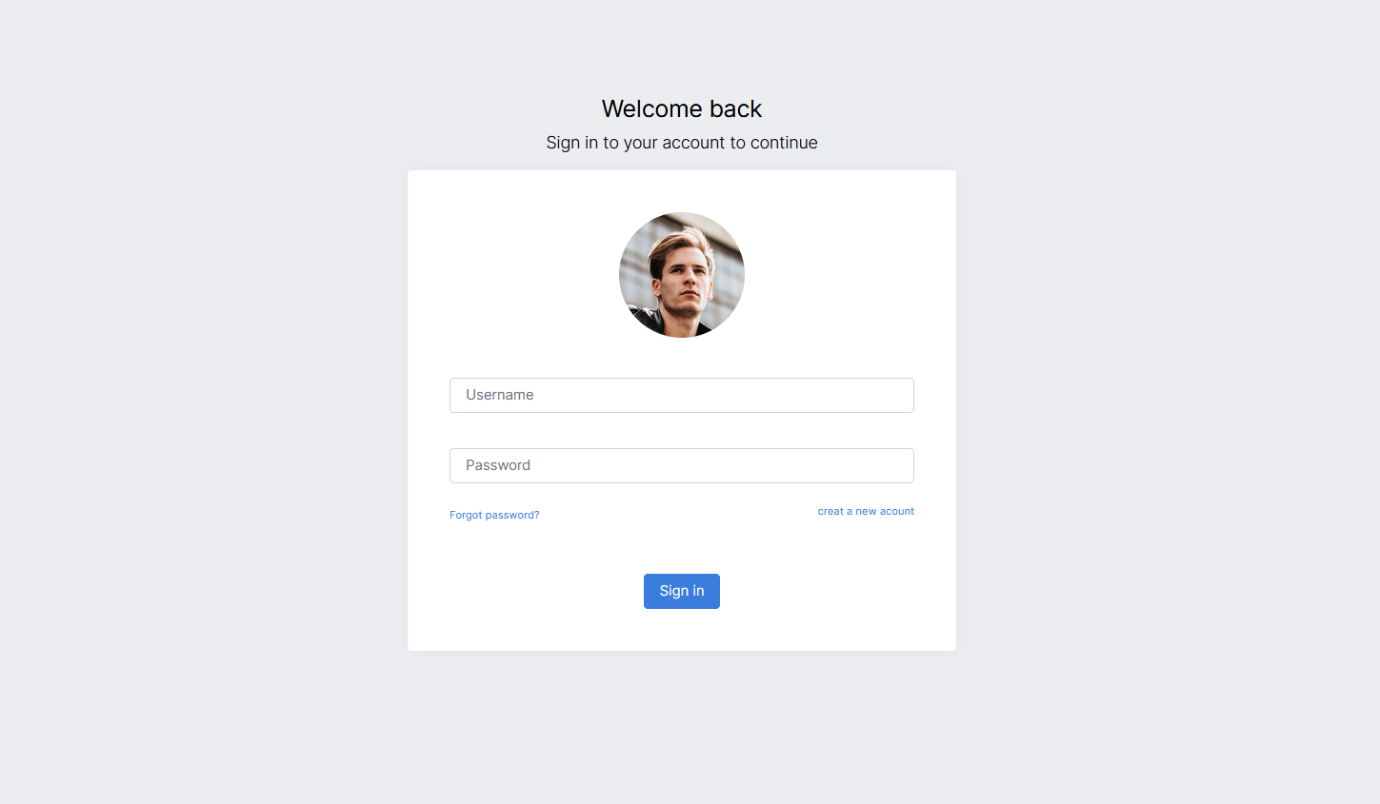
Login page

Slide 6
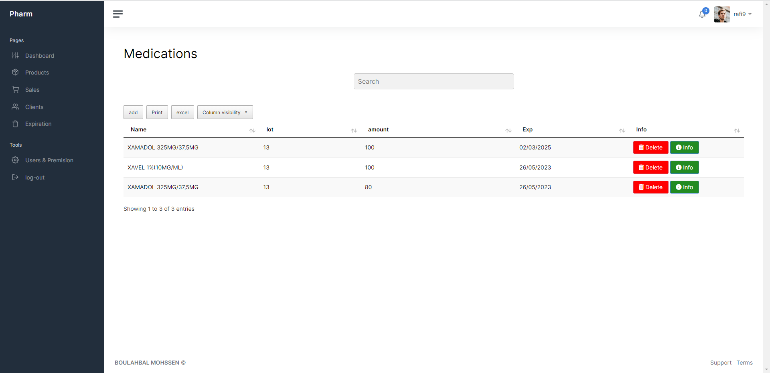
Inventory management

Slide 7
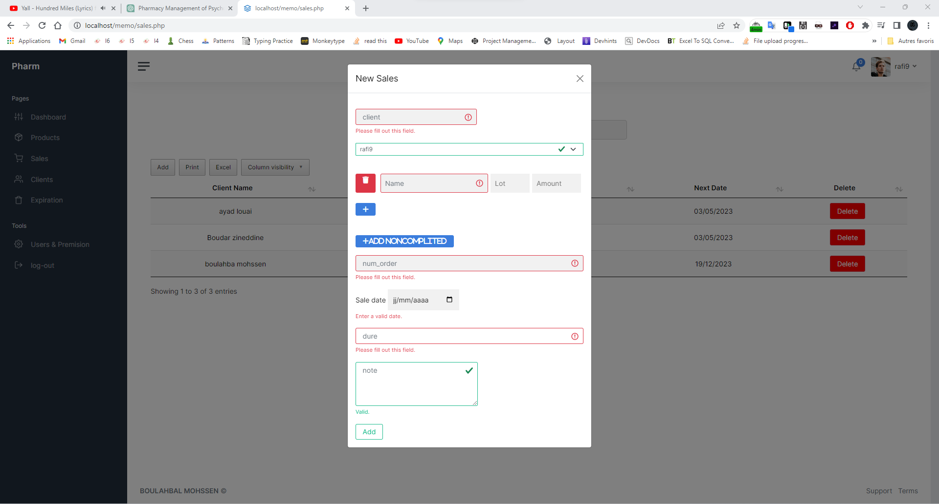
Prescription page

Slide 8
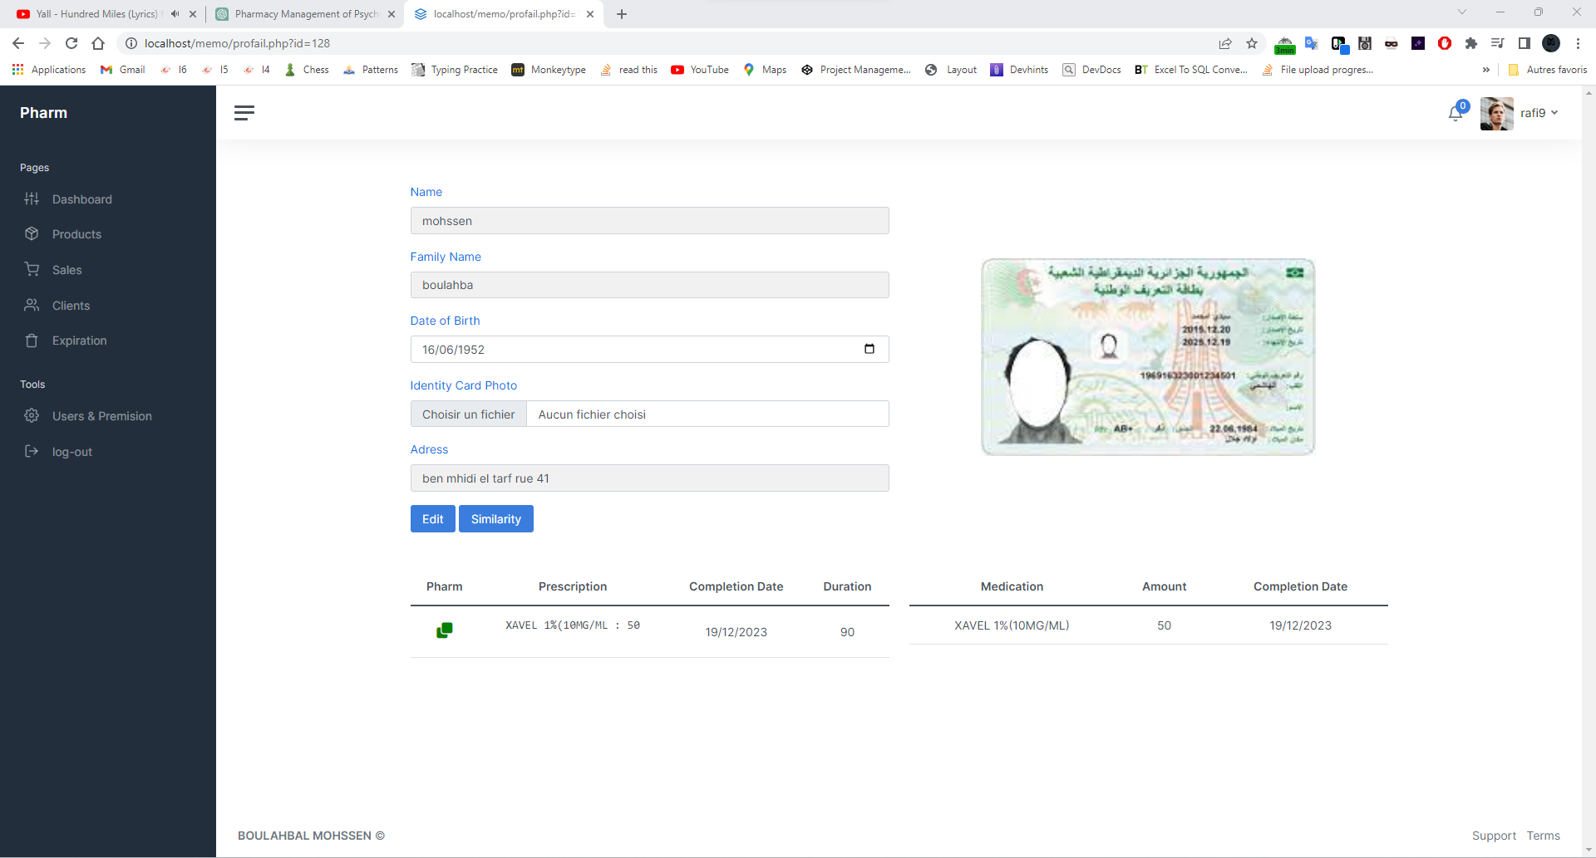
Client profail page

Slide 9
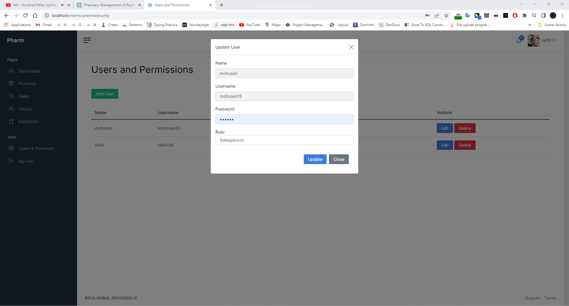
Users & Permission page

Slide 10
3. Technologies Implemented
At ChifaNeuro, we have leveraged cutting-edge technologies to develop our web-based application. Our focus on security, scalability, and performance has led us to utilize robust frameworks, programming languages, and infrastructure components.
The foundation of our backend development lies in PHP and MySQL. These technologies provide a solid and reliable backend infrastructure, enabling seamless data management and processing. With PHP, we have implemented advanced filtering mechanisms and recommendation systems to enhance the accuracy and relevance of drug recommendations.
In addition to PHP and MySQL, we have employed secure authentication mechanisms to protect user login credentials and ensure data privacy. These mechanisms employ industry-standard encryption and hashing techniques, safeguarding sensitive information.
The scalability and performance of our application have been optimized through the use of efficient coding practices and scalable architecture. We have utilized frameworks and libraries that allow for seamless scaling as the demand grows, ensuring a smooth user experience even during peak usage periods.
By harnessing the power of PHP, MySQL, and other technologies, we have created a robust and efficient backend system that forms the backbone of ChifaNeuro, enabling us to deliver a reliable, secure, and user-friendly solution.

Slide 11
3. Technologies Implemented
Here are the key objectives of our company :
Prevention of drug abuse
Inventory management
Analyses et reporting
recommendation system

Slide 12
4. Market Validation
Additionally, in 2013, there were a total of 18,471 consultations related to psychotropic drugs and 45,854 hospitalizations. Although these numbers are not exact, they reflect the significant impact and importance of managing psychotropic drugs effectively.
Furthermore, considering the presence of over 10,000+ pharmacies in Algeria and a market size of US$390.30m in 2023 for psychotropic drugs, there is a substantial market opportunity for ChifaNeuro.
Based on my experience working in a pharmacy for the past three years, I have observed a critical need for a solution like ChifaNeuro. The feedback and information provided by pharmacy owners have further confirmed the demand for such a solution .

Slide 13
5. Business model
Our revenue model is based on a subscription-based pricing structure, offering different tiers of service based on pharmacy needs and scale of operations.
Strategic partnerships with pharmaceutical companies and healthcare providers will further expand our reach.
The estimated revenue for ChifaNeuro is projected to be 180,000 DA by the end of the year 2023. This projection is based on the success and growth we have experienced in previous years, with a revenue of 80,000 DA in both 2021 and 2022. These figures indicate a positive trend and demonstrate the potential for further financial growth in the coming years. We are confident in our business model and market potential, and we are committed to maximizing revenue and delivering value to our customers .

Slide 14
6. Competition
Despite the presence of competitors, such as Chifa Plus, PharmX, and IntelliX, none of them offer the exact set of features and functionalities provided by ChifaNeuro. While other solutions may focus on inventory management, ChifaNeuro sets itself apart by addressing the critical needs of pharmacy drug management, including prescription verification, patient eligibility, and real-time transaction tracking. Our comprehensive and tailored approach positions us as a unique and indispensable solution in the market.

Slide 15
7. Marketing & communications plan
Referral Program
Online Advertising
ChifaNeuro
Content Marketing
Industry Events
funds and revenue

Slide 16
8. The Team
B. Mohssen - Founder and IT Expert
B. Mohssen is a dedicated IT student with three years of freelancing experience. He has also been working as an assistant in a pharmacy for three years. With a deep understanding of the challenges in psychotropic drug management, B. Mohssen conceived the idea behind ChifaNeuro and is the driving force behind the project.
B. Hakime - Pharmacist and Design Lead
B. Hakime is a highly qualified pharmacist with a PHD in pharmacy. With extensive knowledge of pharmaceuticals and patient care, B. Hakime leads the design aspects of ChifaNeuro. Their expertise ensures that the solution meets the specific needs of pharmacies and focuses on enhancing patient safety.
A. Rafik - Communication Lead
A. Rafik is a master's graduate in biology and has experience working as a manager in a pharmacy. With a solid background in communication and a deep understanding of the pharmaceutical industry, A. Rafik leads the communication efforts of ChifaNeuro. Their excellent interpersonal skills and strategic approach contribute to effective market positioning and customer engagement.

Slide 17
9. Funding
Reinvest Revenue
ChifaNeuro
Personal Investment

Slide 18
10. Statutes
ChifaNeuro operates as a Société à responsabilité limitée (SARL), a limited liability company. Our team comprises B. Mohssen, an IT student and founder, and B. Hakime, a pharmacist with a PhD serving as the design lead. We recognize the importance of legal considerations and are actively seeking new team members with legal expertise. This approach ensures compliance, protects our interests, and enhances credibility. Our capital includes reinvested revenue, personal funds, and potential financing through third-party contracts, enabling financial stability for our ambitious plans. ChifaNeuro's SARL structure and diverse team position us for success while upholding legal requirements.

Slide 19

Thank you for your attention
My social contact
Boulahbalmohssen@gmail.com

