Slide 1


Creative Commons
What's the deal with it?

Slide 2

Creative Commons
What is copyright?
C
ALL RIGHTS RESERVED

Slide 3
Fair Use
17 U.S.C. § 107
the purpose and character of the use, including whether such use is of a commercial nature or is for nonprofit educational purposes;
the nature of the copyrighted work;
the amount and substantiality of the portion used in relation to the copyrighted work as a whole; and
the effect of the use upon the potential market for or value of the copyrighted work.
The fact that a work is unpublished shall not itself bar a finding of fair use if such finding is made upon consideration of all the above factors.

Slide 4
Creative Commons
What is Public Domain?
PD
EXPIRED

Slide 5

Creative Commons
What is copyleft?

Slide 6
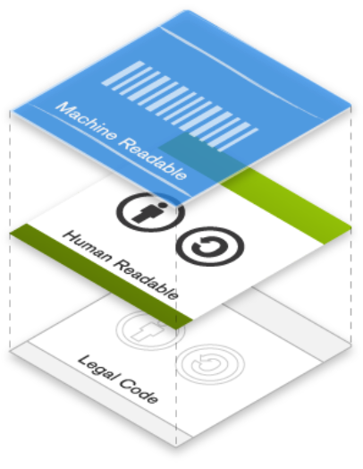
Creative Commons
How CC works?
It's designed for internet era

Slide 7

Licenses
CC has 7 different licenses
I'll discuss the basics of them all

Slide 8

Attribution (BY)

Slide 9

Share-Alike (SA)

Slide 10

Non-Commercial (NC)

Slide 11

No-Derives (ND)

Slide 12

Zero (0)

Slide 13
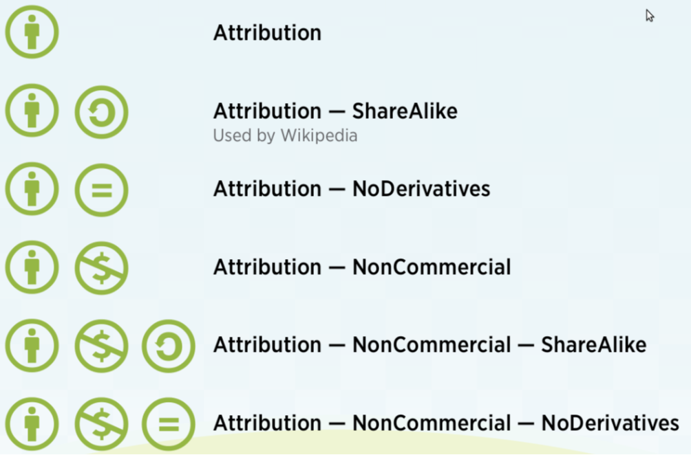

Slide 14
Who uses CC?
U.S.A government (BY)
Google & YouTube
Wikipedia (BY-SA)
Al jazeera (BY)
MIT OpenCourseWare (BY-NC-SA)
TED (BY-NC-ND) And many more...

Slide 15
For more info
Visit CreativeCommons.org
Jamendo for free music
Flicker for free images
Get the knowCC zip-file from me! :D

Slide 16
License
This work is licensed under
CC-BY-SA 4.0 by
Mohsen Dastjerdi Zade
images used in this presentation are licensed under CC-BY by CreativeCommons.org

Slide 17
Download Original version at:
http://dstjrd.ir

