Slide 1
MAY 2026
— THE BUILD-OUT
Roadmap
5 SECTIONS
~100 TASKS
27 – 38 WEEKS
Notes:
Welcome everyone. Today I want to walk you through the full build-out plan for our hotel booking platform. This isn't just databases — it's the whole stack. We've mapped roughly one hundred tasks across five tracks: database schema, admin CRUD, frontend components, public APIs, and the page integrations that pull it all together. I've grouped everything into a sequenced roadmap so you know what we're building, in what order, and how the tracks depend on each other.

Slide 2
HOTEL PLATFORM
02 / 22
— OVERVIEW
Five Sections, one platform.
From schema to shipped pages — backend, frontend, and the seam between them.
Section 1
Section 2
Section 3
Section 4
Section 5
Database Schema
Admin CRUD
Frontend Components
Public APIs
Page Integration
23 tables across 4 phases — hotels, inventory, geo, marketing, users, system.
Operations admin — list, create, edit, delete for every table.
Site chrome, home, hotel detail, search results — reusable library.
Read endpoints feeding the public website — search, detail, discovery.
Home, search results, single hotel — assembly and routing.
23 TABLES
23 MODULES
33 COMPONENTS
19 ENDPOINTS
3 PAGES
Notes:
Quick map. Five tracks. Track one is the database schema — twenty-three tables. Track two is the admin CRUD layer that lets the operations team manage those tables. Track three is the frontend component library — header, footer, hotel cards, filters, the works. Track four is the public APIs that feed the website. Track five is the three page integrations that wire everything together — home, search results, and single hotel. Tracks one and two are pure backend; track three is pure frontend; tracks four and five are the seam between them.

Slide 3
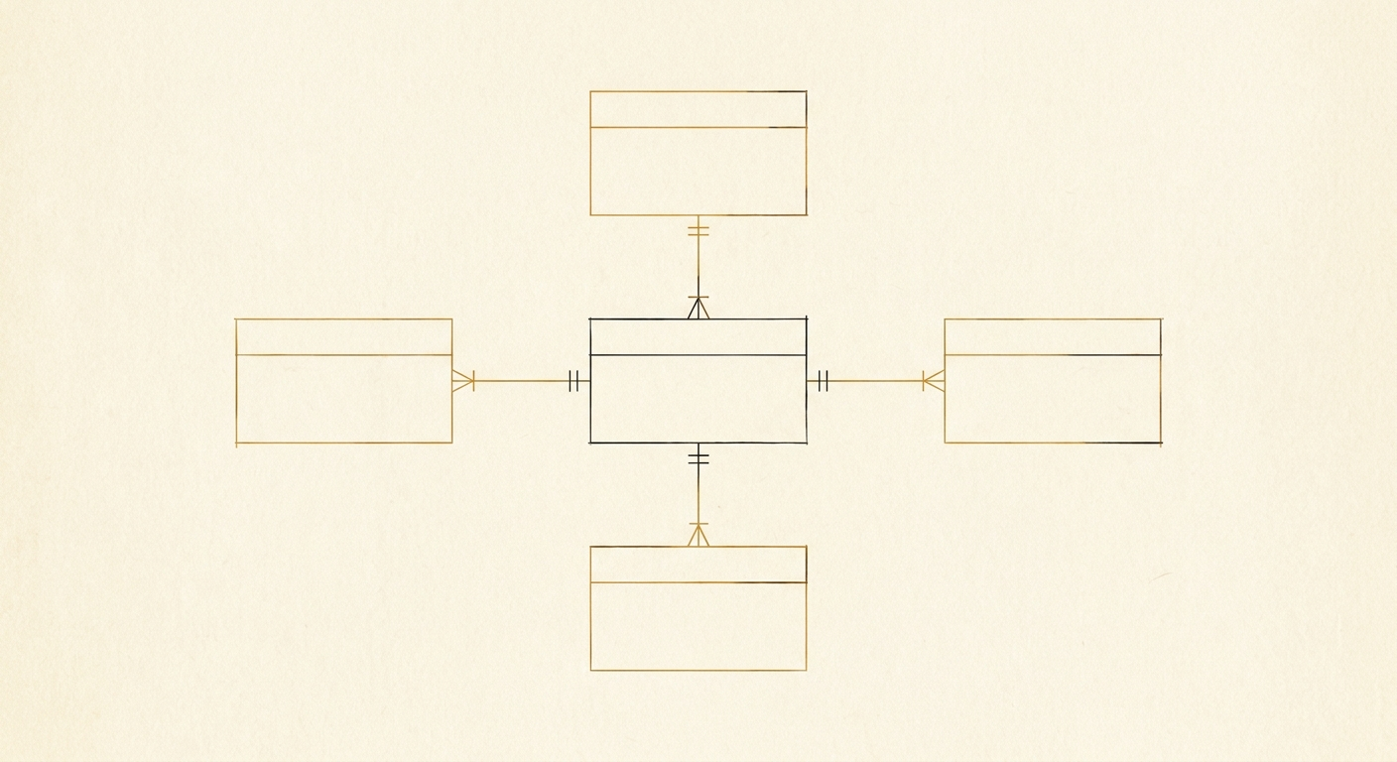
HOTEL PLATFORM / SECTION 1
03 / 22
— Section ONE
Database schema.
The structure consists of 23 tables. The first section serves as the backbone or the core of the system, and all other tables and components depend on it and branch out from it in a cascading manner.
Hotel Core
Inventory & Rates
[ IMAGE_02 ]
Hotel · Hotel_Type Hotel_Group · Hotel_Rules Hotel_Tag
Room_Type · Availability Rate_Plan · Provider
5 TABLES
4 TABLES
Schema diagram
Facilities & Geo
Marketing & System
Minimal line illustration of an entity-relationship diagram with five connected boxes, single-stroke architectural style, ochre and dark-ink lines on warm cream paper.
Facility · Group_Facility Facility_Hotel · Tag Location · Landmark · Category
Banner · Promotion · QA Users · Member · Comment Setting
7 TABLES
7 TABLES
Notes:
Track one — the database schema. Twenty-three tables, grouped into four phases by domain. Hotels and rules. Rooms, rates, and inventory. Facilities and geography. And finally marketing, users, and system configuration. I'll go through each phase on the next slides. Worth noting up front: phase one is a hard dependency for almost everything else, so we land it first.

Slide 4
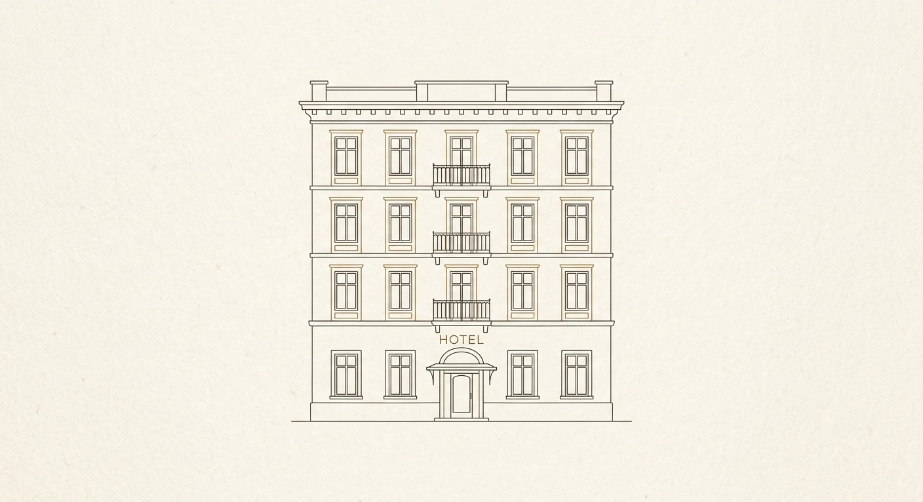
HOTEL PLATFORM / SECTION 1
04 / 22
— PHASE ONE
01
Hotel Core.
The spine of the system — every other domain hangs off these five tables.
5 Tables
Hotel
Hotel Type
Hotel Group
Core record per property — name, address, status.
Property types — boutique, resort, apartment.
Chains and brand families — Parsian, Homa.
Hotel Rules
Hotel Tag
Check-in, cancellation, age and child rules.
Pivot — attaches descriptive tags to any hotel.
Notes:
Phase one — Hotel Core. Five tables. Hotel is the root record. Hotel Type categorizes properties — boutique, resort, apartment. Hotel Group captures chains like Parsian or Homa. Hotel Rules holds check-in policies and cancellation terms. And Hotel Tag is the join table for descriptive tags. This is the spine — week one priority.

Slide 5
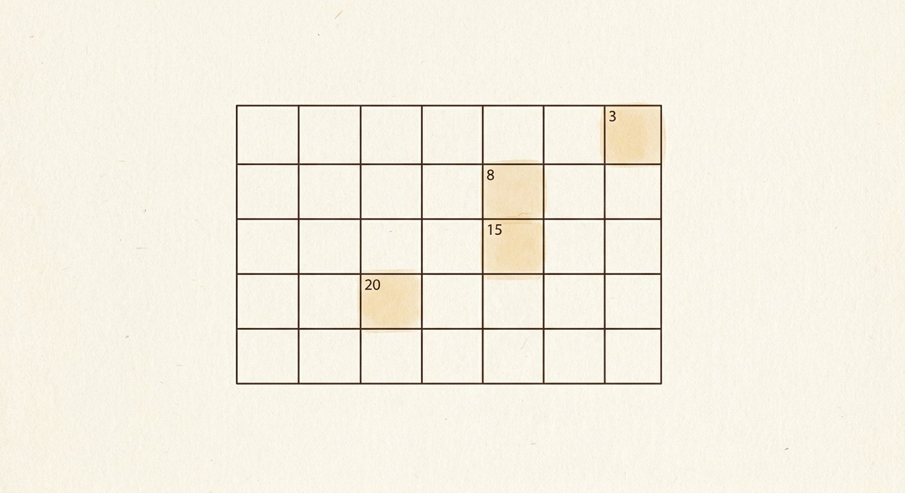
HOTEL PLATFORM / SECTION 1
05 / 22
— PHASE TWO
Rooms, rates & inventory.
02
The booking engine starts here — date-by-date availability, pricing schemes, and external feeds.
4 Tables
Room Type
Availability
Bookable units — single, double, suite, occupancy and bed config.
Date · room · count · price. The hot table — every search hits it.
Rate Plan
Provider
Sale conditions — bed-and-breakfast, refundable, packages.
Source registry for ingested availability and rate feeds.
Notes:
Phase two — Rooms, Rates and Inventory. Four tables. Room Type defines what's bookable. Availability is the high-volume table — date by date, room by room, count and price. This will get hammered on every search query so we index it carefully. Rate Plan layers pricing schemes on top — bed-and-breakfast, refundable, packages. Provider tracks where each external feed of availability and rates came from.

Slide 6
HOTEL PLATFORM / SECTION 1
06 / 22
— PHASE THREE
03
Facilities & geography.
Descriptive layer plus location data. Both run in parallel after phase one.
7 Tables
Facility
Group Facility
Location
Landmark
Master amenity list — wifi, pool, parking.
Buckets — room, common area, sports.
Country · province · city · neighborhood tree.
Airports, metro, attractions near each hotel.
Tag
Category
Editorial tags — luxury, budget, family.
Cross-domain taxonomy — applies to hotels and cities.
Notes:
Phase three combines facilities and geography. Seven tables. On the facility side we have the master Facility list, the Group Facility buckets, the Facility Hotel pivot, and the editorial Tag table. Geography gives us Location for the country-province-city-neighborhood hierarchy, Landmark for nearby points of interest, and Category for the cross-cutting taxonomy that applies to both hotels and cities. None of these block phase two, so we can run them in parallel.

Slide 7
HOTEL PLATFORM / SECTION 1
07 / 22
— PHASE FOUR
04
Marketing, users & system.
Closing out the schema — content, identity, reviews, and configuration.
7 Tables
Banner
Promotion
QA
Promotional banners — homepage hero, search inserts.
Campaigns — discount codes, seasonal deals.
FAQ and user-submitted Q&A.
Users
Member
Comment
Internal staff — admins, operators, editors.
Customer accounts — travelers who book.
Reviews and ratings — feeds search ranking.
Setting
Global configuration — payment gateways, social links, contact info, feature flags. Editable without redeploy.
Notes:
Phase four ties off the schema with marketing, users, and system tables. Seven tables. Banner and Promotion drive the marketing surfaces. QA holds FAQ and user-submitted questions. Users is the internal staff identity stack; Member is the customer-side stack — kept separate. Comment captures reviews and ratings, which feeds search ranking. And Setting holds global configuration that product can edit without a redeploy.

Slide 8
HOTEL PLATFORM / SECTION 1
08 / 22
— DATABASE SCHEMA PHASING
Database schema
In essence, parts of the database structure (tables, relationships, constraints, etc.) are designed and implemented
P1 · Wk 1
P2 · Wk 1
P3 · Wk 1
P4 · Wk 2 – 3
Hotel Core
Rooms, rates & inventory
Facilities & geography.
Marketing, users & system.
Banner, Promotion, QA, User, Member, Comment, Setting
Hotel, Hotel Type, Hotel Group, Hotel Rules, Hotel Tag
Room Type, Availability, Rate Plan, Provider
Facility, Group Facility, Location, Landmark, Tag, Category
5 TABLES
4 TABLES
6 TABLES
7 TABLES
Notes:
How we sequence the CRUD work. We bundle CRUD modules in the same phases as their underlying tables — Hotel CRUD with Hotel DB, Room CRUD with Room DB, and so on. The advantage: the operations team gets a usable admin tool for each domain as soon as the table is migrated. They start seeding real data while we build the next phase. By the time phase four DBs land, the ops team has been live for weeks.

Slide 9
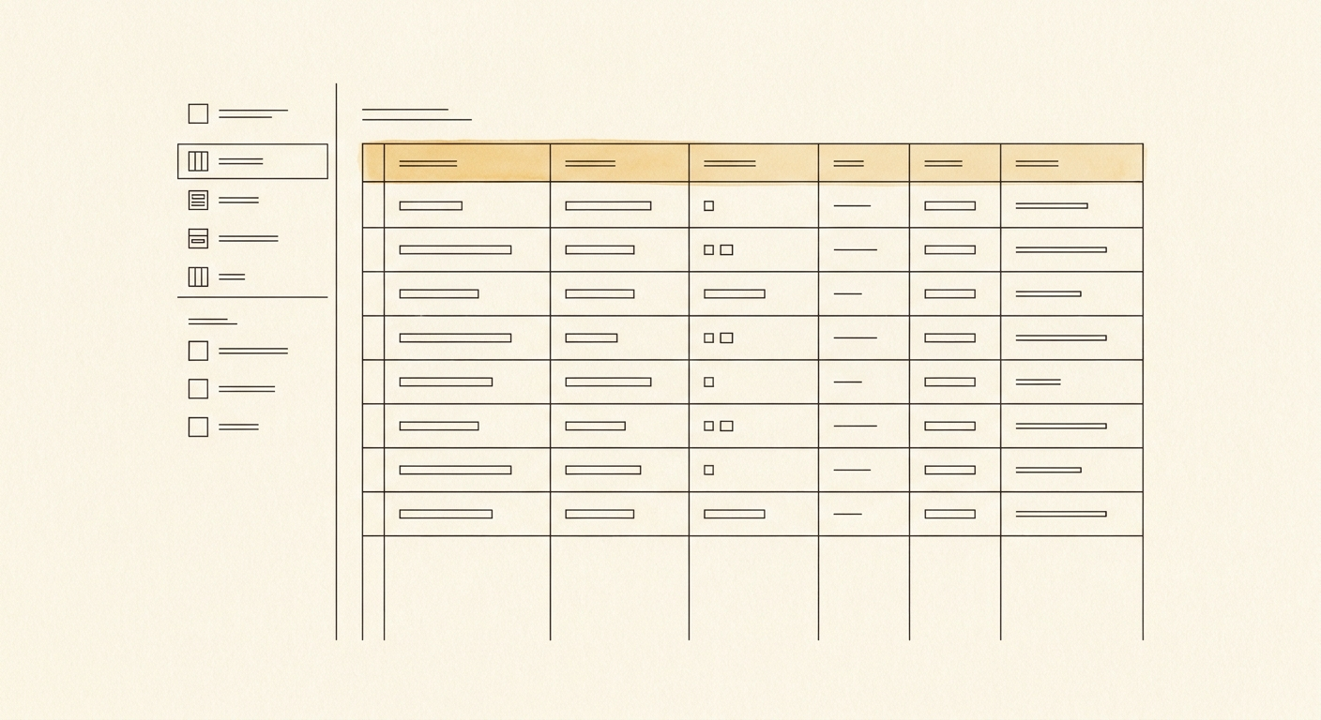
HOTEL PLATFORM / SECTION 2
09 / 22
— SECTION TWO
Admin CRUD layer.
One CRUD module per table. Standard list / create / edit / delete with validation. Ships in lockstep with the underlying schema.
Hotel
Hotel Type
Hotel Group
Hotel Rule
Hotel Tag
Room Type
Availability
Rate Plan
Provider
Pattern
Comment
Setting
List view · Create form · Edit form · Delete with confirmation · Validation. Same shape across all 23 modules.
Reviews
System
Notes:
Track two — Admin CRUD. Twenty-three CRUD modules, one per database table. Each one needs list view, create form, edit form, delete with confirmation, and validation. We standardize the interface so every admin page feels the same. This track lights up incrementally as each table lands — Hotel CRUD goes live the day Hotel DB is ready.

Slide 10
HOTEL PLATFORM / SECTION 2
10 / 22
— TRACK TWO
Admin CRUD layer.
Facility
Group_Facility
Facility_Hotel
Tag
Location
Landmark
Category
Banner
Promotion
QA
User
Member
Comment
Setting
Pattern
List view · Create form · Edit form · Delete with confirmation · Validation. Same shape across all 23 modules.
Reviews
System
Notes:
Track two — Admin CRUD. Twenty-three CRUD modules, one per database table. Each one needs list view, create form, edit form, delete with confirmation, and validation. We standardize the interface so every admin page feels the same. This track lights up incrementally as each table lands — Hotel CRUD goes live the day Hotel DB is ready.

Slide 11
HOTEL PLATFORM / SECTION 2
11 / 22
— CRUD PHASING
CRUD ships with its tables.
Each CRUD module follows its underlying schema by one week. Ops gets a usable admin tool per domain as soon as it's seeded.
P1 · Wk 1 – 2
P2 · Wk 3 – 4
P3 · Wk 1 – 2
P4 · Wk 1 – 2
Hotel CRUD
Inventory CRUD
Facility & Geo CRUD
Marketing & System CRUD
Banner · Promotion · QA User · Member · Comment Setting
Hotel · Type · Group Rule · Tag
Room Type · Availability Rate Plan · Provider
Facility · Group · Pivot · Tag Location · Landmark · Category
5 MODULES
4 MODULES
7 MODULES
7 MODULES
Notes:
How we sequence the CRUD work. We bundle CRUD modules in the same phases as their underlying tables — Hotel CRUD with Hotel DB, Room CRUD with Room DB, and so on. The advantage: the operations team gets a usable admin tool for each domain as soon as the table is migrated. They start seeding real data while we build the next phase. By the time phase four DBs land, the ops team has been live for weeks.

Slide 12
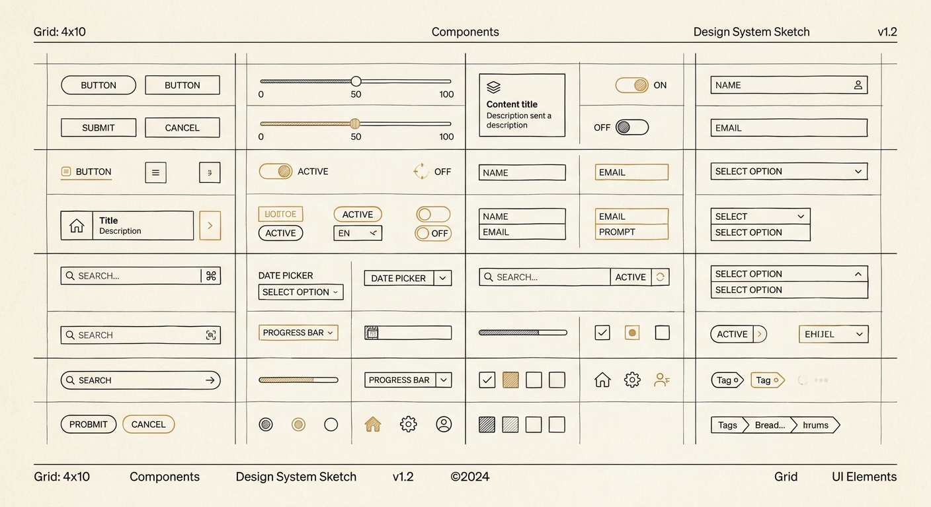
HOTEL PLATFORM / SECTION 3
12 / 22
— SECTION THREE
Frontend component library.
Thirty-three components grouped by surface. Built bottom-up — each piece testable in isolation before assembly.
Home & Shared
Hotel Detail
Header, footer, breadcrumb, hero, banner, hotel/city cards, search inputs.
Header section, gallery, room cards, reviews, accordions, sidebars.
12 COMPONENTS
11 COMPONENTS
Search Results
Filter sidebar, result cards, sort bar, infinite scroll, shimmers.
10 COMPONENTS
Notes:
Track three — Frontend Component library. Thirty-three components, grouped by where they live. Site-wide chrome — header, footer, breadcrumb. Home page surfaces — hero, banners, hotel and city cards, sliders, search box pieces. Hotel detail page — gallery, room cards, reviews, rules accordion, sidebar. Search results page — filter sidebar, result cards, sort bar, infinite scroll, shimmers. We build the library bottom-up so individual pieces are testable in isolation before assembly.

Slide 13
HOTEL PLATFORM / SECTION 3
13 / 22
— COMPONENT GROUP 1
Home & shared.
Site-wide chrome plus the homepage building blocks. Most ship first — they're reused across pages.
Header
Footer
Breadcrumb
Tab List
Site-wide top bar — logo, nav, account.
Quick links, trust marks, contact info.
Hierarchical position indicator.
Switch between flight / hotel / tour search.
Hero Section
Banner
Select Box
Date Picker
Large media area; search box overlay.
Static or animated promo placements.
Dropdown for cities, hotels, types.
Check-in / check-out range selector.
Guest Selector
Hotel Card
City Card
Quick Links Card
Adults, children, infants, rooms.
Image + summary for grid listings.
Destination promo card.
Phone sales, support shortcuts.
Section Title
Slider
Article Section
List and slider section headings.
Horizontal carousel for promos.
SEO-oriented long-form block.
Notes:
Home page and shared components. Eleven components. The site shell — header, footer, breadcrumb. Hero section with the search widget on top. Tab list, select box, date picker, and guest selector together form the search box. Then the marketing surfaces — banner, hotel card, city card, quick links card, slider, section title, article block. Most of these are reusable across pages, so they ship first.

Slide 14
HOTEL PLATFORM / SECTION 3
14 / 22
— COMPONENT GROUP 2
Hotel detail page.
Single-hotel surface — the core conversion page. Reuses search widgets inside the booking sidebar.
Hotel Header
Sticky Page Nav
Image Gallery
Room Card
Name, stars, address, share buttons.
In-page nav — sticks on scroll.
Grid or carousel of hotel photos.
Per-room details, capacity, price.
Facility Item
Quick Info Sidebar
Booking Widget Sidebar
Rating Bar
Single amenity row with icon.
Summary stats, map, key features.
Date picker + check rooms button.
Per-criterion review bars.
Reviews Section
Accordion Item
Policies Section
Aggregate score, tags, rating bars.
Collapsible content block.
Rules, check-in times, cancellation.
Notes:
Hotel detail page components. Eleven components specific to the single-hotel view. Header section with name, stars, address. Sticky in-page nav. Image gallery. Room cards. Facility items. The quick info sidebar. The booking widget sidebar with date picker and search button. Rating bars and the reviews section. Accordion items for the rules and about sections. Policies section. These build on the shared library — the search widget gets reused inside the booking sidebar, for instance.

Slide 15
HOTEL PLATFORM / SECTION 3
15 / 22
— COMPONENT GROUP 3
Search results page.
The result card is the most-viewed surface in the product — it gets the most design and performance attention.
Top Search Widget
Filter Sidebar
Quick Filter Tags
Hotel Result Card
Inline filter changes — no page reload.
Price, stars, amenities, more.
Common filters as clickable chips.
Image, name, address, score, price, CTA.
Sort & Summary Bar
Infinite Scroll Loader
Shimmer
SEO Content Block
Result count + sort dropdown.
Auto-load more results on scroll.
Skeleton animation while loading.
Bottom-of-page descriptive content.
Result card render time is the perf budget anchor. Target sub-50ms for 25 cards.
Notes:
Search results page components. Ten components. The top search widget for filter changes without leaving the page. Filter sidebar with all the criteria — price, stars, amenities. Quick filter tags for the common cases. The hotel result card — the most-viewed surface in the product. Sort and summary bar. Infinite scroll loader and shimmers for the loading states. SEO content block at the bottom. We treat the result card as the primary surface — it gets the most design and performance attention.

Slide 16
HOTEL PLATFORM / SECTION 3
16 / 22
— COMPONENT
Frontend Component
A frontend component is a reusable UI element responsible for displaying data and handling user interactions within an application. It encapsulates both presentation and behavior to keep the interface modular and maintainable
G1 · Wk 1 – 2
G2 · Wk 3 – 4
G3 · Wk 3 – 4
Home & shared
Hotel detail page
Search results page
15 COMPONENT
11 COMPONENT
8 COMPONENT
Notes:
How we sequence the CRUD work. We bundle CRUD modules in the same phases as their underlying tables — Hotel CRUD with Hotel DB, Room CRUD with Room DB, and so on. The advantage: the operations team gets a usable admin tool for each domain as soon as the table is migrated. They start seeding real data while we build the next phase. By the time phase four DBs land, the ops team has been live for weeks.

Slide 17
HOTEL PLATFORM / SECTION 4
17 / 22
— SECTION FOUR
Public APIs.
Nineteen read endpoints feeding the public site. Unblock as the underlying tables seed up.
— HOTEL DETAIL · 7
Hotel Details
Hotel Comments
Hotel Images
Hotel Seo
Hotel Facilities
Hotel Rules
Hotel Rooms
Notes:
Track four — Public APIs. Nineteen endpoints feeding the public website. Hotel detail APIs cover details, images, facilities, rules, rooms, comments, and SEO. Search APIs cover suggestion, filters, hotel list, and city search. Discovery APIs cover special offers, popular hotels, popular domestic destinations, and popular foreign destinations. Plus banners and SEO content. Most of these read from the schema we built in track one — so they unblock as soon as the underlying tables are seeded.

Slide 18
HOTEL PLATFORM / SECTION 4
18 / 22
— SECTION FOUR
Public APIs.
Nineteen read endpoints feeding the public site. Unblock as the underlying tables seed up.
— SEARCH · 5
Search Suggestion
Search Filters
Search Hotel-list
Search By-city
Search Seo
Notes:
Track four — Public APIs. Nineteen endpoints feeding the public website. Hotel detail APIs cover details, images, facilities, rules, rooms, comments, and SEO. Search APIs cover suggestion, filters, hotel list, and city search. Discovery APIs cover special offers, popular hotels, popular domestic destinations, and popular foreign destinations. Plus banners and SEO content. Most of these read from the schema we built in track one — so they unblock as soon as the underlying tables are seeded.

Slide 19
HOTEL PLATFORM / SECTION 4
19 / 22
— SECTION FOUR
Public APIs.
Nineteen read endpoints feeding the public site. Unblock as the underlying tables seed up.
— DISCOVERY · 7
Special Offers
Seo Content
Popular Hotels
Seo Content City
Popular Destinations
Popular Foreign
Banners
Notes:
Track four — Public APIs. Nineteen endpoints feeding the public website. Hotel detail APIs cover details, images, facilities, rules, rooms, comments, and SEO. Search APIs cover suggestion, filters, hotel list, and city search. Discovery APIs cover special offers, popular hotels, popular domestic destinations, and popular foreign destinations. Plus banners and SEO content. Most of these read from the schema we built in track one — so they unblock as soon as the underlying tables are seeded.

Slide 20
HOTEL PLATFORM / SECTION 4
20 / 22
— COMPONENT
Public APIs.
Nineteen read endpoints feeding the public site. Unblock as the underlying tables seed up.
P1 · Wk 1 – 2
P2 · Wk 1 – 2
P3 · Wk 1 – 2
HOTEL DETAILS
SEARCH
DISCOVERY
7 ENDPOINT
5 ENDPOINT
7 ENDPOINT
Notes:
How we sequence the CRUD work. We bundle CRUD modules in the same phases as their underlying tables — Hotel CRUD with Hotel DB, Room CRUD with Room DB, and so on. The advantage: the operations team gets a usable admin tool for each domain as soon as the table is migrated. They start seeding real data while we build the next phase. By the time phase four DBs land, the ops team has been live for weeks.

Slide 21
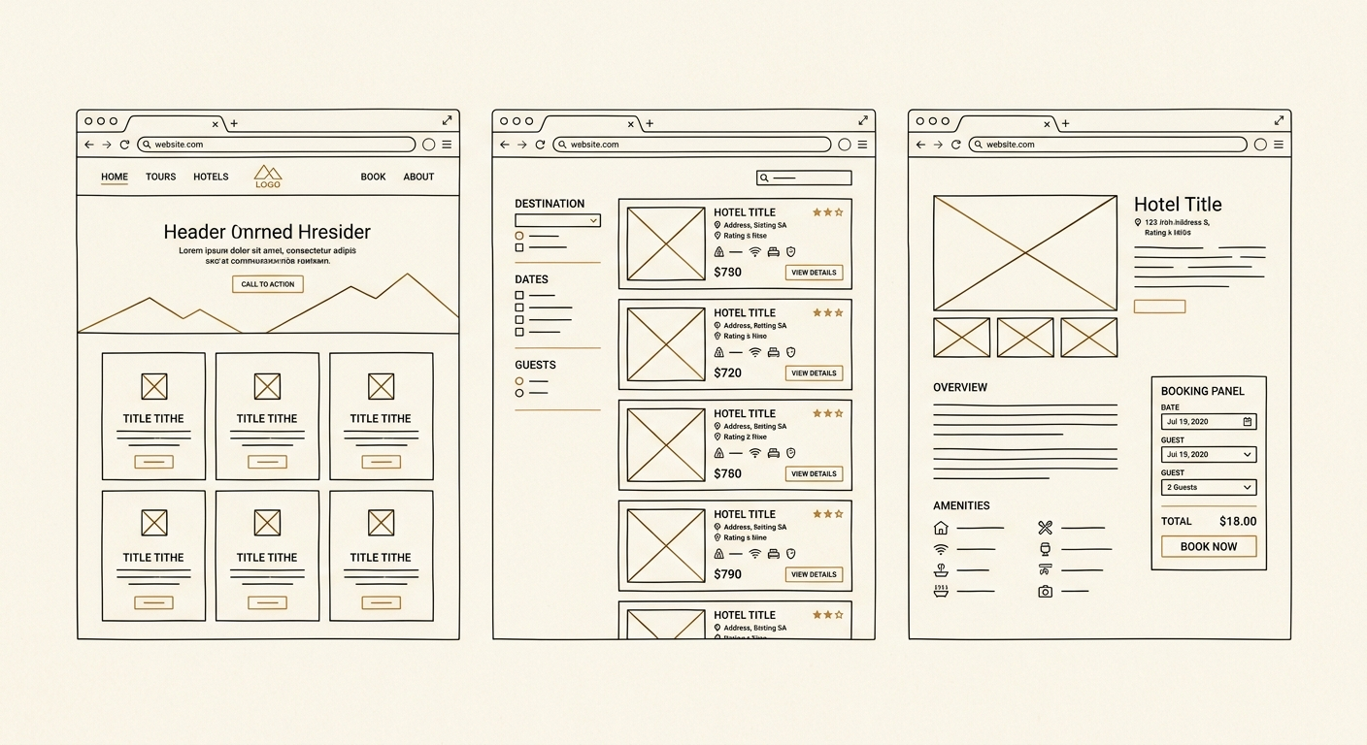
HOTEL PLATFORM / SECTION 5
21 / 22
— SECTION FIVE
Page integration.
Three page-level deliverables. Pure assembly — components plus APIs plus routing. Last track to start.
Home Page
Search Results Page
Single Hotel Page
Integrates public discovery APIs into the homepage layout. Routing and SEO setup.
Filter state in URL. Wires search APIs to the filter sidebar and result cards.
Wires hotel detail APIs into the detail layout. The conversion surface.
WK 1
WK 1
WK 1
Notes:
Track five — Page Integration. The final track, three deliverables. Home page integrates the public APIs into the homepage layout with routing. Search results page does the same for the search flow with filter state in the URL. Single hotel page wires the detail APIs into the hotel detail layout. This track only starts once the components in track three and the APIs in track four are ready — it's pure assembly and routing.

Slide 22
HOTEL PLATFORM
22 / 22
— CLOSE
Sequencing & dependencies.
S1
S2
S3
S4
S5
Database Schema
Admin CRUD
Frontend Library
Public APIs
Page Integration
Wk 5 – 6
Wk 6 – 10
Wk 7 – 10
Wk 3 – 6
Wk 3 – 6
23
33
19
27 – 38 Wk
TABLES · CRUD
FE COMPONENTS
PUBLIC APIS
10 – 16 FRONTEND.
17 – 28 BACKEND
Notes:
Putting it all together. Track one is the trunk — phase one DBs land first, everything cascades from there. Track two CRUD ships in lockstep with track one. Track three frontend components run in parallel from day one — they don't depend on the database. Track four APIs unblock as the underlying tables seed up. Track five page integration is last, pulling together everything from the other tracks. Realistic timeline: ten to twelve weeks for the full build with two backend engineers and two frontend engineers. Questions?

