Slide 1
object oriented programming in
self
init
class
software engineering
super

Slide 2
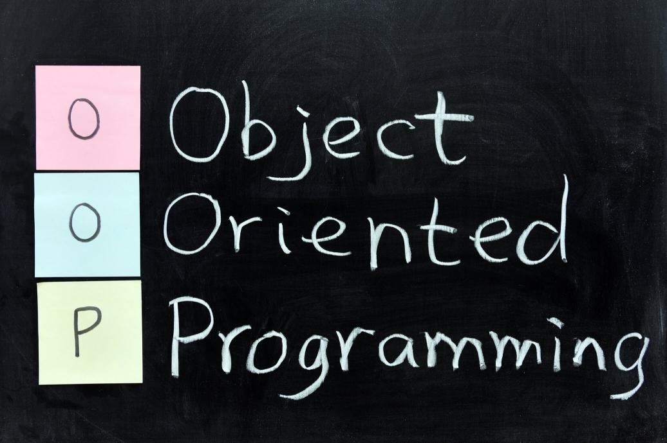

Slide 3
TABLE OF CONTENTS
01.
03.
02.
04.
What is oop?
Advantages of oop
In this section, we will learn about object-oriented programming.
In this section, we will get acquainted with the engineering features of object-oriented software
History of oop
SOLID AND DESIGN PATTERNS
In this section, we will get acquainted with the history of object-oriented programming
In this section, we will hear some examples of object-oriented programming issues

Slide 4
“I made up the term ‘object-oriented’, and I can tell you I didn’t have C++ in mind.”
—Alan Kay

Slide 5
01
introdoction of oop
class

Slide 6
INTRODUCTION
C#
python
Object-oriented programming (OOP) is a computer programming model that organizes software design around data, or objects, rather than functions and logic. An object can be defined as a data field that has unique attributes and behavior.
java

Slide 7
CONCEPTS
object-oriented programming
Functional programming

Slide 8

02
history of oop

Slide 9
oop TIMELINE
first programming language recognized as “object oriented”
Simula
first popular high-level languages
( Fortran ) && ( ALGOL )
1950
1965
1
2
3
4
5
1940
1962-1963
1983
Low level languages like machine code and assembly
Ivan Sutherland’s seminal Sketchpad
OOP come whit C++

Slide 10
Advantages of oop
03.
self
init

Slide 11
FEATURES OF oop
Re-usability
Code Maintenance
Design Benefits
It means reusing some facilities rather than building them again and again. This is done with the use of a class.
Object-Oriented Programs forces the designers to have a long and extensive design phase.
This feature is more of a necessity for any programming languages; it helps users from doing re-work in many ways.

Slide 12
FEATURES OF oop
Problems solving
Data Redundancy
Data redundancy is one of the greatest advantages of OOP.
Decomposing a complex problem into smaller chunks or discrete components is a good practice.
Security
Easy troubleshooting
We can controll accses data and methods.
Working with OOP language, you will know where to look for. This is the advantage of using encapsulation in OOP

Slide 13

SOLID AND DESIGN PATTERNS
04.

Slide 14
SOLID
Single Responsibility
Open/Closed
Liskov Substitution
Interface Segregation
Dependency Inversion
A class should have one and only one reason to change, meaning that a class should have only one job.
Objects or entities should be open for extension but closed for modification.
Let q(x) be a property provable about objects of x of type T. Then q(y) should be provable for objects y of type S where S is a subtype of T.
A client should never be forced to implement an interface that it doesn’t use, or clients shouldn’t be forced to depend on methods they do not use.
Entities must depend on abstractions, not on concretions. It states that the high-level module must not depend on the low-level module, but they should depend on abstractions.

Slide 15
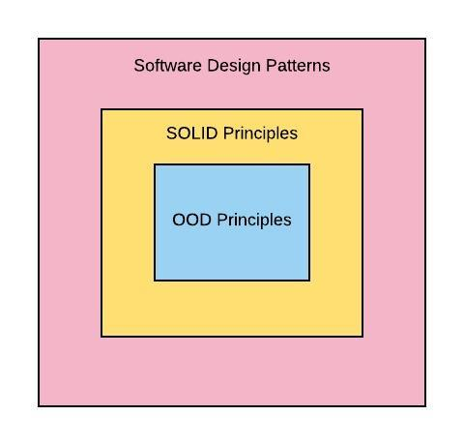
DESIGN PATTERNS
Design patterns are typical solutions to common problemsin software design. Each pattern is like a blueprintthat you can customize to solve a particulardesign problem in your code.

Slide 16

THANKS!
FASA UNIVERSITY
MOHSEN SALARI
9711312
software engineering

Slide 17
RESOURCES
RESOURCES
https://www.digitalocean.com/community/conceptual_articles/s-o-l-i-d-the-first-five-principles-of-object-oriented-design
https://www.educba.com/advantages-of-oop/
https://kajalrawal.medium.com/solid-design-principles-82fc4bdebb8

