Slide 1

Real Estate Price Prediction system
Presented By
Student Name: moshin ahmed
College Name: ultra college of engineering and technology
Department: information technology
Email ID: mohsinahmed1952000@gmail.com
AICTE Student ID: STU6620bd6991cff1713421673

Slide 2
OUTLINE
Problem Statement (Should not include solution)
Proposed System/Solution
System Development Approach (Technology Used)
Algorithm & Deployment
Result (Output Image)
Conclusion
Future Scope
References

Slide 3
Problem Statement
This project focused on real estate price prediction using machine learning in Python. ​
The core problem addressed is the need for accurate and reliable estimations of property prices to aid decision-making for various stakeholders in the real estate market, including buyers, sellers, investors, and professionals. ​
By leveraging machine learning techniques and Python programming, project aims to guide readers through the process of building a predictive model that can forecast real estate values, thus empowering informed transactions and strategic planning within the property sector.

Slide 4
Proposed Solution
For a real estate price prediction system using machine learning in Python, we can propose a solution that involves:
Data Collection:
Gathering historical and current real estate data.
Data Pre-processing:
Cleaning and transforming the data, creating relevant features for the model.
Model Selection:
Exploring and choosing an appropriate machine learning algorithm.
Model Training:
Training the selected model on the prepared data.
Evaluation:
Assessing the model's performance using relevant metrics.

Slide 5
System Approach
The strategy and methodology for developing and implementing the on real estate price prediction using machine learning are:
Data Collection: E.g., House age, Distance to the nearest MRT station, Number of convenience stores, Latitude, Longitude, House price of unit area.
Data Pre-processing: We can use function like drop() and in encoding(e.g., one-hot encoding, binary encoding)
Model Selection: E.g., linear regression, Decision Tree.
Model Training: Select the pre-processed data into training and testing sets.
Evaluation: E.g., Mean Squared Error(mse), Root Mean Squared Error(rmse), Mean Absolute Error(mae).
Library required to build the model: Here are the essential libraries to build the model for real estate price prediction:
Pandas: It is used for data manipulation and analysis.
NumPy: It is used for numerical computations on array.
scikit-learn (sklearn): It provides various algorithms for regression (like Linear Regression, Random Forest Regressor, Gradient Boosting Regressors, etc.), tools for data preprocessing (like scaling, encoding) and evaluation metrics (like MSE, RMSE, R-squared).

Slide 6
Algorithm & Deployment
For a real estate price prediction system using machine learning,
Algorithm Selection:
Linear Regression Algorithm: It assumes a linear relationship between the features (e.g., House age, Latitude, Longitude and the target variable (price)
Random Forest Regression: It is used to address overfitting issue, this often leads to more accurate and robust predictions for real estate prices.
Data Input:
The input features used by the algorithm, are ., House age, Distance to the nearest MRT station, Number of convenience stores, Latitude, Longitude and House price of unit area.
Training Process(work flow):
Data Collection -> Data Preparation -> Model Initialization -> Model Fitting -> Resulting Trained Model
Prediction Process:
It can be used to predict the price of properties just by providing a data set of that property(e.g., House age, Latitude, Longitude)

Slide 7
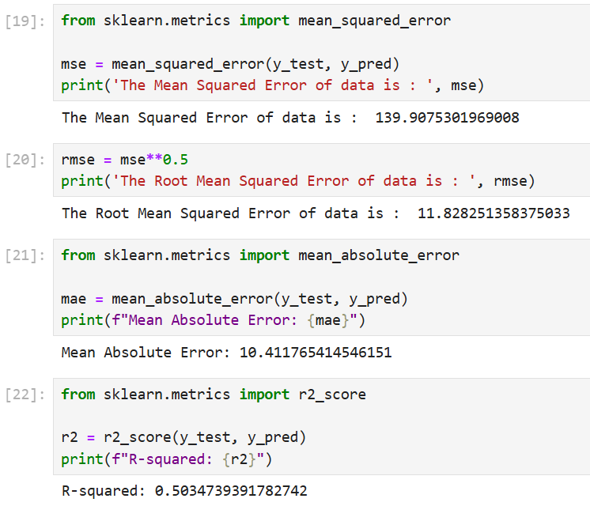
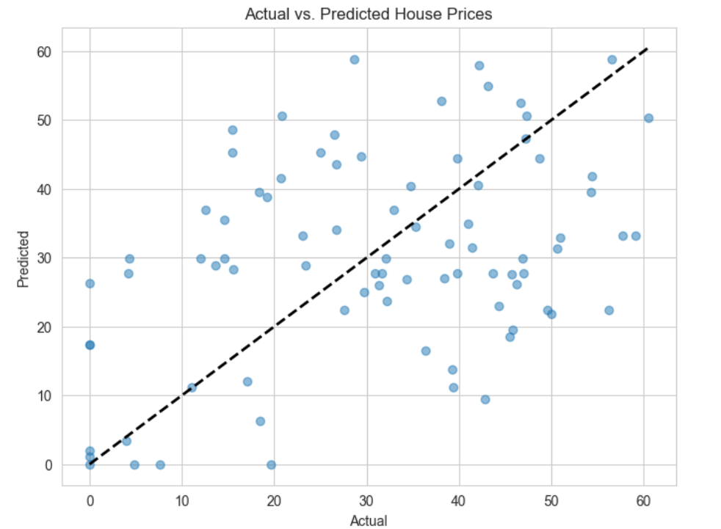
Result
RE
The diagonal dashed line represents where the actual and predicted values would be equal.
Result for Linear Regression Model

Slide 8
Conclusion
In this project, the model makes reasonably accurate predictions for a significant portion of the test set that provide a accurate price for House relevant to ‘House age , House age, Latitude, Longitude, etc.
The Actual and predicted house prices shows a “Positive correlation” , that indicate that model tends to predict higher prices for houses with higher actual prices.
The quantitative evaluation metrics like MSE indicates the average squared difference between the actual and predicted house prices , where RMSE indicates the same units of house prices.

Slide 9
Future scope
Discuss potential enhancements and expansions for the system. This could include incorporating additional data sources, optimizing the algorithm for better performance, and expanding the system to cover multiple cities or regions. Consider the integration of emerging technologies such as edge computing or advanced machine learning techniques.

Slide 10
References
List and cite relevant sources, research papers, and articles that were instrumental in developing the proposed solution. This could include academic papers on bike demand prediction, machine learning algorithms, and best practices in data preprocessing and model evaluation.
GitHub Link: Link

Slide 11
Thank you

