Slide 1
Data Archiving
Prepared by
MOHSIN AKRAM

Slide 2
Agenda
Sno | Data Archiving | Date | Time
1 | Data Archiving Introduction & Concepts -Benefits & Scope of Data Archiving -Purpose of Data Archiving -ADK(Archive Development Kit)
2 | Data Archiving Processes -Archiving Objects -Main Data Archiving processes -Archive Administration – Access via SARA – Central access to archive logs – Tables and Archiving objects – Archiving Information System Table Analysis – Overview
3 | Accessing Archived Data Using Infostructure Using Archiving Information System Document Relationship Browser(DRB) DRB-Display the relationship tree Reloading Archived data

Slide 3
Data Archiving

Slide 4
Introduction to Data Archiving
Data Archiving plays a significant role in the data management of an e-business system.
It permits data pertaining to closed business transactions to be relocated from the database without having to shutdown the system.
SARA is the Transaction code to archive data.
Benefits & Scope of Data Archiving
Purpose of Data Archiving
ADK(Archive Development Kit)

Slide 5
Purpose of Data Archiving
Application data that is no longer required for day-to-day business is relocated from database, so that database resources are used more efficiently.
Resolves memory space and performance problems caused by large volumes of transaction data.
Ensures that data growth remains moderate so that the database remains manageable in the long term.

Slide 6
Scope of Data Archiving
Data that is still required is not deleted from the database, to ensure that the system checks the archivability criteria for individual archiving object.
Two-step method
Ensure that errors do not lead to loss of data during archiving. First, The data is copied to archive files. Second, The archive file is fully written and has successfully read before deleting data from database.
Data Compression
Data is compressed automatically during archiving.
Meta data
Metadata is saved in the archive file along with the data, so the archive can be read long after it was created and even after system is upgraded.

Slide 7
Benefits of Data Archiving
System availability
Faster and easier upgrade to higher software releases. Shorter runtime for backup and recovery.
Resource usage
Reduced hardware costs for Disk, CPU, Memory as well as
administration costs
Response times
Improved system performance and response time online.

Slide 8
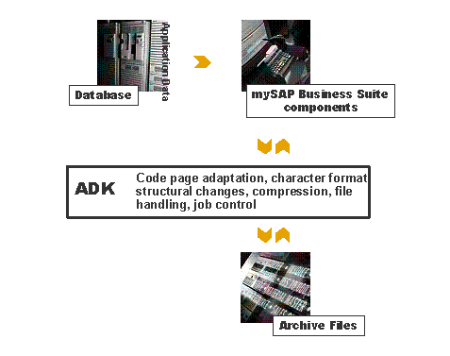
Archive Development Kit (ADK)
The Archive Development Kit (ADK) is a tool for developing archiving solutions.
ADK is an intermediate layer between the application program and the archive files that provides all the functions required for archiving data.

Slide 9
Agenda
Sno | Data Archiving | Date | Time
1 | Data Archiving Introduction & Concepts -Benefits & Scope of Data Archiving -Purpose of Data Archiving -ADK(Archive Development Kit)
2 | Data Archiving Processes -Archiving Objects -Main Data Archiving processes -Archive Administration – Access via SARA – Central access to archive logs – Tables and Archiving objects – Archiving Information System - Table Analysis - Overview
3 | Accessing Archived Data Using Infostructure Using Archiving Information System Document Relationship Browser(DRB) DRB-Display the relationship tree Reloading Archived data

Slide 10
Data Archiving Processes
Data Archiving consists of several successive sub-processes which together make up the actual data archiving procedure.
Archiving Objects
Main Data Archiving Processes
  Writing data from DB to Archive
  Storing Archive Files
  Deleting data from DB

Slide 11
Archiving Object
The Archiving object defines the unit that can be archived and deleted from database as a whole. An archiving object represents business object that has been enhanced to include the components required for data archiving. The components are:
Data declaration part
Describes all data structures and database tables that characterize an application object
Archiving programs
  Write program
  Delete program
  Preprocessing program
  Read program
  Post processing program
  Reload program
Customizing settings

Slide 12
Main Data Archiving Processes
Data Archiving is divided into following main processes
Writing data from DB to Archive:
Data to be archived is read from database and written sequentially to the archive files.
Deleting data from DB:
After the data has been written to archive files, the delete program deleted the data from database. In order to ensure that the data has been archived properly, the delete program first reads the archive files.
Storing Archive files:
Archive files created during the write phase can be transferred to external storage system.

Slide 13
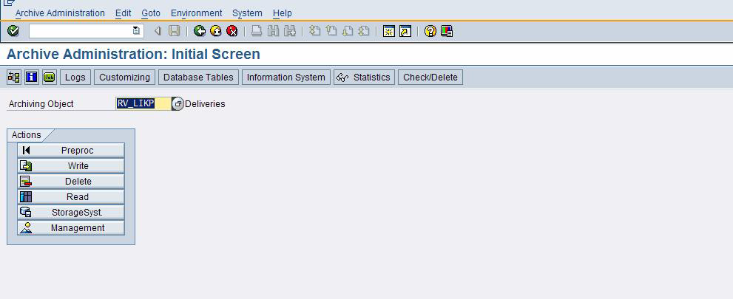
Archive Administration –
Access via Transaction SARA

Slide 14
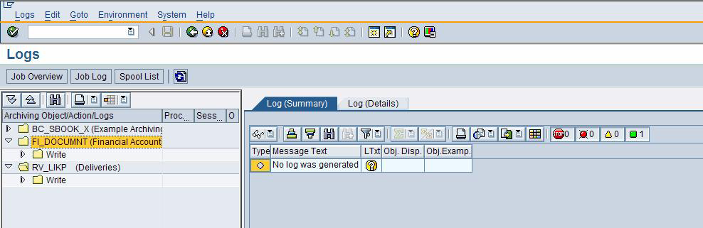
Archive Administration –
Central access to archive logs

Slide 15
Archive Administration –
Tables and Archiving Objects

Slide 16
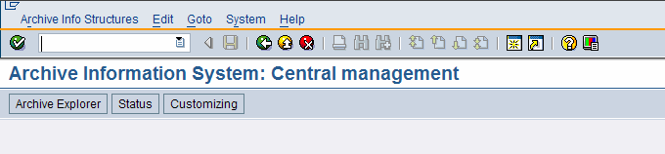
Archive Administration –
Archive Information System

Slide 17
Table Analysis - Overview
Table Analysis (Transaction TAANA)
Distribution of table entries over selected fields, e.g. period of time and /or organizational units
Persistent storage of the analysis

Slide 18
Agenda
Sno | Data Archiving | Date | Time
1 | Data Archiving Introduction & Concepts -Benefits & Scope of Data Archiving -Purpose of Data Archiving -ADK(Archive Development Kit)
2 | Data Archiving Processes -Archiving Objects -Main Data Archiving processes -Archive Administration – Access via SARA – Central access to archive logs – Tables and Archiving objects – Archiving Information System Table Analysis – Overview
3 | Accessing Archived Data Using Infostructure Using Archiving Information System Document Relationship Browser(DRB) DRB-Display the relationship tree Reloading Archived data

Slide 19
Accessing Archived Data Using Infostructure
Archived data can be accessed in many ways, Archive Information System(AIS) is the tool developed specifically for archive accesses.
Enables you to configure your own archive indexes, fill them with data from the archive, and search for archived data.
The Archive Information System is performed via an Infostructure. Infostructures are created using the Archive Retrieval Configurator(transaction SARJ), which is the Customizing component of the Archive Information System.
You can access the Archive Information System using transaction SARI.

Slide 20
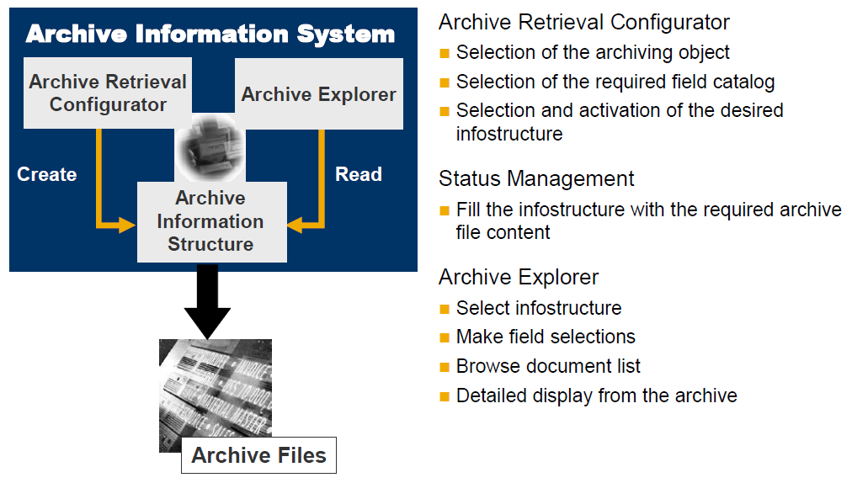
Using Archiving Information System

Slide 21
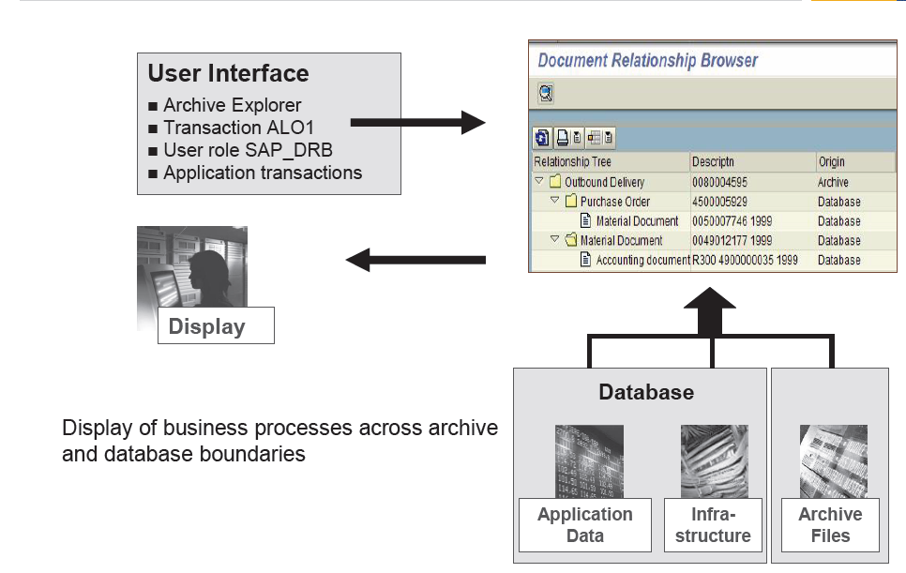
Document Relationship Browser(DRB)

Slide 22
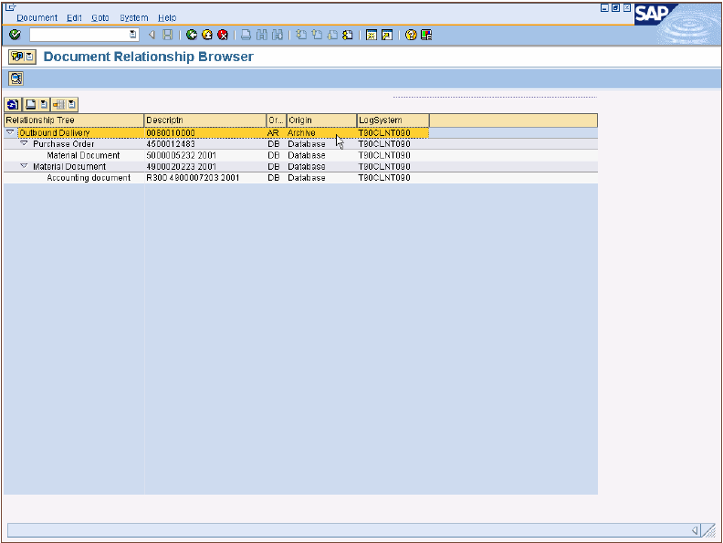
DRB – Display the relationship tree

Slide 23
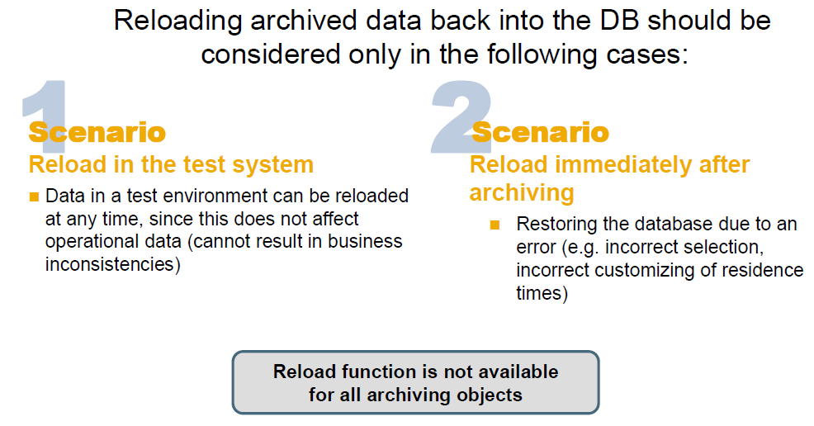
Reloading Archived data

Slide 24
Important Transaction Codes
SARA – Data Archiving
SARI – Archive Information System: Central Management
SARJ – Archive Retrieval Configurator
DB15 – Tables and Archiving Object
OAC0 – Content Repository
AOBJ – Archiving Customizing

Slide 25
Thank You

