Slide 1

Image Encryption Based on Algebraic S-box and Galois Field
ABDUL MOHSIN SIDDIQI (14BCS0036)
ZAKI MUSTAFA FAROOQUI (14BCS0050)
MOHD. ZAIYAN ALAM (14BCS0041)

Slide 2

INTRODUCTION
Why encryption and its importance in today's world
- To Securely protect classified information
Research importance
Conventional techniques: AES, APS and GRAY
Our Minor Project: Contemporary encryption technique regarding the break of “A Novel Image Encryption Based on Algebraic S-box and Arnold Transform” by Shabieh Farwa et al.

Slide 3
MOTIVATION
Better and Advanced Algorithms
Breaking the paper
Propose a better encryption scheme than the one provided by Shabieh Farwa et al.
With optimisation and better results, publish the paper by the end of semester

Slide 4
GALOIS FIELD
Let F be a set of objects on which two operations + and . are defined
• F - {0} forms a commutative group under .
• The multiplicative identity element is labeled as ‘1’.
• The operation + and . distributes: a.(b+c)=(a.b)+(a.c)
• A field with finite number of elements is called a finite field, also called Galois Field, denoted by GF(p). p can be a prime number or power of prime.
o Examples of Galois(Finite) Fields
• Finite field GF(2) consists of elements 0 and 1
‘+’ XOR operation additive identity: 0
‘.’ AND operation; multiplicative identity: 1

Slide 5
S-Box
Another name for Substitution Box
In Cryptography, S-box is a basic component of symmetric key algorithm that performs substitution
Algebraic structure represented by generally an 8x8 (or 16x16) vectorial Boolean matrix
Takes m input bits and transforms it info n output bits (where m may not be equal to n, hence an m*n S-box)
Applications of S-boxes in digital image encryption, stenography and watermarking

Slide 6
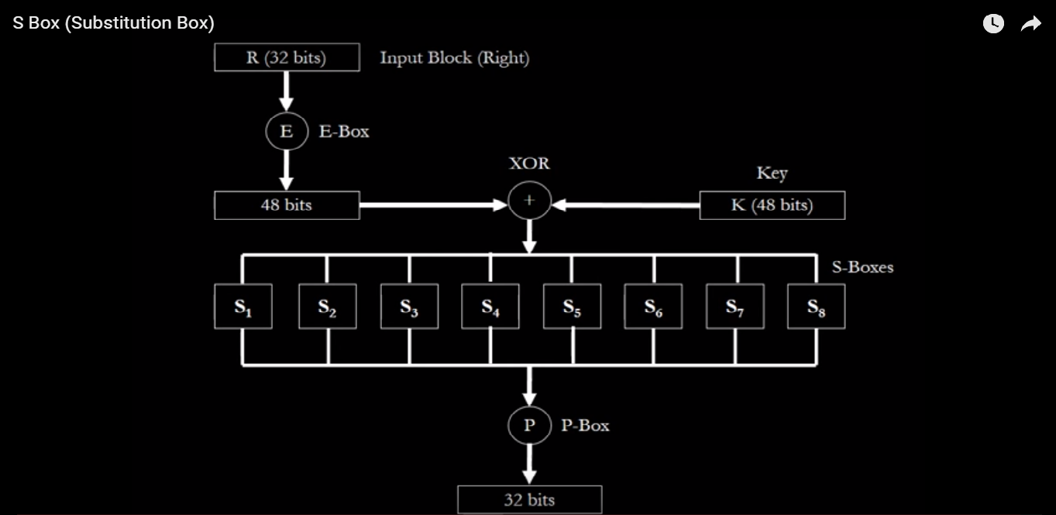
S-Box

Slide 7

HOW-TO APPROACH
TASK 1:- S-BOX GENERATION:
- Generator function using Galois Field GF(2^8)
An Example of Generator Function:
- Heuristic optimization seeking for local and global best S-box candidates on each iteration.

Slide 8
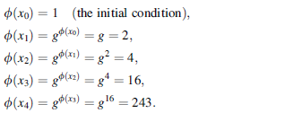
HOW-TO APPROACH
TASK 1:- S-BOX GENERATION:
Other generator functions can also be used for generating S-box candidates.
Will incorporate different initial conditions to generate different S-boxes.
An Example:

Slide 9
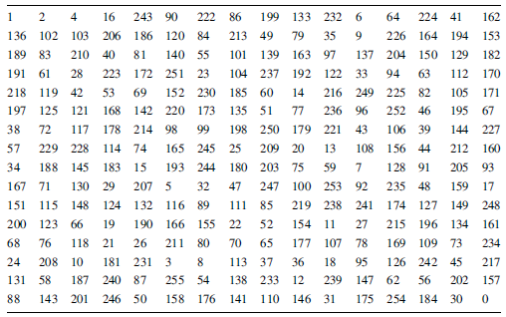
HOW-TO APPROACH
TASK 1:- S-BOX GENERATION:

Slide 10
HOW-TO APPROACH
TASK 2:- IMAGE ENCRYPTION:
- 512x512 image will be chosen for encryption purpose
- Use proposed image encryption scheme
- Then compare for all the following parameters:
- Entropy
- Non-Linearity
- Contrast
- Homogeneity
- Energy, etc.

Slide 11
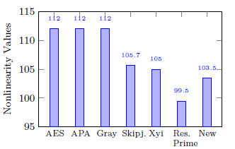
HOW-TO APPROACH
TASK 2:- IMAGE ENCRYPTION:
- Non Linearity values for different encryption techniques:

Slide 12
HOW-TO APPROACH
TASK 3:- CRYPTANALYSIS:
- Attack the encryption scheme provided in the paper
- Show security flaws regarding CPA (A type of attack)
- Compare our result with the scheme mentioned above
- Perform Statistical (histogram) analysis

Slide 13
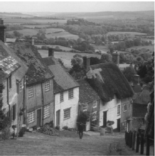
HOW-TO APPROACH
TASK 3:- CRYPTANALYSIS:
- Histogram analysis of a 512x512 image of a Hill:

Slide 14
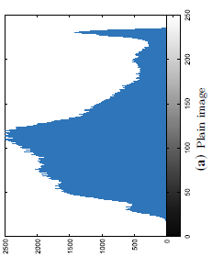
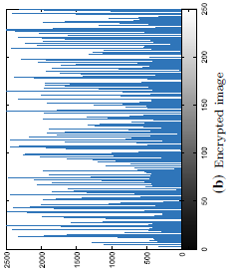
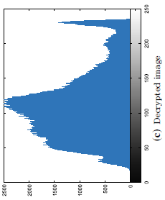
HOW-TO APPROACH
TASK 3:- CRYPTANALYSIS:
- Histogram analysis of a 512x512 image of a Hill:

Slide 15
TOOLS
Procedure implementation –
- Python/MATLAB(Octave)
Statistical analysis (simulations; differential and histogram) –
- Python libraries such as MatPlotLib, Numpy etc…

Slide 16
REFERENCES
PAPER:
1. Shabieh Farwa . Nazeer Muhammad . Tariq Shah . Sohail Ahmad (July 2017)
“A Novel Image Encryption Based on Algebraic S-box and Arnold Transform”,
Published at 3D Research Center, Kwangwoon University and Springer-Verlag GmbH Germany
LINKS: http://faculty.washington.edu/manisoma/ee540/EE540finite.pdf http://crypto.stackexchange.com/questions/2700/galois-fields-in-cryptography https://en.wikipedia.org/wiki/Finite_field_arithmetic http://www.samiam.org/rijndael.html http://web.eecs.utk.edu/~plank/plank/papers/CS-07-593/ https://www.doc.ic.ac.uk/~mrh/330tutor/ch04s02.html https://www.doc.ic.ac.uk/~mrh/330tutor/

Slide 17
THANK YOU

