Slide 1
Different C-mos SRAM Circuits' Implementation and Performance Analysis
Course Code : EEE 4134 Course Name: VLSI I Lab
Group Members
Names | Student ID
Md. Esfaque Ahmed | 190105041
Rahatin Rahman Niloy | 190105045
Mohsin Islam Rifat | 190105046
Anika Tahsin Afia | 190105047
A.K.M Aktaruzzaman Shuvo | 190105050
Prepared For,
Mr. S. M. Ishraqul Huq Assistant Professor,Department of EEE Ahsanulllah university of science & Technology | Mr. Sk. Aqiluzzaman Shihab Lecturer,Department of EEE Ahsanulllah university of science & Technology
Department: EEE
4th Year 1st Semester
Section : X2(A2)

Slide 2
Project analysis slide 2
WHAT IS SRAM?
Memory is the important part of most of the electronic systems but the major problem with the design of memories is performance of devices speed and power dissipation.
To overcome this problem SRAM is used .
By using it, we can frequently access the SRAM cell into power consumption which varies largely.
Using SRAM cell at high frequencies, it consumes much power.
Whereas, if it is used to a slower speed in applications with moderately clocked microprocessors, it consumes almost negligible power.
SRAM stands for Static Random Access Memory which is a conventional device.
It is a form of a semiconductor.
It is used in microprocessors, general computing applications (CPU register files, internal CPU caches, internal GPU caches and external burst mode SRAM caches, hard disk buffers, router buffers, etc.) and electronic devices.
The SRAM is volatile in nature which means if power supply is cut, all stored data will be wiped out.

Slide 3
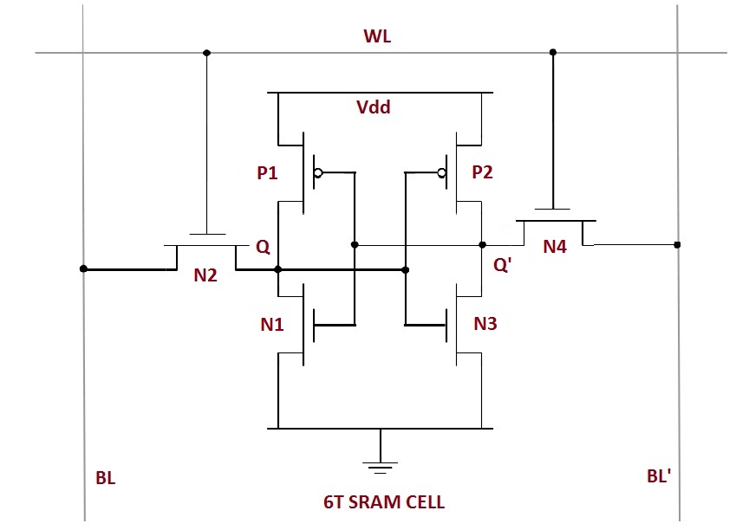
Project analysis slide 4
CONVENTIONAL SRAM
The conventional SRAM is designed with 6 Tansistors cell topology.
In conventional 6T SRAM cell which has two back to back connection of inverters using N1, P1, N2, P2 to store the single bit either ‘0’ or ‘1’. N3, N4 transistors are called as access transistors. WL is used to turn ON the access transistors. BL, /BL are bit lines.
Figure : Conventional 6T SRAM circuit diagram.

Slide 4
Project analysis slide 4
In 6T conventional SRAM, flip-flop is used in circuit to store each data bit. The circuit delivers two stable states, which are read as 1 or 0. To support these states, the circuit requires six transistors, four to store the bit and two to control access to the cell. There is no different read bit line & write bit line, both line are same.
To overcome the same read - write bit line , power consumption,data stability and read operation more efficient
7T,8T,9T & 10T topology SRAM can be used.

Slide 5
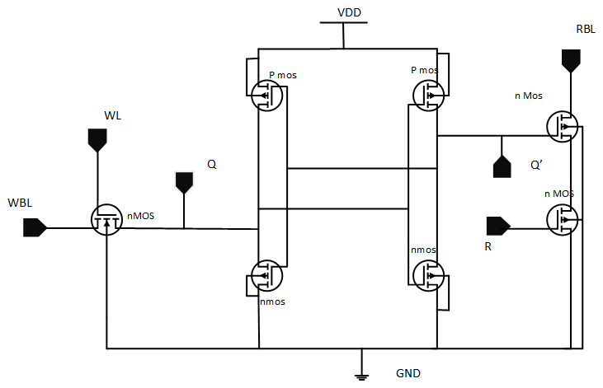
Project analysis slide 4
7T SRAM
Write operation: Set WL=1 ,so the N3 nmos is on so data from WBL will pass to Q .It will on the N2 nmos and Q’ will be 0.When Q’ =0 ,the P1 on and Q will be strongly high(1). So in these process write operation is done. Read Operation: Set R =1,and RBL is input here.when R=1 then the N5 will on and we will gwt low(0) as N5 will shorter with ground.Opposite will happen,when stored bit is 0,then Q’ will 1 and the N4 will on.so a voltage drop can be measured from here.
P1
P2
N4
N3
N5
N1
N2

Slide 6
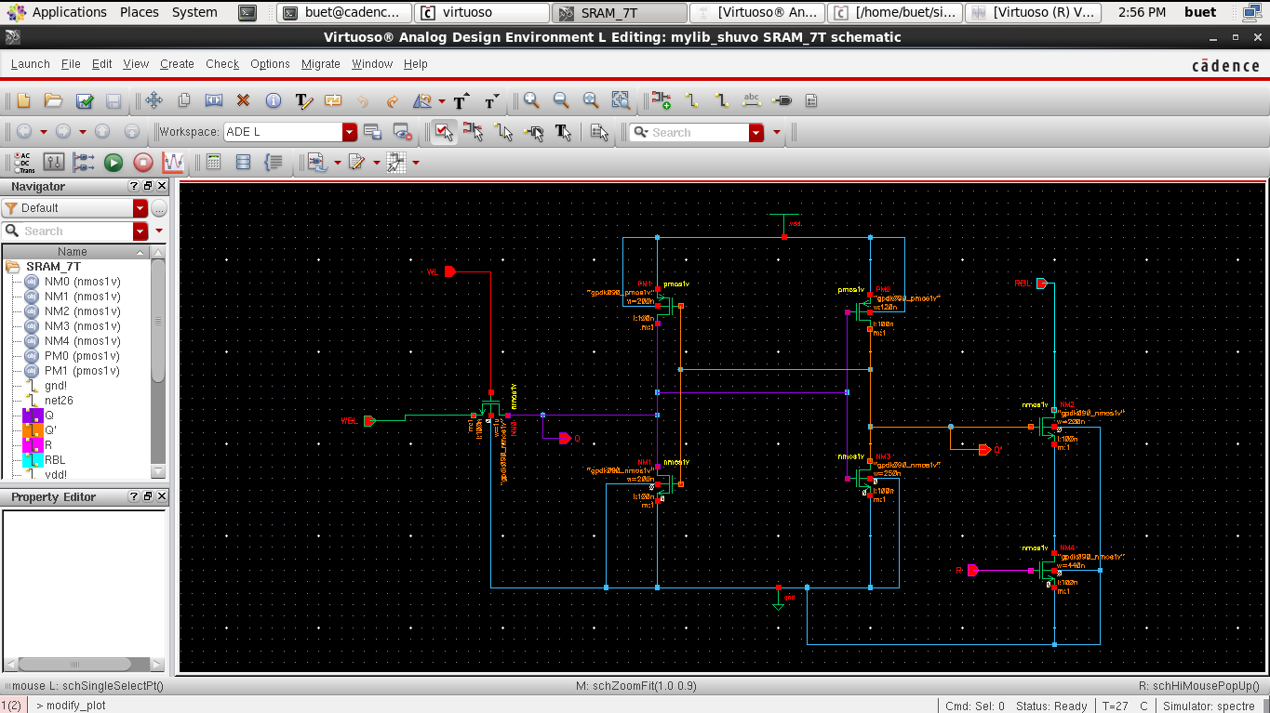
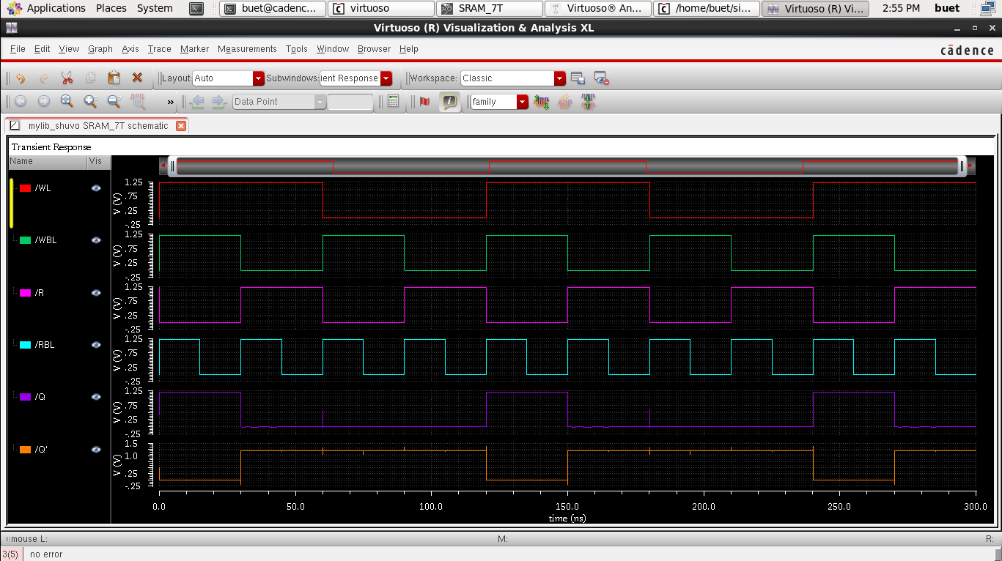
Project analysis slide 4
7T SRAM
Figure:7T SRAM Schemetic Diagram. | Figure: Wave form for Read write operation.

Slide 7
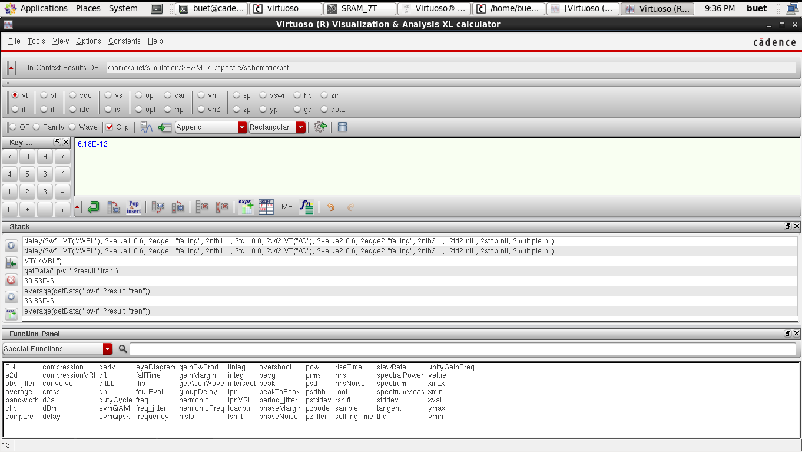
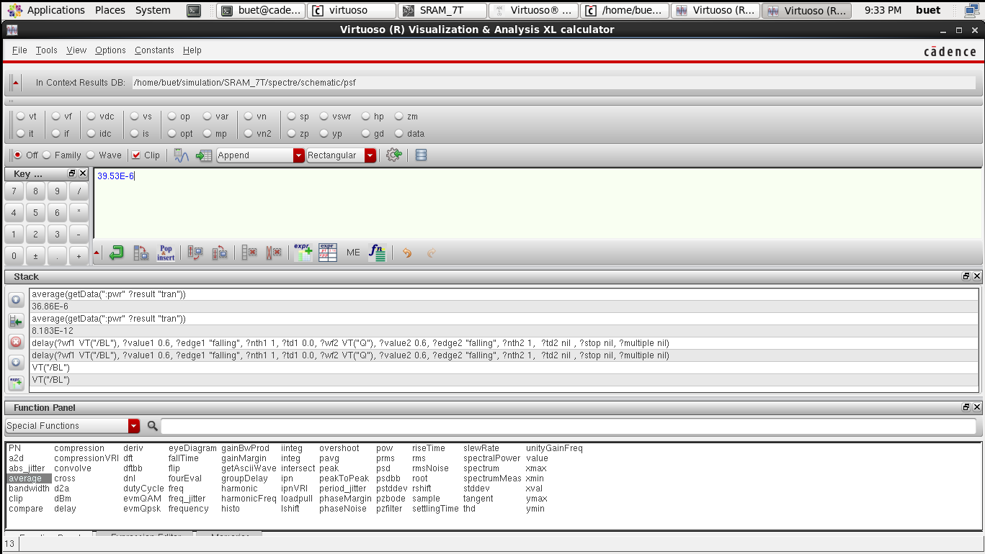
Project analysis slide 4
7T SRAM
Figure:Propagation Delay for 7T SRAM. | Figure:Average power calculation for 7T SRAM.

Slide 8
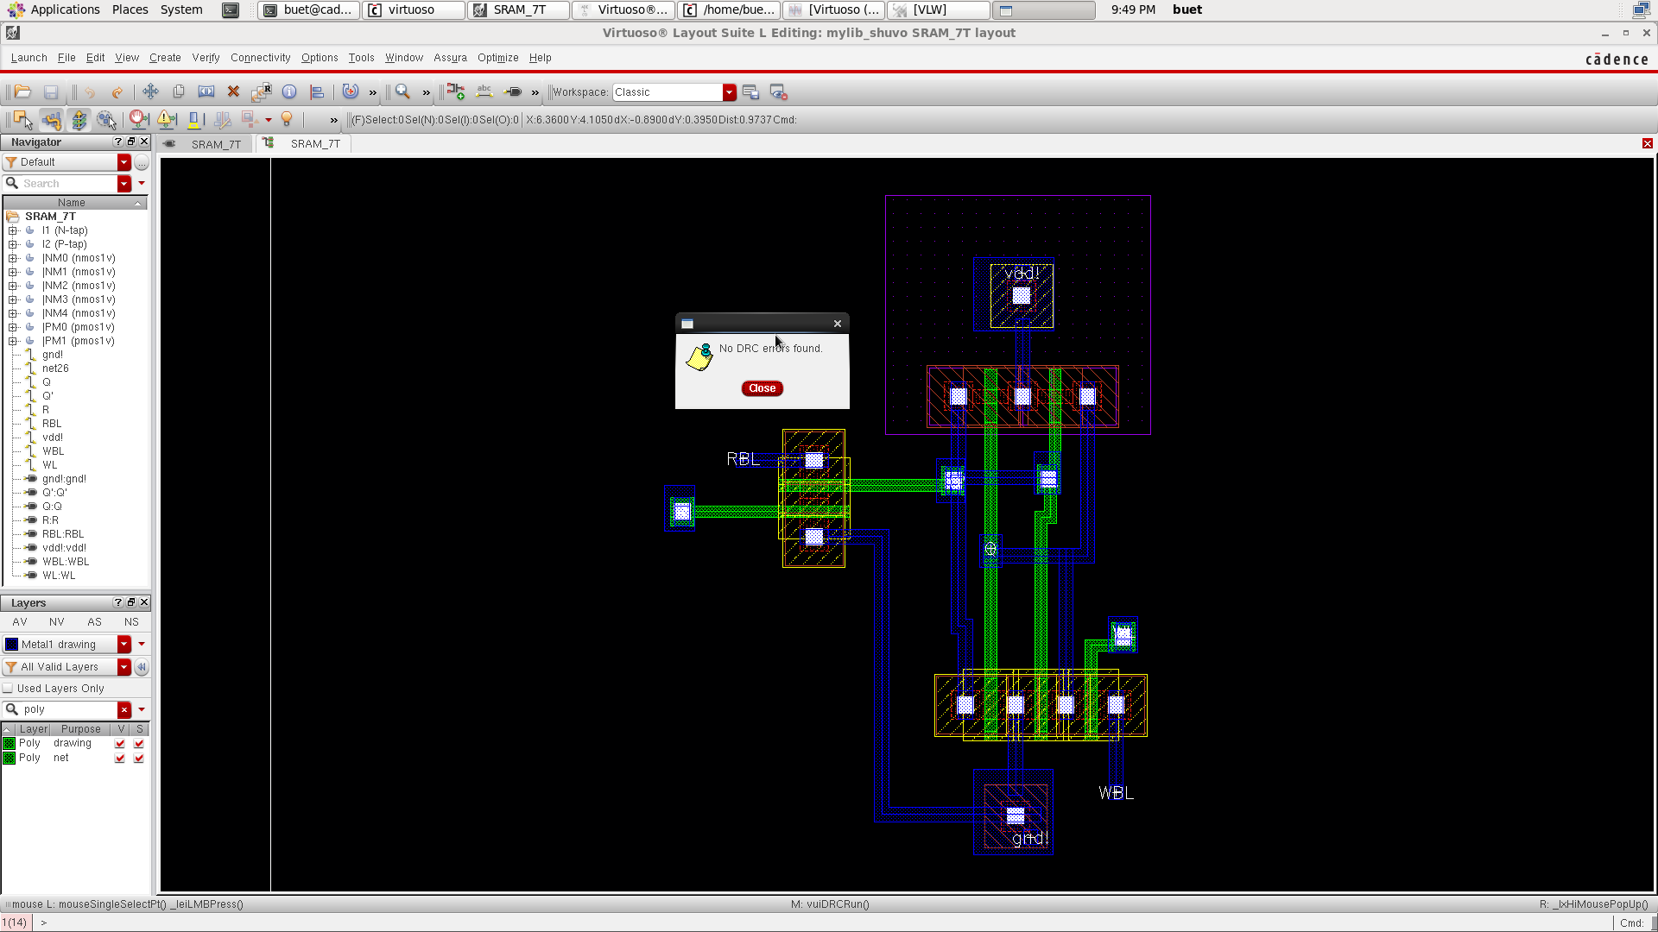
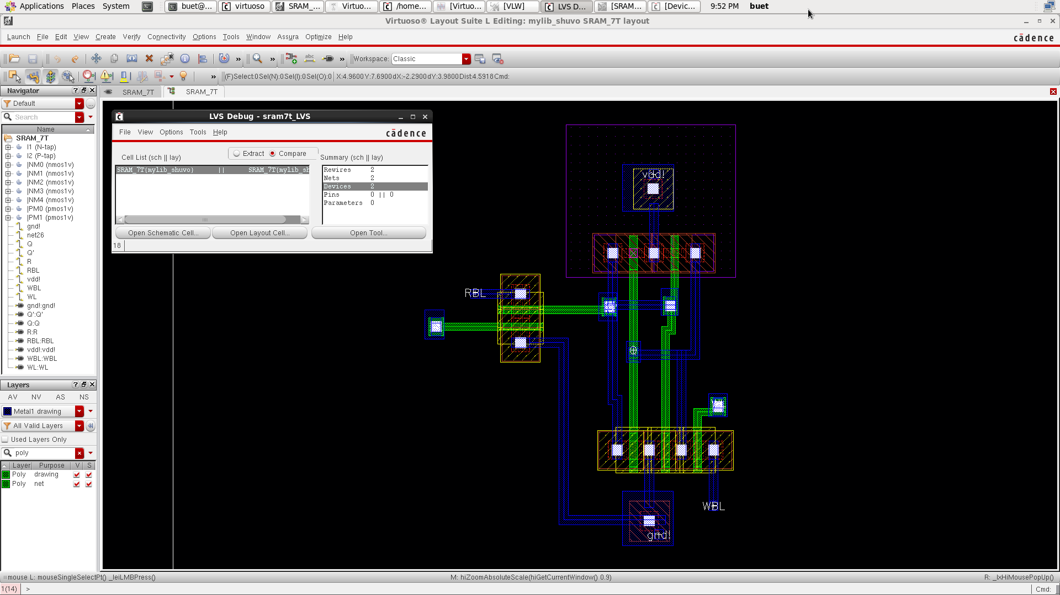
Project analysis slide 4
7T SRAM
Figure:Layout with No DRC Error for 7T SRAM. | Figure:LVS Checking for 7T SRAM.

Slide 9
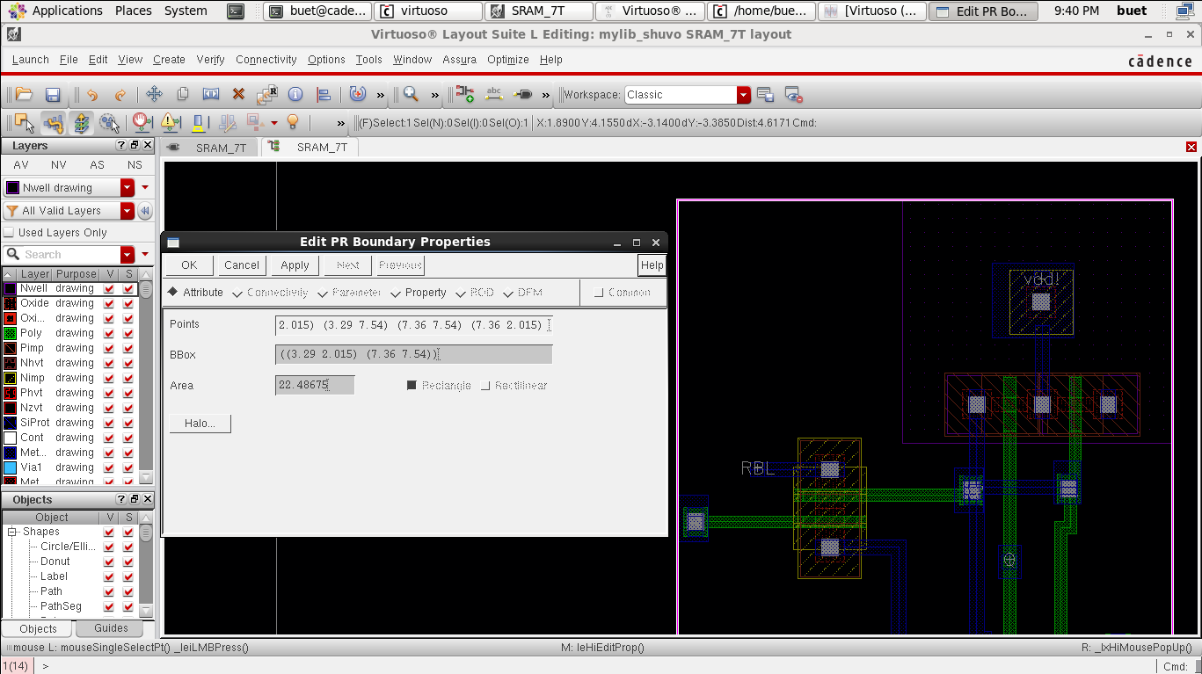
Project analysis slide 4
7T SRAM
Method | Propagation delay | Average power | Power delay product | Cell Area | NO. of Transistor | No.of DRC Errors | No. of LVS Mismatches
7T | 6.18E-12 | 39.53E-6 | 2.44E-16 | 22.486(um^2) | 7 | 0 | 6
Figure: Cell Area of 7T SRAM

Slide 10
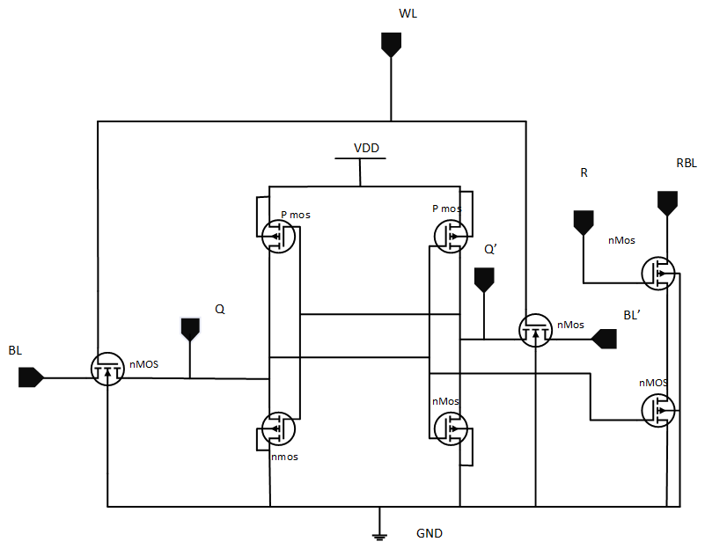
Project analysis slide 4
8T SRAM
Write read
P-1
P-2
N-6
N-4
N-3
N-6
N-1
N-2

Slide 11
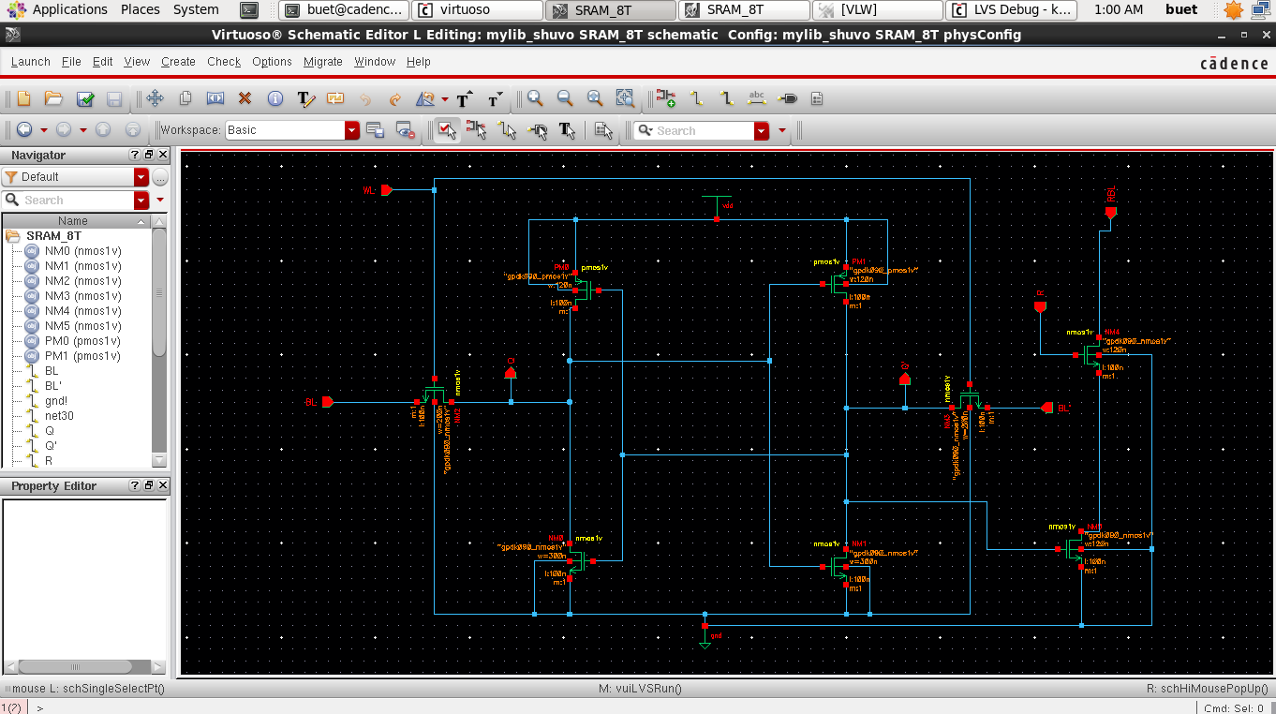
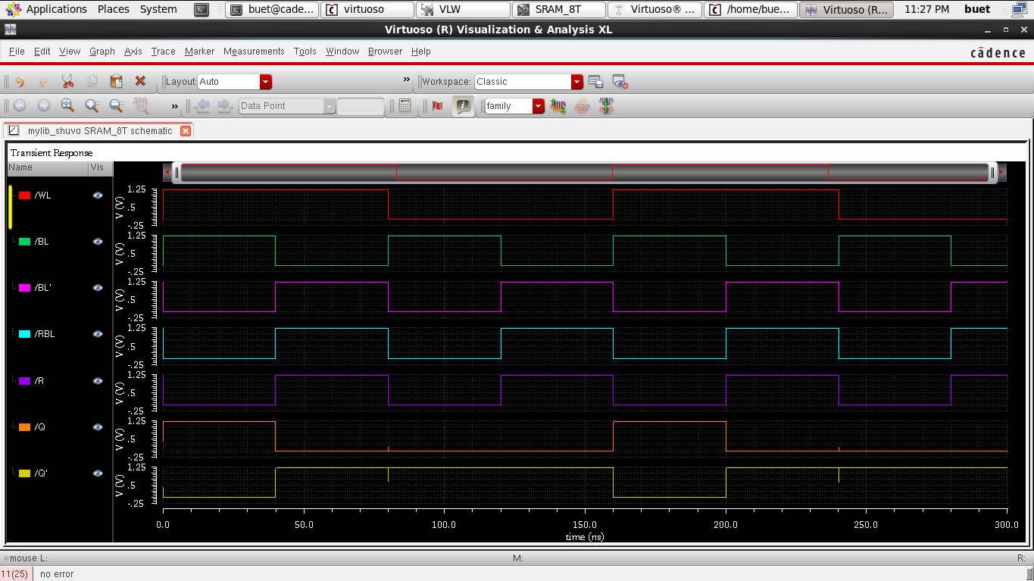
Project analysis slide 4
8T SRAM
Figure:8T SRAM Schemetic Diagram. | Figure: Wave of 8T SRAM.

Slide 12
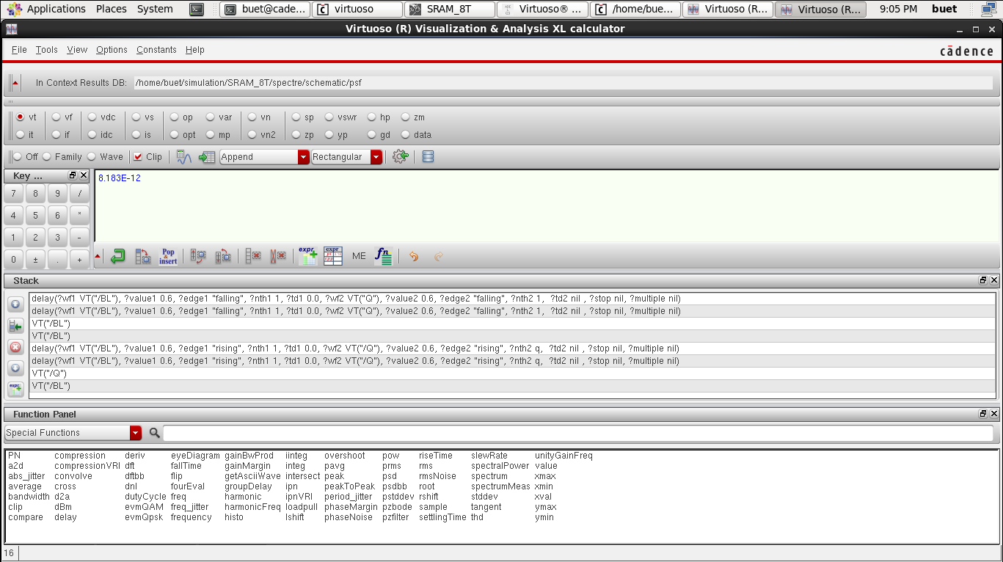
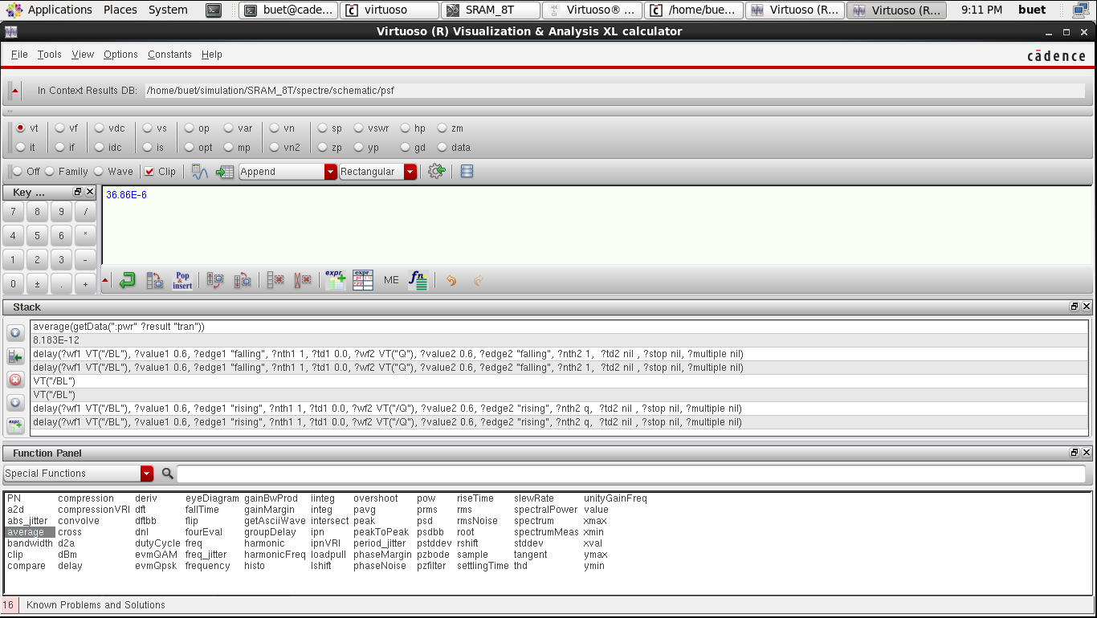
Project analysis slide 4
8T SRAM
Figure:Propagation Delay for 8T SRAM. | Figure:Average power calculation for 8T SRAM.

Slide 13
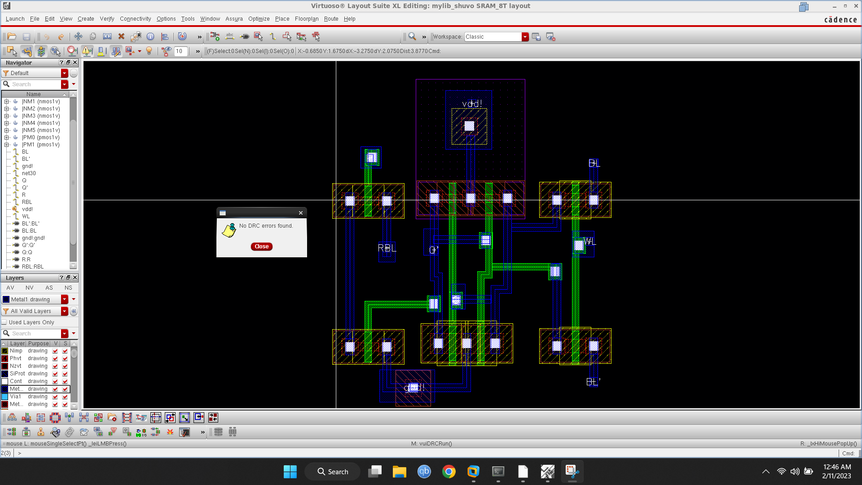
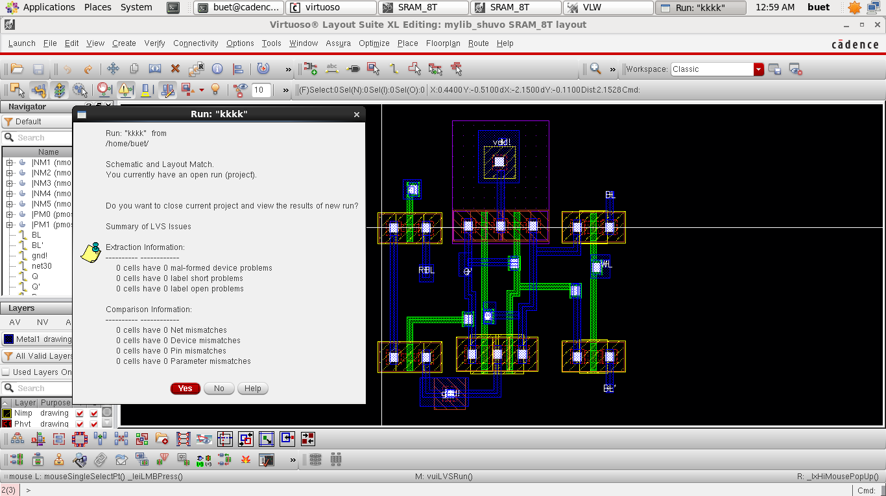
Project analysis slide 4
7T SRAM
Figure:Layout with No DRC Error for 9T SRAM. | Figure:LVS Checking for 9T SRAM.

Slide 14
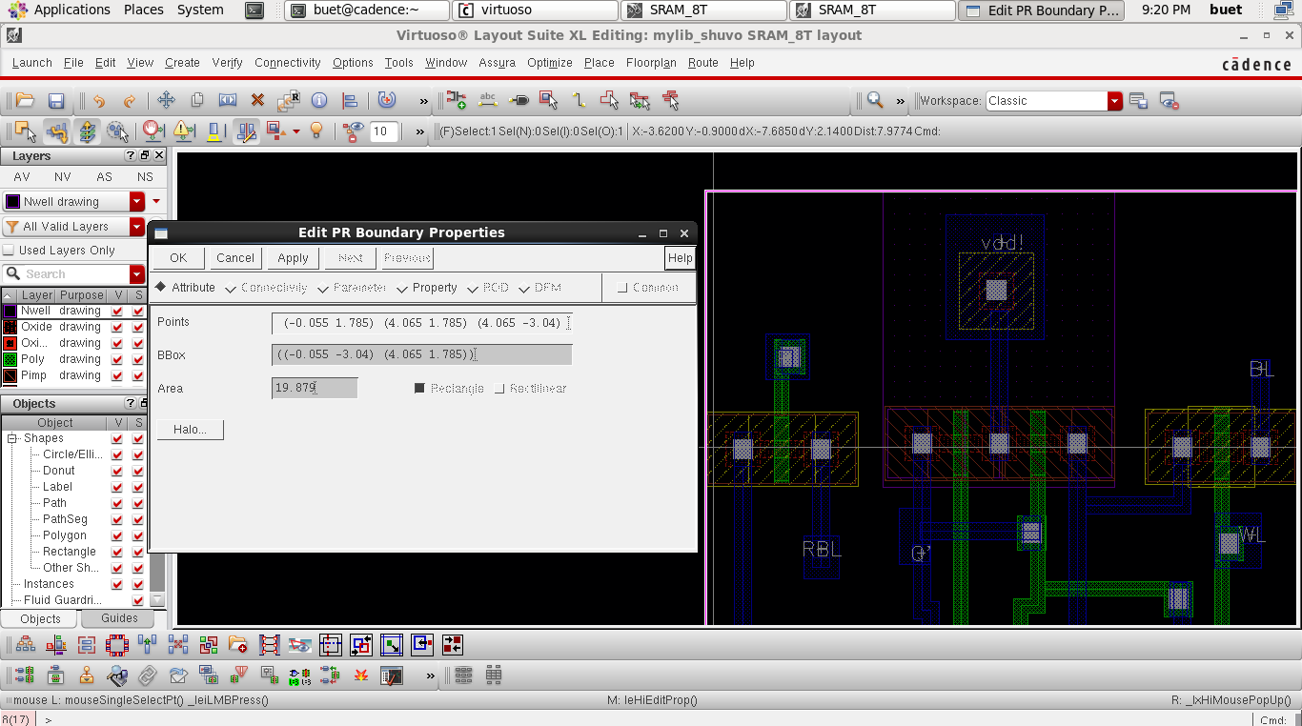
Project analysis slide 4
8T SRAM
Method | Propagation delay | Average power | Power delay product | Cell Area | NO. of Transistor | No.of DRC Errors | No. of LVS Mismatches
8T | 8.183E-12 | 36.86E-6 | 3.0163E-16 | 19.879(um^2) | 8 | 0 | 0
Figure: Cell Area of 7T SRAM

Slide 15
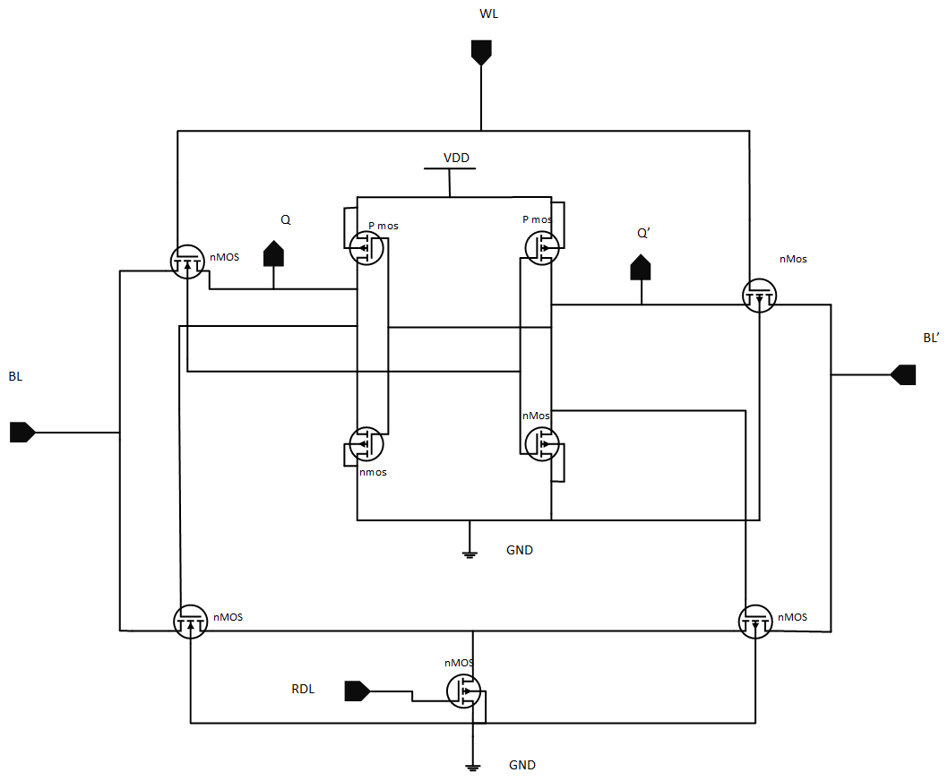
Project analysis slide 4
9T SRAM
Write Operation: we want to write 1 to this memory. For this we have to active the access transistor by giving logic high to WL(word line). After that, we have to give 1 as input through BL(Bit line) & 0 as input through BL’. As NMos uncappable to pass 1 through its source to drain; degraded ‘1’ will be appear to the node of output Q. But 0 will be appear to the node of output Q’ as NMos is fully capable to pass ‘0’ through its source to drain. This ‘0’ will active PM0 & deactivate the NMos NM9. As a result good ‘1’ will appear in the output node Q. This ‘1’ will active NM3 & deactivate PM2. As a result ‘0’ will appear in the node of Q’. So, the input data ‘1’ will be circulating in this ram cell until it get power from the Vdd source. In this way, the write operation is done in the 9T SRAM cell. Read Operation: we want to read ‘1’ from the cell. For this we have to active all the access transistors. Now this data ‘1’ will come out through access transistor NM7 & ‘0’ will come out through access transistor NM8. The sense amplifier of Q will hold high value as it will not get any discharging path. The sense amplifier of Q’ will get logic low as it will get discharging path. Now to get the data, the gateway transistor have to be activated. Gateway transistor NM10 will be activated as its gate will gate logic high from the node of Q. But gateway transistor NM11 will not be activated as its will gate logic low from the node of Q’. Now the data ‘1’ will appear in the drain of NM6 which is called fetch transistor. By giving logic high to RDL(read line) the data ‘1’ will pass through this transistors drain to source. In this way, the read operation is done in the 9T SRAM cell.

Slide 16
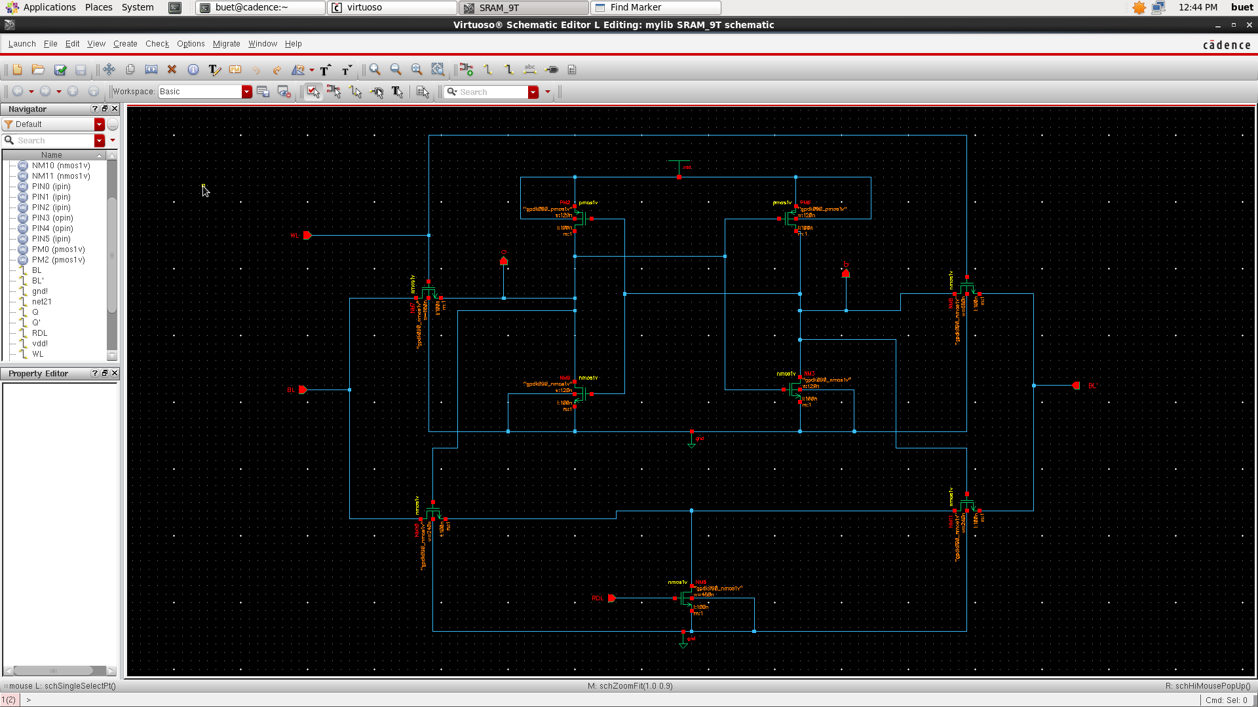
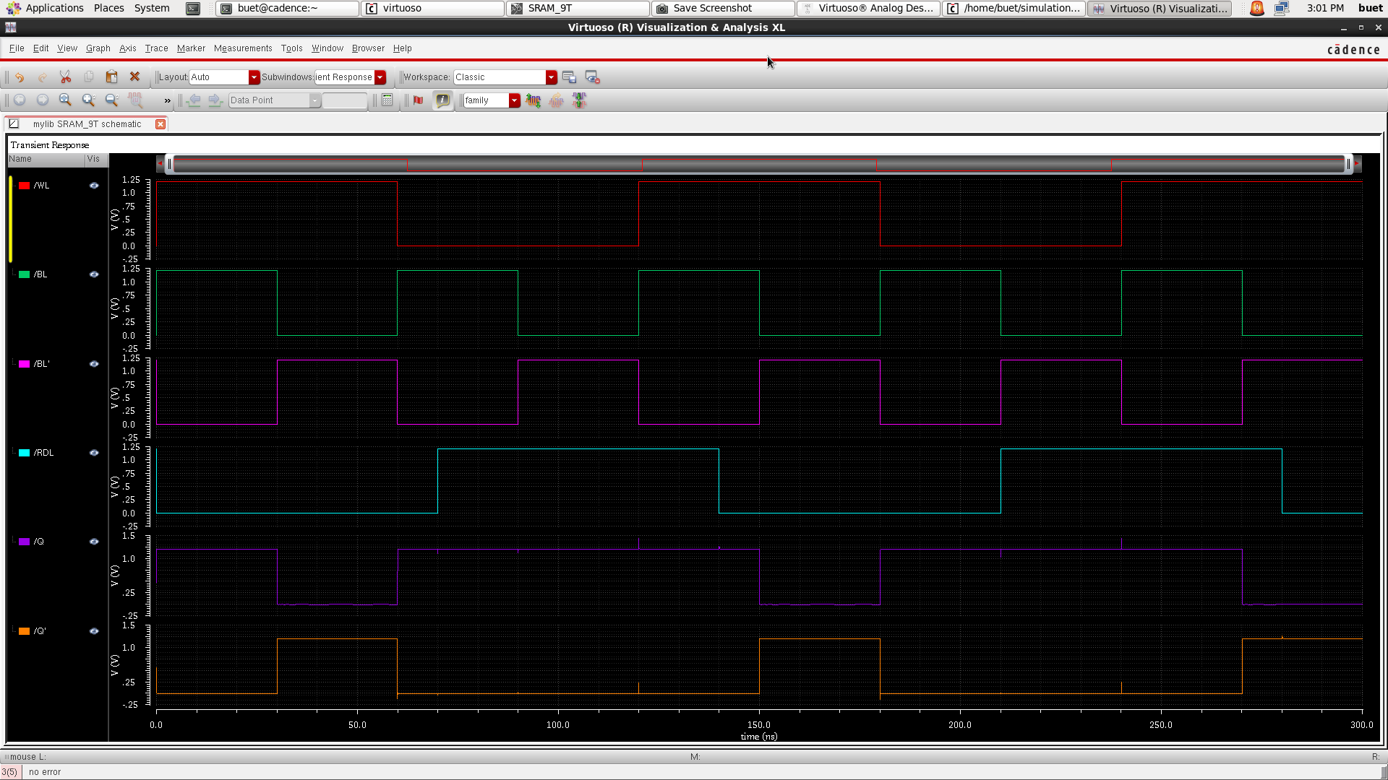
Project analysis slide 4
9T SRAM
Figure:9T SRAM Schemetic Diagram. | Figure: Wave of 9T SRAM.

Slide 17
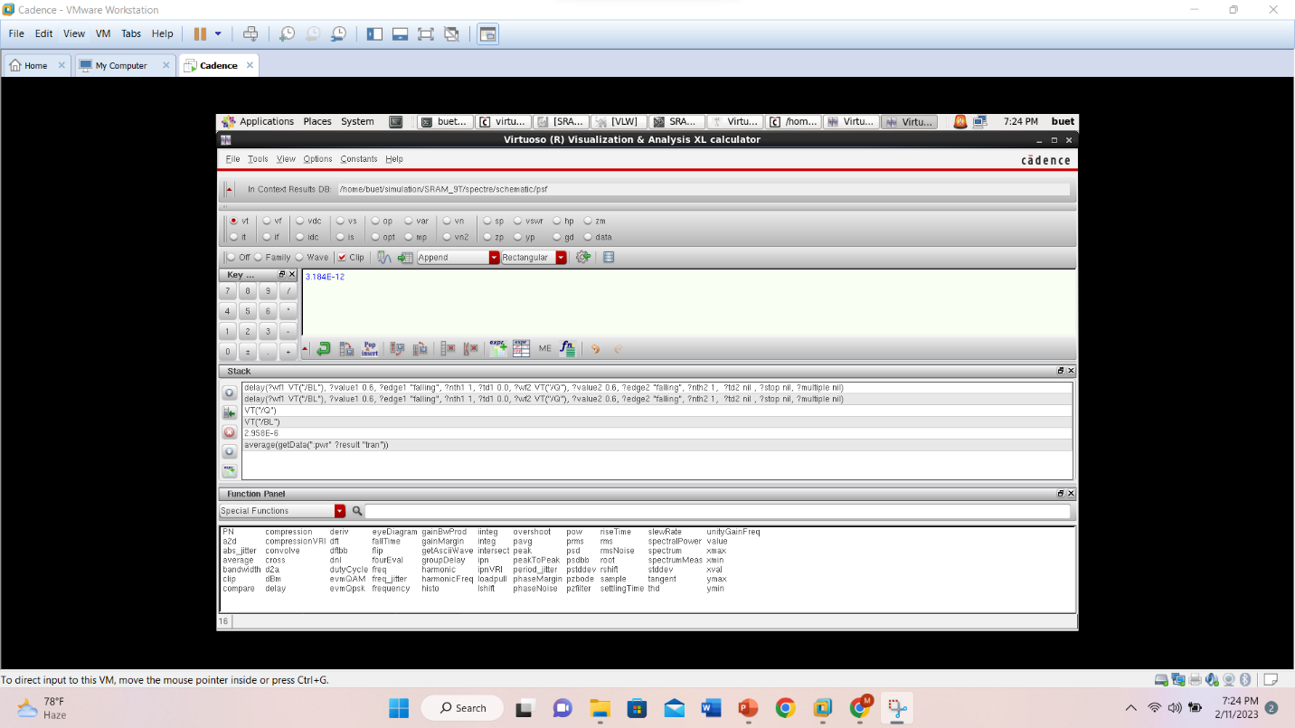
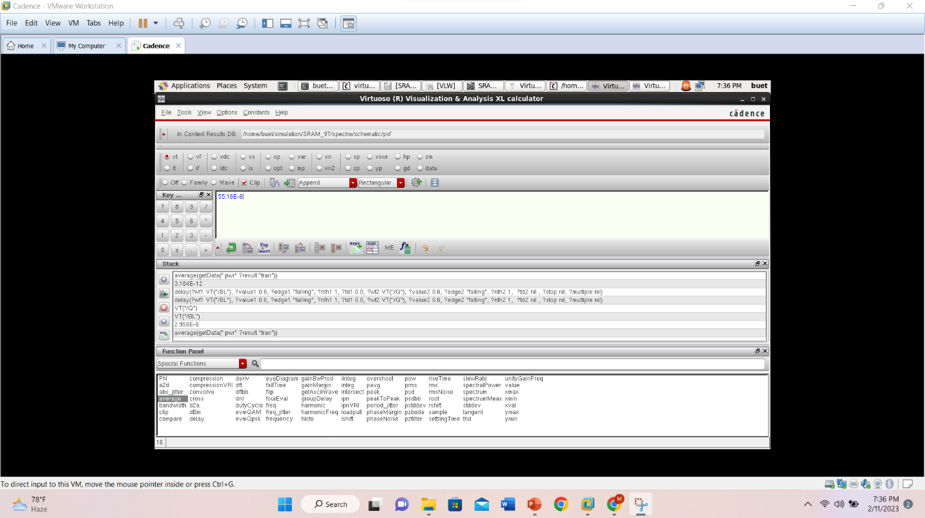
Project analysis slide 4
9T SRAM
Figure:Propagation Delay for 9T SRAM. | Figure:Average power calculation for 9T SRAM.

Slide 18
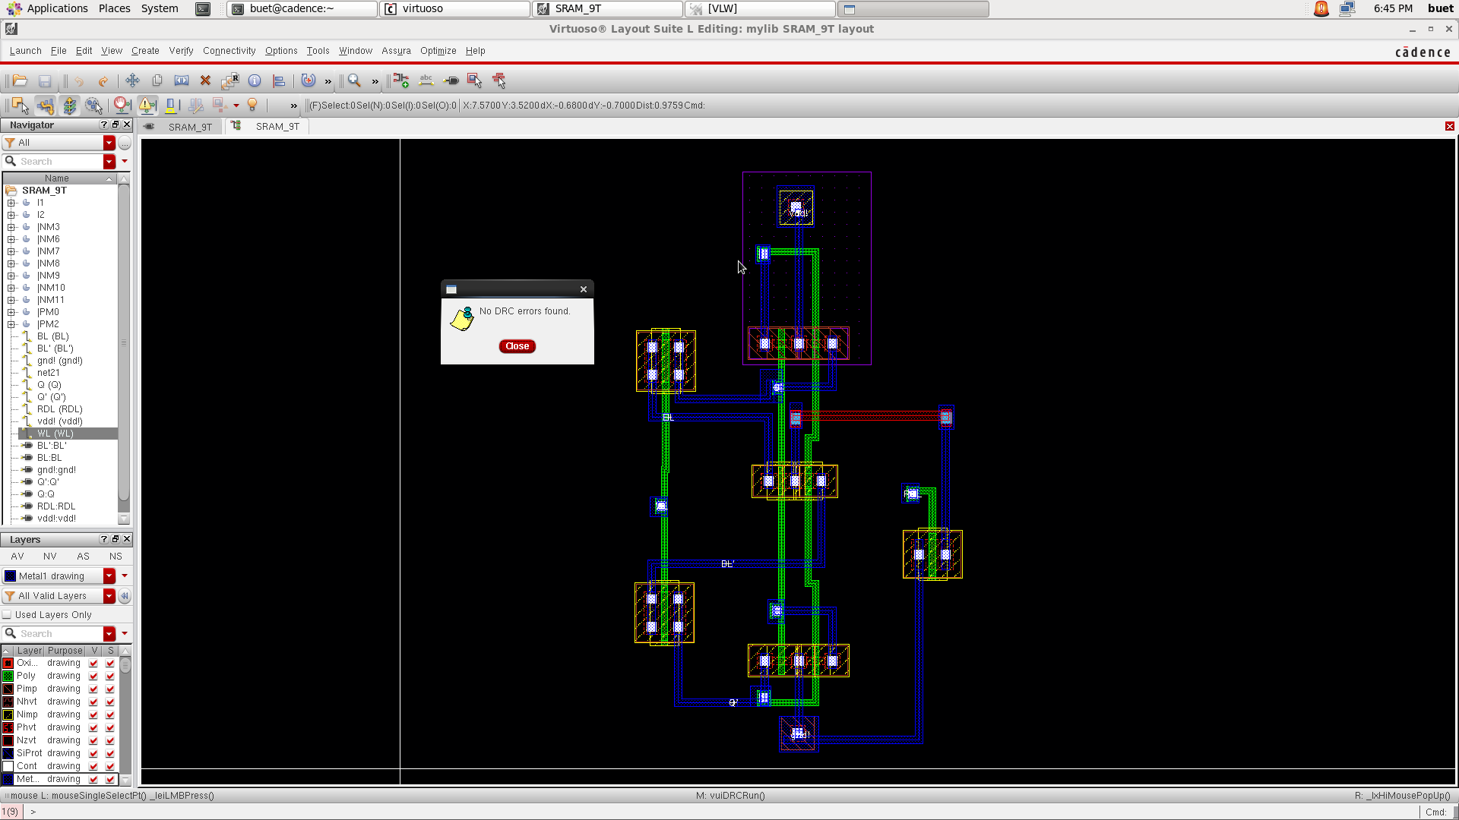
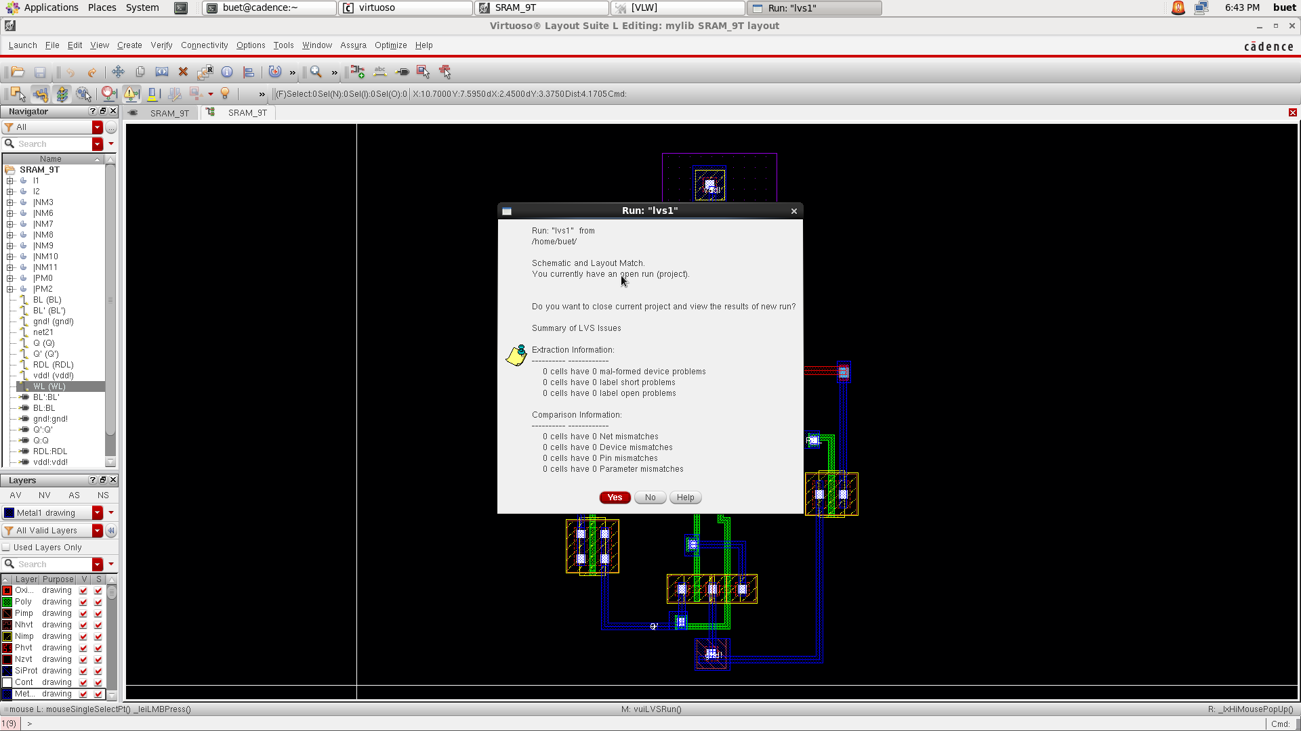
Project analysis slide 4
9T SRAM
Figure:Layout with No DRC Error for 9T SRAM. | Figure:LVS Checking for 9T SRAM.

Slide 19
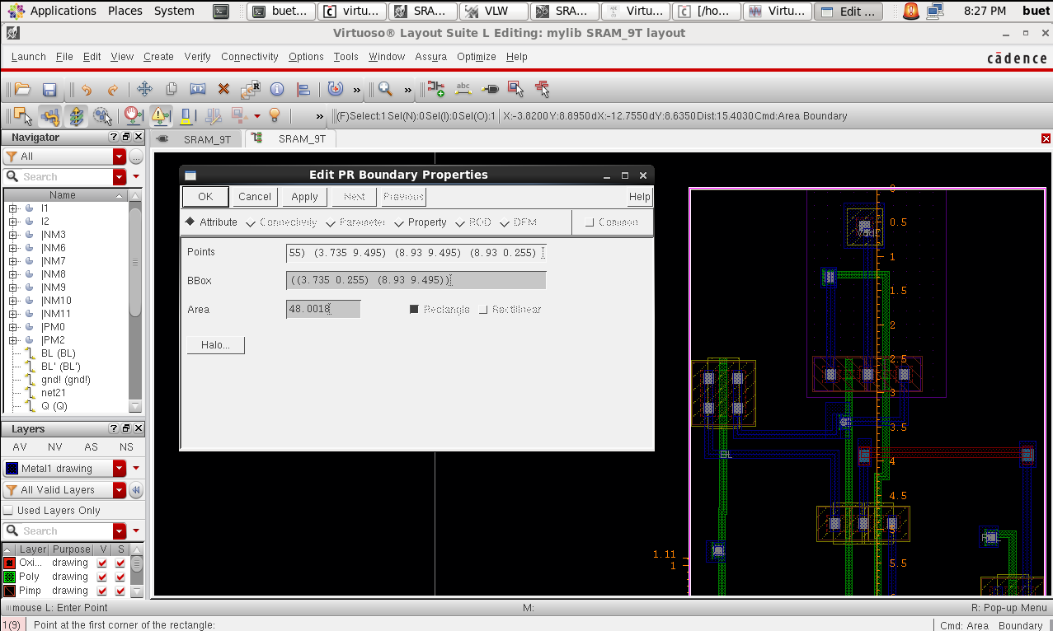
Project analysis slide 4
9T SRAM
Method | Propagation delay | Average power | Power delay product | Cell Area | NO. of Transistor | No.of DRC Errors | No. of LVS Mismatches
9T | 3.184E-12 | 55.16E-6 | 1.756E-16 | 48.0018(um^2) | 9 | 0 | 0
Figure: Cell Area of 9T SRAM

Slide 20
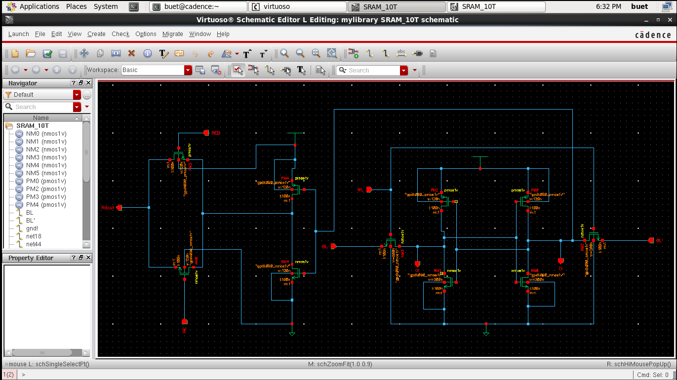
Project analysis slide 4
10T SRAM
Write Operation: During writing the word line (WL) is activated, so the access transistors NM3 and NM2 are conducting. Columns of two-bit lines BL and BL' give complementary values associated with the memory cell composed of simple cross-coupled CMOS converters PM0, NM1 and PM2, NM0. So, the data stored in the memory cell and the data observed by Q & Q’. Read Operation: During the write operation, Q' is connected to a conventional inverter consisting of PM3, NM4 and a pass-transistor or pass-gate consisting of PM4, NM5. When Q is '1' and Q' is '0' then PM3 of inverter circuit is on and '1' is passed as input from pass transistors and is read from 'Rdout' while RE is '1' and REB is '0 ' to enable Pass Gate or Transmission Gate. When Q is '0' and Q' is '1' then NM4 is on and '0' is passed as the input of the pass transistors and is read from 'Rdout' while RE is '1' and REB is ' 0' to activate the Pass Gate or the Transmission Gate.

Slide 21
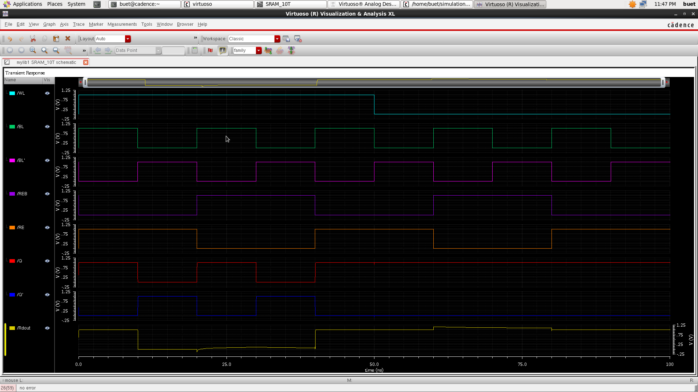
Project analysis slide 4
10T SRAM
Figure:10T SRAM Schemetic Diagram. | Figure: Wave of 10T SRAM.

Slide 22
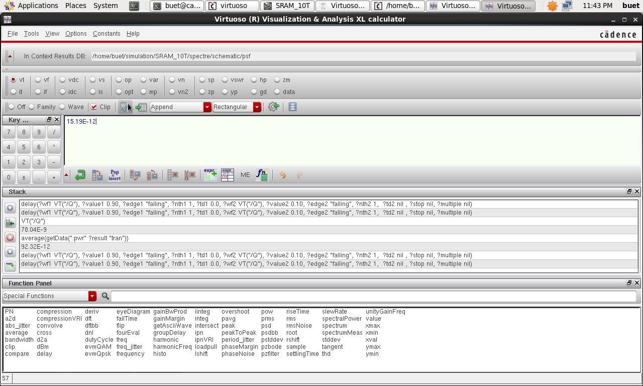
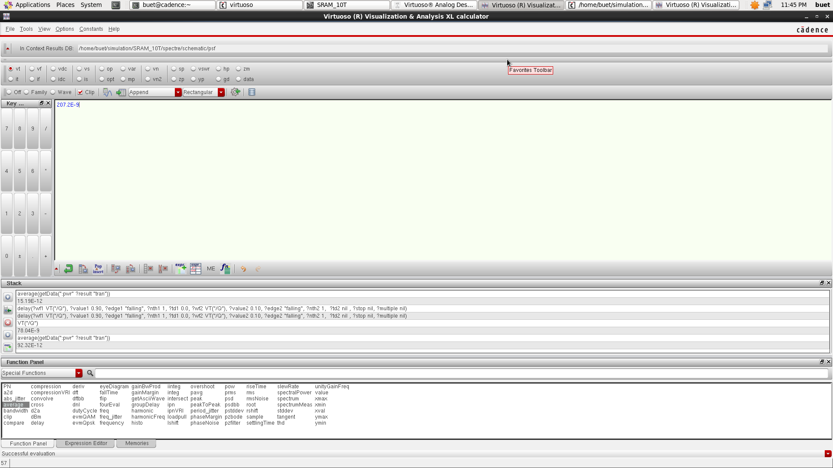
Project analysis slide 4
10T SRAM
Figure:Propagation Delay for 10T SRAM. | Figure:Average power calculation for 10T SRAM.

Slide 23
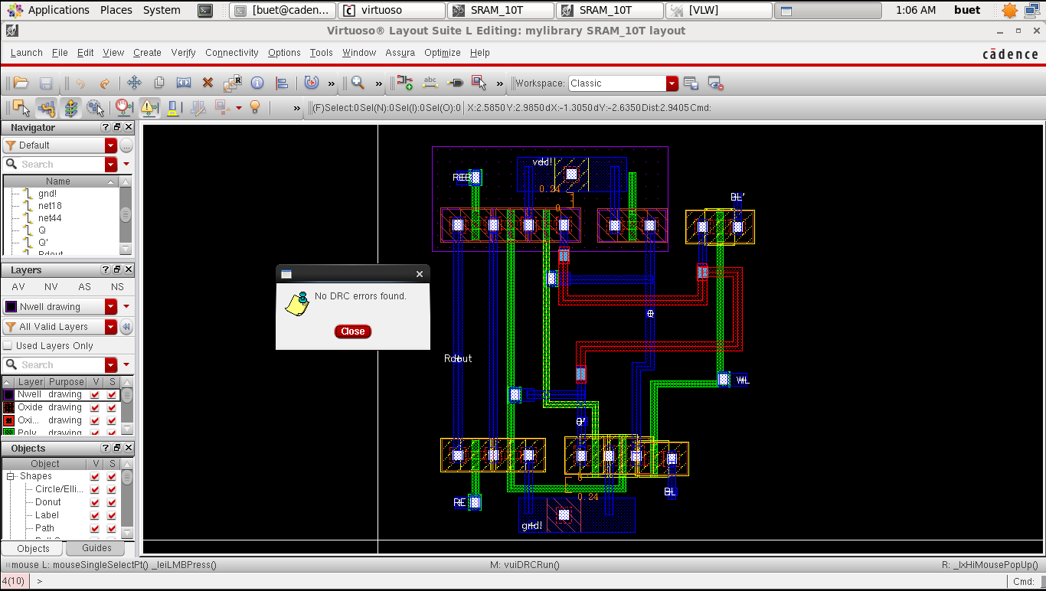
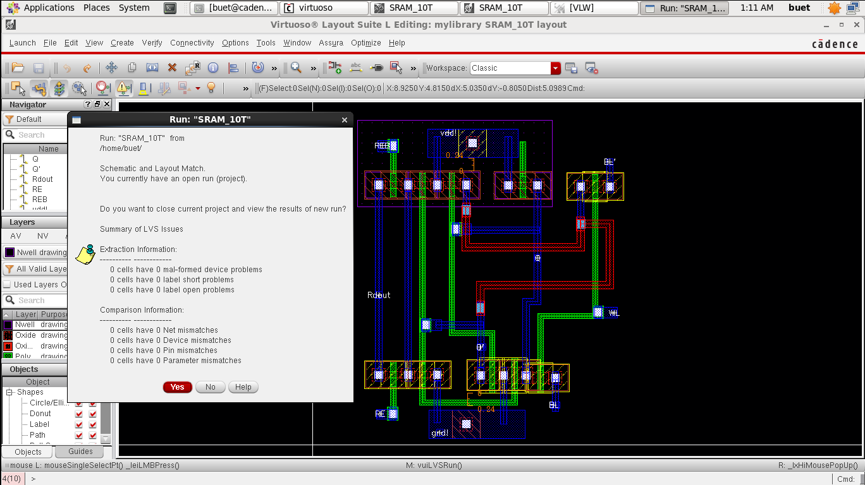
Project analysis slide 4
10T SRAM
Figure:Layout with No DRC Error for 10T SRAM. | Figure:LVS Checking for 10T SRAM.

Slide 24
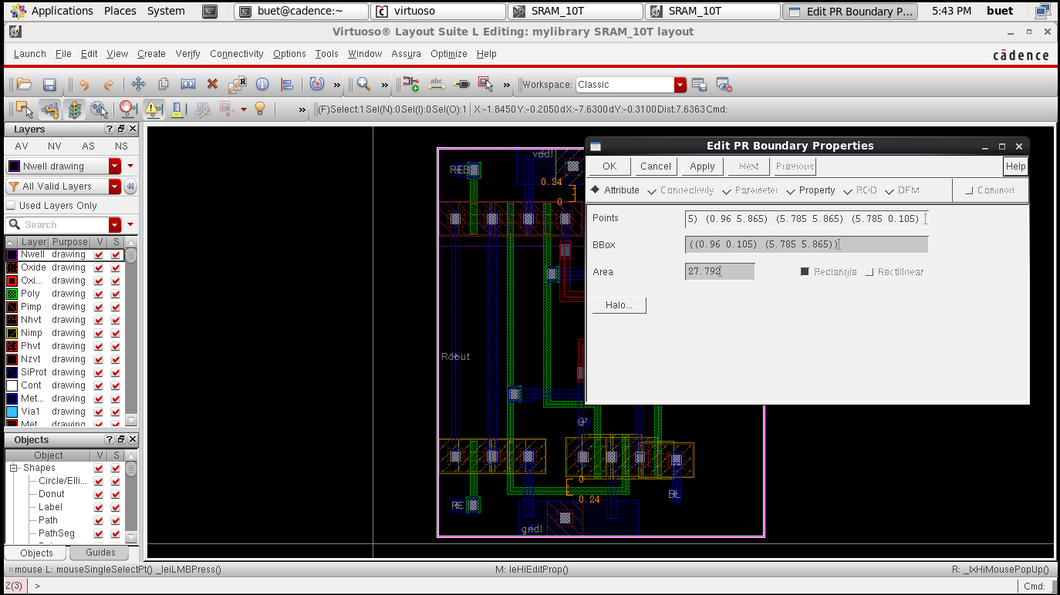
Project analysis slide 4
10T SRAM
Method | Propagation delay | Average power | Power delay product | Cell Area | NO. of Transistor | No.of DRC Errors | No. of LVS Mismatches
10T | 15.19E-12 | 207.2E-9 | 3.147E-19 | 27.792 (um^2) | 10 | 0 | 0
Figure: Cell Area of 10T SRAM

Slide 25
Project analysis slide 4
Conlcusion
Here we can see the difference of propagation delay ,average power consumption,power delay product for different Topology SRAM.And here it is ovserved that the power consumption dreases with Higher transistor SRAM Topology.
Method | Propagation delay | Average power | Power delay product | Cell Area | NO. of Transistor | No.of DRC Errors | No. of LVS Mismatches
7T | 6.18E-12 | 39.53E-6 | 2.44E-16 | 22.486(um^2) | 7 | 0 | 6
8T | 8.183E-12 | 36.86E-6 | 3.0163E-16 | 19.879(um^2) | 8 | 0 | 0
9T | 3.184E-12 | 55.16E-6 | 1.756E-16 | 48.0018(um^2) | 9 | 0 | 0
10T | 15.19E-12 | 207.2E-9 | 3.147E-19 | 27.792 (um^2) | 10 | 0 | 0

Slide 26
Thank You

