Slide 1
Optimum Power Control at Different Loading
Course Code : EEE 4154 Course Name: Power System II Lab
Group Members
Names | Student ID
Rahatin Rahman Niloy | 190105045
Anika Tahsin Afia | 190105047
A.K.M Aktaruzzaman Shuvo | 190105050
Mohsin Islam Rifat | 190105046
Md. Ruddro Raihan | 190105048
Prepared For,
Ms. Shaela Sharmin Ritu Assistant Professor,Department of EEE Ahsanulllah university of science & Technology | Mr. Shameem Hasan Assistant Professor,Department of EEE Ahsanulllah university of science & Technology

Slide 2
Project analysis slide 2
Objective: In this project we have designed a optimum power control system at different loading situation. we designed a system that can deliver the required power to a load using Current injection device.
Equipments: i) 220V-6V Transformer ii) 555 timer iii) Resistors (10K,1K) iv ) Relay 6V DC v) Capacitors –(103pf,10uf,2pf,1000uf) vi)Load (100W,60W,25W) vii) Vero board viii) Diode (1N4001) xi) POT (500K ohm) x)Switch,wires xi) Current Injection device xii) Variac

Slide 3
Project analysis slide 4
Working Principle Different current level : Here 220v is fixed supply to the load.Different rating current will inject across the load to fullfill their power rating at different loading condition .A current injection device is used to supply different current requirement. Timer circuit: We assumed 3 different loading condition in our project .So based on these loading condition the required power will be supplied.But we know Base Load power plant take some times to supply.For that,power will be supplied after that time delay.So,in our project timer circuit is used to make that delay . Relay: Relay is used in this project for switching operation.Every relay is controlled by a timer .Relay is initially off before meeting the time delay that is need to on the base laod power plant or other power station .After that delay, Relay becomes on.

Slide 4
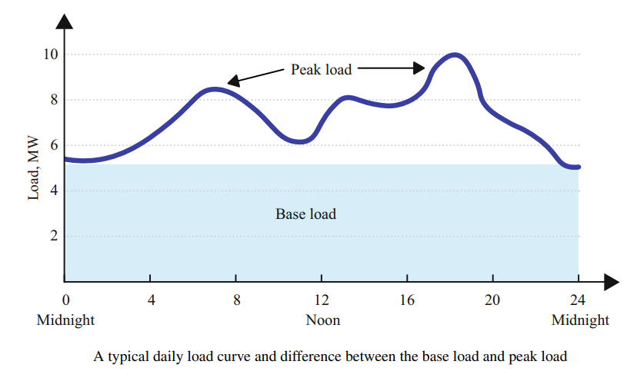
Project analysis slide 4
Type of Load in Load Curve
Base Load: The amount of load is constant at all times during a 24-hour period. This is the minimum amount of load that can be expected at all
Peak load: Occurs during the peak hours. It is the maximum load that occurs when the load demands are the highest.
Intermediate Load : The loads above the base load but below the peak loads can be called the intermediate load.
reference: https://www.barnesandnoble.com/w/the-sun-energy-and-climate-change-eklas-hossain/1142559213

Slide 5
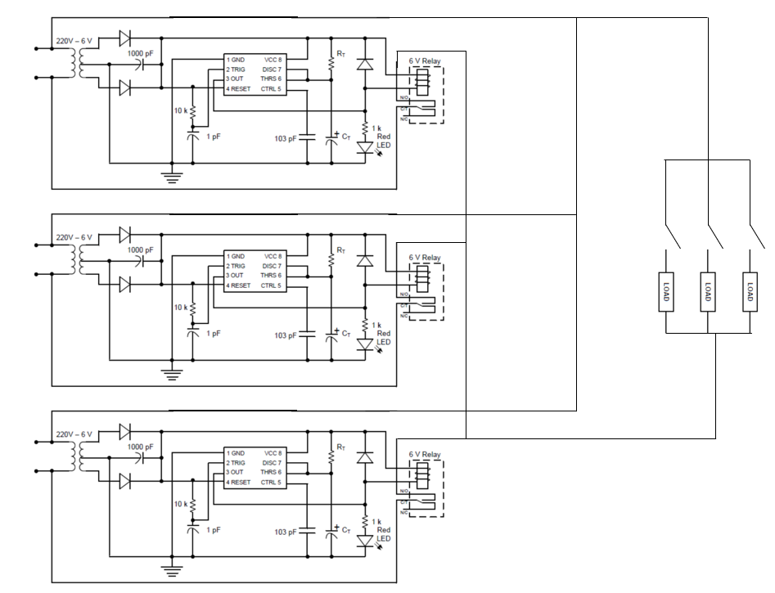
Project analysis slide 4
Circuit Diagram

Slide 6
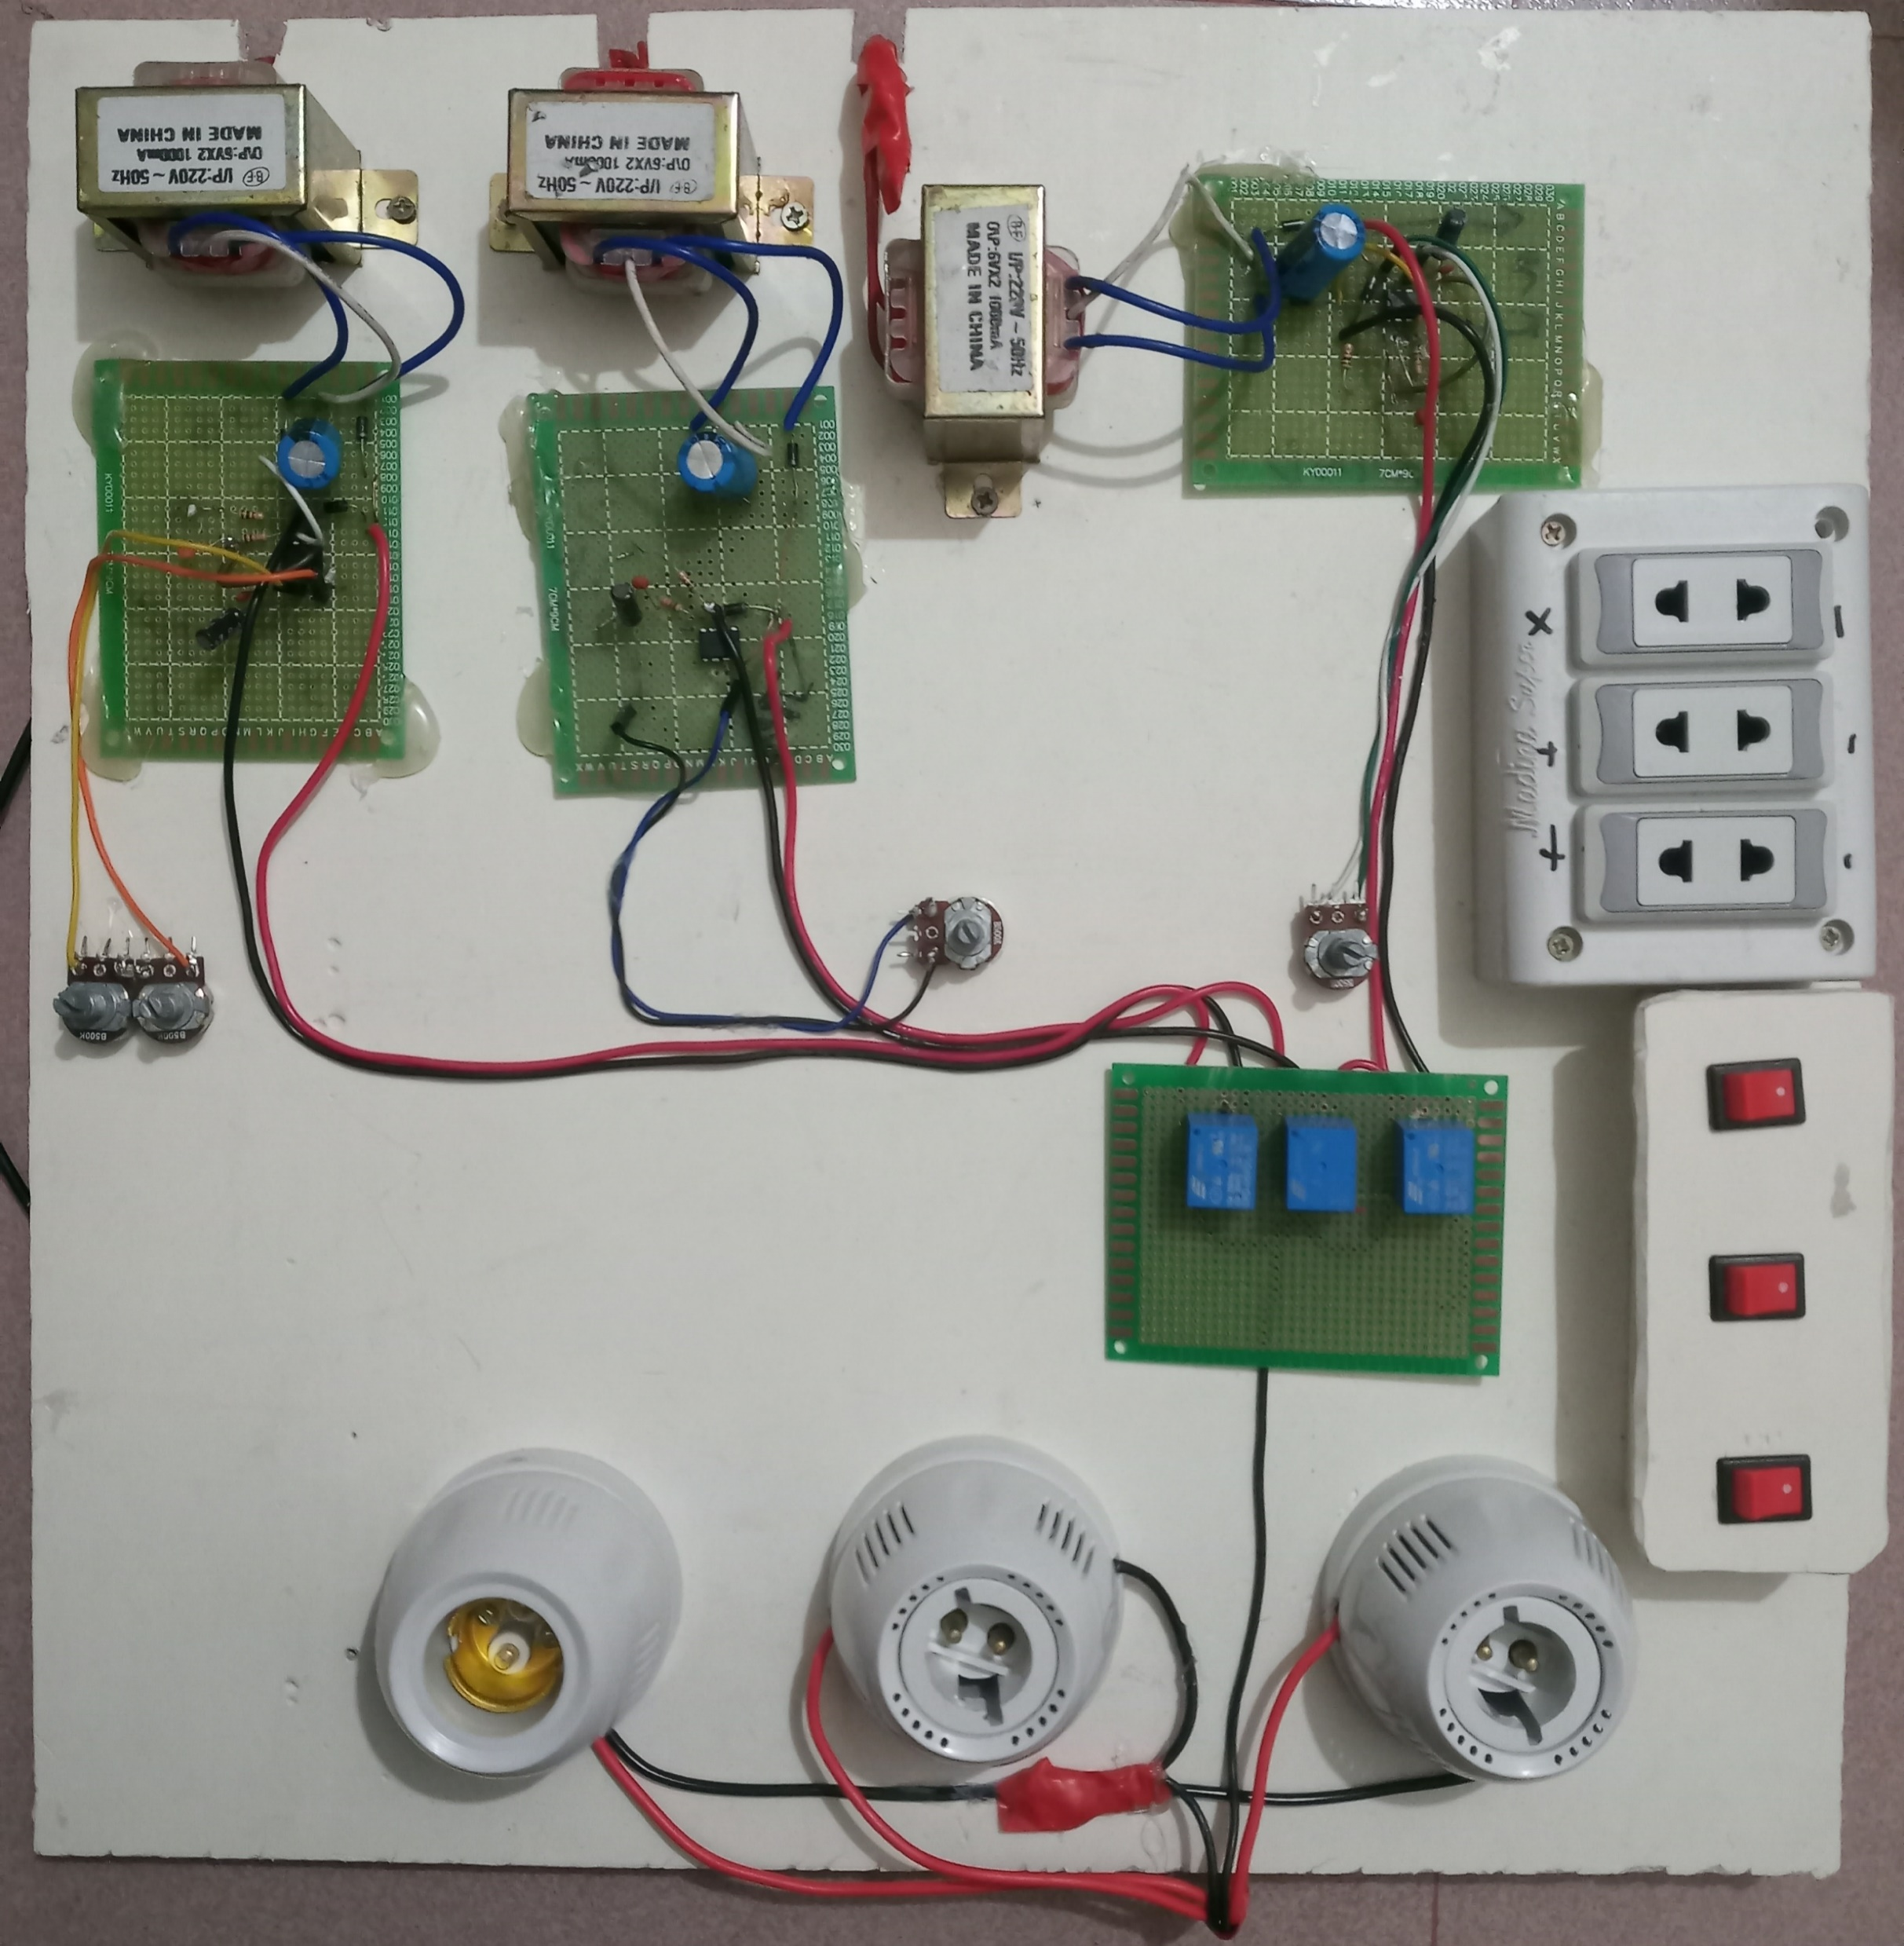
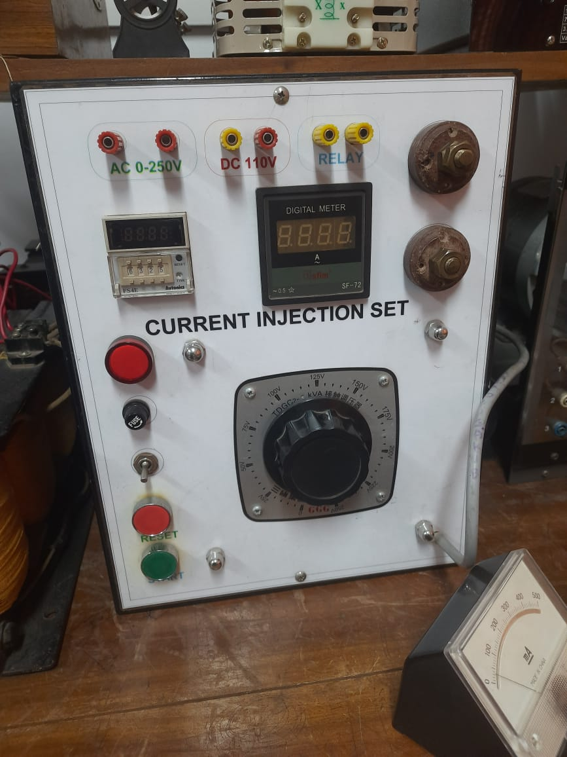
Project analysis slide 4
Physical Circuit
220V-6V transformer
Supply
Current Injector Device
Timer Circuit
Timer Control POT
Load Controlled Switch
Relay
Load

Slide 7
Project analysis slide 4
Future Work
With cylic design we can automate the power system with peak load,off peak load and Base load situation.

Slide 8
Thank You

