Slide 1
Android Application Development
By Mohsin Rasheed

Slide 2
Dalvik virtual machine
Android uses the Dalvik virtual machine with just-in-time compilation to run Dalvik bytecode, which is usually translated from Java bytecode
The Dalvik Debug Monitor Service (DDMS) is a key debugging utility that is integrated into the Eclipse IDE, the favoured development environment for Android

Slide 3
Application components
Activities
Services
Content providers
Broadcast receivers

Slide 4
Android Manifest
Creating activity permission
Services permission
BroadcastReceiver permission
ContentProvider permission
OS built-in functionality permission
Application metadata

Slide 5
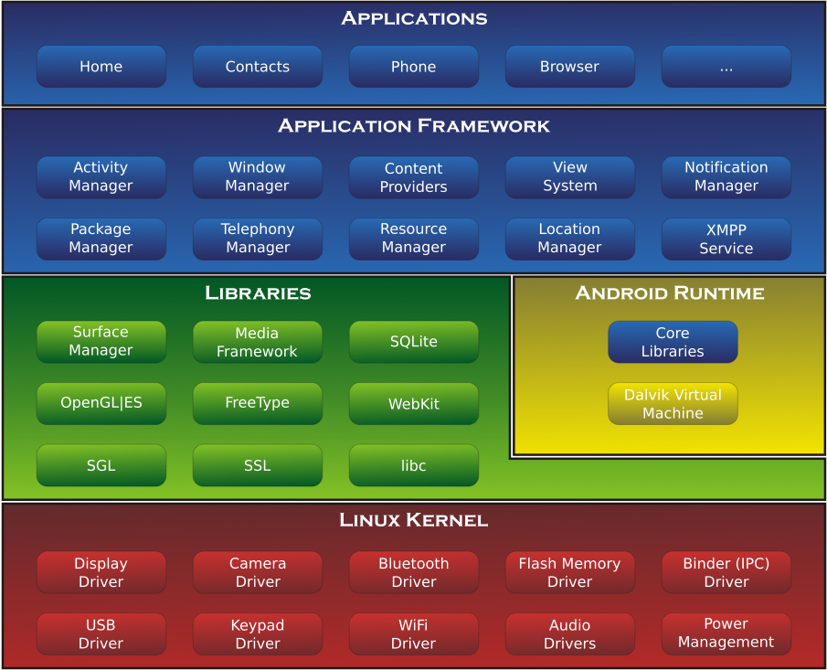
Android System Architecture

Slide 6

App Widgets
App Widgets are miniature application views that can be embedded in other applications (such as the Home screen) and receive periodic updates
An application component that is able to hold other App Widgets is called an App Widget host

Slide 7
Layouts
Using Android's XML vocabulary, you can quickly design UI layouts and the screen elements they contain, in the same way you create web pages in HTML — with a series of nested elements.
Each layout file must contain exactly one root element, which must be a View or ViewGroup object

