Slide 1
1: Title of the Project area sudhar
Smart Civic Issue Detection Platform
Subtitle:AI-Powered Solution for Efficient Civic Issue Reporting
Presented By:

Slide 2
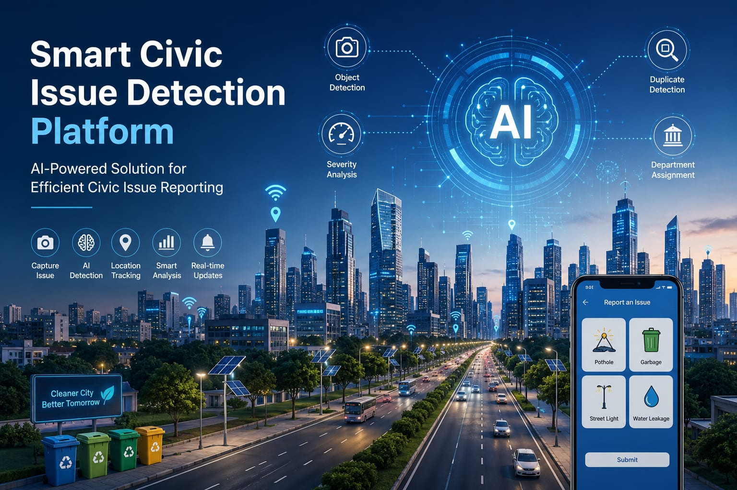
team member:
Harshal M Kamble: 25uam137
Mohasin R Nadaf: 25UAM130
Tabbish I Shaikh : 25UAM143
Samarth s Yamgar: 25UAM122

Slide 3
2: Problem Statement
Many civic issues such as potholes, garbage overflow, damaged streetlights, and water leakage remain unresolved because of:
Manual complaint registration
Difficulty identifying the correct municipal department
Duplicate complaints
Slow response from authorities
Lack of transparency in complaint tracking
Poor prioritization of urgent issues
The project proposes a smart platform that simplifies complaint reporting and improves communication between citizens and municipal authorities.

Slide 4
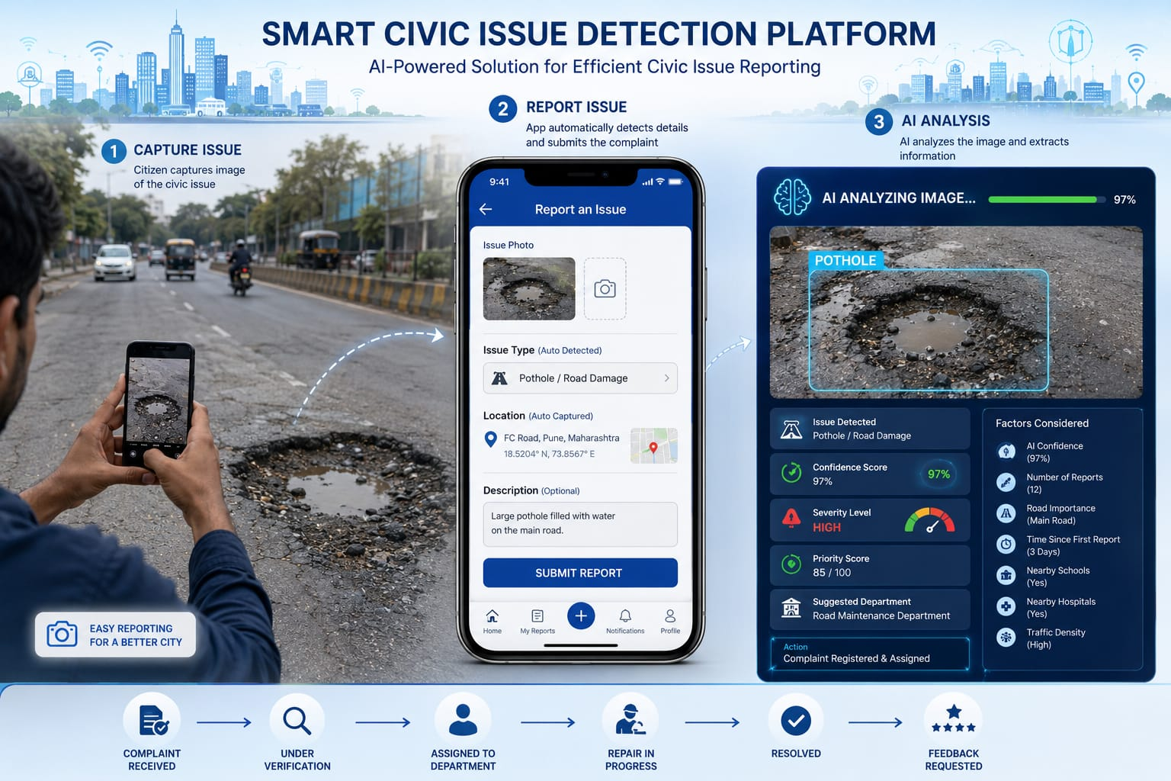
3: Objectives
Simplify the process of reporting civic issues.
Enable citizens to report issues using photos.
Reduce duplicate complaints.
Improve transparency through complaint tracking.
Help authorities prioritize urgent issues.
Encourage active citizen participation in maintaining public infrastructure.

Slide 5
4: Need for the Project
Citizens often face difficulties while reporting civic problems.
Delayed action results in worsening infrastructure conditions.
Many complaints are submitted to the wrong department.
A faster and more organized reporting system can improve public services.
The platform promotes better communication between citizens and government authorities.

Slide 6
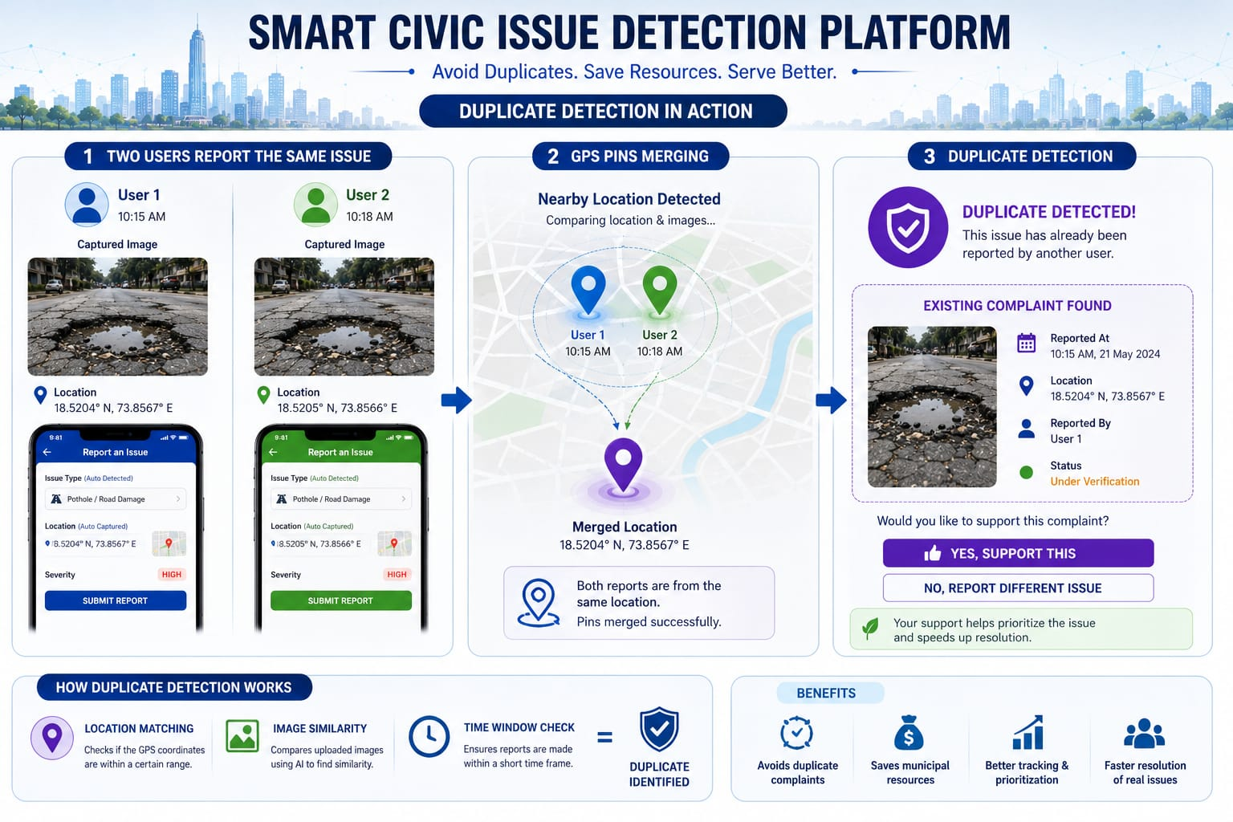
5: Methodology / Plan of Action
Step 1
Select and finalize the civic issue to be addressed.
Step 2
Study existing complaint reporting systems and identify their limitations.
Step 3
Design the complaint reporting workflow and define system requirements.
Step 4
Collect data on common civic issues through surveys, observations, and research.
Step 5
Develop the proposed Smart Civic Issue Detection Platform.
Step 6
Test the complaint reporting process and evaluate the proposed workflow.
Step 7
Analyze the collected data and identify possible improvements.
Step 8
Prepare the final project report, presentation, and project documentation.

Slide 7
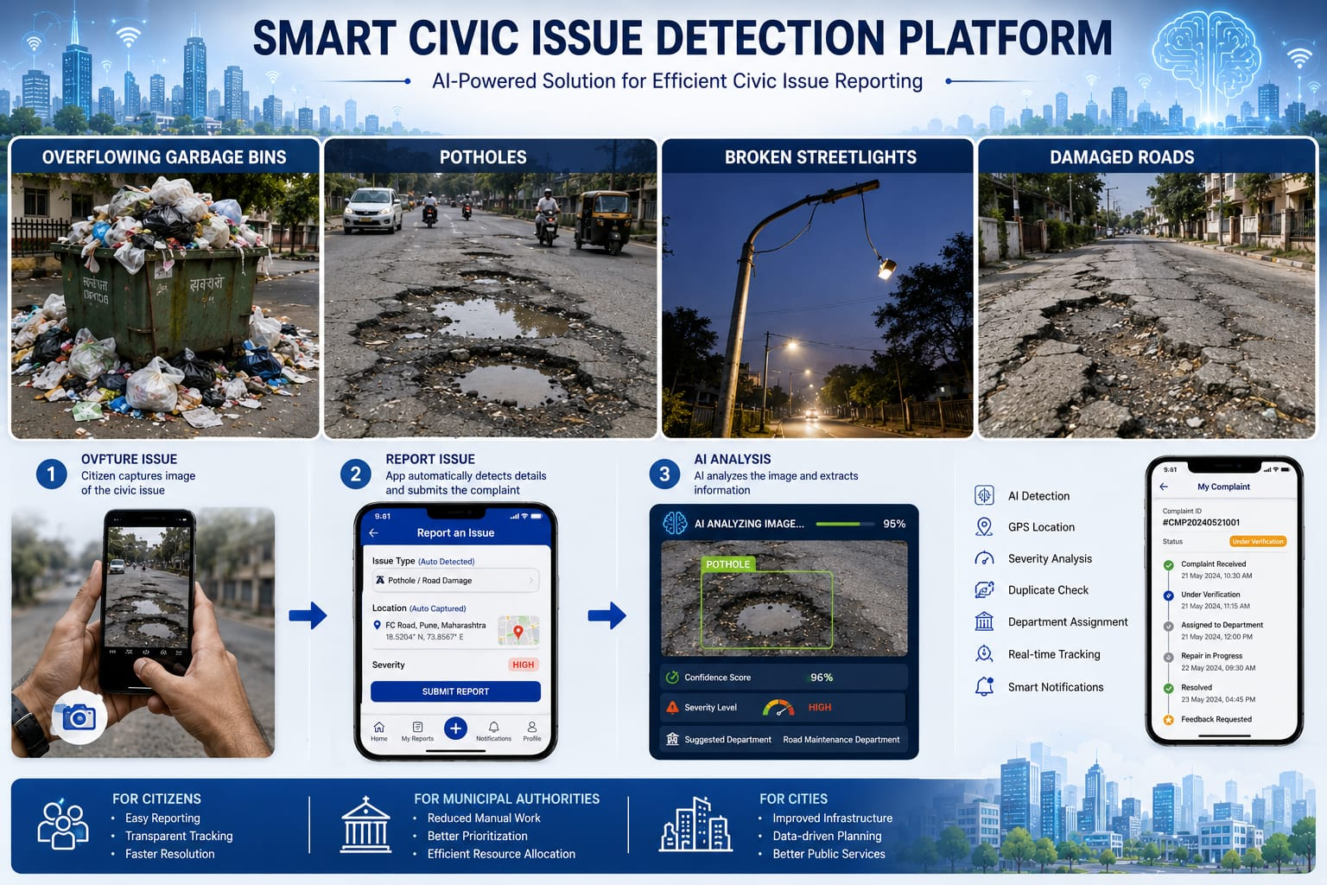
6: Expected Outcomes
Easy and quick complaint registration.
Improved transparency in complaint handling.
Better coordination between citizens and municipal departments.
Faster response to civic issues.
Reduced duplicate complaints.
Improved cleanliness and public infrastructure maintenance.

Slide 8
7: Timeline of Activities
Step 1 (Week 1–3)
Finalize the project topic, identify the problem statement, define objectives, and prepare the project proposal.
Step 2 (Week 4–7)
Study existing complaint systems, collect civic issue data, and design the proposed workflow.
Step 3 (Week 8–10)
Analyze the collected data, prepare documentation, and update the GitHub repository.
Step 4 (Week 11–15)
Complete the final report, prepare the presentation, finalize documentation, and submit the project.

Slide 9
8: References
Ministry of Housing and Urban Affairs (MoHUA)
Swachh Bharat Mission
Smart Cities Mission
Municipal Corporation websites
Government Open Data Portal (data.gov.in)
Research papers on Smart City and Civic Issue Management
Google Scholar

Slide 10
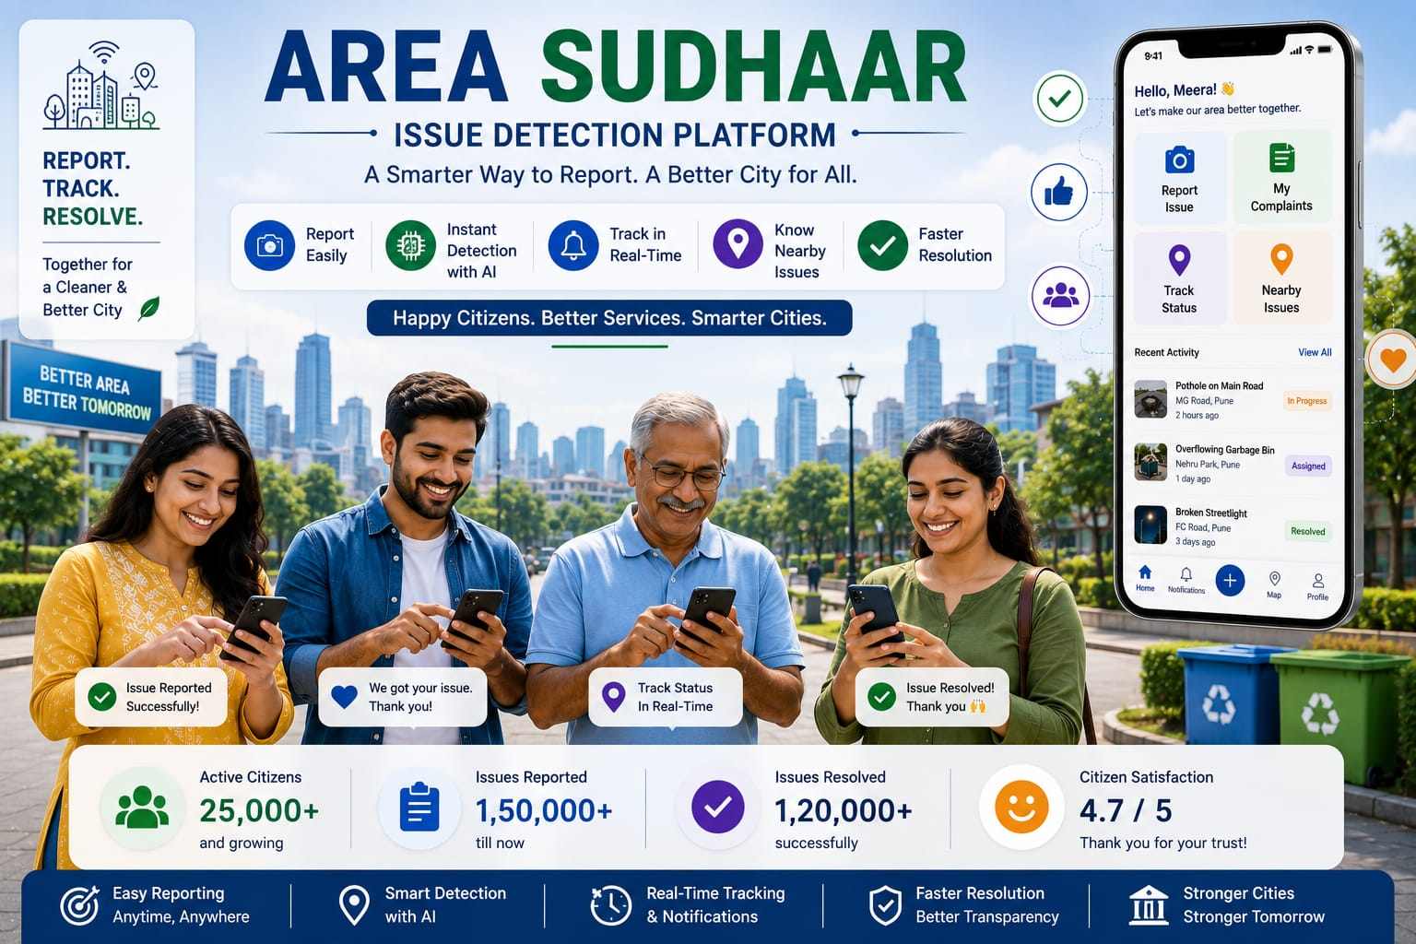
This version is ideal for a (Community Engagement Project)because it focuses on:
The social problem.
The need for the project.
The proposed solution at a high level.
The project workflow.
Expected community benefits.

