Slide 1
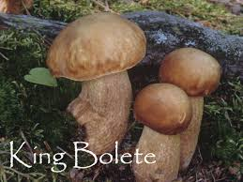
Mushroom Classification
To eat, or not to eat? That is the question!
Patrick Parker-Roach
General Assembly

Slide 2
Executive Summary
General Assembly Data Science Immersion Program Capstone Project
Problem taken from the Kaggle Data Science Competition website
The project is based upon a 30 year old dataset containing physical characteristics of mushrooms and whether each sample is poisonous or edible.
Goal
Given a new set of characteristics, predict whether a mushroom is poisonous or edible to a high degree of confidence.

Slide 3
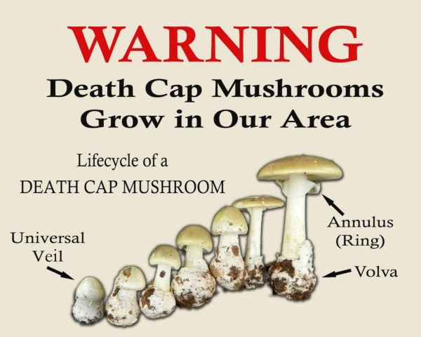
Remember…
“There are old mushroom hunters and bold mushroom hunters, but very few old, bold mushroom hunters!

Slide 4
Data Description
Sources: (a) Mushroom records drawn from The Audubon Society Field Guide to North American Mushrooms (1981 Date: 27 April 1987
Relevant Information: This data set includes descriptions of hypothetical samples corresponding to 23 species of gilled mushrooms in the Agaricus and Lepiota Family (pp. 500-525). Each species is identified as definitely edible, definitely poisonous, or of unknown edibility and not recommended. This latter class was combined with the poisonous one. The Guide clearly states that there is no simple rule for determining the edibility of a mushroom; no rule like "leaflets three, let it be" for Poisonous Oak and Ivy.
Number of Instances: 8124
Number of Attributes: 22 (all nominally valued)

Slide 5
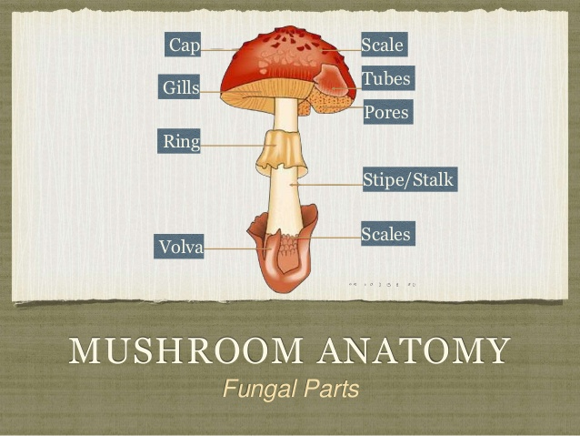
Data Description (continued)
22 attributes relating to the anatomy of a mushroom

Slide 6
Data Description (continued)
The dataset included some rule information
With this information in mind I constructed
4 datasets
Original data
Original data with relevant features from rules
“Dummy Category” data with all features
“Dummy Category” data with only relevant features from rules
P_1) odor=NOT(almond.OR.anise.OR.none
120 poisonous cases missed, 98.52% accu
P_2) spore-print-color=green
48 cases missed, 99.41% accuracy
P_3) odor=none.AND.stalk-surface-below-ring=scaly.AND.
(stalk-color-above-ring=NOT.brown)
8 cases missed, 99.90% accuracy
P_4) habitat=leaves.AND.cap-color=white
100% accuracy
Rule P_4) may also be
P_4') population=clustered.AND.cap_color=white

Slide 7

Approach – Resulted in 100% Accuracy

Slide 8
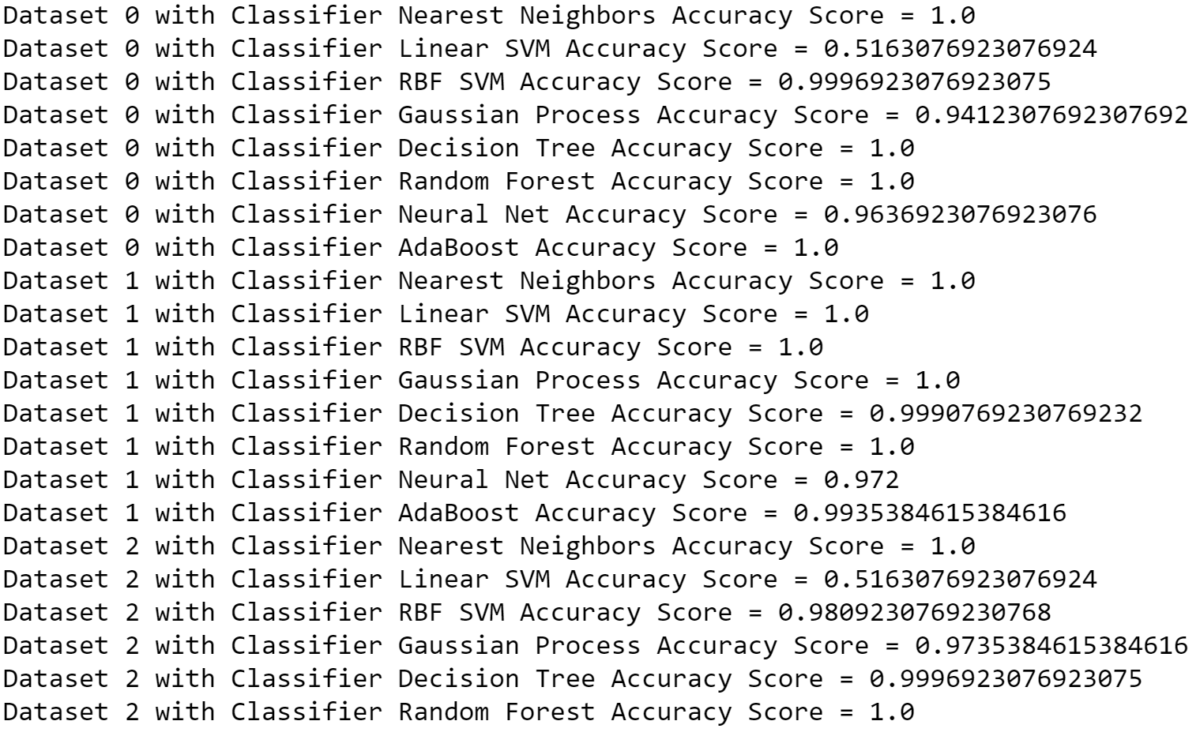
Expanded Approach
Ran the 4 datasets over 10 Machine Learning Classification Algorithms

Slide 9
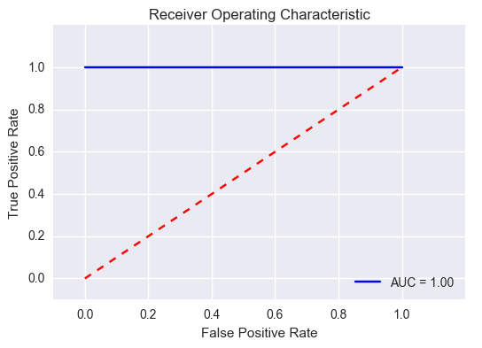
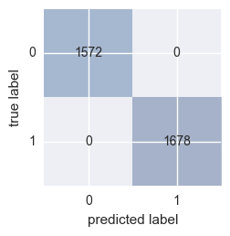
Results
Some models produced better than others but they all did pretty well with most scoring 100% Accuracy

Slide 10
Next Steps
Create a front end to this program which, at run time, will allow the user to first pick a model to run, and once selected, ask the user to select parameter/value pairs to run. Perhaps this could be in the form of an interactive matrix which the user could select models/parameters/values and the output would be in a form for easy comparison.
Geographical region that a mushroom is native to is a very powerful attribute for identifying a particular mushroom. It would be very interesting to have that data added to see if it would be helpful in identifying a mushroom's edibility.
The rules provided with the dataset provide a very powerful mechanism for classifying the edibility of a mushroom. I spent a decade of my earlier career as a Knowledge Engineer building rule-based expert systems. From what I have learned in the execution of this project I believe that an expert systems approach would be very helpful in identifying a specific mushroom, and hence its edibility. I believe that a small rule set could be constructed to make a very accurate identification (see cautions above) and specific mushroom data could be added to expert systems working memory (database) as one collected mushrooms in thier local. Just a thought to think!

Slide 11
Potential Productization
Mobile App
Hybrid Expert System/Machine Learning
Expert System to identify a particular mushroom
Machine Learning to double check edibility potential
The Expert System starts with rules and a few mushrooms in its database – User Extensible
Private Extensible
Public Extensible
Add GPS coordinates to found mushrooms

Slide 12
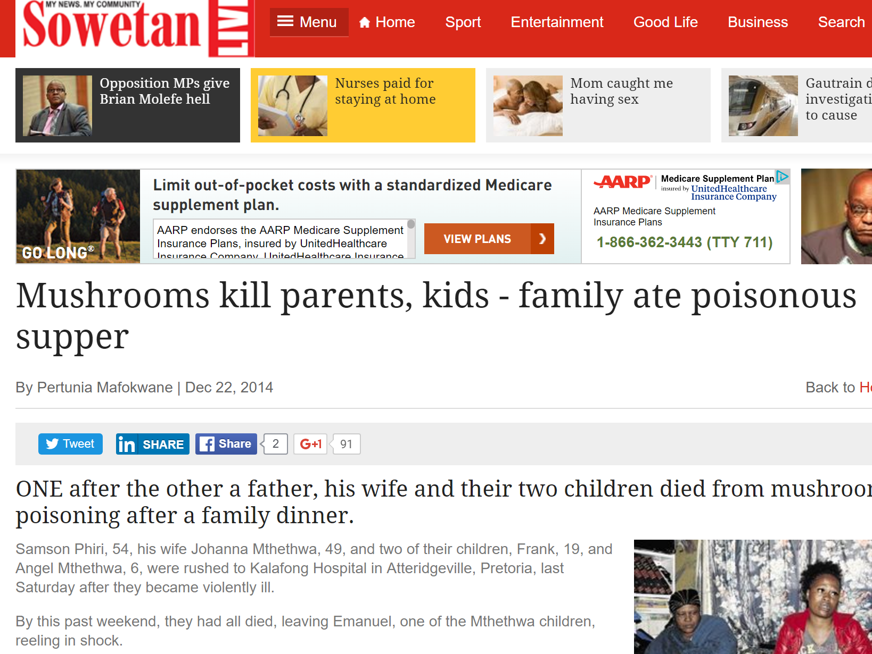
Remember…
“There are old mushroom hunters and bold mushroom hunters, but very few old, bold mushroom hunters!
Take Precautions

