Slide 1
Topics Presentation
Presented by
Mohtshim Ali
1

Slide 2
Contents
Loss Functions in Classification.
How Classification Works?
Confusion Matrix and Accuracy.
2
Notes:
In 1991 the PowerBook 100 became the worlds first modern laptop
40mb Hard drive
8mb RAM
2500$

Slide 3
Loss Function in Classification
Different Loss Function that is used in classification is as followed
Binary Cross Entropy Loss:
Cross-entropy will calculate a score that summarizes the average difference between the actual and predicted probability distributions for predicting class 1.
Hinge Loss:
Hinge Loss in binary classification is where the target values are in the set {-1, 1}.
Squared Hinge Loss.
3
Notes:
They are often used in offices and in big companies

Slide 4
How Classification Works?
In machine learning, classification refers to a predictive modeling problem where a class label is predicted for a given example of input data. Main part in classification is label encoding. There are four main types of classification which are as follows.
Binary Classification.
Multi-Class Classification.
Multi-Label Classification.
Imbalances Classification.
4

Slide 5
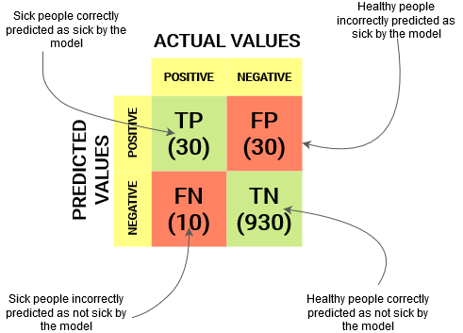
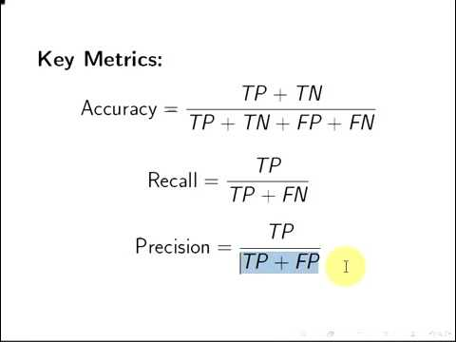
Confusion Matrix and Accuracy
A Confusion matrix is an N x N matrix used for evaluating the performance of a classification model, where N is the number of target classes.
5

