Slide 1
Topics Presentation
Presented by
Mohtshim Ali
1

Slide 2
Contents
Decision Tree
Random Forest
2
Notes:
In 1991 the PowerBook 100 became the worlds first modern laptop
40mb Hard drive
8mb RAM
2500$

Slide 3
Decision Tree
Decision tree is graphical representation of all the possible solution. These decision are based on some conditions and can be easily explained.
3
Notes:
They are often used in offices and in big companies

Slide 4
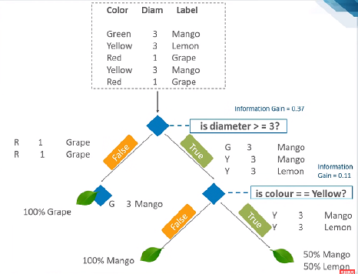
How Decision Tree works?
Entropy?
Information Gain?
4

Slide 5
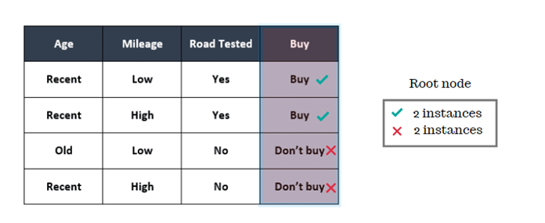
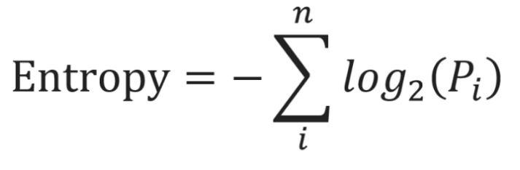
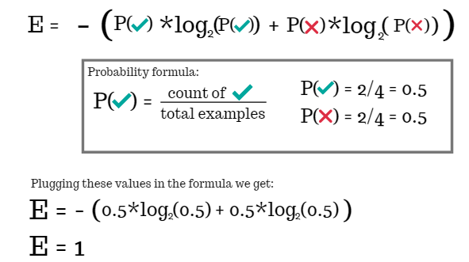
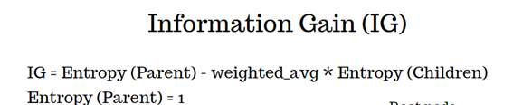
Case example
For calculating Entropy
For calculating IG
5

Slide 6
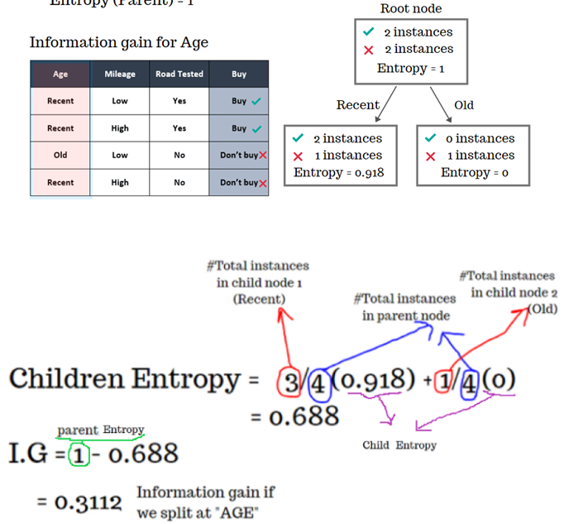
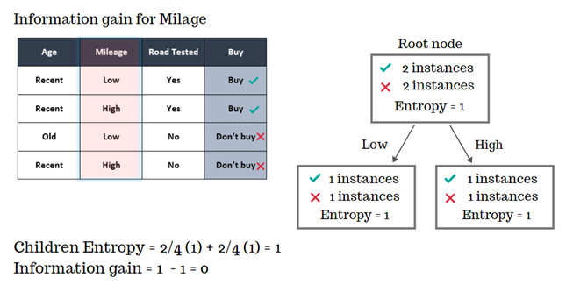
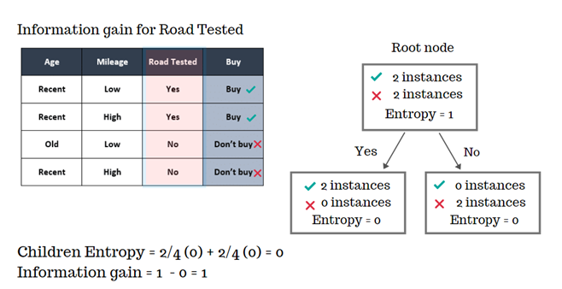
Cont…

Slide 7
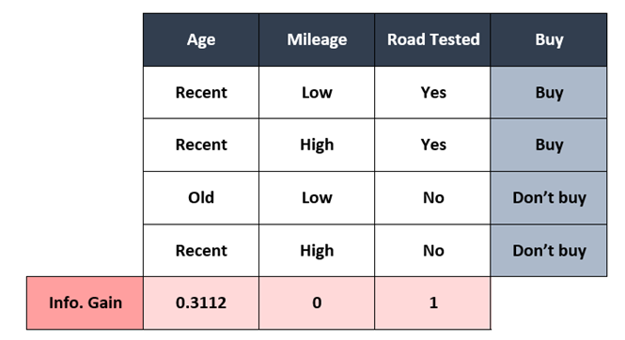
Cont..

Slide 8
Decision Tree in sklearn
from sklearn.tree import DecisionTreeClassifier
decision_tree = DecisionTreeClassifier(random_state=0, max_depth=2)
decision_tree = decision_tree.fit(data, target)

Slide 9
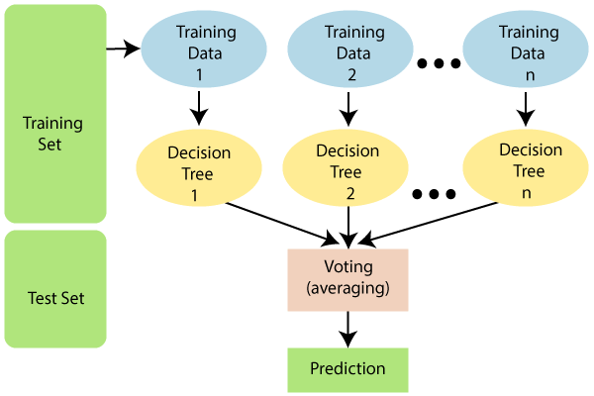
Random Forest
Random Forest builds multiple decision tree and merges them together. Random forest corrects the decision tree’s habit of overfitting of their training set. It is more accurate and stable prediction. It uses a “Bagging Method”.

Slide 10
Random Forest in sklearn
from sklearn.ensemble import RandomForestClassifier
model = RandomForestClassifier(max_depth=2, random_state=0)
model.fit(data, features)

